Slide 1

Quicksort in c++
Mohammad Iqbal
CSC 210
12/04/2024

Slide 2
9
-3
5
2
6
8
-6
1
3

Slide 3
9
-3
5
2
6
8
-6
1
3
-3
2
-6
1
3
9
5
6
8

Slide 4
9
-3
5
2
6
8
-6
1
3
-3
2
-6
1
3
9
5
6
8
-3
-6
1
2

Slide 5
9
-3
5
2
6
8
-6
1
3
-3
2
-6
1
3
9
5
6
8
-3
-6
1
2
5
6
8
9

Slide 6
9
-3
5
2
6
8
-6
1
3
-3
2
-6
1
3
9
5
6
8
-3
-6
1
2
5
6
8
9
-6
-3

Slide 7
9
-3
5
2
6
8
-6
1
3
-3
2
-6
1
3
9
5
6
8
-3
-6
1
2
5
6
8
9
-6
-3
5
6

Slide 8
9
-3
5
2
6
8
-6
1
3
-3
2
-6
1
3
9
5
6
8
-3
-6
1
2
5
6
8
9
-6
-3
5
6

Slide 9
-6
-3
1
2
3
5
6
8
9

Slide 10
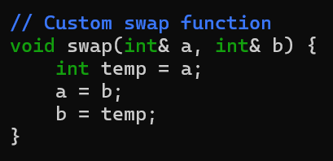
Quicksort in C++ (SWAP)

Slide 11
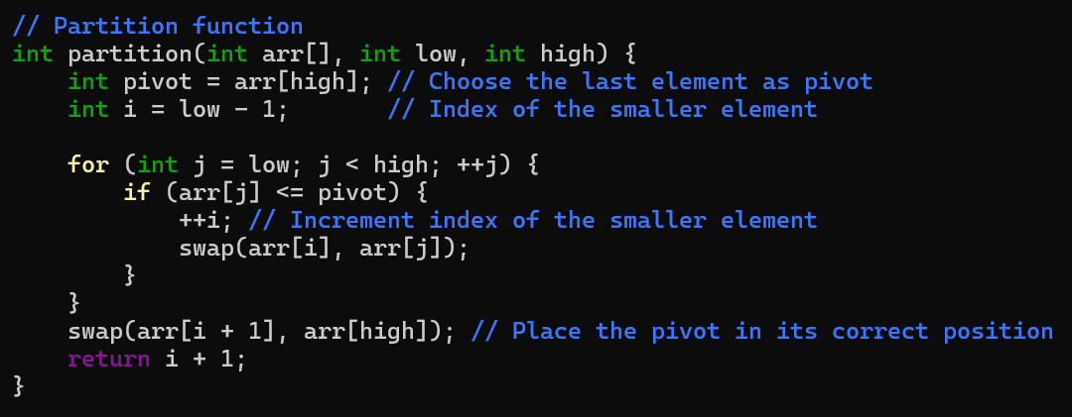
Quicksort in C++ (partition)

Slide 12
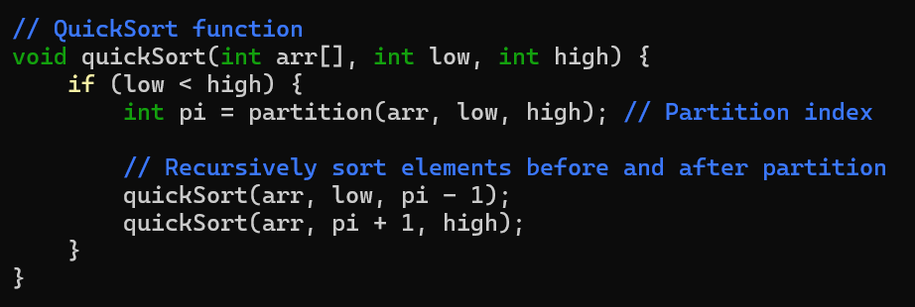
Quicksort in C++ (quicksort)

Slide 13
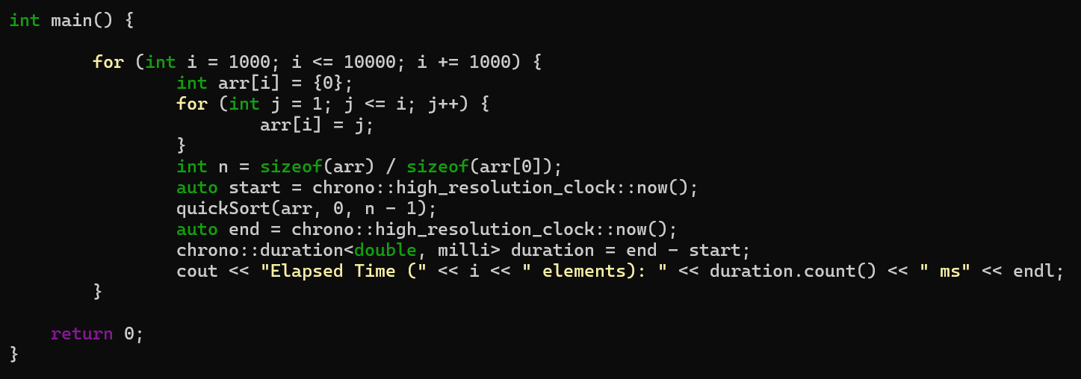
Quicksort in C++ (main worst case scenario)

Slide 14
Quicksort in C++ (runtime ms)
Elements | Time (ms)
0 | 0
1000 | 4.622417
2000 | 18.00897
3000 | 33.60747
4000 | 42.7575
5000 | 66.21823
6000 | 102.9207
7000 | 125.861
8000 | 163.91
9000 | 202.0993
10000 | 250.9937

Slide 15
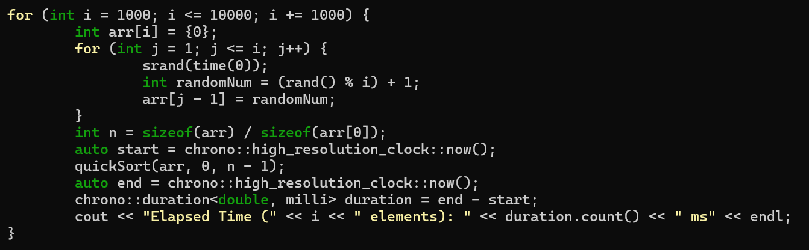
Quicksort in C++ (Best Scenario)

Slide 16
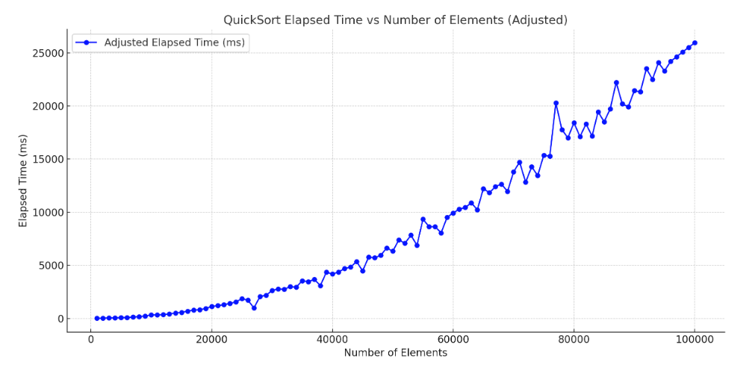
Quicksort in C++ (Runtime ms)

