Slide 1
Rational Number Arithmetic Using Macros in mips assembly
Mohammad Iqbal
CSC 210
10/15/2024

Slide 2
Macro Definitions
print_str (%str)
print_newline
print_int (%int)
print_rational_num (%numerator, %denominator)
read_int
store_int (%reg)
done

Slide 3
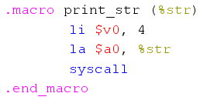
print_str (%str)
Prints a string stored in the .data segment
Example: print_str (prompt_rational1)

Slide 4

print_newline
Prints a newline character using print_str

Slide 5
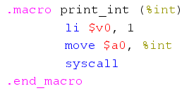
print_int (%int)
Prints the integer value in a register passed as a parameter.

Slide 6
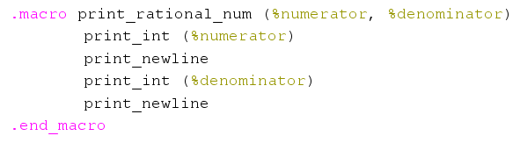
print_rational_num (%numerator, %denominator)
Prints a rational number in the format numerator / denominator.

Slide 7
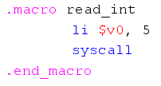

read_int and store_int (%reg)
Reads an integer input from the user.
Stores the read integer in a specified register.

Slide 8
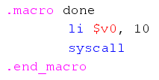
done
Terminates the program.

Slide 9
Data segment
This section contains the strings and messages that will be displayed to the user.
Prompts and Messages:
prompt_rational1: "Enter the first rational number (format: p1 ENTER q1)“
prompt_rational2: "Enter the second rational number (format: p2 ENTER q2)“
prompt_operation: "Choose the operation: (1) Add, (2) Subtract, (3) Multiply, (4) Divide“
error_zero_den: "Error: denominator cannot be zero!“
result_msg: "Result:“
Newline: A string to print a newline for better formatting of output.

Slide 10
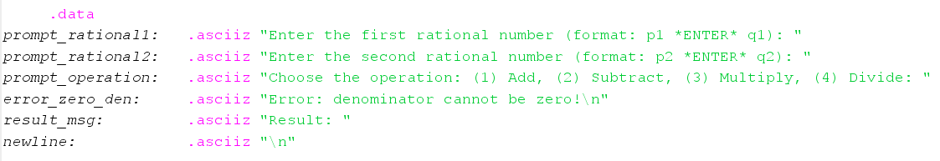
Data Segment

Slide 11
Branches and Logic
The program uses conditional branches to handle different arithmetic operations based on user input.
Addition (add_rationals)
Subtraction (subtract_rationals):
Multiplication (multiply_rationals):
Division (divide_rationals):
denominator_error
print_result

Slide 12


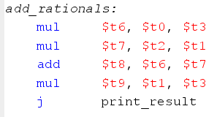
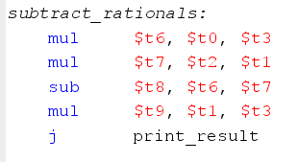
arithmetic

Slide 13


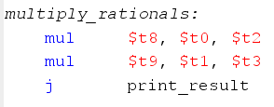
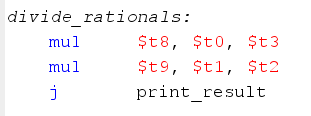
arithmetic

Slide 14

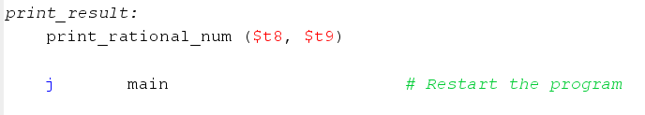
Branching and Control Flow

Slide 15
Advantages of Using Macros in MIPS
Code Reusability: Macros allow for defining repetitive tasks like printing, reading inputs, and formatting outputs.
Simplified Debugging: Changes in behavior (like how integers or strings are printed) only need to be made in the macro definitions.
Improved Readability: Macros make the code more readable by abstracting low-level system calls and repetitive operations.
Modularization: By breaking down tasks (like printing rational numbers), macros help maintain the modular nature of the program.

Slide 16
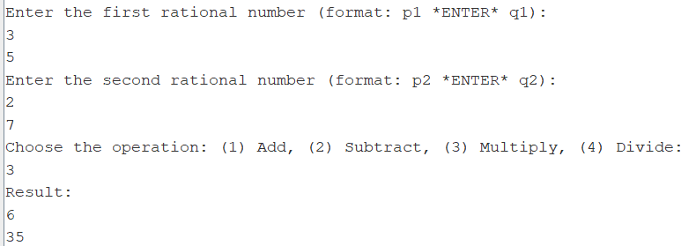
DEMO

Slide 17
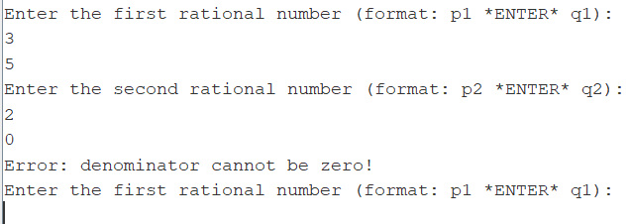
DEMO (ZERO Denominator)

