Slide 1
Campaign Performance Report
December 03, 2025

Slide 2
Executive Summary
• Our campaigns delivered 1,101,460,304 impressions and 109,954,406 clicks.
• Total ad spend was $2,500,878,608.00, generating $1,000,487.57 in revenue.
• The average click-through rate was 14.04%.
• Each click cost $32.01.

Slide 3
Key Performance Indicators
Total Impressions: 1,101,460,304
Total Clicks: 109,954,406
Total Spend: $2,500,878,608.00
Total Revenue: $1,000,487.57
Avg CTR: 14.04%
Avg CPC: $32.01
Avg ROAS: 0.00

Slide 4
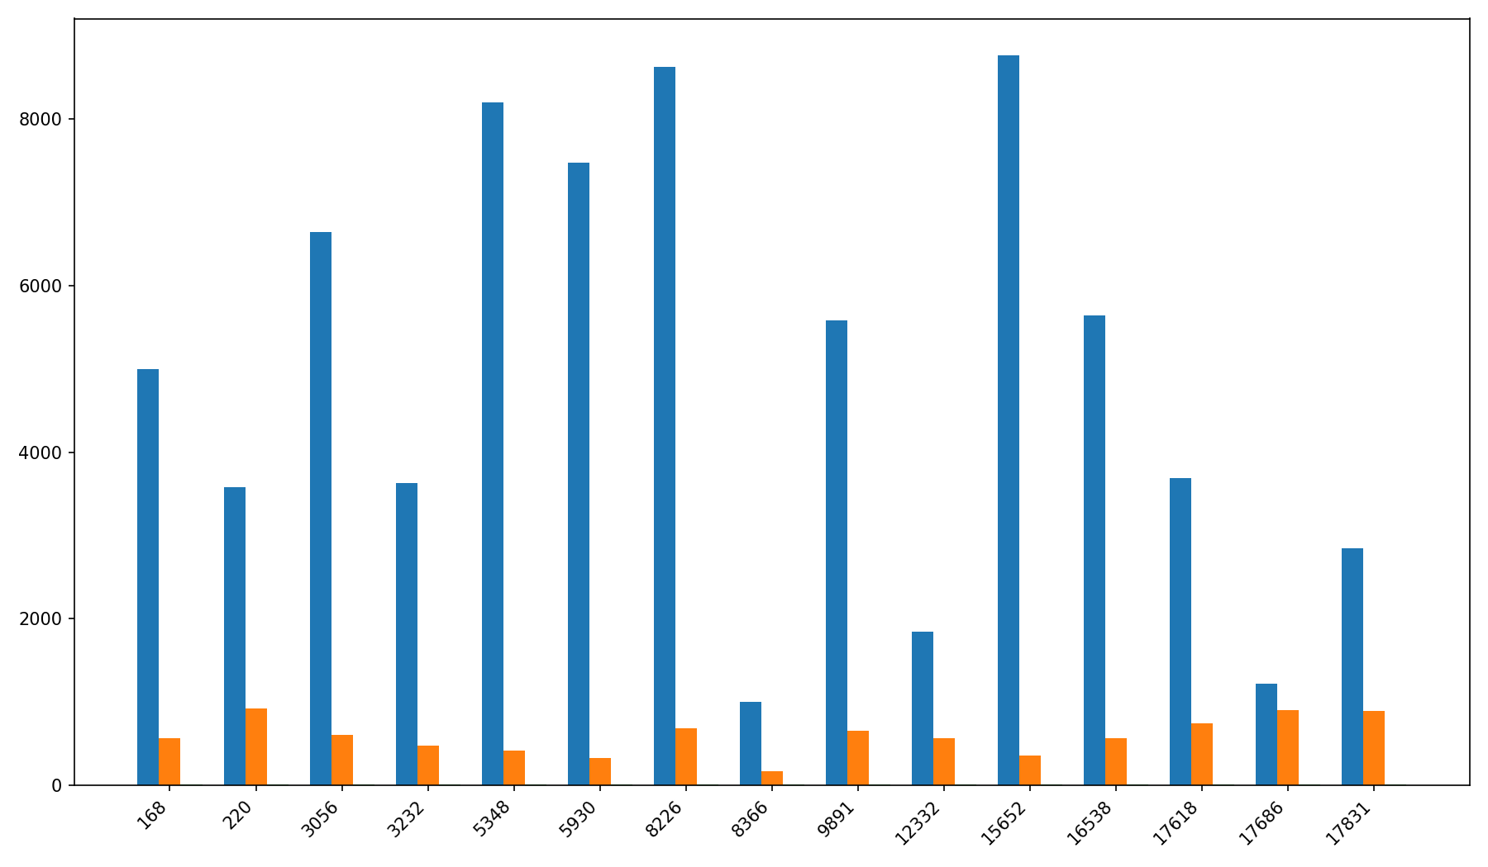
Campaign Performance Overview

Slide 5
Top 5 Campaigns
1. 168: $8.00 (ROAS 0.00)
2. 220: $8.00 (ROAS 0.00)
3. 3056: $8.00 (ROAS 0.00)
4. 3232: $8.00 (ROAS 0.00)
5. 5348: $8.00 (ROAS 0.00)

