Slide 1


Breathing Space & Overcrowding under Factories Act, 1934
Regulations ensuring safe and healthy factory environments
Notes:
AI-generated content may be incorrect. ---

Slide 2
Understanding Breathing Space Concept
Notes:
Definition and Importance of Breathing Space

Slide 3
Definition and Importance of Breathing Space
Provision | Purpose | Impact
Section 15 | Ventilation & Temperature | Maintains fresh air and comfortable working conditions
Section 16 | Dust & Fume Control | Prevents respiratory hazards
Section 18 | Overcrowding | Ensures adequate cubic space per worker
Notes:
The concept of breathing space under the Factories Act, 1934 refers to the requirement that workers in factories must have sufficient air volume and physical space to work comfortably and safely. Although the Act does not explicitly use the term 'breathing space,' it addresses this through provisions on ventilation, temperature control, and overcrowding. Adequate breathing space ensures that workers have access to clean air, reducing risks of suffocation, heat stress, and fatigue. This is critical for maintaining health and productivity in industrial environments where machinery and processes often generate heat and pollutants. Section 15 of the Act mandates proper ventilation and temperature regulation, while Section 16 requires control of dust and fumes to maintain air quality. Section 18 specifically prohibits overcrowding, ensuring that each worker has a minimum cubic space calculated by multiplying the length, width, and height of the workroom and dividing by the number of workers. For example, a room measuring 20 ft × 15 ft × 10 ft provides 3000 cubic feet of air; if 10 workers occupy it, each has 300 cubic feet of space. This calculation helps inspectors determine compliance. The importance of breathing space extends beyond comfort—it directly impacts occupational health by preventing respiratory issues and heat-related illnesses. Factories that fail to provide adequate space often face higher accident rates and lower productivity due to worker fatigue and illness. In Pakistan, enforcement of these provisions is essential in sectors like textiles, garments, and plastics, where large numbers of workers operate in confined spaces. By ensuring breathing space, employers comply with legal standards and create a safer, more efficient workplace.

Slide 4
Section 18 – Overcrowding Explained
Notes:
Legal Requirement and Calculation of Cubic Space

Slide 5
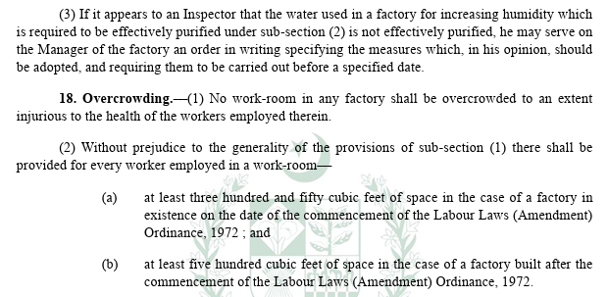
Legal Requirement and Calculation of Cubic Space
Room Size | Total Volume (cubic ft) | Workers | Cubic Space per Worker
20×15×10 ft | 3000 | 10 | 300
60×40×10 ft | 24000 | 80 | 300
50×30×12 ft | 18000 | 45 | 400
Notes:
Section 18 of the Factories Act, 1934 addresses overcrowding in workrooms by requiring that every worker has sufficient cubic space to prevent congestion. Cubic space refers to the volume of air available per worker, calculated as length × width × height of the room divided by the number of workers. This provision ensures that factories do not pack excessive workers into small areas, which can lead to poor ventilation, heat buildup, and health hazards. For example, if a workroom measures 60 ft × 40 ft × 10 ft, its total volume is 24,000 cubic feet. If 80 workers occupy this space, each worker has 300 cubic feet of air. Inspectors use this calculation to determine compliance with overcrowding rules. Adequate cubic space is essential for maintaining air quality and preventing suffocation, especially in industries with high heat or chemical exposure. Overcrowding not only violates legal standards but also reduces productivity and increases accident risks. Factories that comply with Section 18 typically experience better worker morale and efficiency. In Pakistan, common violations occur in garment and plastic molding units where space constraints lead to congestion. Enforcement of this provision is crucial for worker health and safety. Employers should regularly assess room dimensions and workforce size to ensure compliance. Providing breathing space is not just a legal obligation—it is a fundamental aspect of occupational health management.

Slide 6
Practical Examples from Pakistani Factories
Notes:
Case Studies: Textile, Garments, Sports Goods, and Plastic Units

Slide 7
Case Studies: Textile, Garments, Sports Goods, and Plastic Units
Factory Location | Room Size | Workers | Cubic Space per Worker | Status
Faisalabad Textile | 150×60×12 ft | 180 | 600 | Compliant
Lahore Garments | 60×40×10 ft | 80 | 300 | Borderline
Sialkot Sports Goods | 50×30×12 ft | 45 | 400 | Compliant
Karachi Plastic Molding | 40×25×12 ft | 50 | 240 | Non-Compliant
Notes:
Several real-world examples from Pakistani factories illustrate the application of Section 18 and the concept of breathing space. In Faisalabad’s textile sector, large stitching halls often measure 150 ft × 60 ft × 12 ft, providing 108,000 cubic feet of air for 180 workers—about 600 cubic feet per worker, which meets the standard comfortably. Conversely, a garment unit in Lahore with a 60 ft × 40 ft × 10 ft hall housing 80 workers offers only 300 cubic feet per worker, creating congestion and potential health risks. Inspectors frequently flag such setups for overcrowding. In Sialkot’s sports goods industry, finishing rooms of 50 ft × 30 ft × 12 ft accommodate 45 workers, giving 400 cubic feet per worker, which is acceptable and promotes better ventilation. However, in Karachi’s plastic molding facilities, smaller rooms of 40 ft × 25 ft × 12 ft with 50 workers provide only 240 cubic feet per worker, leading to heat stress and suffocation complaints. These examples highlight the importance of calculating cubic space and adjusting workforce size or room dimensions to comply with legal standards. Employers who ignore these requirements face penalties and risk worker health, while those who comply benefit from improved productivity and reduced absenteeism. These case studies serve as practical teaching tools for understanding how breathing space impacts occupational health and legal compliance in Pakistan’s industrial sectors.

