Slide 1
Chapter 10 – Quantitative Facilities Planning Models
Overview of analytical models used in facility planning
Includes location, layout, storage, conveyors, queues, simulation

Slide 2
Facility Location Models
Key decision: where to locate one/multiple facilities
Applications: airports, warehouses, hospitals, machines, etc.
Categories: single vs. multi-facility, continuous vs. discrete

Slide 3
Types of Facility Location Models
Single vs. Multi-facility models
Continuous vs. Discrete locations
Minisum: minimize total weighted distance
Minimax: minimize maximum distance

Slide 4
Distance Measures
Rectilinear (Manhattan): |x−a| + |y−b|
Euclidean: sqrt((x−a)² + (y−b)²)
Chebyshev: max(|x−a|, |y−b|)
Actual flow-path distance

Slide 5
Single-Facility Rectilinear Minisum Model
Objective: Minimize weighted travel distance
Function separable in x and y
Optimal coordinates satisfy median conditions

Slide 6
Notation Explained – Rectilinear Minisum Model
Objective: Minimize Σ wi(|x−ai| + |y−bi|)
x, y: coordinates of the new facility
ai, bi: coordinates of existing facility i
|x−ai|: horizontal distance; |y−bi|: vertical distance
wi: weight (e.g., trips/day, cost per trip, flow)
Σ over i = 1..m: sum over all m existing facilities
Goal: minimize total weighted rectilinear travel distance

Slide 7
Median Condition Illustration
x* such that ≤50% weight left and ≤50% right
y* such that ≤50% below and ≤50% above

Slide 8
Example 10.1 – Machine Coordinates & Weights
Five machine locations used for computing optimal point.
Consider the problem of locating a new general purpose machine tool in a maintenance department. Five machines currently located in the department have the following coordinate locations: P1 (1, 1), P2 (6, 2), P3 (2, 8), P4 (3, 6), and P5 (8, 4). The cost per unit distance traveled between the new machine and each existing machine is the same. The number of trips per day between the new machine and existing machines 1, . . ., 5 are 10, 20, 25, 20, and 25, respectively.
Step 1 (Consolidate the data)
Machine | x | y | Weight
1 | 1 | 1 | 10
2 | 6 | 2 | 20
3 | 2 | 8 | 25
4 | 3 | 6 | 20
5 | 8 | 4 | 25

Slide 9
Step 2: Cumulative Weight Logic
Optimal coordinates satisfy median conditions
Order x-coordinates and accumulate weights
Point where cumulative ≥ 50% gives x*
Repeat same logic for y*

Slide 10
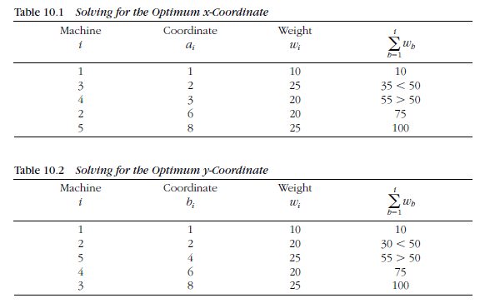
Optimal x* = ??, optimal y* = ??

Slide 11
Final Optimal Location (3,4)
Rectilinear distances drawn from (3,4) to all machines
Represents optimal point minimizing total travel cost

Slide 12
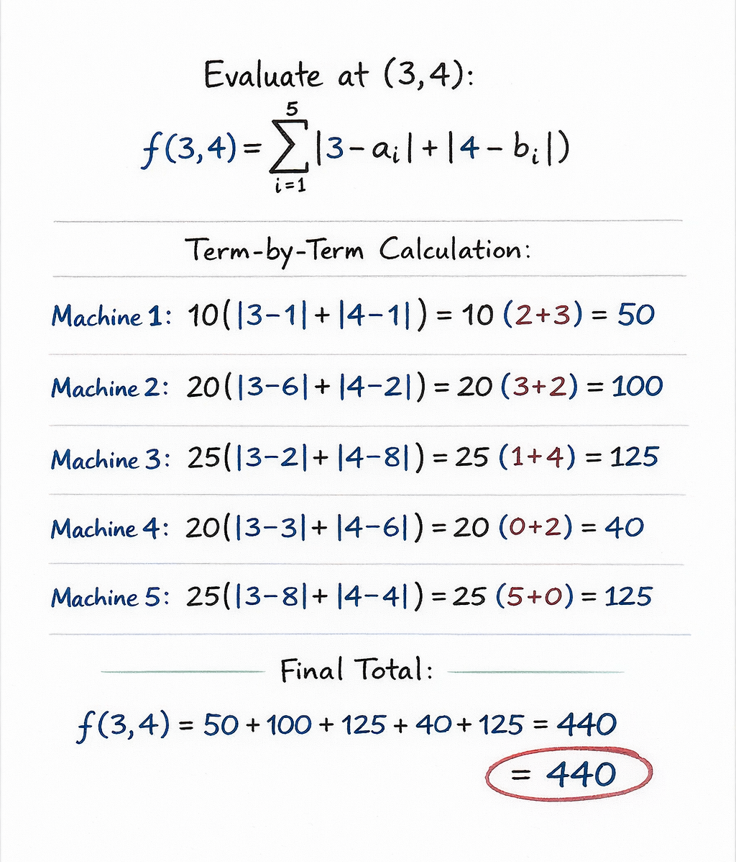

Slide 13
