Slide 1
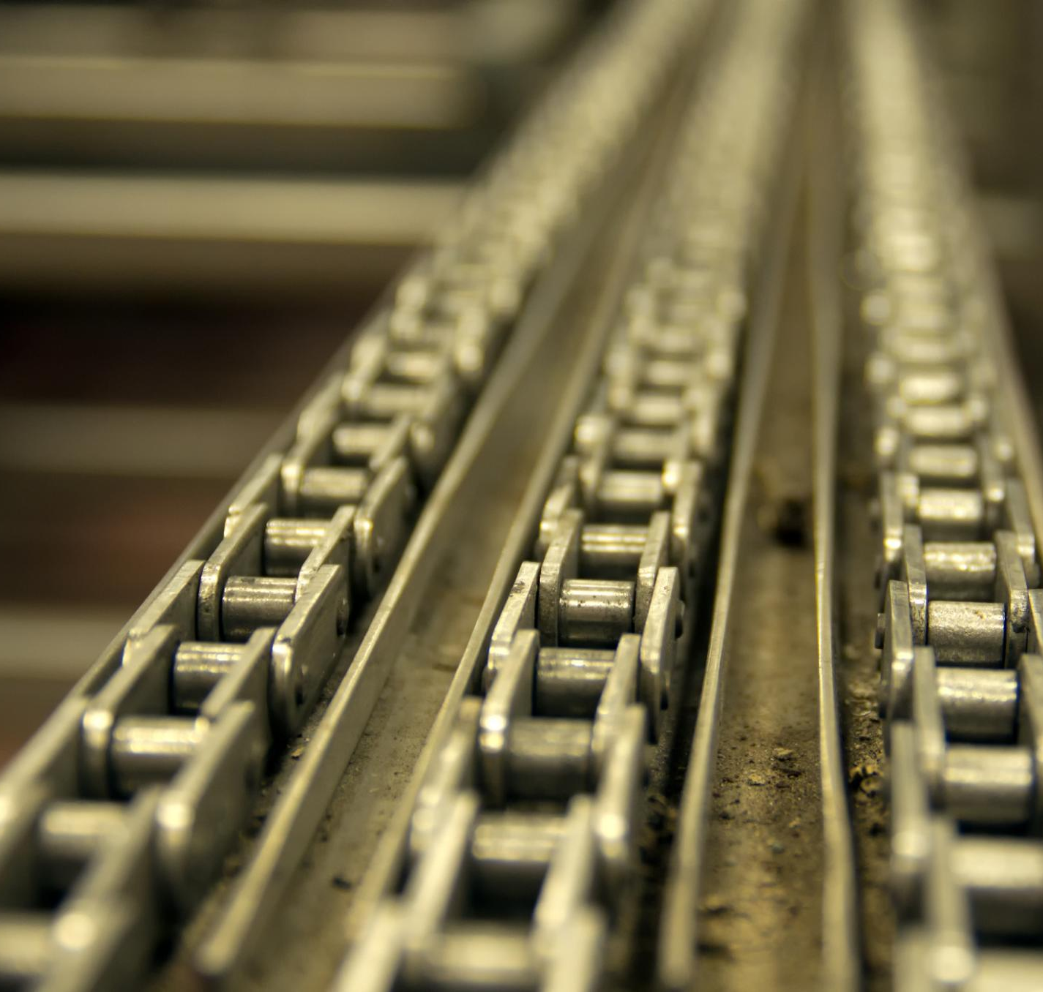
Manufacturing Systems
Exploring production methods in Pakistan's industries
Notes:
AI-generated content may be incorrect. ---

Slide 2
Introduction to Manufacturing Systems
Notes:
Overview and Importance of Manufacturing Systems

Slide 3
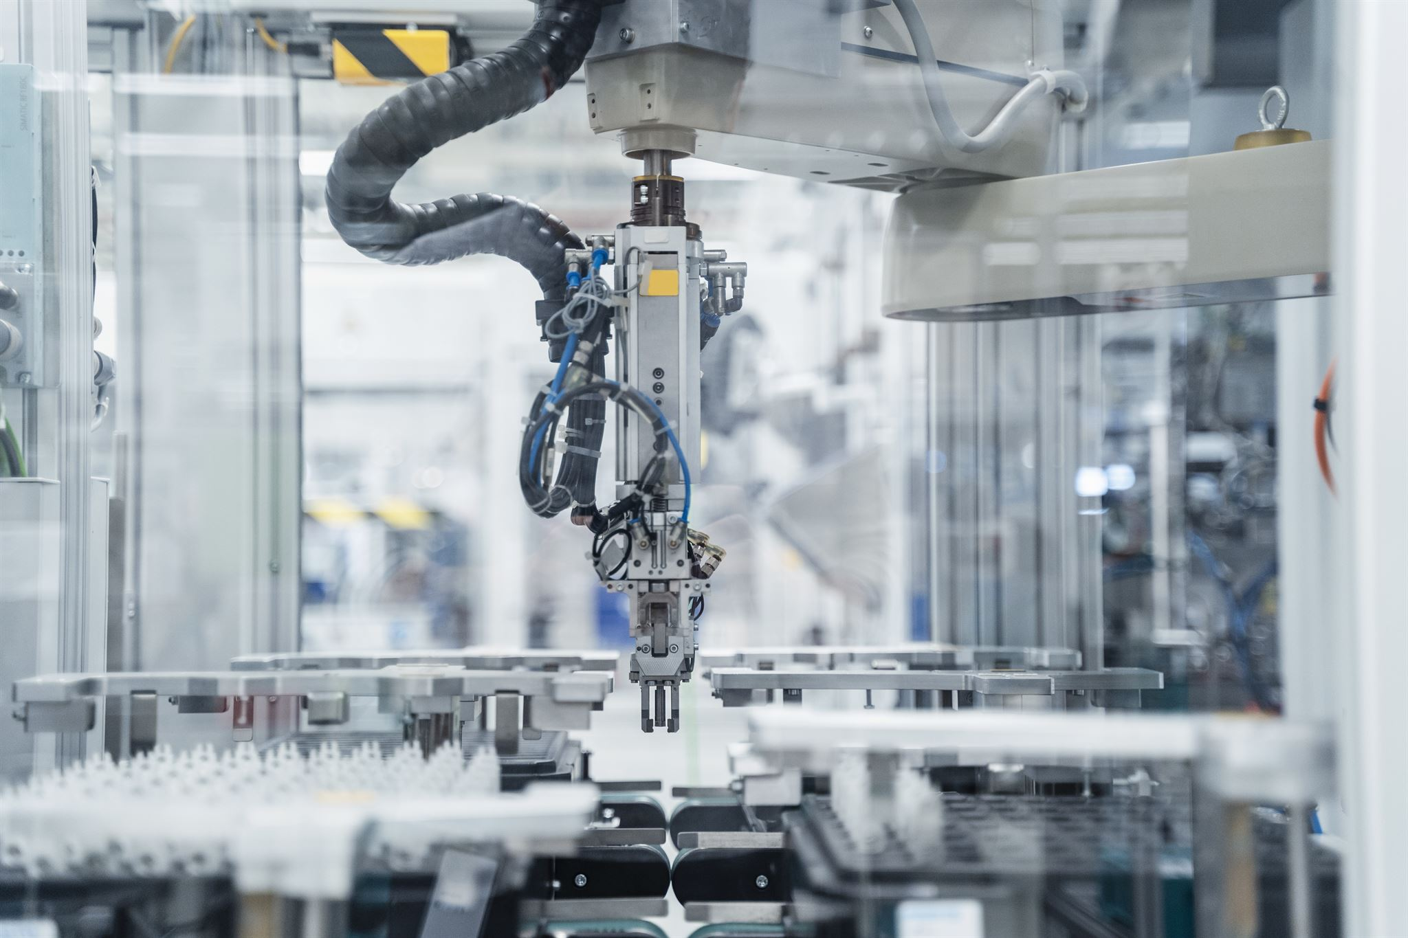
Importance and Role in Facility Design
Role of Facility Design
Facility design determines the interaction between machines, workers, and material handling systems affecting productivity and efficiency.
Impact of Layout on Efficiency
Poor layout causes bottlenecks and waste, while optimized layouts support lean manufacturing and just-in-time production.
Integration of Modern Technologies
Automation, IT, and flexible processes enable manufacturing systems to quickly adapt to changing customer demands.
Industry Example: Pakistan
Pakistani automotive and packaging industries use integrated systems combining automation and flexible cells to improve efficiency.
Notes:
Manufacturing systems are the backbone of industrial production, encompassing the processes, equipment, and organizational structures that transform raw materials into finished goods. Their importance lies in their direct impact on productivity, cost efficiency, and product quality. A well-designed manufacturing system ensures smooth material flow, minimizes waste, and optimizes resource utilization. Facility design plays a critical role because it determines how machines, workers, and material handling systems interact. Poor layout can lead to excessive movement, bottlenecks, and high work-in-process (WIP), while an optimized layout supports lean principles and just-in-time (JIT) production. Modern manufacturing systems integrate automation, information technology, and flexible processes to respond quickly to changing customer demands. For example, in Pakistan, industries such as automotive and packaging have adopted advanced layouts to improve efficiency and reduce costs. Atlas Honda and Pak Suzuki have implemented integrated systems that combine automated assembly with flexible cells, enabling them to handle multiple product variants without major downtime. These improvements not only enhance competitiveness but also align with global trends toward lean manufacturing and Industry 4.0. The strategic design of manufacturing systems thus influences economic performance, customer satisfaction, and long-term sustainability.

Slide 4
Overview and Importance of Manufacturing Systems
Definition and Role
Manufacturing systems transform raw materials into finished goods efficiently, impacting productivity and cost.
Evolution and Modern Trends
Manufacturing evolved from manual shops to automated, flexible, and lean systems to meet market demands.
Integration and Examples
Integration of layout, material handling, and information flow enhances efficiency as seen in automotive and textile industries.
Adaptability and Future Focus
Manufacturing systems must adapt with automation, real-time data, and lean principles to stay competitive and sustainable.
Notes:
Manufacturing systems are structured arrangements of processes, equipment, and resources designed to transform raw materials into finished goods efficiently. They play a critical role in determining a firm's productivity, cost structure, and ability to respond to market demands. The importance of these systems lies in their capacity to add value through streamlined operations, reduced waste, and improved quality. Historically, manufacturing systems evolved from manual job shops to highly automated factories, driven by the need for higher throughput and consistency. Today, global competition and customer expectations for customization have shifted the focus toward flexibility and lean operations. Effective manufacturing systems integrate facility layout, material handling, and information flow to ensure smooth production. For example, in Pakistan, industries such as automotive and textiles have adopted modern manufacturing systems to remain competitive. Atlas Honda’s engine assembly lines demonstrate how structured systems improve efficiency and reduce cycle times. Similarly, Packages Ltd. leverages integrated systems for packaging production, ensuring rapid changeovers and minimal downtime. These examples highlight that manufacturing systems are not static; they must adapt to technological advancements, market volatility, and sustainability goals. The integration of automation, real-time data capture, and lean principles ensures that manufacturing systems remain relevant and capable of delivering high-quality products at competitive costs. Understanding these systems is essential for engineers and managers aiming to optimize operations and achieve long-term profitability.

Slide 5
Fixed Automation Systems
Notes:
Transfer Lines and Hard Automation

Slide 6
Transfer Lines and Hard Automation
Feature | Advantages | Disadvantages
Transfer Line | High production rate, consistent quality | High cost, low flexibility, sensitive to breakdowns
Pakistan Example | Atlas Honda engine assembly | Requires stable demand and skilled maintenance
Feature | Advantage | Disadvantage
High Volume | Low unit cost | Requires large demand
Automation Level | Consistent quality | High capital cost
Flexibility | Efficient for standard products | Poor adaptability to changes
Notes:
Fixed automation systems, often exemplified by transfer lines, are designed for high-volume, low-variety production environments. These systems rely on specialized equipment arranged in a sequential layout, enabling continuous material flow from one workstation to the next. The primary advantage of transfer lines is their unmatched production rate, which is ideal for industries producing standardized products. However, they come with significant limitations, including high initial investment, inflexibility in accommodating product changes, and vulnerability to disruptions caused by equipment failures. In Pakistan, Atlas Honda’s Sheikhupura plant illustrates the application of fixed automation through its engine assembly transfer lines. These lines are configured to maintain synchronized operations, minimizing buffer storage and ensuring consistent output. Similarly, Indus Motor Company employs automated paint and body transfer systems to achieve uniform quality in automotive production. While these systems deliver economies of scale, they require meticulous planning for layout, buffer sizing, and material handling integration. The design process involves determining optimal flow patterns, such as straight-line or U-shaped configurations, to maximize space utilization and minimize handling time. Despite their rigidity, transfer lines remain relevant for mass production sectors where demand stability justifies the investment. Future trends suggest hybrid approaches, combining fixed automation with flexible elements to enhance adaptability without compromising throughput. Understanding the strengths and limitations of fixed automation is crucial for selecting the right manufacturing strategy in competitive markets.

Slide 7
Flexible Manufacturing Systems (FMS)
Notes:
Concept and Design of FMS

Slide 8
Concept and Design of FMS
Company | Application | FMS Feature
Pak Suzuki | Flexible welding & assembly | Quick model changeovers
Atlas Honda | CNC machining cells | Automated tool changes
Packages Ltd. | Packaging production | Mixed-model capability
Notes:
Flexible Manufacturing Systems (FMS) are designed to handle a wide variety of products in low to medium volumes, offering adaptability to changing market demands. An FMS integrates processing equipment, automated material handling, and computer control to enable random, independent movement of parts between workstations. Key benefits include reduced lead times, improved machine utilization, and enhanced responsiveness to schedule changes. In Pakistan, several industries have embraced FMS principles. Pak Suzuki Motor Company employs flexible welding and assembly cells that allow quick transitions between models like Alto and Cultus. Atlas Honda uses CNC machining centers configured for multiple engine variants, supported by centralized tool storage and automated tool change systems. Packages Ltd. operates flexible packaging lines capable of handling diverse materials and designs with minimal setup time. These examples demonstrate how FMS supports scope-based economies, enabling manufacturers to produce customized products efficiently. Designing an FMS requires careful consideration of layout configurations, such as centralized or internal storage systems, and compatibility with computer control for real-time tracking. Scalability and modularity are essential to accommodate future expansions. By adopting FMS, Pakistani firms have improved operational agility, reduced WIP, and enhanced competitiveness in sectors like automotive, packaging, and consumer goods. The success of FMS lies in its ability to combine automation with flexibility, ensuring that production systems remain resilient in dynamic environments.

Slide 9
Lean Principles and WIP Reduction
Notes:
Strategies for Reducing Work-in-Process

Slide 10
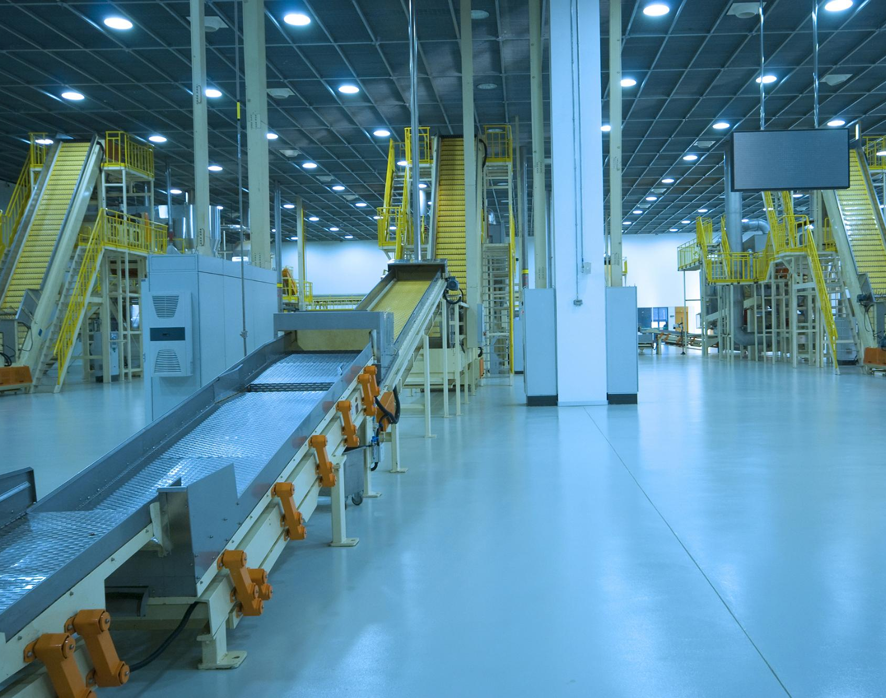
Strategies for Reducing Work-in-Process
Impact of Excessive WIP
Too much WIP causes longer cycle times, higher storage costs, and increased product damage risks.
Lean Manufacturing Strategies
Minimize WIP using JIT systems, optimized layout, and standardized containers for efficient handling.
Successful Applications in Pakistan
Companies like Engro Foods, Nishat Mills, and Packages Ltd. reduced WIP improving flow and profitability.
Effective WIP Control Systems
Use pre-positioned materials, simplified handling, and visual management to increase machine availability.
Notes:
Work-in-process (WIP) represents materials that are partially completed and awaiting further processing. Excessive WIP leads to longer cycle times, higher storage costs, and increased risk of damage. Lean manufacturing principles advocate minimizing WIP by eliminating non-value-adding activities such as unnecessary handling and storage. Strategies include implementing just-in-time (JIT) systems, optimizing layout for minimal movement, and using standardized containers for efficient handling. In Pakistan, Engro Foods has successfully applied lean principles at its Sahiwal plant, reducing WIP through synchronized production and improved material flow. Nishat Mills has optimized yarn and fabric handling to minimize intermediate storage, while Packages Ltd. has streamlined carton production by reducing buffer inventories. These initiatives have resulted in shorter lead times, improved space utilization, and enhanced profitability. Designing effective WIP control systems involves pre-positioning materials for automatic loading, simplifying handling tasks, and leveraging visual management tools. The ultimate goal is to convert wasted time into productive time, thereby increasing machine availability and accelerating revenue generation. By adopting these practices, manufacturers can achieve significant cost savings and operational efficiency, reinforcing the importance of lean thinking in modern manufacturing environments.

Slide 11
Just-in-Time Manufacturing
Notes:
JIT Philosophy and Implementation

Slide 12
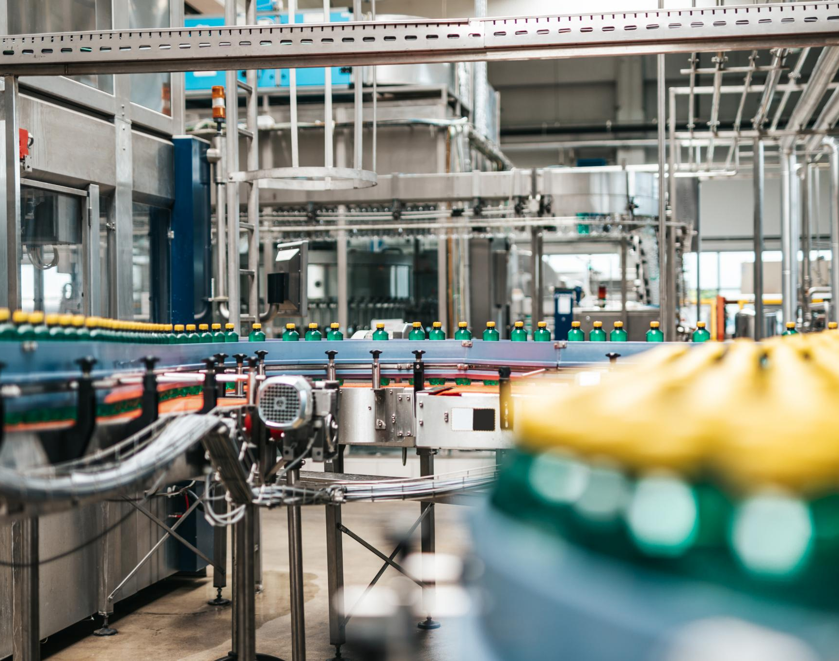
JIT Philosophy and Implementation
JIT Waste Elimination
JIT focuses on eliminating seven types of waste including overproduction, waiting, and excess inventory to improve efficiency.
Implementation Techniques
Techniques like pull systems, kanbans, small lots, quick setups, and multifunctional workers drive JIT success.
JIT in Pakistani Industry
Pakistani companies like Indus Motor and Honda Atlas apply JIT to synchronize supply and reduce inventory costs.
Facility Design Impact
JIT leads to smaller storage needs, decentralized receiving docks, and streamlined layouts for continuous flow.
Notes:
Just-in-Time (JIT) manufacturing is a production strategy aimed at reducing waste by producing only what is needed, when it is needed, and in the required quantity. Originating from Toyota, JIT emphasizes eliminating seven types of waste: overproduction, waiting, transportation, processing inefficiencies, excess inventory, unnecessary motion, and defects. Implementation involves techniques such as pull systems with kanbans, small lot sizes, quick setup changes, and multifunctional workers. In Pakistan, Indus Motor Company has adopted JIT principles to synchronize supplier deliveries with production schedules, reducing inventory levels and improving responsiveness. Honda Atlas also applies JIT in its assembly operations, ensuring timely availability of components and minimizing storage costs. K&N’s Poultry Processing leverages JIT in its cold-chain logistics to maintain product freshness and reduce holding times. Successful JIT implementation requires robust supplier relationships, accurate demand forecasting, and efficient material handling systems. The impact on facility design includes smaller storage areas, decentralized receiving docks, and streamlined layouts to support continuous flow. By embracing JIT, Pakistani manufacturers have enhanced quality, reduced lead times, and improved cost efficiency, demonstrating the universal applicability of lean principles across diverse industries.

Slide 13
U-Shaped Flow Lines
Notes:
Design and Benefits of U-Shaped Lines

Slide 14
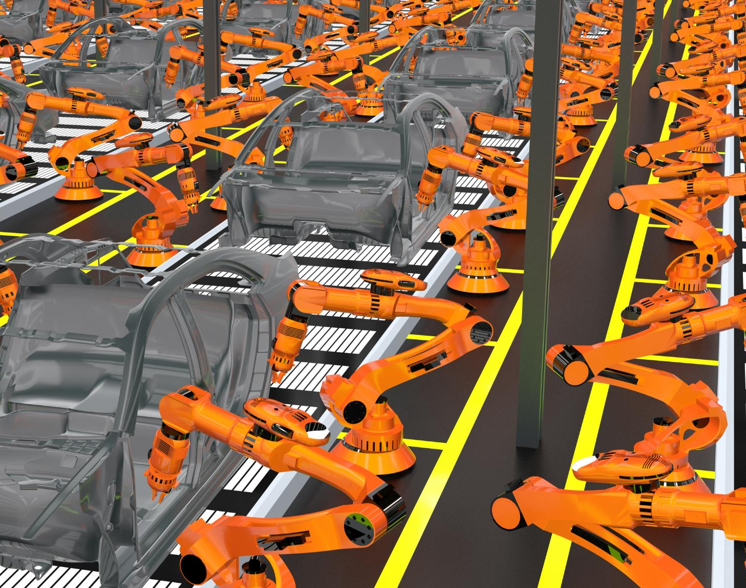
Design and Benefits of U-Shaped Lines
Enhanced Operational Efficiency
U-shaped lines reduce walking time and enable operators to manage multiple machines efficiently, improving productivity.
Lean Manufacturing Benefits
This layout supports lean principles by reducing work-in-progress, promoting teamwork, and enabling quick schedule adjustments.
Industry Applications in Pakistan
Companies like Servis Shoes, Packages Ltd., and Sapphire Textiles use U-shaped cells to optimize production and space utilization.
Design Considerations
Effective U-shaped lines require attention to machine proximity, operator paths, and ergonomics for safety and scalability.
Notes:
U-shaped flow lines are a variation of straight-line layouts designed to enhance communication, reduce material handling, and improve flexibility. By arranging machines in a U-pattern, operators can tend multiple machines efficiently, minimizing walking time and enabling quick adjustments to production schedules. This configuration supports lean principles by reducing WIP and promoting teamwork. In Pakistan, Servis Shoes employs U-shaped assembly cells to streamline footwear production, allowing operators to perform multiple tasks and balance workloads effectively. Packages Ltd. uses U-shaped printing cells to optimize space utilization and reduce handling distances. Sapphire Textiles has implemented U-shaped stitching lines to improve throughput and minimize inventory buffers. The benefits of U-shaped lines include improved line balancing, enhanced visibility for problem-solving, and scalability to meet fluctuating demand. Designing these lines requires careful consideration of machine proximity, operator paths, and ergonomic factors to ensure efficiency and safety. By adopting U-shaped layouts, manufacturers can achieve significant gains in productivity and responsiveness, reinforcing their role as a cornerstone of lean manufacturing strategies.

Slide 15
Conclusion and Future Trends
Notes:
Integration and Emerging Practices

Slide 16
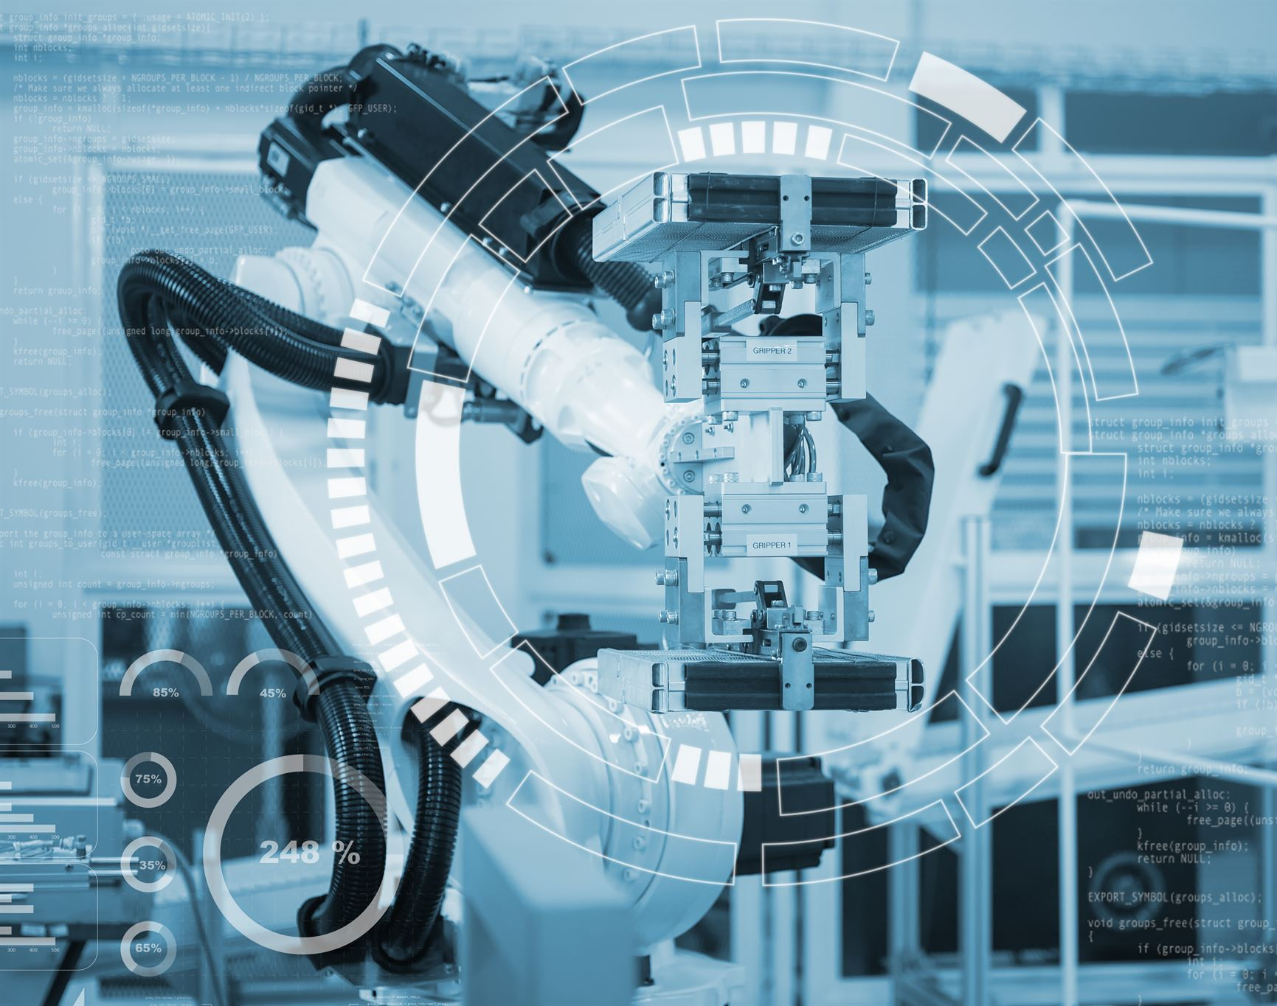
Integration and Emerging Practices
Advanced Manufacturing Concepts
Pakistan's industries adopt JIT, U-shaped lines, and flexible manufacturing systems to enhance competitiveness.
Digital Technologies Adoption
Future trends include RFID, automated guided vehicles, and machine vision for real-time monitoring and control.
Integration and Sustainability
Information systems integration with physical processes and sustainable facility design drive efficiency and waste reduction.
Industry 4.0 Transformation
Automation, data analytics, and smart systems converge to redefine manufacturing for long-term success.
Notes:
The evolution of manufacturing systems reflects a continuous pursuit of efficiency, flexibility, and quality. From fixed automation to flexible manufacturing systems and lean practices, each approach addresses specific operational challenges. In Pakistan, industries are increasingly adopting advanced manufacturing concepts such as JIT, U-shaped lines, and FMS to remain competitive in global markets. Future trends include greater use of digital technologies like RFID, automated guided vehicles (AGVs), and machine vision for real-time monitoring and control. The rise of e-commerce and consumer demand for customization will drive further integration of information systems with physical processes. Sustainability considerations will influence facility design, emphasizing energy efficiency and waste reduction. As manufacturing moves toward Industry 4.0, the convergence of automation, data analytics, and smart systems will redefine production paradigms. For Pakistani manufacturers, embracing these trends offers opportunities to enhance productivity, reduce costs, and expand into new markets. The journey toward integrated, lean, and flexible manufacturing systems is not optional—it is essential for long-term success in an increasingly dynamic and competitive environment.

