Slide 1
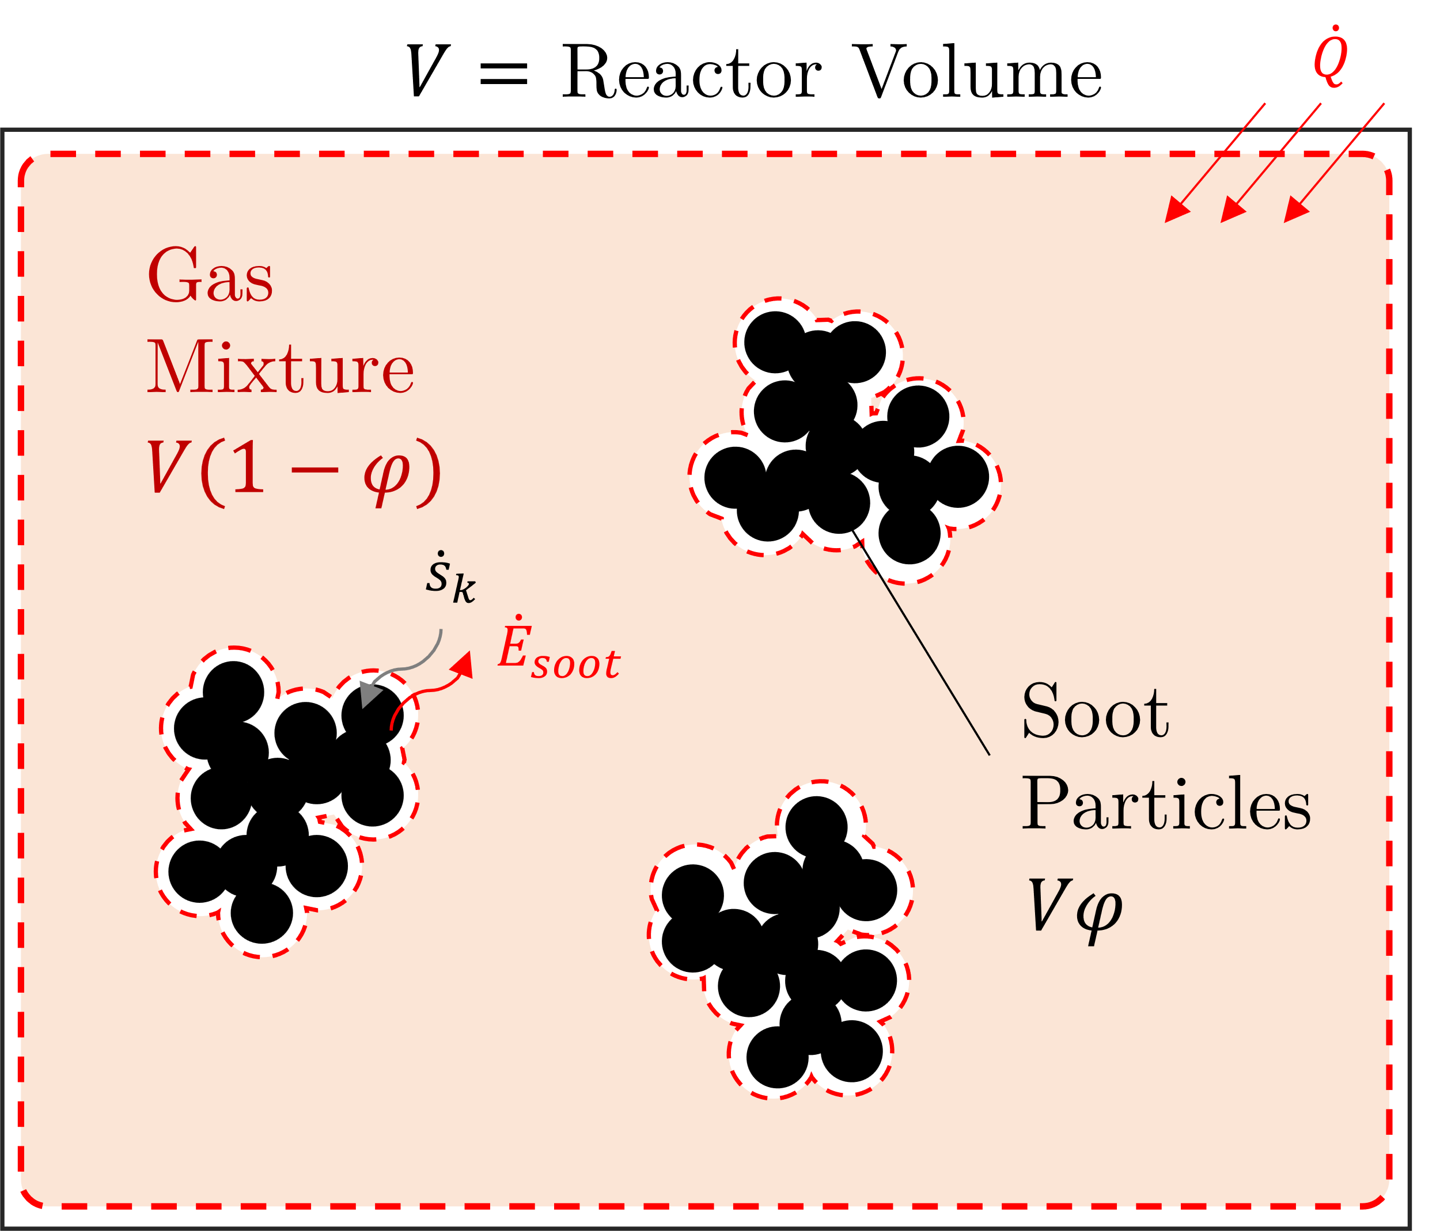
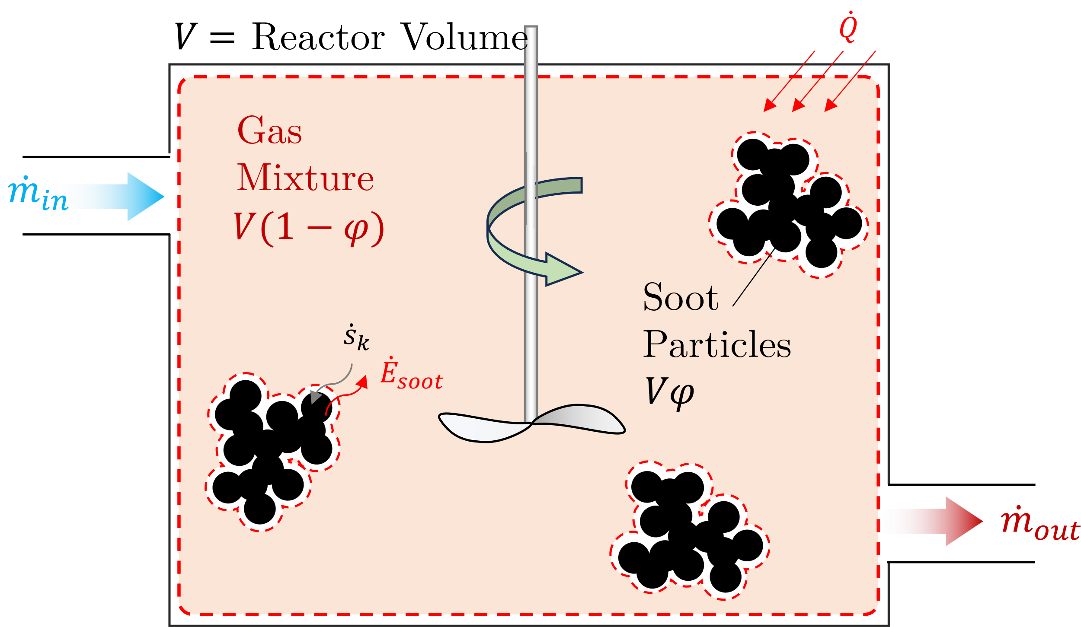
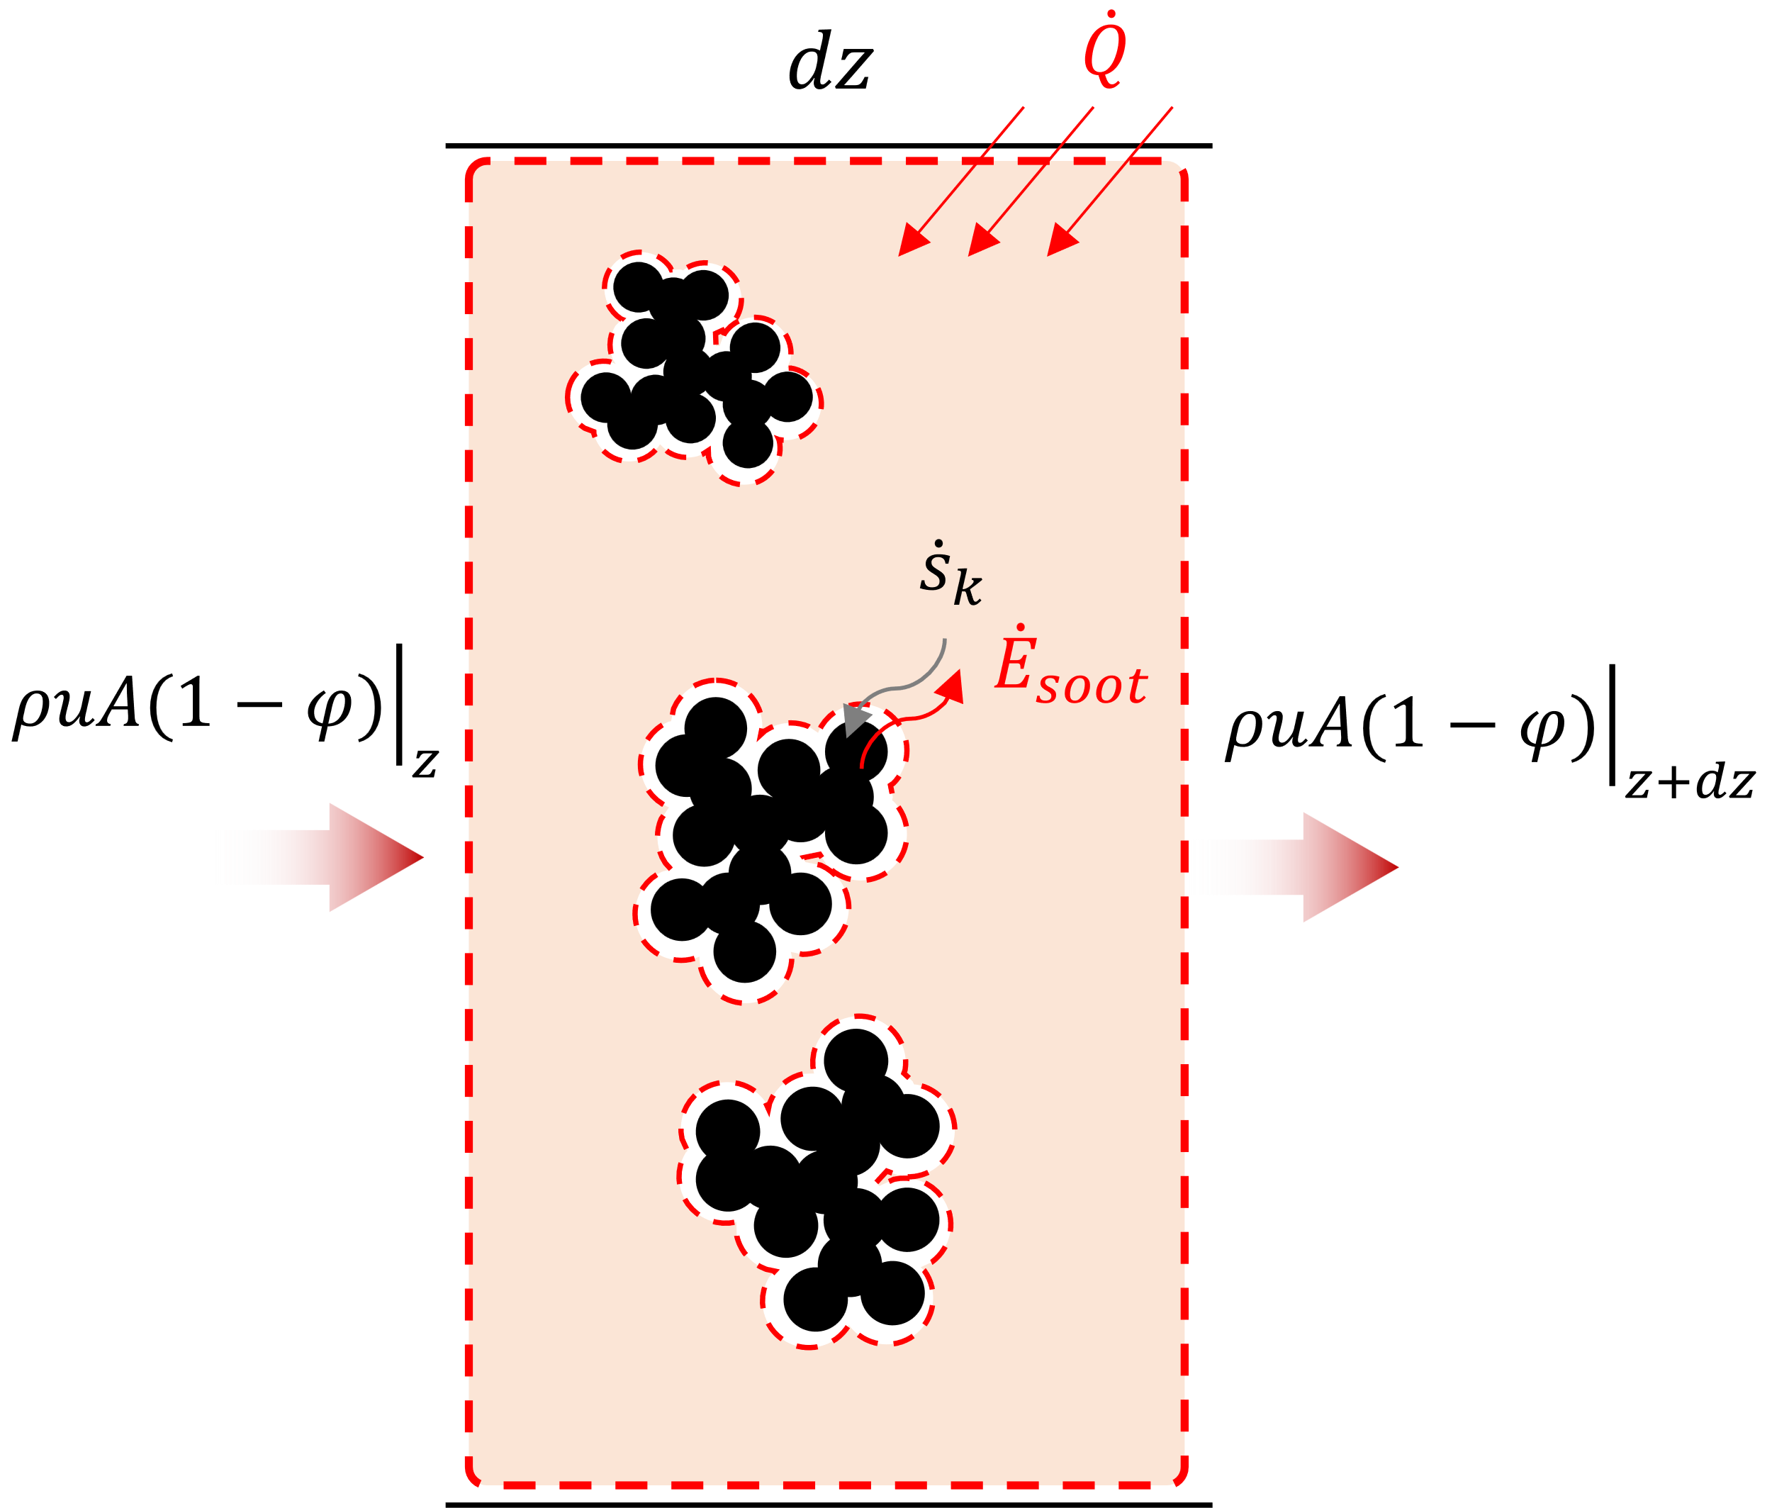
Cantera
Opensource chemical
kinetics package
Omnisoot
Developed package
Constant Volume Reactor
Perfectly Stirred Reactor
Plug Flow Reactor

Slide 2

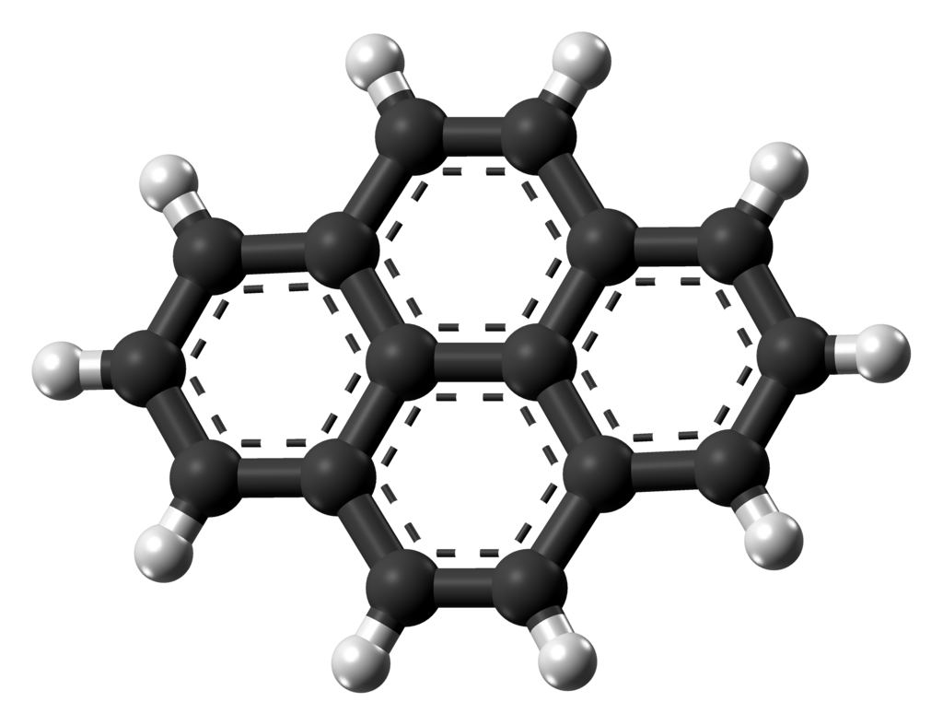
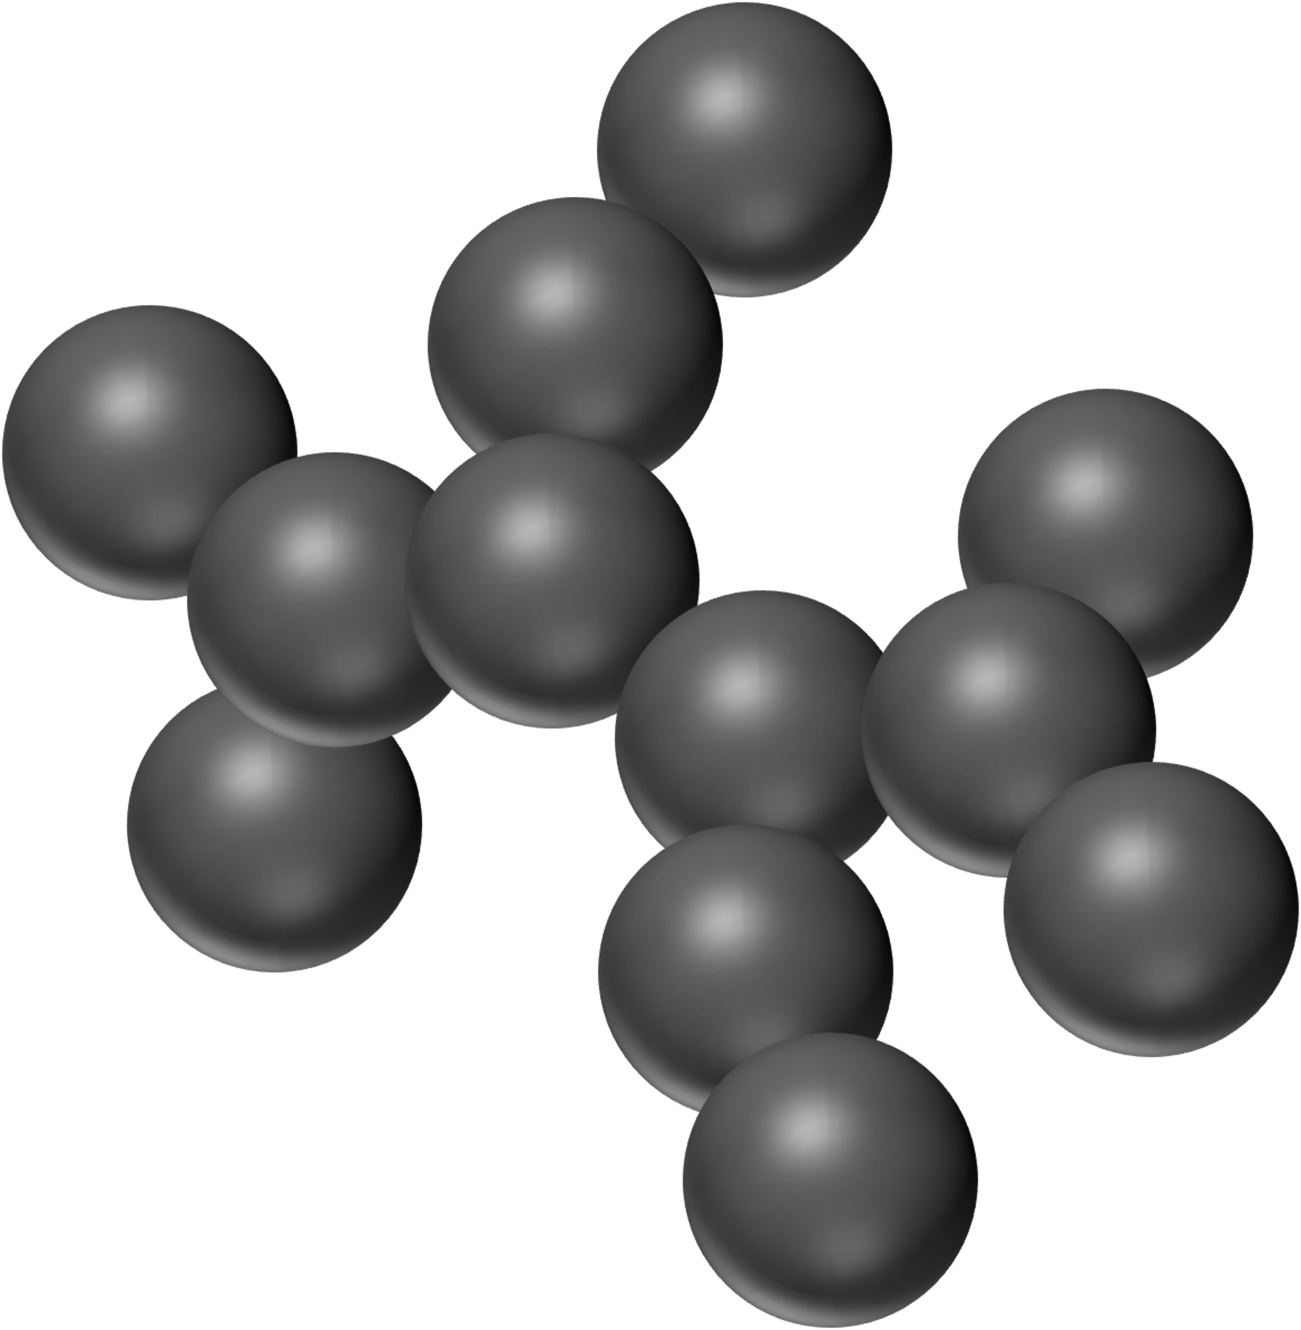


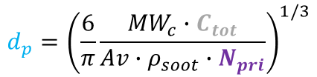

Soot Particle
PAH molecule
PAH molecule
PAH molecule
$$d_{p}={\left(\frac{6}{π}\frac{{MW}_{c}∙C_{tot}}{Av∙ρ_{soot}∙N_{pri}}\right)}^{1/3}$$
$$n_{p}=\frac{N_{pri}}{N_{agg}}$$
$$d_{g}=\frac{d_{m}}{n_{p}^{−0.2}+0.4}$$
Adsorbed PAH
Dimer
PAH Adsorption
Inception
$d_{m}=$ $d_{p} n_{p}^{0.45}$

