Slide 1
Visual Programming-I
عنوان مضمون
توسط : صفری
خزان1397

Slide 2
C# data type and type conversion C# variable, constant and literals

Slide 3
VARIABLES
variables are concerned with the storage of data.
C# syntax for declaring variables merely specifies the type and variable name:
<type> < var-name >;
double d;
where type is the data type of the variable and var-name is its name. <data_type> <variable_list>;
int i, j, k;
char c, ch;
float f, salary;

Slide 4
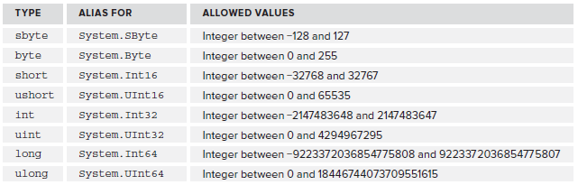
Simple Types
Simple types include types such as numbers and Boolean (true or false) values that make up the fundamental building blocks for your applications.

Slide 5
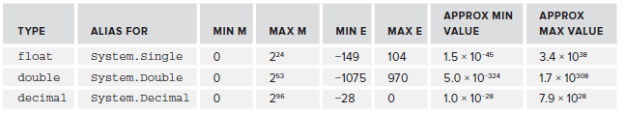
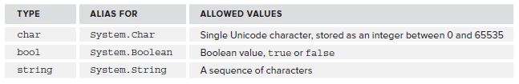
Simple Types

Slide 6
Variable Naming
The basic variable naming rules are as follows:
The first character of a variable name must be either a letter, an underscore character(_), or the at symbol (@).
Subsequent characters may be letters, underscore characters, or numbers.
certain keywords that have a specialized meaning to the C# compiler, such as the using and namespace keywords shown earlier. If you use one of these by mistake, the compiler complains
Remember that C# is case sensitive

Slide 7
Variable Naming
For example, the following variable names are fi ne:
myBigVar
VAR1
_test
These are not, however:
99BottlesOfBeer
namespace
It's-All-Over

Slide 8
Variable Declaration and Assignment
To recap, recall that you declare variables simply using their type and name:
int age;
int xSize, ySize;
You then assign values to variables using the = assignment operator:
age = 25;
int xSize = 4, ySize = 5;

Slide 9
TRY IT OUT
Create a new console application
Add the following code to Program.cs:
static void Main(string[] args)
{ int myInteger;
string myString;
myInteger = 17;
myString = "\"myInteger\" is";
Console.WriteLine("{0} {1}.", myString, myInteger);
Console.ReadKey();
}
Execute the code.

Slide 10
TYPE CONVERSION
However, in general, the different types of variables use varying schemes to represent data. This implies that even if it were possible to place the sequence of bits from one variable into a variable of a different type.
Type conversion is converting one type of data to another type. It is also known as Type Casting.
For example, you might want to assign an int value to a float variable, as shown here:
int i;
float f;
i =10;
F= i;

Slide 11
TYPE CONVERSION
Type conversion takes two forms:
➤ Implicit conversion –(Automatic Conversions) These conversions are performed by C# in a type-safe manner. For example, are conversions from smaller to larger integral types and conversions from derived classes to base classes.
➤ Explicit conversion —(Casting Incompatible Types)These conversions are done explicitly by users using the pre-defined functions. Explicit conversions require a cast operator.

Slide 12
Implicit type conversion –(Automatic Conversions)
When one type of data is assigned to another type of variable, an implicit type conversion will take place automatically if:
• The two types are compatible.
• The destination type has a range that is greater than the source type.
When these two conditions are met, a widening conversion takes place. For example, the int(32 bits) type is always large enough to hold all valid byte(8 bits) values, and both int and byte are compatible integer types, so an implicit conversion can be applied.

Slide 13
For example, the following program is perfectly valid since long to double is a widening conversion that is automatically performed.
class LtoD {
static void Main() {
long L;
double D;
L=100123285L;
D=L;
Console.WriteLine("L and D: " + L + " " + D);
}
}

Slide 14
Although there is an implicit conversion from long to double, there is no implicit conversion from double to long since this is not a widening conversion. Thus, the following version of the preceding program is invalid:
using System;
class LtoD {
static void Main() {
long L;
double D;
D=100123285.0;
L=D; // Illegal!!!
Console.WriteLine("L and D: " + L + " " + D);
}
}

Slide 15

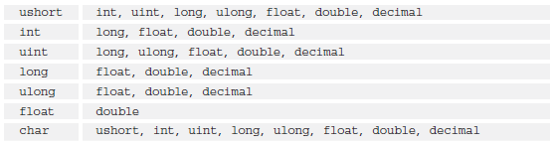
Implicit type conversion –(Automatic Conversions)

Slide 16
Explicit type conversion – (Casting Incompatible Types)
For example, the following modification to the code from the last section attempts to convert a short value into a byte:
byte destinationVar;
short sourceVar = 7;
destinationVar = sourceVar;
Console.WriteLine("sourceVar val: {0}", sourceVar);
Console.WriteLine("destinationVar val: {0}", destinationVar);
If you attempt to compile the preceding code, you will receive the following error:
Cannot implicitly convert type 'short' to 'byte'. An explicit conversion exists (are you missing a cast?)

Slide 17
Explicit type conversion – (Casting Incompatible Types)
Although the implicit type conversions are helpful, they will not fulfill all programming needs because they apply only to widening conversions between compatible types. For all other cases you must employ a cast. A cast is an instruction to the compiler to convert the outcome of an expression into a specified type. Thus, it requests an explicit type conversion. A cast has this general form:
(target-type) expression
(int) (x / y)

Slide 18
using System;
namespace TypeConversionApplication
{
class ExplicitConversion
{
static void Main(string[] args)
{
double d = 5673.74;
int i;
// cast double to int.
i = (int)d;
Console.WriteLine(i);
Console.ReadKey();
}
}
}

Slide 19
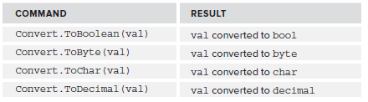
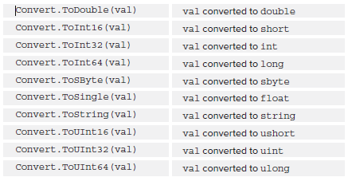
Explicit Conversions Using the Convert Commands
You can specify many such explicit conversions in this way:

Slide 20
Explicit Conversions Using the Convert Commands
Accepting Values from User:
The Console class in the System namespace provides a function ReadLine() for accepting input from the user and store it into a variable.
int num;
num = Convert.ToInt32(Console.ReadLine());

Slide 21
Constants and Literals
The constants refer to fixed values that the program may not alter during its execution. These fixed values are also called literals.
Constants can be of any of the basic data types like an integer constant, a floating constant, a character constant, or a string literal.
Defining Constants
Constants are defined using the const keyword. Syntax for defining a constant is −
const <data_type> <constant_name> = value;

Slide 22
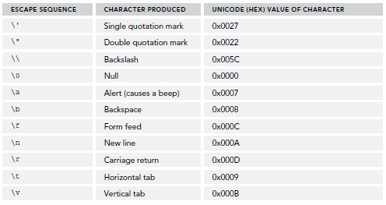
String Literals
you saw a few of the escape sequences you can use in string literals.

