Slide 1
Visual Programming-I
عنوان مضمون
توسط : صفری
خزان1397

Slide 2
operators

Slide 3
operators
C# contains a number of operators for this purpose.
By combining operators with variables and literal values (together referred to as operands when used with operators), you can create expressions, which are the basic building blocks of computation.
Operators can be roughly classified into three categories:
➤ Unary — Act on single operands
➤ Binary — Act on two operands
➤ Ternary — Act on three operands

Slide 4
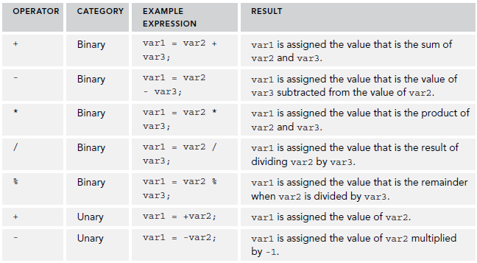
Mathematical Operators
TABLE of Simple Mathematical Operators

Slide 5

Mathematical Operators
TABLE of The String Concatenation Operator
None of the other mathematical operators, however, work with strings.

Slide 6
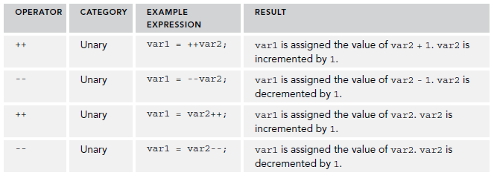
Mathematical Operators
TABLE of Increment and Decrement Operators

Slide 7
Mathematical Operators
Placing one of these operators before its operand means that(++ a)
the operand is affected before any other computation takes place.
Placing it after the operand means that(a --)
the operand is affected after all other computation of the expression is completed.
This merits another example! Consider this code:
int var1, var2 = 5, var3 = 6;
var1 = var2++ * --var3;
Console.WriteLine(var1);
Console.ReadKey();

Slide 8
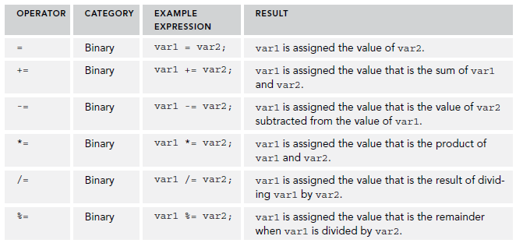
Assignment Operators
So far, you’ve been using the simple = assignment operator, and it may come as a surprise that any other assignment operators exist at all.
so code like var1 += var2;
has exactly the same result as var1 = var1 + var2;

Slide 9
Operator Precedence
When an expression is evaluated, each operator is processed in sequence, but this doesn’t necessarily mean evaluating these operators from left to right. As a trivial example, consider the following:
var1 = var2 + var3;
Here, the + operator acts before the = operator.
This example:
var1 = (var2 + var3) * var4;
Here, the content of the parentheses is evaluated first, meaning that the + operator acts before the * operator.

Slide 10
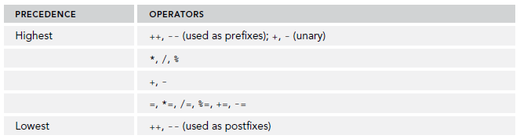
Operator Precedence
TABLE of Operator Precedence:

Slide 11
Namespaces

Slide 12
Namespaces
Namespaces are the .NET way of providing containers for application code, such that code and its contents may be uniquely identified.
The class names declared in one namespace does not conflict with the same class names declared in another.
Namespaces are also used as a means of categorizing items in the .NET Framework. Most of these items are type definitions, such as the simple types in this chapter (System.Int32 and so on).
namespace namespace_name {
// code declarations
}

Slide 13
Namespaces
To call the namespace-enabled version of either function or variable, prepend the namespace name as follows −
namespace_name.item_name;

Slide 14
using System;
namespace first_space {
class namespace_cl {
public void func() {
Console.WriteLine("Inside first_space");
}
}
}
namespace second_space {
class namespace_cl {
public void func() {
Console.WriteLine("Inside second_space");
}
}
}
class TestClass {
static void Main(string[] args) {
first_space.namespace_cl fc = new first_space.namespace_cl();
second_space.namespace_cl sc = new second_space.namespace_cl();
fc.func();
sc.func();
Console.ReadKey();
}
}

Slide 15
The using Keyword
The using keyword states that the program is using the names in the given namespace. For example, we are using the System namespace in our programs. The class Console is defined there. We just write −
Console.WriteLine ("Hello there");
We could have written the fully qualified name as −
System.Console.WriteLine("Hello there");

Slide 16
using System;
using first_space;
using second_space;
namespace first_space {
class abc {
public void func() {
Console.WriteLine("Inside first_space");
}
}
}
namespace second_space {
class efg {
public void func() {
Console.WriteLine("Inside second_space");
}
}
}
class TestClass {
static void Main(string[] args) {
abc fc = new abc();
efg sc = new efg();
fc.func();
sc.func();
Console.ReadKey();
}
}

