Slide 1
Visual Programming-I
عنوان مضمون
توسط : صفری
خزان1397

Slide 2
C# decision making

Slide 3
Flow Control
All the C# code you’ve seen the program execution has proceeded from one line to the next in top-to-bottom order, missing nothing.
This chapter describes two methods for controlling program flow that is, the order of execution of lines of C# code:
Branching:
Branching executes code conditionally, depending on the outcome of an evaluation, such as “Execute this code only if the variable myVal is less than 10.”
Looping:
Looping repeatedly executes the same statements, either a certain number of times or until a test condition has been reached.
Both techniques involve the use of Boolean logic.

Slide 4
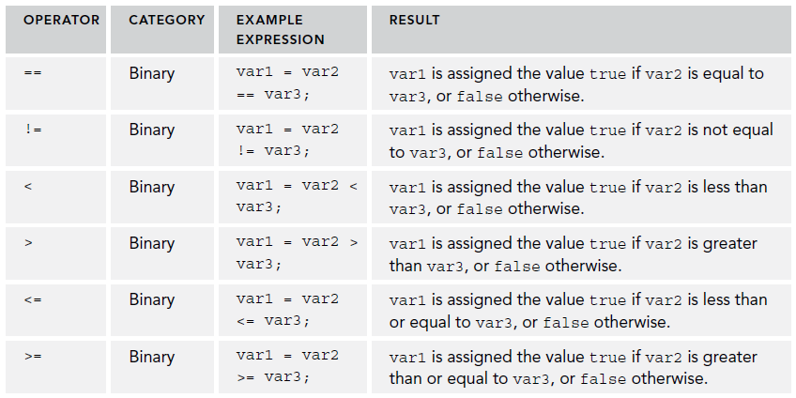
BOOLEAN LOGIC
The bool type can hold one of only two values: true or false.
In particular, bool types are used to store the result of a comparison.

Slide 5
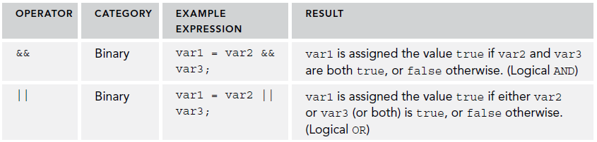
BOOLEAN LOGIC
You might use operators such as these on numeric values in code:
bool isLessThan10;
isLessThan10 = myVal < 10;
The & and | operators also have two similar operators, known as conditional Boolean operators

Slide 6
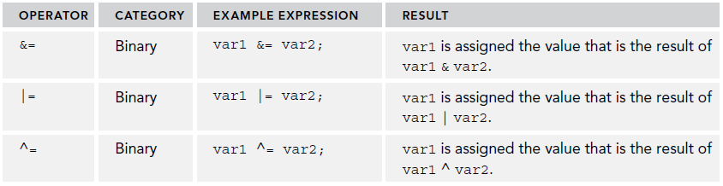
Boolean Bitwise and Assignment Operators
Boolean comparisons can be combined with assignments by combining Boolean bitwise and assignment operators.
When expressions use both the assignment (=) and bitwise operators (&, |, and ^), the binary representation of the compared quantities are used to compute the outcome, instead of the integer, string, or similar values.
the equation var1 ^= var2 is similar to var1 = var1 ^ var2.

Slide 7
using static System.Console;
using static System.Convert;
namespace ConsoleApplication6
{
class Program
{
static void Main(string[] args)
{ WriteLine("Enter an integer:");
int myInt = ToInt32(ReadLine());
bool isLessThan10 = myInt < 10;
bool isBetween0And5 = (0 <= myInt) && (myInt <= 5);
WriteLine($"Integer less than 10? {isLessThan10}");
WriteLine($"Integer between 0 and 5? {isBetween0And5}");
WriteLine($"Exactly one of the above is true? " +
$"{isLessThan10 ^ isBetween0And5}");
ReadKey();
}
}
}

Slide 8
BRANCHING
Branching is the act of controlling which line of code should be executed next.
This section describes three branching techniques available in C#:
➤ The ternary operator
➤ The if statement
➤ The switch statement

Slide 9
BRANCHING
The Ternary Operator:
You’ve already seen unary operators that work on one operand, and binary operators that work on two operands, so it won’t come as a surprise that this operator works on three operands. The syntax is as follows:
<test> ? <resultIfTrue>: <resultIfFalse>
You might use this as follows to test the value of an int variable called myInteger:
string resultString = (myInteger < 10) ? "Less than 10" : "Greater than or equal to 10";

Slide 10
BRANCHING
The if Statement:
The simplest use of an if statement is as follows, where <test> is evaluated (it must evaluate to a Boolean value for the code to compile) and the line of code that follows the statement is executed if <test> evaluates to true:
if (<test>)
<code executed if <test> is true>;
You can also specify additional code using the else statement in combination with an if statement.
if (<test>)
<code executed if <test> is true>;
else
<code executed if <test> is false>;

Slide 11
BRANCHING
Because the result of the if statement cannot be assigned to a variable, you have to assign a value to the variable in a separate step:
string resultString;
if (myInteger < 10)
resultString = "Less than 10";
else
resultString = "Greater than or equal to 10";

Slide 12
BRANCHING
Checking More Conditions Using if Statements:
if (var1 == 1)
{ // Do something.
}
else
{ if (var1 == 2)
{ // Do something else.
}
else
{ if (var1 == 3 || var1 == 4)
{ // Do something else.
}
else
{ // Do something else.
}
}
}

Slide 13
BRANCHING
The switch Statement:
This test is limited to discrete values, rather than clauses such as “greater than X,” so its use is slightly different; however, it can be a powerful technique.
The basic structure of a switch statement is as follows:
switch (<testVar>)
{ case <comparisonVal1>:
<code to execute if <testVar> == <comparisonVal1> >
break;
case <comparisonVal2>:
<code to execute if <testVar> == <comparisonVal2> >
break;
...
default:
<code to execute if <testVar> != comparisonVals>
break;
}

Slide 14
static void Main(string[] args)
{ const string myName = "benjamin";
const string niceName = "andrea";
const string sillyName = "ploppy";
string name;
WriteLine("What is your name?");
name = ReadLine();
switch (name.ToLower())
{ case myName:
WriteLine("You have the same name as me!");
break;
case niceName:
WriteLine("My, what a nice name you have!");
break;
case sillyName:
WriteLine("That's a very silly name.");
break;
}
WriteLine($"Hello {name}!");
ReadKey();
}

Slide 15
LOOPING
Looping refers to the repeated execution of statements.
do Loops:
The structure of a do loop is as follows, where <Test> evaluates to a Boolean value:
do
{ <code to be looped>
} while (<Test>);

Slide 16
LOOPING
For example, you could use the following to write the numbers . . .
int i = 1;
do
{ WriteLine("{0}", i++);
} while (i <= 10);

Slide 17
LOOPING
while Loops:
while loops are very similar to do loops, but they have one important difference: The Boolean test in a while loop takes place at the start of the loop cycle, not at the end.
Here’s how while loops are specified:
while (<Test>)
{ <code to be looped>
}
They can be used in almost the same way as do loops:
int i = 1;
while (i <= 10)
{ WriteLine($"{i++}");
}

Slide 18
LOOPING
for Loops:
This type of loop executes a set number of times and maintains its own counter. To define a for loop you need the following information:
➤ A starting value to initialize the counter variable
➤ A condition for continuing the loop, involving the counter variable
➤ An operation to perform on the counter variable at the end of each loop cycle
This information must be placed into the structure of a for loop as follows:
for (<initialization>; <condition>; <operation>)
{ <code to loop>
}

Slide 19
Interrupting Loops
Sometimes you want finer-grained control over the processing of looping code. C# provides commands to help you here:
➤ break—Causes the loop to end immediately
➤ continue—Causes the current loop cycle to end immediately (execution continues with the next loop cycle)
➤ return—Jumps out of the loop and its containing function

Slide 20
Interrupting Loops
The break command simply exits the loop, and execution continues at the first line of code after the loop, as shown in the following example:
int i = 1;
while (i <= 10)
{ if (i == 6)
break;
WriteLine($"{i++}");
}
This code writes out the numbers from 1 to 5 because the break command causes the loop to exit when i reaches 6.

Slide 21
Interrupting Loops
continue only stops the current cycle, not the whole loop, as shown here:
int i;
for (i = 1; i <= 10; i++)
{ if ((i % 2) == 0)
continue;
WriteLine(i);
}
In the preceding example, whenever the remainder of i divided by 2 is zero, the continue statement stops the execution of the current cycle, so only the numbers 1, 3, 5, 7, and 9 are displayed.

Slide 22
homework
you use a loop to calculate how many years it will take to get a specified amount of money in the account, based on a starting amount and a fixed interest rate.(in winform)

