Slide 1
Visual Programming-II
عنوان مضمون
توسط : صفری
بهار1398

Slide 2
Visual Programming-II
Course Code: 78031
Lecturer: Baba Ali Safari
Course Credit: 3
Class Hours: 48
Theory: 2
Practice: 1

Slide 3

Textbooks:
BEGINNING C# Programming with
Visual Studio 2017
Benjamin Perkins
Jacob Vibe Hammer
Jon D. Reid

Slide 4
Topic to be Covered:
C# File I/O (Week 1)
Class library (Week 2)
windows services (Week 3)
Events (Week 4)
Collections (Week 5)
Generics (Week 6)
WCF services (Week 7)
Mid Term (Week 8)
Multithreading (Week 9)
Connecting to database using ADO.net (Week 10)
Basic Desktop Programming (Week 11)
Basic Desktop Programming (Week 12)
Basic Desktop Programming (Week 13)
C# Advanced Desktop Programming (CREATING AND STYLING CONTROLS, THE MAIN WINDOW) (Week 14)
C# Advanced Desktop Programming (Animations, WPF USER CONTROLS) (Week 15)
Overview (Week 16)

Slide 5
Grading Policy:
Lab Assignments and Quizzes: 20%
Midterm Exam: 20%
Project: 20%
Final Exam: 40%

Slide 6
File I/O

Slide 7
File I/O
A file is a collection of data stored in a disk with a specific name and a directory path. When a file is opened for reading or writing, it becomes a stream.
The stream is basically the sequence of bytes passing through the communication path. There are two main streams: the input stream and the output stream. The input stream is used for reading data from file (read operation) and the output stream is used for writing into the file (write operation).

Slide 8
C# I/O Classes
The System.IO namespace has various classes that are used for performing numerous operations with files, such as creating and deleting files, reading from or writing to a file, closing a file etc.
The following table shows some commonly used non-abstract classes in the System.IO namespace −

Slide 9
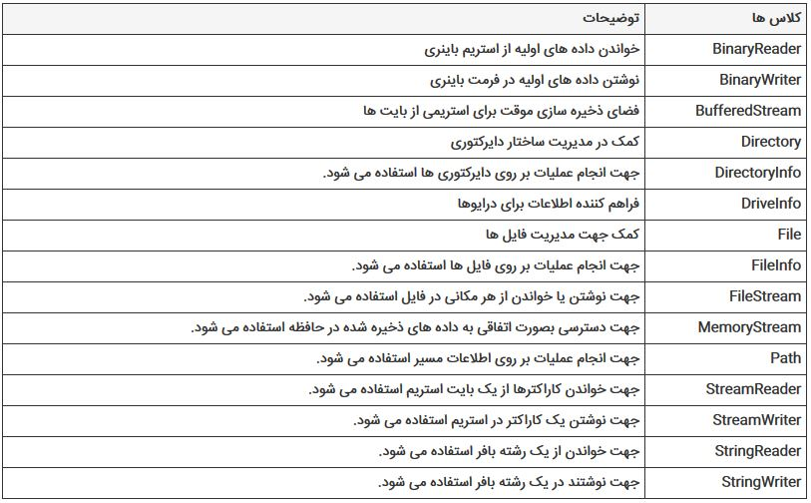

Slide 10
Example
System.IO.File.WriteAllText("D:\\Test.txt", " The following table shows some commonly ");
List<string> lines = new List<string>();
lines.Add("This is line1");
lines.Add("This is line2");
System.IO.File.WriteAllLines("d:\\file.txt", lines);

Slide 11
Example
var text = "Hello ITPro.ir";
var textBytes = System.Text.Encoding.UTF8.GetBytes(text);
System.IO.File.WriteAllBytes("D:\\file.txt", textBytes);

Slide 12
Example
var text = System.IO.File.ReadAllText("D:\\file.txt");
var lines = System.IO.File.ReadAllLines("D:\\file.txt");
foreach (var line in lines)
{
Console.WriteLine(line)
}

Slide 13
Save Files and open Files Using the SaveFileDialog and the openFileDialog Components
Display the Save File dialog box and call a method to save the file selected by the user
Display the Open File dialog box and call a method to Open the file selected by the user

Slide 14
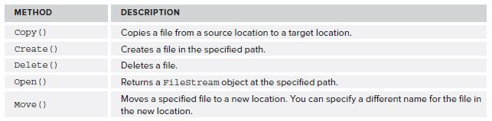
Methods of the File Class

Slide 15
Example
System.IO.File.Copy("d:\\file.txt", "e:\\copy.txt");
System.IO.File.Move("d:\\file.txt", "e:\\copy.txt");
if (System.IO.File.Exists("d:\\data.dat"))
{
// your code
}
System.IO.File.Delete("d:\\data.dat");

Slide 16
The FileStream Class
The FileStream class in the System.IO namespace helps in reading from, writing to and closing files. This class derives from the abstract class Stream.

Slide 17
You need to create a FileStream object to create a new file or open an existing file. The syntax for creating a FileStream object is as follows −
FileStream aFile = new FileStream(filename, FileMode.<Member>, FileAccess.<Member>);

Slide 18
For example, we create a FileStream object F for reading a file named sample.txt as shown −
FileStream F = new FileStream("sample.txt", FileMode.Open, FileAccess.Read);

Slide 19
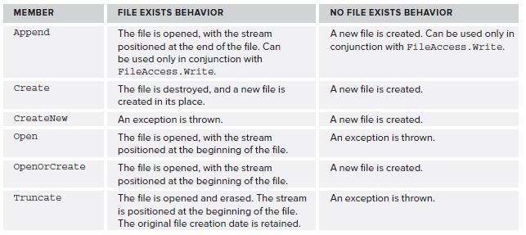
FileMode Enumeration Members

Slide 20

FileAccess Enumeration Members

Slide 21
Example
The following program demonstrates use of the FileStream class −

Slide 22
using System;
using System.IO;
namespace FileIOApplication {
class Program {
static void Main(string[] args) {
FileStream F = new FileStream("test.txt", FileMode.OpenOrCreate,
FileAccess.ReadWrite);
for (int i = 1; i <= 20; i++) {
F.WriteByte((byte)i);
}
F.Position = 0;
for (int i = 0; i <= 20; i++) {
Console.Write(F.ReadByte() + " ");
}
F.Close();
Console.ReadKey();
}
}
}

Slide 23
When the above code is compiled and executed, it produces the following result −
1 2 3 4 5 6 7 8 9 10 11 12 13 14 15 16 17 18 19 20 -1

Slide 24
File Position
The FileStream class maintains an internal file pointer that points to the location within the file where the next read or write operation will occur.
In most cases, when a file is opened, it points to the beginning of the file, but this pointer can be modified. This enables an application to read or write anywhere within the file, which in turn enables random access to a file and the capability to jump directly to a specific location in the file.
This can save a lot of time when dealing with very large files because you can instantly move to the location you want.

Slide 25
File Position
The method that implements this functionality is the Seek() method, which takes two parameters.
The first parameter specifies how far to move the file pointer, in bytes.
The second parameter specifies where to start counting from, in the form of a value from the SeekOrigin enumeration.
The SeekOrigin enumeration contains three values: Begin, Current, and End.

Slide 26
File Position
For example, the following line would move the fi le pointer to the eighth byte in the file, starting from the very first byte in the file:
aFile.Seek(8, SeekOrigin.Begin);
The following line would move the file pointer two bytes forward, starting from the current position. If this were executed directly after the previous line, then the file pointer would now point to the tenth byte in the file:
aFile.Seek(2, SeekOrigin.Current);

Slide 27
Example
private void save_Click(object sender, EventArgs e)
{
saveFileDialog1.ShowDialog();
String s = saveFileDialog1.FileName;
FileStream f = new FileStream(s,FileMode.Append,FileAccess.Write);
f.Seek(10,System.IO.SeekOrigin.End);
byte[] info = new UTF8Encoding(true).GetBytes(textbox.Text);
f.Write(info,0,info.Length);
f.Close();
}

