Slide 1
Visual Programming-II
عنوان مضمون
توسط : صفری
بهار1398

Slide 2
Creating an MSI Package for C# Windows Application

Slide 3
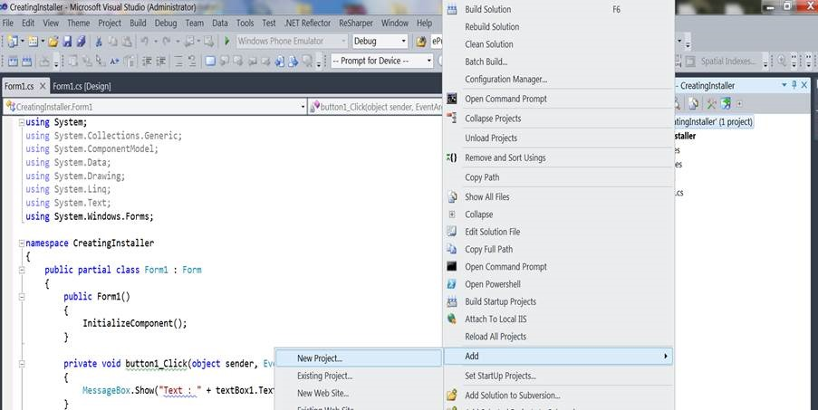
Start the Show
So far so good. Now let’s create an installer for the same windows application. Right click on solution and add a new project to your solution like in the following figure,

Slide 4
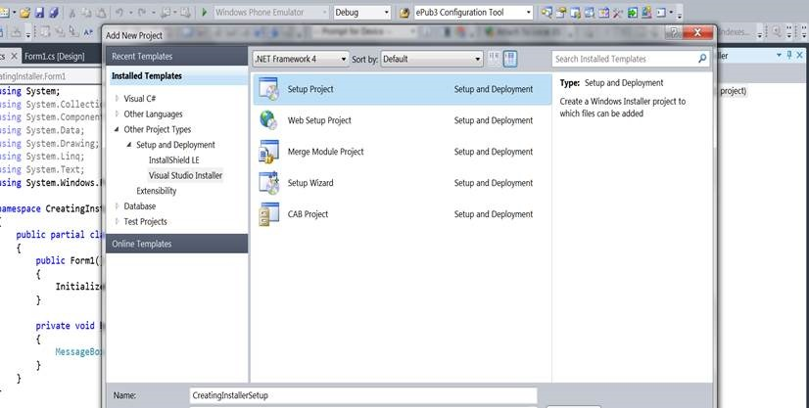
And add a setup project by Other project Types->Setup and Deployment->Visual Studio Installer

Slide 5
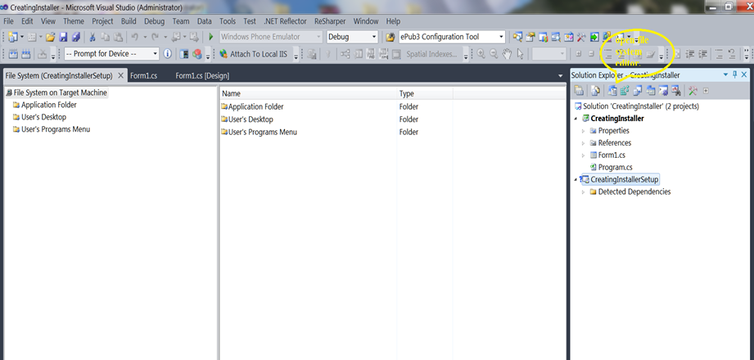
The project will be added to the solution , now open file system editor by clicking on the project and selection the option to open file system editor like shown in below figure,
You’ll get to see Application Folder, User’s Desktop and User’s Program Menu.

Slide 6
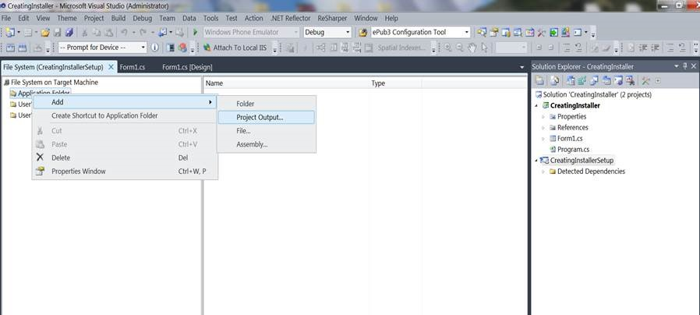
Right click on Application Folder and add an output project , out project specifies for the project we are creating an installer to, like in following figure,

Slide 7
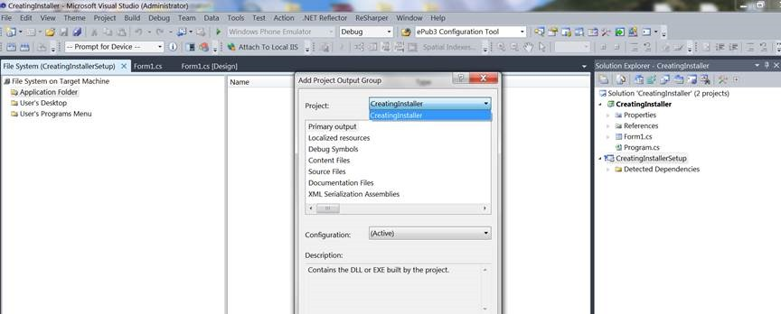
Select CreatingInstaller i.e. the windows application project name in Add output project window, select it as a primary output as shown below and click ok

Slide 8
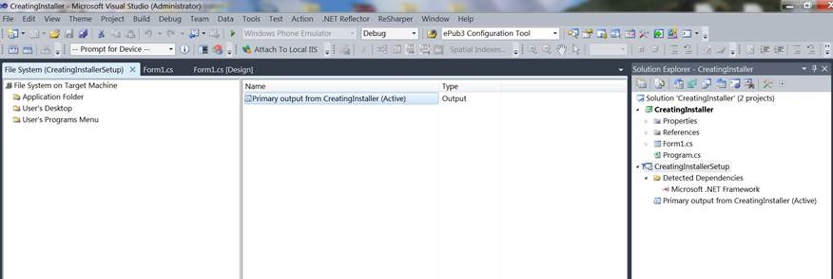
The Primary output will be added as shown below, having the type defined as Output

Slide 9
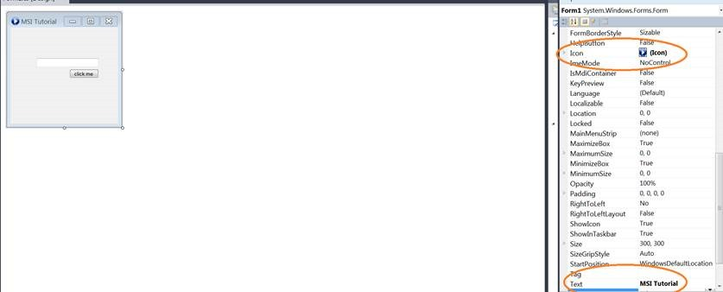
Create Shortcuts
You can decorate your form to add an icon to it, that icon will also be required at the time of installation to create a shortcut icon to our application. Add an icon to the form like in below-mentioned figure,

Slide 10
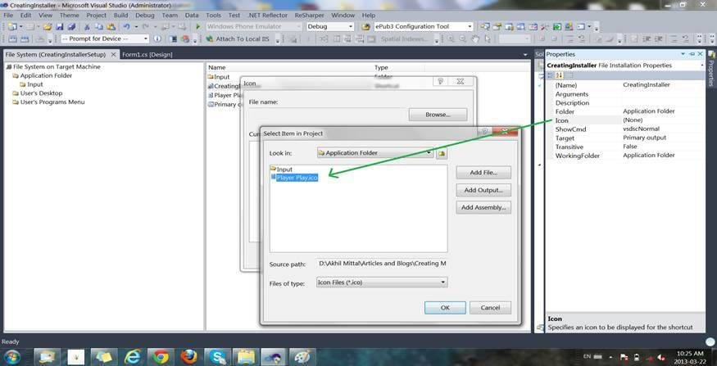
To create a shortcut to the application, right click on Primary output in the middle window pane and select Create shortcut to Primary output, the name that shortcut as CreatingInstaller.
Select the properties of the shortcut, by right clicking it and add an icon to it. This icon will be created at the desktop when the application will launch. Below figures explain how to add an icon.

Slide 11
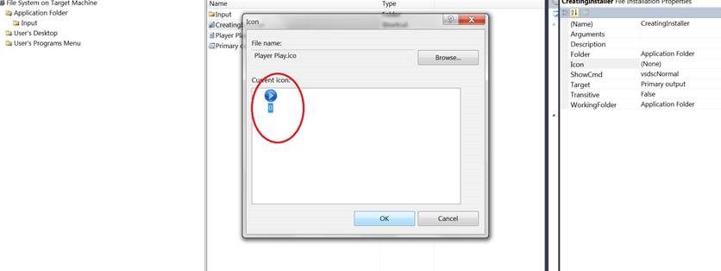
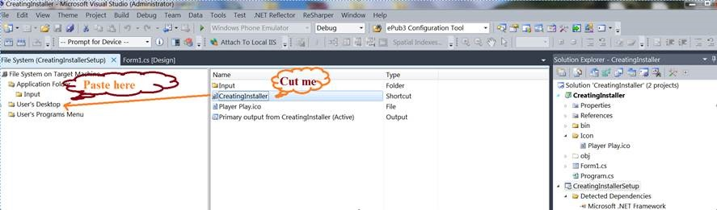
Cut the shortcut created at Application Folder and Paste it under User’s Desktop Folder. Job was done create a shortcut to user’s desktop

Slide 12
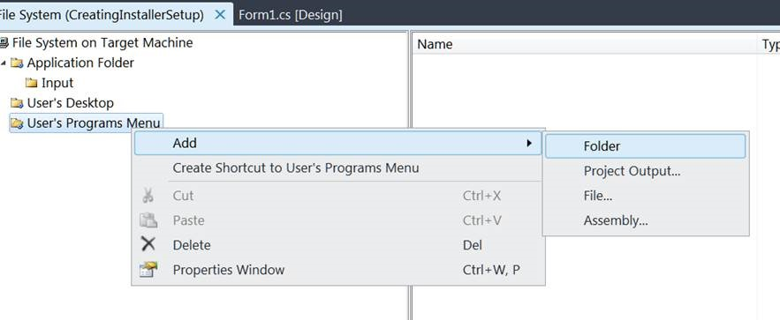
For shortcuts to be created at User’s Program Menu, add a new folder to User’s Program Menu, that will be created at program’s menu location, in that folder create a new shortcut pointing the primary output as done for creating a desktop shortcut. The three images as following describe the process,

Slide 13
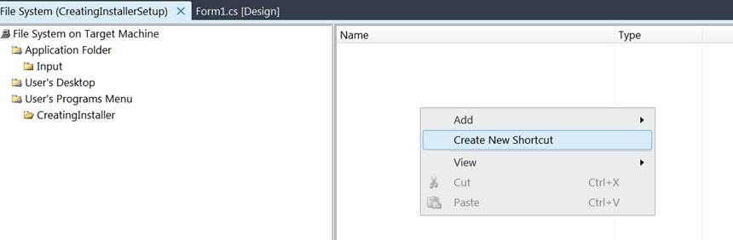
Name the folder CreatingInstaller.
Right click on the middle window pane to create a new shortcut.

Slide 14
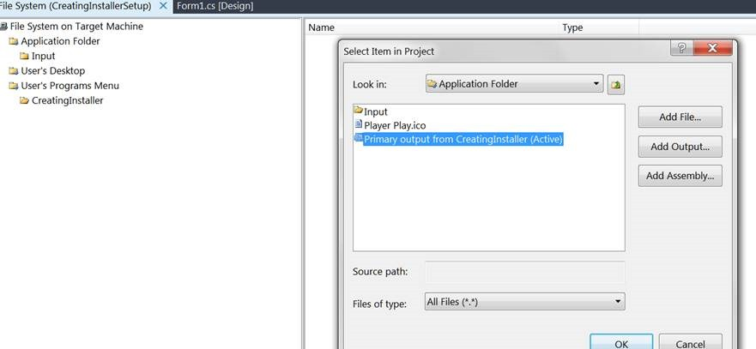
Select shortcut source to primary output selected.
Also add an icon to shortcut, as done for Desktop shortcut.

Slide 15
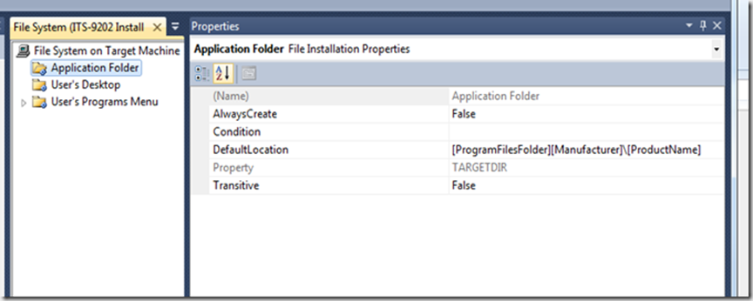
Right click Application folder to set the properties of where to install the application,

Slide 16
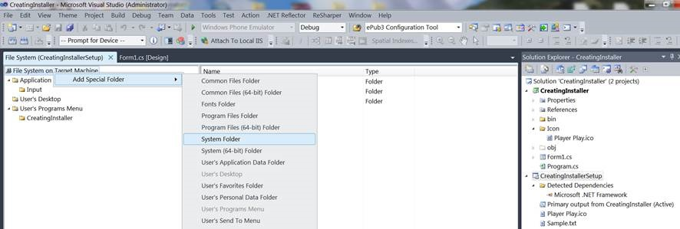
Uninstall
We always have the option to uninstall the application from control panel’s Programs and Features list as simple as that but how about creating our own uninstaller, that too under programs menu so that we do not have to disturb control panel.
Step1:Right click on File System on target Machine and Add Special Folder->System Folder as shown in below figure.

Slide 17
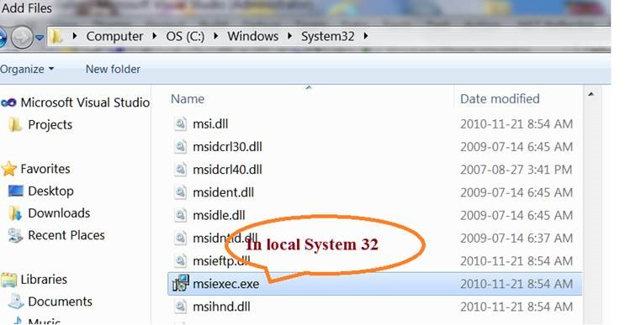
Step2:
Right click on newly created system folder and browse for the msiexec.exe file in local System.Windows32 folder. This file takes responsibility to install and uninstall the application based on certain parameters specified.

Slide 18
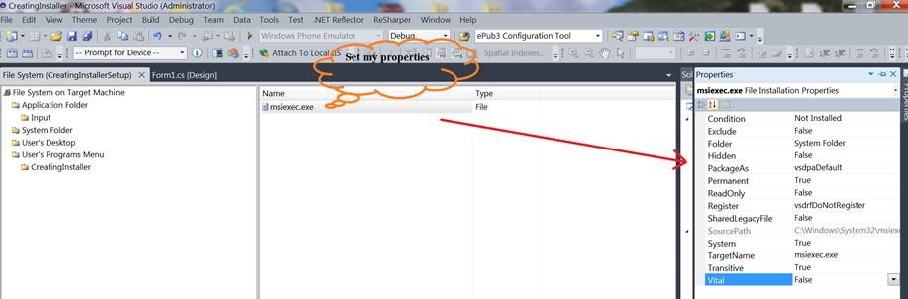
Set the properties of the file exactly as shown in the figure,

Slide 19
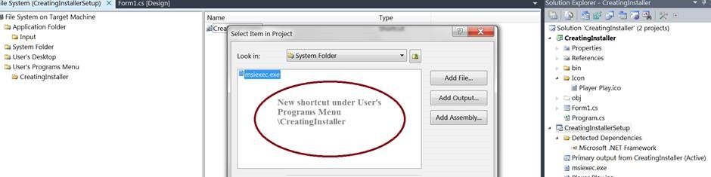
Step4:
Now create a new shortcut under User’s program Menu and point its source to msiexec as shown below. You can add icons and name to your shortcut. I have given it the name “Uninstall”

Slide 20
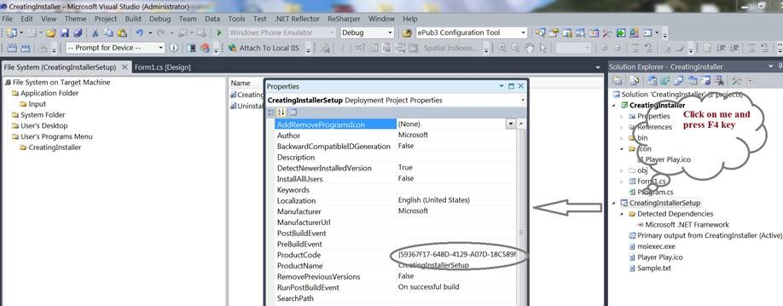
Step5:
Press F4 key by selecting the setup project, we see a list of properties, we can customize these properties as per out installation needs, like set Product name, Author, Installation location, I’ll not go into a deep discussion about all this, as they are quite easy to understand and set.
Just take a note of product code shown below in the list of properties. We would need product code as a parameter to msiexec for uninstallation.

Slide 21
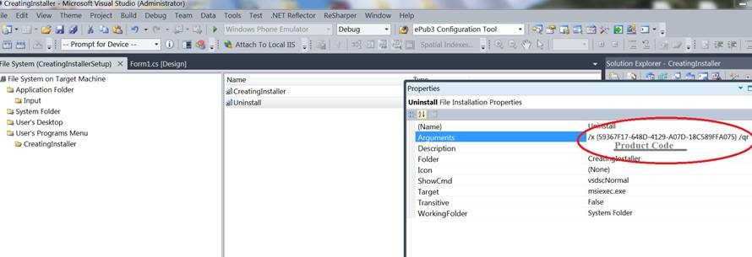
Step6:
Right click the Uninstall shortcut and set the arguments property as shown in below figure,
/x {product code} /qr
/x is for uninstallation.
You can get the whole detailed list of parameters and their use at http://technet.microsoft.com/en-us/library/cc759262(v=ws.10).aspx , chose the one you like to.

Slide 22
Step7:
Save all and Rebuild the setup project.
Job Done !
Now our setup is ready to install our windows application.
Just browse the debug folder location of Setup project, we find a msi and a setup.exe, one can run either of two to initiate setup.

