Slide 1
Visual Programming-II
عنوان مضمون
توسط : صفری
بهار1397

Slide 2
سرفصل ها
collections, generics and Events, WCF services

Slide 3
windows services and WCF services

Slide 4
WCF services

Slide 5
Windows Communication Foundation(WCF)
A web service is like a website that is used by a computer instead of a person.
For example, instead of browsing to a website about your favorite TV program, you might instead use a desktop application that pulled in the same information via a web service.
The .NET Framework has supported web services for some time now. However, in the more recent versions of the framework, web services have been combined with another technology, called remoting, to create Windows Communication Foundation (WCF), which is a generic infrastructure for communication between applications.

Slide 6
WHAT IS WCF?
WCF is a technology that enables you to create services that you can access from other applications across process, machine, and network boundaries. You can use these services to share functionality across multiple applications, to expose data sources, or to abstract complicated processes.

Slide 7
WCF CONCEPTS
➤ WCF communication protocols
➤ endpoints
➤ Addresses
➤ bindings
➤ Contracts
➤ Message patterns
➤ Behaviors
➤ Hosting

Slide 8
WCF Communication Protocols
HTTP — Enables you to communicate with WCF services from anywhere, including across the Internet. You can use HTTP communications to create WCF web services.
TCP — Enables you to communicate with WCF services on your local network or across the Internet if you configure your firewall appropriately. TCP is more efficient than HTTP and has more capabilities, but it can be more complicated to configure.
UDP — Similar to TCP in that it enables communications via the local network or Internet, but it’s implemented in a subtly different way. One of the consequences of this implementation, which you won’t look at in detail, is that a service can broadcast messages to multiple clients simultaneously. The UDP protocol is new the .NET 4.5 Framework, although previously third-party implementations were available.
Named pipe — Enables you to communicate with WCF services that are on the same machine as the calling code, but reside in a separate process.
MSMQ — A queuing technology that enables messages sent by an application to be routed through a queue to arrive at a destination. MSMQ is a reliable messaging technology that ensures that a message sent to a queue will reach that queue. MSMQ is also inherently asynchronous, so a queued message will be processed only when messages ahead of it in the queue have been processed and a processing service is available.

Slide 9
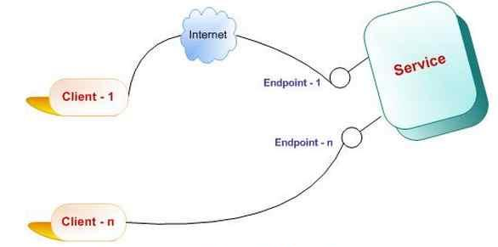
Endpoints
It defines the address where a message is to be sent or received. It also specifies the communication mechanism to describe how the messages will be sent along with defining the set of messages. A structure of an endpoint comprises of the following parts
➤ Addresses
➤ bindings
➤ Contracts

Slide 10
Addresses
The type of address you use for a service depends on the protocol that you are using. Service addresses are formatted for the three protocols described in this slide(MSMQ is not covered) as follows:
HTTP — Addresses for the HTTP protocol are URLs of the familiar form http://<server>:<port>/<service>.
For SSL connections, you can also use
https://<server>:<port>/<service>.
If you are hosting a service in IIS, <service> will be a file with a .svc
extension. IIS addresses will probably include more subdirectories
than this example — that is, more sections separated by / characters
before the .svc file.

Slide 11
Addresses
TCP — Addresses for TCP are of the form net.tcp://<server>:<port>/<service>.
UDP — Addresses for UDP are of the form soap.udp://<server>:<port>/<service>. Certain <server> values are required for multicast communications, but this is beyond the scope of this chapter.
Named pipe — Addresses for named pipe connections are similar but have no port number. They are of the form net.pipe://<server>/<service>.

Slide 12
For example, imagine you create a WCF service with a single operation that has bindings for all three of the protocols listed here. You might use the following base addresses:
http://www.mydomain.com/services/amazingservices/mygreatservice.svc
net.tcp://myhugeserver:8080/mygreatservice
net.pipe://localhost/mygreatservice
You could then use the following addresses for operations:
http://www.mydomain.com/services/amazingservices/mygreatservice.svc/greatop
net.tcp://myhugeserver:8080/mygreatservice/greatop
net.pipe://localhost/mygreatservice/greatop

Slide 13
Bindings
Bindings, specify more than just the transport protocol that will be used by an operation. You can also use them to:
specify the security requirements for communication over the transport protocol, . A binding might require username and password authentication or a Windows user account token
transactional capabilities of the endpoint,
message encoding,
and much more.
Because bindings offer such a great degree of flexibility, the .NET Framework provides some predefined bindings that you can use.
Each binding type is represented by a class in the System.ServiceModel namespace.
next slide lists these bindings along with some basic information about them.
In WCF, an endpoint can have multiple bindings, each of which specifies a means of communication.

Slide 14
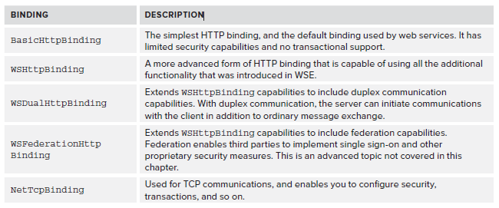
predefined bindings

Slide 15
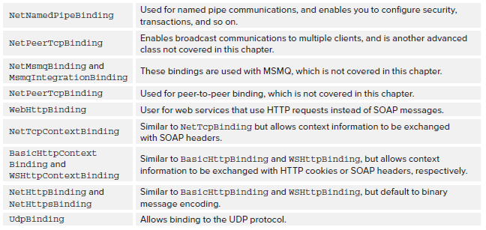
predefined bindings

Slide 16
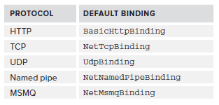
predefined bindings
Since .NET 4, endpoints have default bindings that vary according to the protocol used. These defaults are shown in

Slide 17
Contracts
Contracts define how WCF services can be used. Several types of contract can be defined:
Service contract — Contains general information about a service and the operations exposed by a service. This includes, for example, the namespace used by service. Services have unique namespaces that are used when defining the schema for SOAP messages in order to avoid possible conflicts with other services.
Operation contract — Defines how an operation is used. This includes the parameter and return types for an operation method along with additional information, such as whether a method will return a response message.

Slide 18
Contracts
Message contract — Enables you to customize how information is formatted inside SOAP messages — for example, whether data should be included in the SOAP header or SOAP message body. This can be useful when creating a WCF service that must integrate with legacy systems.
Fault contract — Defines faults that an operation can return. When you use .NET clients, faults result in exceptions that you can catch and deal with in the normal way.
Data contract — If you use complex types, such as user-defined structs and objects, as parameters or return types for operations, then you must define data contracts for these types. Data contracts define the types in terms of the data that they expose through properties.
You typically add contracts to service classes and methods by using attributes

Slide 19
Example of Endpoints
<endpoint address="ServiceUrlGoesHere" binding="TypeOfBinding" contract="NameOfContract" />
<endpoint address=http://localhost:8731/DemoService/ binding="basicHttpBinding"
contract=" DemoService.IDemo">

Slide 20
Message Patterns
An operation contract can define whether an operation returns a value. You’ve also read about duplex communications that are made possible by the WSDualHttpBinding binding. These are both forms of message patterns, of which there are three types:
Request/response messaging — The “ordinary” way of exchanging messages, whereby every message sent to a service results in a response being sent back to the client. This doesn’t necessarily mean that the client waits for a response, as you can call operations asynchronously in the usual way.
One-way, or simplex, messaging — Messages are sent from the client to the WCF operation, but no response is sent. This is useful when no response is required. For example, you might create a WCF operation that results in the WCF host server rebooting, in which case you wouldn’t really want or need to wait for a response.
Two-way, or duplex, messaging — A more advanced scheme whereby the client effectively acts as a server as well as a client, and the server as a client as well as a server. Once set up, duplex messaging enables both the client and the server to send messages to each other, which might not have responses. This is analogous to creating an object and subscribing to events exposed by that object.

Slide 21
Behaviors
Behaviors are a way to apply additional configuration that is not directly exposed to a client to services and operations.
By adding a behavior to a service, you can control how it is instantiated and used by its hosting process, how it participates in transactions, how multithreading issues are dealt with in the service, and so on.
Operation behaviors can control whether impersonation is used in the operation execution, how the individual operation affects transactions, and more.
Since .NET 4, you can specify default behaviors at various levels, so that you don’t have to specify every aspect of every behavior for every service and operation. Instead, you can provide defaults and override settings where necessary, which reduces the amount of configuration required. Because this chapter is intended to give you a basic understanding of WCF services, you will only see the most basic functionality of behaviors here.

Slide 22
Hosting
WCF services can be hosted in several different processes. These possibilities are as follows:
Web server — IIS-hosted WCF services are the closest thing to web services that WCF offers. However, you can use advanced functionality and security features in WCF services that are much more difficult to implement in web services. You can also integrate with IIS features such as IIS security.
Executable — You can host a WCF service in any application type that you can create in .NET, such as console applications, Windows Forms applications, and WPF applications.

Slide 23
Hosting
Windows service — You can host a WCF service in a Windows service, which means that you can use the useful features that Windows services provide. This includes automatic startup and fault recovery.
Windows Activation Service (WAS) — Designed specifically to host WCF services, WAS is basically a simple version of IIS that you can use where IIS is not available.

Slide 24
WCF PROGRAMMING
Now that you have covered all the basics, it is time to get started with some code. In this section you’ll start by looking as a simple web server–hosted WCF service and a console application client. After looking at the structure of the code created, you’ll learn about the basic structure of WCF services and client applications.

Slide 25
A Simple WCF Service and Client: Ch25Ex01Client
1. Create a new WCF Service Application project called Ch25Ex01
2. Add a console application called Ch25Ex01Client to the solution.
3. On the Build menu, click Build Solution.
4. Right-click the Ch25Ex01Client project in the Solution Explorer and select Add Service Reference.
5. In the Add Service Reference dialog box, click Discover.

Slide 26
6. When the development web server has started and information about the WCF service has been loaded, expand the reference to look at its details, as shown in below Figure (you might have a different port number).
7. Click OK to add the service reference.

Slide 27
8. Modify the code in Program.cs in the Ch25Ex01Client application as follows:
using Ch25Ex01Client.ServiceReference1;
namespace Ch25Ex01Client
{ class Program
{ static void Main(string[] args)
{ string numericInput = null;
int intParam;
do
{Console.WriteLine("Enter an integer and press enter to call the WCF service.");
numericInput = Console.ReadLine();
}
while (!int.TryParse(numericInput, out intParam));
Service1Client client = new Service1Client();
Console.WriteLine(client.GetData(intParam));
Console.WriteLine("Press an key to exit.");
Console.ReadKey();
}
}
}

Slide 28
9. Right-click the Ch25Ex01Client project in the Solution Explorer and select Set as StartUp Project.
10. Run the application. Enter a number in the console application window and press Enter. The result is shown in below Figure .
11. Exit the application, right-click the Service1.svc file in the Ch25Ex01 project in the Solution Explorer, and click View in Browser.
12. Review the information in the window
13. Click the link at the top of the web page for the service to view the WSDL. Don’t panic — you don’t need to understand all the stuff in the WSDL file!

Slide 29
The WCF Test Client
the client application you want to use might be complex, and it can be tricky to test services properly.
To ease the development of WCF services, VS provides a test tool you can use to ensure that your WCF operations work correctly. This tool is automatically configured to work with your WCF service projects, so if you run your project the tool will appear. Alternatively, you can run the test client as a standalone application.
You can find the test client on 64-bit operating systems at: C:\ProgramFiles(x86)\MicrosoftVisualStudio11.0\Common7\IDE\WcfTestClient.exe.

Slide 30
Using the WCF Test Client:Ch25Ex01\Web.config
1. Open the WCF Service Application project from the previous Try It Out, Ch25Ex01.
2. Right-click the Service1.svc service in Solution Explorer and click Set As Start Page.
3. Right-click the Ch25Ex01 project in Solution Explorer and click Set As StartUp Project.
4. In Web.config, ensure that metadata is enabled:
<serviceMetadata httpGetEnabled="true" httpsGetEnabled="true" />

Slide 31
Using the WCF Test Client:Ch25Ex01\Web.config
Run the application. The WCF test client appears, as shown in Figure(it takes a moment or two to add the service).

Slide 32
Using the WCF Test Client:Ch25Ex01\Web.config
In the left pane of the test client, double-click Config File. The config file used to access the service is displayed in the right pane

Slide 33
Using the WCF Test Client:Ch25Ex01\Web.config
7. In the left pane, double-click the GetDataUsingDataContract() operation.
8. In the pane that appears on the right, change the value of BoolValue to True and StringValue to Test String, and then click Invoke.
9. If a security prompt dialog box appears, click OK to confirm that you are happy to send information to the service.

Slide 34
Using the WCF Test Client:Ch25Ex01\Web.config
10. The operation result appears, as shown in Figure 25-7.

Slide 35
Using the WCF Test Client:Ch25Ex01\Web.config
11. Click the XML tab to view the request and response XML, shown in Figure

Slide 36
Defining WCF Service Contracts
The previous examples showed how the WCF infrastructure makes it easy for you to define contracts for WCF services with a combination of classes, interfaces, and attributes. This section takes a deeper look at this technique.
WCF Service ایجاد کنیم که نام و زبان خود را به آن ارسال کنیم و به زبان ارسالی به ما سلام کند.

Slide 37
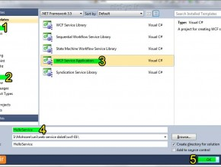
نخست ویژوال استودیو را اجرا کرده و پس از آن از منوی File و زیرمنویNew، روی Project کلیک کنید. از پنجره‌ی باز شده و از سمت چپ Visual C# و زیر دسته‌ی WCF را انتخاب کرده و سپس از قسمت میانی پنجره WCF service application را انتخاب کرده و نامی برای سرویس خود برگزینید که در اینجا من نام HelloService را بکار بردم.

Slide 38
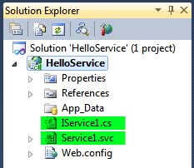
ویژوال استودیو همه‌ی فایل‌های لازم را برای شروع کار می‌سازد. بصورت پیش‌فرض سرویس نام Service1.svc و رابط IService.csرا دارد. شکل زیر نمایی از پنچره Solution Explorer پروژه‌ی ایجاد شده است:
در اینجا به این دو پیش‌فرض نیاز نداریم، یا باید حذف کنیم و یا برای ادامه‌ی کار، این دو را ویرایش کنیم. من در اینجا هر دو را با کلیک راست کردن روی هر کدام، حذف (Delete) می‌کنم.

Slide 39
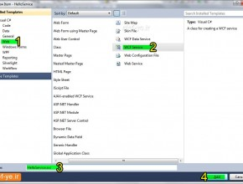
حال این پروژه برای سرویس‌دهی آماده نیست، پس برای ساختن سرویس از پنچره Solution Explorer روی نام پروژه (HelloService) کلیک راست کرده، Add را انتخاب و سپس روی New Item کلیک می‌کنیم.
در پنجره‌ی باز شده WCF service را انتخاب کرده و نام HelloService.svc را وارد کرده و روی دکمه‌ی Add کلیک می‌کنیم.

Slide 40
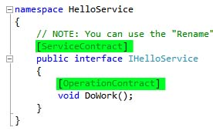
حالا ویژوال استودیو دو فایل با نام‌های IHelloService.cs و HelloService.svc ساخته است. این فایل‌ها در واقع برای تعریف سرویس IHelloService.cs) و اجرای سرویس HelloService.svc) هستند.
اجازه دهید که در اینجا رابط IHelloService.cs را بررسی کنیم، شکل زیر مربوط به محتویات IHelloService است:
کدهای موجود در IHelloService برای تعریف سرویس و فراهم‌کننده‌های اپریشن/متد با نام DoWork() است .هر سرویس WCF، فایل رابطی را دارد که سرویس را تعریف می‌کند.

Slide 41
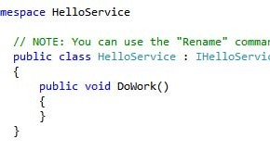
و حالا اجازه دهید که فایل HelloService.svc را بررسی کنیم که شکل زیر مربوط به آن است:
کد نشان داده شده برای اجرای رابط IHelloService است. کلاس HelloService نیاز به اجرای همه‌ی متدهای مشخص شده در تعریفات سرویس را دارد.

Slide 42
IHelloService.cs را در محیط ویژوال استودیو با کلیک کردن بر روی نام آن باز کنید و متد DoWork() را حذف کرده و یک تعریف برای SayHello() ایجاد کنید. اضافه کردن OperationContract به متد را فراموش نکنید. کدهای لازم برای این کار به شکل زیر می‌باشد:
using System.Runtime.Serialization;
using System.ServiceModel;
using System.Text;
namespace HelloService
{
[ServiceContract]
public interface IHelloService
{
[OperationContract]
string SayHello(String name, String language);
}
}

Slide 43
حالا برای پیاده‌سازی متد SayHello فایل HelloService.svc.cs را ویرایش کرده و کدهای زیر بنویسید:
using System.Runtime.Serialization;
using System.ServiceModel;
using System.Text;
namespace HelloService
{ public class HelloService : IHelloService
{
public string SayHello(String name, String language)
{ switch (language)
{ case "en":
return "Hello " + name;
case "fa":
return+ سلام name;
default:
return “زبان پشتیبانی نشده”
}
}
}
}

Slide 44
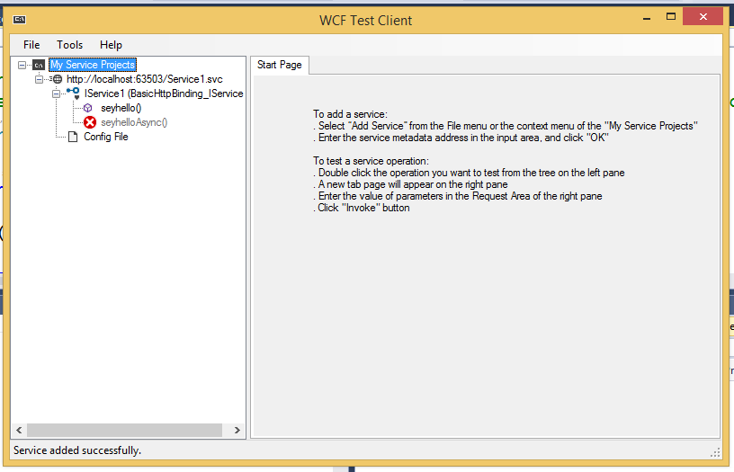
ما موفق به ساخت این سرویس شده‌ایم.
حالا برای اجرای این سرویس می‌توان کلید F5 را از صفحه‌کلید فشار داده و یا از منوی Debug روی گزینه‌ی start debugging کلیک کنید.
اگر همه‌ی مراحل بالا را به درستی انجام داده باشید؛ ویژوال استودیو میزبانی سرویس شما را به WCF Test Client می‌دهد که قبلا با آن اشنا شده اید و شکل زیر نمایش داده می‌شود:

