Slide 1
Visual Programming-II
عنوان مضمون
توسط : صفری
بهار1397

Slide 2
Multithreading

Slide 3
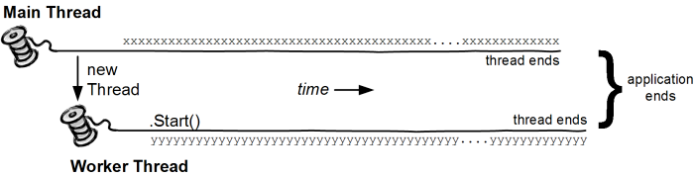
Multithreading
A thread is defined as the execution path of a program.
Each thread defines a unique flow of control. If your application involves complicated and time consuming operations, then it is often helpful to set different execution paths or threads, with each thread performing a particular job

Slide 4
Multithreading
Threads are lightweight processes. One common example of use of thread is implementation of concurrent programming by modern operating systems. Use of threads saves wastage of CPU cycle and increase efficiency of an application.
So far we wrote the programs where a single thread runs as a single process which is the running instance of the application. However, this way the application can perform one job at a time. To make it execute more than one task at a time, it could be divided into smaller threads.

Slide 5
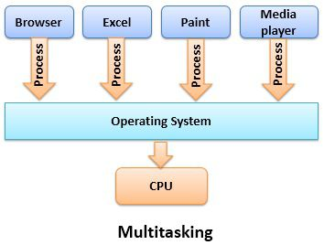
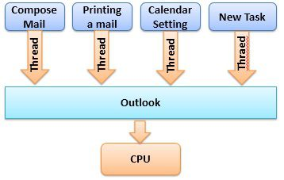
Multitasking and Multithreading
The basic difference between multitasking and multithreading is that in multitasking, the system allows executing multiple programs and tasks at the same time, whereas, in multithreading, the system executes multiple threads of the same or different processes at the same time.
Multithreading

Slide 6
Multitasking and Multithreading
In multitasking CPU has to switch between multiple programs so that it appears that multiple programs are running simultaneously. On other hands, in multithreading CPU has to switch between multiple threads to make it appear that all threads are running simultaneously.
Multitasking allocates separate memory and resources for each process/program whereas, in multithreading threads belonging to the same process shares the same memory and resources as that of the process.

Slide 7
Thread Life Cycle
The life cycle of a thread starts when an object of the System.Threading class is created and ends when the thread is terminated or completes execution.
Following are the various states in the life cycle of a thread −
The Unstarted State − It is the situation when the instance of the thread is created but the Start method is not called.
The Ready State − It is the situation when the thread is ready to run and waiting CPU cycle.
The Not Runnable State − A thread is not executable, when
Sleep method has been called
Wait method has been called
Blocked by I/O operations
The Dead State − It is the situation when the thread completes execution or is aborted.

Slide 8
The Main Thread
In C#, the System.Threading class is used for working with threads. It allows creating and accessing individual threads in a multithreaded application. The first thread to be executed in a process is called the main thread.
When a C# program starts execution, the main thread is automatically created. The threads created using the Thread class are called the child threads of the main thread. You can access a thread using the CurrentThread property of the Thread class.

Slide 9
The following program demonstrates main thread execution
static void Main(string[] args) {
Thread th = Thread.CurrentThread;
th.Name = "MainThread";
Console.WriteLine("This is {0}", th.Name);
Console.ReadKey();
}
When the above code is compiled and executed, it produces the following result
This is MainThread

Slide 10
Creating Threads
Threads are created by extending the Thread class. The extended Thread class then calls the Start() method to begin the child thread execution.
The following program demonstrates the concept
Thread childThread = new Thread(DoTask);
childThread.Start();

Slide 11
public static void CallToChildThread() {
Console.WriteLine("Child thread starts");
}
static void Main(string[] args) {
Console.WriteLine("In Main: Creating the Child thread");
Thread childThread = new Thread(CallToChildThread);
childThread.Start();
Console.ReadKey();
}

Slide 12
public static void CallToChildThread() {
Console.WriteLine("Child thread starts");
}
static void Main(string[] args) {
ThreadStart childref = new ThreadStart(CallToChildThread);
Console.WriteLine("In Main: Creating the Child thread");
Thread childThread = new Thread(childref);
childThread.Start();
Console.ReadKey();
}

Slide 13
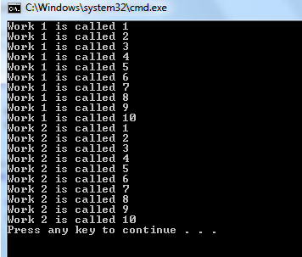
Before Multithreading
static void Main(string[] args)
{ Work1();
Work2();
}
static void Work1()
{for(int i = 1; i <=10; i++)
{Console.WriteLine("Work 1 is called " + i.ToString());
}
}
static void Work2()
{ for (int i = 1; i <= 10; i++)
{ Console.WriteLine("Work 2 is called " + i.ToString());
}
}

Slide 14
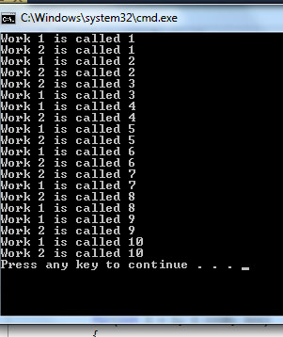
After Multithreading
static void Main(string[] args)
{
Thread oThreadone = new Thread(Work1);
Thread oThreadtwo = new Thread(Work2);
oThreadone.Start();
oThreadtwo.Start();
}
static void Work1()
{for(int i = 1; i <=10; i++)
{Console.WriteLine("Work 1 is called " + i.ToString());
}
}
static void Work2()
{ for (int i = 1; i <= 10; i++)
{ Console.WriteLine("Work 2 is called " + i.ToString());
}
}

Slide 15
Thread Methods
Method | Action
Start | Causes a thread to start to run.
Sleep | Pauses a thread for a specified time.
Suspend | Pauses a thread when it reaches a safe point.
Abort | Calling this method usually terminates the thread..
Resume | Restarts a suspended thread
Join | Causes the current thread to wait for another thread to finish. If used with a time-out value, this method returns True if the thread finishes in the allocated time.

Slide 16
Managing Threads
The following example demonstrates the use of the sleep() method for making a thread pause for a specific period of time
public static void CallToChildThread() {
Console.WriteLine("Child thread starts");
// the thread is paused for 5000 milliseconds
int sleepfor = 5000;
Console.WriteLine("Child Thread Paused for {0} seconds", sleepfor / 1000);
Thread.Sleep(sleepfor);
Console.WriteLine("Child thread resumes");
}
static void Main(string[] args) {
ThreadStart childref = new ThreadStart(CallToChildThread);
Console.WriteLine("In Main: Creating the Child thread");
Thread childThread = new Thread(childref);
childThread.Start();
Console.ReadKey();
}

Slide 17
Destroying Threads
The Abort() method is used for destroying threads.
The runtime aborts the thread by throwing a ThreadAbortException. This exception cannot be caught, the control is sent to the finally block, if any.

Slide 18
public static void CallToChildThread() {
Console.WriteLine("Child thread starts"); // do some work, like counting to 10
for (int counter = 0; counter <= 10; counter++) {
Thread.Sleep(500);
Console.WriteLine(counter);
}
Console.WriteLine("Child Thread Completed");
}
static void Main(string[] args) {
ThreadStart childref = new ThreadStart(CallToChildThread);
Console.WriteLine("In Main: Creating the Child thread");
Thread childThread = new Thread(childref);
childThread.Start();
Thread.Sleep(2000); //stop the main thread for some time
Console.WriteLine("In Main: Aborting the Child thread"); //now abort the child
childThread.Abort();
Console.ReadKey();
}

Slide 19
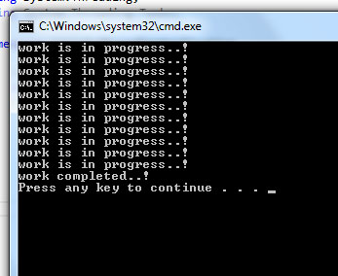
static void Main(string[] args)
{ Thread oThread = new Thread(MethodJoin);
oThread.Start();
oThread.Join();
Console.WriteLine("work completed..!");
}
static void MethodJoin()
{ for (int i = 0; i <= 10; i++)
{ Console.WriteLine("work is in progress..!");
}
}

