Slide 1
Static Analysis vs.
Machine Learning for Vulnerability Detection
Mohammed Almasi
M.Sc. Computer Science
University of Passau
almasi01@ads.uni-passau.de

Slide 2
1. Problem Statement
2. Vulnerability Types Covered
3. Implementation Architecture
4. Evaluation & Results
5. Live System Demonstration
6. Machine Learning Methodology Overview

Slide 3
1. Problem Statement
Current Tool Limitations
Cost: Professional security scanners are expensive. Tools like Veracode or Checkmarx cost thousands of dollars per year, which most students and small teams can’t afford.
Hard to Use: Many security tools are complex to set up and use. They require special training or expertise that many developers don’t have.

Slide 4
2. Vulnerability Types Covered (SQL Injection)
Vulnerability Type | Description | Example
String Concatenation | When code adds user input directly to SQL queries | query = "SELECT * FROM users WHERE id = " + user_input
F-String Formatting | When code uses f-strings with user input in SQL | query = f"SELECT * FROM users WHERE id = {user_input}"
Error-based | direct string interpolation into SQL | def find_user_by_email(email): sql = "SELECT id, name FROM users WHERE email = '%s'" % email cur.execute(sql) return cur.fetchall()
Union-based | INSECURE if column comes from user input — allows injection of SQL fragments | def get_users_ordered_by(column): sql = f"SELECT id, name FROM users ORDER BY {column}" cur.execute(sql) return cur.fetchall()
Boolean-based blind | Vulnerable: concatenating conditions from user input, leading to logic changes. | def is_admin_by_username(username): sql = "SELECT is_admin FROM accounts WHERE username = '%s'" % username cur.execute(sql) row = cur.fetchone() return bool(row and row[0])
Time-based blind | Accepts an entire WHERE expression from user | def search_products_freeform(where_clause): sql = "SELECT sku, name FROM products WHERE " + where_clause cur.execute(sql) return cur.fetchall()

Slide 5
2. Vulnerability Types Covered (xss)
Vulnerability Type | Example
Reflected XSS | def search(): query = request.args.get("q", "") ❌ Insecure: directly injecting user input into HTML template = "<h1>Results for {{ query }}</h1>" return f"<h1>Results for {query}</h1>"
Stored XSS | def show_comments(): cur = db.execute("SELECT text FROM comments") ❌ Insecure: directly injects stored content into HTML comments = [row[0] for row in cur.fetchall()] html = "<br>".join(comments) return f"<h2>Comments</h2>{html}"
DOM-based XSS | <script> const query = new URLSearchParams(window.location.search).get("q"); ❌ Insecure: writes user input directly into DOM as HTML document.getElementById("results").innerHTML = query; </script>
JavaScript Context Injection | def user(): username = request.args.get("name", "") ❌ Insecure: directly embedding user input into JS string literal return f""" <script> var user = '{username}'; // unsafe if username contains JS-breaking characters document.write("Welcome, " + user); </script>

Slide 6
2. Vulnerability Types Covered (Command Injection & Cross-Site Request Forgery)
Vulnerability Type | Description
OS System Calls | When a program asks the operating system to do things like open files or run programs.
Subprocess Vulnerabilities | When a program runs another program using user input and the user can make it run harmful commands
Shell Execution Methods | When a program sends text to a shell (like bash) and the user can make the shell do dangerous things.
Eval-Based Command Execution | When a program turns a string into code and the user can make it run any code they want
Shell Script Generation | When a program builds a shell script using user input and the user can make it do bad actions
Environment Variable Usage | When a program uses environment settings that a user can change to make it behave badly
Vulnerability Type | Description
Unprotected POST Routes | When a server accepts POST requests without checking if they come from a trusted source, allowing attackers to send fake requests
Direct Form Processing | When a server processes form data without verifying its source, letting attackers submit malicious or unauthorized data.
Direct Form Processing | Problems specific to different database systems
AJAX Operations Without CSRF | When AJAX requests change server data without CSRF protection, allowing attackers to trick users into unwanted actions
HTML Forms Without Tokens | When a form doesn’t include a CSRF token, making it easy for attackers to submit it from other sites
GET Method State Changes | When a GET request changes data on the server, allowing attackers to trigger unwanted actions just by visiting a URL

Slide 7
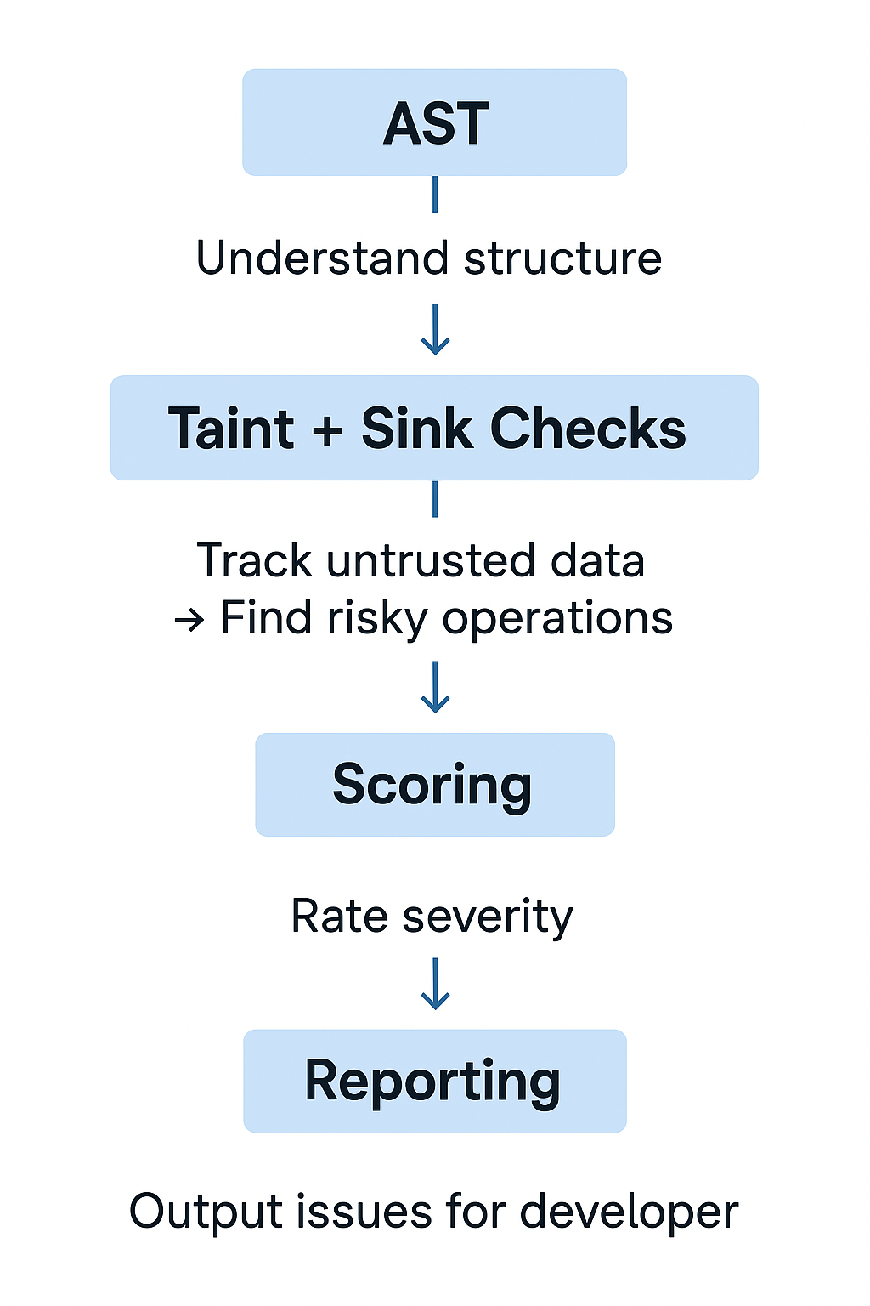
3. Implementation Architecture
What is an AST (Abstract Syntax Tree)?
An AST is a structured, tree-like representation of source code.
This is the pipeline many static analysis or security vulnerability detection tools use.
It shows how code is analyzed from structure to final report

Slide 8
3. Implementation Architecture
user = input("Enter name: ")
query = "SELECT * FROM users WHERE name = " + user
cursor.execute(query)
The AST shows relationships like:
user is assigned from input()
query uses user
cursor.execute() runs with query
So the analyzer understands what’s happening in code.
🧬 Taint check
“Tainted” = data that comes from an untrusted source (like user input, HTTP request, etc.)
💣 Sink
A “sink” = a dangerous operation that could cause a vulnerability if it receives tainted data.
So if tainted data reaches a sink, that’s a potential vulnerability.
user_input → query → cursor.execute() ✅ (danger)

Slide 9
3. Implementation Architecture
Aspect | Description
Why use AST? | Provides structured, language-aware understanding of code for analysis.
What problem does it solve? | Eliminates ambiguity of regex-based or text-based analysis.
What are current problems? | Limited semantics, inter-procedural blindness, false positives/negatives, scalability, and language variance.
What’s next? | Moving to richer code representations (e.g., Code Property Graphs) and hybrid ML-based models.

Slide 10
LAYER 2: AST ANALYSIS
• Parse code into Abstract Syntax Tree
• Track variable origins and data flow
• Identify user input sources (request.form, etc.)
• Analyze function call contexts
• Understand control flow and conditions
➤ Context-aware validation, reduces false positives
3. Implementation Architecture
INPUT CODE
Python source files, code upload, GitHub repos
LAYER 3: DEDUPLICATION & SCORING
• Remove duplicate findings on same line
• Calculate confidence scores (0-100%)
• Classify severity: Critical/High/Medium/Low
• Generate remediation suggestions
• Create detailed vulnerability reports
➤ Actionable, prioritized results
LAYER 1: REGEX PATTERNS
• String concatenation: "SELECT * FROM " + table
• F-string injection: f"WHERE id = {user_input}”
• Format strings: "WHERE name = {}".format(name)
• Dangerous functions: os.system(), eval(), exec()
• Framework patterns: Django ORM, Flask queries
➤ Fast initial screening, high recall
RESULTS
Word reports with line numbers, fixes
Why This Hybrid Approach Works**
- **Layer 1 (Regex)**: Catches obvious patterns quickly, ensures high recall
- **Layer 2 (AST)**: Adds semantic understanding, improves precision
- **Layer 3 (Processing)**: Makes results actionable for developers

Slide 11
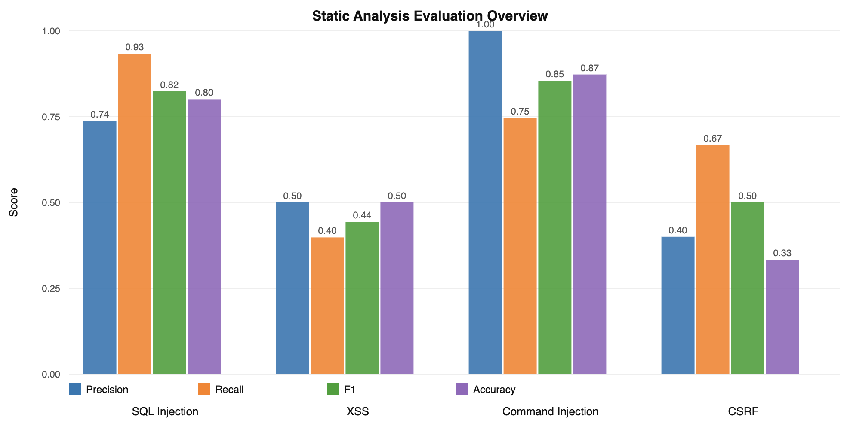
4. Evaluation & Results

Slide 12
6. PREVIEW: MACHINE LEARNING APPROACH
Step | Description
1. Source Code Collection | Collects source code from GitHub repositories, focusing on commits related to security or vulnerability fixes.
2. Tokenization | Cleans and splits the collected code into tokens by removing comments, whitespace, and unnecessary syntax elements.
3. Labeling | Assigns labels to code snippets — marking them as vulnerable or safe based on commit messages or change context.
4. Word2Vec Embedding | Converts the tokens into numerical vector representations that capture their semantic meaning for the model.
5. Model Training | Trains an LSTM or neural network model to recognize patterns that indicate vulnerable code segments.
6. Threshold-Based Classification | Uses model output probabilities and predefined thresholds to classify vulnerability severity. 🔴 Red = Critical • 🟡 Yellow = Moderate • 🟢 Green = Safe
7. Visualization | Displays the classified results, highlighting code areas with color codes according to their risk level.

Slide 13
Thank you for your attention!
Questions

