Slide 1

DIGITAL MARKETING CAMPAIGN CONVERSION PREDICTION
Presented By: Mohammad Amil Khan

Slide 2
PROBLEM STATEMENT
Develop a robust machine learning model to accurately predict customer conversions based on various demographic and engagement factors. By utilizing this model, the company aims to improve campaign targeting.

Slide 3
OBJECTIVE
This project aims to enhance the effectiveness of digital marketing campaigns by accurately predicting customer conversions. By leveraging machine learning, the project seeks to identify potential converters and optimize marketing strategies. The objective is to develop a robust model that predicts customer conversions based on demographic and engagement data, enabling:
Improve Campaign Targeting: Identify potential converters, allowing for more precise and efficient marketing efforts.
Increase Conversion Rates: Enhance the effectiveness of campaigns by focusing on the most promising leads.

Slide 4
WORK FLOW
Step 1 | Import Libraries
Importing Required Libraries
Step 2 | Read Dataset
Gathering and organizing data to train machine learning models.
Step 3 | Dataset Overview
Basic and Descriptive Data Overview
Step 4 | EDA
Analyzing and visualizing data patterns to understand its characteristics
Step 5 | Data Preprocessing
Preparing and cleaning data to enhance its quality and suitability
Step 6 | Split Train And Test Data
Dividing the dataset into training and testing sets to evaluate
Step 7 | Model Training
Choosing a suitable machine learning algorithm and optimizing its parameters
Step 8 | Model Evaluation
Assessing the performance of a machine learning model using metrics
Step 9 | Conclusion
Conclusion of Models and EDA
Step 10 | Power BI Dashboard
Power BI Dashboard and it’s Conclusion

Slide 5
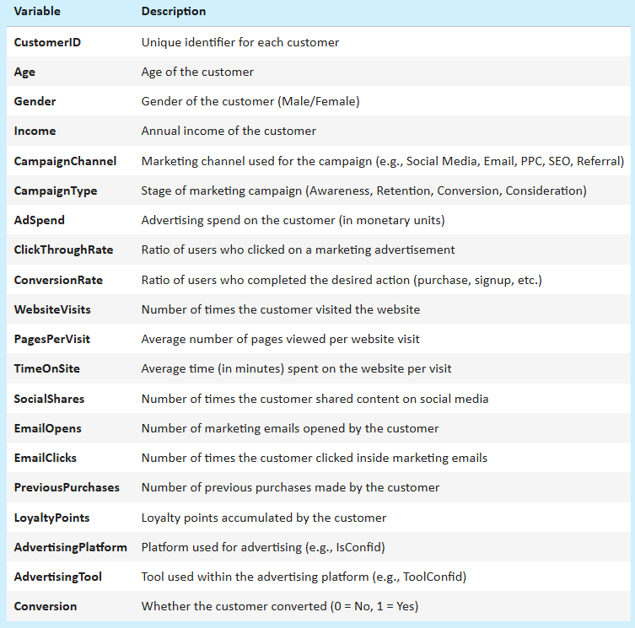
DATA COLLECTION & REFINEMENT
01 Demographics: Age, Gender, Income
02 Engagement Metrics: Adspend, socialshare, so on.
Target Variable =Conversion
0=N0 & 1 =Yes
Data types: float64(5), int64(10), object(5)
ROWS=8000
Columns=20

Slide 6

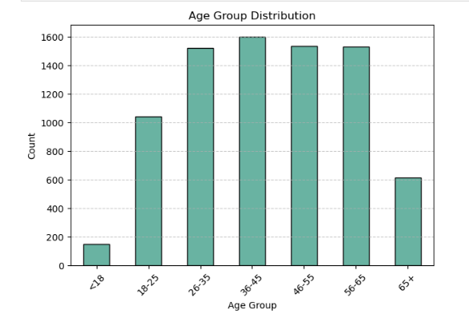
EXPLORATORY DATA ANALYSIS
Exploratory Data Analysis (EDA) helped us understand the data structure, find patterns, identify trends, and gain valuable insights from the dataset.
From EDA we analyze, the distribution of each features, checking the correlation between the features .
The datasets is clean, as there is no NULL no DUPLICATE VALUES and no OUTLIERS.
We used the univariate and bivariate analysis approach to gain insights into individual characteristics of the data and likewise how each feature relates to main goal: predicting the target variable.

Slide 7
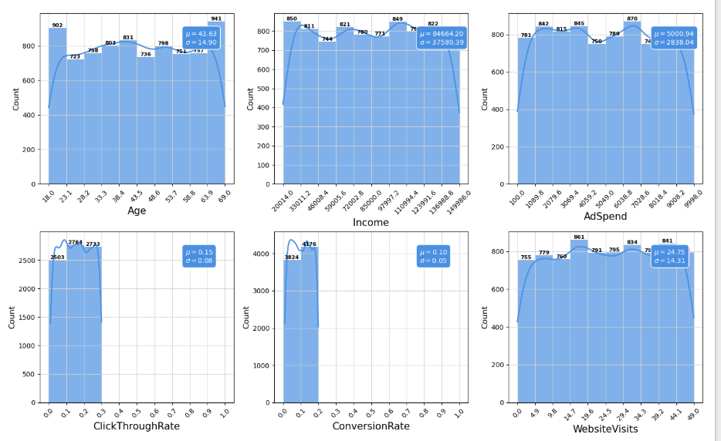
DISTRIBUTION OF CONTINUOUS VARIABLE
Age: Fairly even distribution, mean ~43.6 years.
Income: Broad spread, high variability, mean ~84,664.
Ad Spend: Evenly distributed, mean ~5,000.
Click Through Rate: Mostly between 0.1–0.3, mean ~0.15.
Conversion Rate: Concentrated between 0.05–0.2, mean ~0.10.
Website Visits: Slight peak at 20–30, mean ~24.75.
After examining the histograms of the continuous features and comparing them with the provided descriptions, the data seems consistent and falls within expected limits. **No significant noise or unrealistic values were observed among the continuous variables.

Slide 8
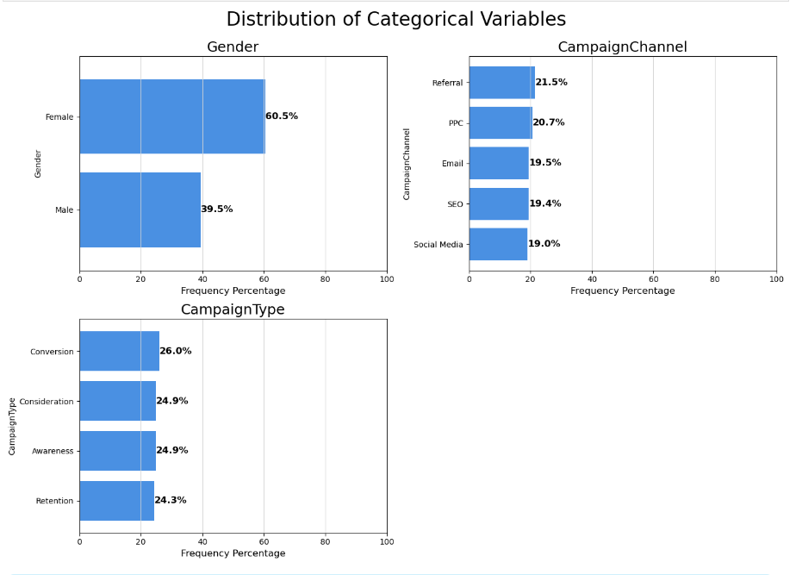
DISTRIBUTION OF CATEGORICAL VARIABLE
Gender: The majority of users are female (60.5%), while males make up 39.5%.
Campaign Channel: Referral is the most used channel (21.5%), followed by PPC (20.7%), Email (19.5%), SEO (19.4%), and Social Media (19.0%).
Campaign Type: Campaign types are evenly distributed, with Conversion campaigns slightly leading (26.0%), followed by Consideration and Awareness (both 24.9%), and Retention (24.3%).

Slide 9
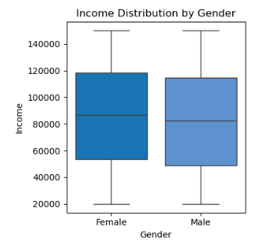
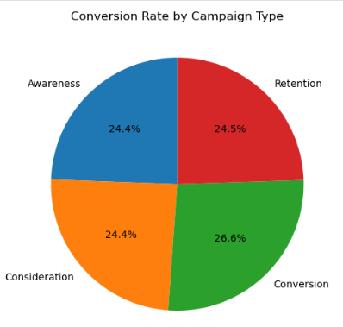
Income Distribution by Gender
It presents the income distribution for males and females:
Females: The median income is slightly higher than that of males. The interquartile range (IQR) is also larger, indicating more variability in female incomes. The whiskers suggest that the income range is broader for females.
Males: The median income is lower compared to females, with a smaller IQR, indicating less variability. The whiskers are shorter, suggesting a narrower income range.
Conversion Rate by Campaign Type
It shows the distribution of conversion rates across four types of marketing campaigns:
Conversion: 26.6%
Consideration: 24.4%
Awareness: 24.4%
Retention: 24.5%
This chart indicates that the "Conversion" campaign type has the highest conversion rate, slightly more than the other three types, which are nearly equal.

Slide 10
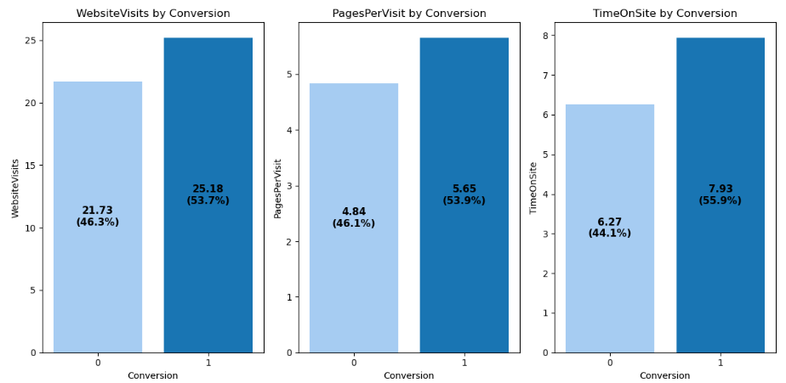
Website Engagement Metrics
WebsiteVisits by Conversion: Users who converted visited the website more frequently on average, indicating that higher engagement correlates with a greater likelihood of conversion.
PagesPerVisit by ConversionConverting: users tend to explore more content per visit, suggesting that deeper interest or better navigation leads to conversion.
TimeOnSite by Conversion: Converting users spend more time on the site, reinforcing the idea that more engaged users are more likely to convert.

Slide 11
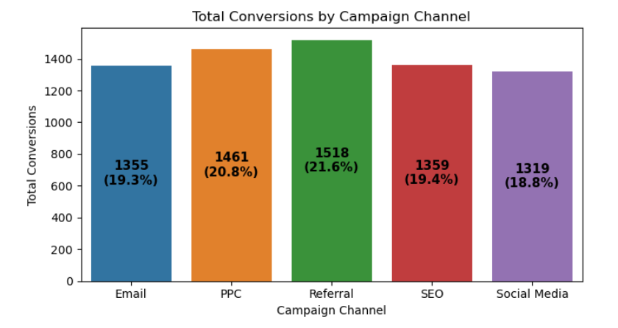
Conversion by Campaign Channel
Referral campaigns resulted in the highest number of conversions.
PPC,SEO and Email campaigns followed closely in conversion performance.
Social Media had the lowest conversion counts among the channels.

Slide 12
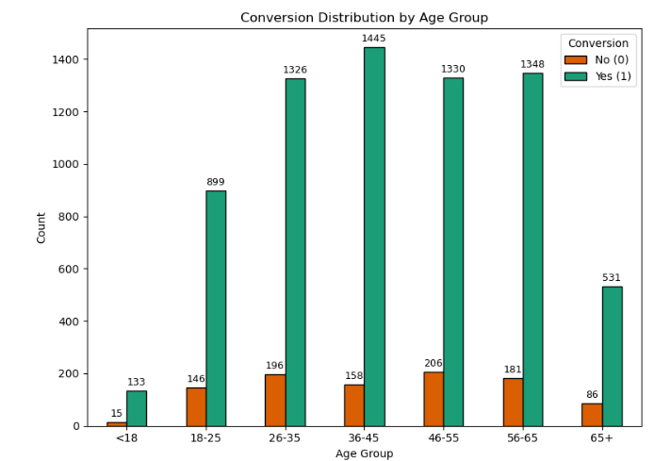
Conversion Distribution by Age Group
The 36–45 age group had the highest number of conversions.
Age groups 26–65 all showed strong conversion counts, especially 26–35, 46–55, and 56–65.
Users under 18 had the lowest number of conversions.
Conversion counts drop significantly in the 65+ age group compared to middle-aged groups.

Slide 13
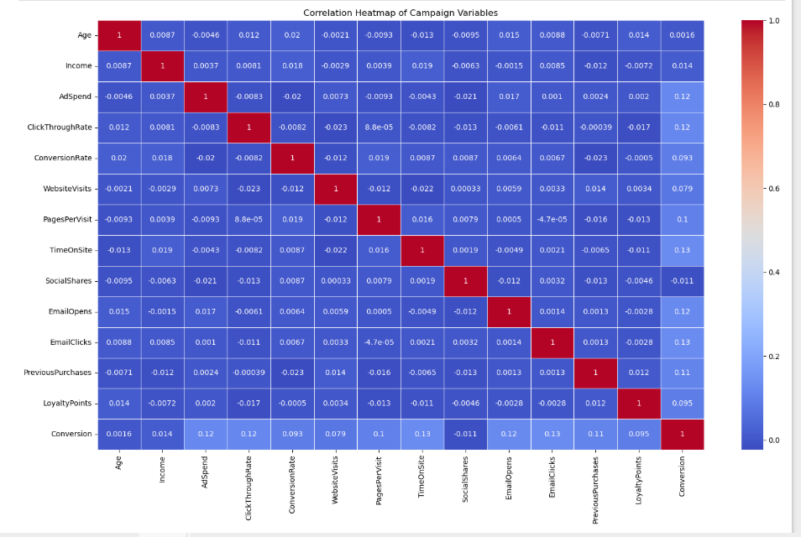
INSIGHTS FROM THE CORRELATION HEATMAP
Click Through Rate: Shows a moderate positive correlation with conversion, suggesting that higher click-through rates are associated with more conversions.
Pages Per Visit and Time On Site: Both have moderate positive correlations with conversion, indicating that more page views and longer site visits are linked to higher conversion rates.
Ad Spend: Also positively correlated, suggesting that increased spending can lead to more conversions.
Email Opens and Email Clicks: Show positive correlations with conversion, highlighting the importance of effective email campaigns.
Social Shares: Has a slight positive correlation, indicating some impact on conversion.

Slide 14

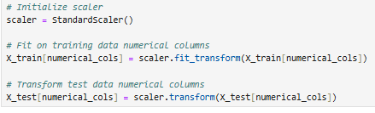
PREPROCESSING
Irrelevant Feature Removal: `CustomerID`, `AdvertisingPlatform`, and `AdvertisingTool` are removed.
Duplicates Value: No Duplicates found in Data.
Missing Value Treatment: No missing value found in the dataset.
Outliers Treatment: Checked outliers using IQR method for the continuous features and upon identifying outliers, nature of algorithm, and given small dataset size direct removal of outliers might not be best approach. No outlier found in our data.
Categorical Feature Encoding: Applied one hot encoding to the columns like “Gender”, “Campaign Type” and “Campaign Channel” since these variables are nominal variables.
Feature Scaling: Standard scaling done after train and test split on numerical columns.

Slide 15

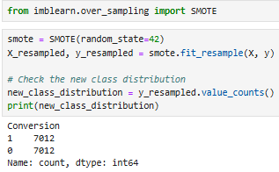
SPLITING THE DATA INTO X & Y
We divided the dataset into two parts: X and y.
"X" typically represents the independent Variables, and "y" represents the Dependent (target variable) that we want to predict or understand.
Before Over Sampling
Over sampling Using SMOTE
After Over Sampling
We use SMOTE to oversample because the dataset is imbalanced, with significantly fewer conversion=0 instances than conversion=1.
TRAIN TEST SPLIT
We divided the data into training (80%) and testing (20%) sets.

Slide 16
MODEL SELECTION
Models used:
Logistic Regression: logistic Regression is commonly used for binary classification problems. it's preferred because it provides a simple an efficient way to model the relationship between the independent variables and the probability of a certain outcome.
Decision Tree: Decision Tree algorithms are used for classification because they are simple, computationally efficient, and effective in handling high-dimensional data.
Works best for categorical independent columns.
Random Forest Algorithm: Random Forest: Random Forest is a robust supervised algorithm suitable for both regression and classification tasks.
Support Vector Machine: SVM is a powerful supervised algorithm that works best on smaller datasets but on complex ones. Support Vector Machine(SVM)can be used for both regression and classification tasks, but generally, they work best in classification problems.
XGBoost: XGBoost (Extreme Gradient Boosting) is a powerful and efficient supervised learning algorithm based on gradient boosting, designed for both classification and regression tasks.

Slide 17
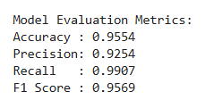
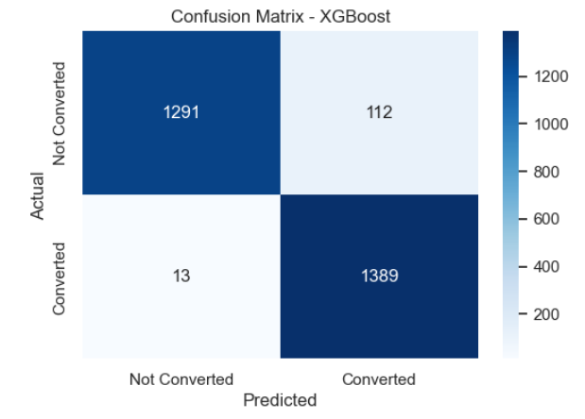
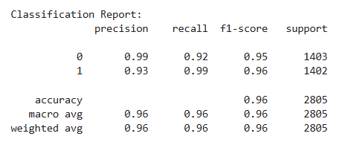
XGBoost Report

Slide 18
MODEL COMPARISON
MODEL | Accuracy | Precision | Recall | F1-Score
Logistic Regression | 93 | 89 | 98 | 93
Decision Tree | 87 | 88 | 86 | 87
Random Forest Classifier | 94 | 91 | 99 | 95
SVM | 93 | 90 | 97 | 94
XGBoost | 95 | 92 | 99 | 95
XGBoost Leads: With 95% accuracy, 92% precision, and 99% recall, XGBoost delivers the strongest overall performance, combining excellent predictive power and minimal false negatives.
Random Forest Classifier: Matches XGBoost’s 99% recall and scores a 95% F1-score, indicating a powerful balance between precision and recall.
Support Vector Machine (SVM): Achieves 93% accuracy, 90% precision, and 97% recall, maintaining solid, balanced classification performance.
Logistic Regression: Performs well with 93% accuracy, high recall (98%), but slightly lower precision (89%), making it reliable for identifying positives.
Decision Tree: Trails behind others with 87% accuracy, reflecting lower predictive consistency despite decent precision (88%) and recall (86%).

Slide 19
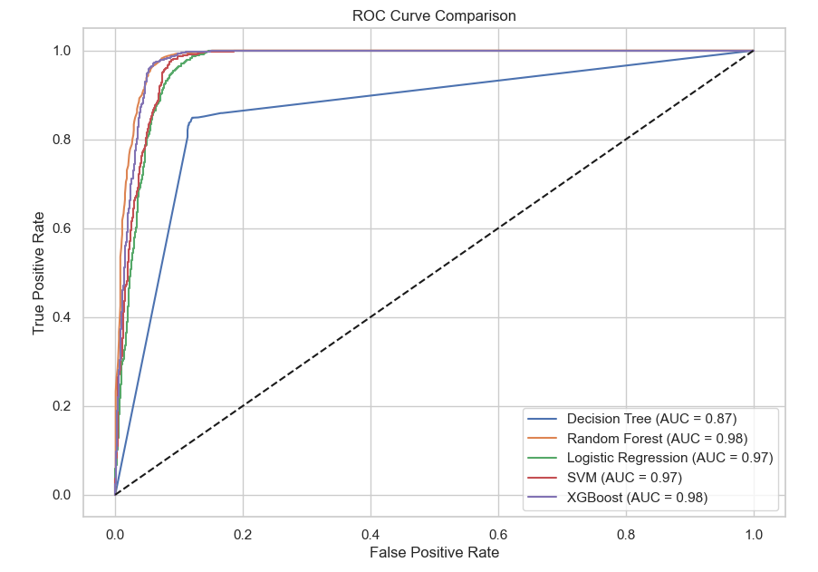
AUC-ROC CURVE FOR ALL MODELS
XGBoost and Random Forest lead with the highest AUC of 0.98, indicating superior classification capability and excellent distinction between classes.
SVM and Logistic Regression both show strong performance with an AUC of 0.97, closely trailing the top models.
Decision Tree lags with an AUC of 0.87, reflecting comparatively weaker model performance and lower discriminative power.
Conclusion: XGBoost and Random Forest are the most reliable choices in terms of ROC-AUC, ideal for maximizing true positives while minimizing false positives.

Slide 20
Final Conclusion
Engaged users (more visits, time, pages) are more likely to convert.
Email interactions (opens, clicks) are strong conversion drivers.
Best-performing age group: 26–65, especially 36–45.
High-income users convert more frequently.
Referral and PPC channels are slightly more effective.
Surprisingly, "Conversion" campaigns perform the worst.
Model Results
XGBoost is the best model (95% accuracy, 0.98 AUC).
Random Forest and SVM are also strong.
Decision Tree performed the weakest (87% accuracy, 0.87 AUC).
Recommendations
Focus on high-income, aged 26–65 users.
Invest in email and referral campaigns.
Use XGBoost for future predictions.
Reevaluate "Conversion" campaign strategy.

Slide 21
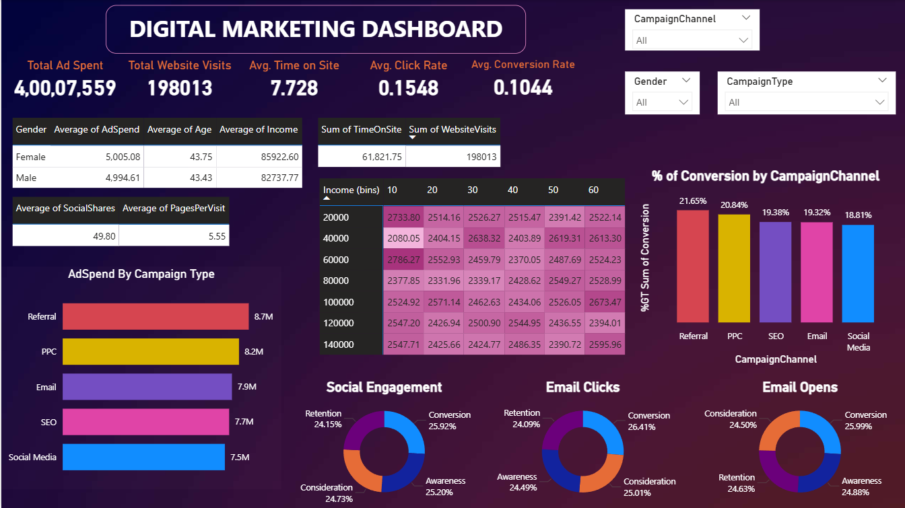

Slide 22
INSIGHTS
Overall Performance Metrics
Total Ad Spend: ₹4,00,07,559
Total Website Visits: 198,013
Average Time on Site: 7.728 minutes
Average Click Rate: 15.48%
Average Conversion Rate: 10.44%
Demographic Performance
Gender-wise Spend & Engagement:
Females spend slightly more on average (₹5,005) than males (₹4,995).
Female users have slightly higher average income (₹85,922) vs. males (₹82,737).
Engagement Metrics:
Average Pages per Visit: 5.55
Average Social Shares: 49.80
Campaign Effectiveness
Conversions by Channel:
Referral (21.65%) leads, followed by PPC (20.84%), then Email, SEO, and Social Media.
Ad Spend by Campaign Type:
Referral has the highest spend (~₹8.7M), followed closely by PPC and Email.
Social Media has the lowest ad spend (~₹7.5M).
Engagement by Campaign Type
Social Engagement:
Balanced distribution, with Conversion (25.92%) slightly leading.
Email Clicks & Opens:
Email campaigns show high engagement:
Clicks are evenly distributed (~24-26% for Conversion, Retention, Consideration).
Opens are highest for Conversion (25.99%) and Awareness (24.88%).

Slide 23
Conclusion
Referral and PPC channels are the most effective for conversions and receive the highest ad spend, indicating good ROI.
Conversion campaigns, despite having the highest email opens and engagement, may benefit from further optimization to improve conversion rate.
Female users show slightly better engagement and spending patterns, suggesting a potential segment for focused targeting.
Email marketing performs well and remains a strong conversion channel.
Investments in Social Media show lower conversions and may require reevaluation or retargeting.
Recommendation: Continue prioritizing Referral and PPC strategies, optimize Conversion campaigns, and leverage email insights for segmented targeting.

Slide 24

THANK YOU
GitHub Link

