Slide 1

Promotional Campaign
Analysis
Using

Slide 2
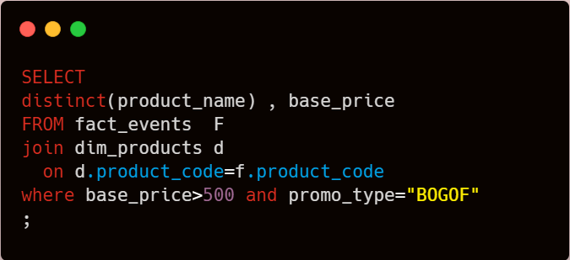

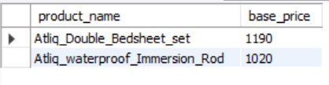
1. High-Value BOGOF Products::
Provide a list of products with a base price greater than 500 and featured in promo type 'BOGOF' (Buy One Get One Free).

Slide 3
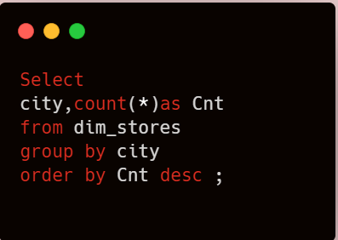

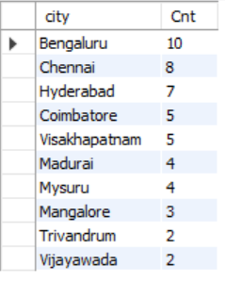
2. Store Count Overview:
Generate a report showing the number of stores in each city, sorted in descending order of store counts. Include essential fields: city and store count.

Slide 4
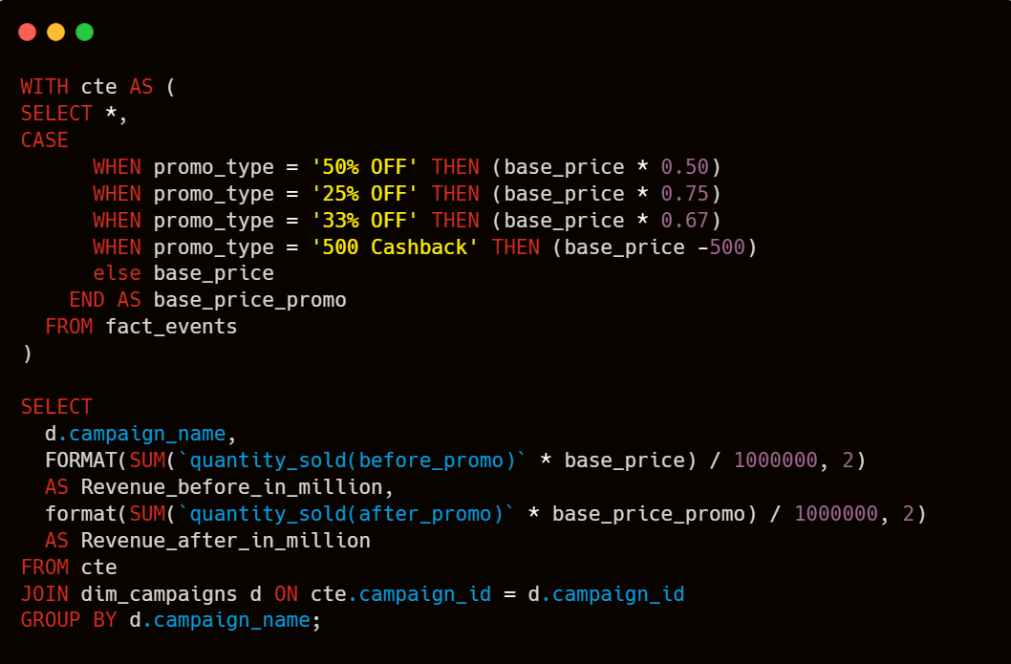


3. Campaign Revenue Analysis:
Generate a report displaying each campaign, total revenue before and after the campaign, in millions. Fields: campaign_name, total_revenue(before_promotion), total_revenue(after_promotion).

Slide 5
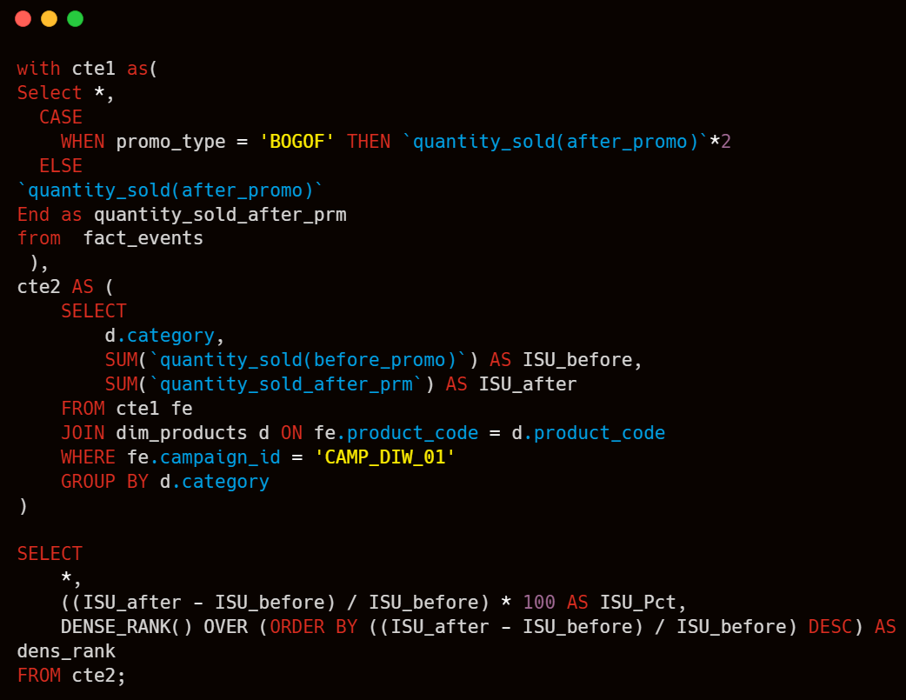
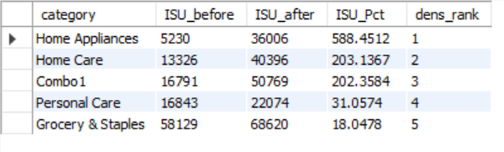
4. Diwali Campaign ISU% Report:
Produce a report calculating Incremental Sold Quantity (ISU%) for each category during the Diwali campaign. Include category, isu%, and rank order. ISU% is the percentage change in quantity sold (after the promo) compared to before the promo.

Slide 6
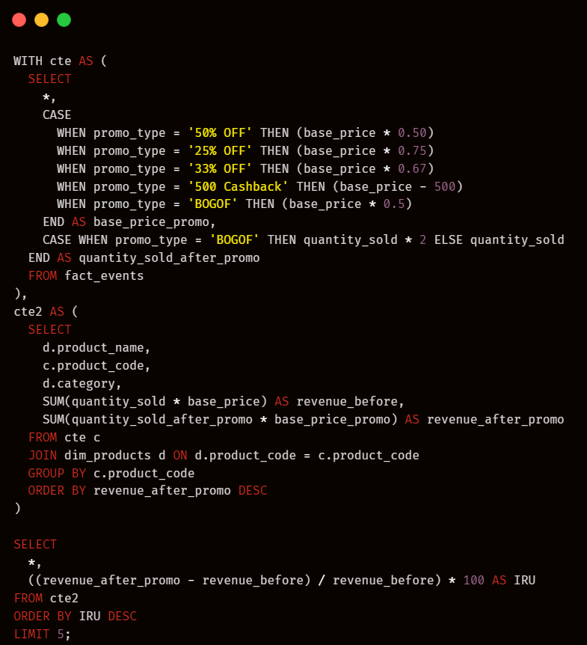
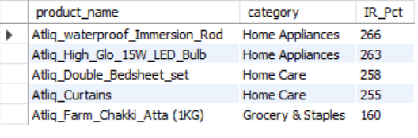
5. Top 5 Products by IR%:
Create a report featuring the top 5 products ranked by Incremental Revenue Percentage (IR%) across all campaigns. Include product name, category, and ir%. This analysis helps identify successful products in terms of incremental revenue.

Slide 7

Do you have any questions ?
ayaanalam139@gmail.com

