Slide 1

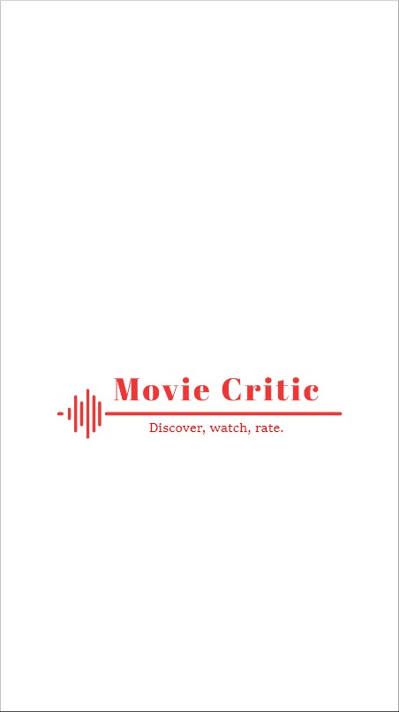
CMPS344-Software Engineering
Mohammad Qrah Mohammad-202203623
Mohammad Ayoub-202202663
Jamil Saleh-202201608
Tamer Rifai-202201180

Slide 2
Main Project Description:
The idea of our project is to create an app where users can purchase movie tickets online and write reviews and give them a rating, rather than relying on a small group of professional critics. This approach aims to provide the Lebanese people an insight on price fluctuations and get their money’s worth through a fairer evaluation of movies, by considering the opinions of a larger and more diverse group of people.
The app would likely allow users to search for movies and get their current prices, read reviews written by other users, and write their own reviews. Users could rate movies on a scale, such as 1-5 stars, and the app would aggregate these ratings to provide an overall score for each movie.
Overall, our project aims to provide a way for people to know current prices, get discounts and give representative and accessible evaluation of movies, by giving everyone the opportunity to have their say.

Slide 3
Problem Statement:
The problem for online ticket prices in Lebanon is that the economic challenges facing the country, such as high inflation rates, devaluation of the Lebanese pound, political instability, have led to a steady increase in the price of online movie tickets. This increase in ticket prices has made it difficult for many Lebanese people to afford or purchase movie tickets online, limiting their access to entertainment options. Additionally, the fluctuations in online ticket prices due to changes in demand, availability, and economic conditions have made it challenging for online ticket providers to maintain stable prices, leading to further frustration and confusion for consumers. Moreover, some people cannot afford this level of entertainment due to the outgoing economic challenges. Our app will feature family discounts and special offers to its customers. And lastly some consumers might not enjoy the movie they are watching and feel like they were robbed of their money and experience. To combat this problem, our app Movie Critic allows the people that have watched the movie to write reviews and rate the movie, to give a fairer insight.

Slide 4
Project Goal:
Our goal is to create an app for the Lebanese people to get access to movie tickets at their current prices with special offers and discounts meant for users to afford this level of entertainment. In addition to help the customer to choose which movie he/she wants to watch by looking at the consumer reviews and then writing their own after watching the movie.

Slide 5
Project Plan:
SDLC Model
Project Organization
Ethical Standards and Guidelines
Feasibility Study:
Risk Management
Technical Feasibility
Economic Feasibility
Delivery
Software Requirement Specifications:
Product Function
User Characteristics
Non-Functional Requirements
Functional Requirements
System Requirements

Slide 6
SDLC Model
A software development life cycle (SDLC) model is a conceptual framework describing all activities in a software development project from planning to maintenance. To implement our application making sure it’s foolproof, we will use the waterfall model. After numerous meetings and discussions, we have concluded that the waterfall model is the best approach towards building our project. Firstly, all the milestones we have set are well understood. Our project is not flexible and the probability of any changes throughout the project is almost non-existent. Second, similar apps already exist on the market, however they lack the features that our application Movie Critic provides. Finally, the waterfall approach has several benefits, such as predictability, explicit stage and task definitions, and simplicity and ease of use.

Slide 7
Project Organization
We chose to work concurrently on each step because the waterfall model is a sequential approach, which means we couldn't enter one phase until fully completing the preceding one. With the help of our team, we were able to acquire requirements, analyze them, create one stage at a time, jointly, with testing and maintenance. This, in our opinion, would expedite and improve the efficiency of each stage. Additionally, every team member is free to contribute their own ideas, which helps us diversify the project and ensures that everyone is maximizing their potential.

Slide 8
Ethical Standards and Guidelines:
As a movie ticketing system, there are several ethical standards and guidelines that we should adhere to in order to ensure that our system is fair, transparent, and respects the privacy and security of our customers.
Here are some key considerations:
• Transparency: our movie ticketing system should be transparent in terms of how it operates, what fees and charges are levied, and how user data is collected and used. Our customers should be able to easily understand how our system works and what their obligations are.
• Fairness: our movie ticketing system should treat all customers fairly, without discrimination based on factors such as race, gender, age, or socioeconomic status. This means ensuring that ticket prices are reasonable and that everyone has equal access to tickets.
• Privacy: our movie ticketing system should respect the privacy of our customers, and collect and use their personal information only for the purposes of providing the service they have requested. We should also ensure that user data is stored securely and protected against unauthorized access.
• Security: Our movie ticketing system should be secure and protected against fraud, hacking, and other forms of malicious activity. This includes implementing strong passwords, encryption, and other security measures to prevent unauthorized access.

Slide 9
Economic Feasibility
Since it is crucial for us to complete this project on schedule, we will outline the anticipated time frame for constructing Movie Critic. We want to spend as much time as we can making sure the waterfall model we're using is as accurate as possible.
With all the requirements gathered, the schedule will look like this:
Requirements Gathering & Analysis: 3-4 weeks.
Design: 2 weeks.
Implementation: 1 month.
Testing: 2-3 weeks.
Maintenance: 2 weeks.
In summary, Movie Critic shouldn't take more than 4 months. Implementation, testing, and maintenance shouldn't take long if the earlier phases are done well. When it comes to the cost of developing our application, it won't be very expensive. We will have to pay for a variety of expenses in order to create this application from start to finish. They are listed below:
Rent an office to work from: $200/month
Hardware (laptops): $2400
Subscriptions: $30/month
Graphic designer: $280
Server maintenance: $150/month
According to the calculations above, we would need a budget of about 4200$ to achieve our objectives in the span of 4 months for our app to be ready. Remember that the costs in this budget were determined based on what is typically expected in Lebanon.

Slide 10
Delivery
We will distribute our application by making it accessible on both iOS and Android smartphones once it is finished. Delivery documentation aims to make the application more understandable for our clients. Even though the app provides a tutorial outlining the capabilities and how to use them, we will also send along some documents. But we will only submit a user guide along with our mobile application. This is because our application must be simple to use; users won't need any particular training to use it.

Slide 11
Non-Functional Requirements
Performance:
The system must exhibit exceptional performance, capable of handling an immense influx of users simultaneously, without any delays or performance issues. It must be able to process transactions swiftly and efficiently, even under heavy loads.
Reliability:
The system must demonstrate utmost reliability and always remain available. In the event of any system failures, it must be able to recover quickly and seamlessly, without losing any data.
Security:
The system must maintain the highest level of security, with robust measures in place to prevent any unauthorized access to the system and safeguard sensitive user data. It must comply with all pertinent data privacy regulations and guidelines.
Usability:
The system must be exceedingly user-friendly and intuitive, with clear, concise, and user-friendly instructions on how to use it, regardless of the user's technical skill level.
Scalability:
The system must be scalable and designed to handle rapid growth in user numbers and changing demand levels. It must be able to adjust to changing usage patterns and capacity requirements, without any interruptions or disruption to its service.
Compatibility:
The system must be compatible with a wide range of devices, to ensure that users can access it from any platform, device, or operating system, without any compatibility issues.

Slide 12
Functional Requirements
A. User Requirements:
Users will be able to create an account through credentials.
Users will be able to enter their credit card information to book a ticket seamlessly.
A narrow window of 12 hours will be provided for users to initiate a refund for their ticket, with an assured refund of 80% of the initial ticket price
Users will be able use his points to get special offers
Users will be able to search for movies currently available
Users will be able to write reviews on movies
Users will be able to rate the movie on a scale
Users will be able to create an account through emails.
Users will be able to update account info
B. System Requirements:
The system should provide a secure user registration process and enable users to log in using their credentials.
The system should display a comprehensive list of movies, along with their details, such as genre, rating, and reviews
The system should allow users to book tickets for movies and reserve their desired seats at their desired Theaters.
The system should have a refund policy that enables users to cancel their bookings and receive refunds if necessary.
The system should provide a platform for users to share their reviews and ratings for movies they have watched.
The system should ensure that user data is secure and protected against potential threats, such as hacking and data breaches.

Slide 13
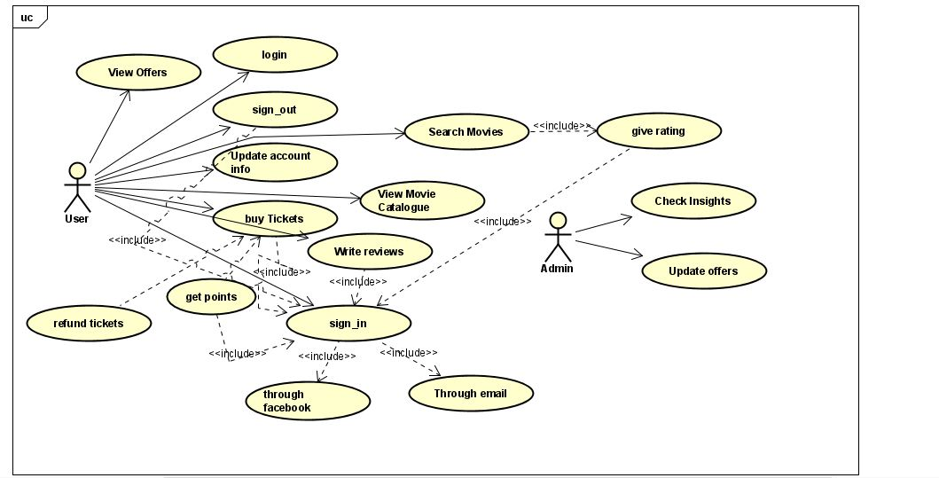
Use Case Description:
We converted all of the user requirements into use cases in order to capture the functional needs of the system from the viewpoint of the user. The following use cases were used to generate a use case diagram. The relevant use case details were provided for each: sign in, sign out, update info, buy tickets, write review, give rating, and earn points.

Slide 14
Use case Name: Sign in
Related Use Cases:
Generalization of: Through Credentials, Through Email, includes buy ticket, get points, write reviews, give rating and Sign out.
Actor: User
Actor Actions:
1. Press on sign in method
2.Enter required fields
System Response:
1.Sign in successful or sign in failed.
b) Use Case Name: Sign Out
Related Use Cases: (inclusion)
Actor: User
Actor Actions:
1.Request log out
System Response:
1.Redirect to homepage
C) Use Case Name: Update account info
Related Use Cases: (inclusion)
Actor: User
Actor Actions:
1.Enter new data
2.Press on update account info
Response:
Redirect to homepage
D) Use case Name: buy ticket
Related Use Cases: refund ticket, get points.
Actor: User
Actor Actions:
1.choose a cinema
2.choose a movie
3.choose a seat
4.press on buy ticket
5.Add credit card info
System Response:
1.Reserve seat
E) Use case Name: Refund ticket
Related Use Cases: Buy ticket
Actor User
Actor Actions:
1.press on refund ticket
System Response:
1. Refund 80 percent of the ticket price.
2.remove reserved seat
F) Use case name: Write reviews
Actor: User
Actor Actions:
1.press on write reviews
2.type in your review
System Response:
1.Upload review to the public
G) Use case name: Give rating
Related Use Cases(inclusion)
Actor:User
Actor Actions:
1.Press on give rating
2.choose from the rate scale
H) Use case name: View offers
Related Use Cases:None
Actor:User
Actor Actions:
1.Press on View offers
2. Choose desired offer.
System Response
1.Display New offers
Apply the offer on the users account.

Slide 15
Prototype
The following slides will showcase the prototype design for our project. Our team has invested significant effort and time into designing the prototype, and we are excited to present it to you. Our objective is to provide you with a comprehensive understanding of the design and to gather feedback from you.

Slide 16
Start Up
This is what appears when the user first starts the application

Slide 17
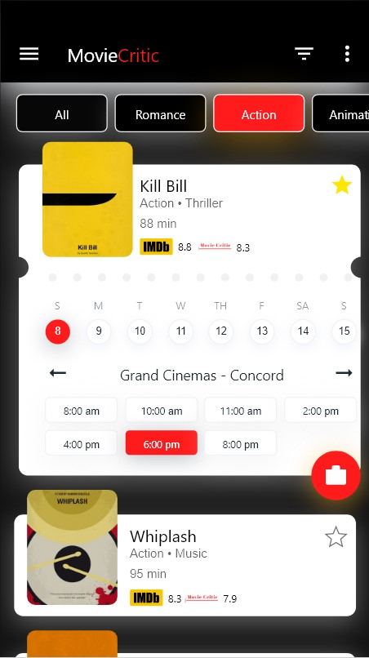
Home Page
A comprehensive homepage that provides the user with a list of movies from each genre available in local cinema halls and an excellent UX.

Slide 18
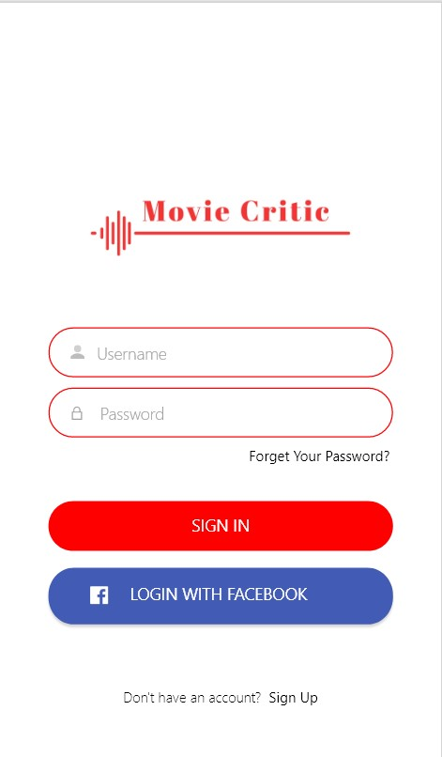
Log In
In order to book a ticket, the user must sign in.

Slide 19
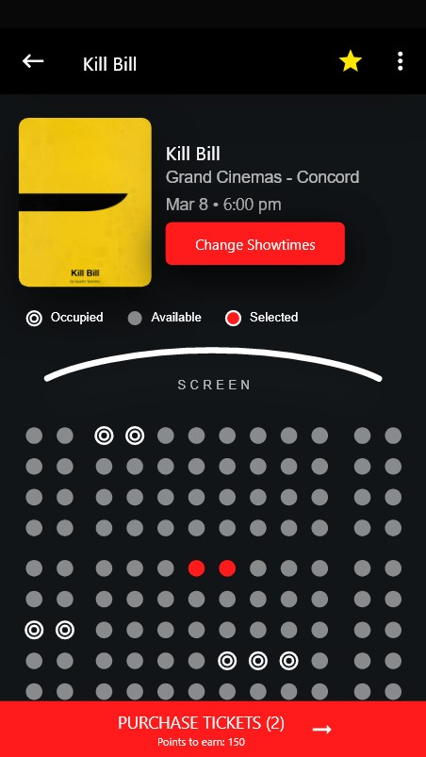
Reservation
Now that the user has logged into their account, they’ll be able to reserve any seat of choice if available.

Slide 20
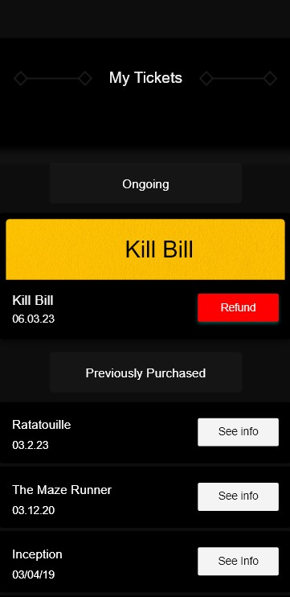
Refund
Users also have the ability to refund their tickets in case of any complications.

Slide 21
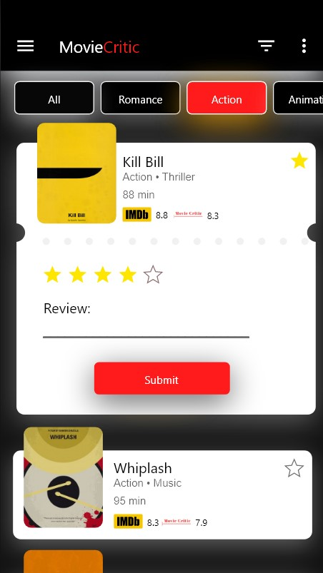
Review
As our slogan says, “Discover, watch, rate.”, the user will be suggested to rate the movie watched.

Slide 22
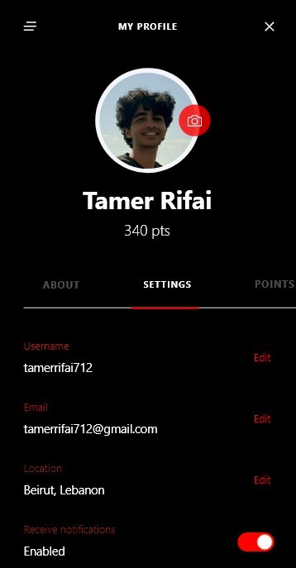
Profile
Each user has their own profile in which they can check their credentials, points…

Slide 23
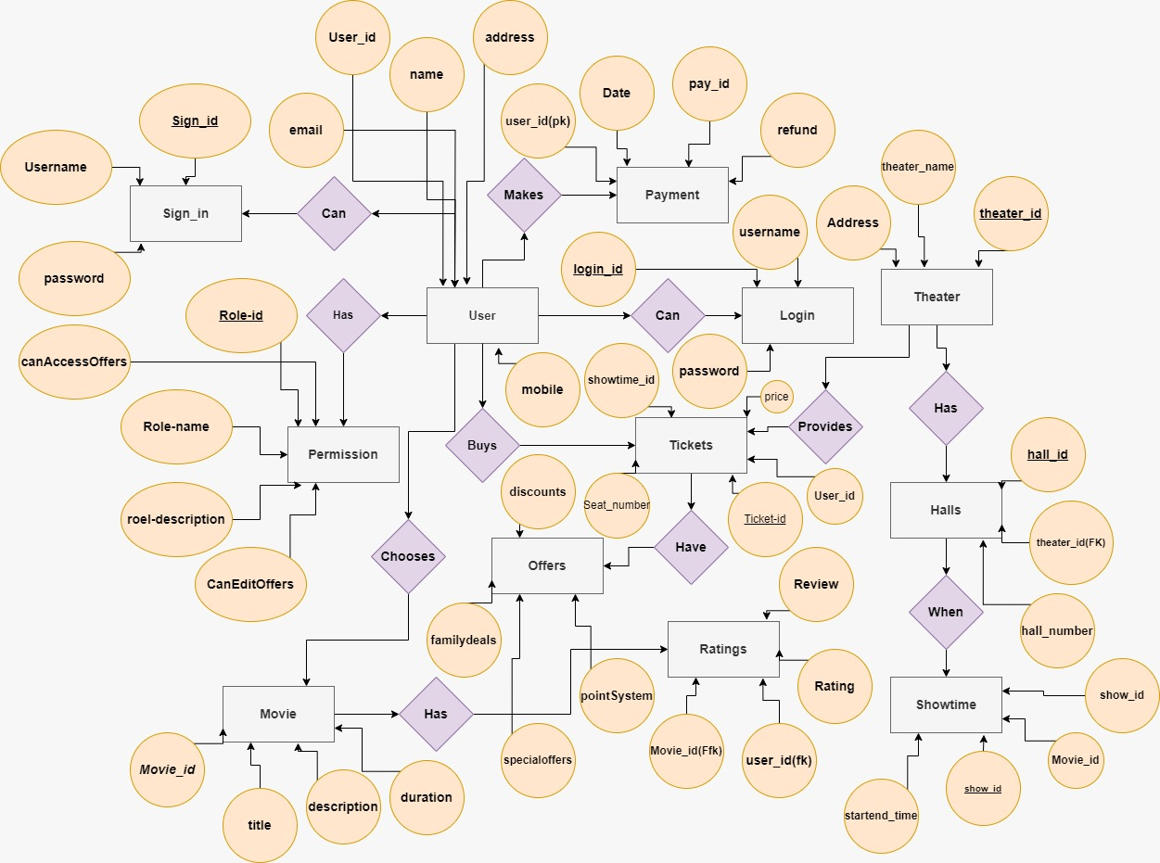
Database Diagram:
MovieCritic requires a database to store our user’s data. Below is an EER Diagram of how the data is stored.

Slide 24
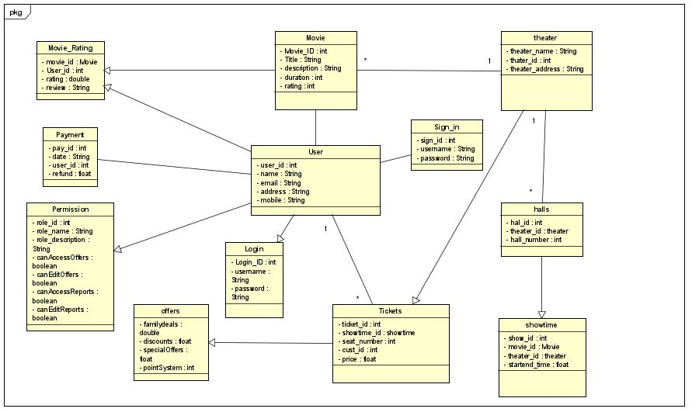
Class Diagram:
The class diagram is similar to the database diagram There are also twelve classes:User,Movie,MovieRating,Theater,SignIn,Halls,Payment,Permission,Login,Offers,Tickets,Showtime.The User has a one-to-man relationship with data just like in the database diagram.

Slide 25
Sequence Diagram:
MovieCritic features a wide range of use cases, each of which has been thoroughly described before. During our lab sessions, we created a sequence diagram for each use case in order to clearly depict a user's progression through the system.

Slide 26
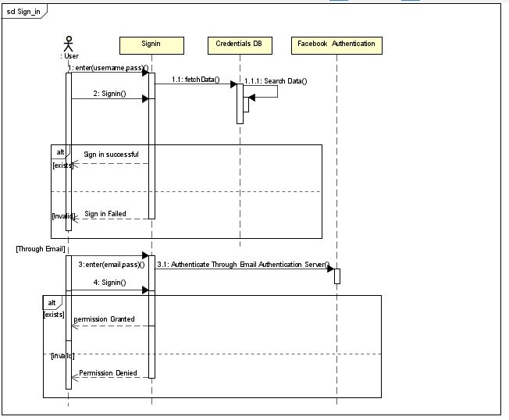
Sequence diagram for “Sign in” – through credentials or through email

Slide 27
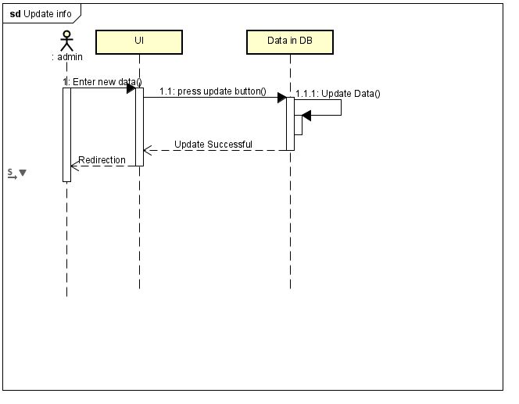
Sequence diagram for “Update Info”

Slide 28
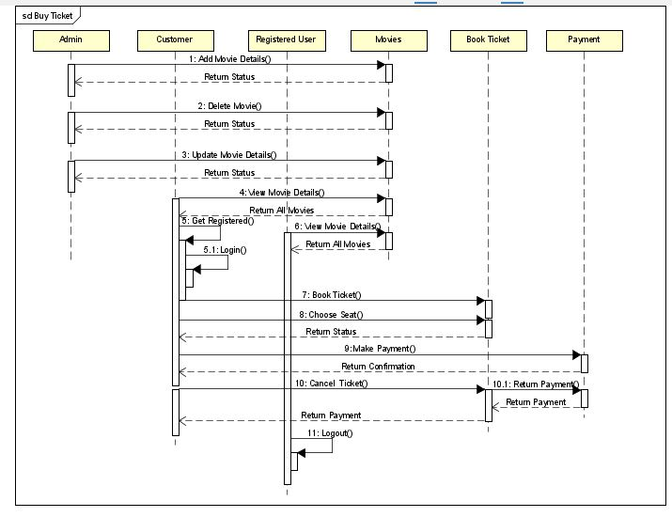
Sequence diagram for “Buy Ticket”

Slide 29
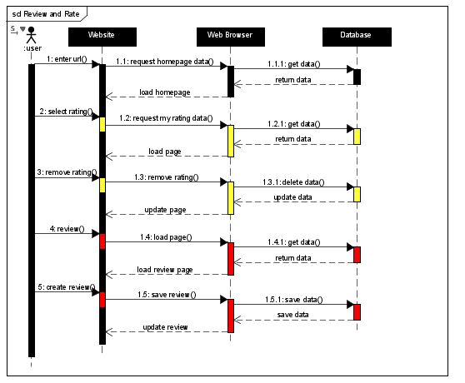
Sequence diagram for “Review and Rate”

Slide 30
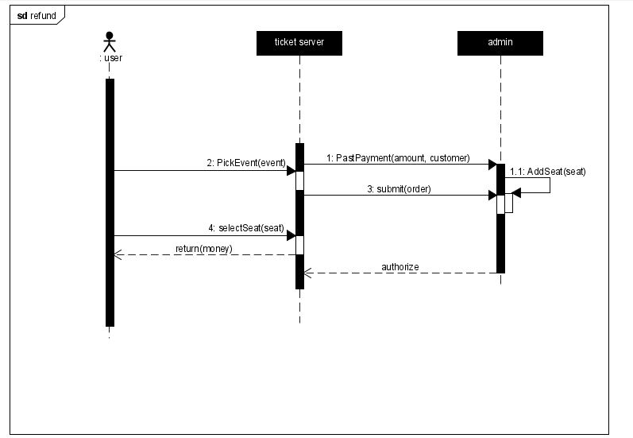
Sequence diagram for “refund”

Slide 31
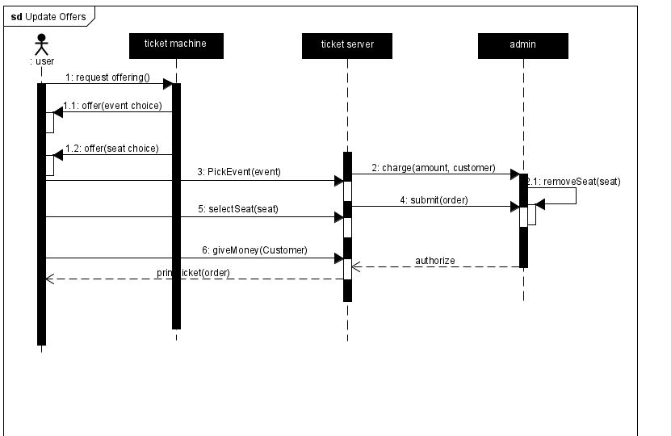
Sequence diagram for “Update Offers”

Slide 32
Implementation
We will utilize Flutter to implement our application, as we already described in the Technical Feasibility section. We selected Flutter because it offers a wide variety of advantages for speedy development and more user-friendly mobile applications. We want to construct cross-platform mobile applications. Rather than using kotlin to develop our application on android and swift for ios
Since Flutter was created using the Dart programming language, it enables native apps for iOS and Android to use the same scripts without any changes.
We will utilize VS code since it is free easy to use code editor that offers top-notch support.
We chose MySQL for our database since it has several benefits over other database management systems. It makes easier efficient database administration through software integration. It is a strong, dependable, and stable relational database system with cutting-edge capabilities including high performance, data security, and scalability.

Slide 33
Testing
After implementing a movie ticketing and rating system, it's essential to conduct thorough testing to ensure that the application works as expected and meets the requirements of its users. First Functional testing, Functional testing verifies that the application's primary features, such as purchasing cinema tickets, rating films, and posting reviews, are operating as intended. All conceivable situations should be included in test cases, including legitimate input, unsuccessful purchases, and handling of errors. Second, User experience testing, User experience testing focuses on how the application feels to use. This includes testing the application's responsiveness, ease of use, and overall usability. User testing can be conducted with real users or using simulated users to ensure that the application meets user expectations. Third Performance testing, this type of testing ensures that the application can handle the expected user load and that it performs optimally under various conditions, such as high traffic volumes or slow internet connections. Fourth Security testing, Security testing ensures that the application is secure from potential threats such as hacking, data breaches, and unauthorized access. This includes testing the application's authentication and authorization systems, encryption methods, and error handling. Fifth Compatibility testing, Compatibility testing ensures that the application works as expected across different devices, operating systems, and web browsers. This testing should cover a range of popular devices and configurations to ensure that the application works correctly on all platforms.
By accomplishing these testing goals, the movie ticketing and rating system can be validated as a reliable and high-quality application that meets the needs of its users.

Slide 34
Maintenance
As previously mentioned, before we will be using gitlab for version control.
We will require a version control system to help us manage and to facilitate teamwork since our team consists of several people and we will all be working on each stage of the project at the same time. Gitlab was our choice because it helps us deal with the misunderstanding that frequently results when several members of our team are modifying the same files at once. It makes it easy to see any modifications that any team member made. In this manner, everyone on the team will constantly be informed.

Slide 35
Conclusion:
In conclusion, we will go through a drawn-out process of gathering requirements and creating models in order to develop our application, MovieCritic. After that, MovieCritic will be applied to Flutter. We will test and maintain our application when everything is finished to ensure its security. MovieCritic will be prepared to launch on the market for our users after it has completed each step. To ensure that everyone has access to it, it will be available on both Android and iOS smartphones. We believe that by establishing MovieCritic, we will help family and friends to afford this level of entertainment and help cinemas to bounce back.

Slide 36
Thank you so much for your interest and attention.

