Slide 1


Slide 2


Slide 3


Slide 4


Slide 5

LITERATURE REVIEW

Slide 6
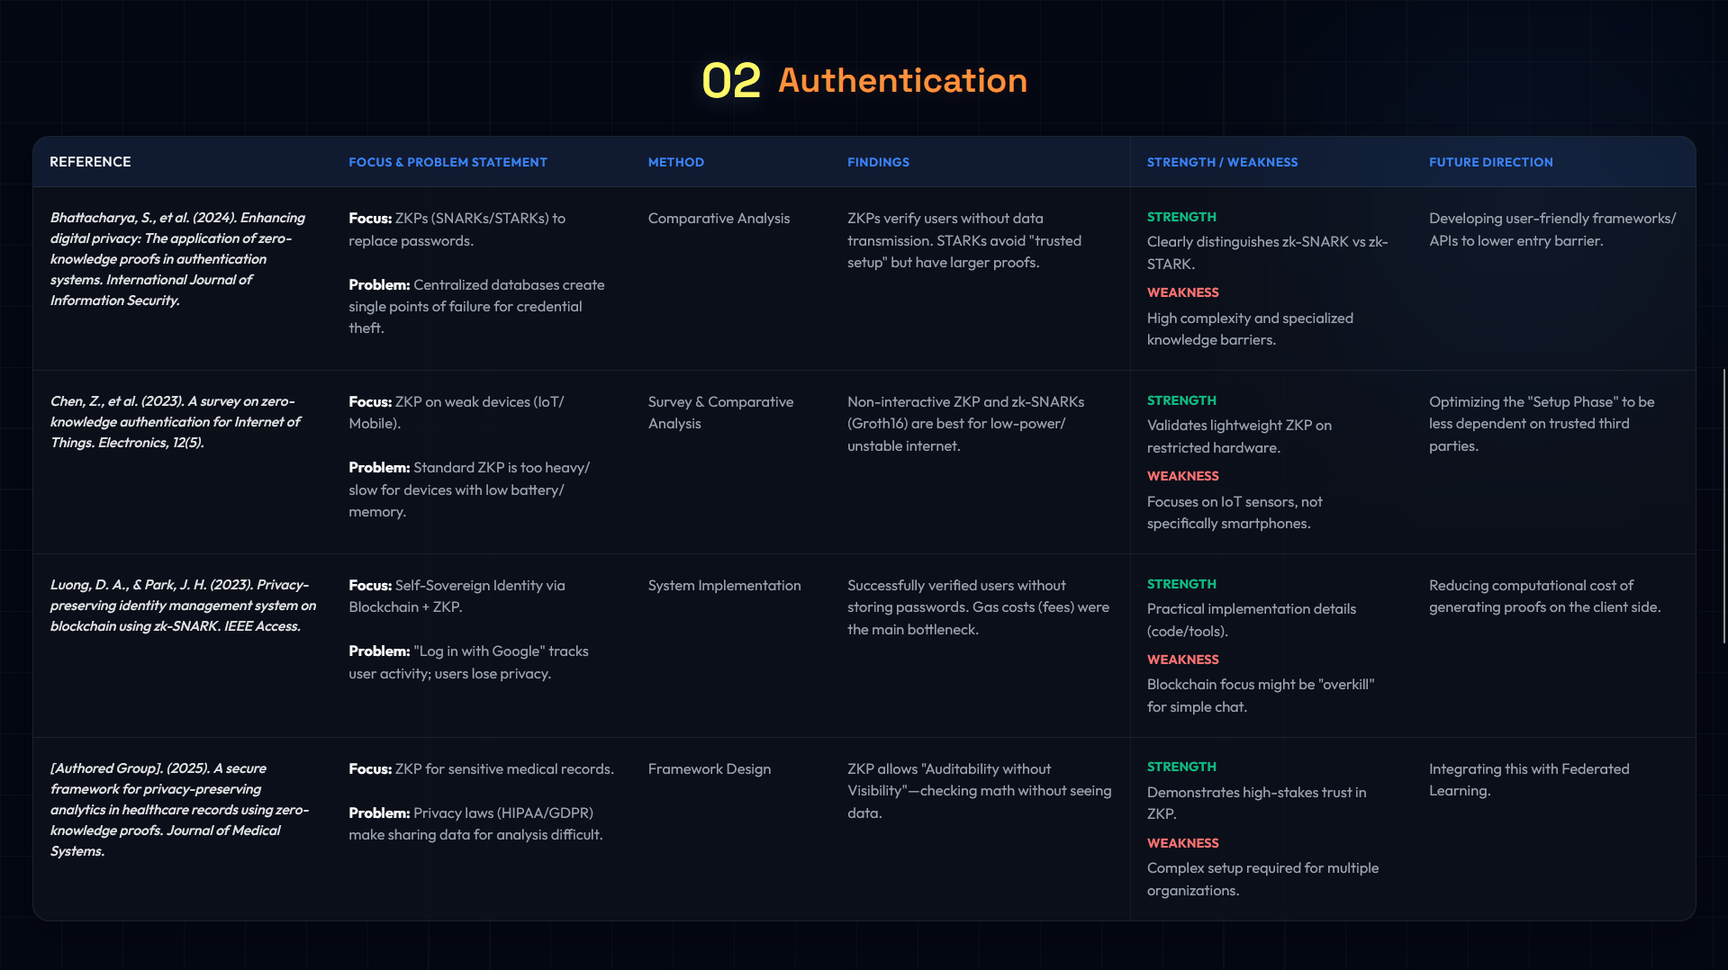
LITERATURE REVIEW
LITERATURE REVIEW

Slide 7
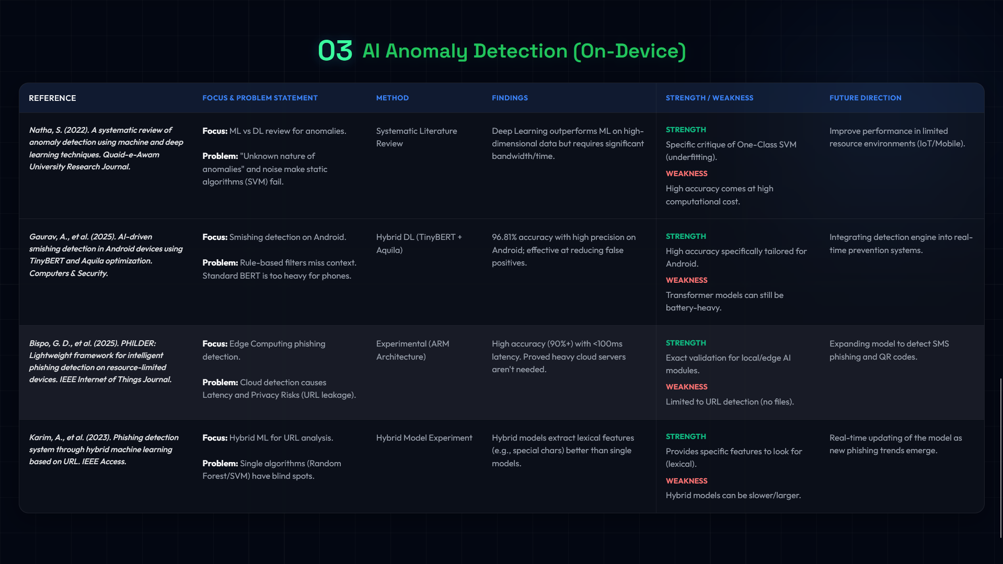
LITERATURE REVIEW

Slide 8
LITERATURE REVIEW

