Slide 1
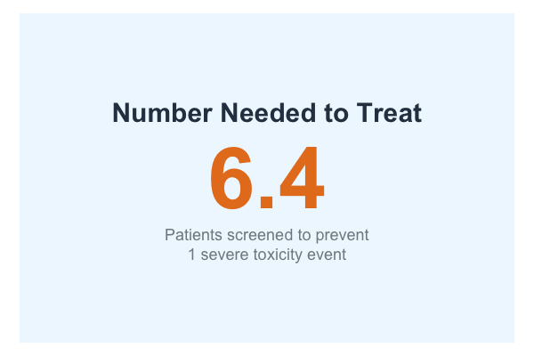
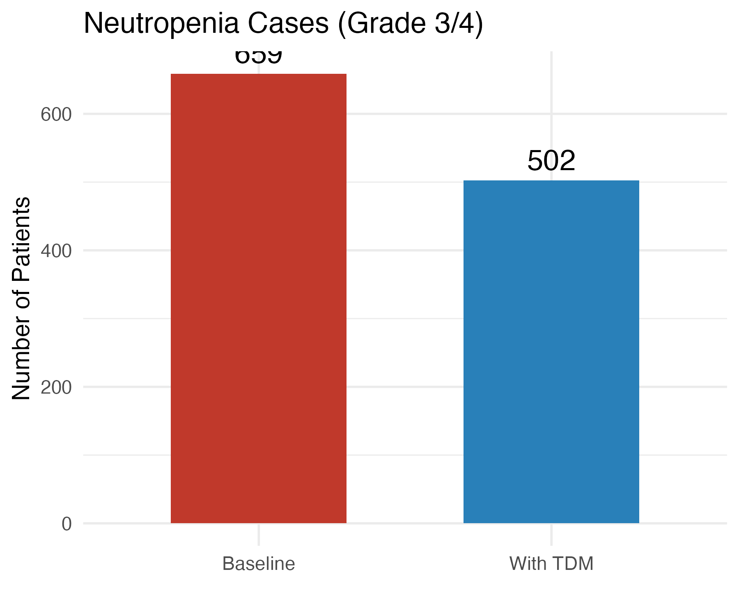
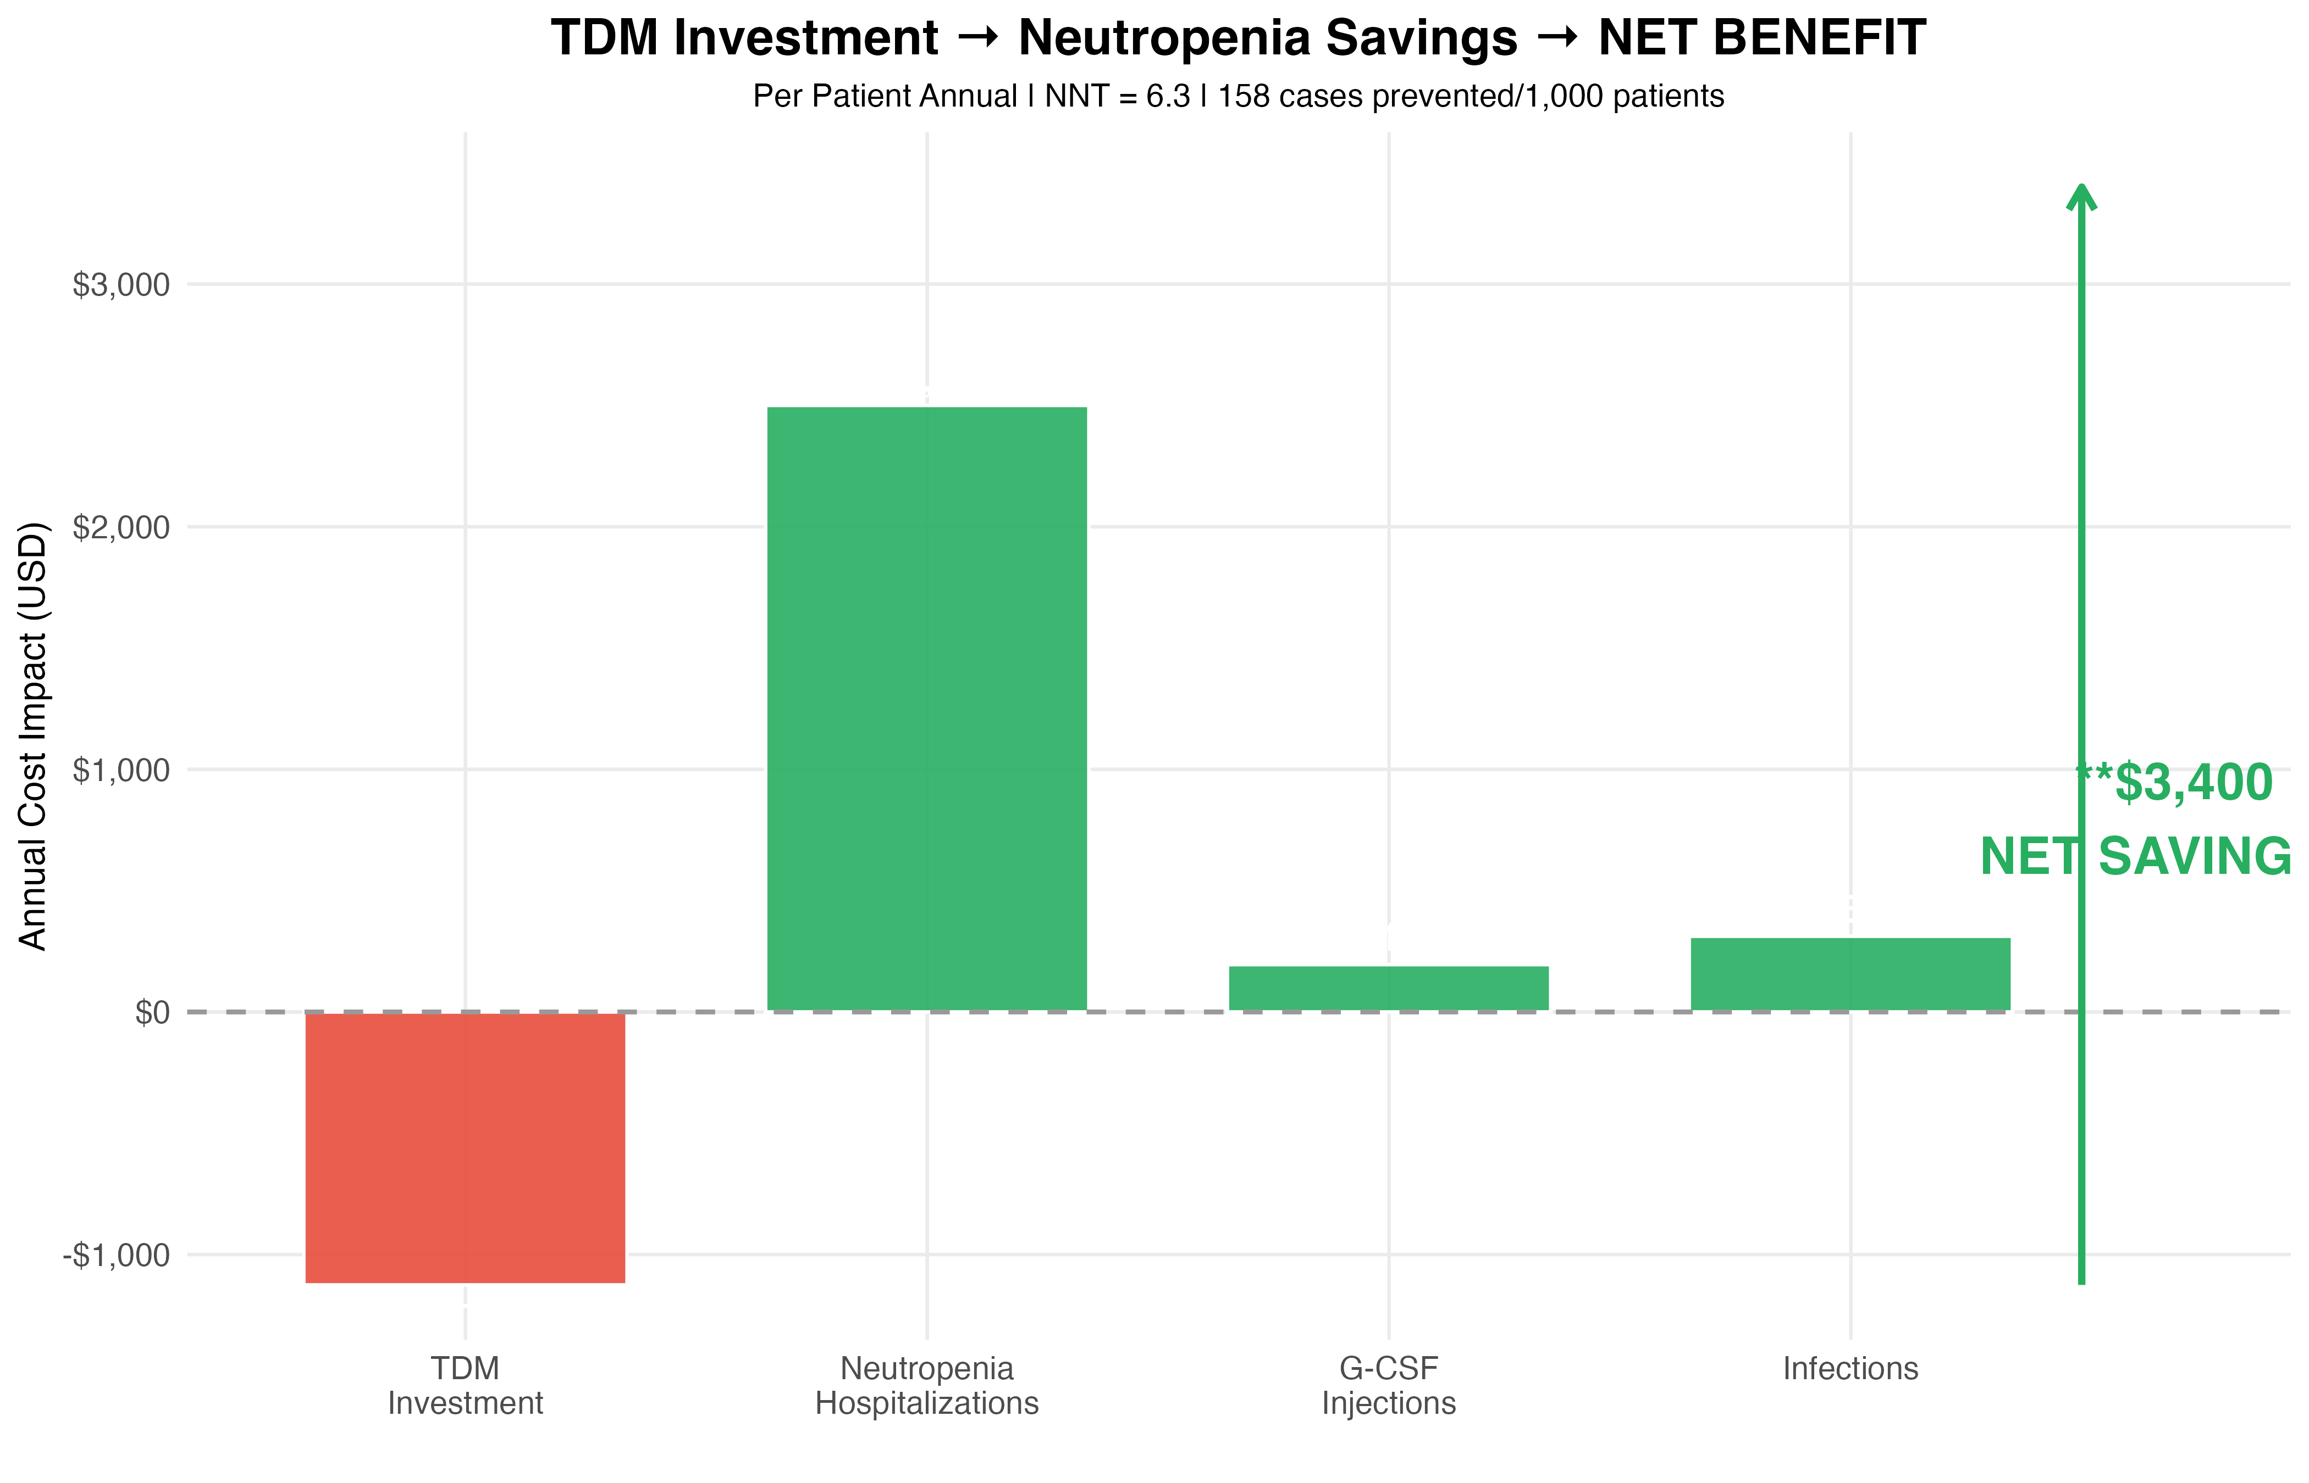
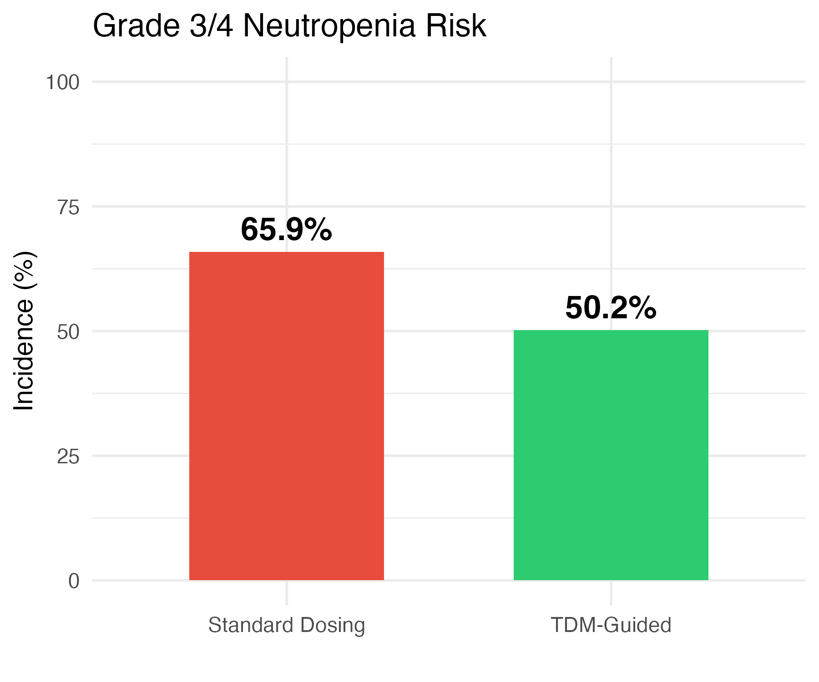
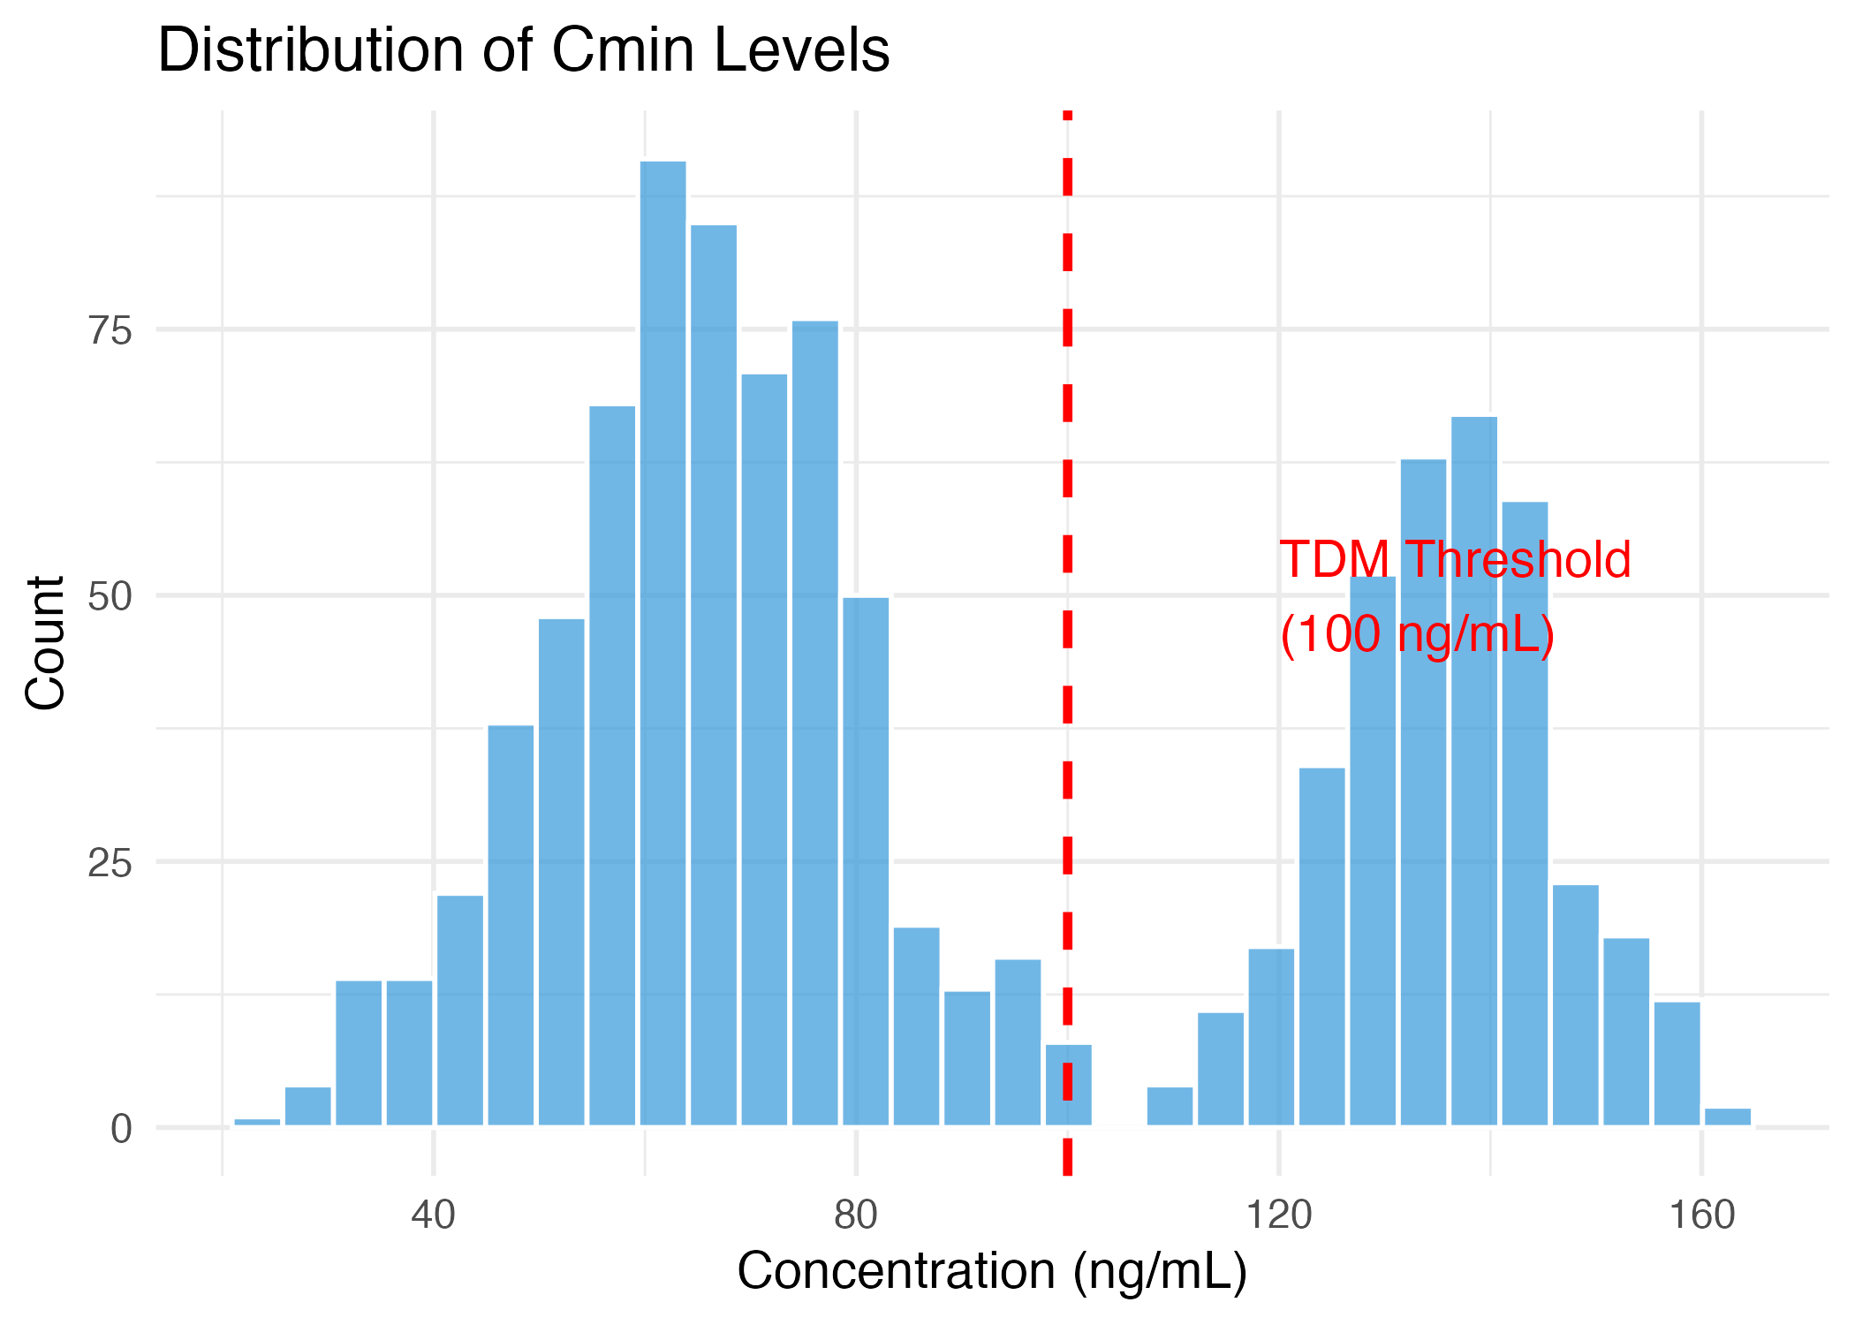
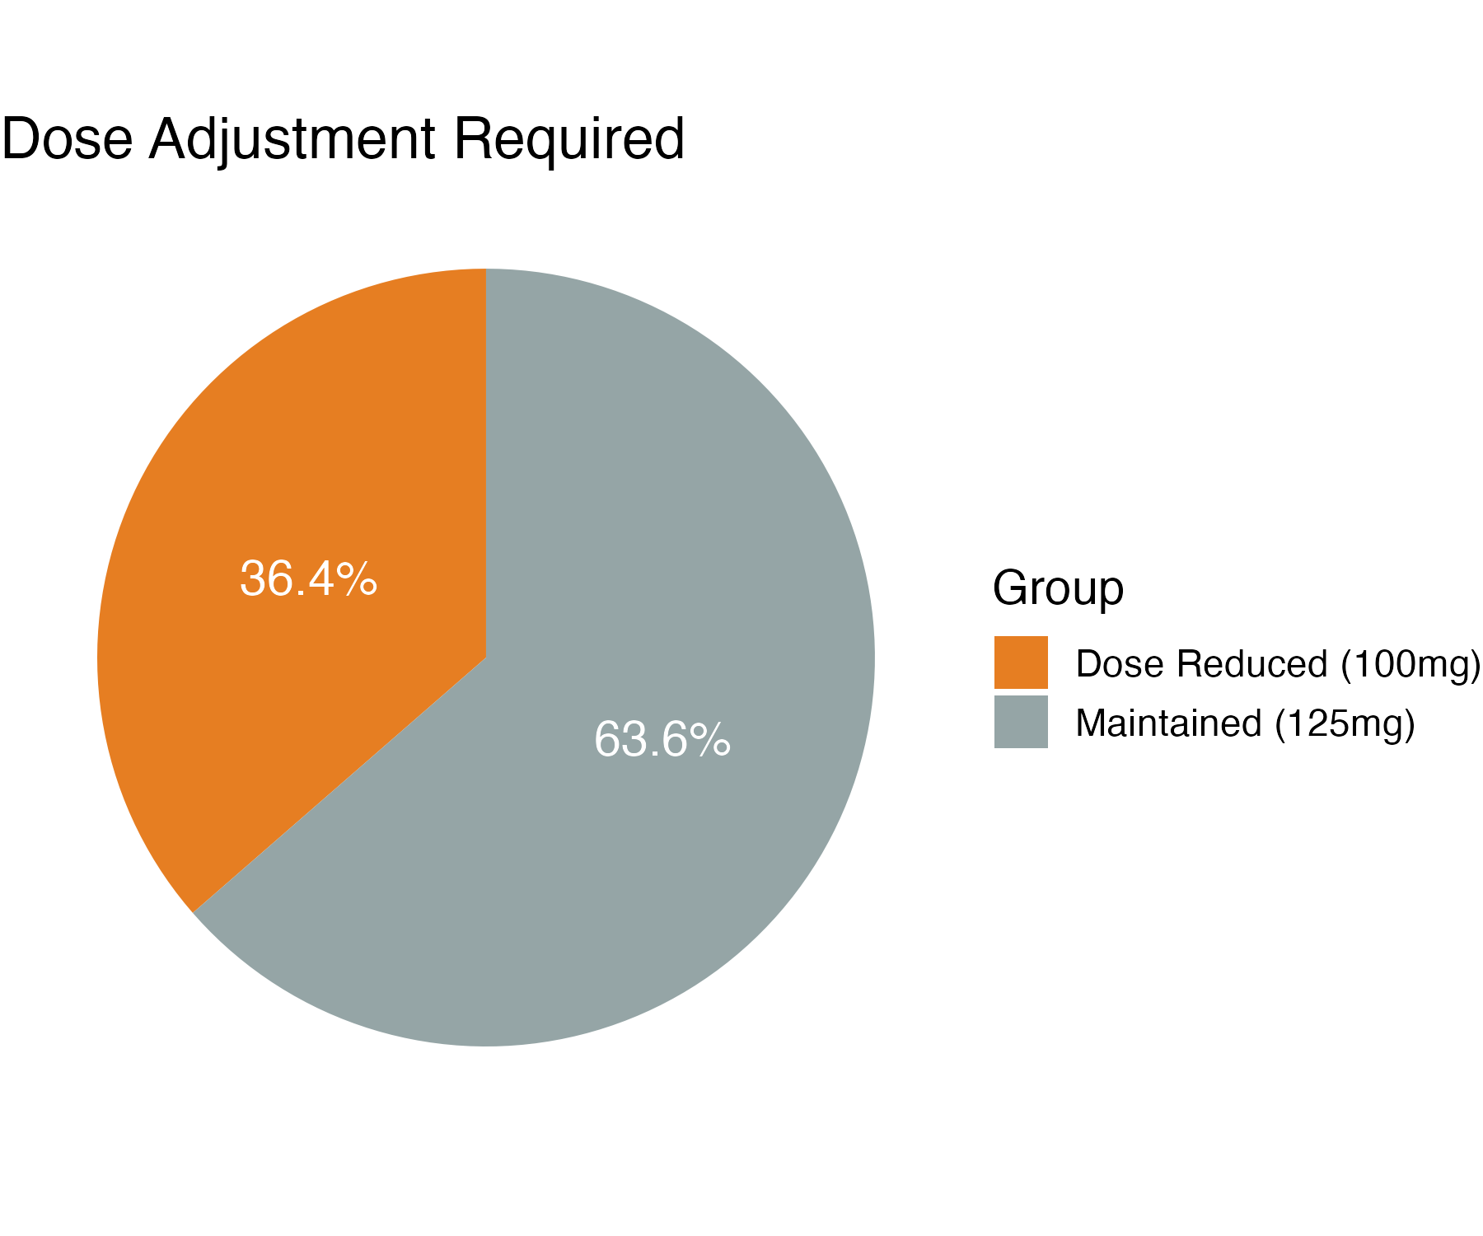

Clinico-economic Effect of therapeutic drug monitoring of Palbociclib - A PALOMA Calibrated pK pD Simulation
Mohammad Bisam Ali Aslam
3rd Year PharmD, Akhtar Saeed College of Pharmacy (ASCP) Rawalpindi , Pakistan
INTRODUCTION
CONCLUSION
Palbociclib is a CDK4/6 inhibitor applied in treatment of HER-/HR+ breast cancer, but complications of palbociclib use include high inter-patient pharmacokinetic variability (CV 40%), and high incidence of Grade 3/4 neutropenia (66%). The existing guidelines imply that the dose can only be decreased in the following effect of toxicity. The aim of the study was the evaluation of clinical utility and cost-effectiveness of Therapeutic Drug Monitoring (TDM) as directed dosing strategy, in reducing the incidence of elevated neutropenia levels, versus conventional fixed dosing.
This conservative Cmin threshold was chosen because no patient data was available. To model the Exposure-Response Relationship Hill Model was selected because this was more adjusted to the PALOMA trial data. The primary results included the percentage G 3/4 neutropenia and Number Needed to Treat (NNT) to prevent 1 cases of the severe neutropenia. And the secondary outcomes were dose reduction rate and net cost impact which were dominated by the cost of drug acquisition, toxicity management cost, ($22,839/event), and TDM test cost, ($150-300/assay).
Although wait and treat is the standard, TDM-informed palbociclib dosing leading to reduced incidence of severe neutropenia suggests that TDM-based dosing is a viable rational alternative and lowers the chance of severe neutropenia. As it can be used to determine the patients at risk of developing a toxicity prior to its occurrence, the Model Informed Precision Dosing or MIPD methodology may result in a substantial reduction in costs and has tangible concord with the reported safety results in pivotal clinical trials.
OBJECTIVES
A comprehensive Monte Carlo simulation package for population pharmacokinetic/ pharmacodynamic (PK/PD) modeling and health economic evaluation of therapeutic drug monitoring (TDM)-guided palbociclib dosing in patients with hormone receptor-positive HER2-negative metastatic breast cancer.
METHODS
RESULTS
In order to test the validated semi-mechanistic, population pharmacokinetic/population pharmacodynamic (PK/PD) model with a logistic component describing exposure-toxicity, we ran a Monte Carlo simulation (n=1000) with a set seed to reproducibly simulate the model. We selected a one-compartment model (first-order absorption ka =0.187), lag time=0.5 hrs and standard model variables based on the literature consensus including Clearance (58.3 litres/hr) and Volume (1580 litres). The PALOMA-2 clinical trial was used to calibrate the virtual population since it justified the lack of clinical data. The primary intervention utilized TDM guided dose reduction (125 mg to 100 mg) in patients with trough Cmin >= 100 ng/mL, which is a dose identified as having severe hematologic toxicity.
The baseline means of toxicity of PALOMA-2 were recreated with 65.9% toxicity in the standard dose arm in TDM (66.4% in PALOMA-2).Firstly, Grade 3/4 neutropenia has lower incidence in the TDM (incidence of 50.2% with toxicity) which contributed to lower incidence of toxicity in the TDM as compared to PALOMA-2 incidence of 66.4%. Secondly, the number of patients meeting the dose reduction criteria is nearly 36.4% which will be consistent with the real world prescribing patterns and therefore will justify our methodology even more. The costs caused by TDM in the healthcare system led to a net cost savings of about $3.4-8.5 M per 1000 patients, most of the net cost savings were made up of cost saved on neutropenia that neutralized the cost of the testing assay.
REFRENCES
github.com/mohammadbisamaliaslam-pharmadocx/palbociclib-pkpd-simulation/tree/main

