Slide 1
MySQL
Workbench
mohammadbtc100@gmail.com

Slide 2
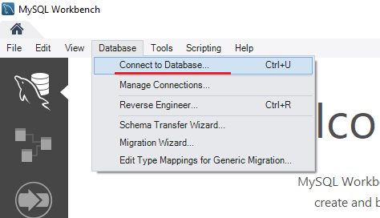
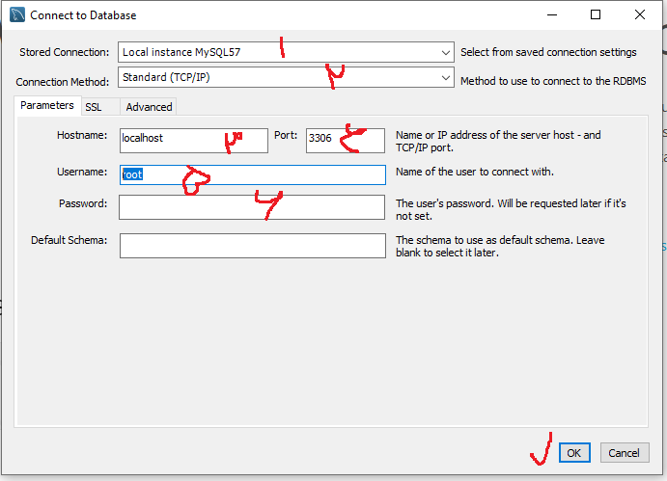
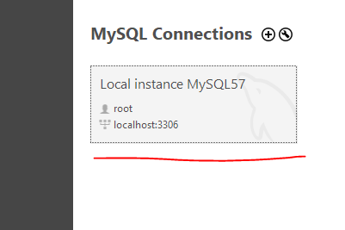
MySQL

Slide 3
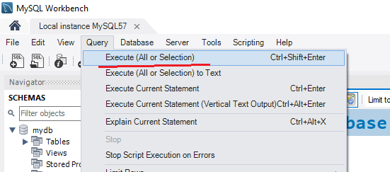
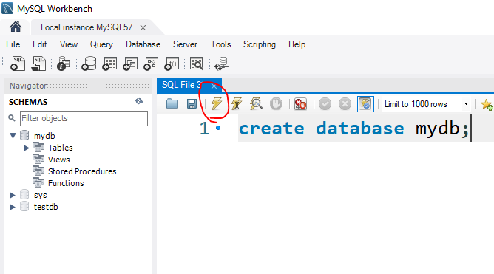
MySQL

Slide 4
MySQL
Database Elements:
Table
View
Index
Triger
Function
Store Procedure
Data Types:
Int, smallInt, bigInt -5, 18
Decimal(5,2) 17.25
Char ‘a’
nchar, varchar, nvarchar
Bit 0,1
Binary, image, blob
Text, memo
Datetime
Timestamp
N=unicode a-z,الف-ی 0-9, @+$ and etc…
Var=variable
Field Constraints:
Not null
Unique
Default
Check in
Index
Key
Auto_increment
And etc…
Primary Key=not null+unique

Slide 5
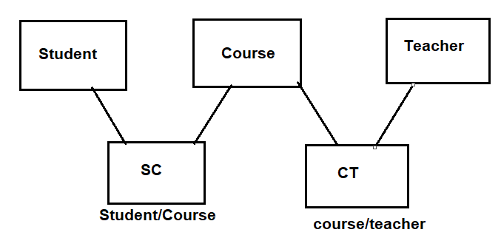
Database schema

Slide 6
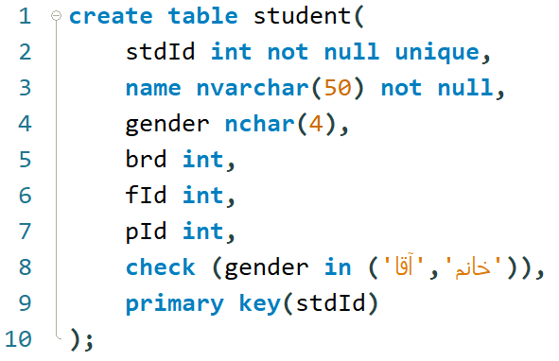
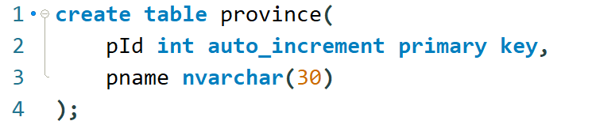
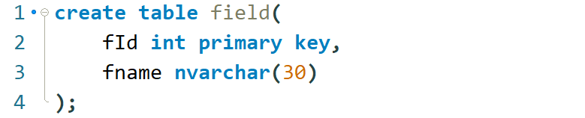
MySQL-Student case study

Slide 7
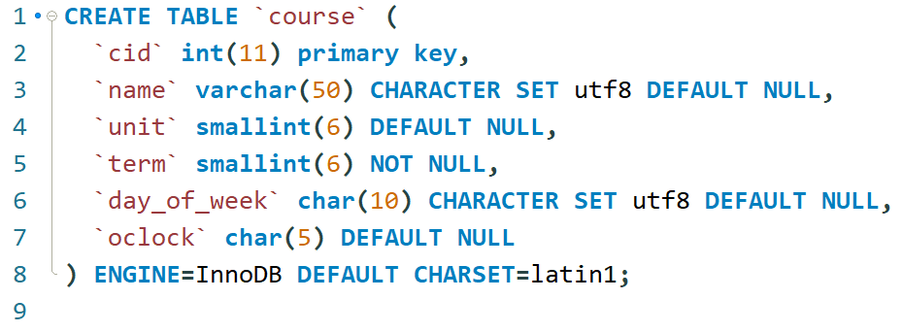
MySQL-Student case study

Slide 8
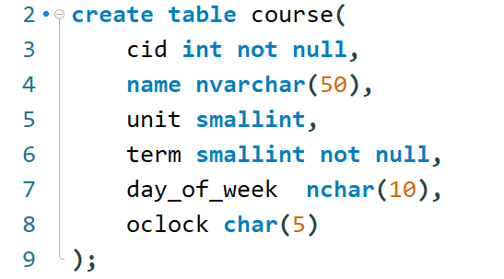
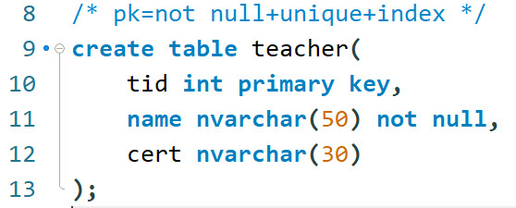
MySQL-Student case study

Slide 9
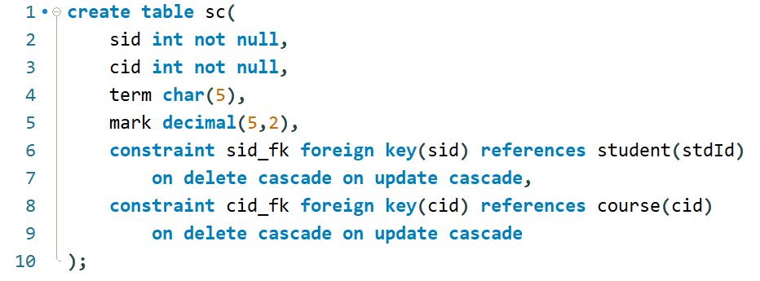
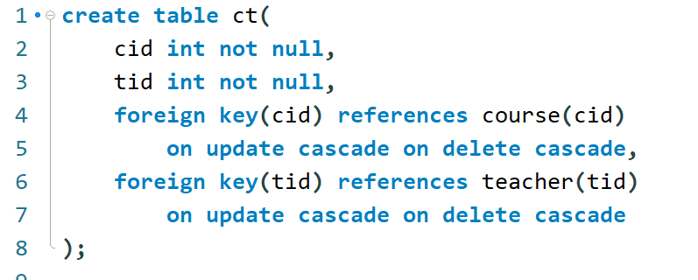
MySQL-Student case study

Slide 10
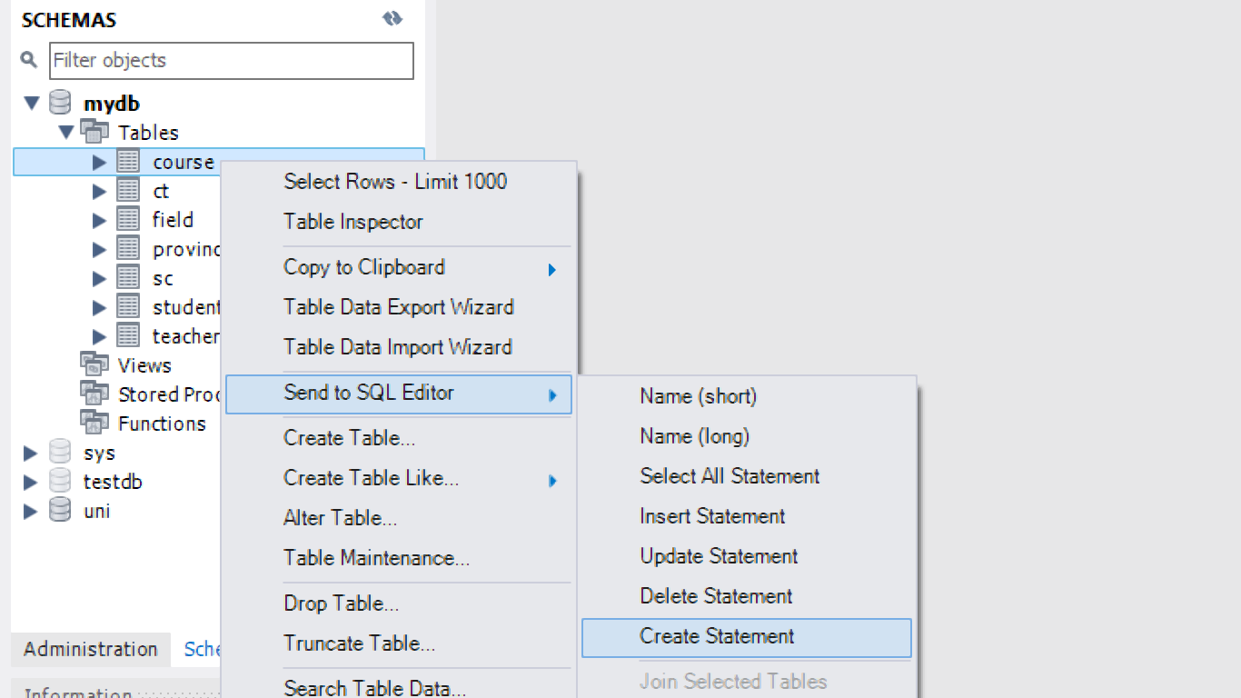
MySQL-Student case study
Edit table codes :

Slide 11
Index

Slide 12
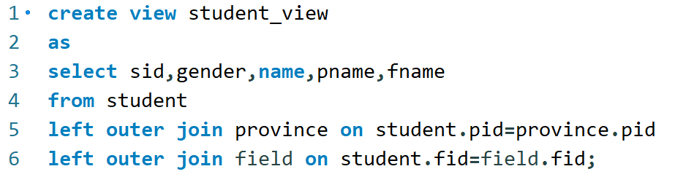

View

Slide 13
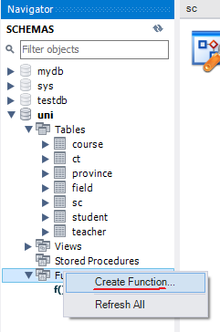
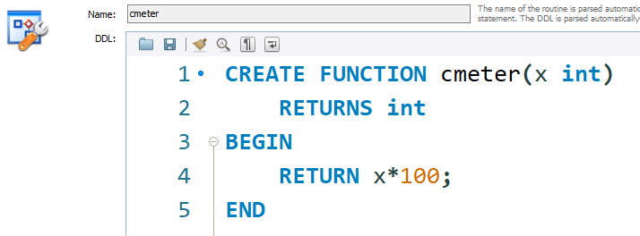
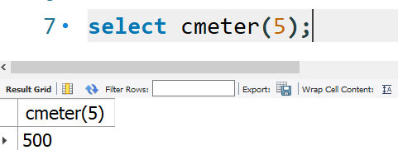
Function

Slide 14
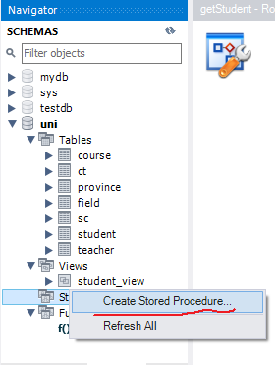
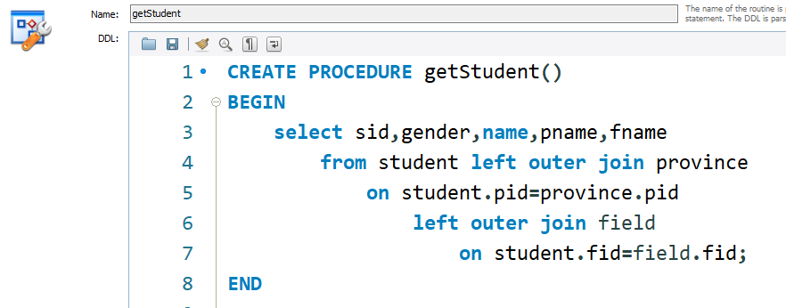
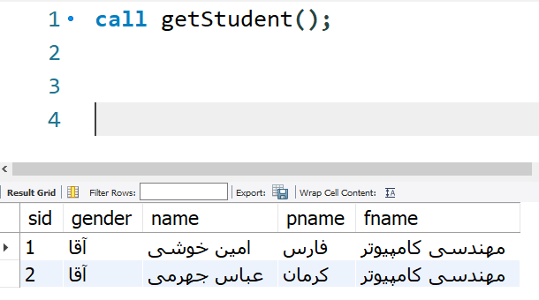
Store Procedure

