Slide 1
Alhada EState
A specialized website for selling
real estate and land.

Slide 2
Introduction
1.Before our website
2. Comprehensive Information
3. Current Problem
4. Gathering information
5. Requirement
6. Analysis
7. Implementation

Slide 3






Proposed Solution
Windows Server or IIS
Website

Slide 4
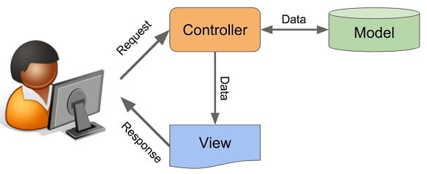
What is MVC Pattern
MVC stands for Model, View, and Controller.
Model is responsible for data.
View is responsible for UI (HTML, JSON, etc.).
Controller is responsible for the flow of the application by accepting the user input.

Slide 5
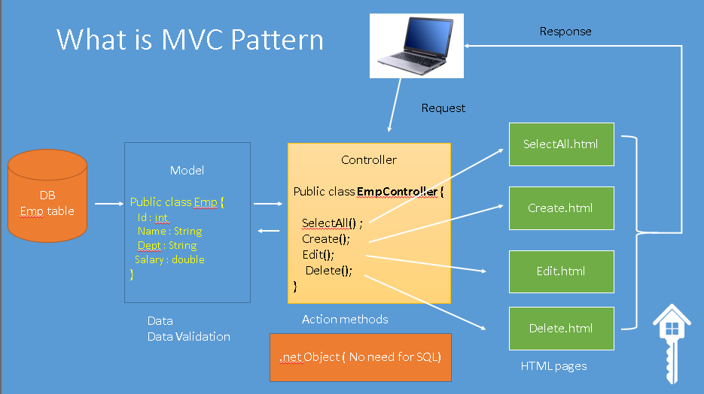

Slide 6
Obstacles
The obstacles we encountered during the project work.
01
Academic Coursework Pressure.
02
Lack of Experience in Developing a Comprehensive Project or Working within a Team
03
Lack of Proficiency in ASP.NET Core.
04
Time Constraints
05
Adhering to Client Requirements

Slide 7
Use Case

Slide 8
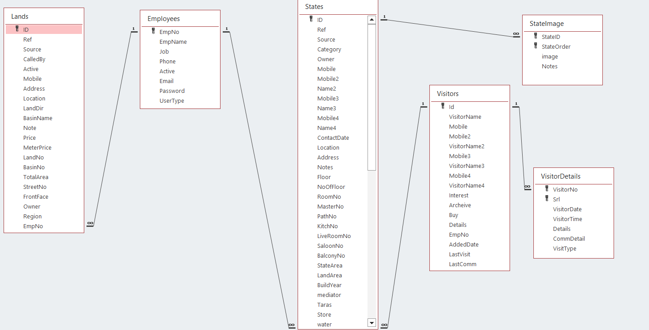
Database Diagram
Diagram

Slide 9
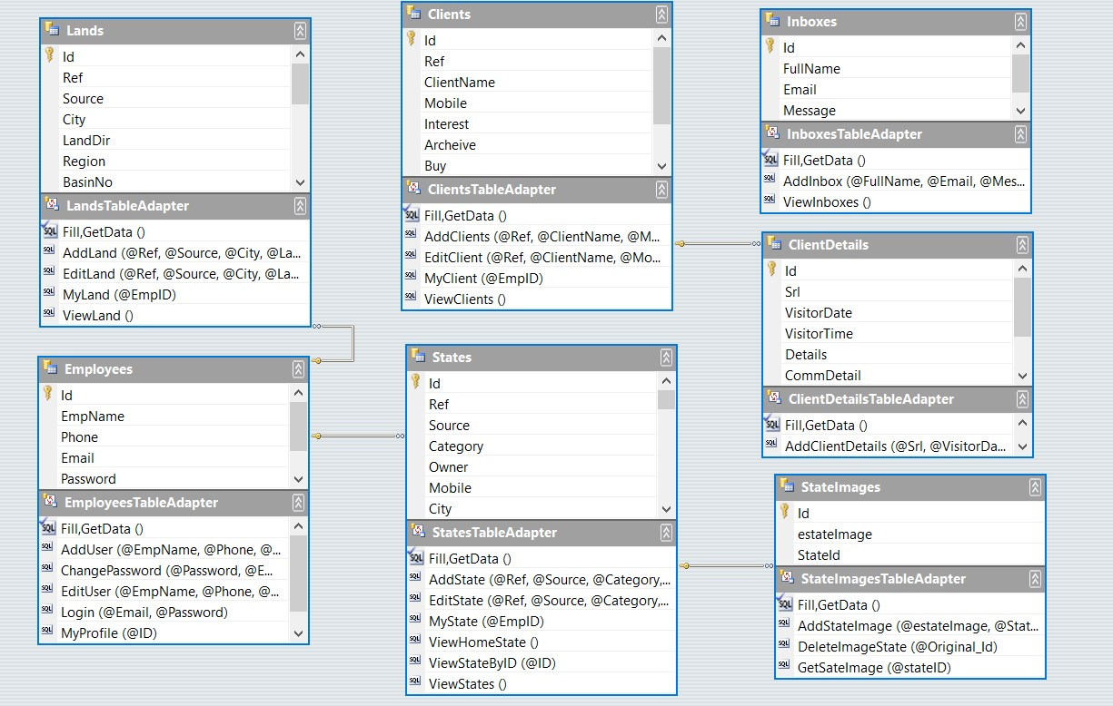
Domain Class Diagram
Diagram

Slide 10
Activity Login
Activity

Slide 11
Employee Add State

Slide 12
Admin Login

Slide 13
Employee Login

Slide 14
Admin Login
Sequence

Slide 15
Admin Add State
Sequence

Slide 16
Employee Login
Sequence

Slide 17
Employee Add State
Sequence

Slide 18
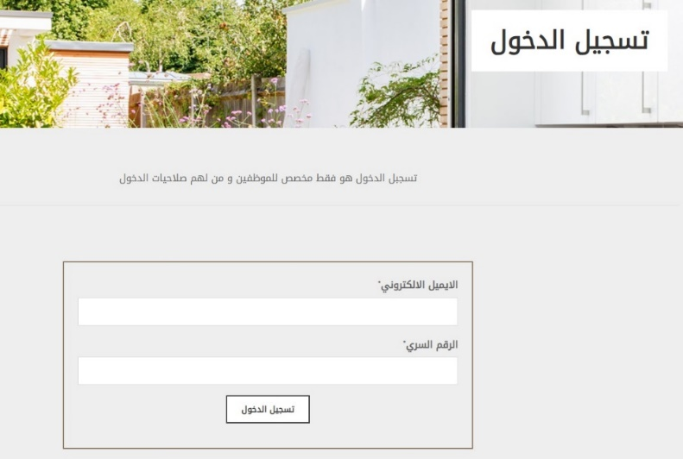
Login Page
This page for login in website .

Slide 19
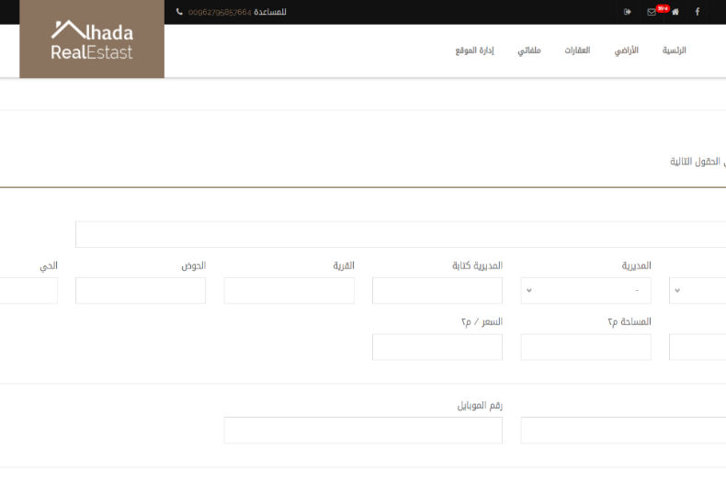
Admin Add Land
This page for add new land in website

Slide 20
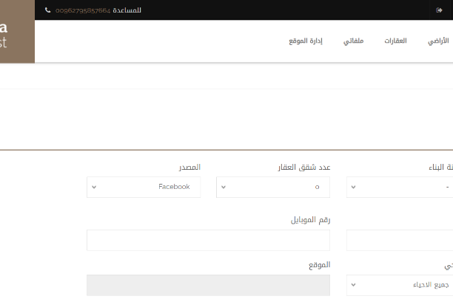
Admin Add State
This page for add new State in website

Slide 21
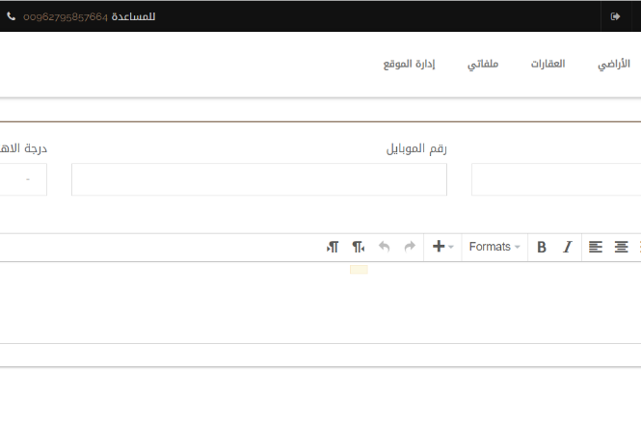
Admin Add Customer
This page for add new Customer in website

Slide 22
Future Work
Matters that time did not permit us to address
01
Import Data and operate the website on real server
02
Validations ( not enough time)
03
Map (Land and Apartment) : a tool to capture a location.
04
SEO : Search Engine Optimizing

Slide 23
Thank you
Insert the title of your subtitle here

