Slide 1
Implementing a secure image-based password system
Mohammad Forhad Hossain

Slide 2
Our Objectives
Achieve a password complexity which is secure.
Save the password into the database.
Make sure the password is hashed in case the database is compromised.

Slide 3
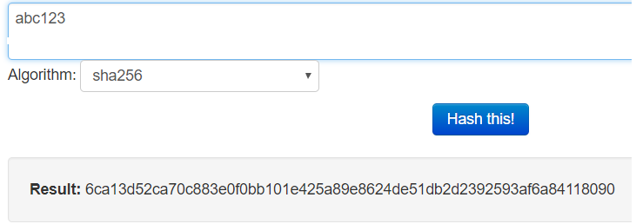
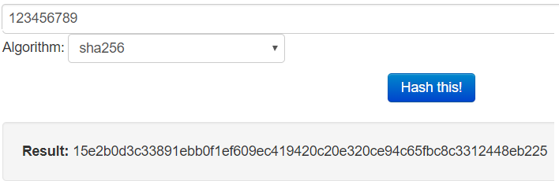
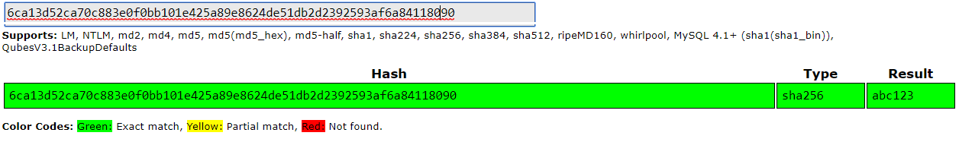
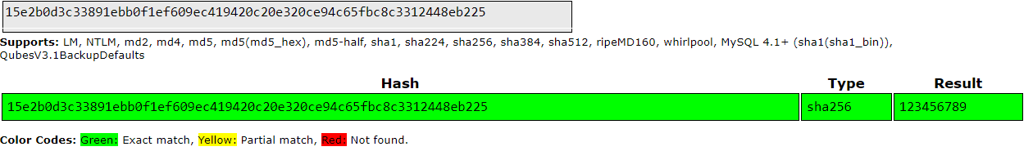
How easy to break week text-base password
Reference:
For Hash: https://www.tools4noobs.com/online_tools/hash/
For Crack password: https://crackstation.net/

Slide 4
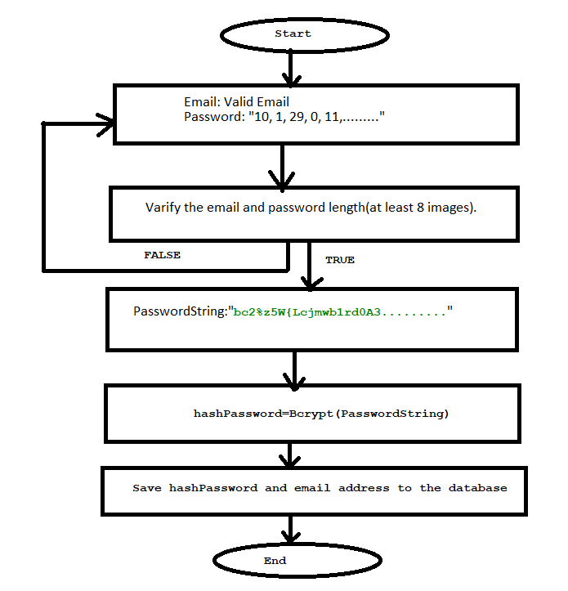
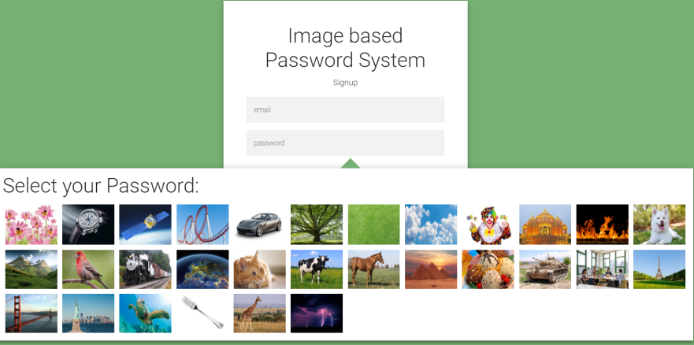
Registration process

Slide 5
How password save in the database
A bcrypt "hash" that is stored in the database looks like this:
$2a$10$JozQv9pEcmSHNOB1CSkZbOq1AW3H6Cxvm1mEu1vZjH/UgX4ly69.C
"2a" defines version of bcrypt algorithm.
"10" defines the cost factor. So 2¹⁰ iterations of the key derivation function are used in the system.
The rest of the hash string includes the cost parameter, a 128-bit salt (base-64 encoded as 22 characters)
184 bits of the resulting hash value (base-64 encoded as 31 characters)

Slide 6
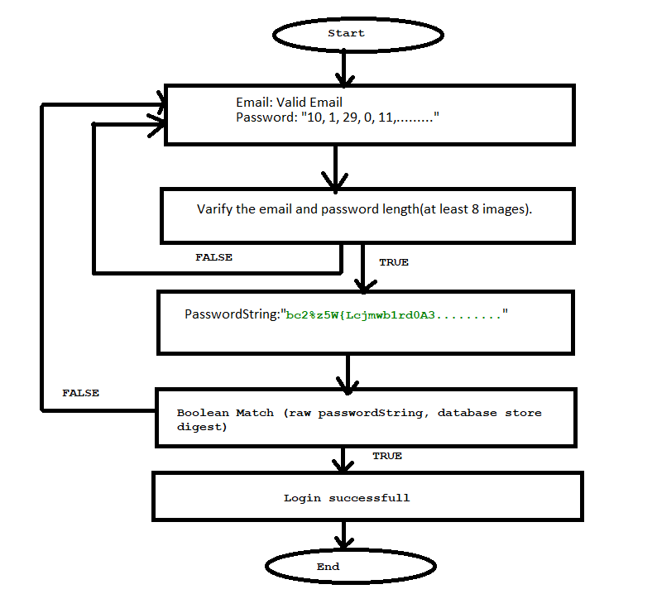

Login process

Slide 7
How Bcrypt password encoder work
BCryptPasswordEncoder
public boolean matches(CharSequence rawPassword, String encodedPassword)
Parameters: rawPassword - the raw password to encode and match
encodedPassword - the encoded password from storage to compare with
Returns: true if the raw password, after encoding, matches the encoded password from storage

Slide 8
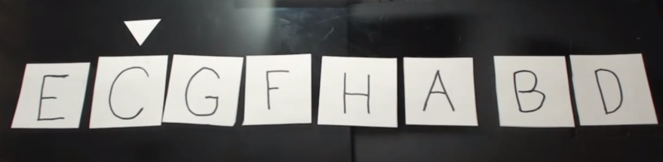
Shuffling the images
Knuth Fisher Yates algorithm
private static void shuffleList(List<String> a) { int n = a.size(); SecureRandom random = new SecureRandom(); random.nextInt(); for (int i = 0; i < n; i++) { int change = i + random.nextInt(n - i); swap(a, i, change); } }
private static void swap(List<String> a, int i, int change) { String helper = a.get(i); a.set(i, a.get(change)); a.set(change, helper); }

Slide 9


After Shuffling

