Slide 1
Distributed RAG-Based
Web Scraper
Fault-tolerant distributed crawling · content versioning · pgvector semantic search · RAG question answering with citations
UNIVERSITY FINAL PROJECT

Slide 2
Distributed RAG Scraper
OVERVIEW
What it does
Crawls multiple sites — static, JS-rendered, and a 500+ page catalog — using many independent worker containers coordinated through a shared job queue.
Cleans HTML to Markdown and versions every change — nothing is ever overwritten.
Chunks, embeds, and indexes content into pgvector for semantic search.
Serves keyword, semantic, and hybrid search over the crawled corpus.
Answers questions with a RAG pipeline that streams an answer and cites every claim.
Demonstrates horizontal scaling and graceful recovery from worker failure.
1 / 17

Slide 3
Distributed RAG Scraper
ARCHITECTURE
Two decoupled halves, one database
INGESTION — the slow, distributed, fault-tolerant path: crawl → clean → version → chunk → embed → index.
SERVING — the fast, read-mostly path: keyword / semantic / hybrid search, and RAG question answering.
The two never talk directly; they meet in Postgres. Crawling and searching run concurrently — freshly crawled pages appear in results as they finish indexing.
Coordination (queues + per-crawl counters) lives entirely in Redis, so workers share nothing and scale horizontally.
2 / 17

Slide 4
Distributed RAG Scraper
ARCHITECTURE
The services
SERVICE | ROLE
api (Fastify) | HTTP: search, streaming ask, admin; enqueues crawls
worker × N (BullMQ) | Runs scrape / discover / index jobs — horizontally scalable
web (Next.js 15) | Public search + ask UI, and the operator admin panel
scheduler | Sweeps every 5 min to rescue stuck crawl runs
Postgres + pgvector | Sources, pages, versions, chunks, and embedding vectors
Redis | Job queues + per-crawl coordination counters
3 / 17

Slide 5
Distributed RAG Scraper
TECH STACK
Locked choices & why
CONCERN | CHOICE | WHY
Queue | BullMQ on Redis | Built-in retries, backoff, rate limiting, DLQ
Scraper | Crawlee (Cheerio + Playwright) | One API for static + JS pages
DB / vectors | Postgres 16 + pgvector | One store, HNSW index, no extra service
Embeddings | OpenAI text-embedding-3-small | Cheap, strong, 1536-dim
LLM | OpenAI GPT-5.5 | Good citation adherence; one provider
API / UI | Fastify · Next.js 15 · Tailwind | TS-native, SSR + streaming
4 / 17

Slide 6
Distributed RAG Scraper
KEY DESIGN DECISION
BullMQ owns coordination.
Crawlee is just the fetcher.
Crawlee’s built-in RequestQueue is in-process — it cannot coordinate across containers. Using it as the coordinator would make horizontal scaling impossible. Instead, every discovered link is handed back to BullMQ, not Crawlee. That single decision is what makes the “distributed” story real.
5 / 17

Slide 7
Distributed RAG Scraper
INGESTION
The crawl lifecycle
Start crawl → API opens a tracked CrawlRun, reserves the seed URL, enqueues one scrape job.
scrape — cancel check → robots.txt → per-domain rate limit (non-blocking defer) → fetch (Cheerio or Playwright).
Clean to Markdown, hash it, compare to the latest version: unchanged → skip; changed/new → write a new PageVersion.
Fan out: filtered links → a discover job; the saved version → an index job.
discover reserves each genuinely-new link and enqueues its scrape job — the loop spreads across all workers.
6 / 17

Slide 8
Distributed RAG Scraper
INGESTION
Processing & versioning
Readability strips boilerplate; Turndown converts to Markdown; tables are extracted separately as structured JSON.
Content dedup by SHA-256 of the cleaned Markdown — an unchanged re-crawl costs nothing (no re-embed).
Every change is a NEW version; history is never destroyed — this powers the admin diff viewer.
URL dedup via a per-run “seen” set, so no page is crawled twice in one run.
7 / 17

Slide 9
Distributed RAG Scraper
INGESTION
Indexing: text → searchable vectors
Heading-aware chunking (~800 tokens, 150 overlap); tables become their own chunks with a caption.
Chunks are embedded in batches via OpenAI text-embedding-3-small (1536-dim).
Stored in Postgres via raw SQL with a pgvector column (HNSW, cosine) + a generated tsvector (GIN) for keyword search.
Re-indexing a changed page deletes the old version’s chunks — only the latest version is searchable; old ones remain for history.
8 / 17

Slide 10
Distributed RAG Scraper
SERVING
Retrieval: three modes
keyword — Postgres full-text search over the tsvector column. Fast, exact-term.
semantic — pgvector cosine similarity over the embedded query. Finds meaning, not words.
hybrid (default) — Reciprocal Rank Fusion (k=60) of both lists, since a keyword score and a cosine distance aren’t on comparable scales.
All three share one code path and an optional per-source filter.
9 / 17

Slide 11
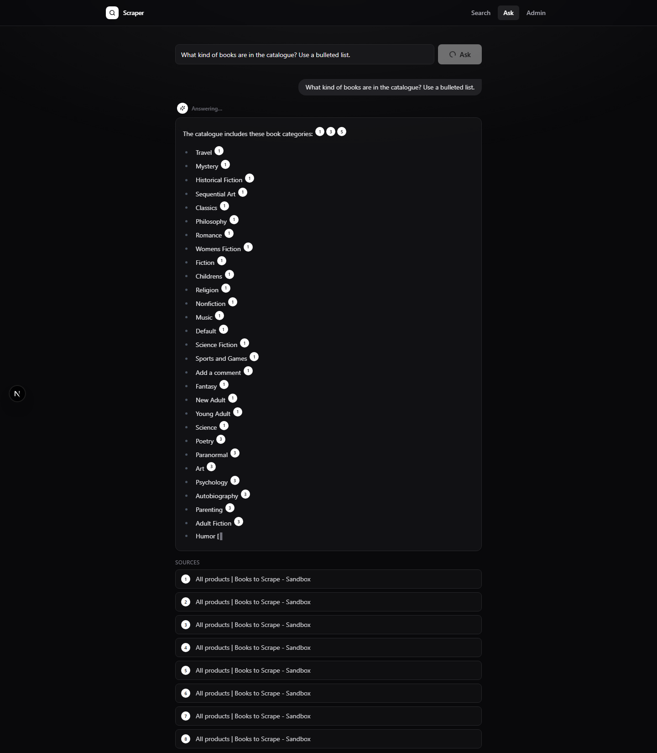
Distributed RAG Scraper
SERVING
RAG with citations
Retrieve top chunks → build ONE citation-forcing prompt → stream GPT-5.5 over SSE.
Every claim must cite [n]; the answer streams token-by-token with a live cursor.
Each [n] is a clickable chip that jumps to the exact cited chunk on its source page.
Guarantee: a citation can never point at a URL the model invented — the list is built from the actual retrieved chunks.
10 / 17

Slide 12
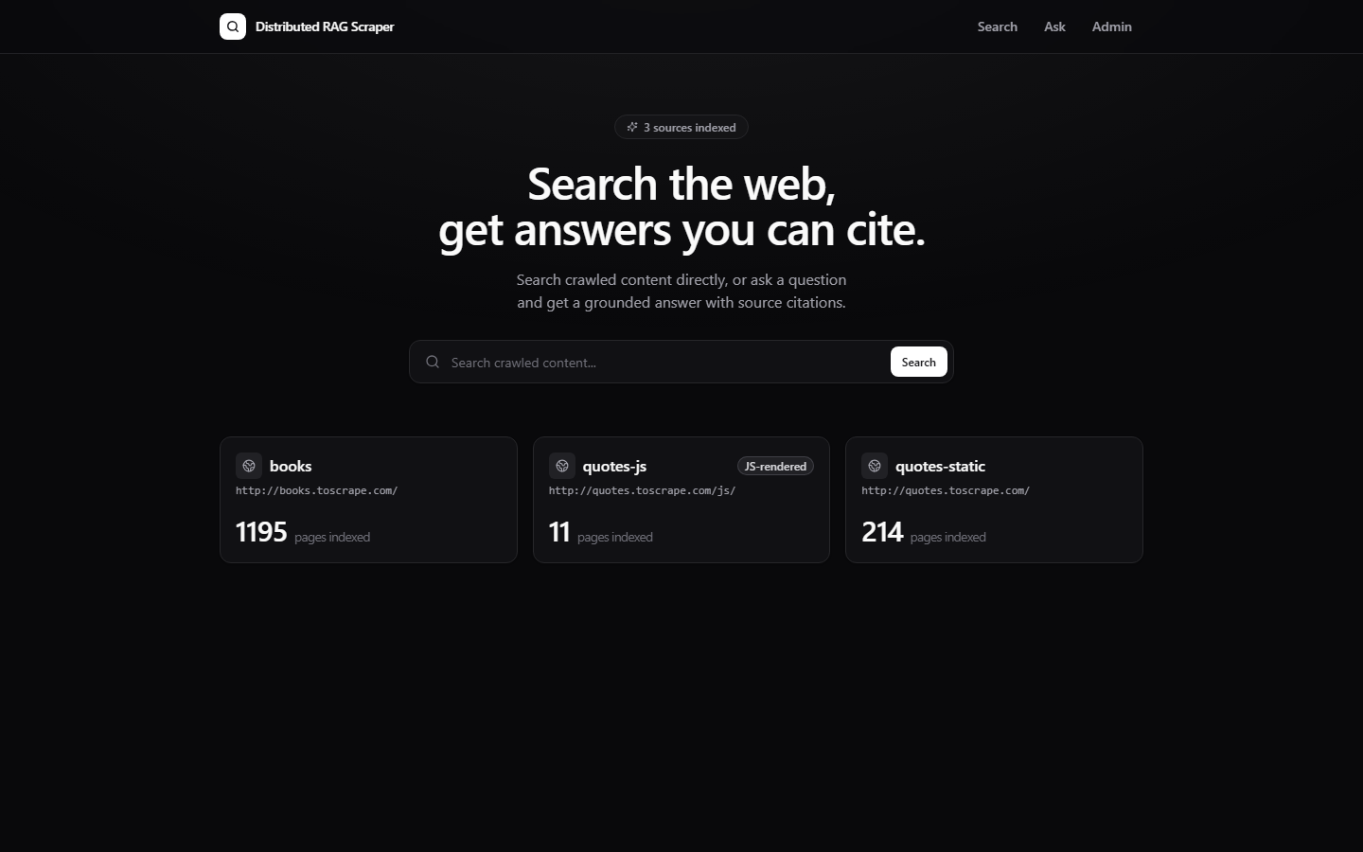
Distributed RAG Scraper
PRODUCT
The interface
Public: a landing page with live source stats, a search page with mode + source filters, and the streaming ask page.
Admin (token-gated): live queue dashboard, source management + start-crawl, dead-letter-queue retry, and a word-level version diff viewer.
Next.js 15 App Router, SSR + streaming, a dark hand-built design system.
11 / 17

Slide 13
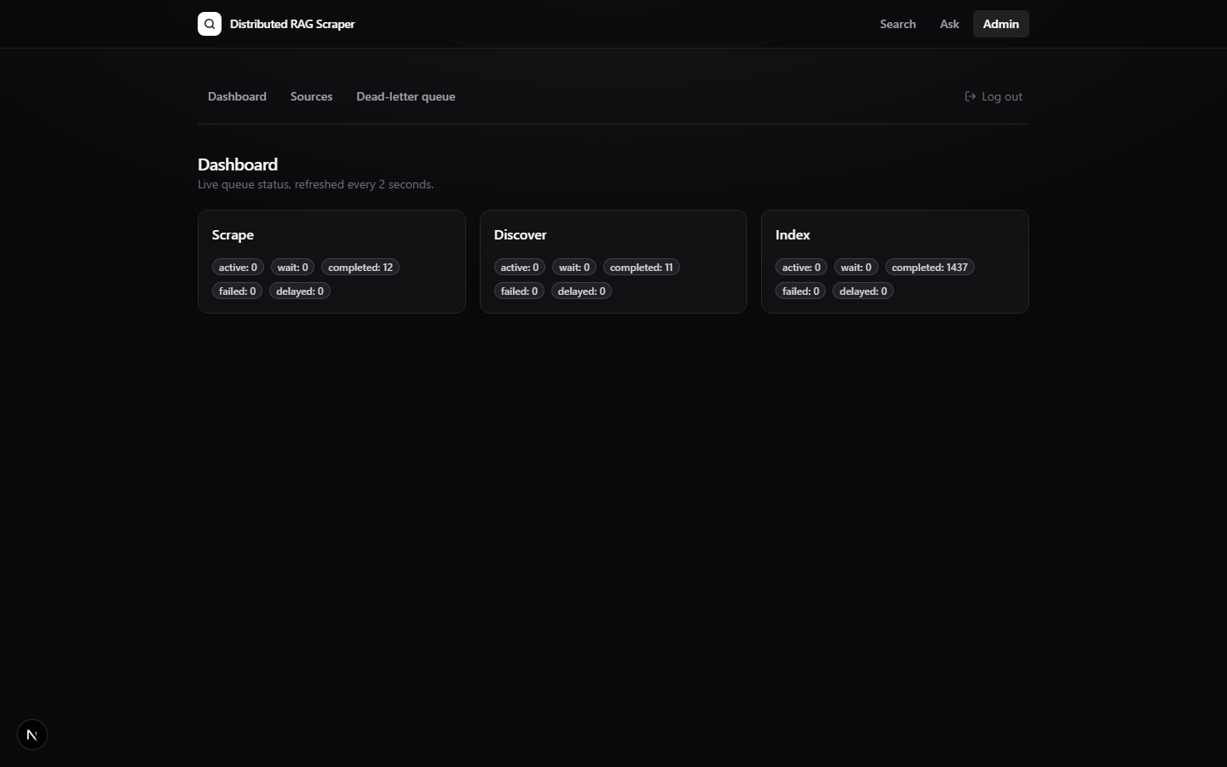
Distributed RAG Scraper
OPERATIONS
Operator dashboard
Live queue counters (scrape / discover / index) poll every 2 seconds.
Dead-letter queue: jobs that exhausted retries are visible and one-click retryable — nothing fails silently.
Per-source crawl progress and history, driven by the tracked CrawlRun counters.
12 / 17

Slide 14
Distributed RAG Scraper
RELIABILITY
Fault tolerance
Retries: every job retries 5× with exponential backoff (2s → 32s); terminal failures land in the DLQ.
Worker death: a killed worker’s in-flight jobs are detected as stalled (~30s) and re-run by a survivor.
Fleet-wide politeness: the per-domain rate limit and origin-pushback cooldowns live in Redis — adding workers never hammers a site harder.
Stuck-run safety net: the scheduler force-finalizes any run silent for 30+ minutes.
13 / 17

Slide 15
Distributed RAG Scraper
RESULTS
Horizontal scaling (measured)
WORKERS | CRAWL TIME | PAGES/SEC | SPEEDUP
1 | 52.8 s | 4.05 | 1.00×
2 | 30.6 s | 6.99 | 1.73×
4 | 19.4 s | 11.03 | 2.72×
214-page crawl, rate cap raised so the queue — not politeness — is the bottleneck. Sublinear because every worker updates one hot CrawlRun counter row.
14 / 17

Slide 16
Distributed RAG Scraper
CHAOS ENGINEERING
The chaos test found a real bug —
and proved the fix.
Before: SIGKILL 1 of 4 workers mid-crawl → run stuck at 213/214, one URL orphaned between reserve and enqueue. Fix: split “seen” (counted) from “enqueued” (job confirmed) so a retry re-creates the lost job; reconcile the queued counter from Redis. After (rebuilt image): 214/214, settled == queued, zero lost jobs — verified end-to-end.
15 / 17

Slide 17
Distributed RAG Scraper
HONESTY
Known limitations
Compound questions: single-shot top-K retrieval can starve one half of a two-part question — the stronger match crowds out the other.
Citations prove a source was retrieved, not that the model characterized it correctly — it can misdescribe a real cited source.
RAG answers are single-turn (no conversation memory); LLM latency is variable.
Documented, reproduced, and each with a considered fix — see docs/limitations.md.
16 / 17

Slide 18
Distributed, fault-tolerant,
and honest about its limits.
Distribution that’s real: shared-nothing workers, Redis-coordinated, chaos-verified.
Content integrity: full version history, content-hash dedup, no silent overwrites.
Grounded answers: hybrid retrieval + citation-forced RAG that can’t fabricate sources.
THANK YOU

