Slide 1
XSS Attack Detection Using Machine Learning
Cross-Site Scripting Detection with Random Forest, XGBoost & Logistic Regression
Mohammad Ibrahim · Omar Adel · Mohamed Ahmed
University of East London | Dr. Wael El Sersy

Slide 2
Agenda
1. Problem Introduction What is XSS?
2. Related Work & Literature Review
3. Dataset Overview
4. Methodology & System Architecture
5. Data Preprocessing Pipeline
6. Feature Analysis
7. Model Selection & Training
8. Results & Performance Comparison
9. Live Demo
10. Challenges & Solutions
11. Conclusion & Future Work
12. Q & A

Slide 3
What is Cross-Site Scripting (XSS)?
XSS is a code injection vulnerability where attackers insert
malicious scripts into trusted web pages viewed by other users.
Ranked #7 in the OWASP Top 10 (2021) critical security risks.
Impact of successful XSS attacks:
• Session hijacking stealing authentication cookies
• Data exfiltration capturing passwords and credit cards
• Phishing redirecting users to fraudulent sites
• Malware distribution serving drive-by downloads
Three main types: Stored, Reflected, and DOM-based XSS.

Slide 4
Why Machine Learning?
Traditional WAFs use rule-based pattern matching:
- High false-positive rates on JS-heavy pages
- Cannot detect obfuscated or zero-day payloads
- Require continuous manual signature updates
Machine Learning advantages:
Learns complex, non-linear decision boundaries
Detects novel attack variants without explicit rules
Adapts to evolving attack patterns with retraining
Provides probability scores for risk assessment

Slide 5
Related Work & Literature
Likarish et al. (2009) SVM/NB on HTTP parameters --> 92% acc.
Wang et al. (2018) CNN on character sequences --> 99.2% acc.
Mokbal et al. (2019) MLP with 42 dynamic features --> 99.0% acc.
Mokbal et al. (2021) XGBoost + IG-SBS feature selection --> 99.4% acc.
Fang et al. (2018) LSTM for sequential XSS patterns --> 98.2% acc.
Zhou & Wang (2019) RF ensemble with HTML/JS/URL --> 98.8% acc.
Our contribution: Systematic comparison of RF, XGBoost, and LR
on the same 138K-sample dataset with 66 optimally selected features.

Slide 6
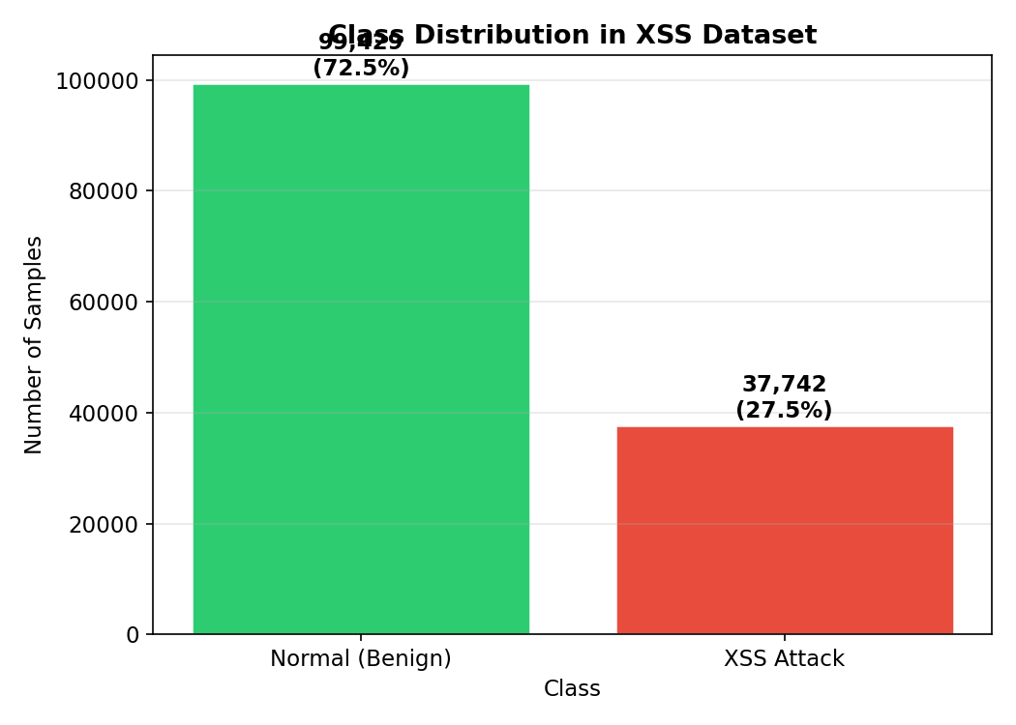
Dataset Overview
Source: Mokbal et al. github.com/fawaz2015/XSS-dataset
Total samples: 138,567
• Normal : 99,999 (72.1%)
• XSS Attack: 38,568 (27.9%)
Features: 66 pre-selected via IG-SBS from 167 original
Feature categories:
• URL features (11) URL structure and content
• HTML features (38) DOM tags, attributes, event handlers
• JavaScript features (17) API calls, code complexity
All features are integer-valued counts.

Slide 7
System Architecture
End-to-end ML pipeline:
Raw CSV ---> Preprocessing --> Feature Scaling
↓
Evaluation <-- Training (CV) <-- Train/Val/Test Split
↓
Streamlit Demo App
Key design decisions:
• Stratified 70/15/15 split preserving class distribution
• StandardScaler fitted on train only (no data leakage)
• 5-fold stratified cross-validation for robust estimation
• All config centralised in config.yaml

Slide 8
Data Preprocessing
1. Load CSV with 66 named features + class label
2. Remove duplicate rows
3. Impute missing values with column medians
4. Stratified train/validation/test split (70/15/15)
5. StandardScaler normalisation (zero mean, unit variance)
6. Save processed arrays + scaler to data/processed/
Split sizes:
• Training: ~96,997 samples
• Validation: ~20,785 samples
• Test: ~20,785 samples

Slide 9
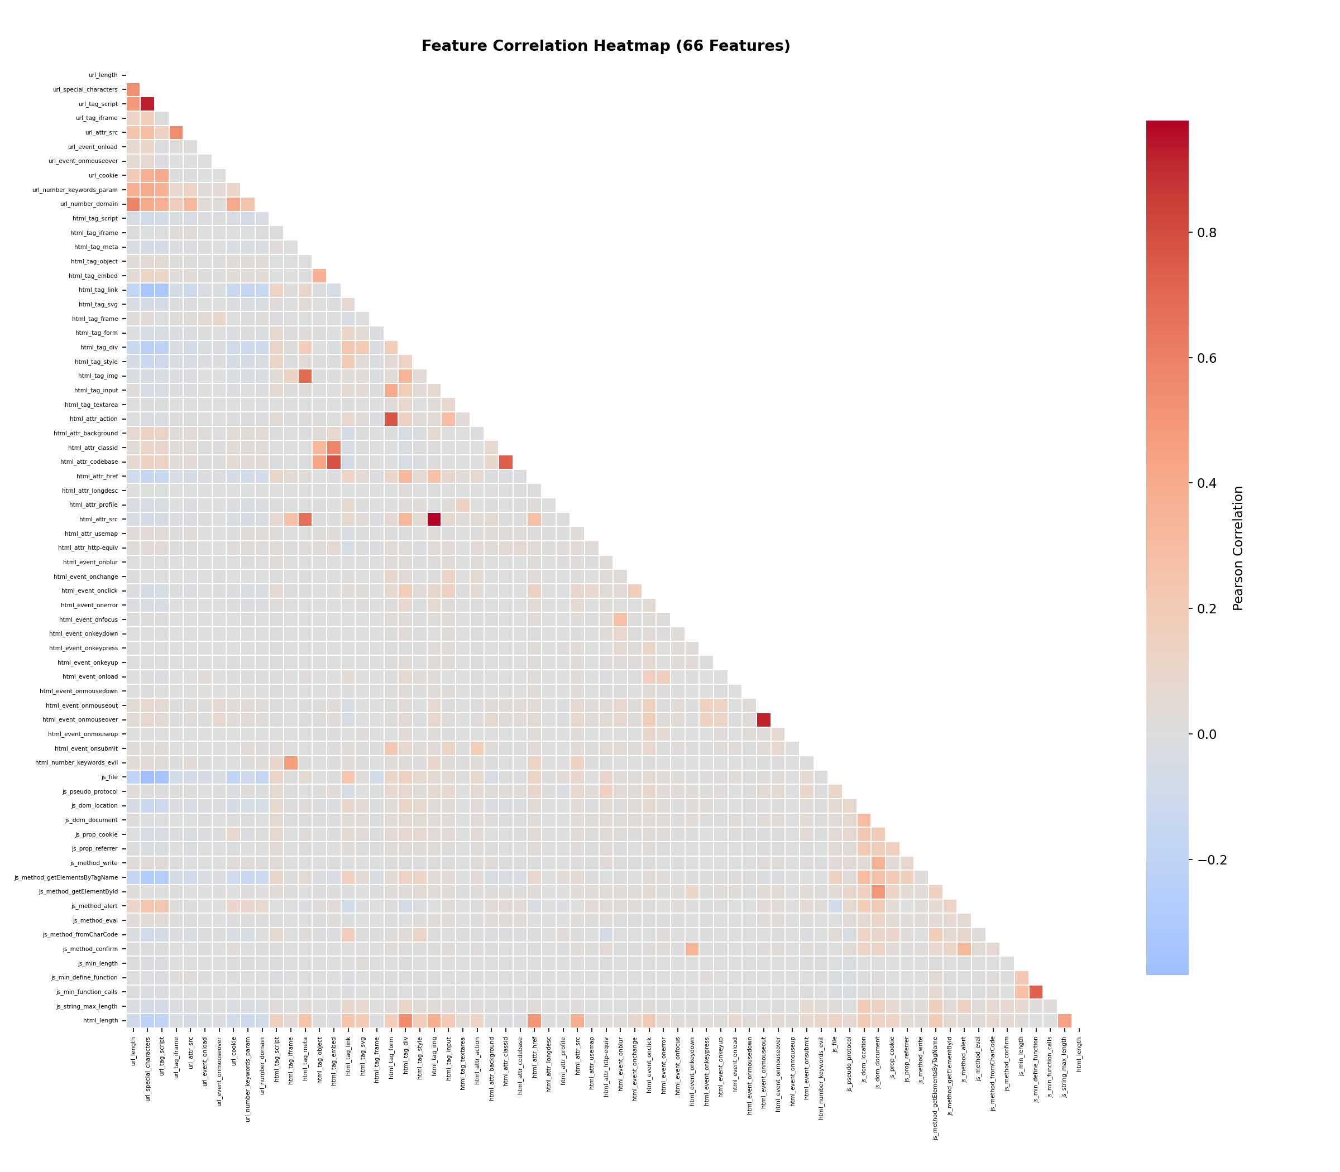
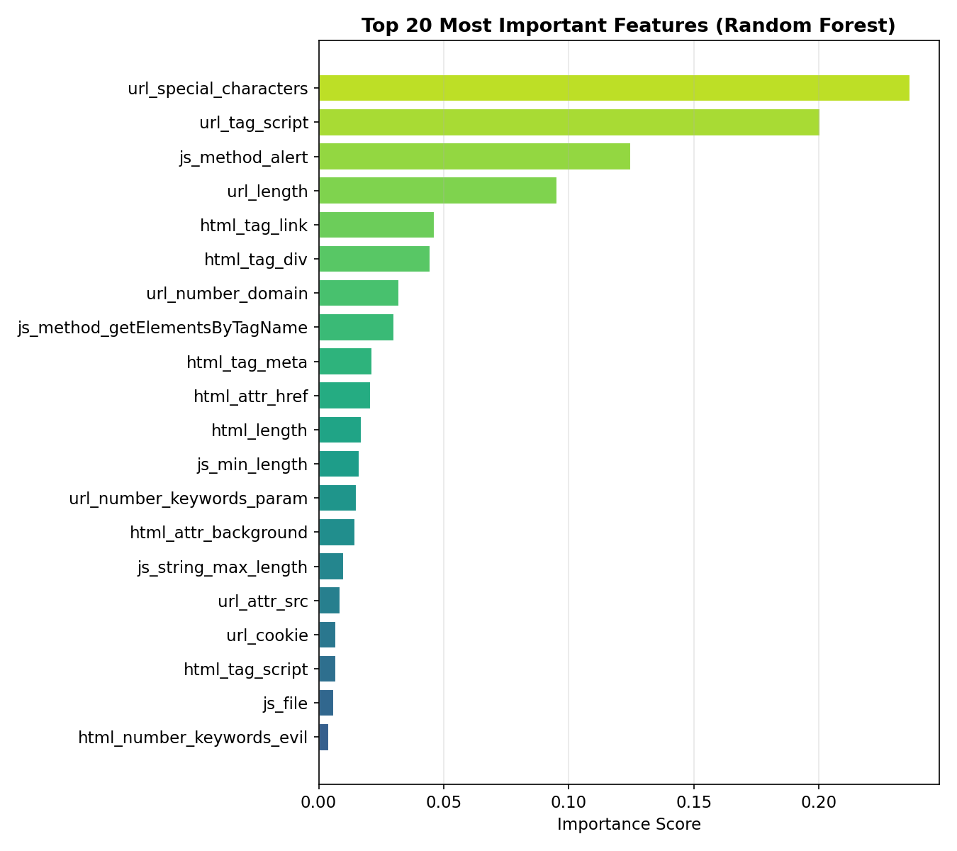
Feature Analysis

Slide 10
Model Selection
Random Forest (primary model):
• Ensemble of 200 decision trees
• Robust to overfitting, interpretable feature importances
XGBoost (gradient boosting):
• 200 sequential boosted trees, learning rate 0.1
• Used in original XGBXSS paper enables direct comparison
Logistic Regression (baseline):
• Linear model to quantify gains from non-linear approaches
• Tests whether features are linearly separable
All trained with 5-fold stratified cross-validation.

Slide 11
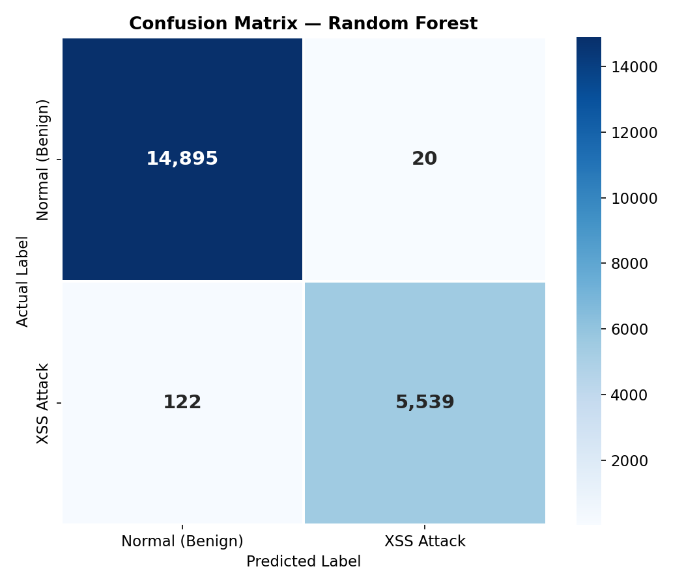

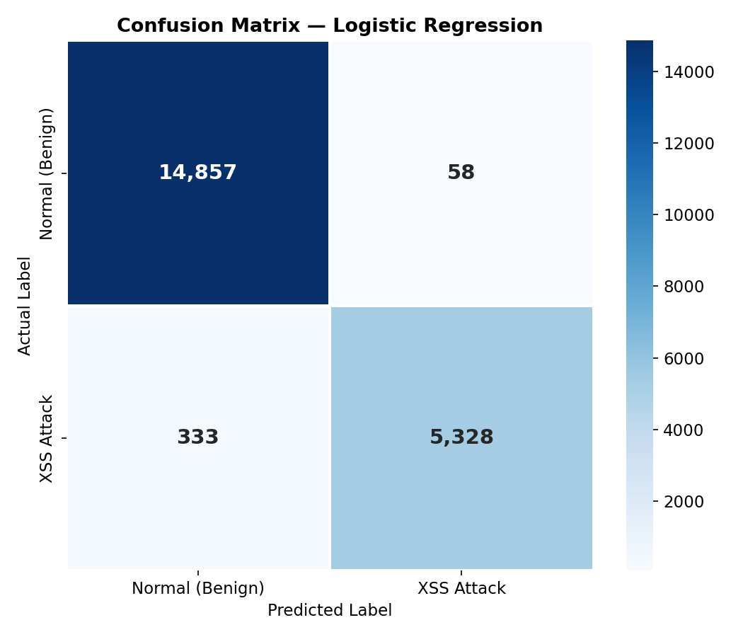
Results Confusion Matrices

Slide 12
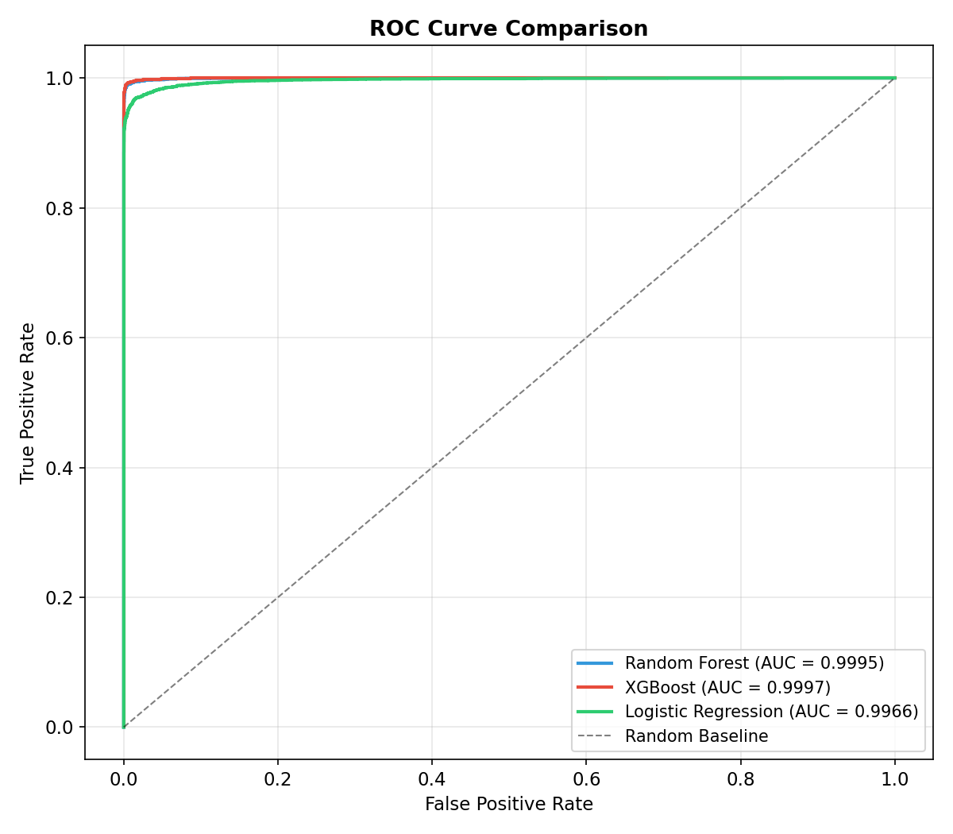
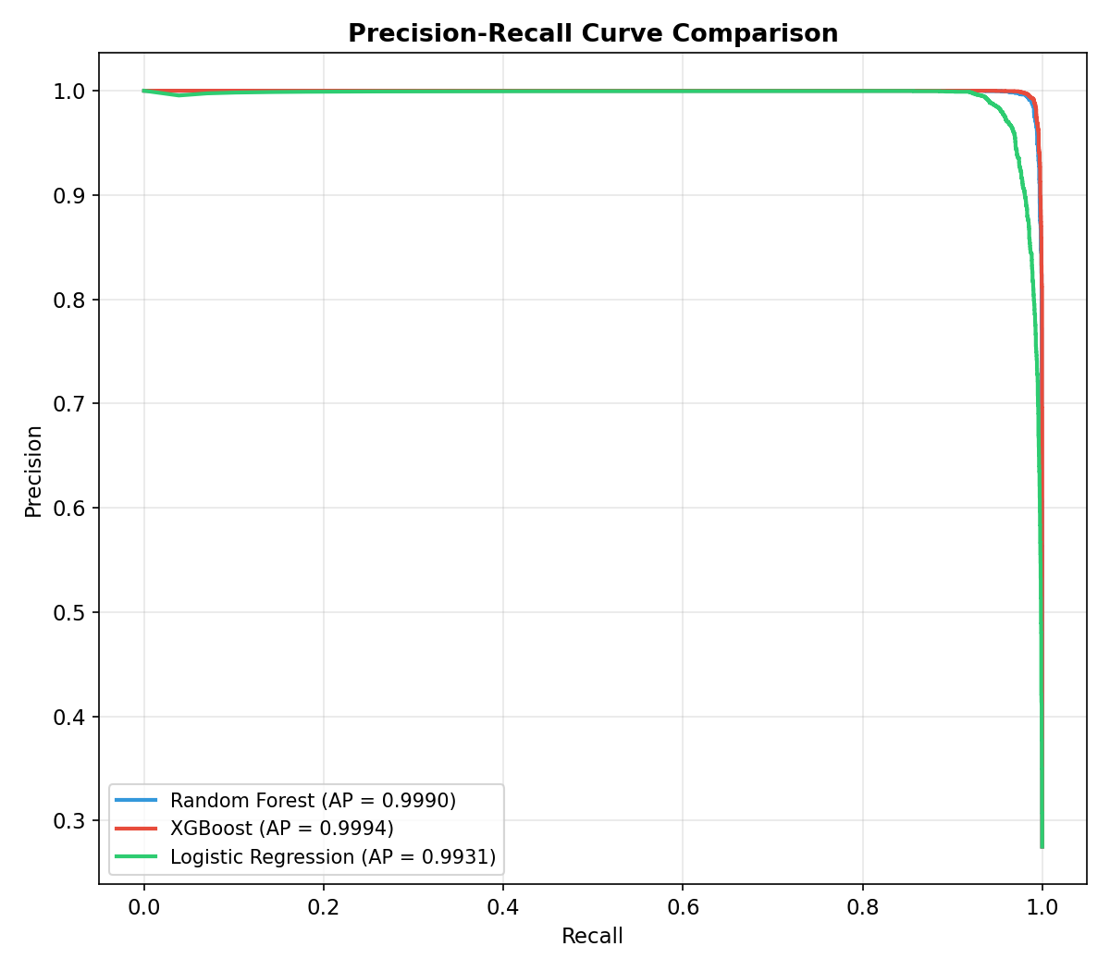
Results ROC and PR Curves

Slide 13
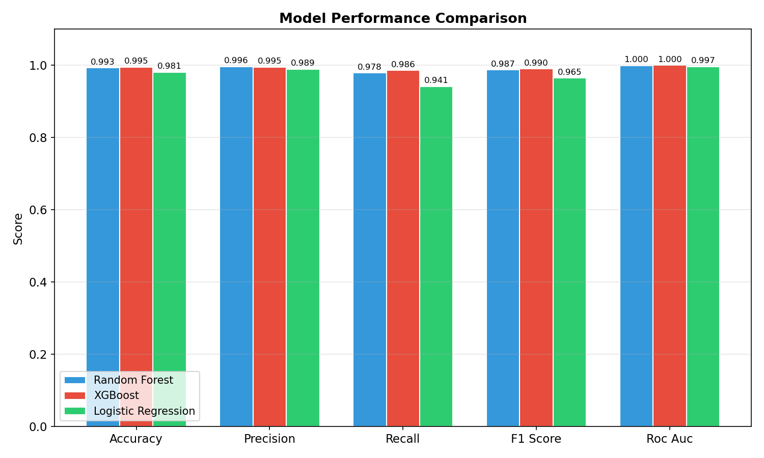
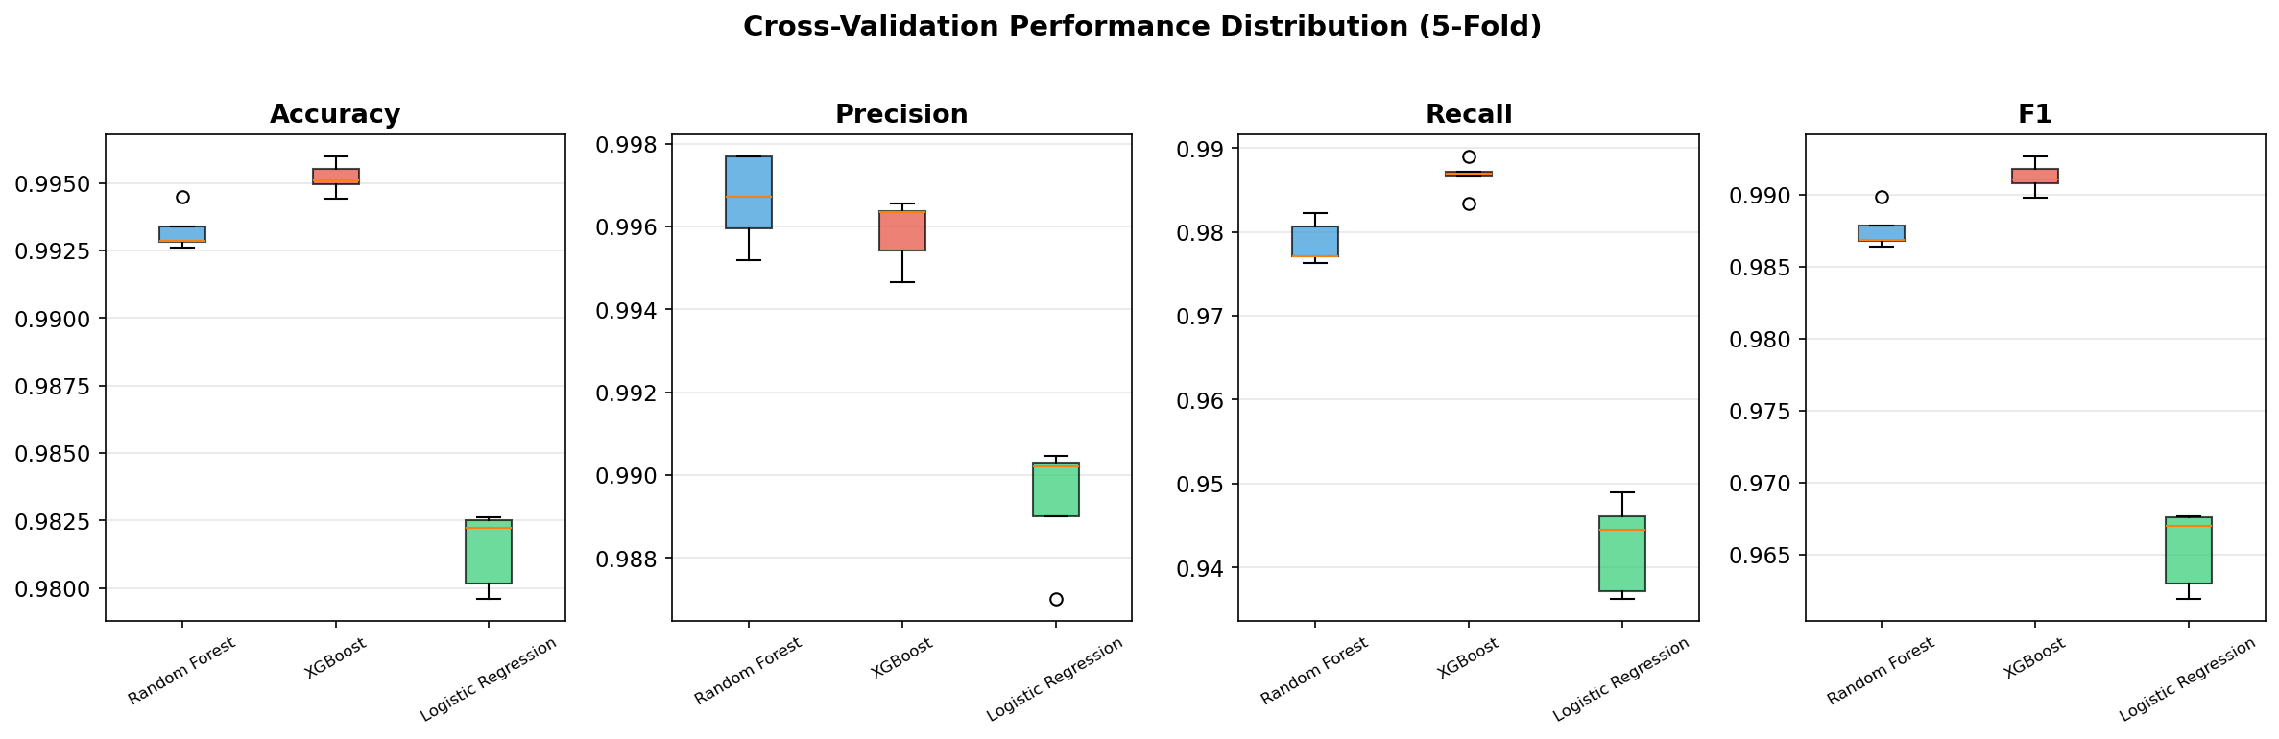
Results :Model Comparison

Slide 14
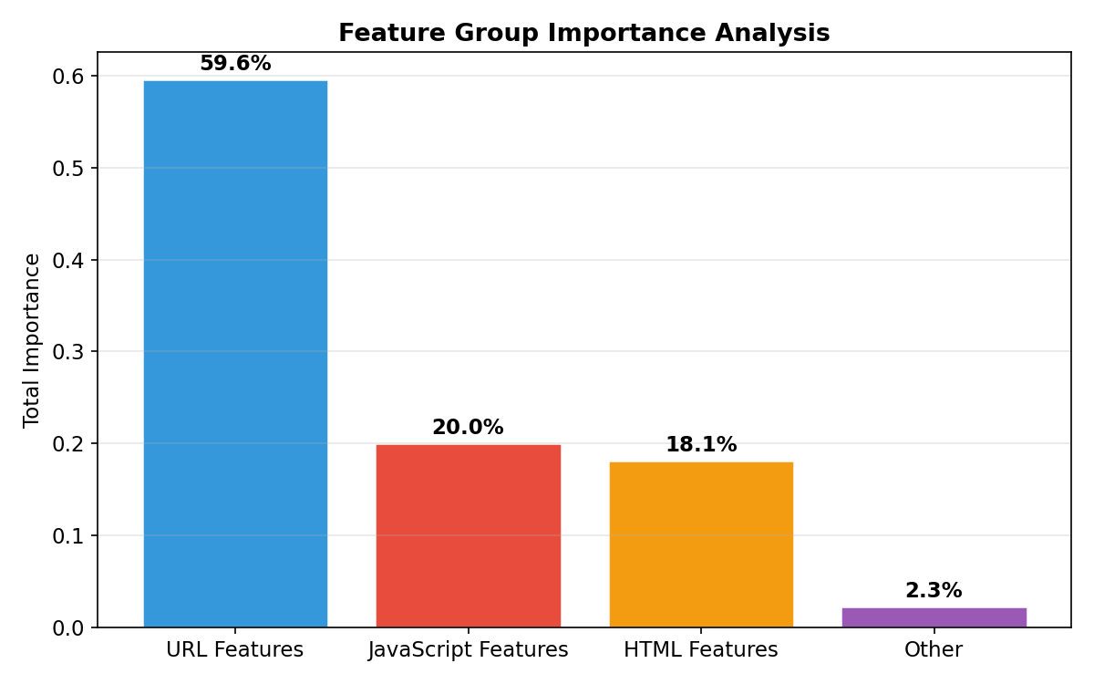
Feature Group Importance
Feature groups ranked by contribution to detection:
Which signal source matters most for XSS detection?
• HTML features DOM structure and event handlers
• JavaScript features API calls and code patterns
• URL features URL structure and embedded payloads

Slide 15
Live Demo
Interactive Streamlit web application:
• Sample Predictions 10 random test cases with labels
• Model Performance metrics dashboard with all figures
• Manual Input enter feature values for real-time prediction
Launch command:
streamlit run demo/app.py
The demo loads trained models from models/ directory
and shows predictions with confidence scores.

Slide 16
Challenges and Solutions
Challenge 1: Class imbalance (72% vs 28%)
--> Used stratified splitting and F1-score evaluation
Challenge 2: High-dimensional feature space (66 features)
--> Leveraged pre-selected IG-SBS features; analysed correlations
Challenge 3: Ensuring reproducibility
--> Fixed random seeds, centralised config, persisted all artefacts
Challenge 4: Preventing data leakage
--> Scaler fitted on training set only; strict split boundaries

Slide 17
Conclusion and Future Work
Conclusions:
• Ensemble methods (RF, XGBoost) outperform linear baseline
• Feature importance aligns with known XSS attack patterns
• 66 pre-selected features are sufficient for high-accuracy detection
• Fully reproducible pipeline: one command runs everything
Future work:
• Deep learning (LSTM/Transformer) for raw payload analysis
• Real-time feature extraction from live web traffic
• Multi-class classification (Stored vs Reflected vs DOM XSS)
• Adversarial robustness testing and defence
• Integration with WAF systems (ModSecurity plugin)

Slide 18
Any Questions?
Mohammad Ibrahim · Omar Adel · Mohamed Ahmed
University of East London | Dr. Wael El Sersy

