Slide 1
Small-World Networks
Mohammad Hosein Jalali
Dr.Estlahchi

Slide 2
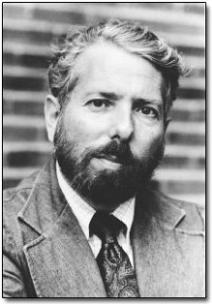
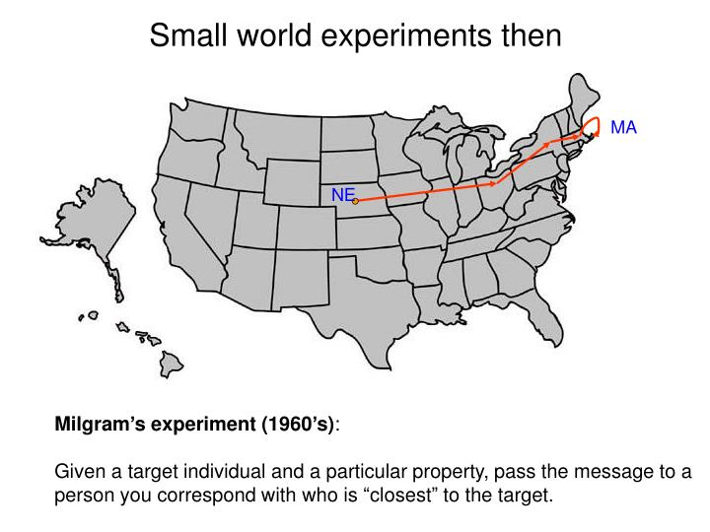
What is a small-world network?
Social Psychologist

Slide 3

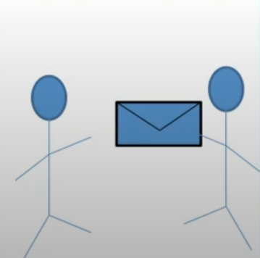
What is a small-world network?
Nebraska Farmer
Boston Stockbroker
On Average: Six Degree of Separation

Slide 4
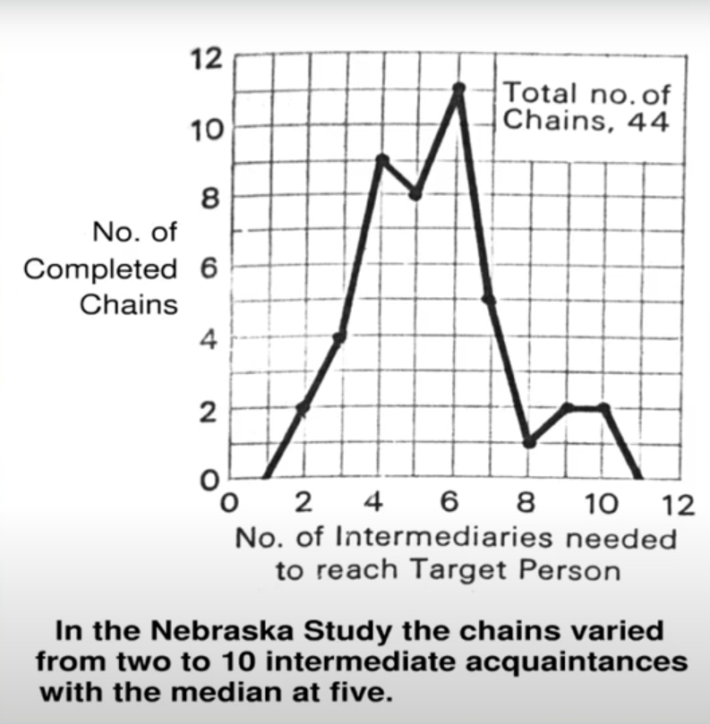
What is a small-world network?

Slide 5
Watts & Strogatz | June 1988
Film actors:
Nodes = Individual actors;
Two nodes are linked if the two actors appeared in the same movie.
Power grid:
Nodes = generators, transformers, and substations;
Two nodes are linked if they have a transmission line between them.
C. elegans:
Nodes = neurons;
Two nodes are linked if they are connected by a synapse or a gap junction.

Slide 6
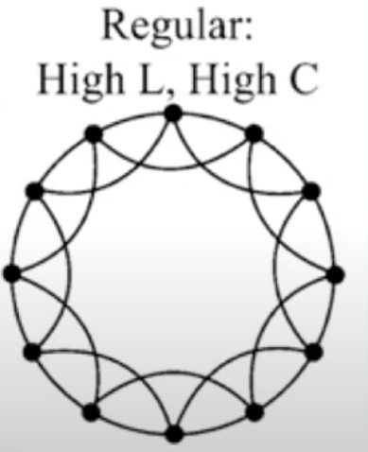
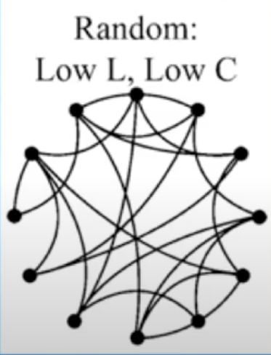
Network Structure
Naïve guess for the network structure of real-world networks would be either completely “regular” or completely random.
High average distance between nodes,
High average clustering
Low average distance between nodes,
Low average clustering

Slide 7
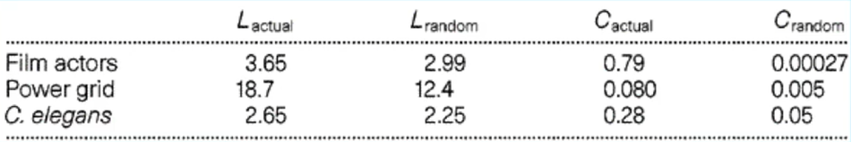
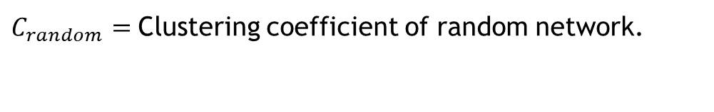
$L_{actual}=$Average distance (shortest path length) between pairs of nodes in the given network.
$L_{random}=$Average distance (shortest path length) in a randomly connected network with the same number of nodes and links.
$C_{actual}=$Clustering coefficient of the given network.
$C_{random}=$Clustering coefficient of random network.

Slide 8
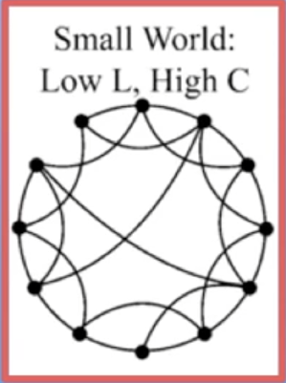
Network Structure
Naïve guess for the network structure of real-world networks would be either completely “regular” or completely random.
High average distance between nodes,
High average clustering
Low average distance between nodes,
High average clustering
Low average distance between nodes,
Low average clustering

Slide 9
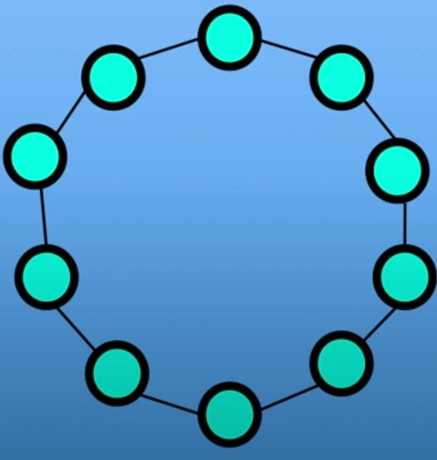
Watts and Strogatz’s model
Start with a regular network with N nodes and m neighbors per node. Let M be the
number of links.
For this example,
N = 10
m = 2
M = 10

Slide 10
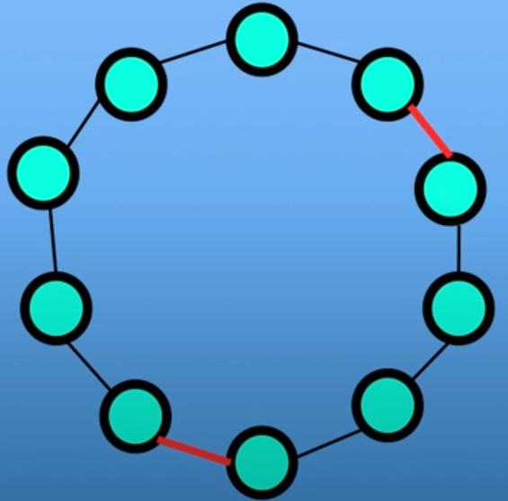
Watts and Strogatz’s model
Define beta, the probability of rewiring.
For this example, let beta=0.2
Randomly choose beta x M links
For this example, we choose 0.2 x 10 = 2

Slide 11
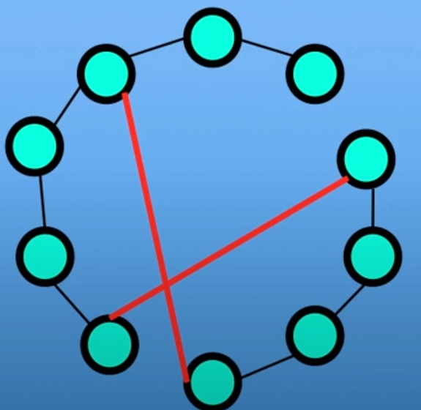
How are small-world networks formed?
Watts and Strogatz’ model:
Rewire one end of the chosen links to another randomly chosen node.
Original Network
New Network

Slide 12
Biological implications of small-world properties
Neural Systems: Balancing Specialization and Integration
Genetic and Metabolic Networks: Efficiency and Evolution
Plant Communication: Underground Signaling Networks
Cellular Communication: Coordinated Responses
Ecological Systems: Synchronization and Stability

