Slide 1
Agile Communication
Project

Slide 2
Agile Communication
Project
Sprints 1-3

Slide 3
Sprints 1-3 Questions
What is your Velocity for the past 3 sprints?
21
How do you know your Velocity is correct?
The velocity is deemed accurate when the team consistently achieves sustainable results.
What would the BURN DOWN chart look like for Sprints 1-3?
Done
What would the BURN UP charts look like for Sprints 1-3?
Done
How many points do you think the Team should commit to for Sprint 4 and justify your answer?
I believe 21 points would be an appropriate number based on the calculated velocity from previous sprints.

Slide 4
Agile Communication
Project
Sprint 4

Slide 5
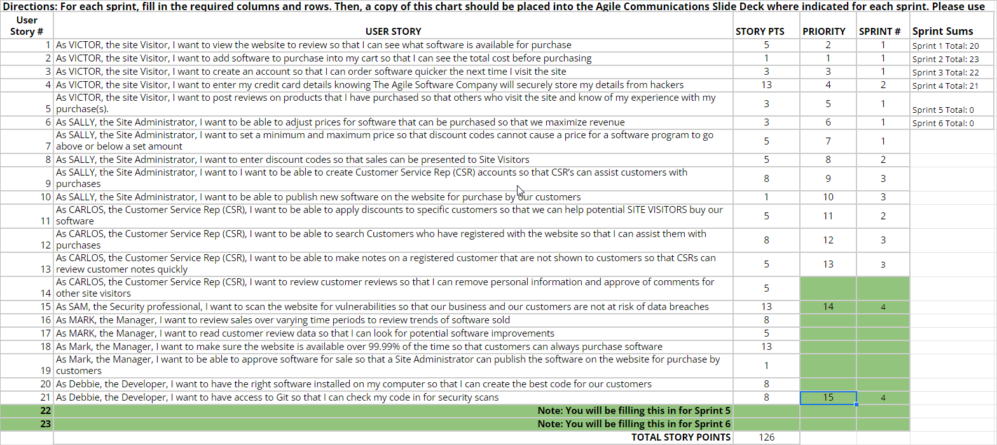

Slide 6
Sprint 4 Questions
What would the BURN DOWN chart look like for Sprints 1-4?
Done
What would the BURN UP charts look like for Sprints 1-4?
Done
What Risks did you identify in Sprint 4 and how do they affect the project? (Note: These would be your narrative findings)
Sprint 4 holds critical importance in addressing the significant security risks highlighted by the customer.
What Theme or Name did you give to Sprint 4?
Guardian Force!

Slide 7
SPRINT 4 DEMO of Working Product
The A-Team
Sprint 4 Name
“Guardian Force!“
User Stories in Sprint 4
1. Story # 15 with 13 points
2. Story # 21 with 8 points
3. Story # x with xx points
Total Sprint 4 Points: 21
Sprint 4 marked a pivotal moment for the A-Team as we focused on fortifying the website's defenses. We diligently scanned for vulnerabilities to safeguard our customers' data and ensured access to Git for security checks on our code. This sprint underscored the importance of engaging security professionals, even with high code quality, to gain fresh insights and enhance our software. Neglecting these aspects would have left our website vulnerable to data breaches.

Slide 8
Agile Communication
Project
Sprint 5

Slide 9
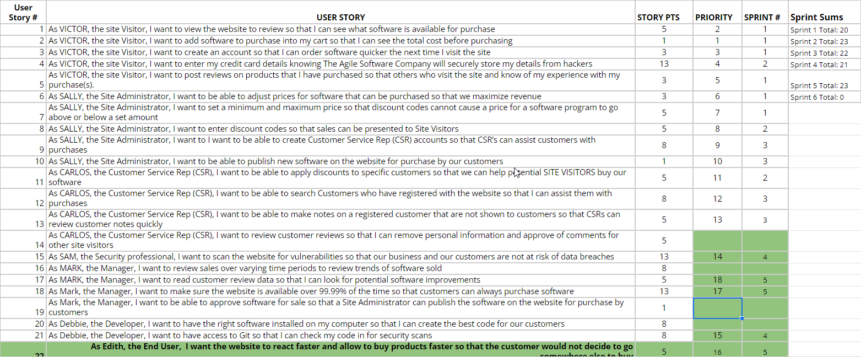

Slide 10
Sprint 5 Questions
What would the BURN DOWN chart look like for Sprints 1-5? Done
What would the BURN UP charts look like for Sprints 1-5? Done
What Risks did you identify in Sprint 5 and how do they affect the project? (Note: These would be your narrative findings)
In Sprint 5, the primary concern revolves around the potential dissatisfaction of end users. Therefore, I've assigned the highest priority to addressing this particular story.
How confident are you in delivering all of the user stories by the end of Sprint 6? Justify your answer.
I am reasonably confident that we will deliver the stories on time, as our velocity suggests. However, should unexpected challenges arise, we are committed to maximizing the value delivered to our customers under any circumstances..

Slide 11
SPRINT 5 DEMO of Working Product
The A-Team
Sprint 5 Name
“Resilient Velocity“
User Stories in Sprint 5
1. Story # 22 with 5 points
2. Story # 18 with 13 points
3. Story # 17 with 5 points
Total Sprint 5 Points: 23
In Sprint 5, we took feedback from our End Users and utilized it to fortify our website's "Resilient Velocity". We prioritized enhancing website responsiveness, ensuring customers could purchase products swiftly and securely 99.99% of the time. Additionally, we focused on making End Users' feedback readable for continued software improvements, aiming to meet their specific expectations and deliver maximum value.

Slide 12
Agile Communication
Project
Sprint 6

Slide 13
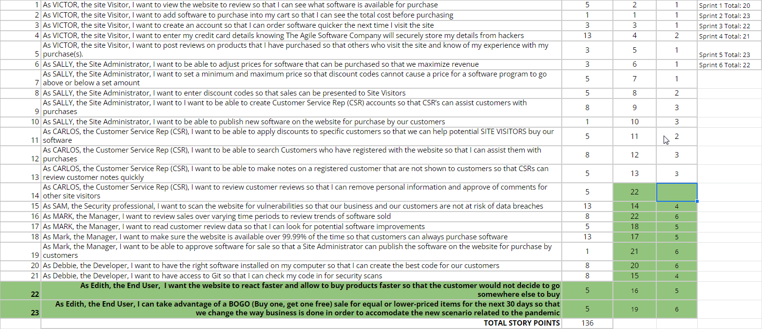

Slide 14
What would the BURN DOWN chart look like for Sprints 1-6? Done
What would the BURN UP charts look like for Sprints 1-6? Done
Was the Team able to complete all the work in the backlog or did you have to adjust what could be delivered? How would you tell this to Management and justify your answer.
The team was not able to complete all the work because of the ongoing pandemic. We had to adapt and change our plan to bring the most value for our customers. For this reason we gave highest priority to the BOGO story which will help us in changing our business and adapt fastly to this new situation and decided to postpone story 14. This solution allowed us to keep our velocity and guarantee high quality and sustainability.

Slide 15
"Adapt or Perish"
SPRINT 6 DEMO of Working Product
The A-Team
Sprint 6 Name
“"Adapt or Perish"
“
User Stories in Sprint 6
1. Story # 23 with 5 points
2. Story # 20 with 8 points
3. Story # 21 with 1 points
4. Story # 22 with 8 points
Total Sprint 6 Points: 22
Sprint 6 proved challenging due to the enduring pandemic. This unprecedented situation compelled us to prioritize a story enabling business adaptation, while reluctantly postponing one centered around CSR. Despite the adjustments, we're satisfied with the outcome, as delivering value to customers remains our foremost objective. This experience underscored the inevitability of adapting even the most meticulous plans in the face of uncontrollable global circumstances.

Slide 16
BVIR for Management Questions
Which charts would you want to include in the BVIR that Management would need and why?
Move the Orange boxes to the correct column below
The Burn Up Chart serves as an excellent tool for management, vividly illustrating the value being delivered over time. Similarly, the Burn Down Chart, reflecting the team's consistent and sustainable velocity, effectively communicates ongoing progress in the project. Additionally, the Committed vs. Delivered Chart plays a crucial role in ensuring that the team maintains a balance, avoiding the addition of unnecessary features that could inflate costs or falling short of expected deliveries per sprint. However, I suggest excluding the Story Point Cost per Team, as delving into this metric might lead us down a rabbit hole that's best avoided..
Included
Not included
Burn Up Charts
Burn Down Charts
Committed vs. Delivered Chart
Story Point Cost per Team

Slide 17
Creating the BVIR for Management
Questions to answer before you start the BVIR
What would tell Management if they want to know the details about actual stories?
[Select from the choices below]
"While I understand that you want to get into individual stories and know all the details, we would prefer that Management spends your valuable time guiding and influencing the Roadmap and direction of the project and leave the story delivery to the Teams you have empowered."
Absolutely, let's get into the details!
No, that is none of your business
Which of the above did you choose (1,2,3) and why?
I would opt for option 1 because it clearly delineates and emphasizes the roles of both Management and the Team within a genuine Agile working environment.

Slide 18
Creating the BVIR for Management
Questions to answer before you start the BVIR
Is it project considered a failure because backlog items still remain? Explain.
I don't perceive the project as a failure. Despite facing unprecedented challenges such as the pandemic, the project consistently delivered the utmost value to customers. Our primary aim as agilists is to prioritize customer value, and our ability to swiftly adapt and respond to the pandemic while aligning with client objectives reaffirms the success of our efforts. Therefore, I regard our project as successful. I intend to learn from every misstep for future endeavors, striving to anticipate the unpredictable to a greater extent.

Slide 19
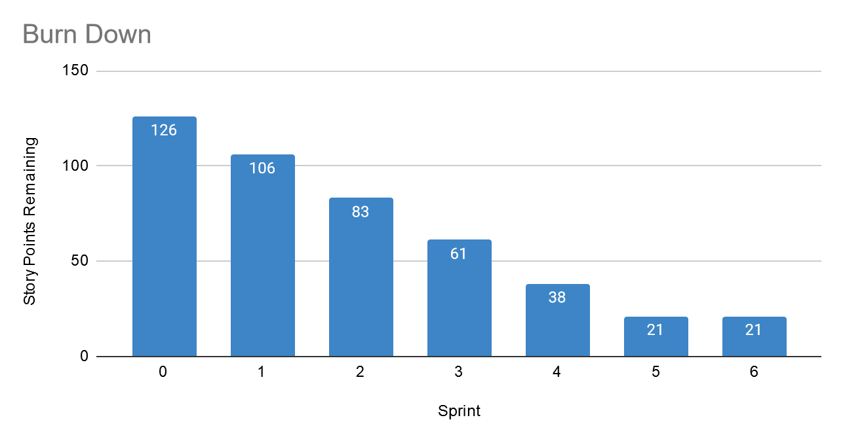
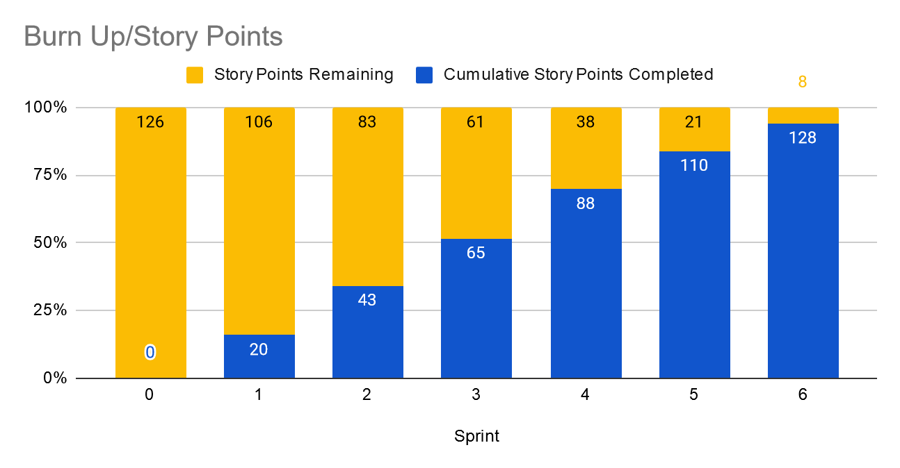
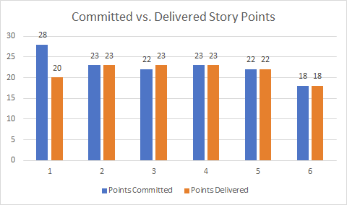
Creating the BVIR for Management
Instructions:
Start by creating your own BVIR. From the charts and sections below, please drag and drop items you would like to display to convey the story behind the MVP project
[Cut and paste items from this section and add them to the next slide. Remember to fill in information in the boxes where it is needed]
Roadmap
MVP VISION
Team Name
Chart Comparing Sprint Velocity of Teams 1 vs Team 2
Chart showing cost per story point

Slide 20
BVIR for Management
[Use this slide to create your BVIR. We have not provided a template for this, you get to decide what it looks like using the information from the previous slide]
Team Name
MVP VISION
Roadmap

Slide 21
BVIR for Management
[Now that you have created your BVIR for management, you need to create a video or written narrative explaining the MVP delivery status.
Use this slide to write your narrative or plan what you want to say in your video. ]
Include (at the minimum) the following:
Team Name
Vision
Sprint Burn Down Charts for Sprints 1-6
Sprint Burn Up Charts for Sprints 1-6
Project status (complete / incomplete)
Answers:
The A-Team
Enable our customers to purchase our software quickly and seamlessly through our new website, ensuring maximum satisfaction.

Slide 22
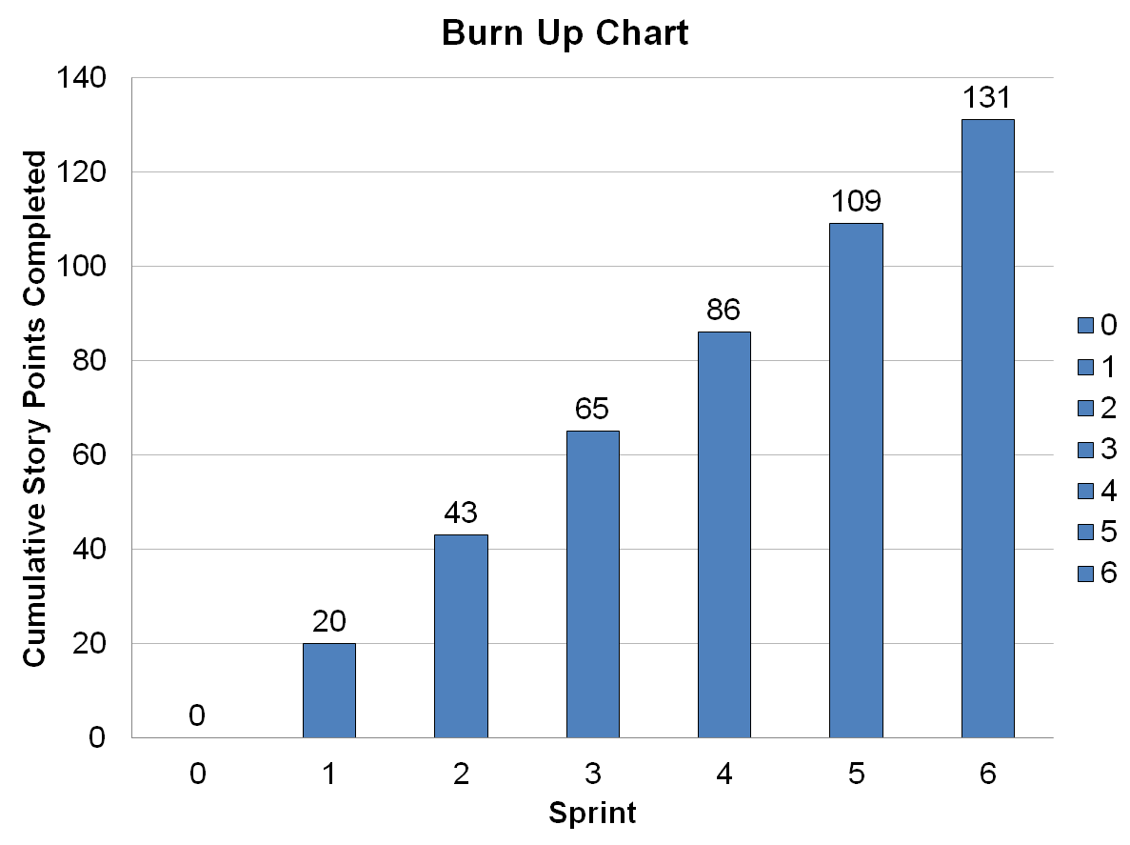
3.
4.
5The project status is considered complete, despite one outstanding story. Our objective was to deliver a Minimum Viable Product (MVP), and I believe that with the current state of the software, we have successfully presented a robust preview of its final form. We are eager to finalize the project and address the postponed story, ensuring that we continue to deliver value to customers, particularly during the challenging period of the pandemic.

Slide 23
Questions from Management (Using Videos would be great!)
Instructions:
Watch the videos in the classroom.
Record your videos or provide your answers below. Remember to justify your answer.
[Video # 1 Answer]
The cornerstone of success lies in delivering value to the customer, which holds greater significance than achieving perfection in the product. Our creation embodies substantial value and addresses the customer's needs with utmost priority. I am confident that building upon this foundation will lead to continued success in our endeavors.

Slide 24
Questions from Management (Using Videos would be great!)
Instructions:
Watch the videos in the classroom.
Record your videos or provide your answers below. Remember to justify your answer.
[Video # 2 Answer]
As agilists, we had to devise a new plan to ensure we could deliver the maximum value to our customers. While the pandemic has introduced new and complex challenges, it has also presented significant opportunities. Disregarding our customers' requests would not only have led to their disappointment but also prevented our software from driving crucial business transformations during this period of upheaval.

Slide 25
Questions from Management (Using Videos would be great!)
Instructions:
Watch the videos in the classroom.
Record your videos or provide your answers below. Remember to justify your answer.
[Video # 3 Answer]
While I acknowledge the desire for detailed insights into individual stories, we believe it's more beneficial for Management to invest valuable time in guiding and shaping the project roadmap and direction. Story delivery is entrusted to the empowered teams. Adhering to our velocity is crucial because attempting to accelerate beyond it could strain the team and compromise the quality of our output. Such actions could lead to detrimental consequences for the entire company, akin to a dangerous boomerang effect.

Slide 26
Questions from Management (Using Videos would be great!)
Instructions:
Watch the videos in the classroom.
Record your videos or provide your answers below. Remember to justify your answer.
[Video # 4 Answer]
I would suggest considering a final sprint, even if it's a short one, perhaps just one week, to address the remaining 5-point story. This approach would enable us to swiftly wrap up our current tasks and transition seamlessly to the next high-priority project.

