Slide 1
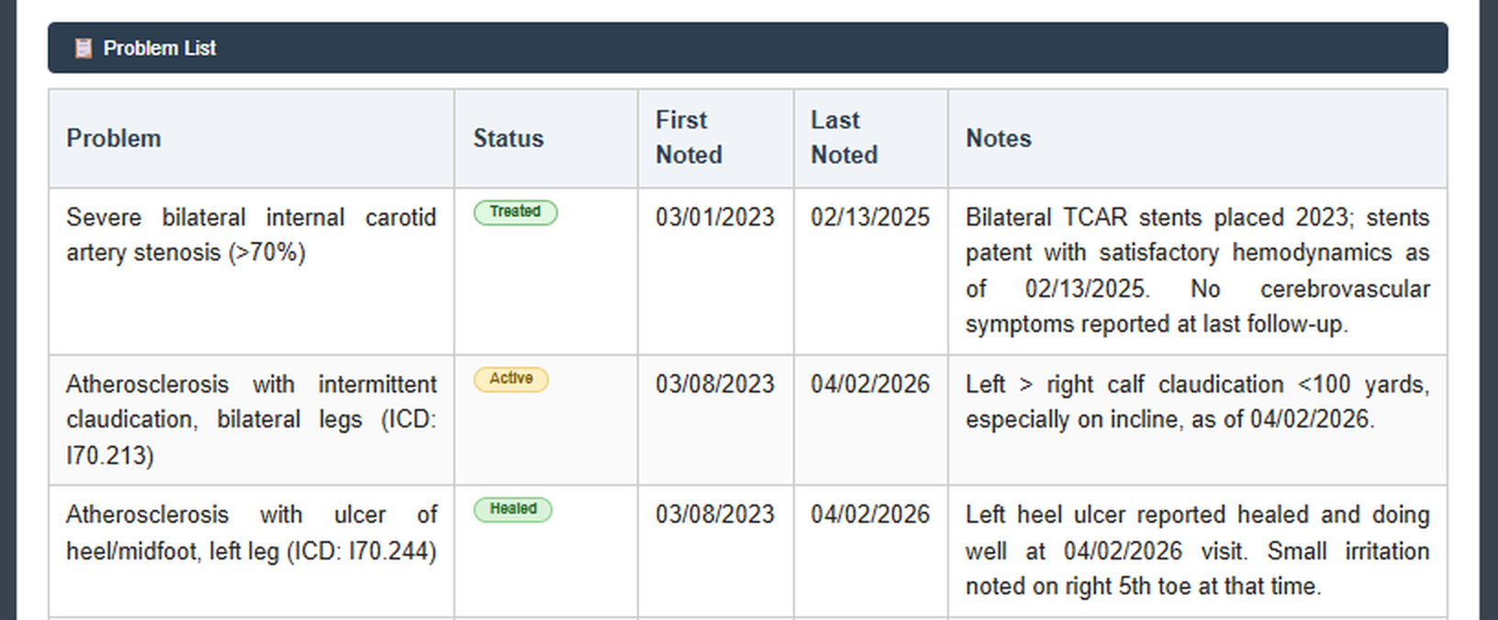
DELIVERED · PATIENT HISTORY SUMMARIZATION
Years of Prior Reports, One Structured Patient View
Live in the reporting workflow today; pilot and production adoption not yet evidenced.
Before Search → read every prior report → summarise mentally
After Open exam → summary ready → validate → report
Faster review
Prefetched before the exam opens
Better context
Findings, progression and procedures together
AI History Summary — demo data, identifiers removed.
Consistent structure
Structured to USCDI v4 / C-CDA
BUSINESS VALUE
Less re-reading; history harder to miss
IMPACT / EVIDENCE
Generated today; time saved not yet measured
EFFORT & SCOPE
Effort not documented · v5.21, v5.22
Notes:
Opening: we have taken AI from idea to a working capability inside the product our
clinicians already use every day.
The problem: before finalising a report, a reading physician may need several years of
prior reports across modalities. The information exists, but rebuilding the clinical
story is slow, inconsistent between readers and easy to get wrong ("Patient History
Summarization .pptx", slides 2-3 and notes). That is cognitive load on our most
expensive clinical minute.
The value: the AI generates two views — AI History Summary and AI History Details —
reachable in one click from the Previous Exams tab, with critical and abnormal items
visually prioritised ("AI-Powered Patient History Summarization.docx", Key capabilities;
"AI Patient Summary - Customer Perspective 1.html"). Because the summary is prefetched
when the order arrives and refreshed when the report is verified, it is waiting before
the clinician asks for it (use-case PDF, page 1, "AI processing strategy"). We chose
USCDI v4 and C-CDA as the summary skeleton so one mission serves all exam types and
customers rather than per-customer variants (deck slides 5 and 11).
Example: the sample on screen consolidates a vascular patient's problem list with status,
first/last noted dates and progression notes — explicitly flagging what is "not documented
in any provided report" rather than inventing content.
Status and limits — important for credibility: development is complete and summaries are
generated automatically after exam finalisation, with baseline and incremental jobs run by
a dedicated parser ("AI Patient Summary - Support Runbook 1.html", sections 2 and 4). What
we do NOT have in our sources is pilot validation data, customer adoption, measured time
saved or accuracy benchmarking. Every benefit on this slide is an expected benefit.
Effort, dependencies, risk: delivery effort is not documented anywhere in the source set,
so I am not quoting a figure. Known effort concentrations were Matcha model selection
(quality vs. latency vs. token cost) and caching to control cost (deck slides 8-9).
Dependencies: Matcha AI availability, the MATCHA_API_KEY held server-side, and customer
versions 5.21 / 5.22. Privacy design anonymises the PDF before the AI call and re-injects
identifiers locally (runbook, section 4) — worth stating, but it is a design claim, not an
audited compliance statement.
Decision / next step: approve a measured pilot — agree the sites, the baseline and the two
or three metrics (review time, findings surfaced, clinician acceptance) so the next review
reports evidence instead of intent.
Transition: that is value delivered. Next, the value we are building for our own
operations teams.
Sources: MS-AI/AI Priors/AI-Powered Patient History Summarization.docx;
MS-AI/AI Priors/Patient History Summarization .pptx (slides 2-3, 5-9, 11-12 + notes);
MS-AI/AI Priors/Patient-History-Summarization-UseCase 1.pdf (pages 1-2);
MS-AI/AI Priors/AI Patient Summary Customer Perspective 1.html;
MS-AI/AI Priors/AI Patient Summary Support Runbook 1.html (sections 1-4).

Slide 2
IN PROGRESS · SENTINEL AI OPERATIONS DASHBOARD
Governed Console for Server Health and AI Forecasts
Monitoring, approval-gated actions and forecasting are built; secure file transfer and agent relay remain.
Detect → Forecast → Recommend → Approve → Act → Audit
COMPLETED
· Health and capacity dashboard
· Approval-gated commands, audited
· Disk, memory, CPU forecasts
IN PROGRESS
· Governed file transfer
· Staged relay rollout
· Automation rules
NEXT
· HL7 and PACS monitoring
· Contract alerts from CRM
· Plain-language ops assistant
BUSINESS VALUE
Faster triage; fewer inbound paths to customers
IMPACT / EVIDENCE
Expected benefits; no measured MTTR data yet
EFFORT & DEPENDENCIES
Sizing to be confirmed · agent rollout, Matcha
Notes:
Opening: the same AI approach is now pointed at our own cost base — the effort our support
and operations teams spend keeping customer server environments healthy.
The problem: teams work reactively across PACS environments, HL7 interfaces, archives and
storage growth. Alerts arrive after business impact has started, investigation is manual,
and the effort scales with every new customer environment ("Proactive Infrastructure
Management…pptx", slide 2 and notes).
What Sentinel enables: a single dashboard for server inventory, health, performance,
storage and incidents; a Windows agent that executes only allow-listed commands with
risk classification and approval gates; browser-based RDP that keeps RDP credentials out
of the platform; and AI forecasting for disk, memory and CPU risk with deterministic
fallbacks ("AI Dashboard Brief Project Description.docx", Key Capabilities).
Why management should care: it reduces time to resolution, removes the need for inbound
access and VPN routing into customer networks because agents connect outbound, and it
leaves an audit record for every login, command, approval and remote session — which is
exactly what customers ask us for during security reviews.
Status and evidence limits: the capability list is documented as built, but the document
itself signals unfinished work — the file transfer layer today returns policy decisions
and audit records "before enabling full real file streaming", and the newer AgentRelay
capability is being "introduced and validated in stages" while direct connectivity
remains. Note a discrepancy the executives should know about: the May 2026 deck is an
AI-assisted proof of concept with generated mockups (slide 15), whereas the project
description describes a working platform. I am presenting the project description as the
status of record and treating the deck's autonomous-operations phases as roadmap, not
delivery.
Effort, dependencies, risk: remaining effort is not sized in any source, so the honest
answer is "to be confirmed"; I would not quote a date. Dependencies are Matcha AI through
the abstraction layer, Azure AD / Microsoft Identity for dashboard sign-in, Zoho Vault for
secret lookup, PostgreSQL/SQLite telemetry storage, and customer willingness to install
the agent. Main risks: agent rollout friction, forecast trust, and scope creep toward
autonomous remediation before approval controls are proven.
Decision / next step: confirm the next milestone — complete governed file transfer and
staged relay validation on a defined set of internal servers — and approve whether HL7 and
PACS monitoring is in scope for the next increment, since that is what converts this from
an IT tool into a managed-services differentiator.
Transition: with one capability delivered and one in flight, the question becomes where we
invest next.
Sources: MS-AI/AI Dashboard/AI Dashboard Brief Project Description.docx (Objectives, Key
Capabilities, Business Value); MS-AI/AI Dashboard/Proactive Infrastructure Management_…
_20260513141714.pptx (slides 2-9, 13-15 + notes); "next" items also appear in
MS-AI/Next Ideas/Q4 and 2027 ideas.docx (AI monitoring dashboard for HL7/PACS; CRM
contract alerts).

Slide 3
NEXT · INVESTMENT OPTIONS FOR Q4 AND 2027
Four Themes, One Recommended Starting Point
Preliminary R&D sizing, not delivery commitments; full initiative list in the notes.
THEME
BUSINESS VALUE
EFFORT
PROPOSED NEXT STEP
Reporting quality & safety
Catch prelim-vs-final discrepancies
Medium–Large
Pilot with one customer
Operational intelligence
AI triage of HL7 and interface failures
Medium
Extend Sentinel to HL7 / PACS
Engineering productivity
AI test automation and codebase access
Small–Medium
Continue the existing POC
PACS independence & platform
Retire EMR dependency; object storage
Large
Run the object-storage POC first
RECOMMENDATION — NO ASK DOCUMENTED IN SOURCES
Approve discovery funding for the discrepancy detector; confirm HL7/PACS in the next Sentinel increment.
Notes:
Opening: the planning material holds roughly twenty ideas. Rather than read a feature
list, I have grouped them into four investment themes and put one recommendation in front
of you.
Why these four, and what is behind each theme (all from
MS-AI/Next Ideas/Q4 and 2027 ideas.docx):
1. Reporting quality & safety — AI report discrepancy detector comparing preliminary and
final reports (critical, major, follow-up, laterality and measurement discrepancies with
a pre-sign-off warning), findings-vs-impression consistency checks, critical result
detection, template completeness and a prelim-to-final quality score, plus follow-up
recommendation tracking that creates tasks in PACS or an administrative dashboard, and
ORU / report enrichment for referring physicians.
2. Operational intelligence — HL7 and interface issue triage from interface-engine logs,
HL7 troubleshooting executive summary mode, AI log analysis, error-grouping over logs
already collected, and integration of the AI dashboard with CRM contract data to raise
alerts when storage or concurrent-user limits are exceeded.
3. Engineering productivity — the EHR Orchestrator test-automation proof of concept
(chat-driven, record, test and AI modes across desktop and web, which already surfaced
defects logged in TFS), natural-language codebase knowledge access, and dead-code
cleanup.
4. PACS independence & platform modernisation — removing the out-of-support EMR module and
moving required logic to PACS, separating thick-client and web business logic with
cross-OS file handling, an admin tool for PACS-only installations, object storage in an
OCI bucket, and AI-generated ECG findings from ECG signals.
Deliberately kept off the slide: the market comparators — Us2.ai for automated
echocardiography reporting and Intelerad for detection and triage. They are evidence that
the market is moving toward AI measurement extraction and worklist prioritisation; they are
not our achievements and should not be presented as such. Also omitted for space: the ECG
finding generation idea, which is scientifically attractive but carries the heaviest
regulatory load, and the autonomous infrastructure-remediation agent concept.
Gap to flag: secure image and report sharing was requested as a topic, but I could not find
it anywhere in the planning document. If leadership expects it in the portfolio, the idea
needs to be supplied before it can be positioned.
Effort basis and uncertainty: Small / Medium / Large here are preliminary R&D judgements
based on documented scope and dependency breadth — discrepancy detection needs clinical
validation and sign-off workflow changes; operational intelligence largely reuses the
Sentinel platform; engineering productivity already has a working proof of concept; PACS
independence touches database, business logic and deployment across every customer. No
source contains effort figures or dates, and none of the proofs of concept justify
estimating full-product delivery. Treat all four as recommendations for discovery, not
commitments.
Why the recommended starting point: the discrepancy detector addresses patient-safety and
liability risk — the highest-value problem in the set — while the Sentinel HL7/PACS
extension gives the fastest return because the platform already exists. Both are testable
at small scale.
The ask: approve discovery funding for a discrepancy-detector pilot with one customer, and
confirm whether HL7/PACS monitoring belongs in the next Sentinel increment. Each of the
other themes returns with a sized proposal once discovery output is available.

