Slide 1
RentEase
Rental Management Web Application
Student: Mohammad Mojahid
Course: B.Tech (Computer Science) — 6th Semester
College: Your College Name Here
Year: 2025 – 2026
6th Semester Project Presentation

Slide 2
📋 Contents / Agenda
01
05
Introduction
App Screenshots — Landing & Login
02
06
Objectives
App Screenshots — Owner Dashboard
03
07
Hardware & Software Requirements
App Screenshots — Tenant & Payments
04
08
Important Panels — Overview
Future Scope
09
Conclusion
10
Bibliography

Slide 3
🏠 Introduction
What is Rental Management?
Problems Without Digital Systems
A rental management system is a digital platform that helps property owners manage their properties, tenants, and payments efficiently.
It replaces manual record-keeping with automated, organized digital processes.
Enables real-time tracking of payment dues, complaints, and notices.
Facilitates smooth communication between landlords and tenants through a centralized platform.
Manual paper-based records are error-prone and time consuming.
Rent payment tracking is difficult — delays and disputes arise frequently.
No centralized system for complaints or maintenance requests.
Owners struggle to manage multiple properties and tenants simultaneously.
Tenants lack transparency about rent dues, notices and property rules.
Document management (Aadhaar, ID proof) is disorganized and insecure.

Slide 4
🎯 Objectives
🏢
👥
🌐
Simplify Property Management
Tenant & Payment Tracking
Centralized Digital Platform
Allow owners to add, manage and track multiple properties and units with ease.
Maintain detailed tenant records, track monthly rent payments and dues automatically.
Provide a single, unified platform accessible from any device via web browser.
💬
📄
📊
Improved Communication
Document Management
Financial Reporting
Enable seamless communication through notices, complaints, and notifications between owners and tenants.
Securely upload and store tenant documents like Aadhaar and ID proof in the cloud.
Give owners clear visibility into income, pending payments and financial history.

Slide 5
⚙️ Hardware & Software Requirements
🖥️ Hardware Requirements
💻 Software Requirements
Device
Laptop or Desktop PC (minimum 4GB RAM)
⚛️
React + TypeScript
Frontend UI framework with type safety
Processor
🔥
Firebase
Intel Core i3 / AMD Ryzen 3 or higher
Authentication, Firestore DB & File Storage
Storage
⚡
Vite
Minimum 256 GB SSD / HDD
Ultra-fast development build tool
▲
Vercel
Internet
Broadband or WiFi connection (for Firebase)
Cloud deployment & hosting platform
💙
VS Code
Display
Minimum 1280×720 resolution screen
Primary code editor / IDE
🐙
GitHub
Version control & source code management

Slide 6
🏗️ System Architecture
👤 USER TIER — Web Browser (React + TypeScript + Vite)
🔥 BACKEND TIER — Firebase Platform
Firebase Authentication
(User Login & Register)
Firestore Database
(Real-time NoSQL DB)
Firebase Storage
(Document & File Upload)
▲ DEPLOYMENT TIER — Vercel (CDN + Serverless Hosting) | GitHub (Version Control)

Slide 7
🖥️ Important Panels — Overview
🏠
Landing Page
👔
Owner Dashboard
🧑‍💼
Tenant Dashboard
Public home page with Owner & Tenant login options, project branding and multi-language support (Hindi/English).
Property management, tenant overview, floor/unit management, financial reports and send rent notices.
View assigned property details, apply for property, submit complaints, view notifications.
🏗️
Property / Unit Management
📁
Document Upload
💰
Rent Payment & Tracking
Owners can add properties, define floors/units, mark vacancy, and assign tenants to specific units.
Tenants upload Aadhaar card, ID proof and profile photo securely stored in Firebase Storage.
Owners send rent notices; tenants pay via UPI/QR code. Real-time payment status tracking with history.

Slide 8
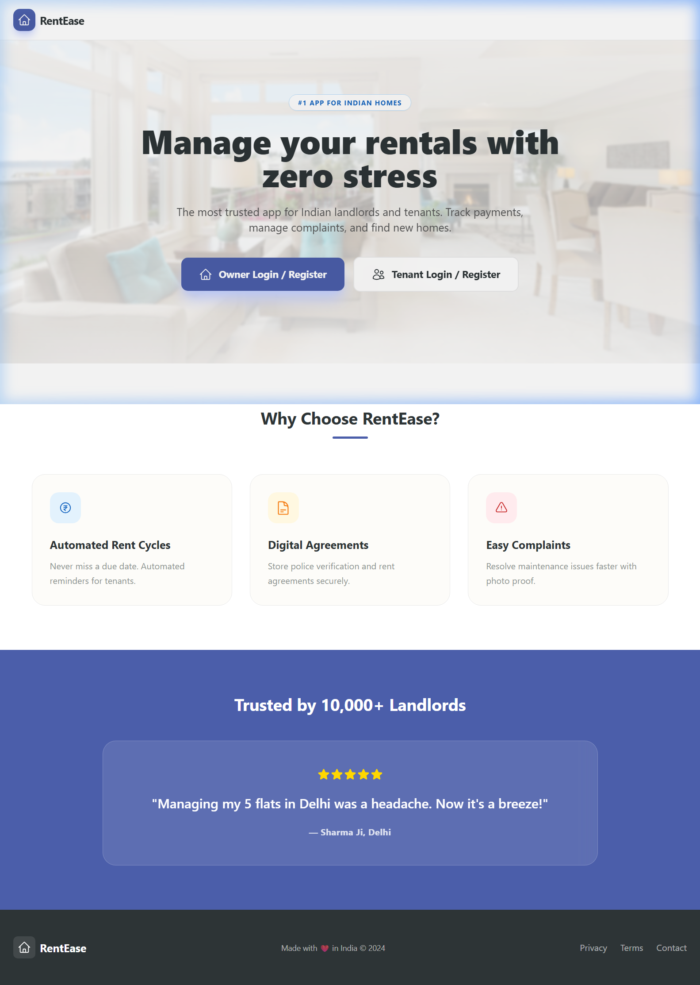
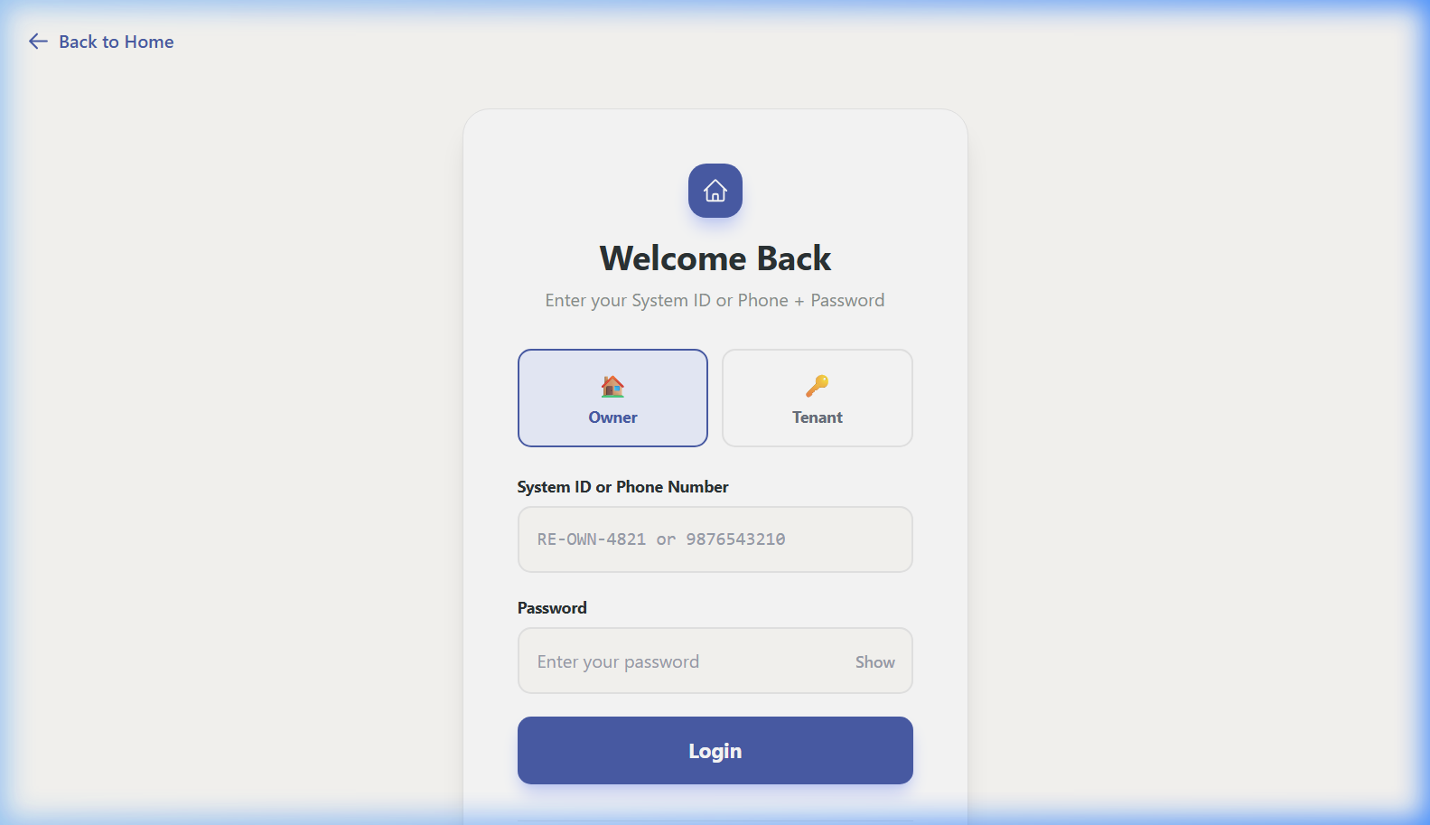
🏠 App Screenshot — Landing Page & Login
🏠 Landing Page
🔐 Login Page (Owner / Tenant)
Left: Public landing page with Owner & Tenant login options | Right: Unified login panel with role selection (Owner/Tenant)

Slide 9
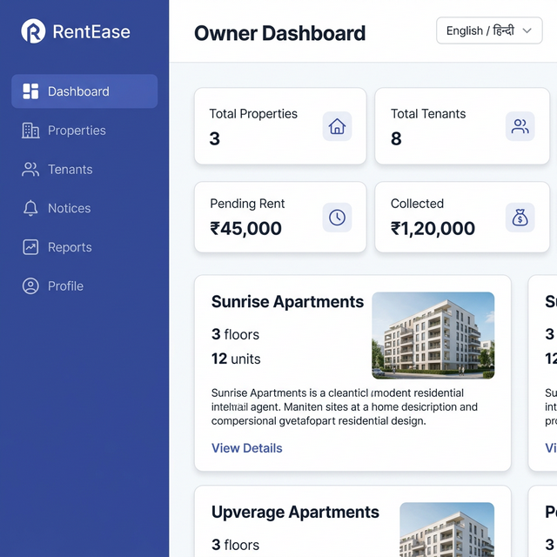
👔 App Screenshot — Owner Dashboard
👔 Owner Dashboard — Property & Tenant Overview
📊 Stats Cards
🏢 Property Cards
👥 Tenant Management
📜 Send Notices
📈 Financial Reports
🌐 Hindi/English Toggle

Slide 10
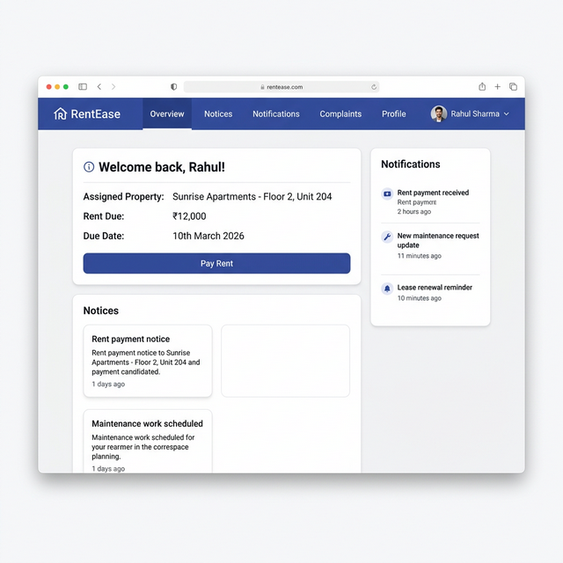
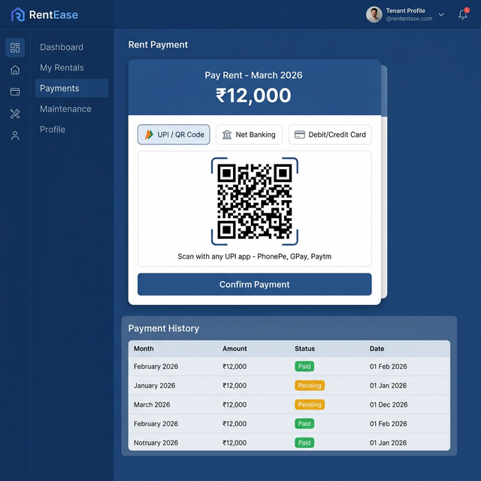
🧑‍💼 App Screenshot — Tenant Dashboard & Rent Payment
🧑‍💼 Tenant Dashboard
💰 Rent Payment — UPI / QR Code
Left: Tenant panel with property info, notices & notifications | Right: UPI/QR Code payment with payment history

Slide 11
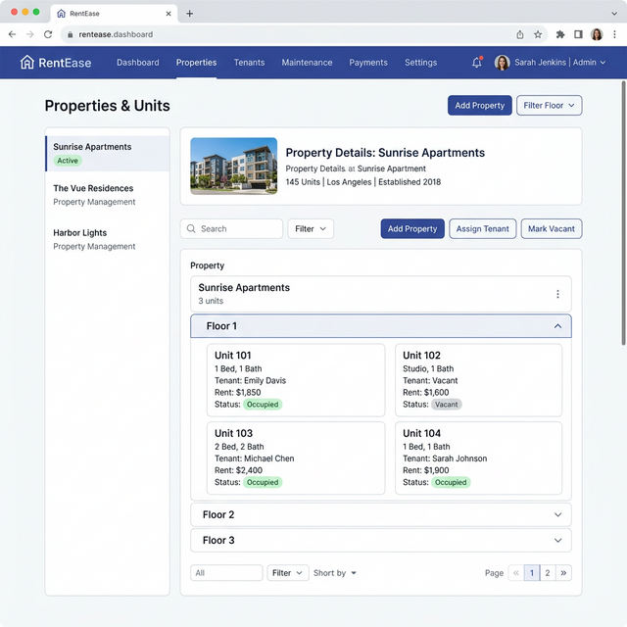
🏗️ App Screenshot — Property & Unit Management
🏗️ Property & Unit Management — Floor-wise Unit Overview
🏢 Multiple Properties
🏗️ Floor-wise View
🟢 Occupied Units
⬜ Vacant Units
👤 Assign Tenant
📋 Unit Details

Slide 12
Key Features of RentEase
🔐
🏢
📜
📱
Secure Firebase Auth
Multi-Property Support
Rent Notice System
QR Code Payment
Phone-based login with OTP, role-based access (Owner / Tenant)
Manage multiple properties, floors and units from one dashboard
Owners send digital rent notices; tenants receive real-time alerts
Tenants scan QR code to pay rent via UPI apps instantly
🔔
🌐
📂
📊
Notifications
Multi-Language
Document Storage
Financial Reports
In-app notification system for payments, notices and complaints
Supports Hindi and English for wider accessibility
Secure cloud storage of Aadhaar, ID proof and profile photos
Owner dashboard shows income summary and late payment alerts

Slide 13
🚀 Future Scope
📱
Mobile Application
💳
Online Payment Integration
Develop native Android & iOS apps using React Native for easier access on smartphones.
Integrate Razorpay / Stripe for direct rent collection within the app — automated receipts.
🤖
AI Tenant Verification
📈
Advanced Analytics
Use AI/ML to verify tenant identity documents automatically and flag suspicious profiles.
Owner analytics dashboard with graphs — income trends, occupancy rates, payment forecasting.
💬
In-App Chat
🗓️
Automated Reminders
Real-time chat between owners and tenants for faster issue resolution without external apps.
Auto-scheduled SMS/email reminders for rent due dates, lease renewals and inspections.

Slide 14
Conclusion
RentEase successfully bridges the gap between traditional rental management and modern digital solutions.
✅
Owners can add properties, manage tenants, send rent notices and view financial reports — all in one place.
Tenants enjoy a transparent experience — viewing their dues, paying rent via QR code, and submitting complaints.
Built with modern technologies (React, TypeScript, Firebase) ensuring reliability, scalability and security.
RentEase demonstrates how technology can transform everyday rental management challenges into seamless experiences.

Slide 15
📚 Bibliography / References
[1]
Firebase Documentation
Official Firebase docs for Authentication, Firestore & Storage.
https://firebase.google.com/docs
[2]
React Documentation
Official React docs for component-based UI development.
https://react.dev
[3]
TypeScript Handbook
Official TypeScript language documentation and best practices.
https://www.typescriptlang.org/docs/
[4]
Vite Documentation
Build tool documentation used for development and bundling.
https://vitejs.dev
[5]
Vercel Documentation
Deployment platform documentation for hosting the web app.
https://vercel.com/docs
[6]
MDN Web Docs
Reference for HTML, CSS, and JavaScript web standards.
https://developer.mozilla.org
[7]
GitHub Docs
Version control and repository management documentation.
https://docs.github.com

Slide 16
Thank You!
🏠 RentEase — Rental Management Web Application
Questions & Feedback are Welcome
Presented by: Mohammad Mojahid | B.Tech CSE — 6th Semester

