Slide 1
RentEase – Rental Management System
A Web-Based Platform for Property Rental Management
Presented By: MD Mojahid, Rahul Mishra, Satya Swaddhaya, Tauhid Ahmed
Department: (B.Sc Computer Science)
Institution: (Dharanidhar University)

Slide 2
Contents
1. Introduction
2. Objectives
3. System Overview
4. Hardware & Software Requirements
5. Website Panels
6. Future Enhancements
7. Conclusion
8. Bibliography

Slide 3
Introduction
RentEase is a web-based rental management platform designed to simplify property rental operations. It allows landlords to manage properties, tenants, and rental records digitally, reducing the need for manual paperwork and improving efficiency.

Slide 4
Problem Statement
• Manual record keeping
• Difficulty managing multiple tenants
• Lack of centralized rental data
• Poor communication between landlords and tenants
• Inefficient rent tracking

Slide 5
Objectives
• Provide a centralized rental management platform
• Simplify tenant and property management
• Enable rent tracking and management
• Improve communication between landlord and tenant
• Provide an easy-to-use user interface

Slide 6
System Overview
Landlord Module:
• Add and manage properties
• Manage tenants
• Track rent payments
Tenant Module:
• View available properties
• Manage rental information
• Track payment records

Slide 7
Hardware Requirements
• Processor: Intel i3 or higher
• RAM: Minimum 4GB
• Storage: 500MB free space
• Internet connection required
• Device: Laptop / Desktop / Smartphone

Slide 8
Software Requirements
Frontend: React.js, HTML5, CSS, JavaScript, Tailwind CSS
Backend: Node.js / Express.js
Database: Firebase
Tools: VS Code, GitHub, Vercel

Slide 9
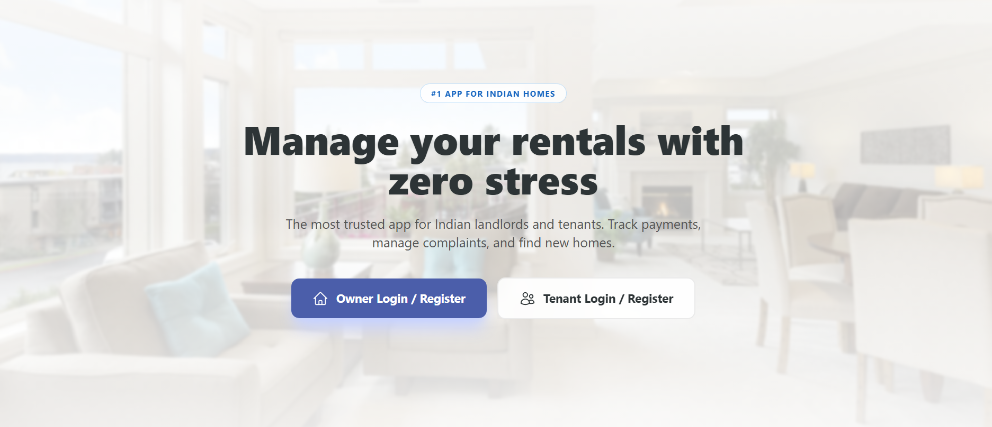
Landing page

Slide 10
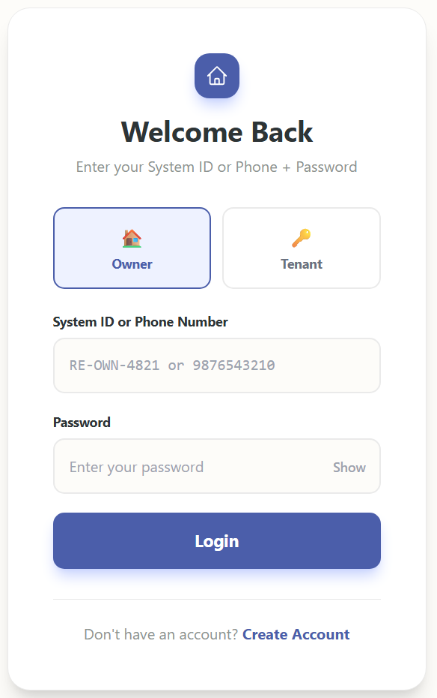
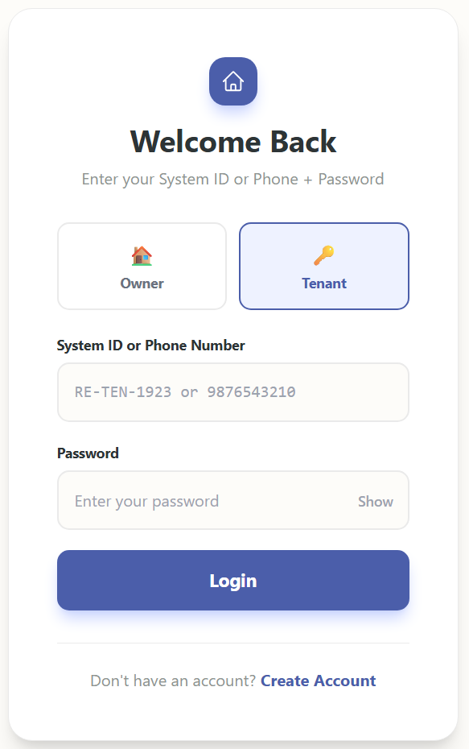
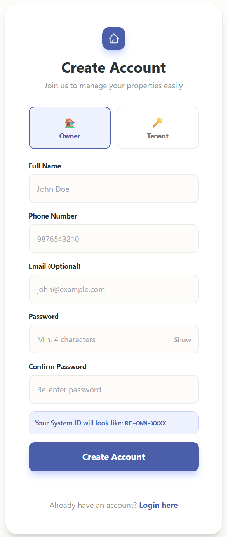
Login/create account panel

Slide 11
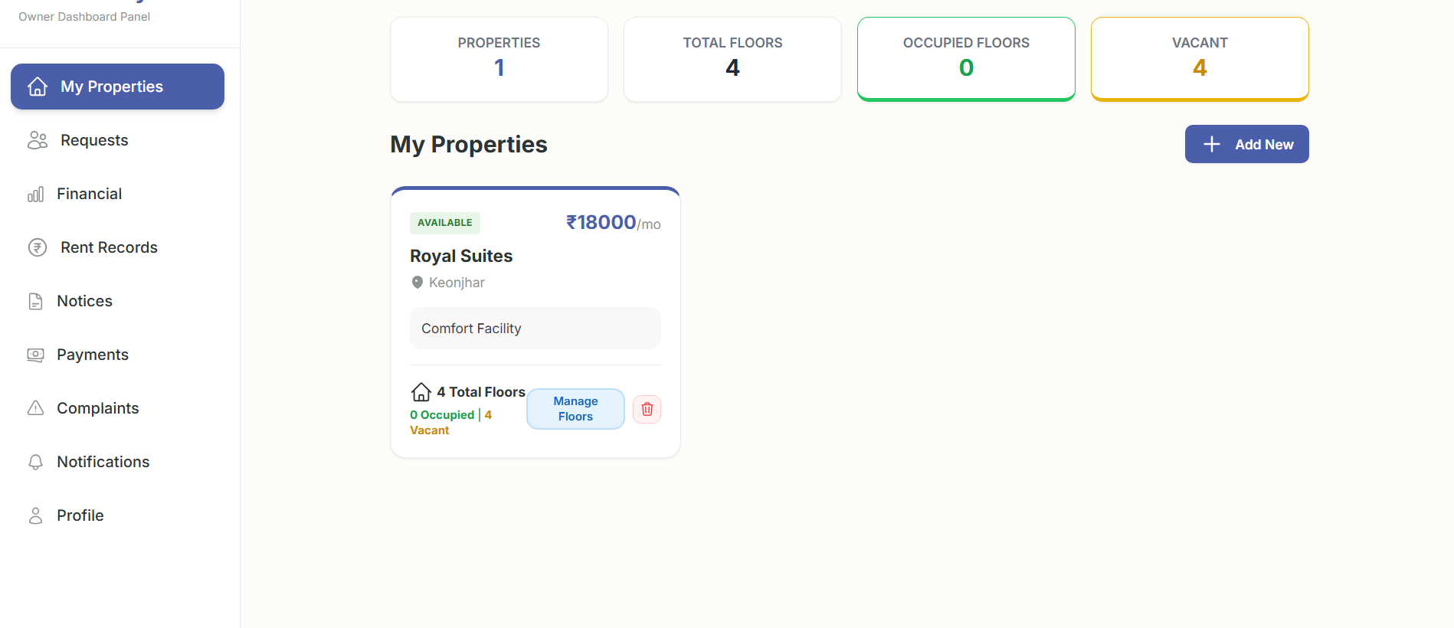
OWNER SIDE DASHBOARD

Slide 12
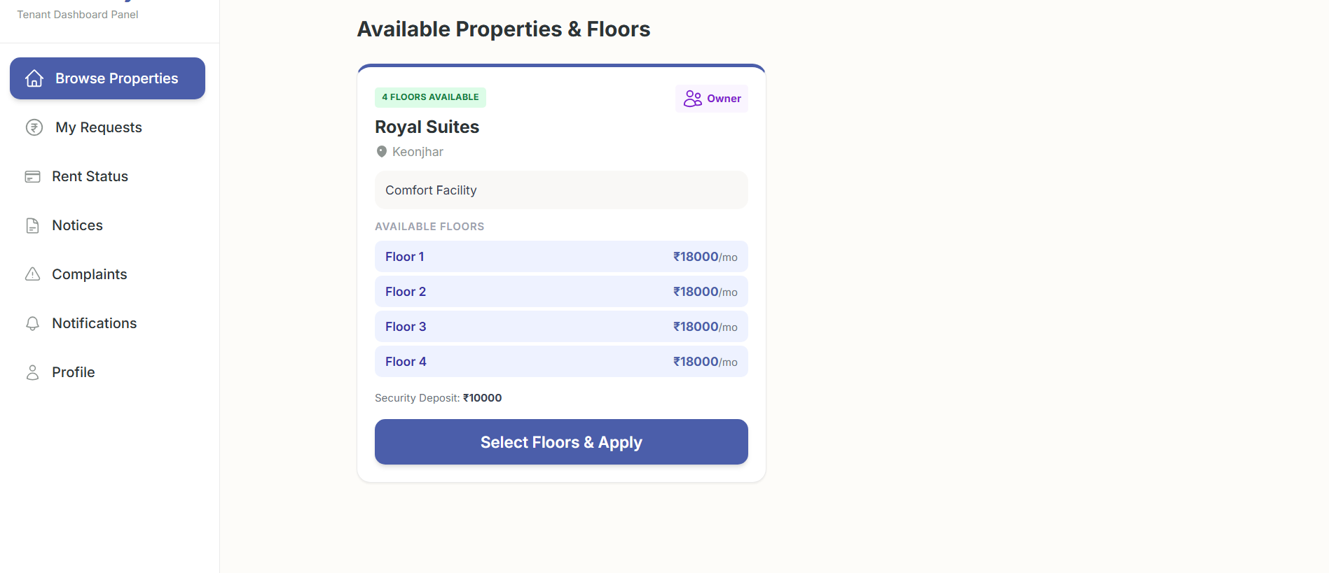
TENANT SIDE DASHBOARD

Slide 13
Future Enhancements
• Online payment gateway integration
• Mobile application development
• Notification system for rent reminders
• AI-based property recommendation
• Advanced analytics dashboard

Slide 14
Conclusion
RentEase provides a digital solution for efficient rental property management. It reduces manual work, improves data organization, and enhances communication between landlords and tenants.

Slide 15
Bibliography
• React.js Documentation
• Firebase Documentation
• Tailwind CSS Documentation
• Vercel Deployment Documentation
• Project GitHub Repository

