Slide 1
Smart Rental Property
Management System
A Smart Web-Based Rental Management Platform
Student: Satya Swadhhaya, Rahul Mishra, Md Mojahid , Tauhid Ahmed
Course: B.Sc — 6th Semester
College Dharanidhar University
Year: 2023 – 2026
UNDER THE GUIDANCE OF:
MR. SHUBHASHISH BEHERA
MR. SAMBIT
6th Semester Project Presentation

Slide 2
Contents
Presentation Roadmap
01
Introduction
06
Screenshots — Landing Page
02
Objectives
07
Screenshots — Owner Panel
03
Tech Stack & Requirements
08
Screenshots — Tenant & Payments
04
Features Overview
09
Future Enhancements
05
System Architecture
10
Conclusion & Bibliography

Slide 3
01
Introduction

Slide 4
Introduction
Understanding the problem & solution
What is Smart Rental Management?
Problems Without Digital Systems
🏠
Digital platform for property owners to manage tenants & payments
📝
Paper-based records — error-prone & slow
⚡
Replaces manual records with automated processes
⚠️
Rent disputes & tracking failures
📊
Real-time tracking of dues, complaints & notices
🚫
No centralized complaint system
💬
Centralized communication between landlords & tenants
🔒
No transparency for tenants on dues & rules

Slide 5
02
Objectives

Slide 6
Objectives
What our system aims to achieve
🔍
Easy Property Browsing
👥
Owner-Tenant Management
✅
Request & Approval Flow
Search by city, GPS location, price range filters
Multi-property, unit management, tenant tracking
Document upload, owner review, one-click approval
💳
Payment Simulation
🔔
Smart Notifications
📄
Document System
UPI, Card, Net Banking with QR code & transaction IDs
Auto reminders: 5-day, 2-day, due-date, overdue alerts
Cloudinary-based ID proof upload with validation

Slide 7
03
Hardware & Software Requirements

Slide 8
Hardware & Software
Technology stack powering the system
Hardware
Software Stack
🖥️
Device
Laptop/PC, 4GB+ RAM
⚛️
React.js + TypeScript
Frontend framework
⚙️
Processor
Intel i3 / Ryzen 3+
🔥
Firebase
Auth + Firestore DB
💾
Storage
256GB SSD/HDD
☁️
Cloudinary
Image/Doc uploads
⚡
Vite
🌐
Internet
Broadband/WiFi
Build tool
▲
Vercel
🖥️
Display
1280×720+
Deployment
💙
VS Code
IDE

Slide 9
04
Features Overview

Slide 10
Key Features
What makes this system powerful
🏢
🔍
✅
💳
Property Listing
Search & Filter
Request & Approval
Payment Gateway
Add properties with images, units, pricing
City, GPS, price range, popular cities
Apply with docs, owner reviews
UPI, Card, Net Banking, QR code
📊
⏰
📁
🛡️
Rent Tracking
Auto Reminders
Document Upload
Admin Panel
Pending/Paid/Overdue + late fees
5-day, 2-day, due-date alerts
ID proof via Cloudinary
Property approval, user mgmt

Slide 11
05
App Screenshots

Slide 12
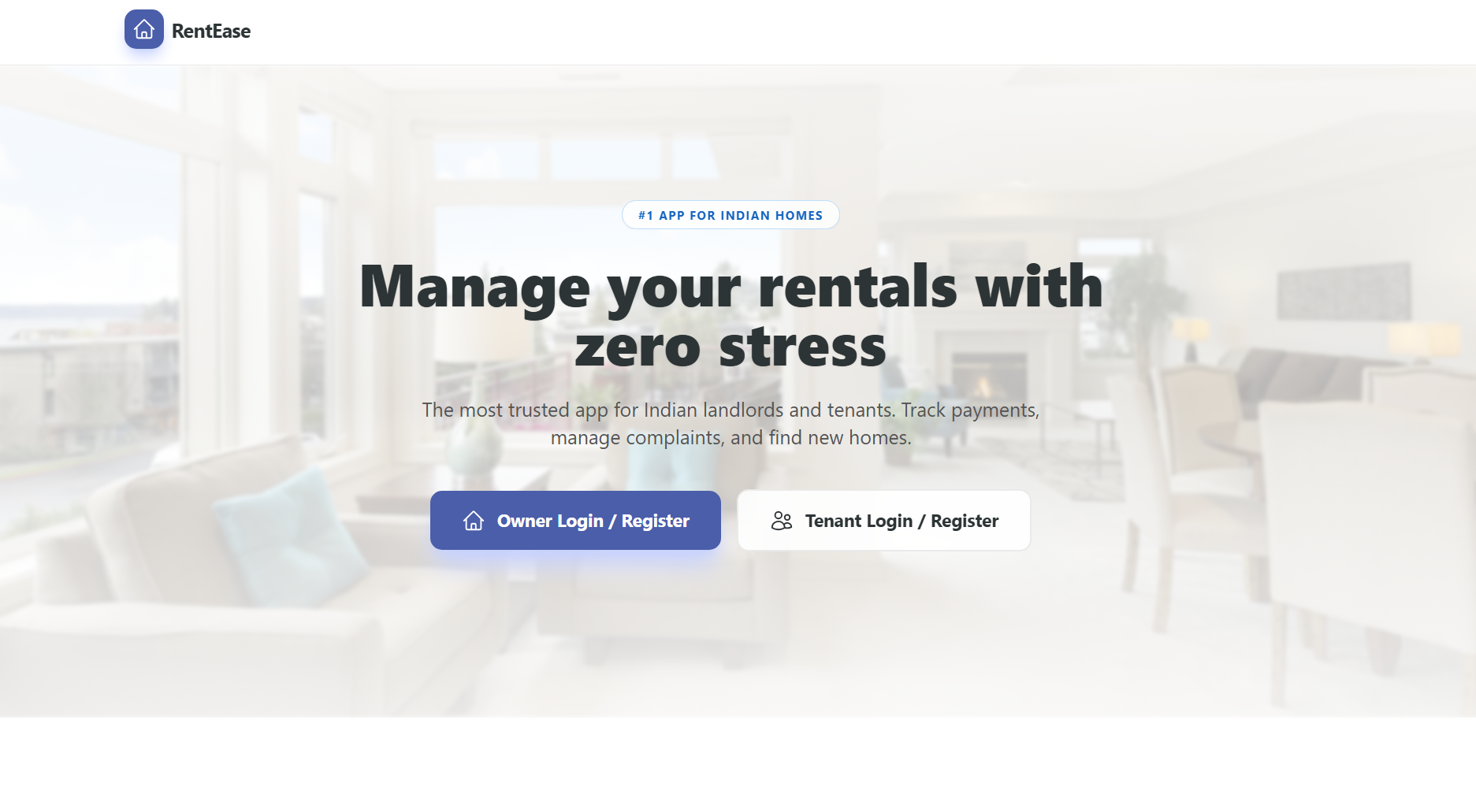
Landing Page Preview
User-friendly homepage with property browsing and filters
[ Insert Landing Page Screenshot ]
Clean, modern homepage • Property browsing • Role-based login
Clean, modern homepage • Property browsing • Role-based login

Slide 13
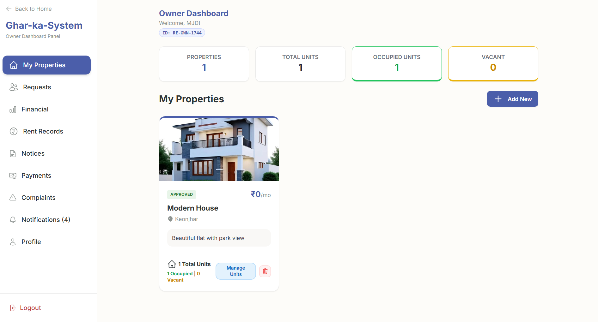
Owner Panel
Property management, tenant overview, financial reports
Owner Panel
[ Insert Screenshot ]
Dashboard
Properties
Tenants
Rent Records
Finances
Notices

Slide 14
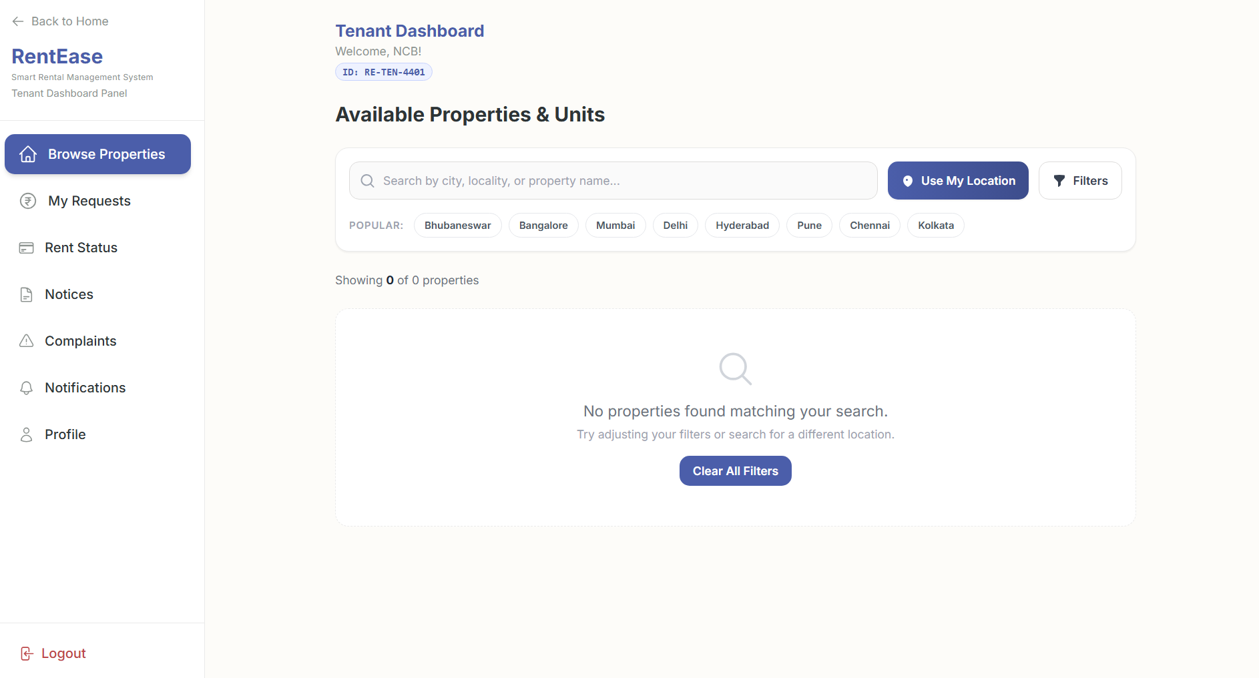
Tenant Dashboard
Browse properties, apply with documents, track rent status
Tenant Dashboard
[ Insert Screenshot ]
Search
Filter
Apply
Documents
Rent Status
Profile

Slide 15
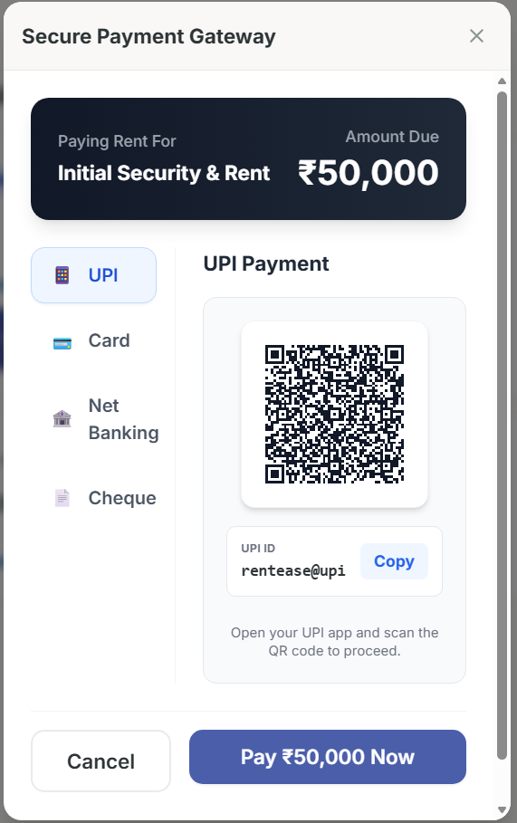
Payment System
UPI, Card, Net Banking with QR code and transaction tracking
Payment System
[ Insert Screenshot ]
UPI Pay
Card
Net Banking
QR Code
Transaction ID
Success

Slide 16
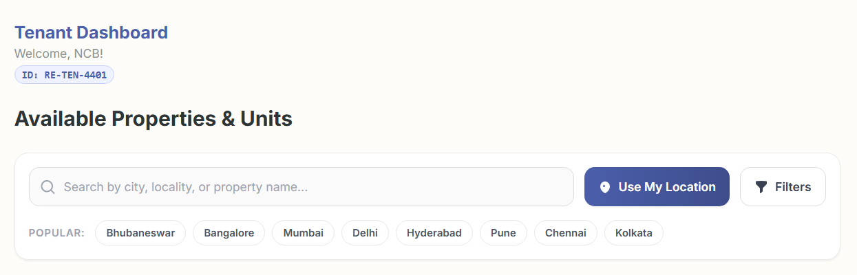
Property Search & Filters
City search, GPS location, price range, popular cities
Property Search & Filters
[ Insert Screenshot ]
City Search
GPS Detect
Price Range
Popular
Filter Tags
Results

Slide 17
RENTEASE
SMART RENTAL MANAGEMENT SYSTEM
COMING TO ITS
WORKING

Slide 18
06
Future Enhancements

Slide 19
Future Enhancements
Where this system is heading next
💳
Razorpay / Stripe
🤖
AI Recommendations
Live rent collection with receipts
ML-based property suggestions
💬
In-App Chat
📱
Mobile App
Real-time owner-tenant messaging
React Native for iOS & Android
📈
Advanced Analytics
🗓️
SMS/Email Automation
Income trends, occupancy forecasting
Server-side scheduled reminders

Slide 20
Conclusion
Simplifies the entire rental lifecycle — listing to payment.
✅
Eliminates paperwork with automated rent cycles & late fees.
Improves transparency through real-time notifications.
Scalable architecture — ready for real payment gateways.
Modern tech stack ensures reliability & security.

Slide 21
Bibliography
Sources & References
[1]
Firebase Docs
firebase.google.com/docs
[2]
React Documentation
react.dev
[3]
Cloudinary Docs
cloudinary.com/documentation
[4]
TypeScript Handbook
typescriptlang.org/docs
[5]
Vite Documentation
vitejs.dev
[6]
Vercel Docs
vercel.com/docs
[7]
Stack Overflow
stackoverflow.com

Slide 22
Thank You!
Smart Rental Property Management System
Questions & Feedback are Welcome
Presented by: Mohammad Mojahid | B.Tech CSE — 6th Semester

