Slide 1


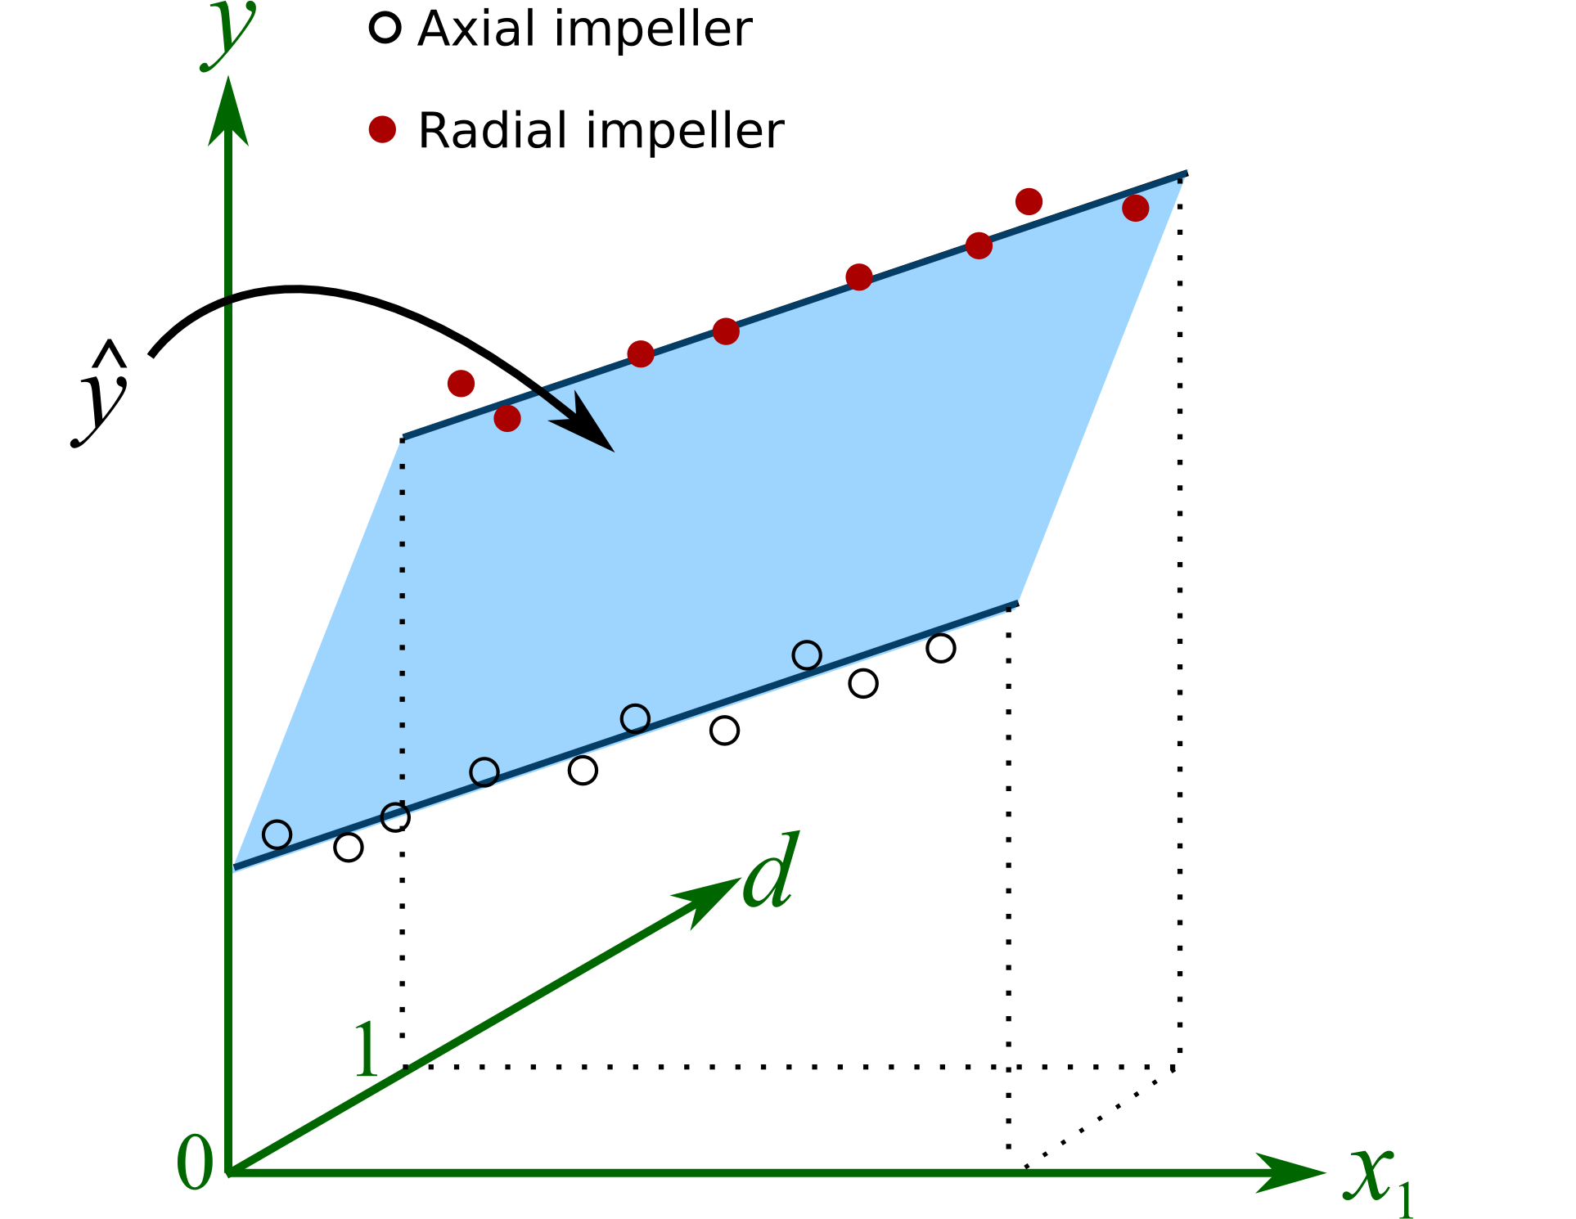
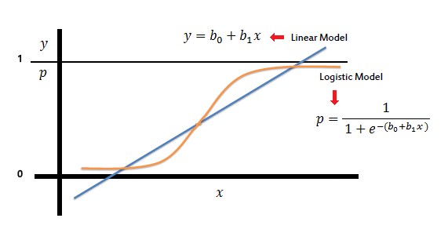
Multiple Linear Regression Logistic Regression Models by Python

Slide 2
Submitted by
Mohammad Monjur-E-Elahi
Course: Data Mining- Advanced Statistical Modeling [DSA09]
Program: Data Science and Application - Advanced Diploma [6060]
Metro College of Technology
Date: 30 April, 2021

Slide 3
The Project: Multiple Linear Regression
Familiarize with the dataset
Perform Exploratory Data Analysis
Prepare Dataset for sklearn
Build Linear Regression Machine Learning Model
Evaluate Performance of the Model

Slide 4
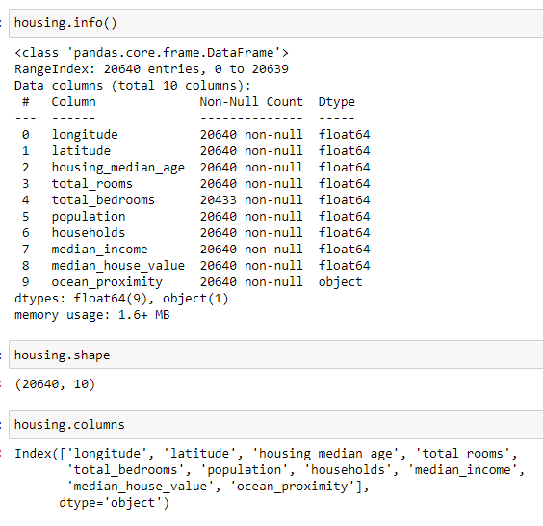
Dataset housing.csv from Kaggle.org
“median_house_value” was our target column
Rows:
10,640,
Columns:
10
Target
Column:
Median_house_value

Slide 5
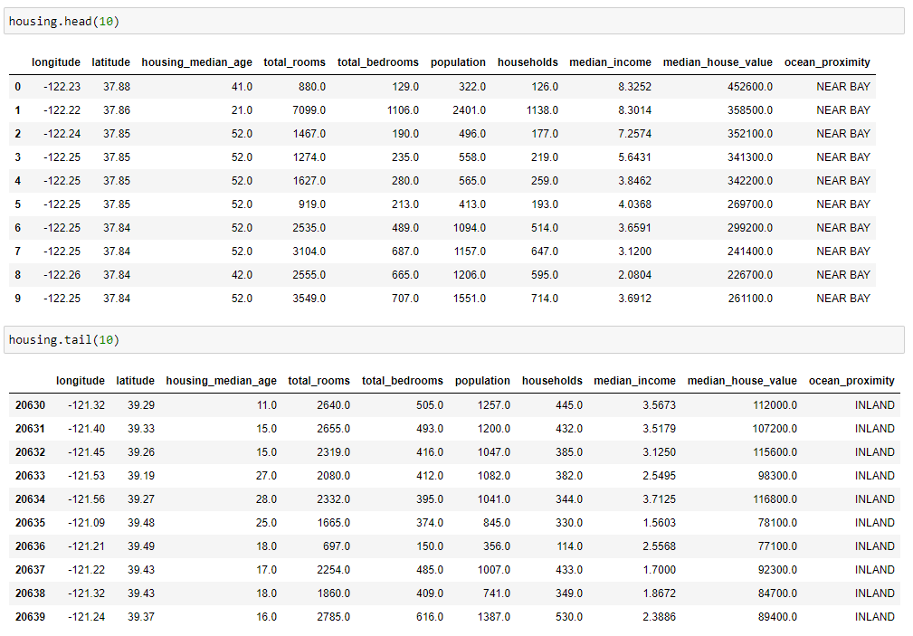
The Dataset

Slide 6
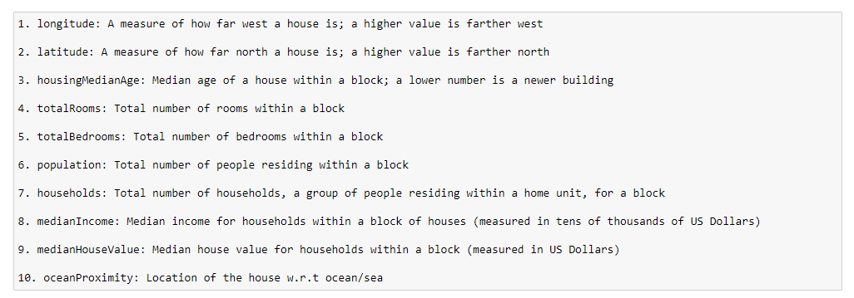
Meaning of Features
As found in:
Kaggle.org

Slide 7
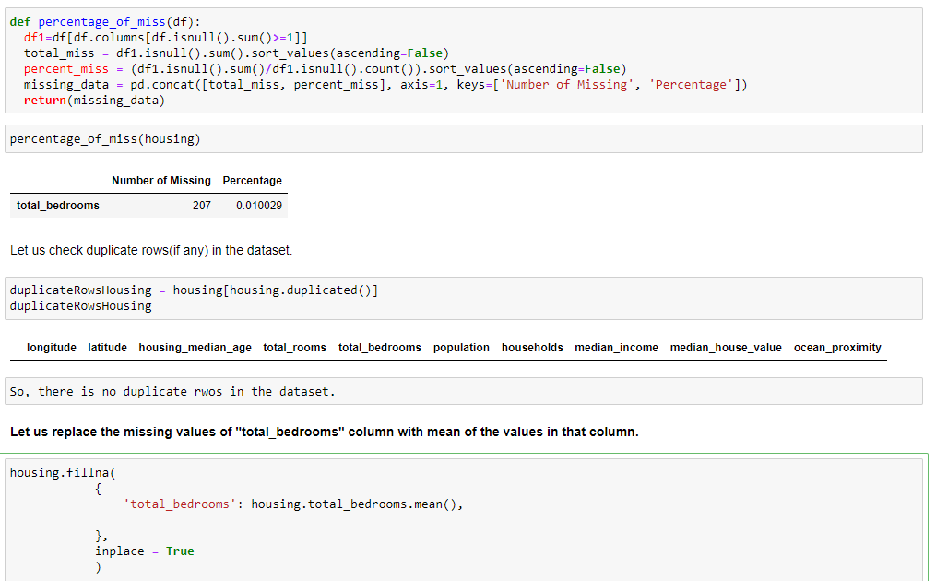
Treating Missing values
Duplicates:
No
Missing:
total_bedrooms

Slide 8
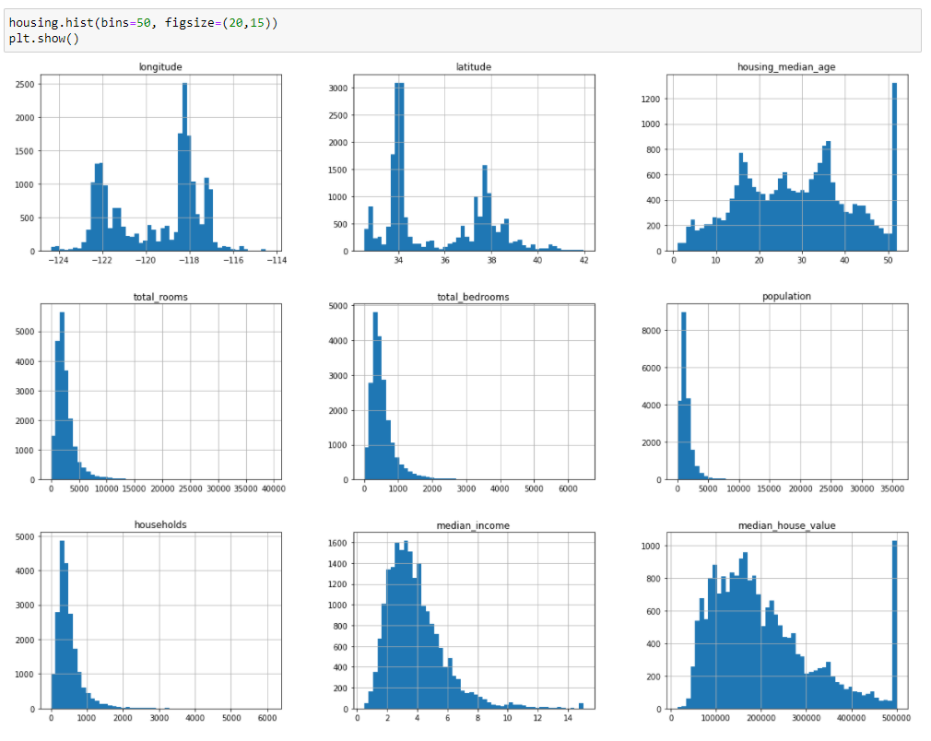
Visualization of the Numeric features

Slide 9
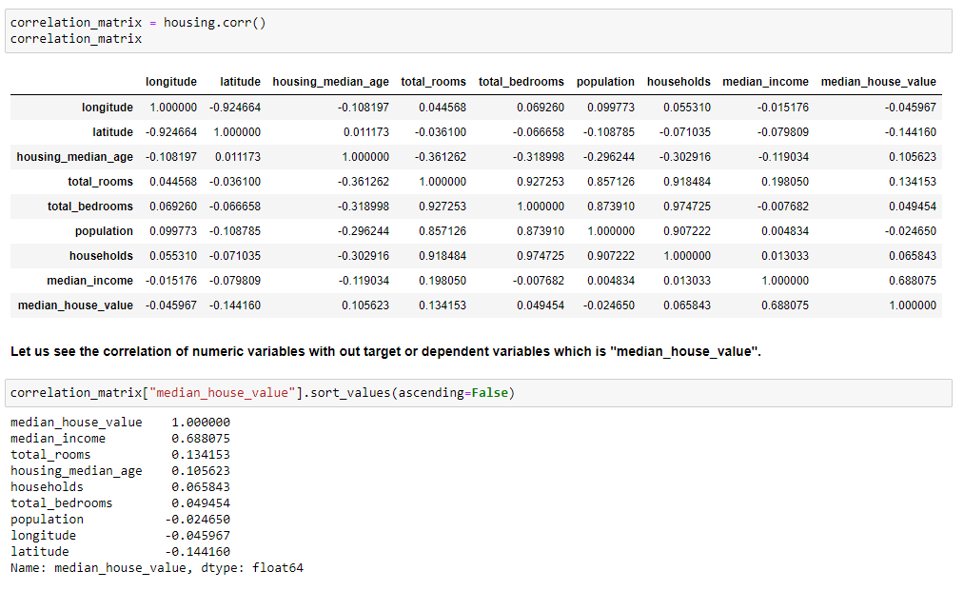
Correlation among the numeric features
Highest correlation with the target

Slide 10
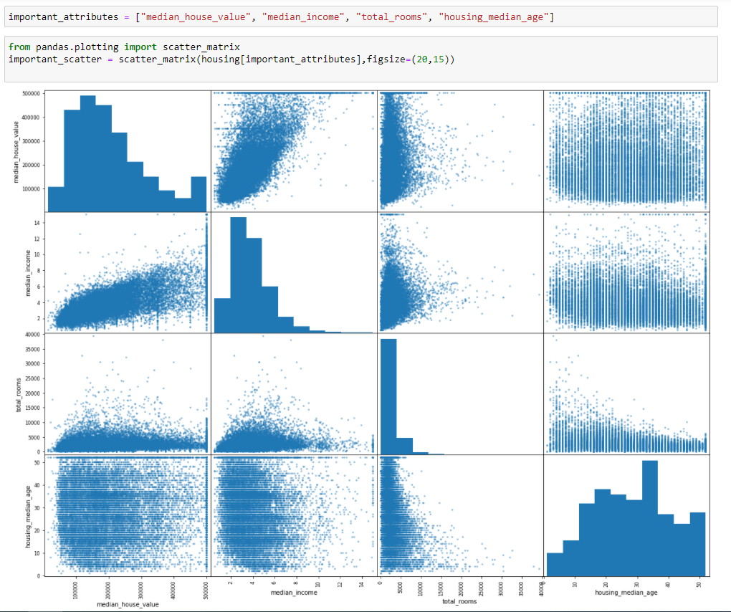
Scatter Plot Among Important Features

Slide 11
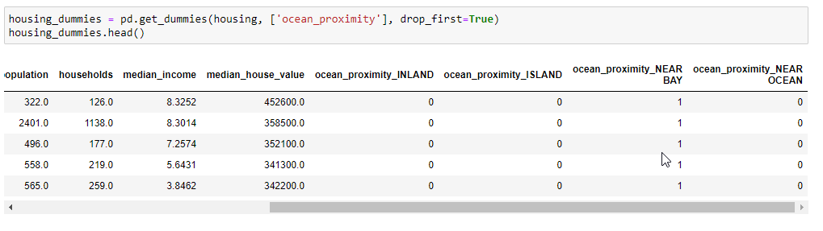
Converting Categorical Feature into Dummies

Slide 12
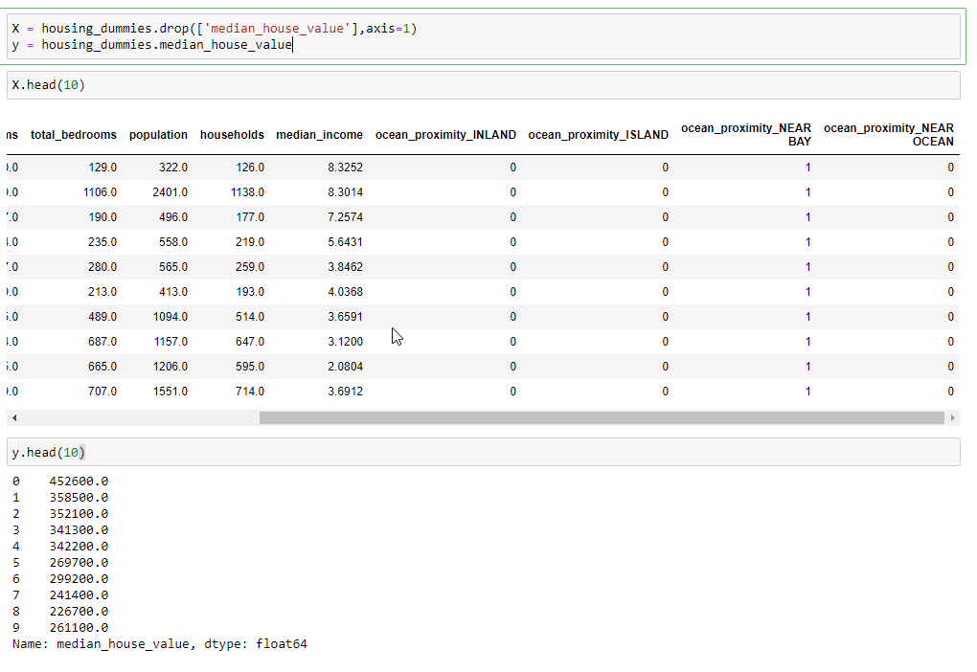
Extract Dependent and Independent Variables

Slide 13
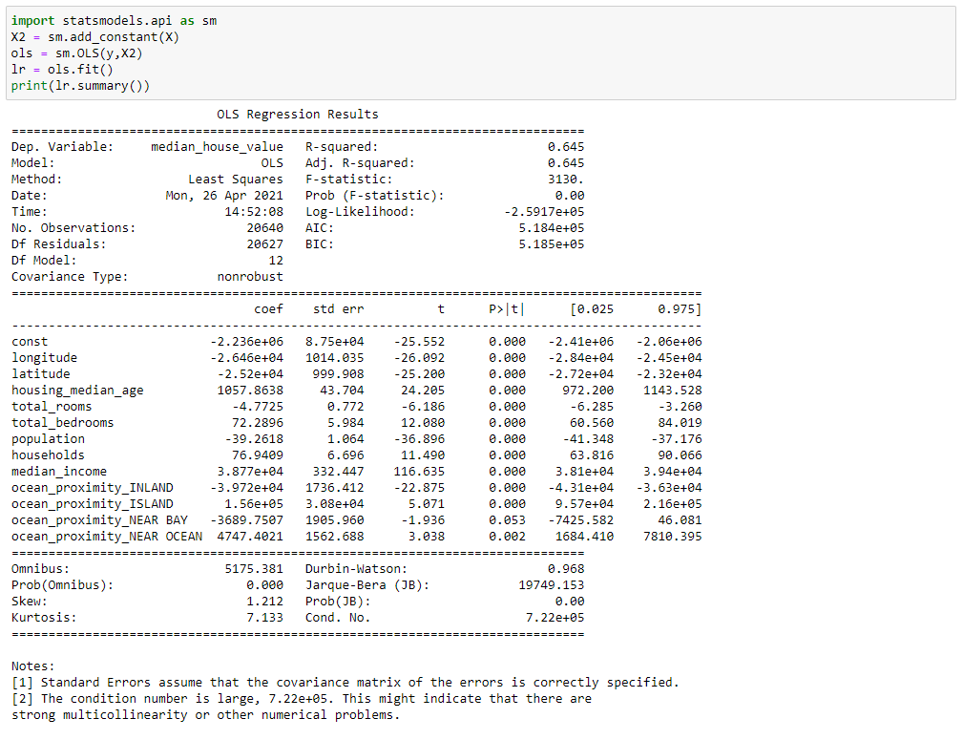
Checking p-values of the Independent variables

Slide 14
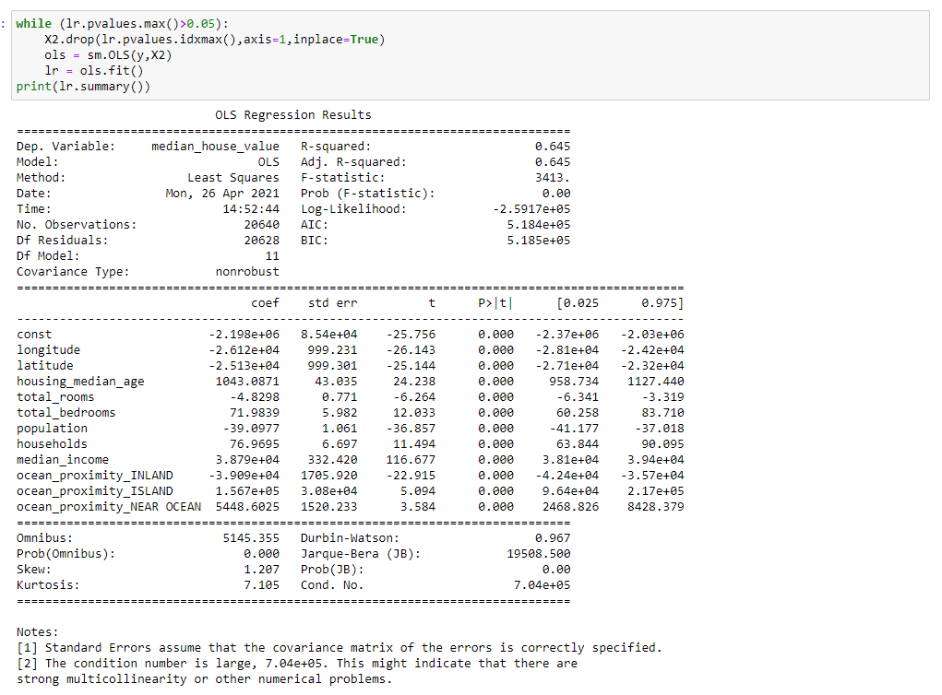
Backward Feature Elimination

Slide 15
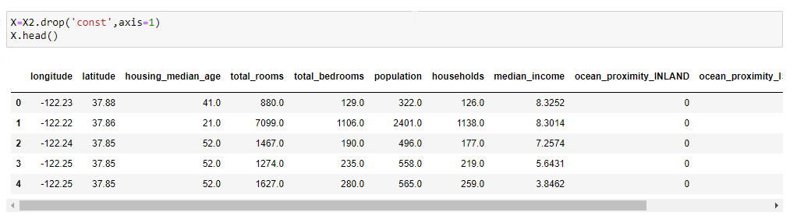
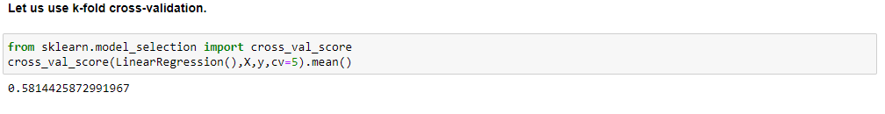
K-Fold Cross Validation

Slide 16
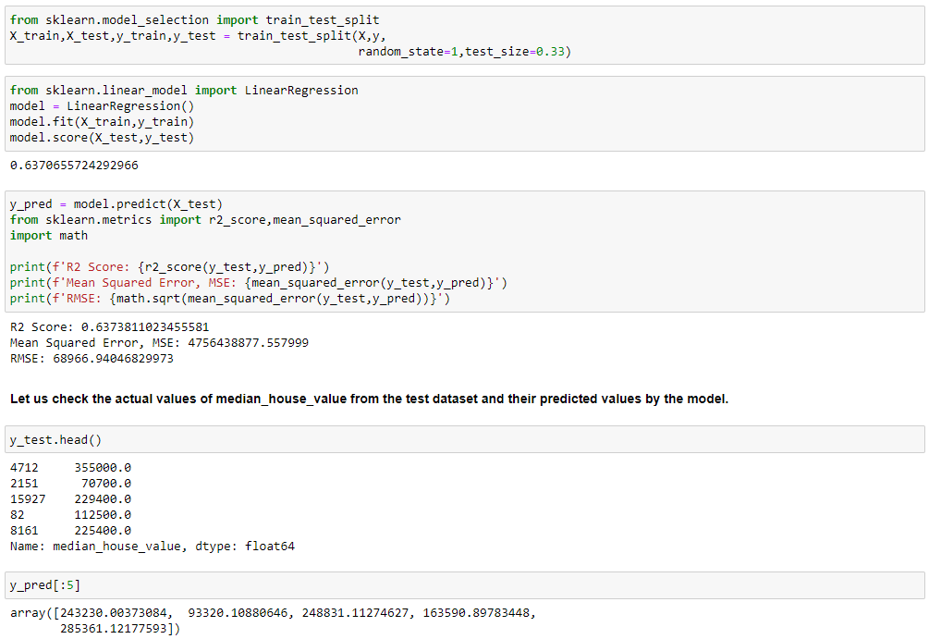
Training, Model, Prediction and Evaluation
Scores of the Model

Slide 17
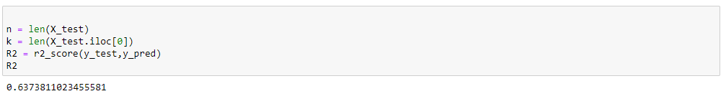
Adjusted R2

Slide 18
Conclusion
The model seems to be a moderate one since the k-fold-cross-validation, R^2 value and Adjusted R^2 values are not substantially high.
Need to deal with the multi-collinearity among independent features
So, we might need to try for other machine learning models like decision tree to achieve better results

Slide 19
The Project: Logistic Regression
Familiarize with the Dataset
Perform Exploratory Data Analysis
Prepare Dataset for sklearn
Build Logistic Regression Machine Learning Model
Evaluate Performance of the Model

Slide 20
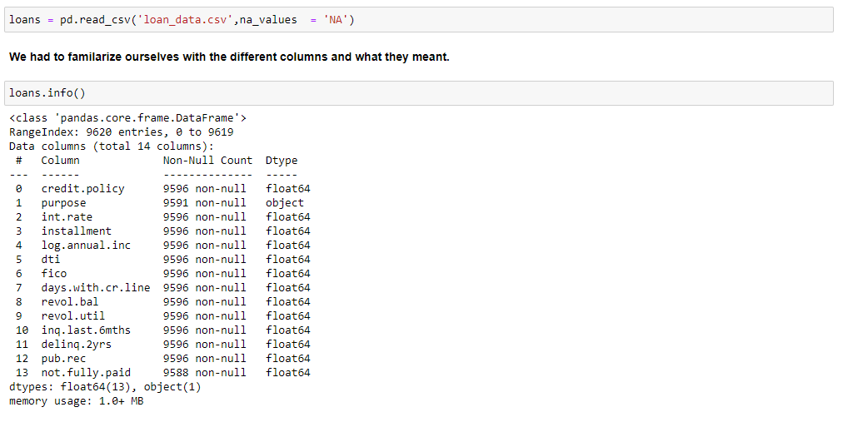
The Dataset
Dataset loan_data.csv LendingClub.com
“NotFullyPaid” was our target column
Rows:
9620,
Columns:
14
Target
Feature:
NotFullyPaid

Slide 21
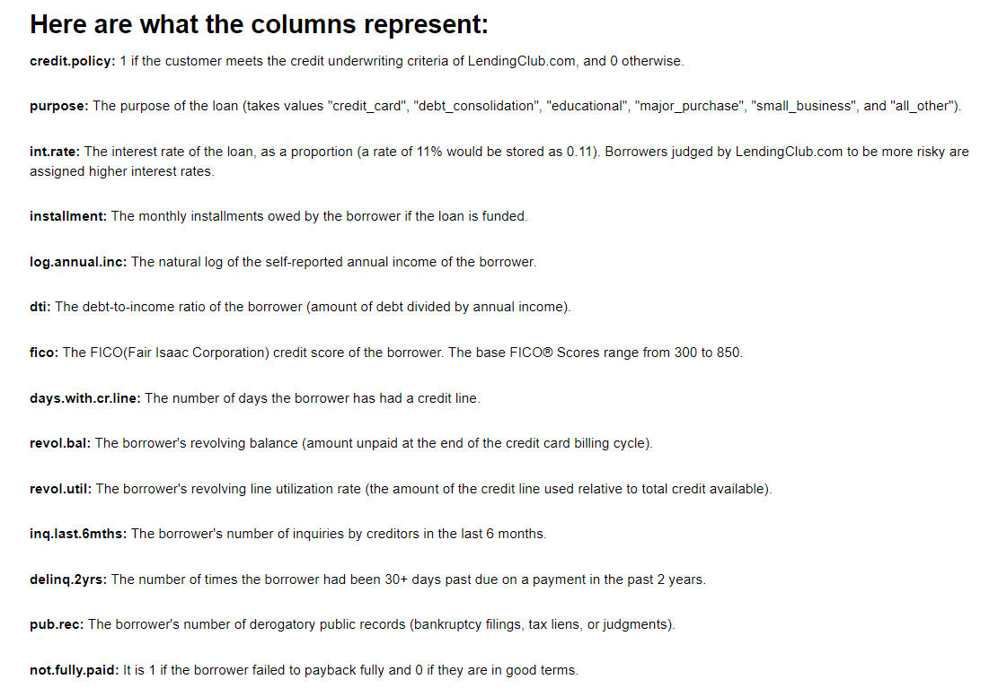
Meaning of Features
Familiarize:
Meaning of Features

Slide 22
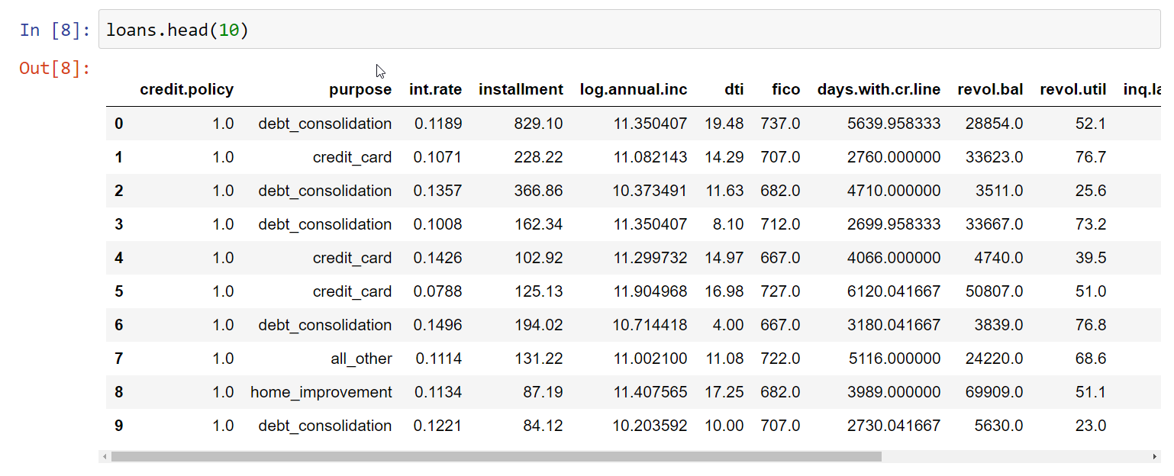
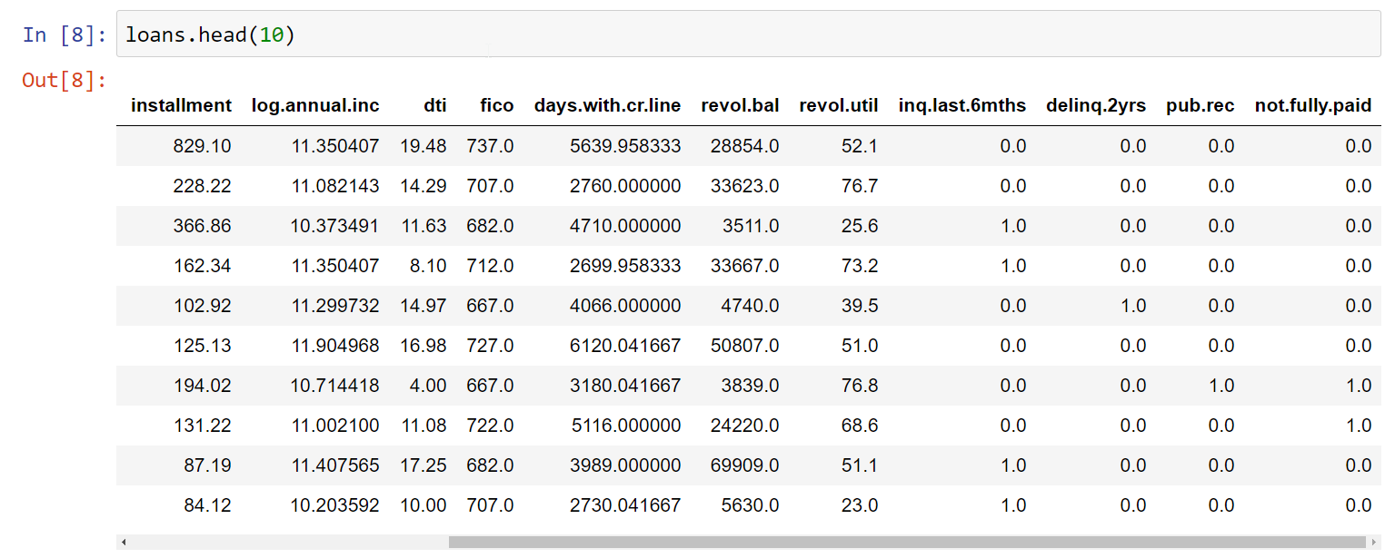
The dataset

Slide 23
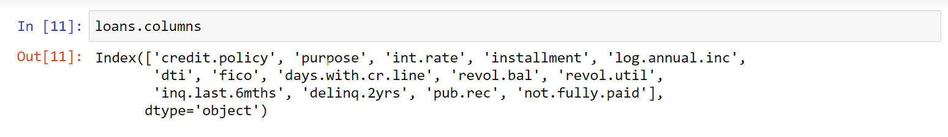
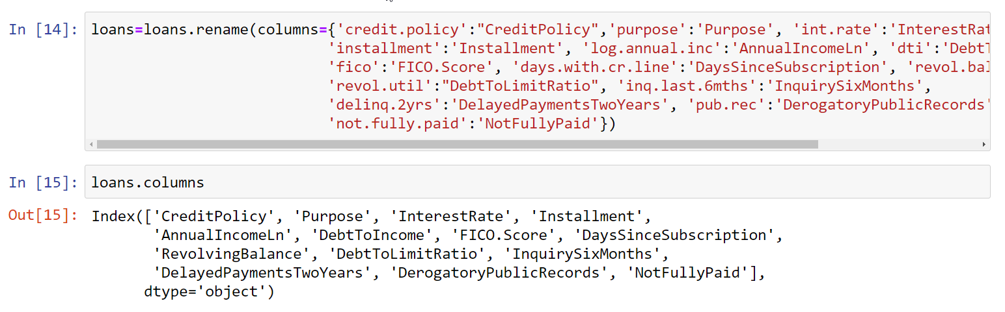
Renamed the Columns
Used rename to
Change column
names

Slide 24
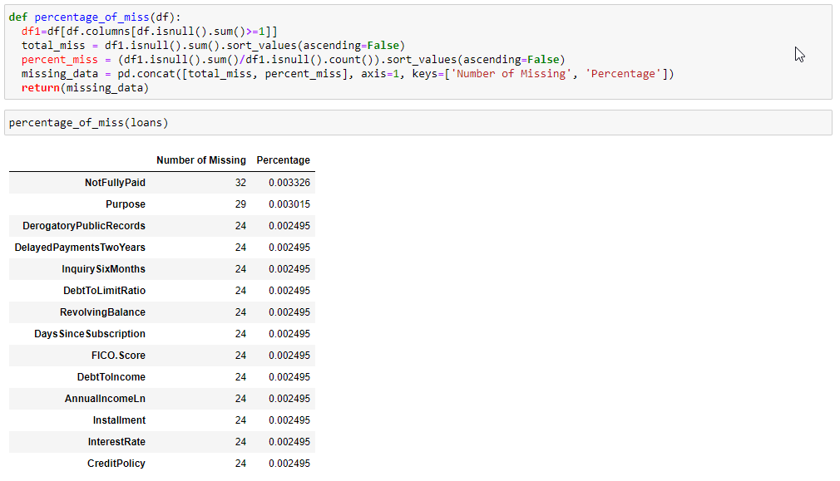
Dealing with null values and duplicate rows
Visualization:
Missing, Null

Slide 25
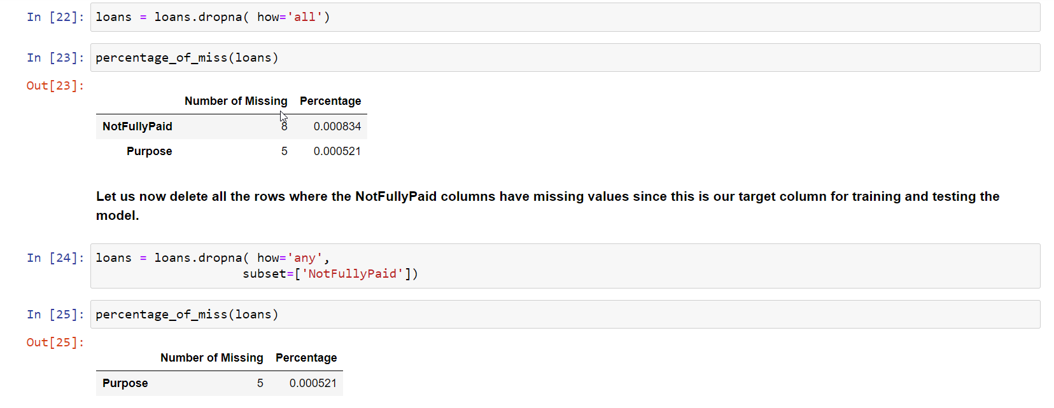
Dealing with null values and duplicate rows
Dropping null for all columns
Dropped 8 rows where target column had null

Slide 26
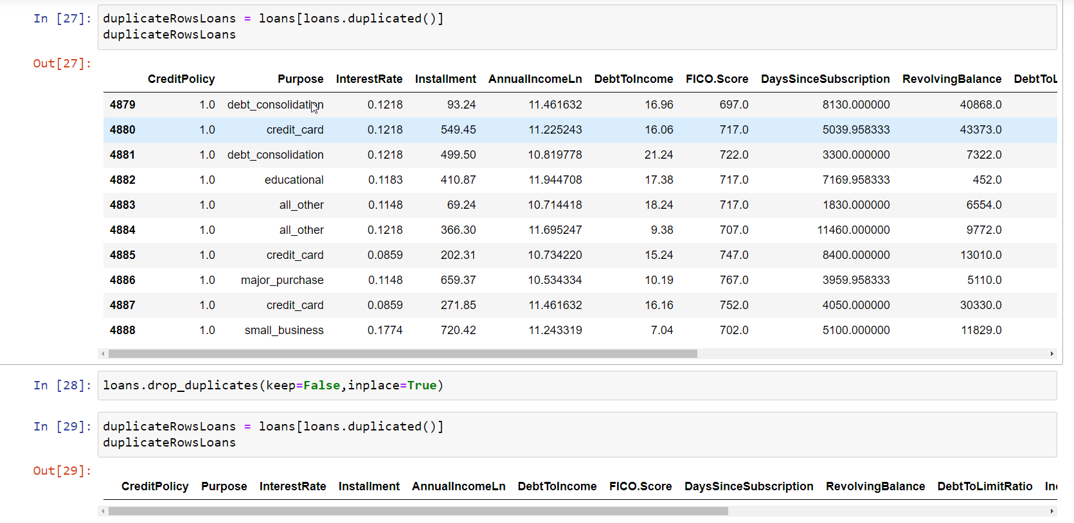
Dealing with null values and duplicate rows
Removed all duplicate rows

Slide 27
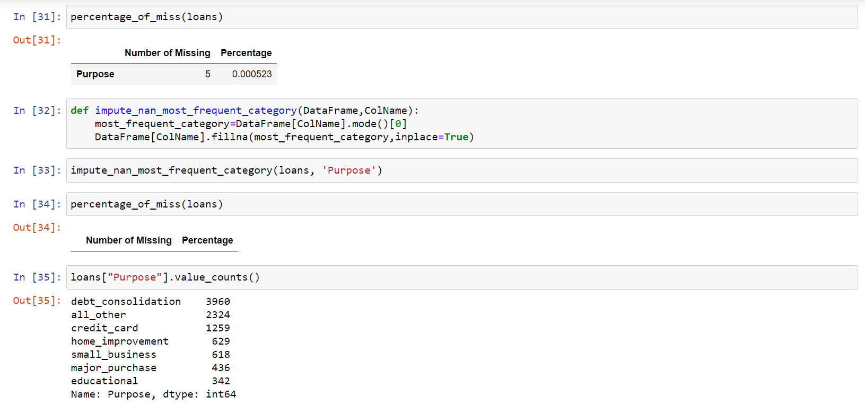
Dealing with null values and duplicate rows
UDF to handle missing value of Purpose with mode

Slide 28
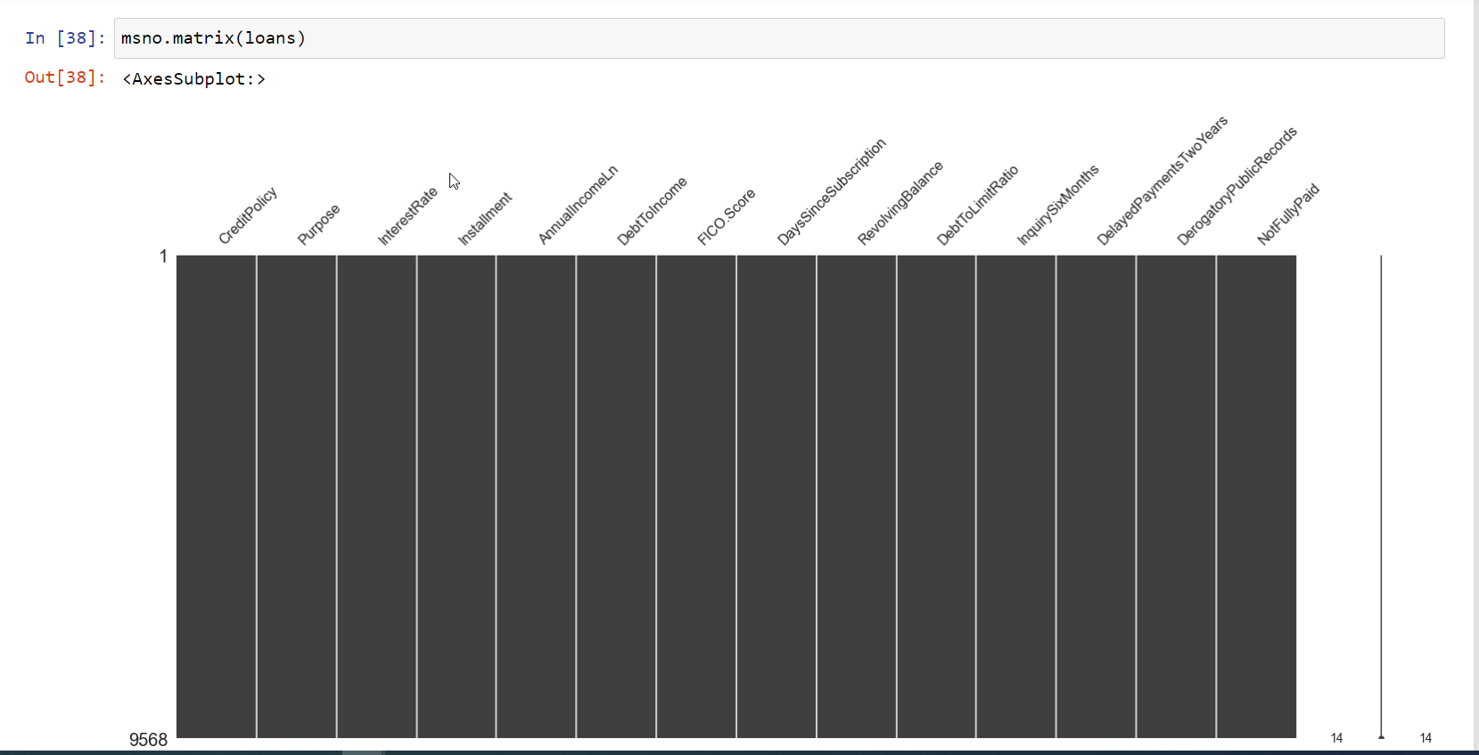
Dealing with null values and duplicate rows Visualization
No Horizontal white lines depicting no missing values

Slide 29
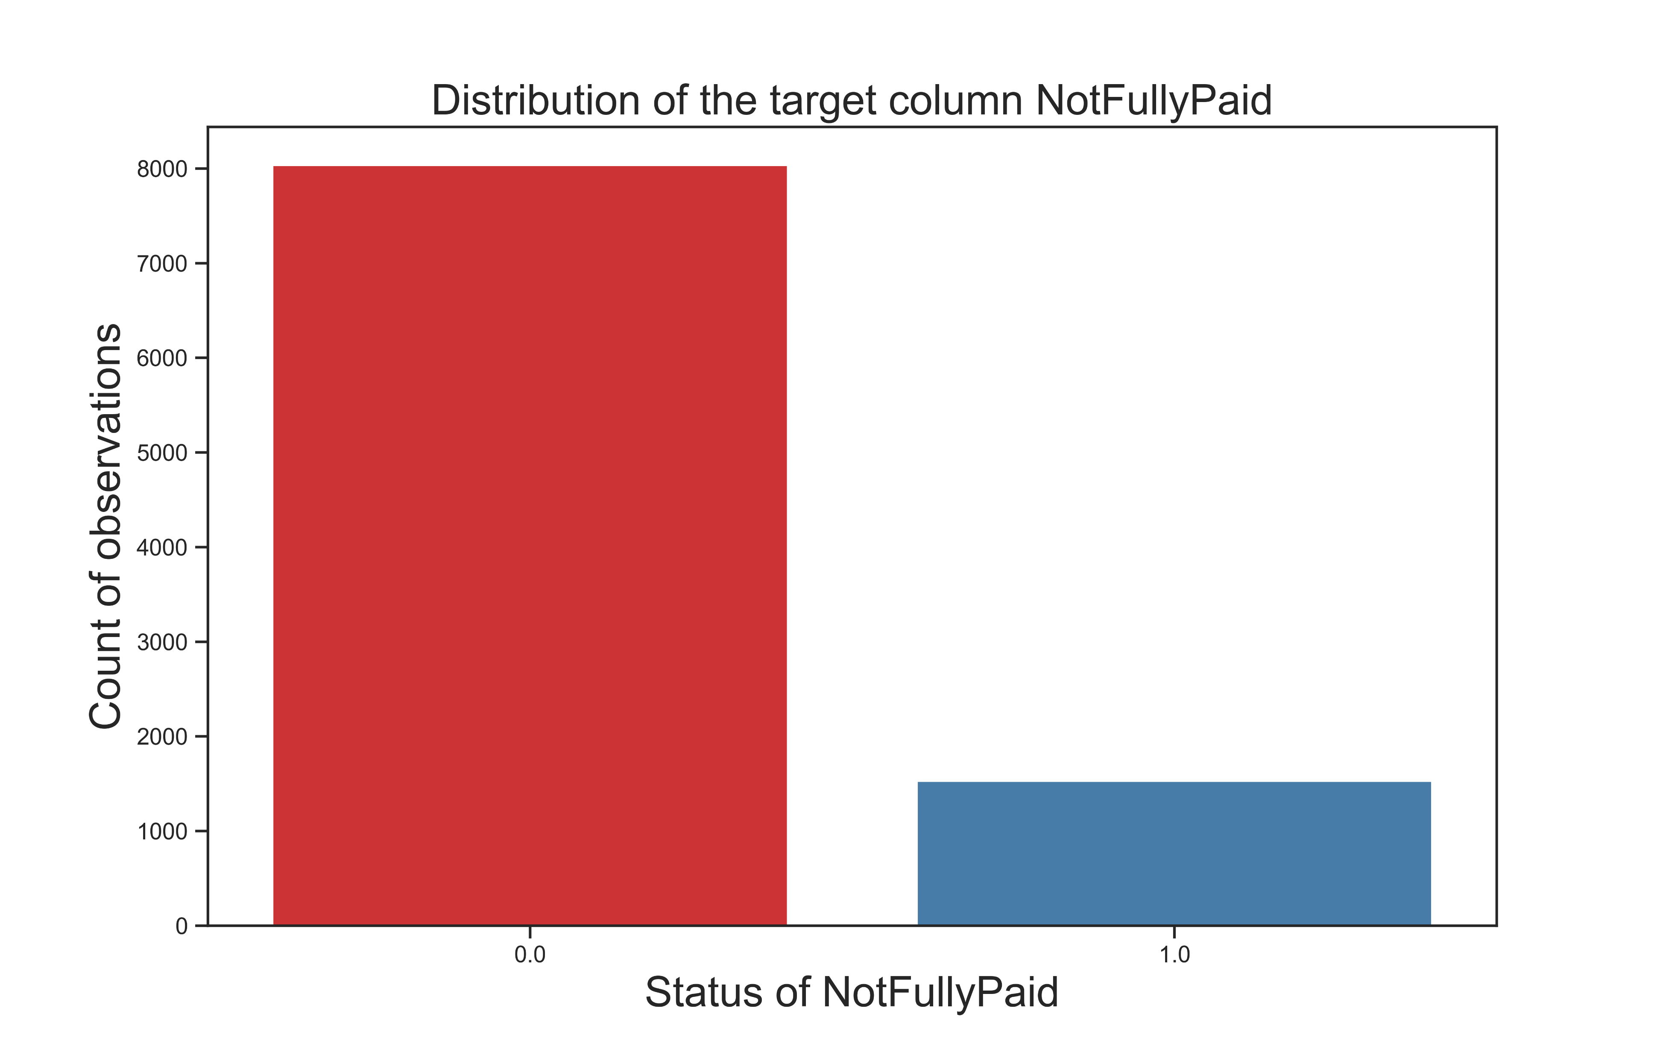
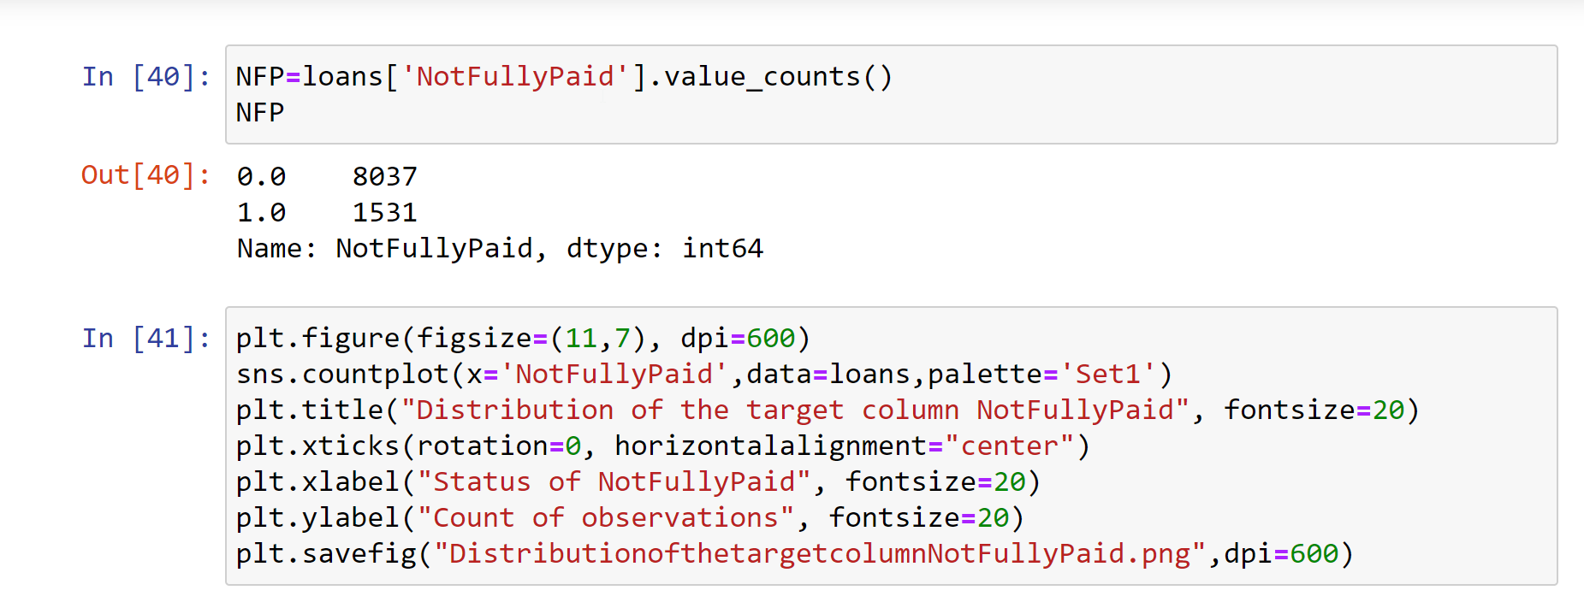
The target Column: “NotFullyPaid” Distribution
We are dealing with unbalanced data

Slide 30
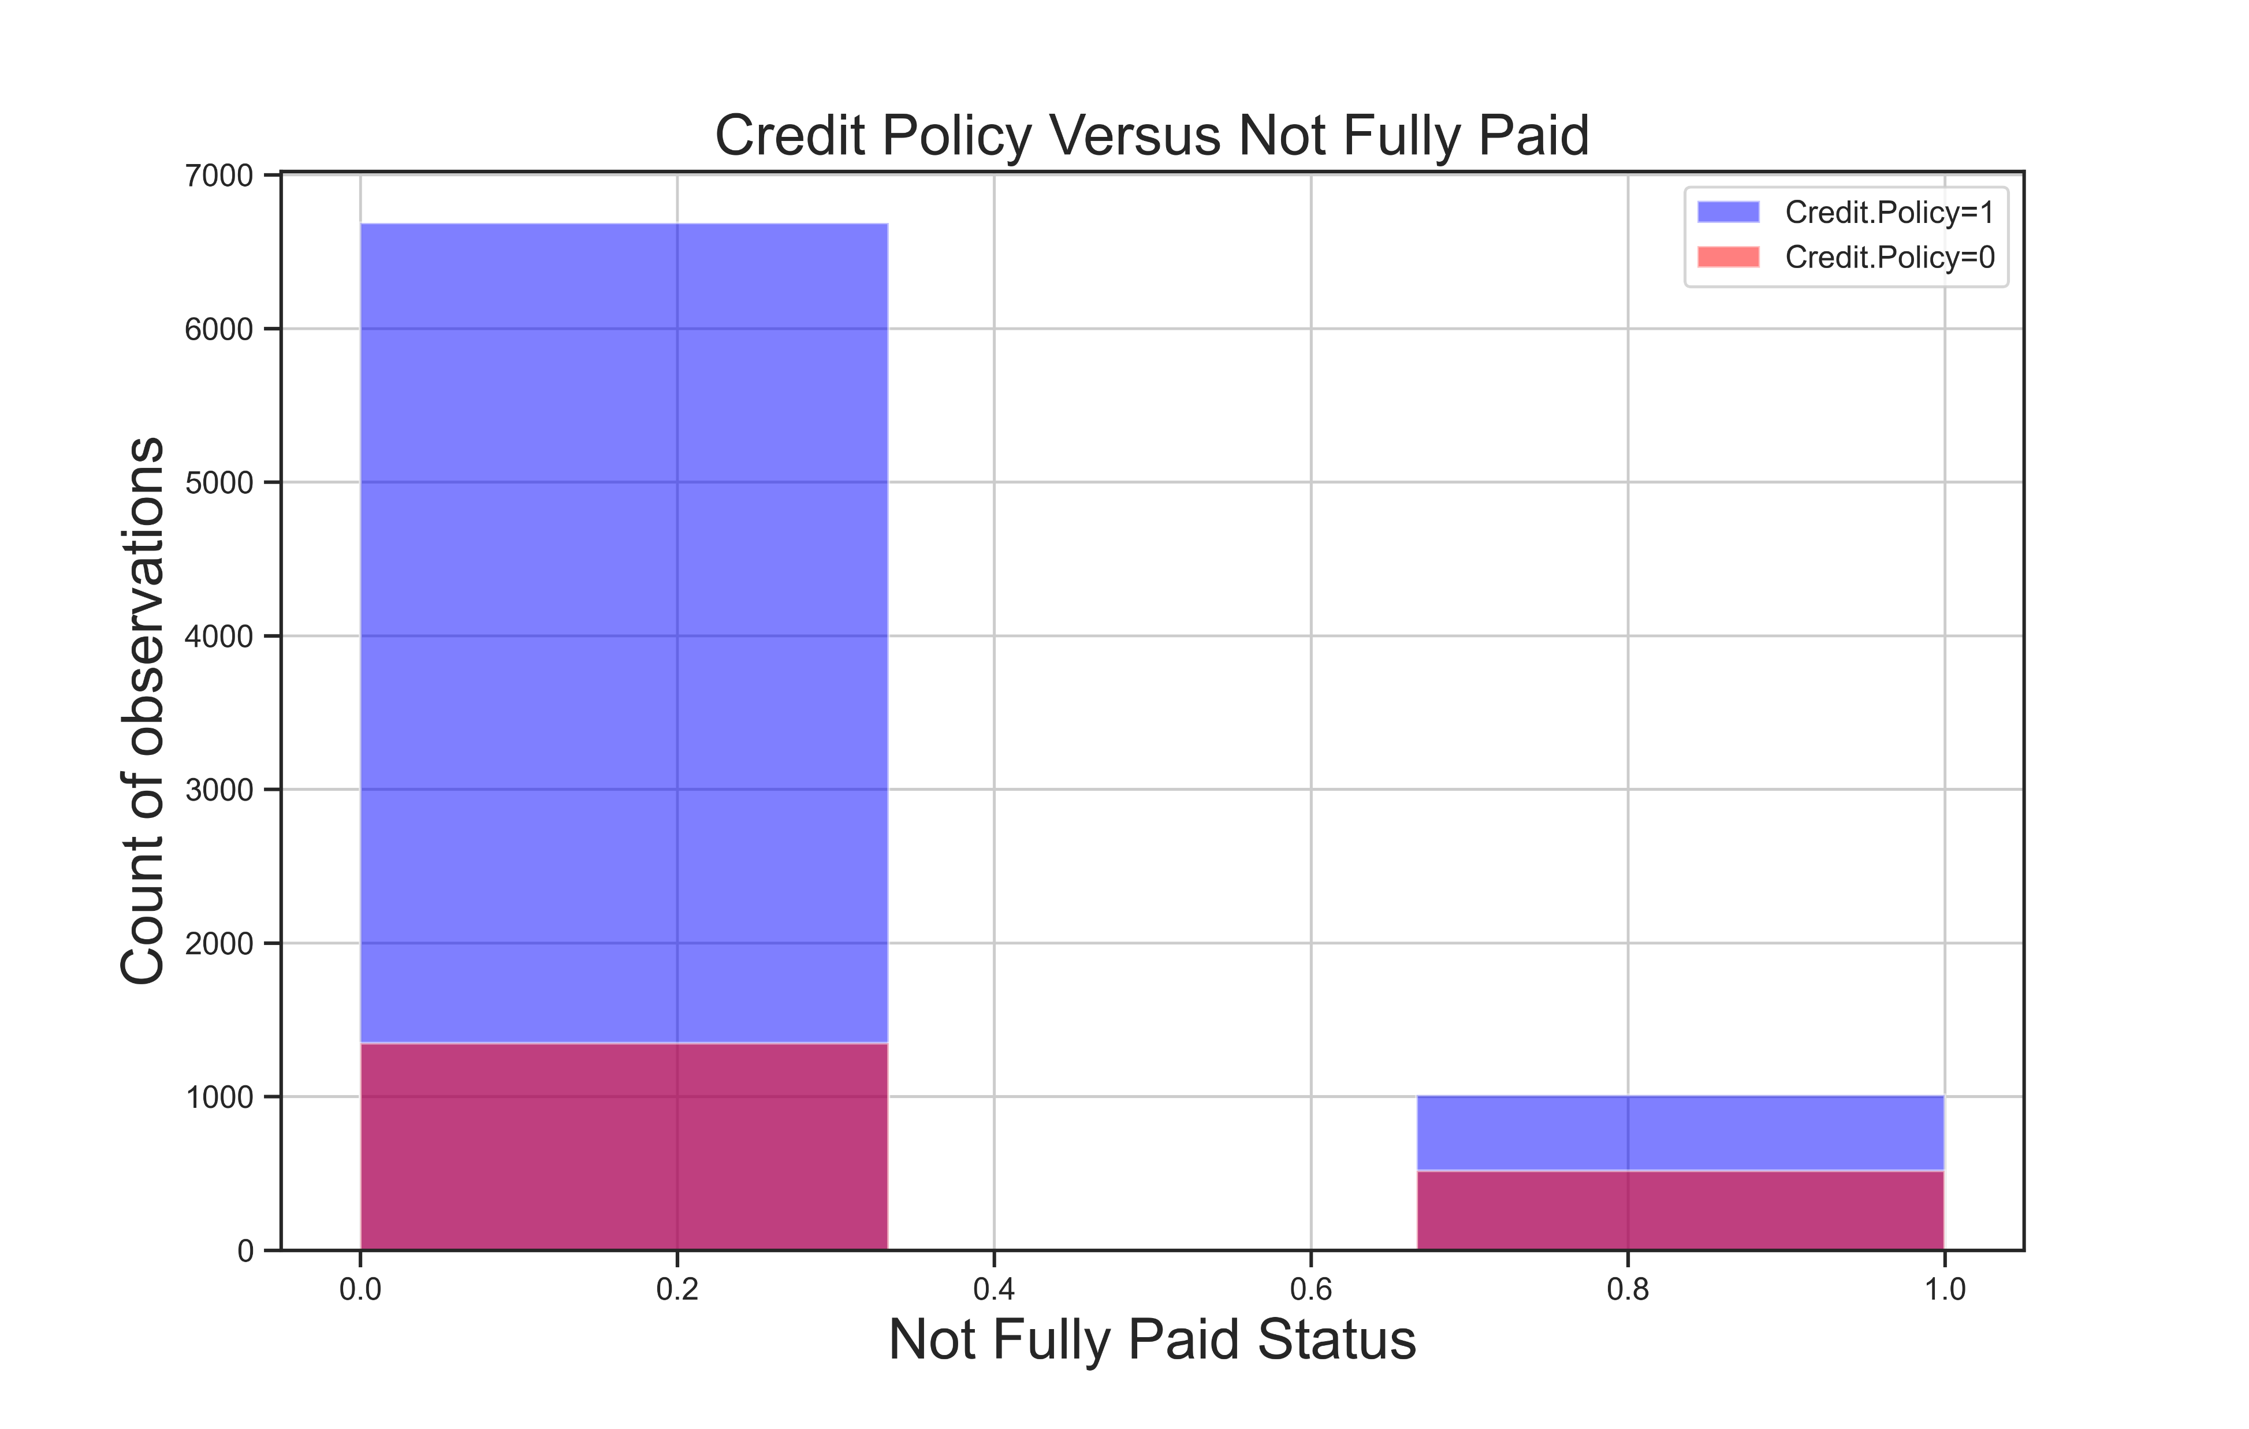
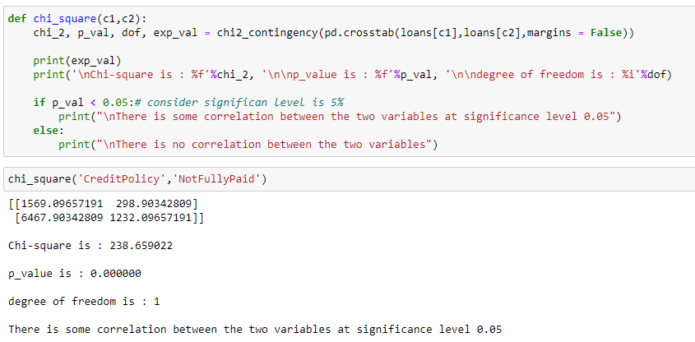
Analysis of CreditPolicy and Target Column Categorical versus categorical
Shows statistically significant association

Slide 31
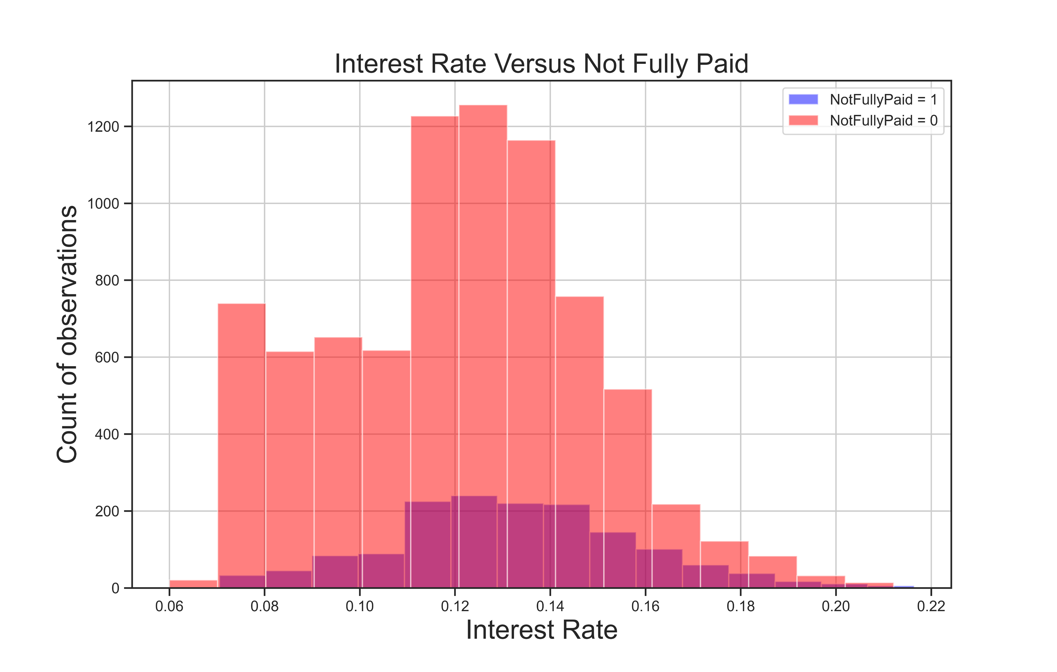
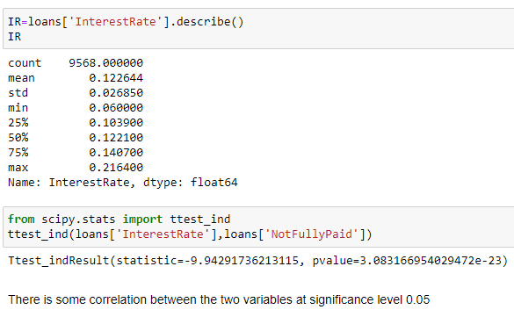
Analysis of InterestRate and Target Column
Numeric versus categorical
Shows statistically significant association

Slide 32
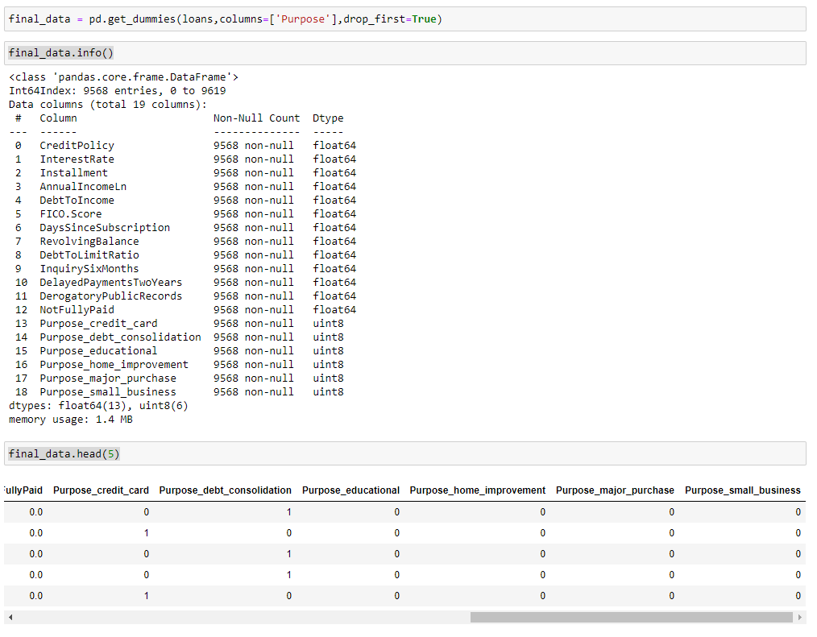
Creating the Dummy Variables
Dummy
Variables:
Sklearn
Library
Understands
Numerical
only

Slide 33
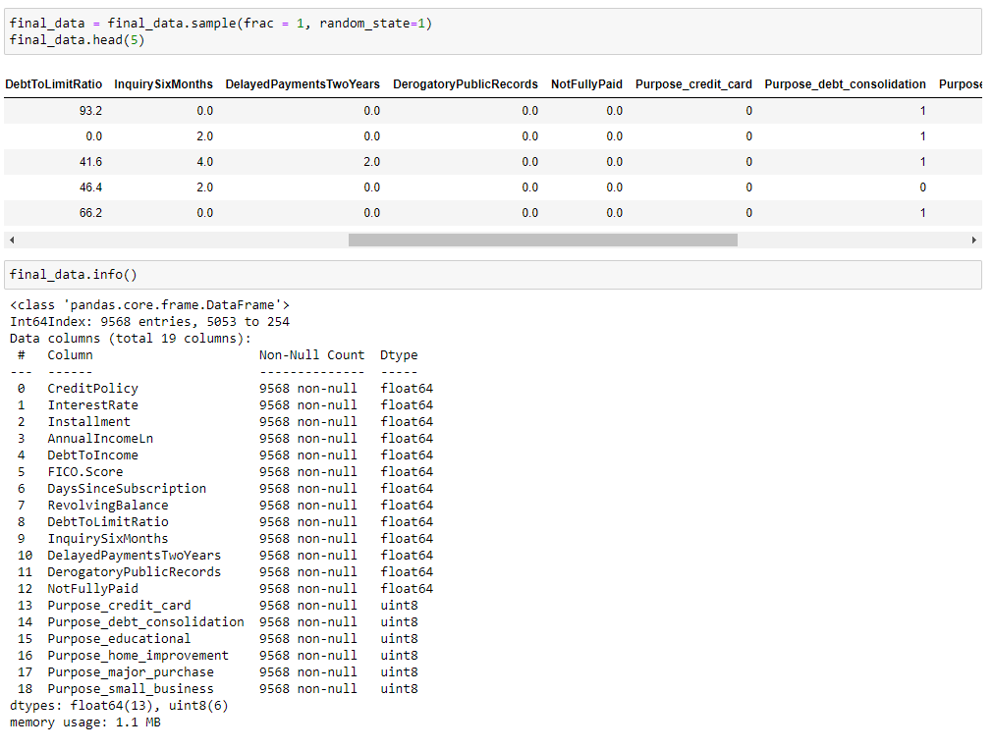
Shuffled the dataset for proper sampling

Slide 34
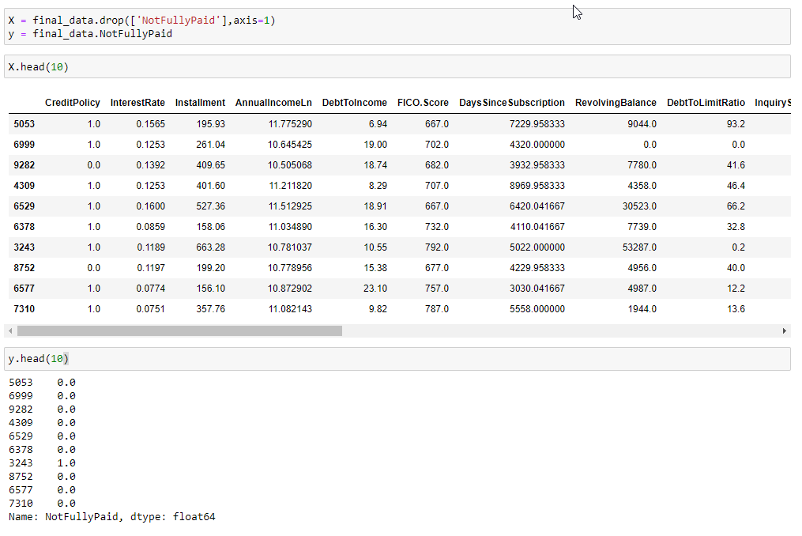
Extract Dependent and Independent variables

Slide 35
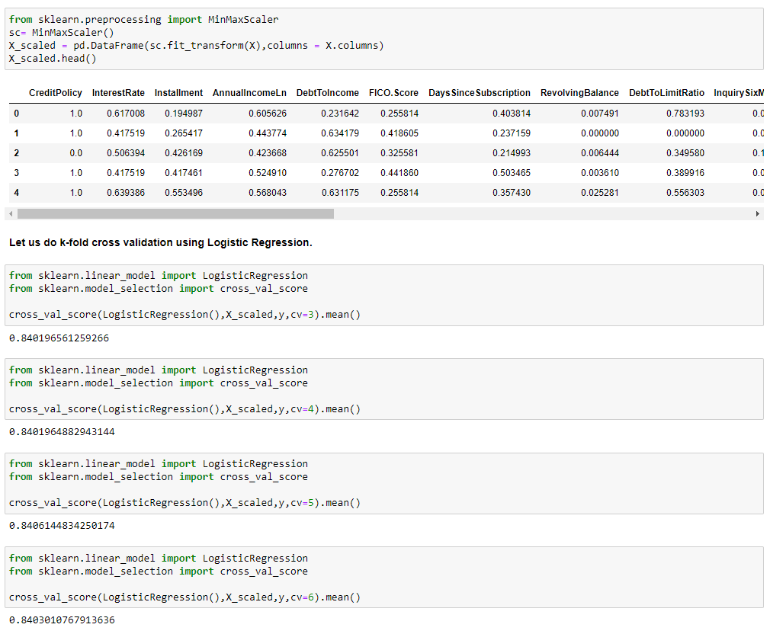
Scaling the Independent Variable and k-fold validation

Slide 36
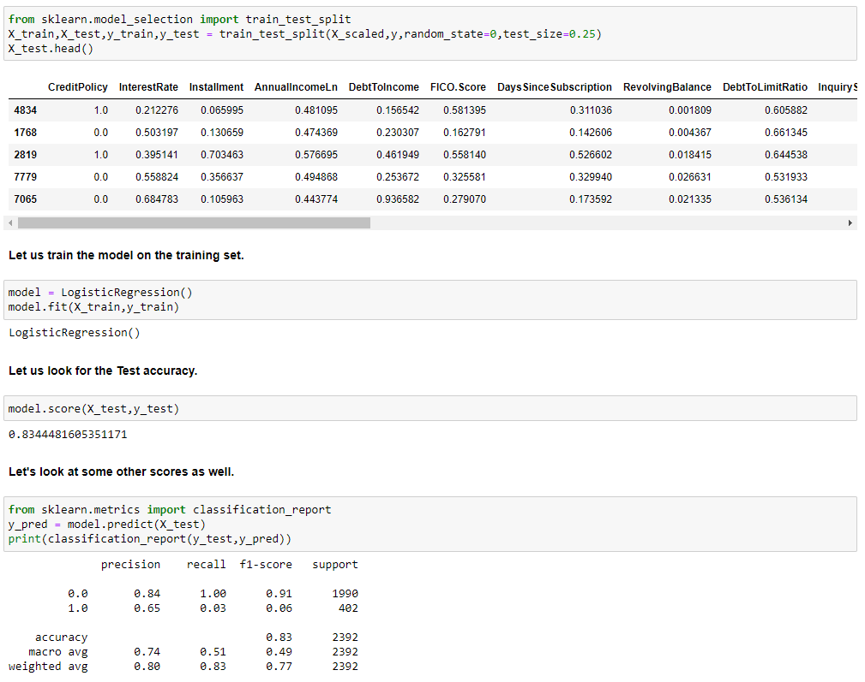
Test-Train Split, Training and evaluation
Recall for positive (TPR) is very low

Slide 37
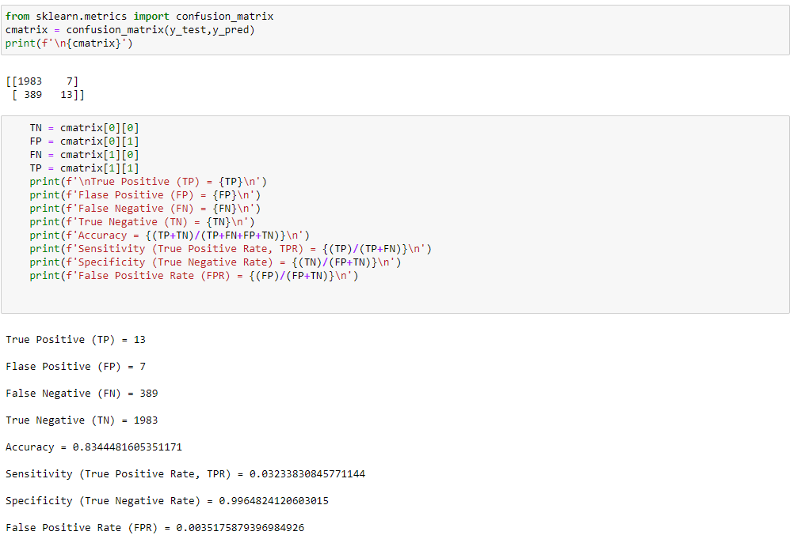
Test-Train Split, Training and evaluation

Slide 38
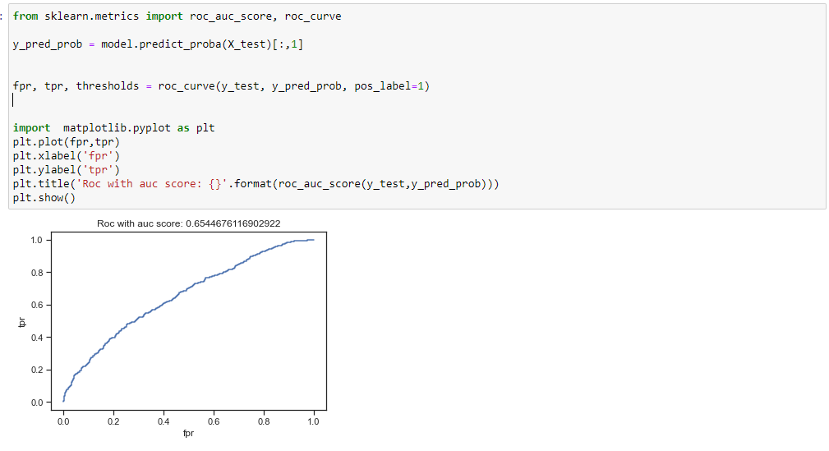
ROC with AUC Score

Slide 39
Conclusion
AUC Score 0.65 means that Logistic Regression Model is probably not the best fit for the data.
True Positive Rate is very low and hence model will probably fail to predict positive class.
We need to deal with the imbalance of the target column
We can go ahead and check other classification methods like decision tree and random forest to find out whether these two perform better

Slide 40
Thanks
Questions ?

