Slide 1


Machine Learning Regression and Classification Models by Python

Slide 2
Submitted by
Mohammad Monjur-E-Elahi
Course: Machine Learning and Big Data Analysis [DSA10]
Program: Data Science and Application - Advanced Diploma [6060]
Metro College of Technology
Date: 25 May, 2021

Slide 3
The Project Aspects
Familiarize with the dataset
Execution of the Codes
Showing the Results
Conclude Base on the Results

Slide 4
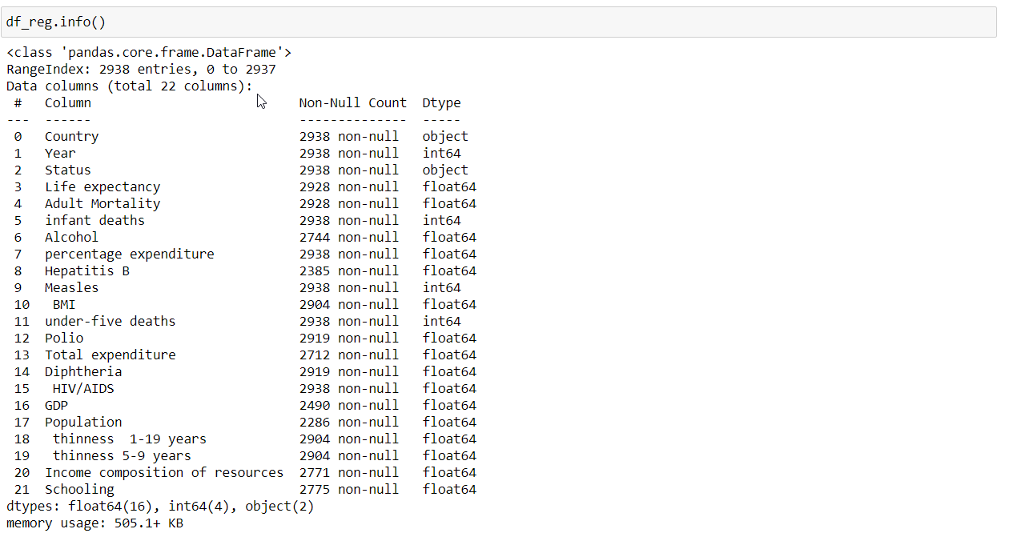
Dataset Life Expectancy Data.csv from Kaggle.org
“Life expectancy” was our target column
Regression will be performed on the dataset
Life duration of people we needed to predict
Rows:
2,938
Columns:
22
Target
Column:
Life Expectancy

Slide 5
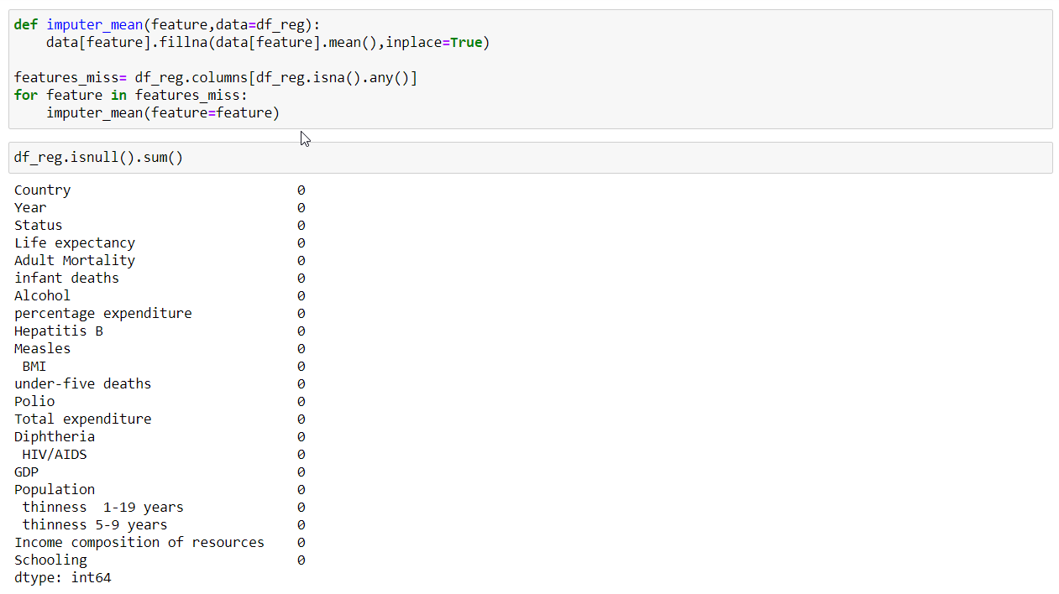
Missing Values Treated
Only numeric columns had missing values

Slide 6
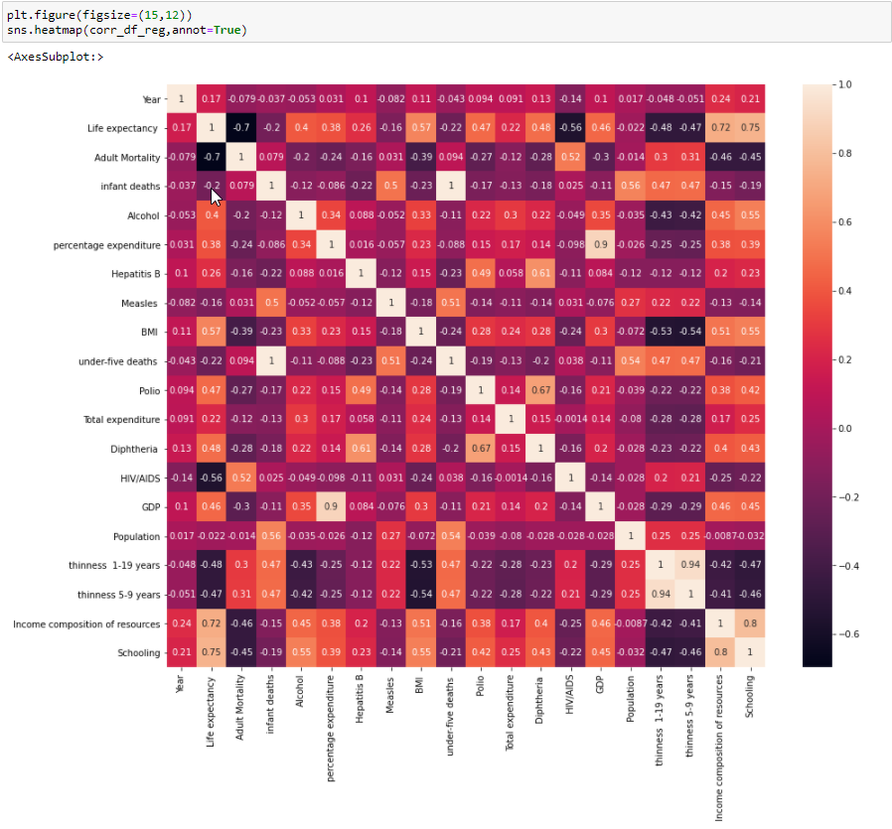
The Heatmap Correlation

Slide 7
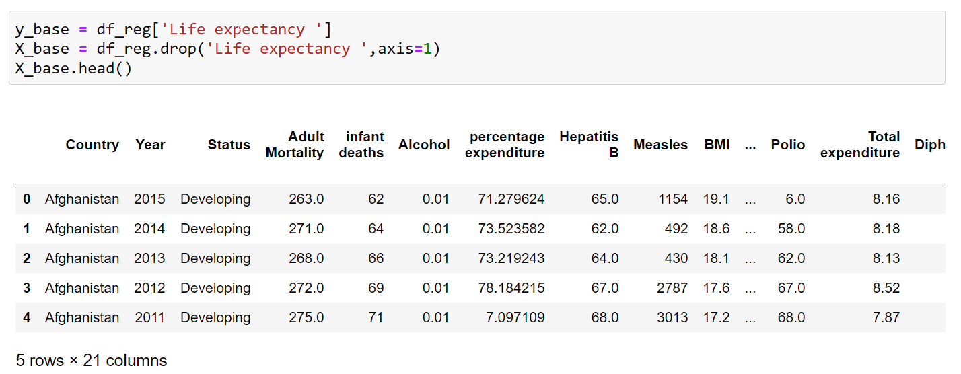
Label and Features are Separated

Slide 8
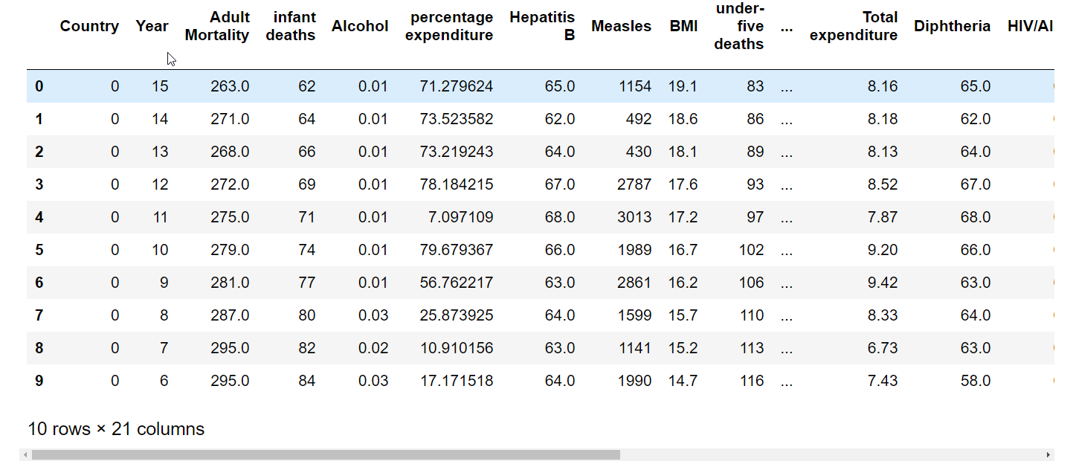
Label Encoder and Dummies on Features

Slide 9
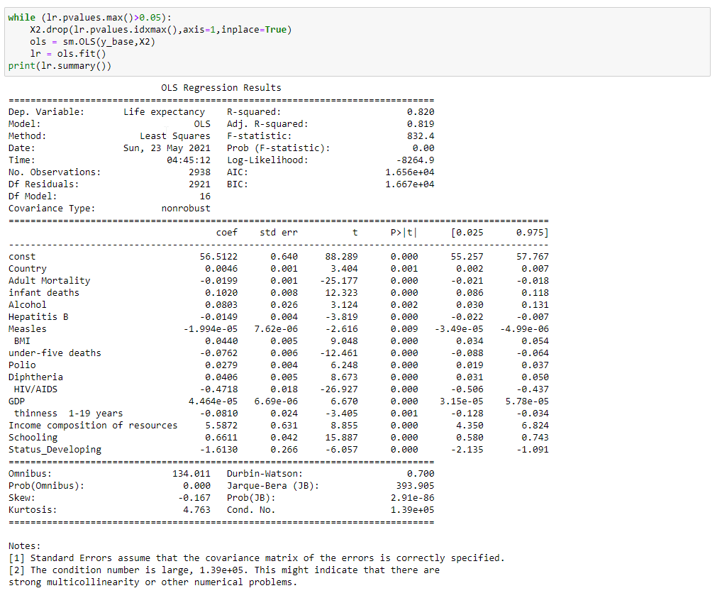
Backward Elimination Based on p-value

Slide 10
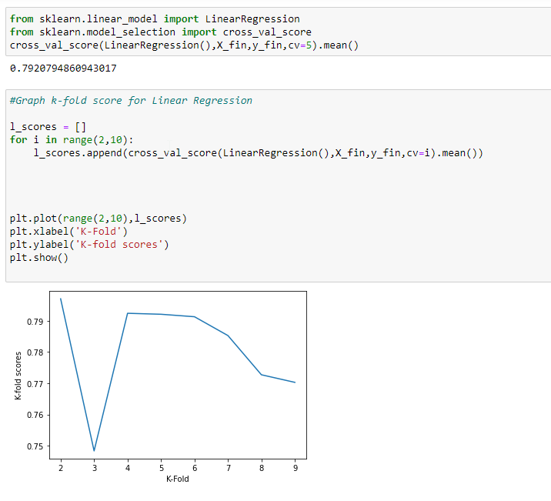
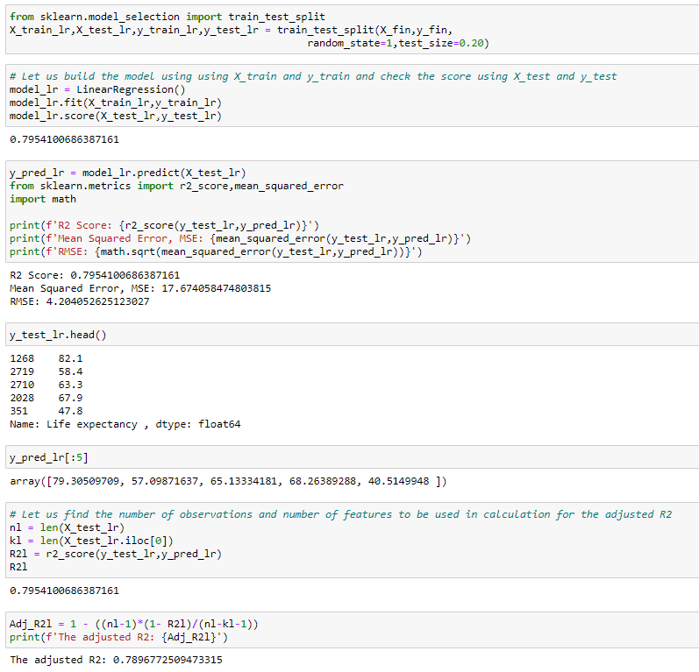
Linear Regression Model
K-fold
Cross validation
R2:
0.7954

Slide 11
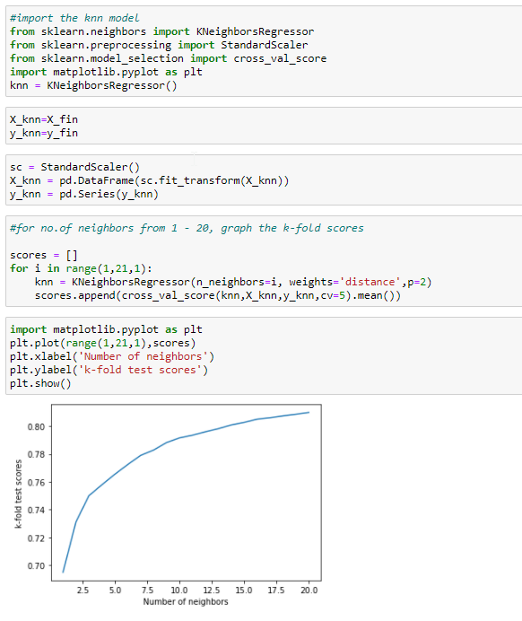
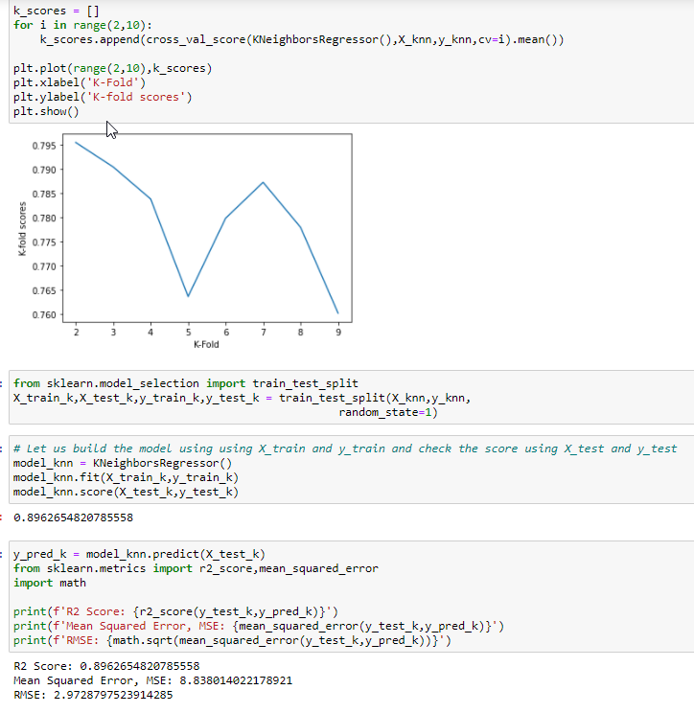
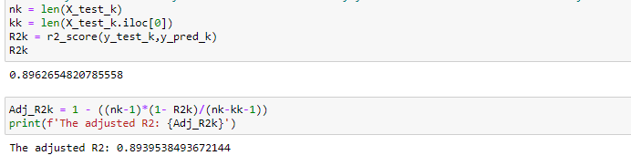
KNN Regression Model
Used the processed data
In all regression models
R2:
0.8963

Slide 12
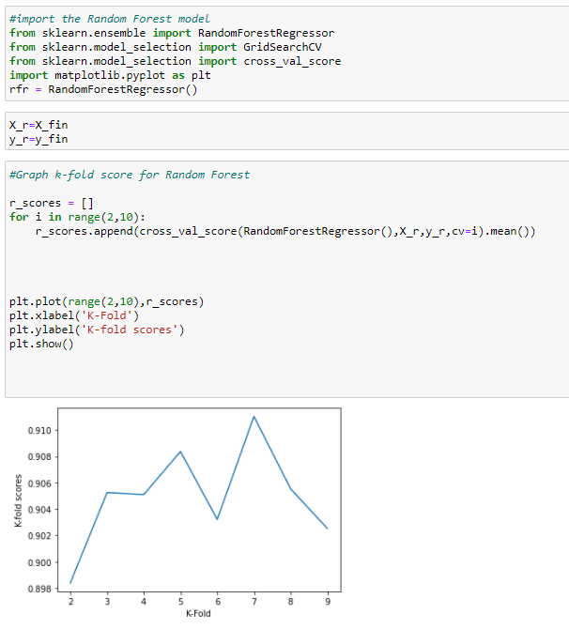
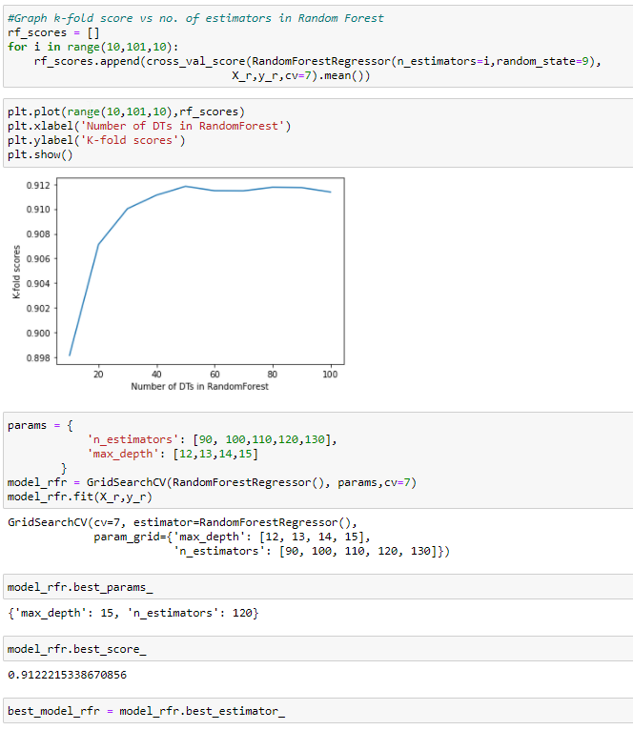
Random Forest Regression Model
GridSearch
Performed

Slide 13
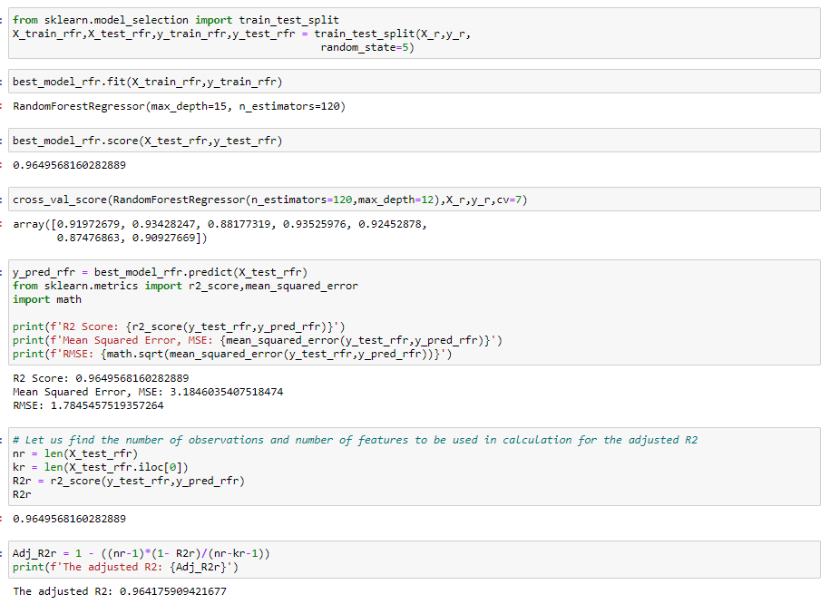
Random Forest Regression Model
R2:
0.9649

Slide 14
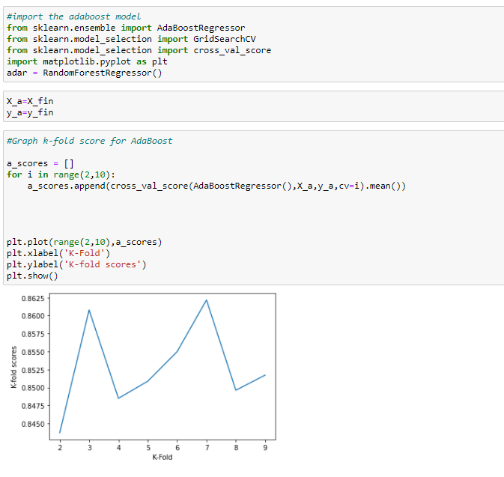
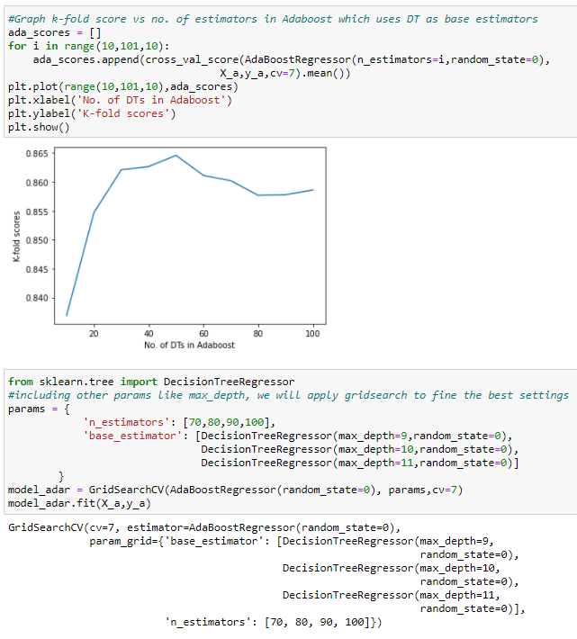
AdaBoost Regression Model
GridSearch
Tuning

Slide 15
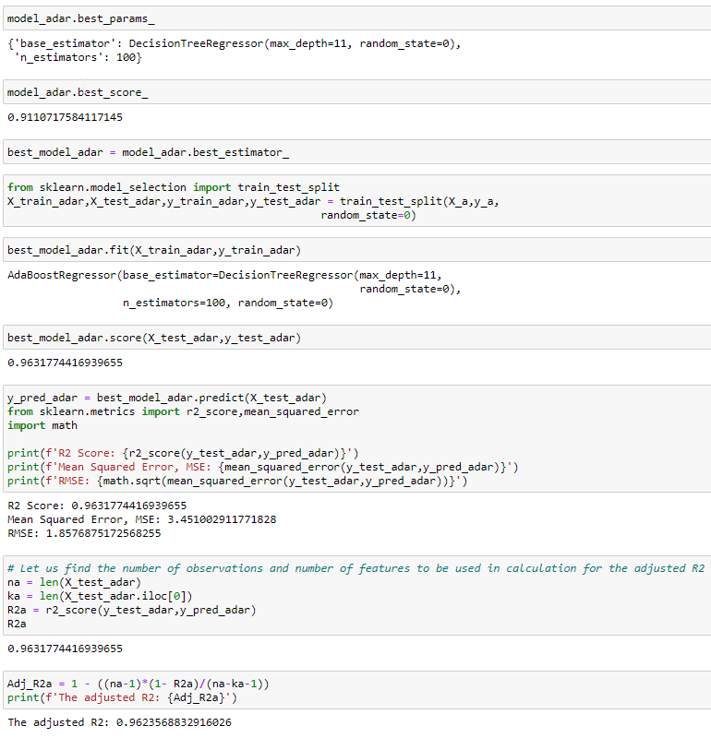
AdaBoost Regression Model
R2:
0.9631

Slide 16
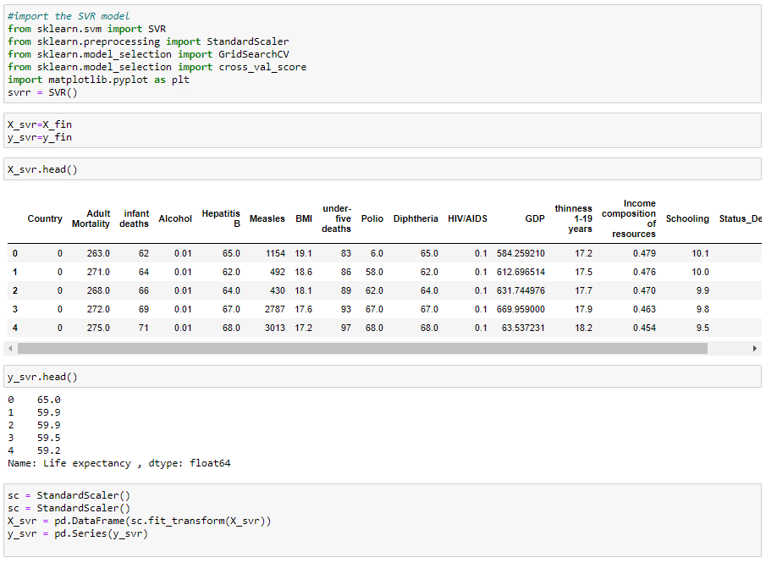
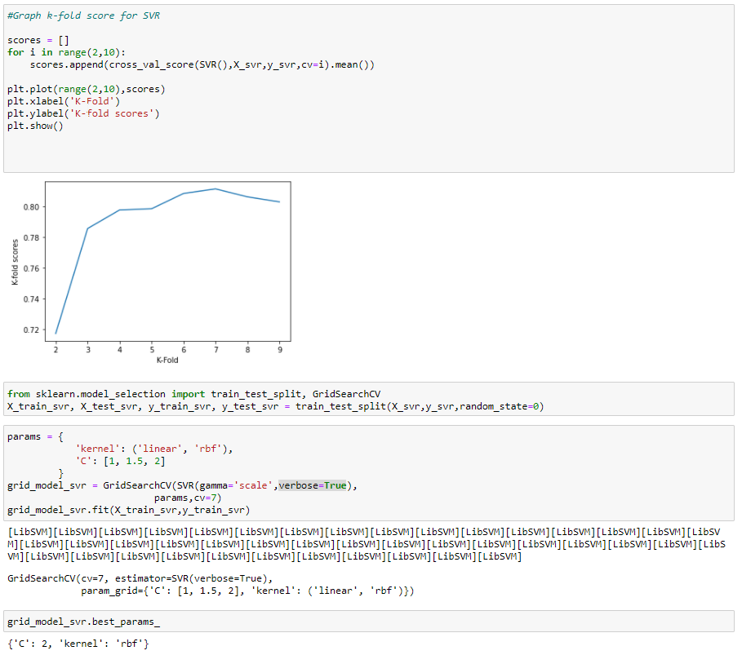
SVR Regression Model
GridSearch
Tuning

Slide 17
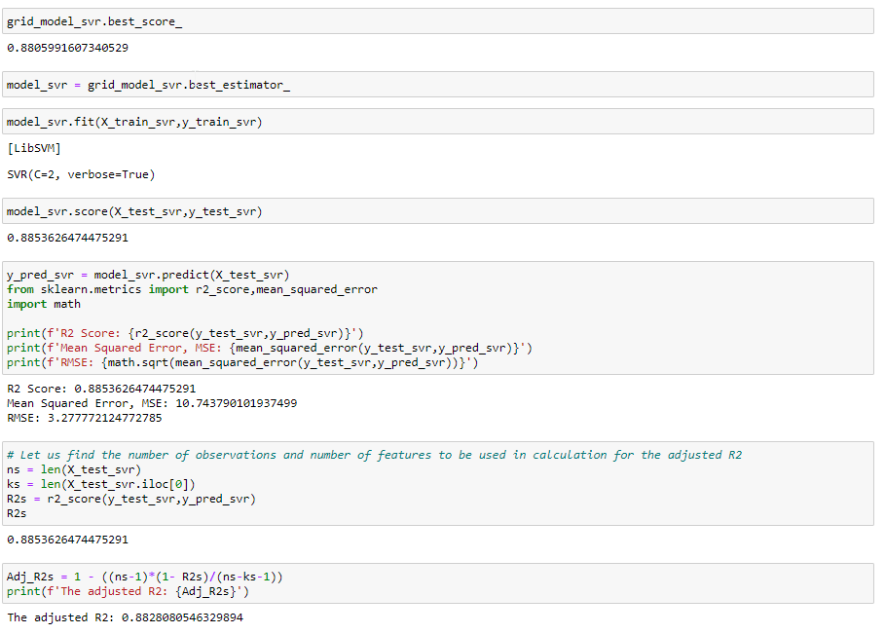
SVR Regression Model
R2:
0.8854

Slide 18
Regression Model Summary
Result | Linear Regression | KNN Regression | Random Forest Regression | AdaBoost Regression | SVR Regression
R2 | 0.7954 | 0.8963 | 0.9649 | 0.9631 | 0.8854
Adjusted R2 | 0.7897 | 0.8939 | 0.9642 | 0.9624 | 0.8828
Based on the value of R2 and Adjusted R2 Random Forest and AdaBoost performed the best
Linear Regression performed the worst of the models
In-depth knowledge of tuning will help the model perform better

Slide 19
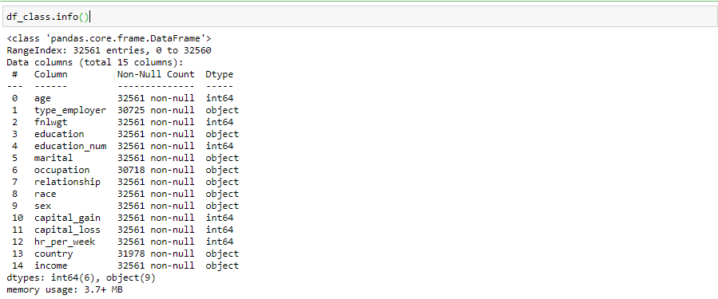
The Project: Classification
Dataset adult.csv from UCI
“income” was our target column
Classification Will be applied to the dataset
We have to predict an income group(<=50k or >50k) a person belongs to
Rows:
32,561
Columns:
15
Target
Column:
income

Slide 20
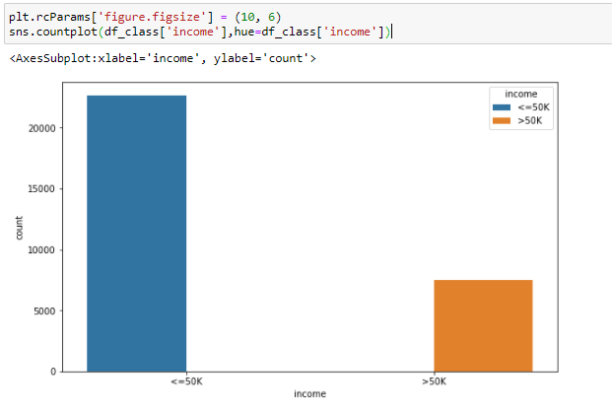
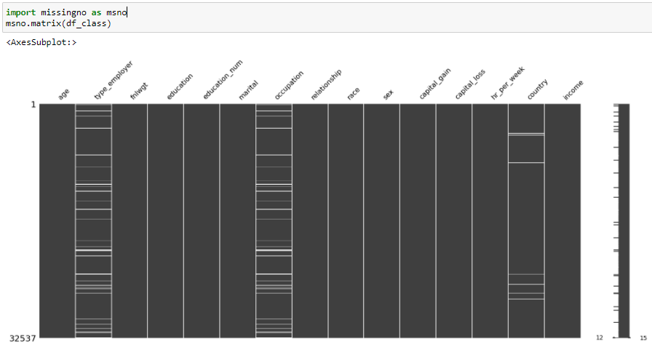
Distribution of Target and missing values
Target Column:
Imbalance
Data

Slide 21
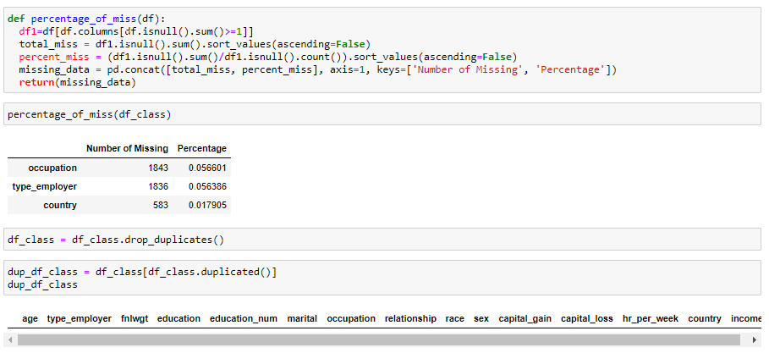
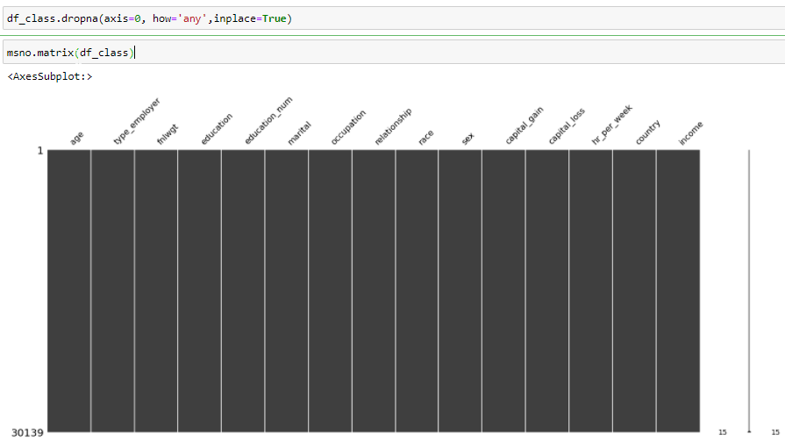
Duplicates and missing were treated
As the missing values are low in percentage, I dropped the rows

Slide 22
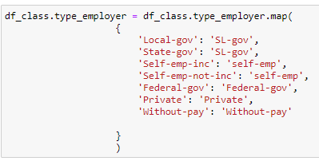
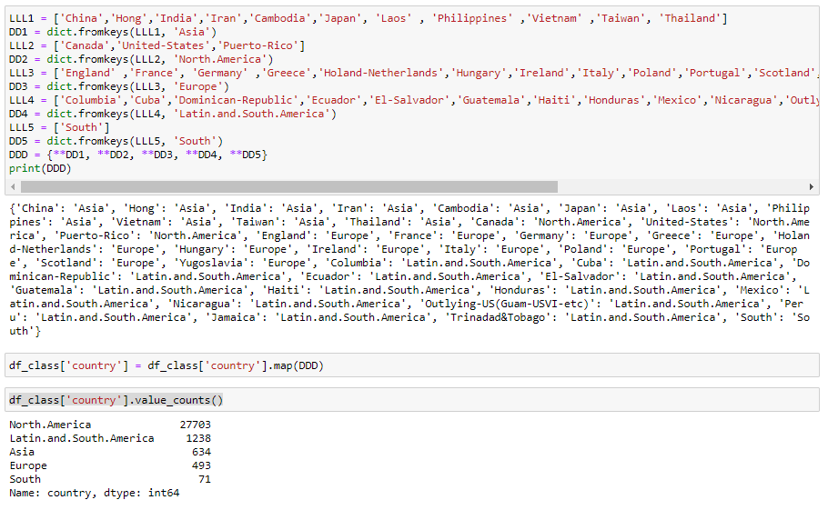
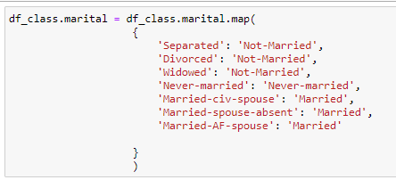
Few categorical features were remapped

Slide 23
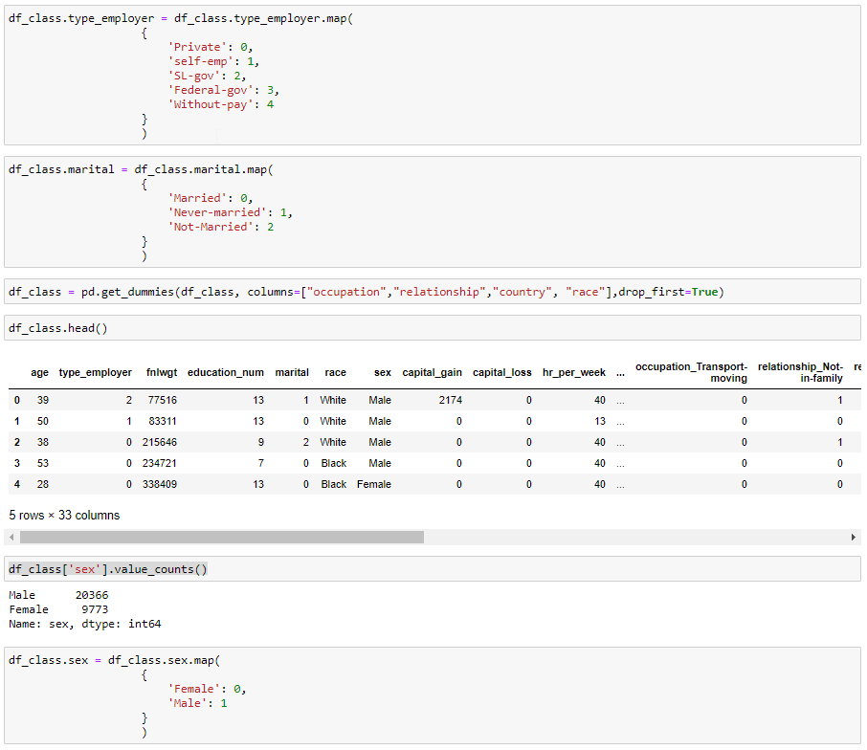
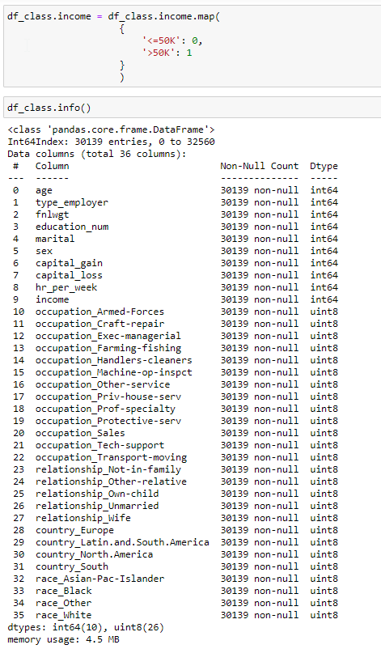
Label Encoding and Dummies
To convert to numeric

Slide 24
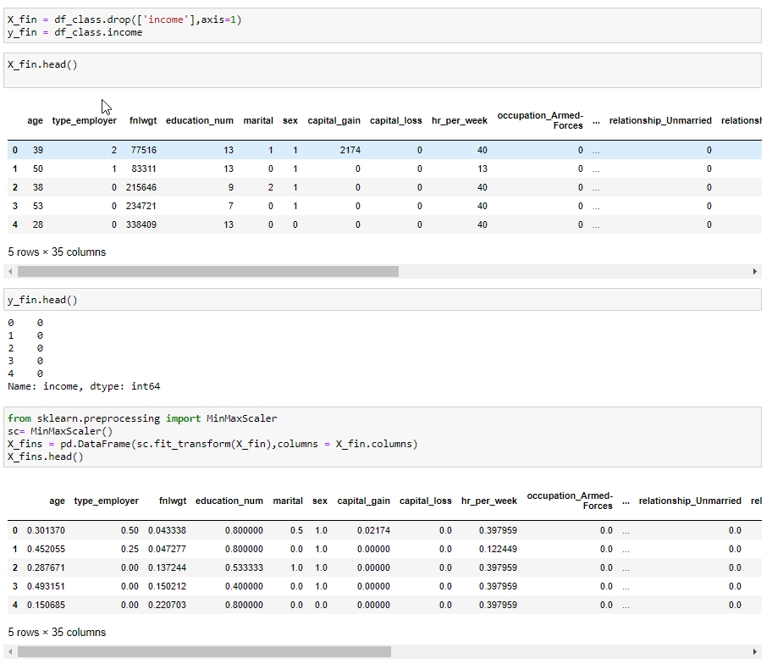
X, y separated and MinMaxScaler applied

Slide 25
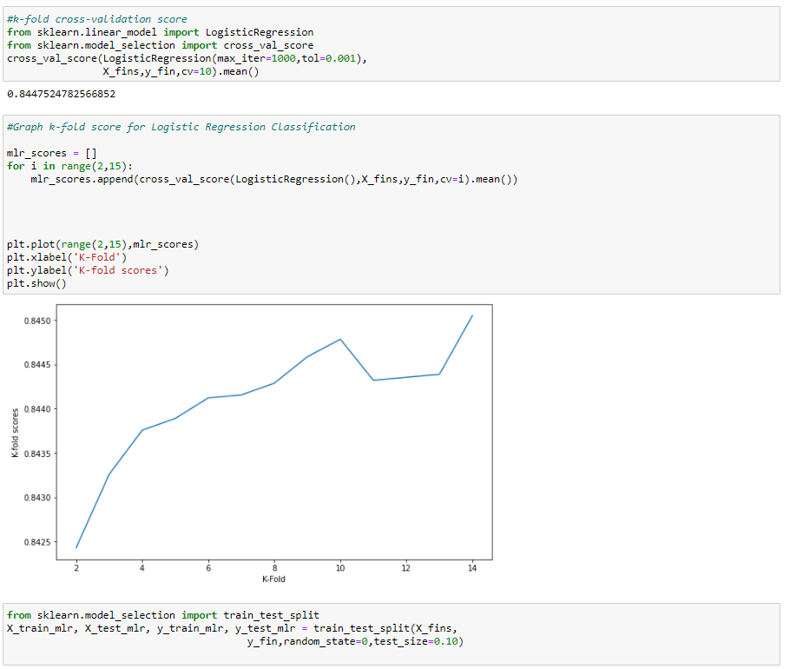
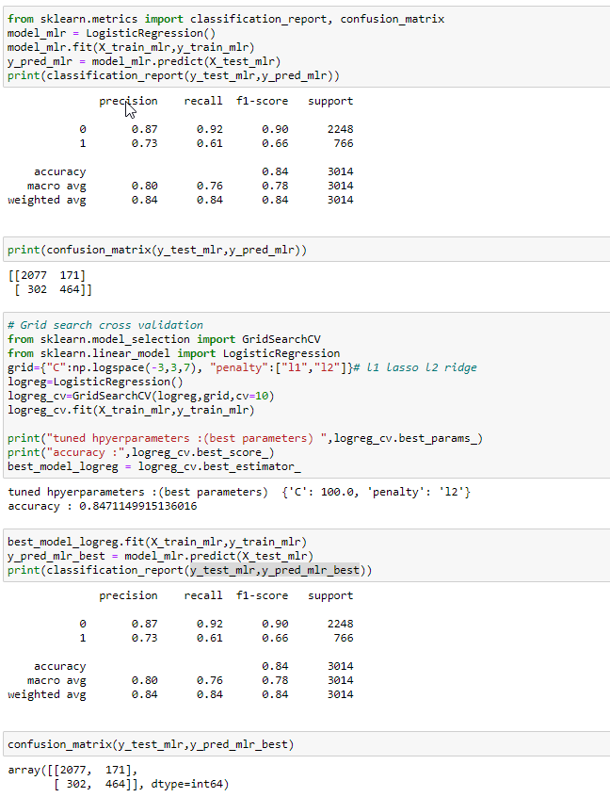
Classification: Logistic Regression
F1-Test Score:
Accuracy:
0.84

Slide 26
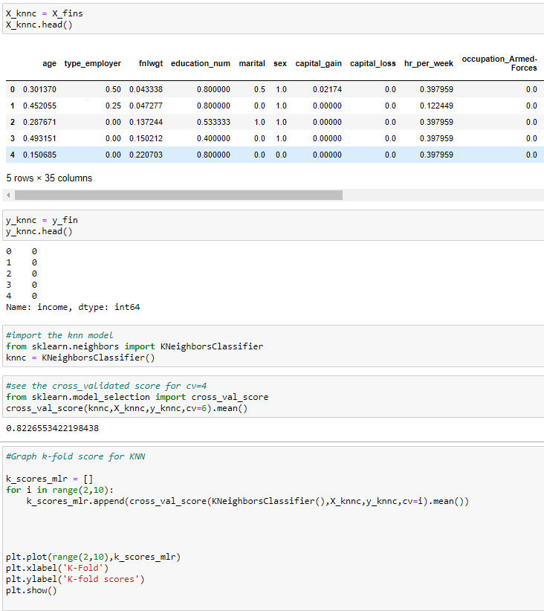
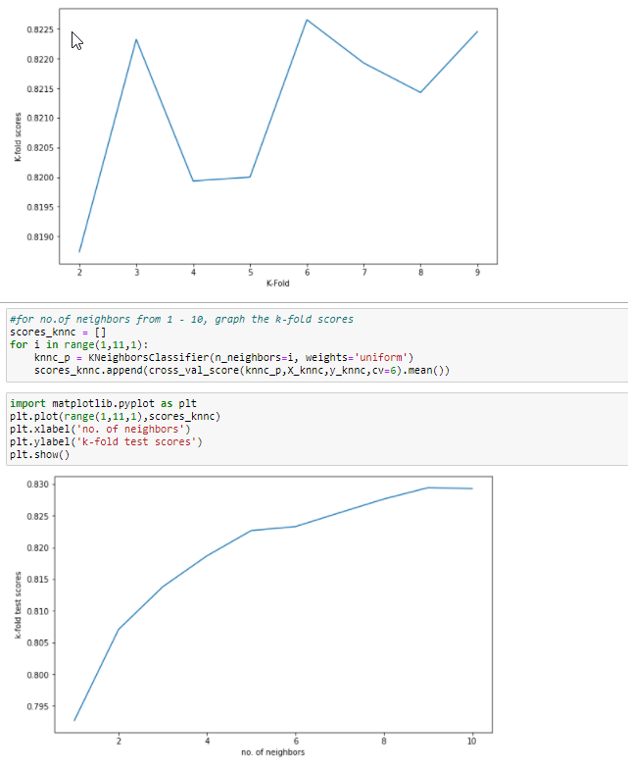
Classification: K Nearest Neighbor
Used the processed data
In all Classification models

Slide 27
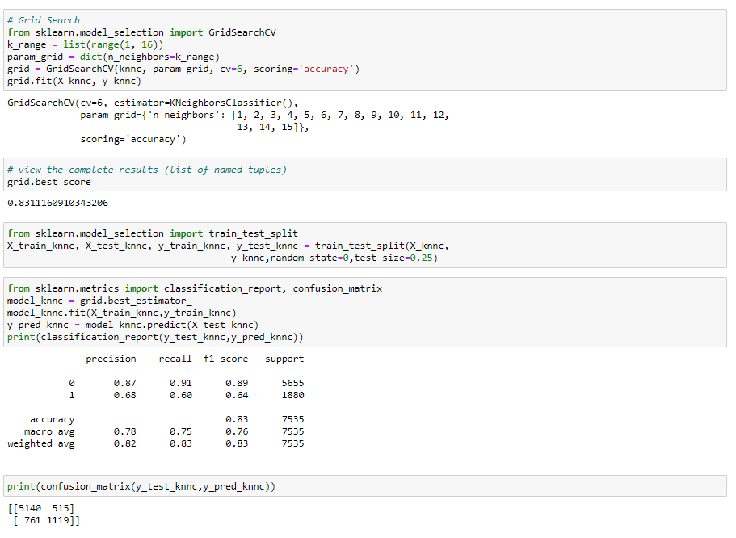
Classification: K Nearest Neighbor
F1-Test Score:
Accuracy:
0.83

Slide 28
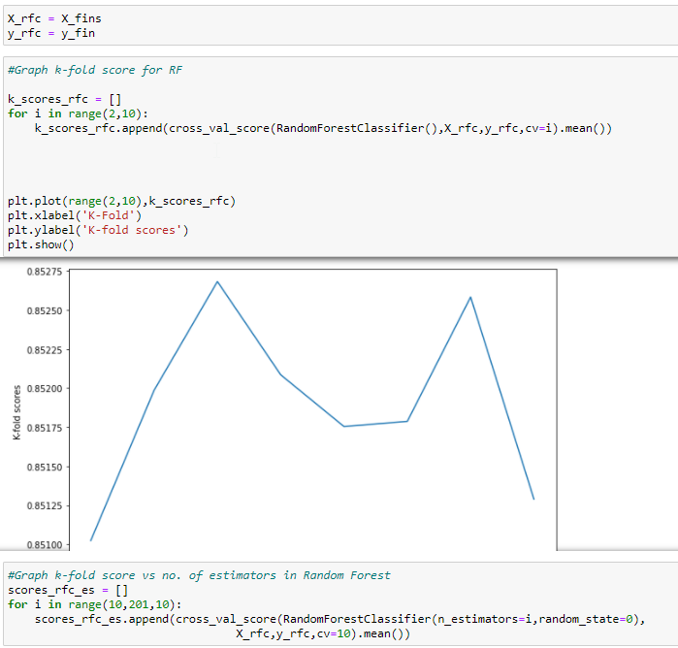
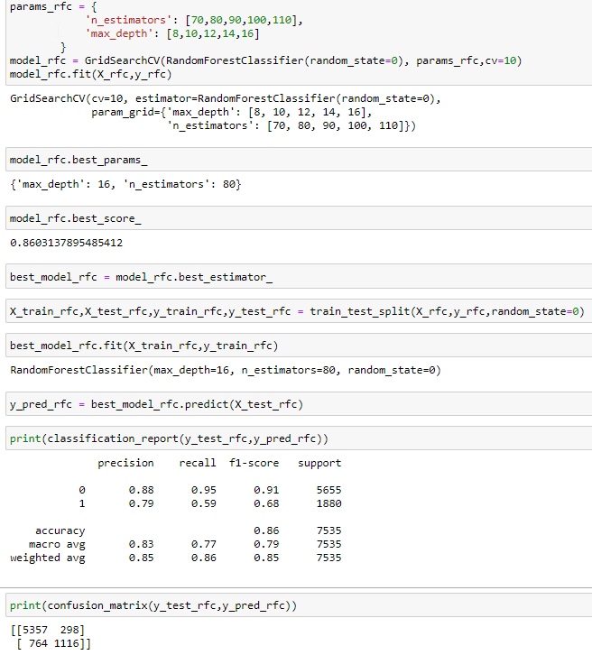
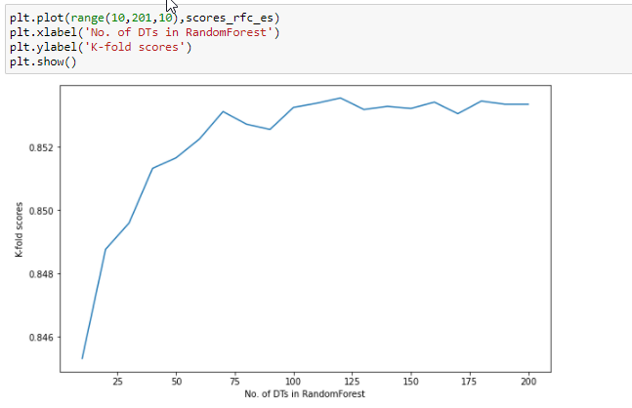
Classification: Random Forest
F1-Test Score:
Accuracy:
0.86

Slide 29
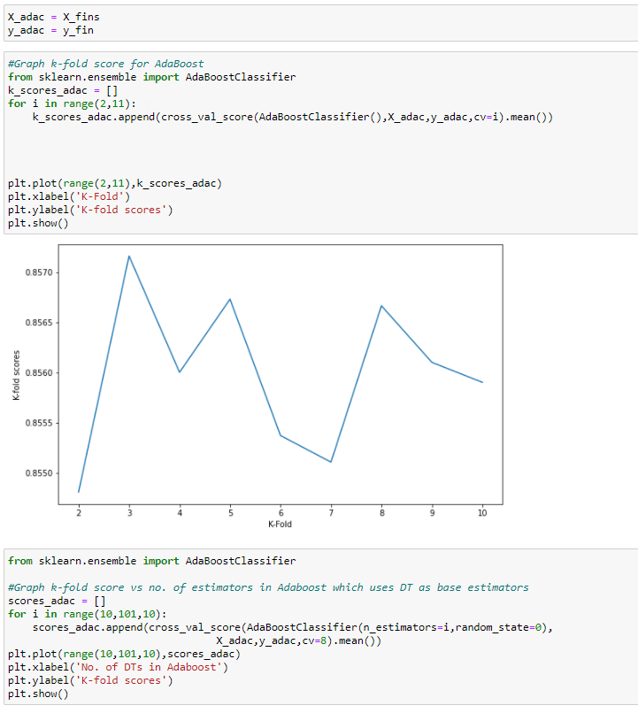
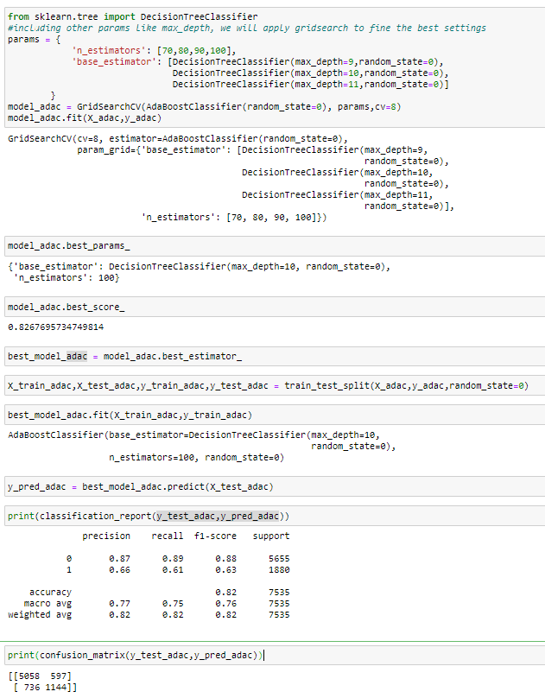
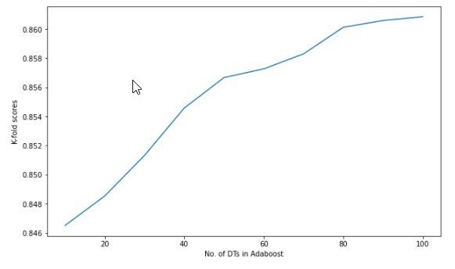
Classification: AdaBoost
F1-Test Score:
Accuracy:
0.82

Slide 30
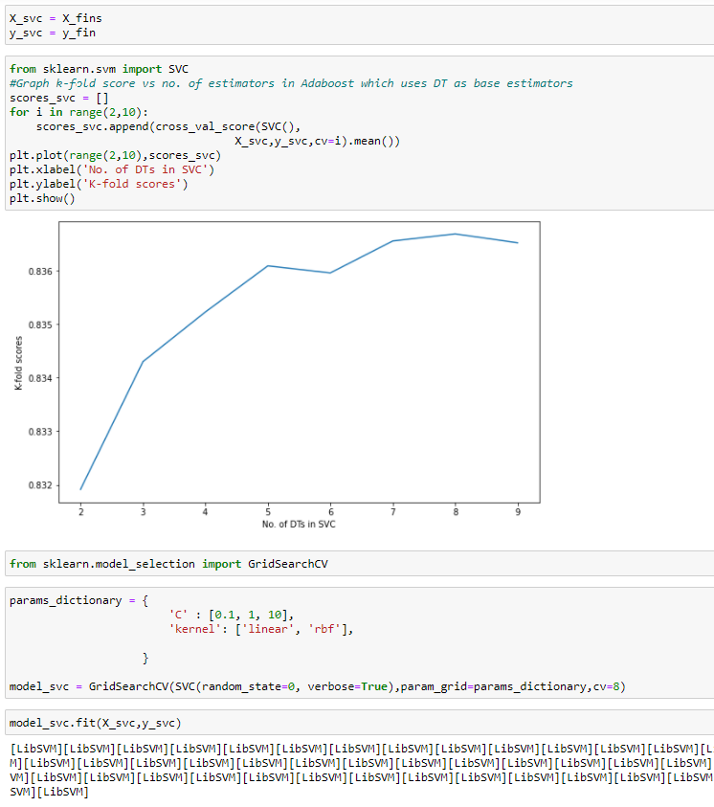
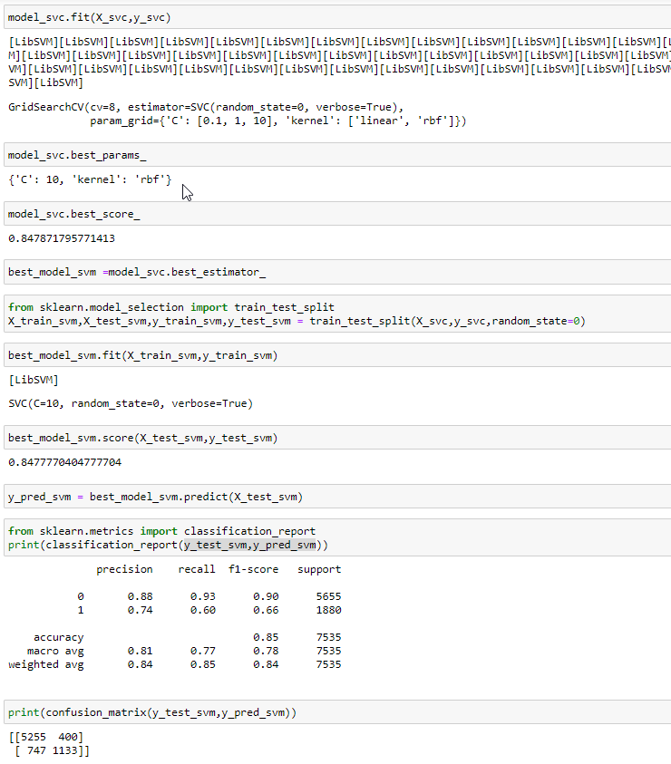
Classification: SVM
F1-Test Score:
Accuracy:
0.85

Slide 31
Classification Model Summary
Result | Logistic Regressio Classification | KNN Classification | Random Forest Classification | AdaBoost Classification | SVM Classification
F1-Accuracy | 0.84 | 0.83 | 0.86 | 0.82 | 0.85
Precision-Macro | 0.8 | 0.78 | 0.83 | 0.77 | 0.81
Precision-Weighted | 0.84 | 0.82 | 0.85 | 0.82 | 0.84
The result suggests that Random Forest Classification performed the best
AdaBoost performed a bit low of the models
Scores of all models were close

Slide 32
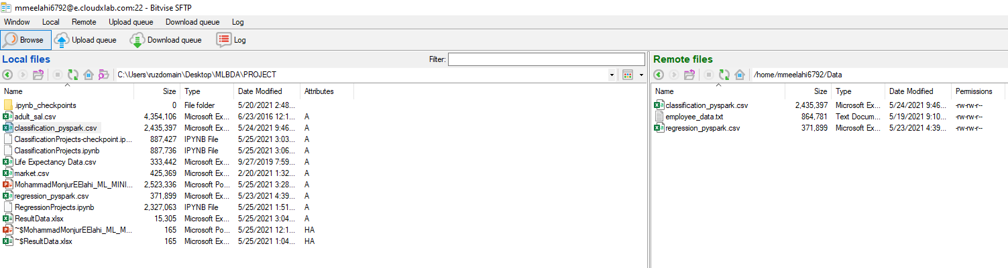
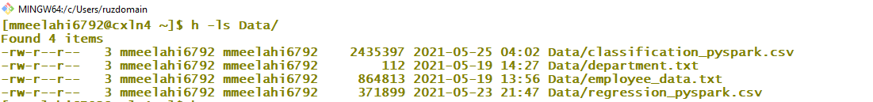
SparkML: Regression and Classification
Treated dataset was sent to Hadoop environment

Slide 33
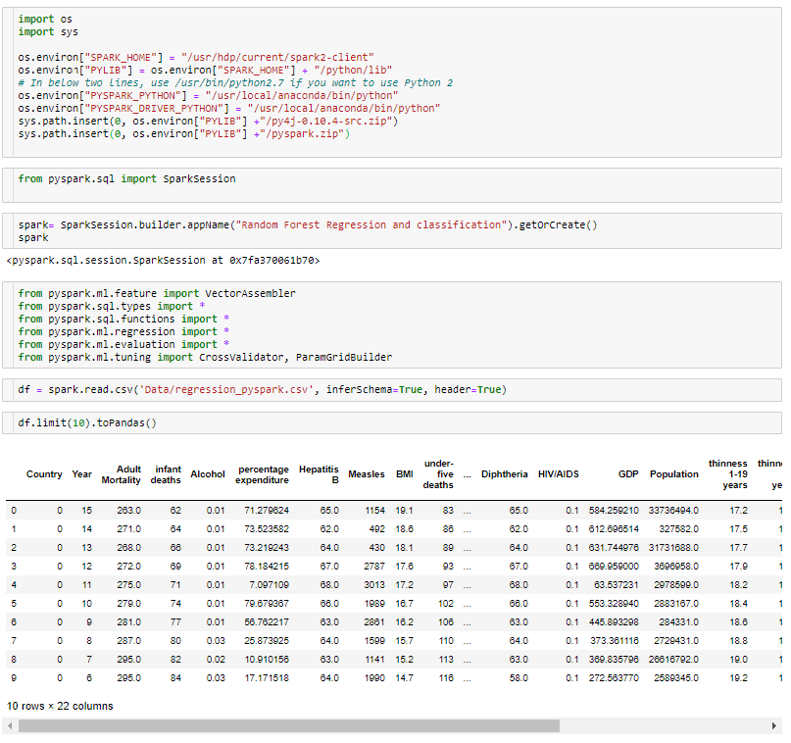
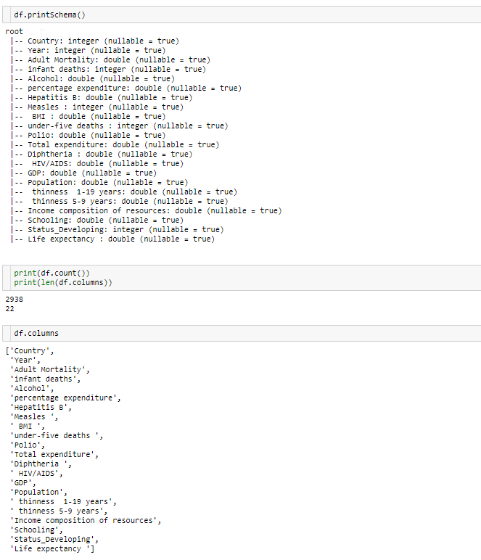
SparkML: Random Forest Regression

Slide 34
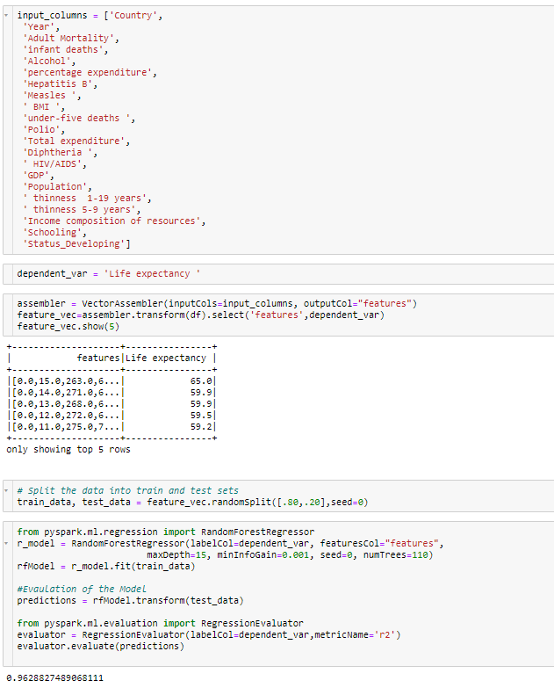
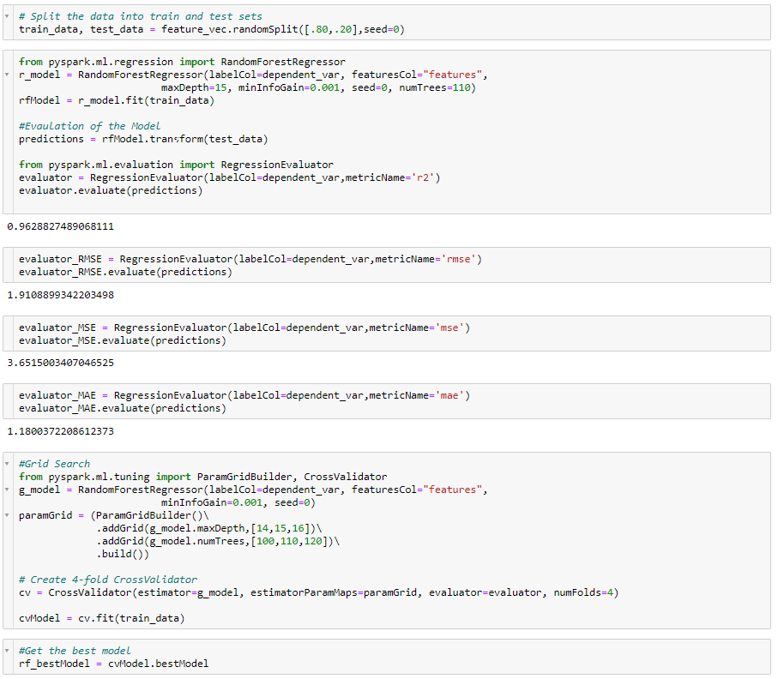
SparkML: Random Forest Regression
R2 score:
0.9629

Slide 35

SparkML: Random Forest Regression
R2 score:
0.9631

Slide 36


SparkML: Random Forest Classification
Renaming the target column from income to label

Slide 37


SparkML: Random Forest Classification
AUC score:
0.9073

Slide 38
Conclusion
Random Forest was found to be the best of the models
Trying GridSearch is compute resource intensive especially for SVM
In-depth understanding of parameter tuning is felt
For KNN regression it performed very poorly when the features were not scaled
PySpark performed the same on Anaconda local installation

Slide 39
Thanks
Questions ?

