Slide 1



Cardiovascular Disease Prediction
Business Questions
Do Systolic and Diastolic Blood Pressures lead to Cardiovascular Disease?
Does Cholesterol Level Play a vital role?
Is Glucose Level Responsible significantly?
Are smoking tobacco and drinking alcohol playing their part?
Can Cardiovascular Diseases be attributed to Physical Inactivity?
Do demographic Variables like gender and age have their roles?
Could Body Mass Indicator(BMI) be a critical player as well?
Objectives
Identification of the features which impacts the Cardiovascular Disease
Develop a binary classification model with the highest performance
Conclude whether our hypothesis holds good

Slide 2
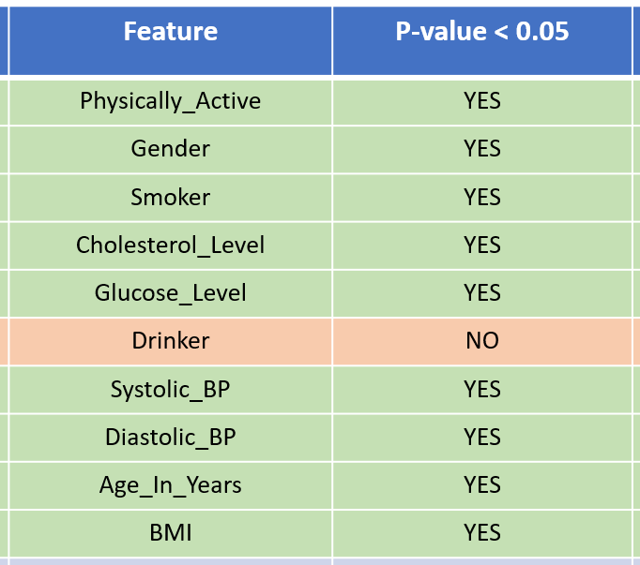
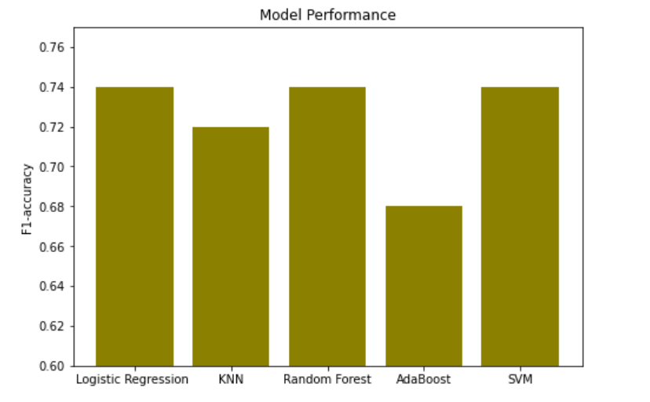
Evaluation & Conclusion
The result suggests that Logistic Regression, Random Forest and SVM Classification performed better
Only one of our hypothesized parameters(alcohol) that were in the dataset marginally showed statistical insignificance.
Some of our hypothesized parameters were absent in our dataset and inclusion of those might improve the model performance

