Slide 1



Cardiovascular Disease Prediction

Slide 2
Submitted by
Mohammad Monjur-E-Elahi
Course: Data Science Project Using Python [DSA13]
Program: Data Science and Application - Advanced Diploma [6060]
Metro College of Technology
Date: 17 July, 2021
Supervised by
Mr. Vijay Kumar
Course: Data Science Project Using Python Instructor
Metro College of Technology

Slide 3
The Project Introduction
Cardiovascular Disease is one the widespread health issues in the healthcare system
Our job is to perform queries and generate the best possible binary classification model to predict people who are likely to have Cardiovascular Diseases.
Our dataset consists of 13 columns and 69,301 rows
All our columns are of numeric type

Slide 4
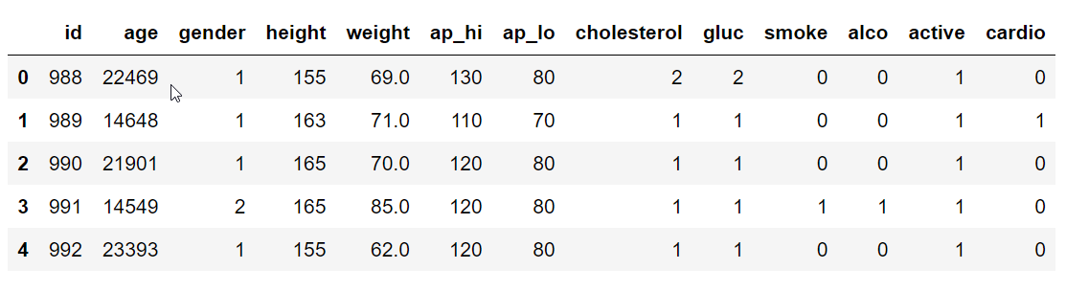
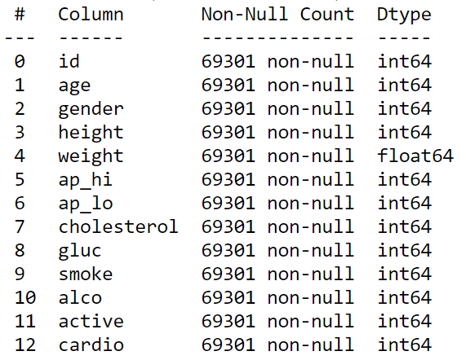
Dataset At a Glance
13 Columns
69,301 Rows
Link To Dataset

Slide 5
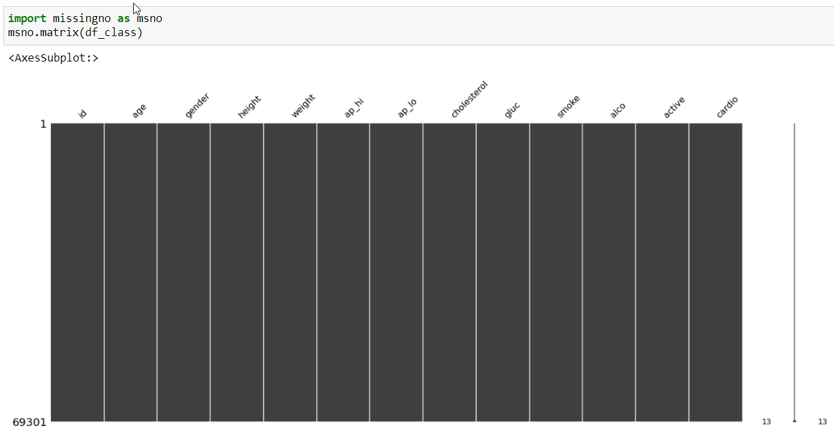
Dataset At a Glance
No missing values
No duplicate rows
Numeric columns had outliers

Slide 6
Developing Hypothesis
We chalked down the below reasons and/or signals as the probable influencing factors of cardio vascular diseases:
Blood Pressure (Systolic and diastolic)
Blood Cholesterol Level
Blood Glucose Level
Smoking Habit
Drinking Alcohol
Body Mass Index(BMI)
Age
Ethnic Background
Family Cardiovascular Disease History
Stressful Working Environment
Indiscipline Life Style
Addiction of Other Drugs
Inactivity meaning lack of physical activities
Gender

Slide 7
Developing Hypothesis
We chalked down the below reasons and/or signals as the probable influencing factors of cardio vascular diseases:
Blood Pressure (Systolic and diastolic)
Blood Cholesterol Level
Blood Glucose Level
Smoking Habit
Drinking Alcohol
Body Mass Index(BMI)
Age
Ethnic Background
Family Cardiovascular Disease History
Stressful Working Environment
Indiscipline Life Style
Addition of Other Drugs
Inactivity meaning lack of physical activities
Gender

Slide 8
Business Questions
Do Systolic and Diastolic Blood Pressures lead to Cardiovascular Disease?
Does Cholesterol Level Play a vital role?
Is Glucose Level Responsible significantly?
Are smoking tobacco and drinking alcohol playing their part?
Can Cardiovascular Diseases be attributed to Physical Inactivity?
Do demographic Variables like gender and age have their roles?
Could Body Mass Indicator(BMI) be a critical player as well?

Slide 9
Objectives
Identification of the features which impacts the Cardiovascular Disease
Develop a binary classification model with the highest performance
Conclude whether our hypothesis holds good

Slide 10
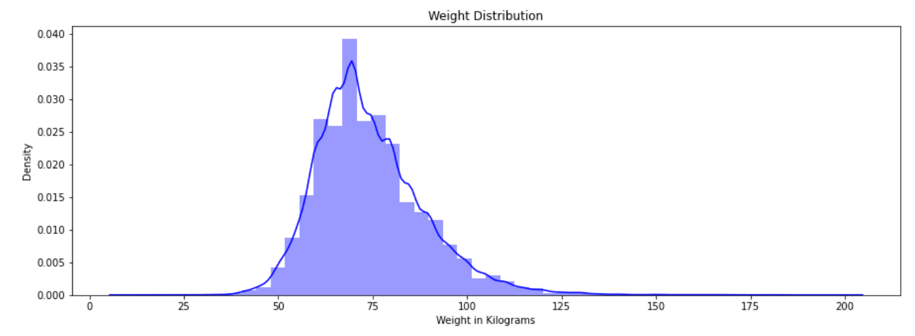
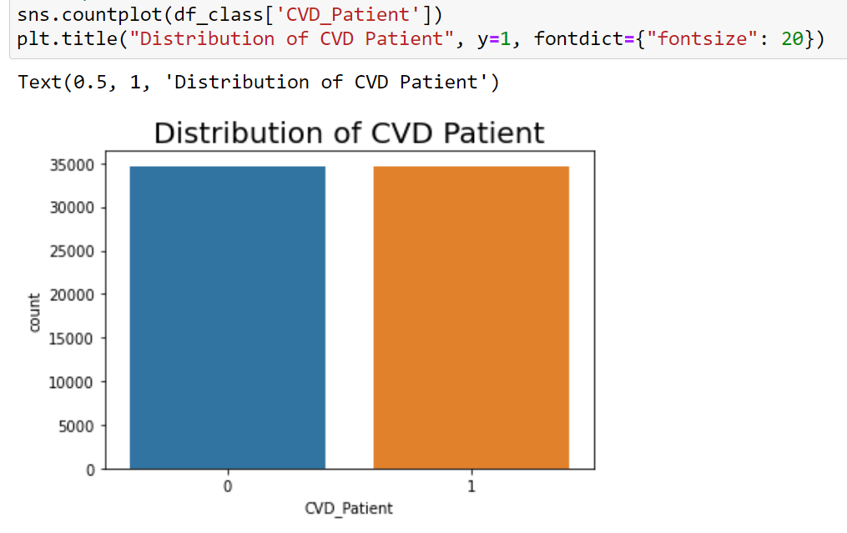
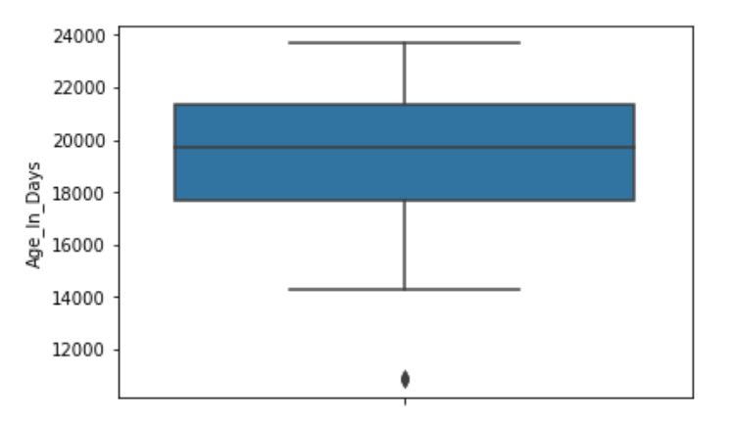
Descriptive Analysis
Univariate Analysis
Balanced
Data
Also performed for each categorical
(binary or few discrete level) columns
Performed for each continuous numeric columns

Slide 11
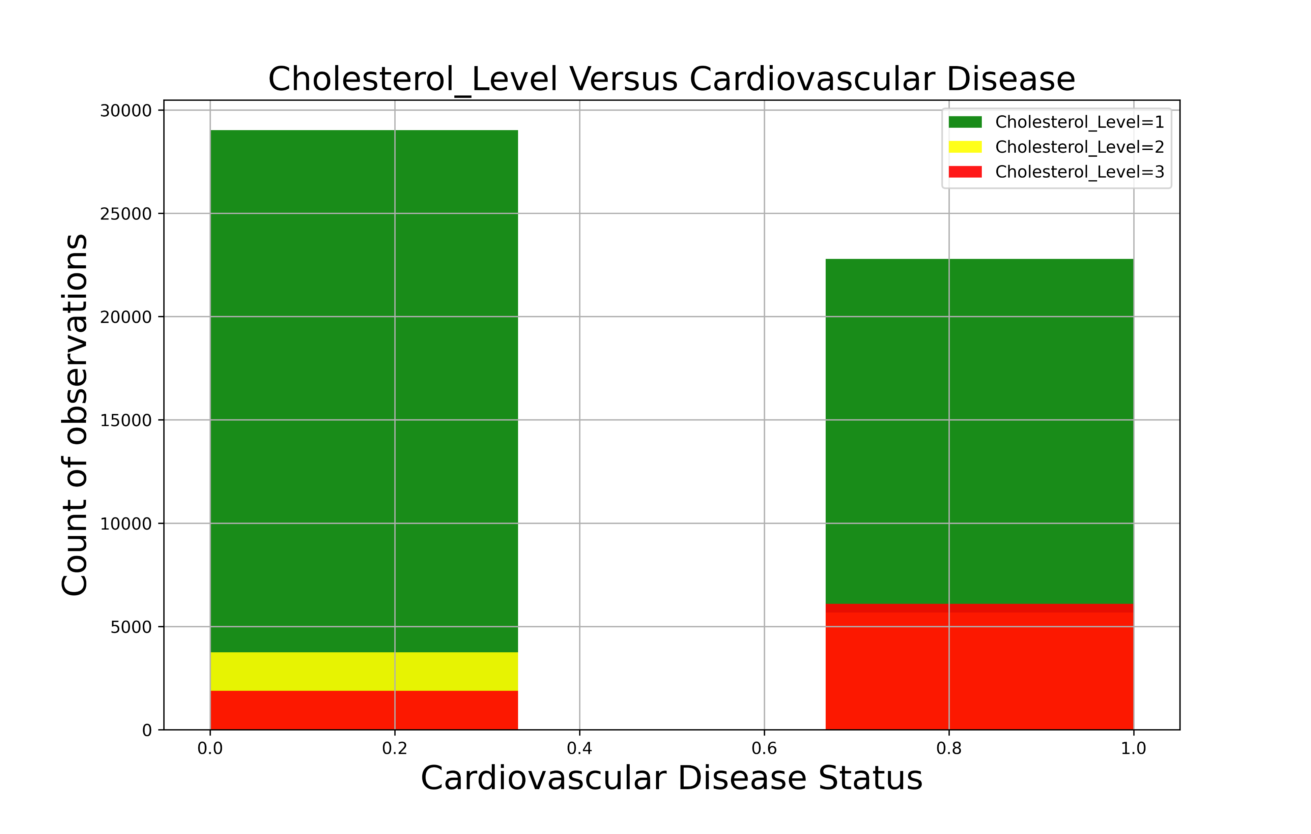
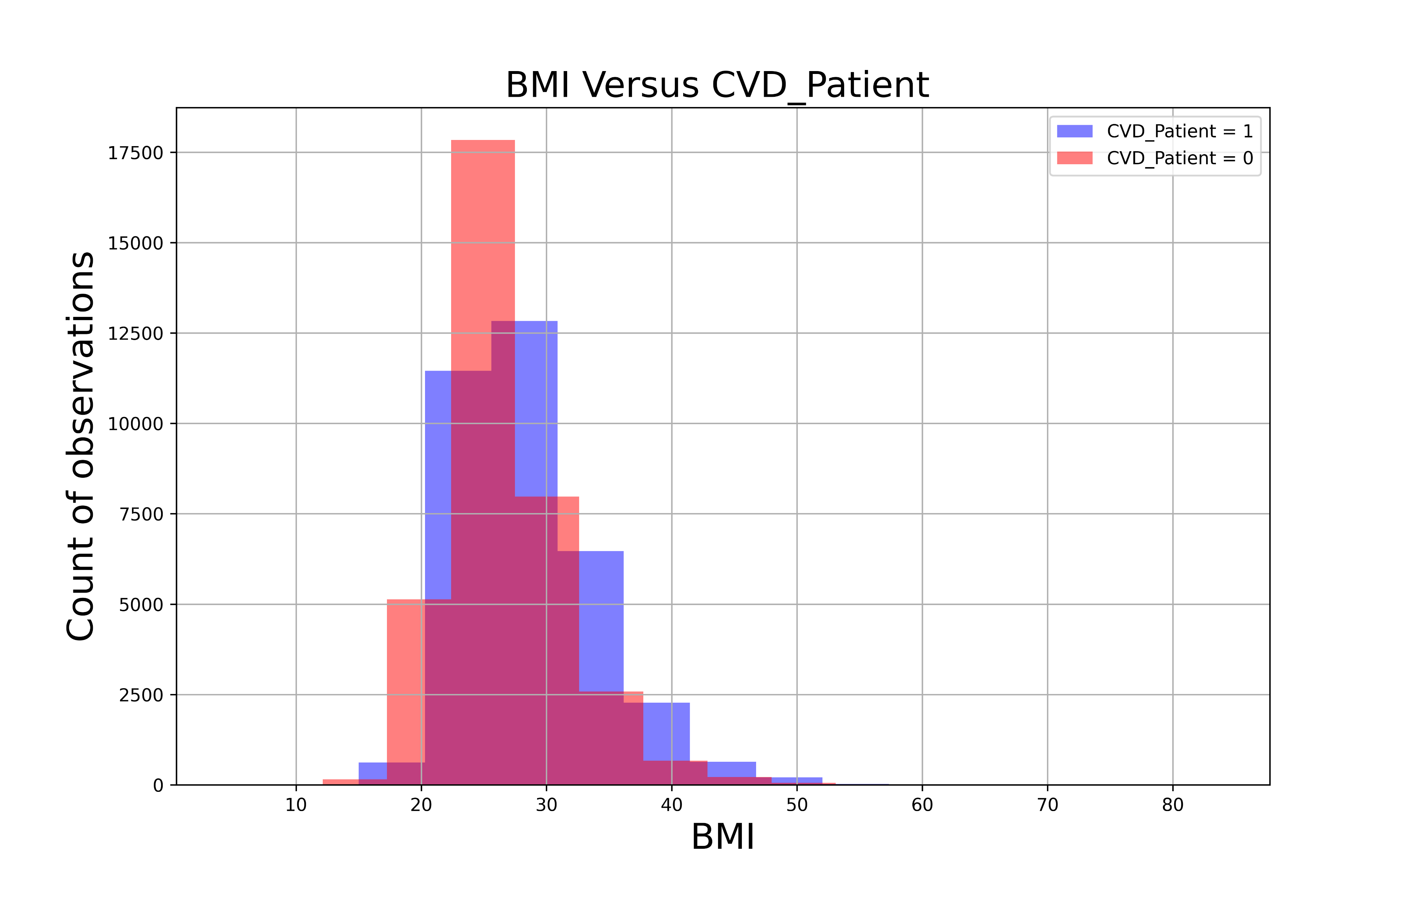
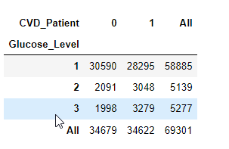
Descriptive Analysis
Bivariate Analysis
Also performed for each continuous columns Against the Target
Also performed for each categorical
(binary or few discrete level) columns
Against the Target

Slide 12
Descriptive Analysis
Bivariate Analysis
Target | Feature | Type | P-value < 0.05 (CHI) | P-value < 0.05 T-Test
CVD_Patient | Physically_Active | Categorical | YES
CVD_Patient | Gender | Categorical | YES
CVD_Patient | Smoker | Categorical | YES
CVD_Patient | Cholesterol_Level | Categorical | YES
CVD_Patient | Glucose_Level | Categorical | YES
CVD_Patient | Drinker | Categorical | NO
CVD_Patient | Systolic_BP | Continuous |  | YES
CVD_Patient | Diastolic_BP | Continuous |  | YES
CVD_Patient | Age_In_Years | Continuous |  | YES
CVD_Patient | BMI | Continuous |  | YES
Ch-Squire Test for Categorical
vs the Categorical target
T-Test for Continuous
vs the Categorical target
ANOVA for Continuous
vs the Categorical target
with More than 2 categories

Slide 13
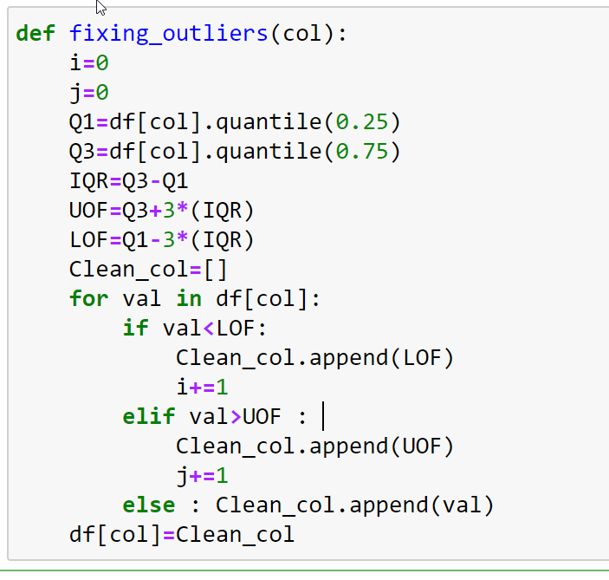
Outlier Handling
Systolic_BP, Diastolic_BP, Height, Weight had outliers
Outliers were handled by UDF
Data points greater than Q3+3IQR
& less than Q1-3IQR were excluded

Slide 14
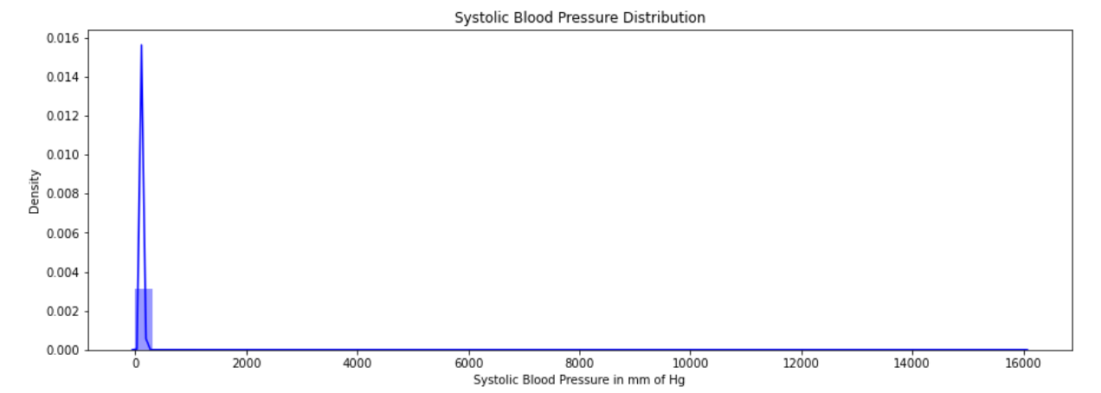
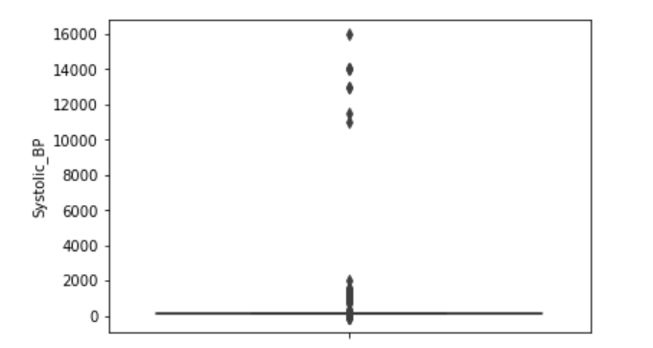
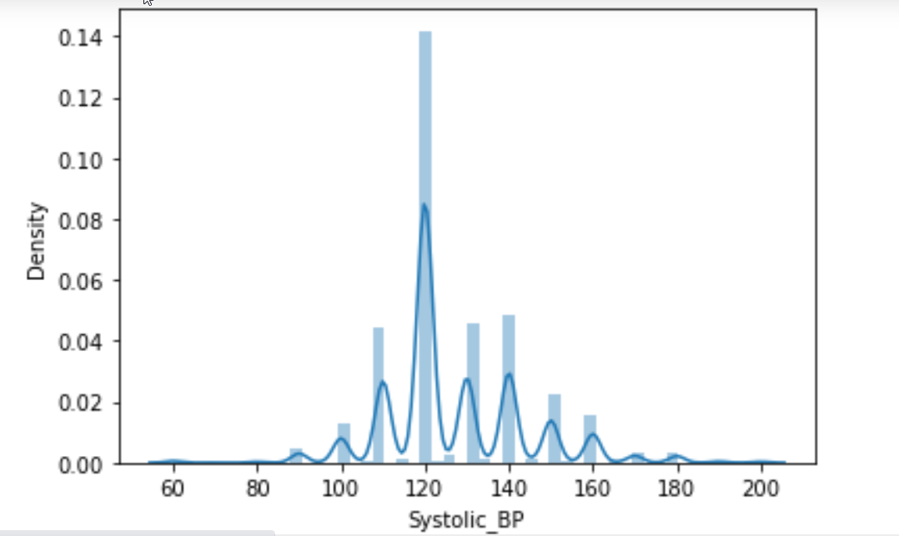
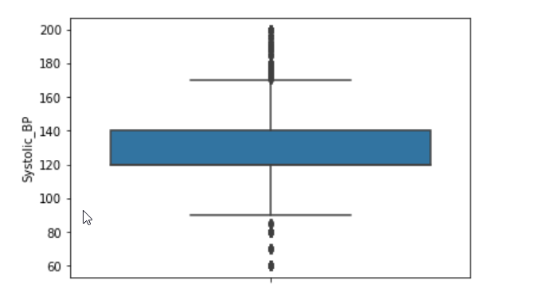
Outlier Handling

Slide 15
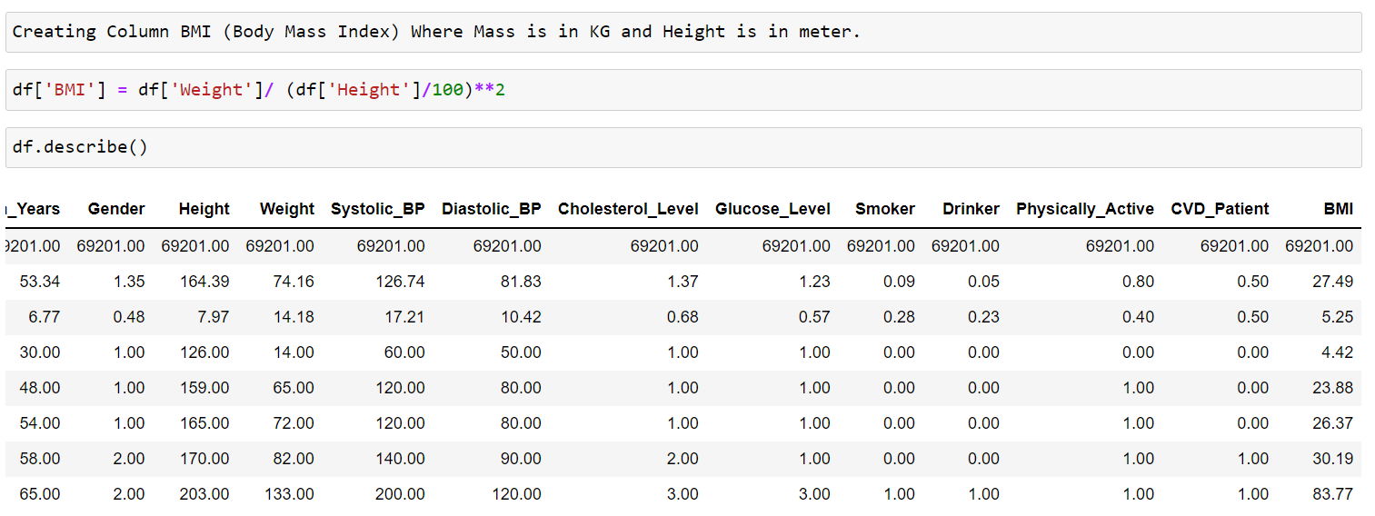
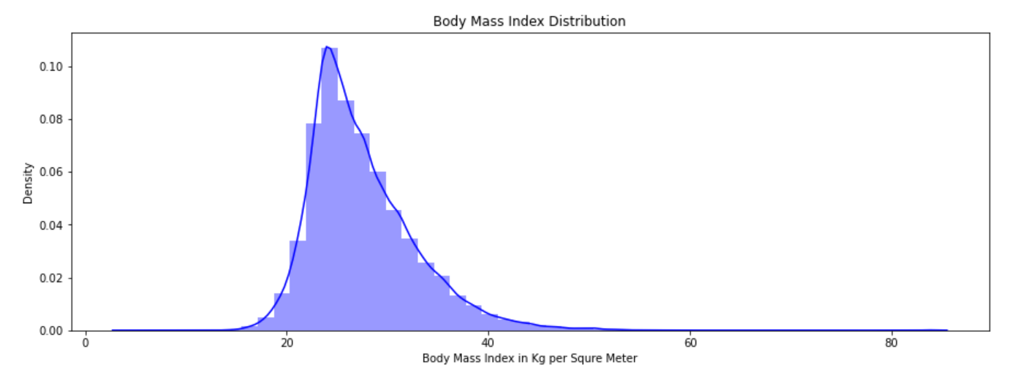
Feature Engineering

Slide 16
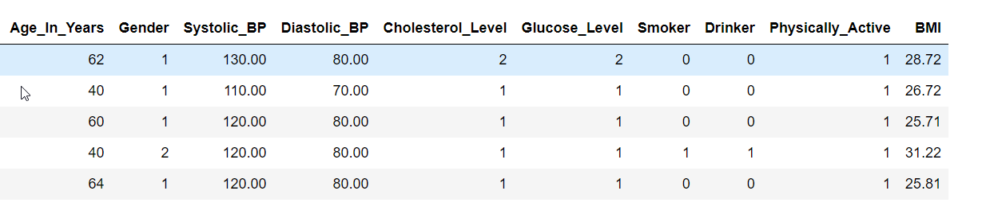
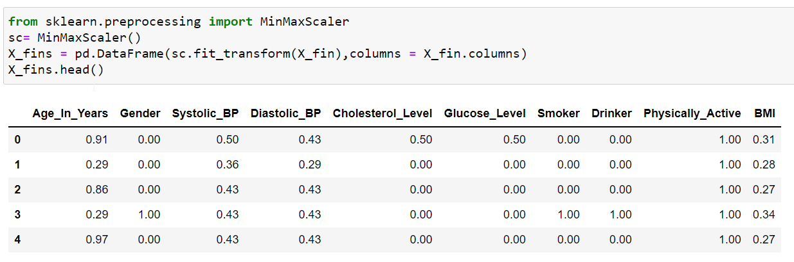
Feature Scaling

Slide 17
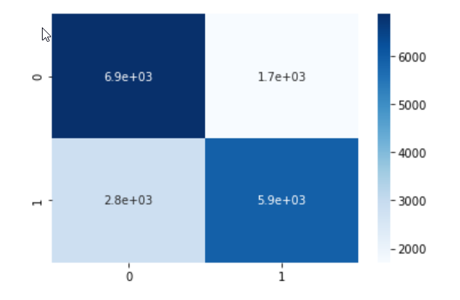
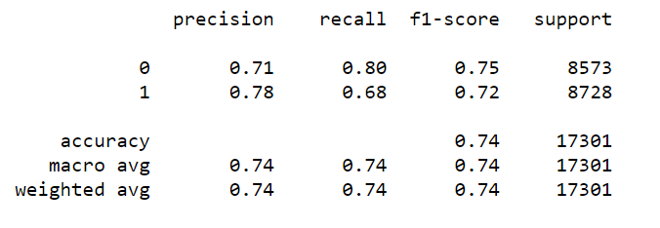

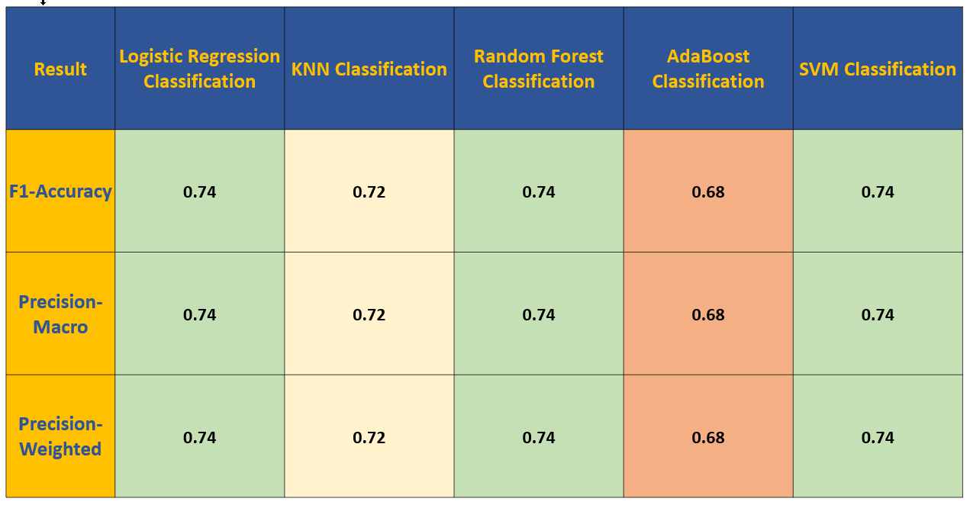
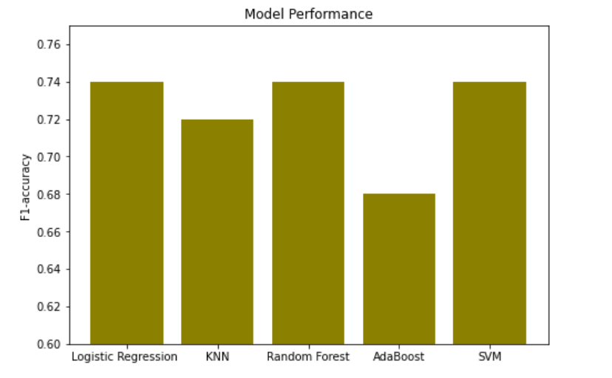
Model Evaluation
Confusion Matrix
Classification Report

Slide 18
Conclusion
The result suggests that Logistic Regression, Random Forest and SVM Classification performed better
Only one of our hypothesized parameters(alcohol) that were in the dataset marginally showed statistical insignificance.
Some of our hypothesized parameters were absent in our dataset and inclusion of those might improve the model performance

Slide 19
Thanks
Questions ?

