Slide 1


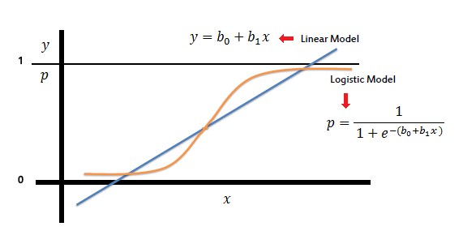
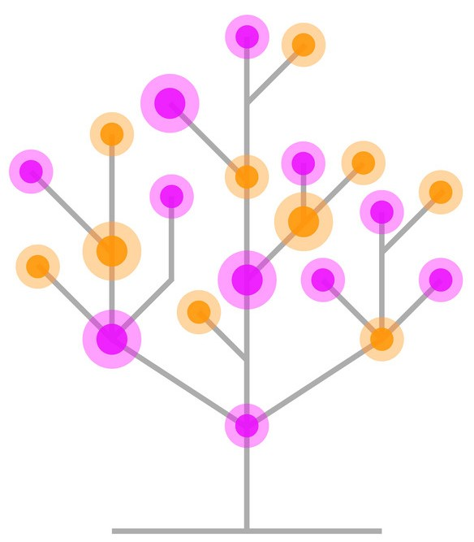

Exploratory Data Analysis and Comparing Machine Learning Models with Python

Slide 2
Submitted by
Mohammad Monjur-E-Elahi
Course: Python for Data Analytics [DSA08]
Program: Data Science and Application - Advanced Diploma [6060]
Metro College of Technology
Date: 5 April, 2021

Slide 3
The Dataset
Target
Feature:
not.fully.paid
Dataset loan_data.csv LendingClub.com lending and borrowing site
Depicts different features for borrowers
From Financial Industry
Consisted of null, duplicates values
Had 9620 observations and 14 variables to start with
13 numerical and 1 categorical variables
Reshaped finally with 9568 observations and 19 columns
Categorical column “Purpose” was converted to dummy variables
“NotFullyPaid” was our target column

Slide 4
The Project
Ultimate
Objective:
Predicting
Fully Paying
Borrowers
Clean the dataset
Conduct Univariate and Bivariate Analysis
Perform statistical significant association analysis
Visualize different aspects of the dataset
Perform required feature engineering
Develop package to build and evaluate machine learning models
Logistic Regression, Decision Tree, Random Forest included

Slide 5
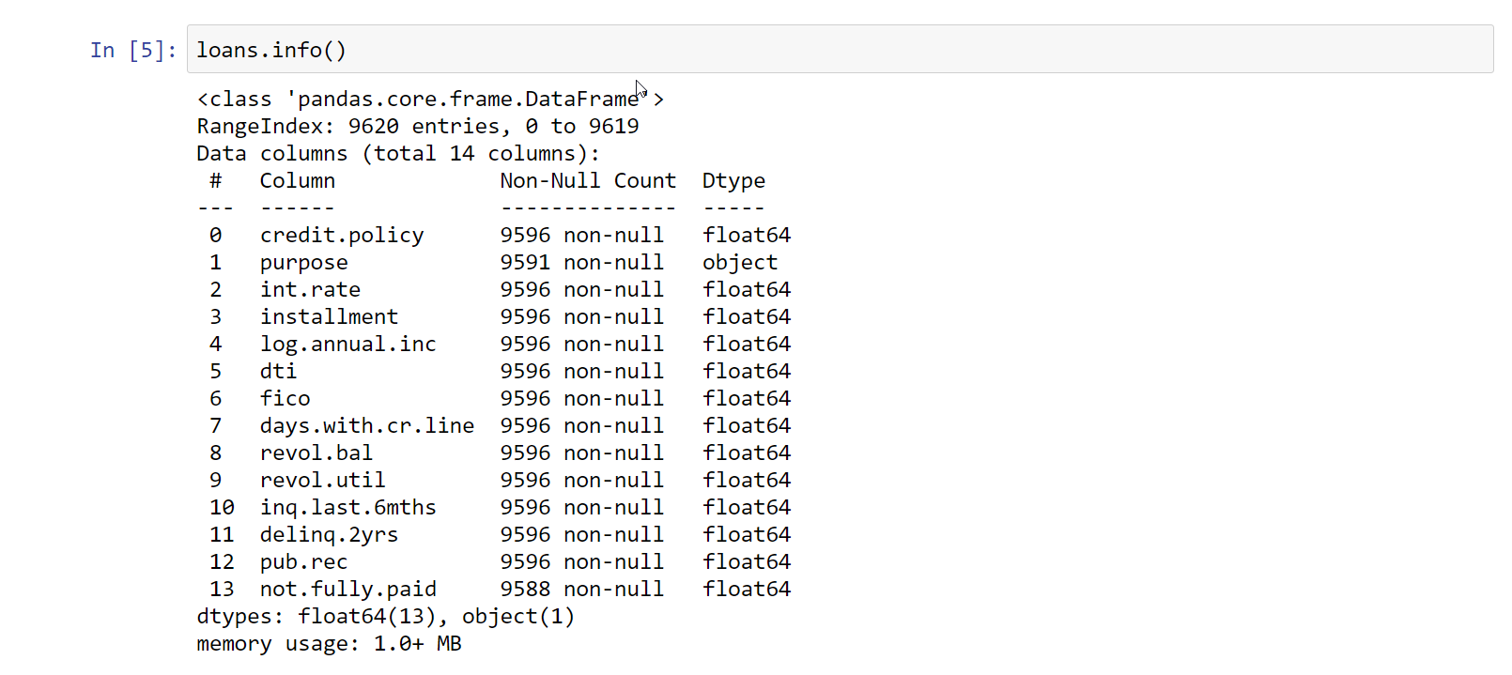
At the beginning
Rows & Columns:
9620,
14

Slide 6
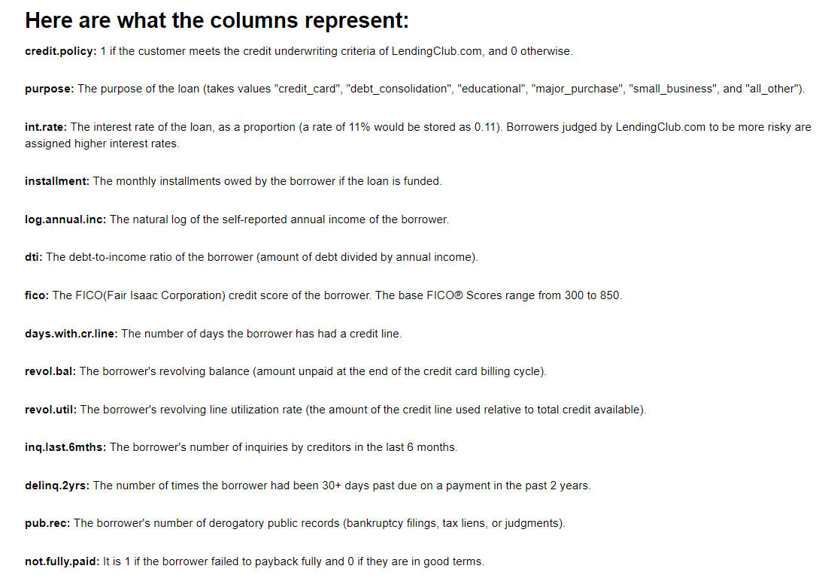
At the beginning Meaning of the features of the dataset
Familiarize:
Meaning of Features

Slide 7
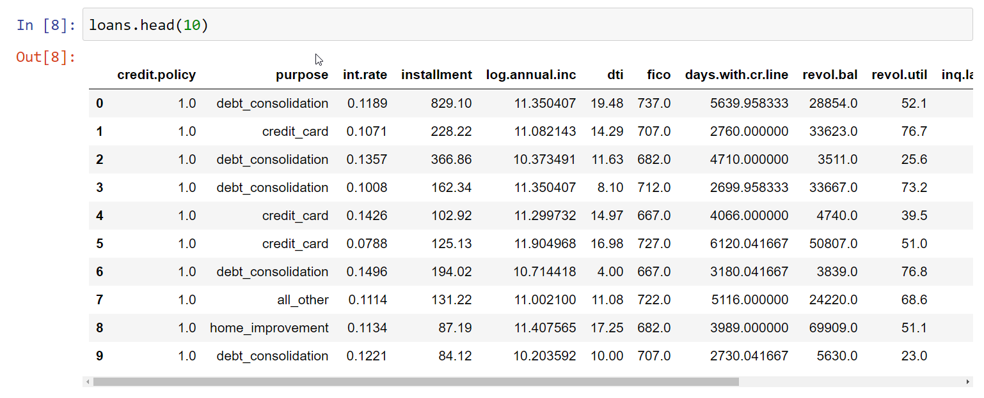
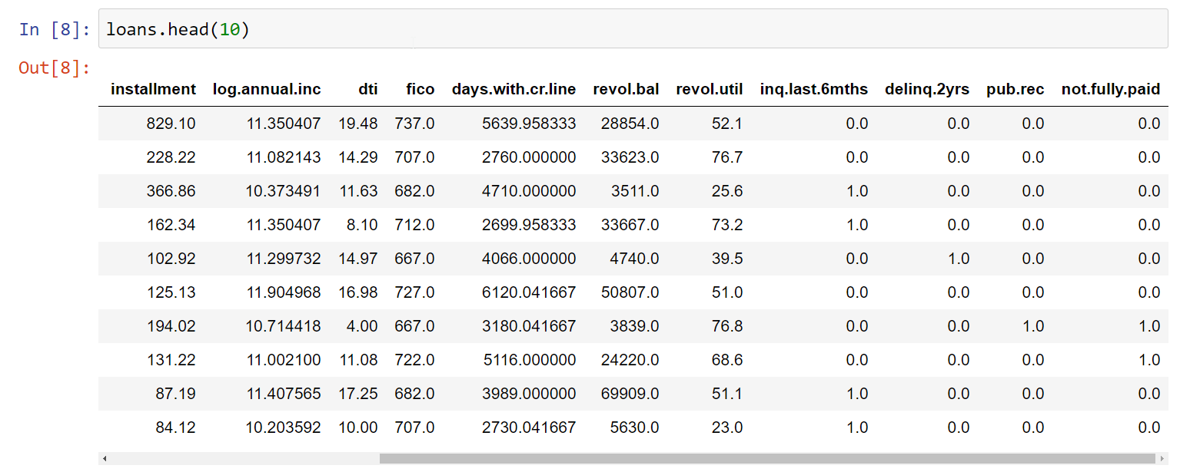
At the beginning Head of the data frame

Slide 8
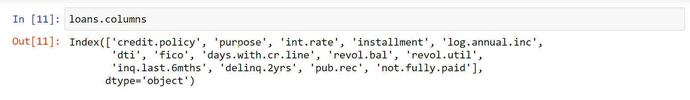
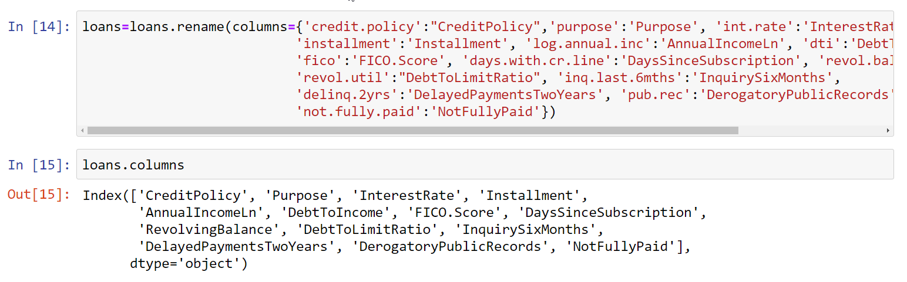
Ready for the model We opted to change the column names to make it more intuitive.
Used rename to
Change feature
names

Slide 9
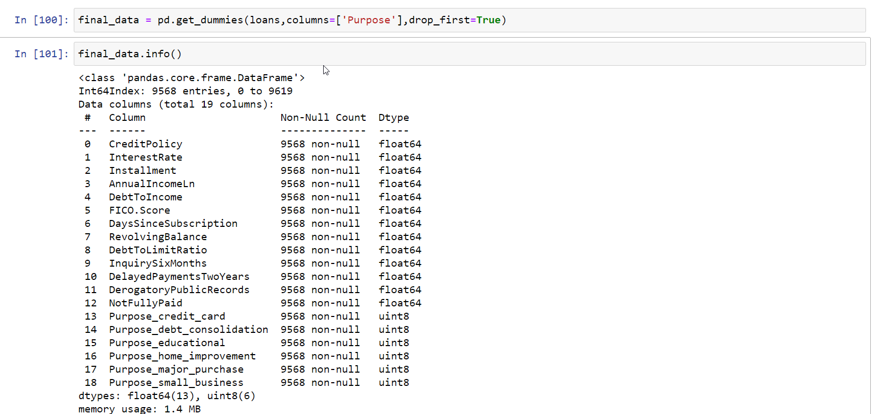
Ready for the model We had to convert the categorical column “Purpose” in dummy variables
Created a different dataset to keep the original
Feature
Engineering:
Sklearn
Library
Understands
Numerical
only

Slide 10
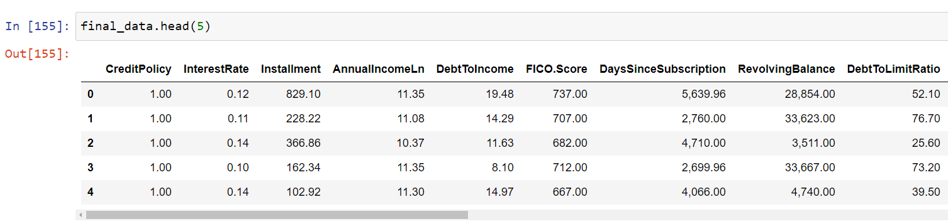
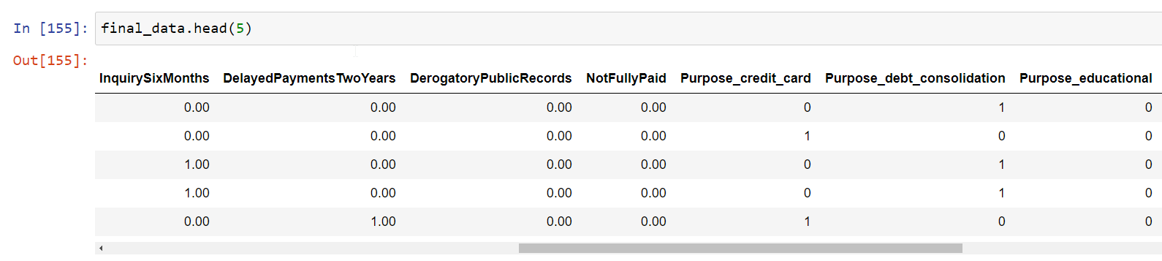
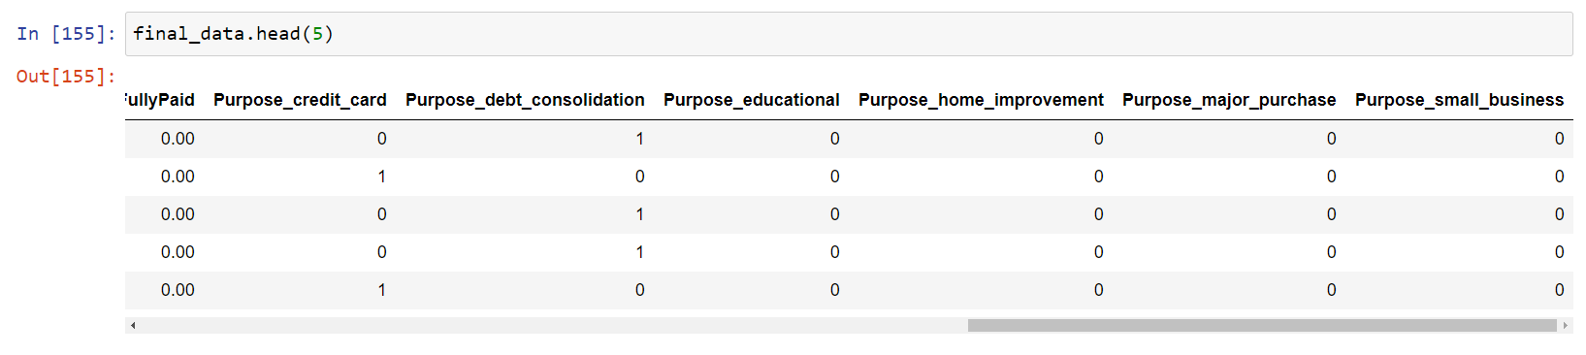
Ready for the model

Slide 11
What is covered…
Null/missing and duplicate handling
Univariate, Bivariate, chi-test and visualization for cat versus cat
Univariate, Bivariate, t-test and visualization for num versus cat
Package built for Models and evaluation

Slide 12
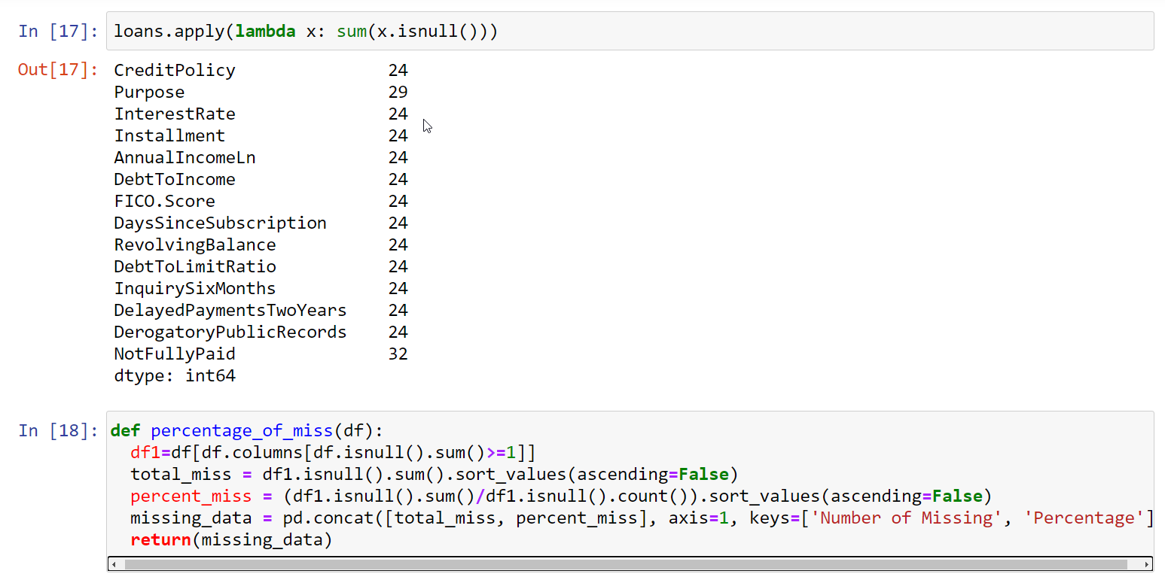
Dealing with null values and duplicate rows
Visualization:
Missing, Null
Data Read:
na_values = ‘NA’

Slide 13
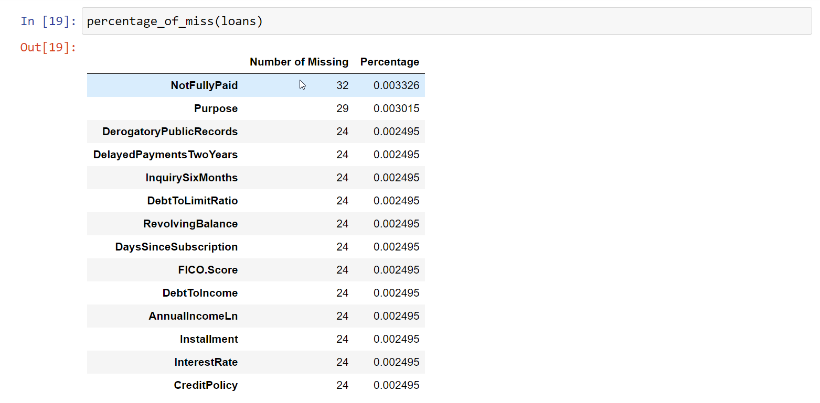
Dealing with null values and duplicate rows
Visualization:
Missing, Null

Slide 14
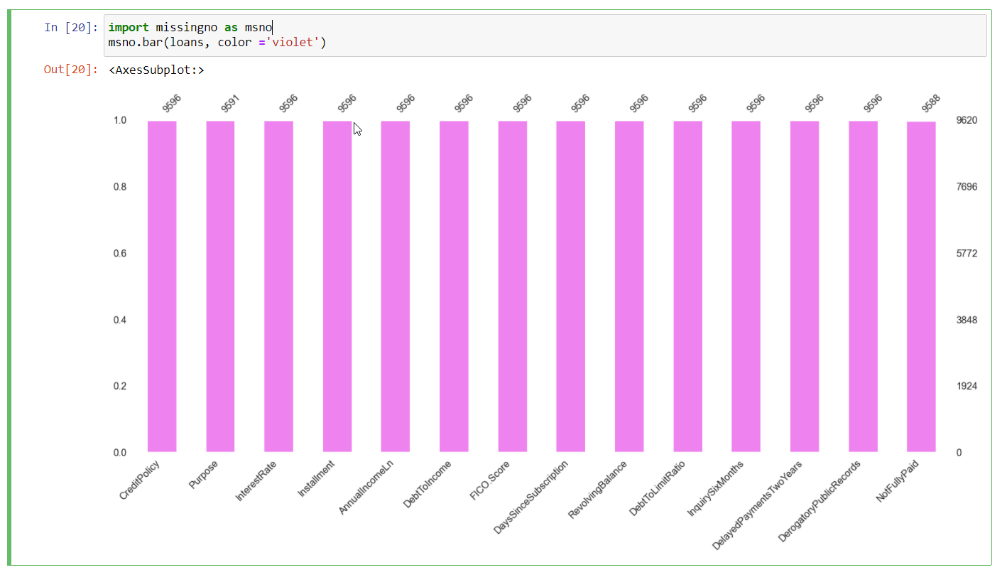
Dealing with null values and duplicate rows Visualization
Missingno is used for visualization

Slide 15
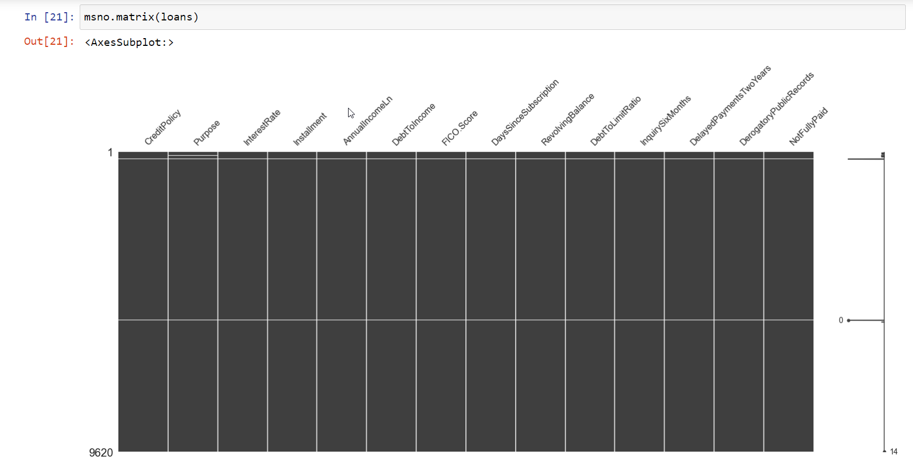
Dealing with null values and duplicate rows Visualization
Horizontal white line depicting missing values

Slide 16
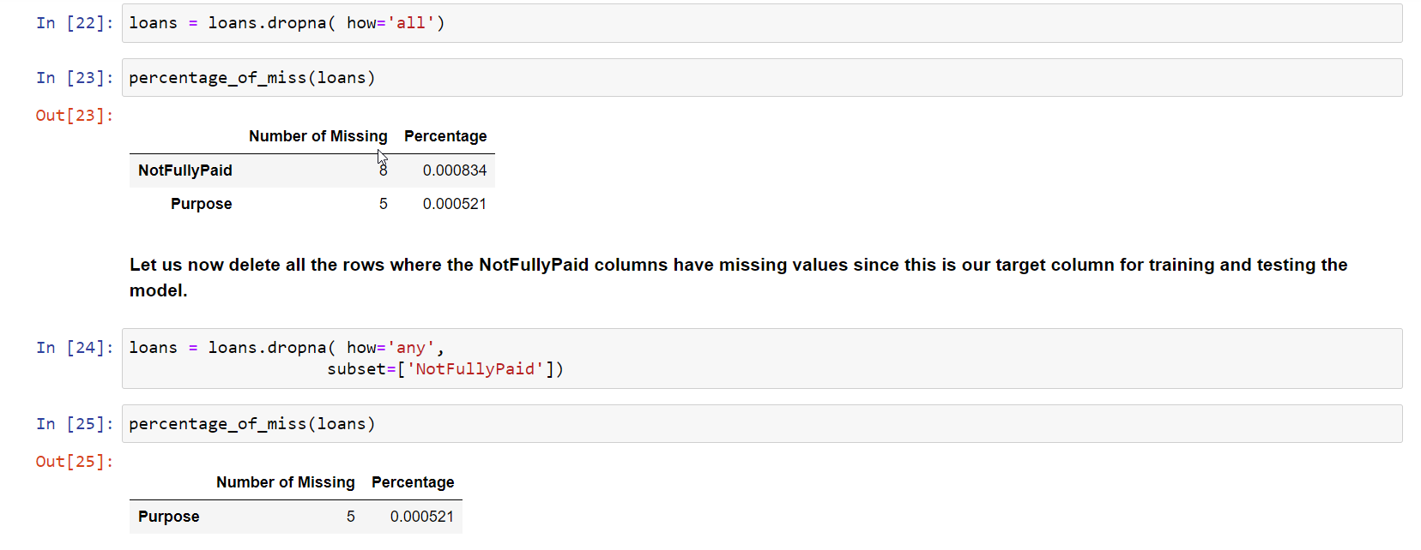
Dealing with null values and duplicate rows
Dropping null for all columns
Dropped 8 rows where target column had null

Slide 17
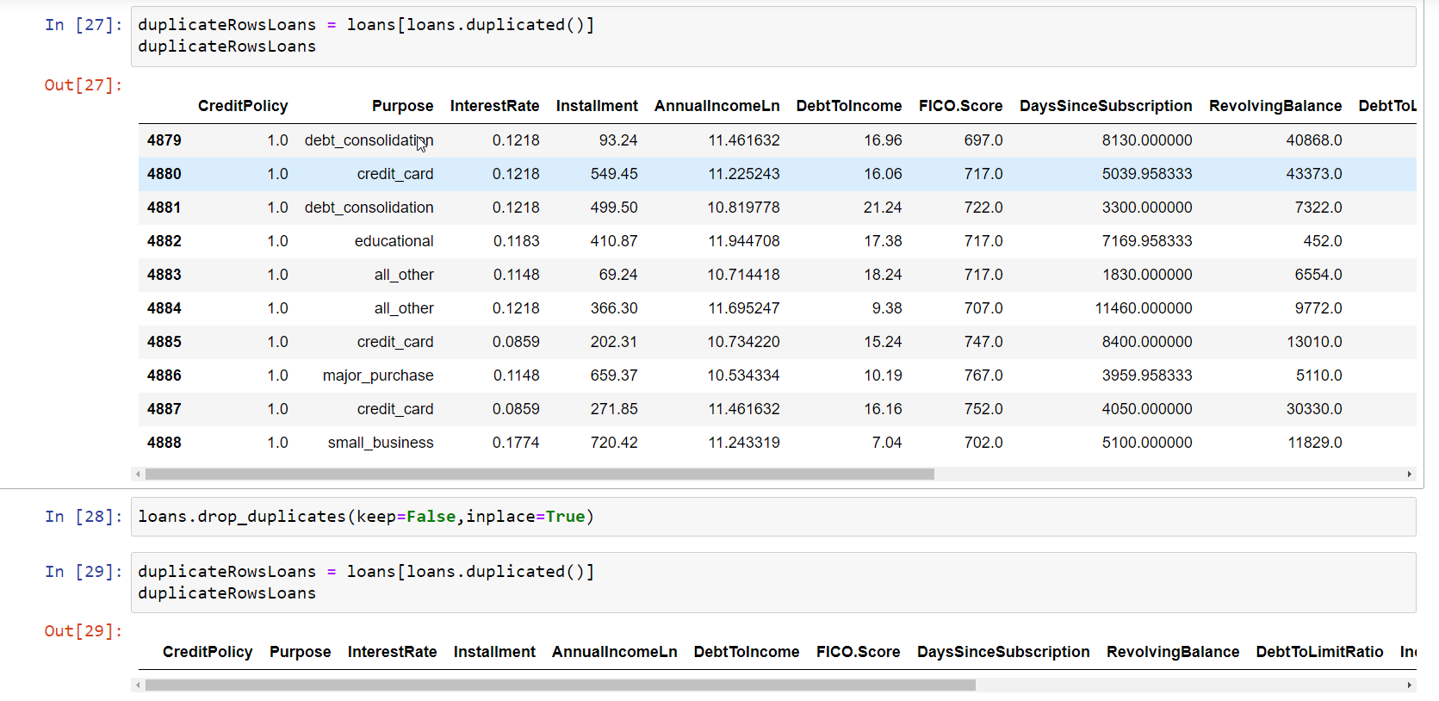
Dealing with null values and duplicate rows
Removed all duplicate rows

Slide 18
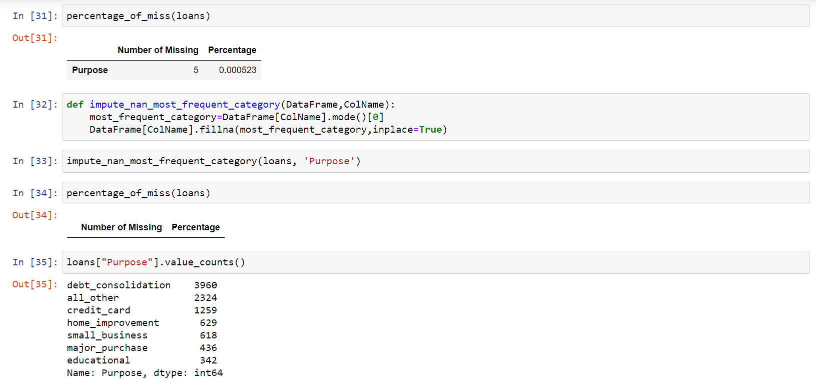
Dealing with null values and duplicate rows
UDF to handle missing value of Purpose with mode

Slide 19
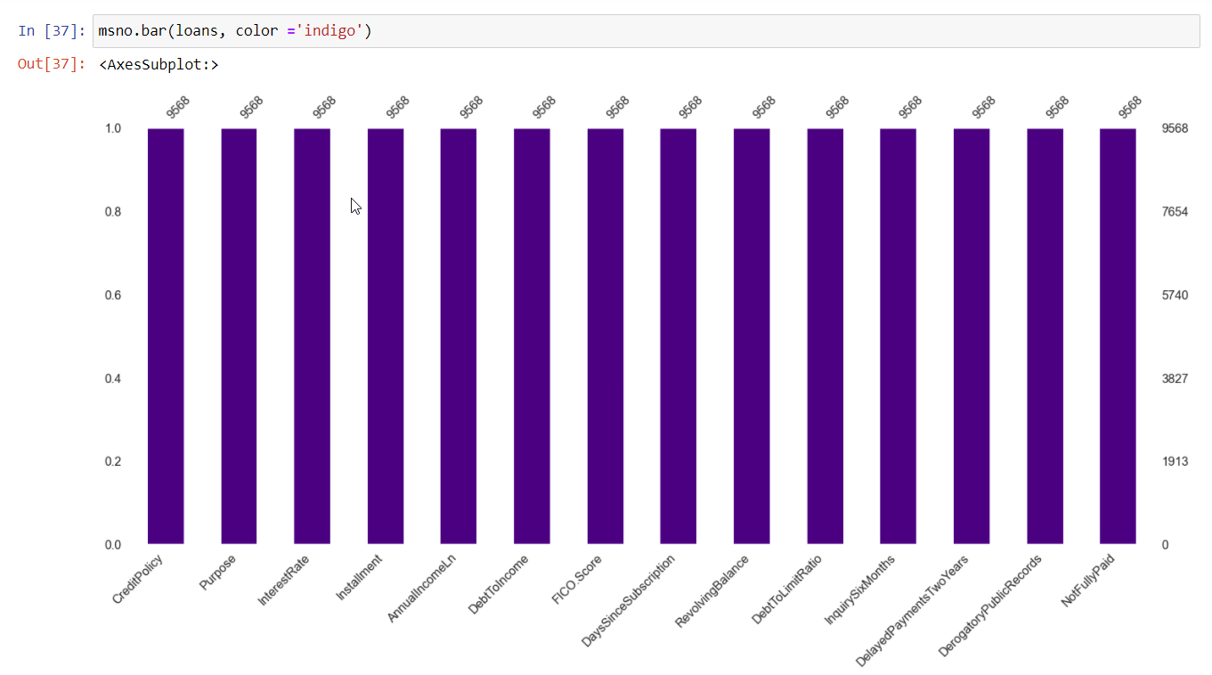
Dealing with null values and duplicate rows Visualization

Slide 20
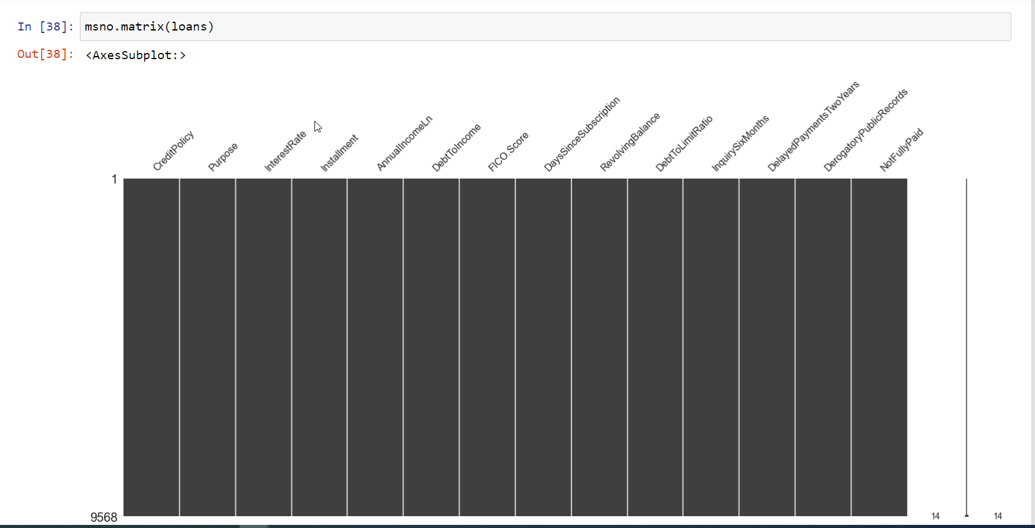
Dealing with null values and duplicate rows Visualization
No Horizontal white lines depicting no missing values

Slide 21
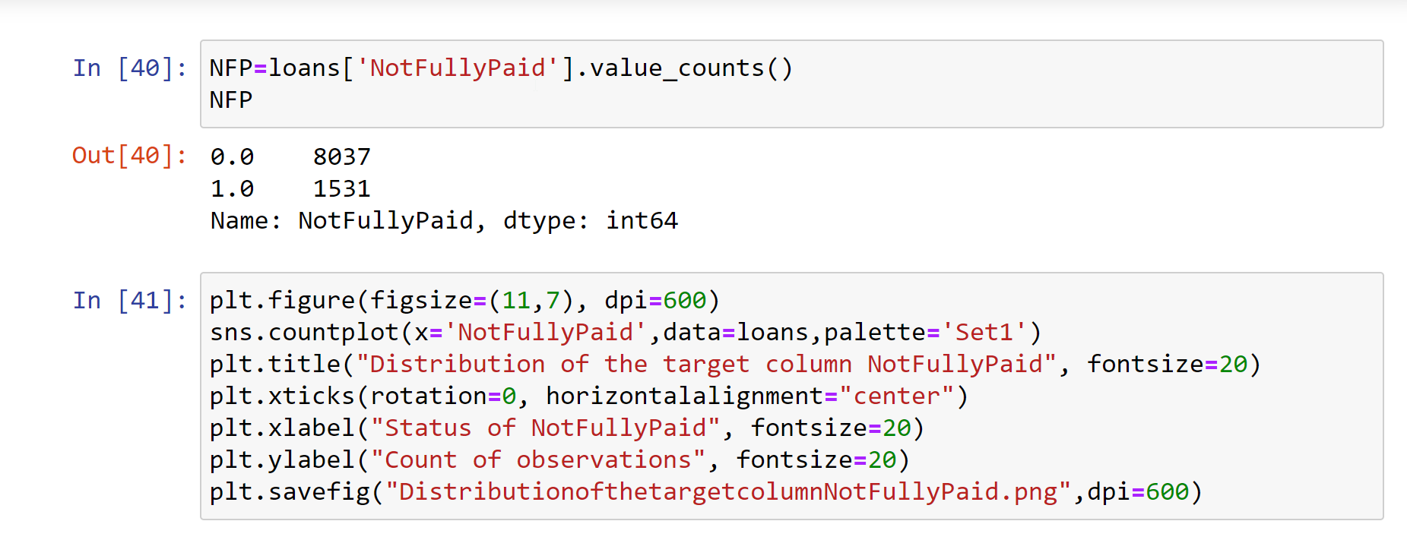
The target Column: “NotFullyPaid” Distribution Tabular

Slide 22
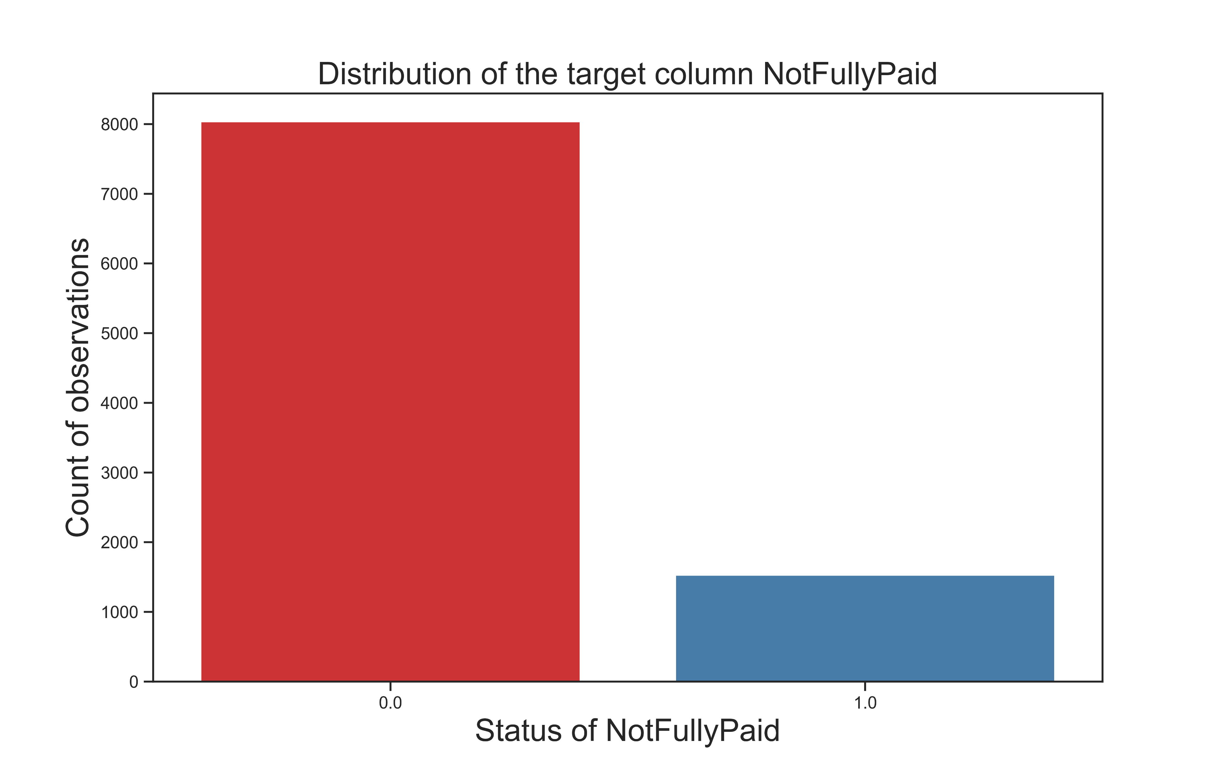
The target Column: “NotFullyPaid” Distribution Visulization
We are dealing with unbalanced data

Slide 23
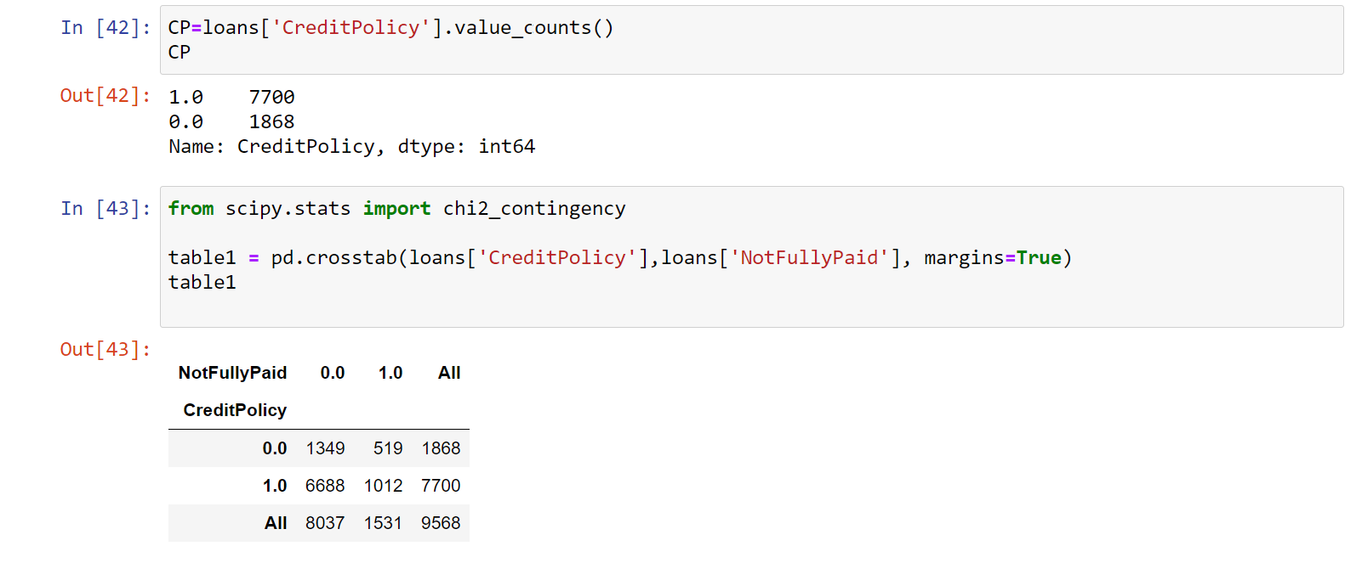
Analysis of CreditPolicy and Target Column Categorical versus categorical
Treated Credit Policy and NotFullyPaid as categorical as it was binary

Slide 24
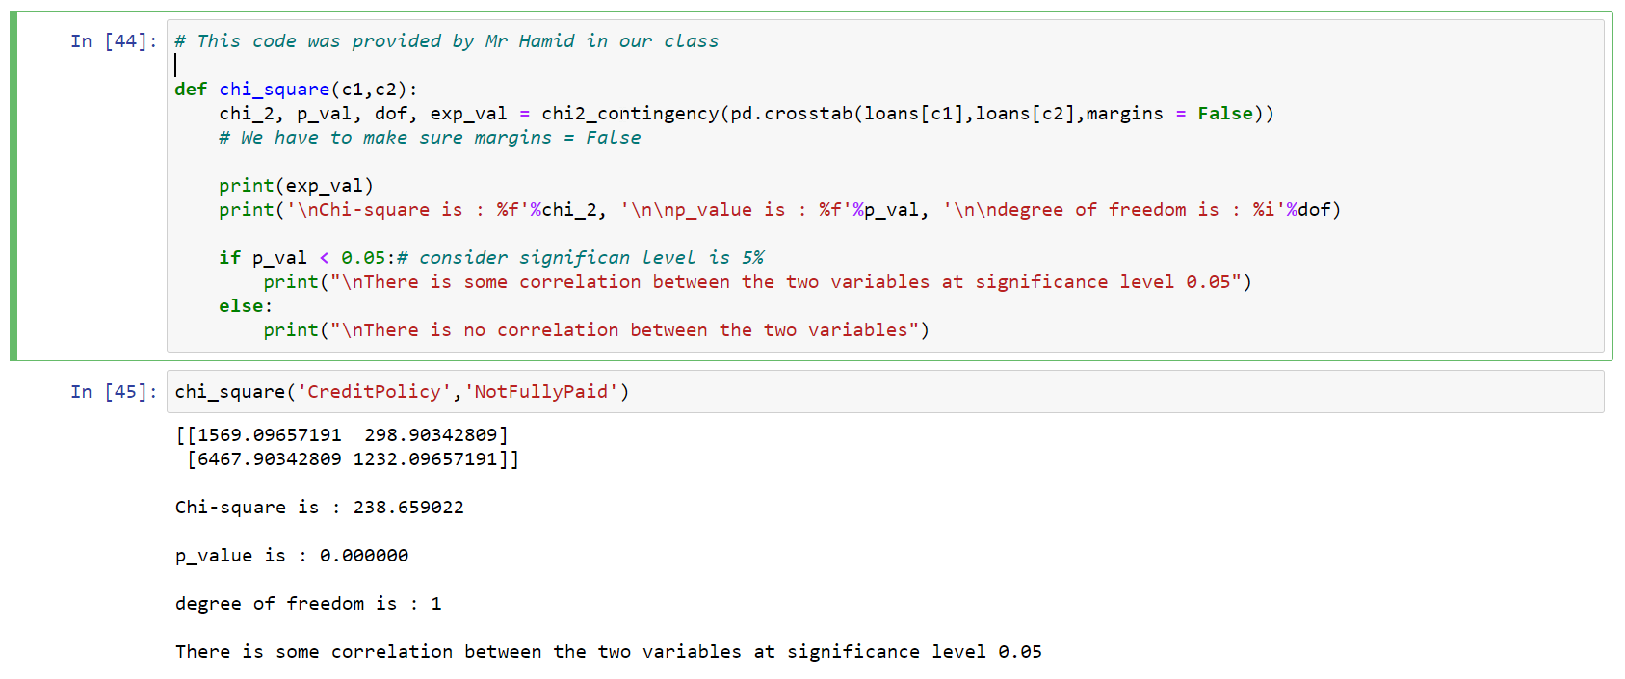
Analysis of CreditPolicy and Target Column
Shows statistically significant association

Slide 25
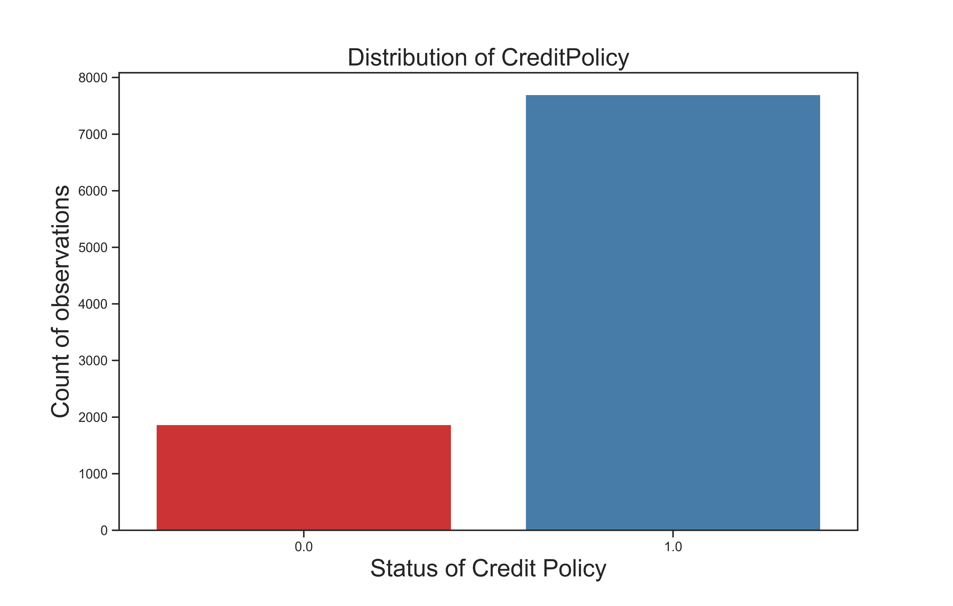
Analysis of CreditPolicy and Target Column Visualization
Countplot:
Most borrowers had credit policy

Slide 26
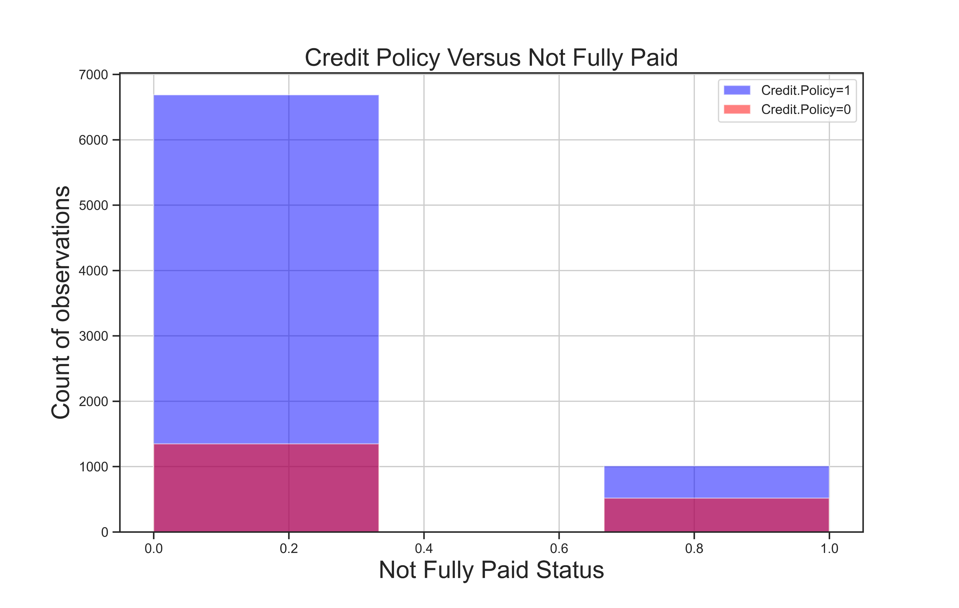
Analysis of CreditPolicy and Target Column Visualization
Stacked Histogram

Slide 27
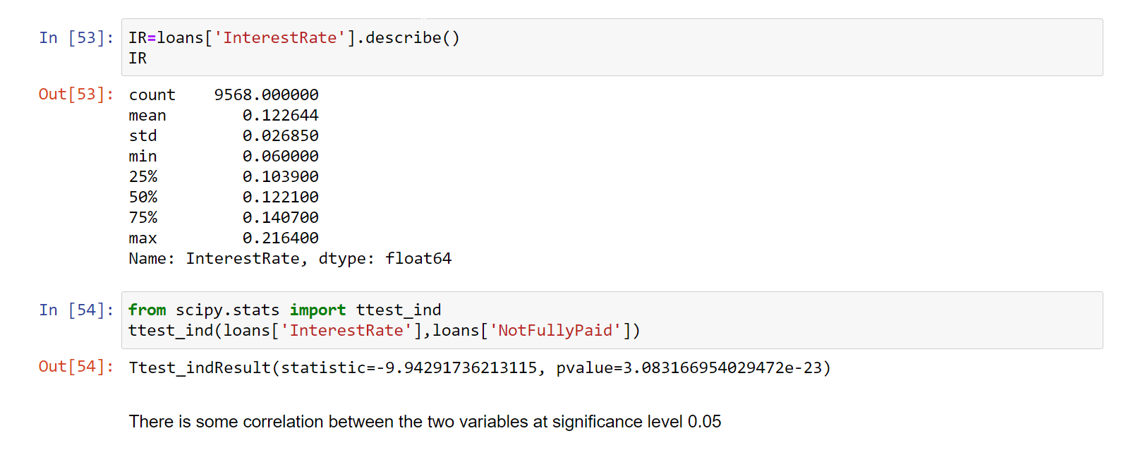
Analysis of InterestRate and Target Column
Numerical versus categorical
Shows statistically significant association

Slide 28
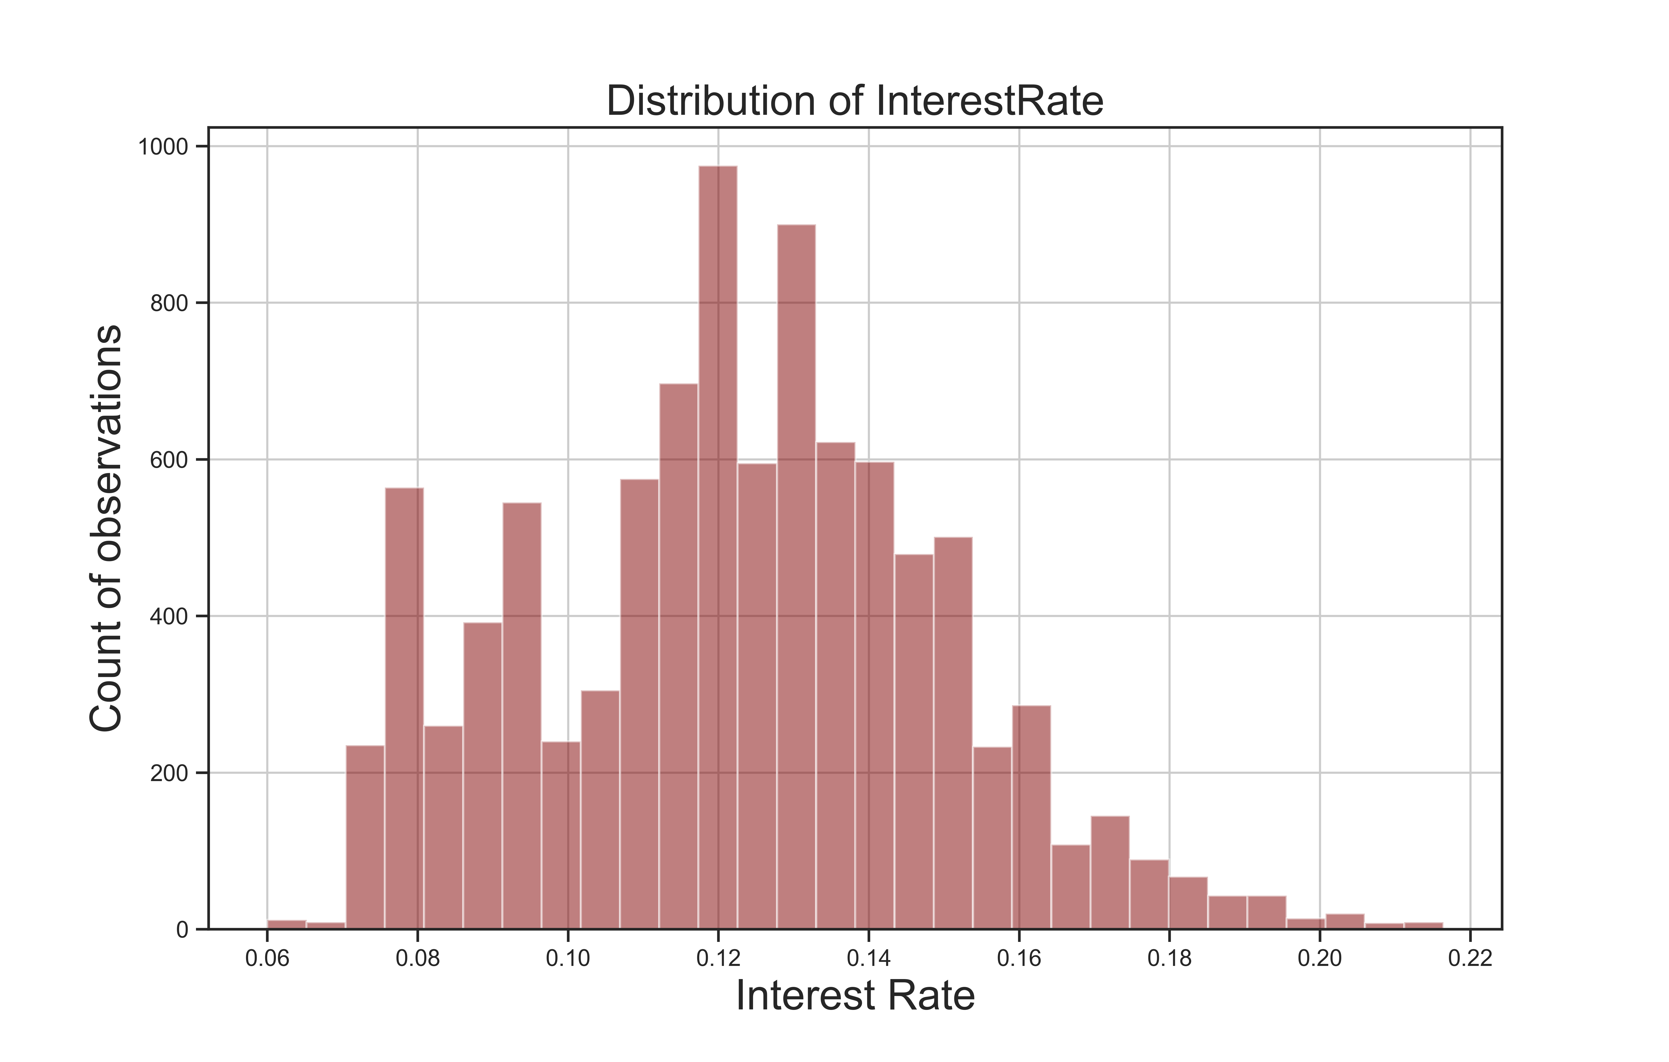
Analysis of InterestRate and Target Column
Visualization
Histogram

Slide 29
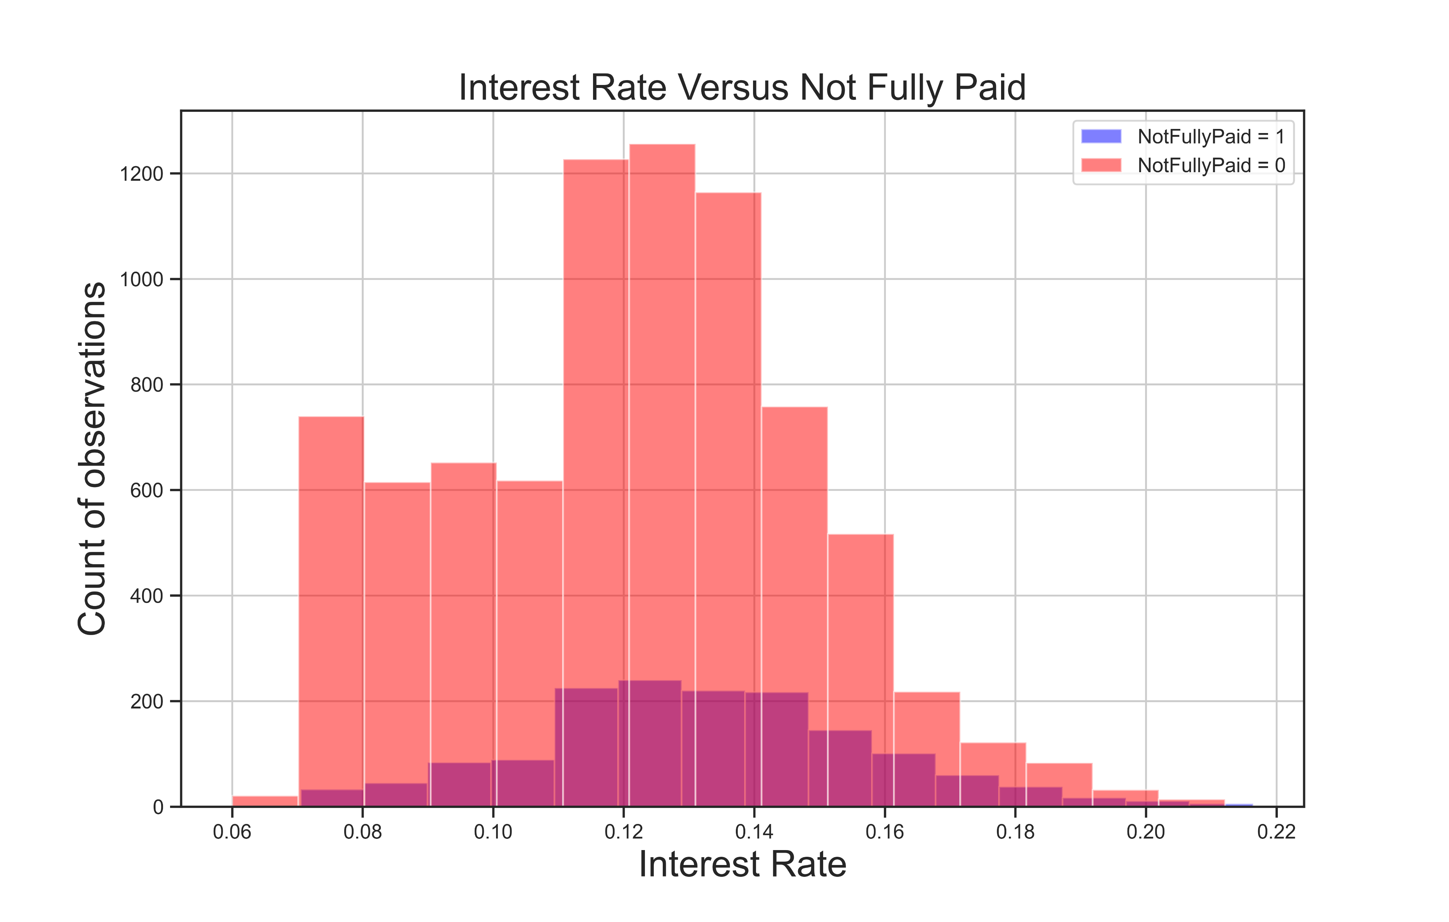
Analysis of InterestRate and Target Column
Visualization
Stacked Histogram

Slide 30
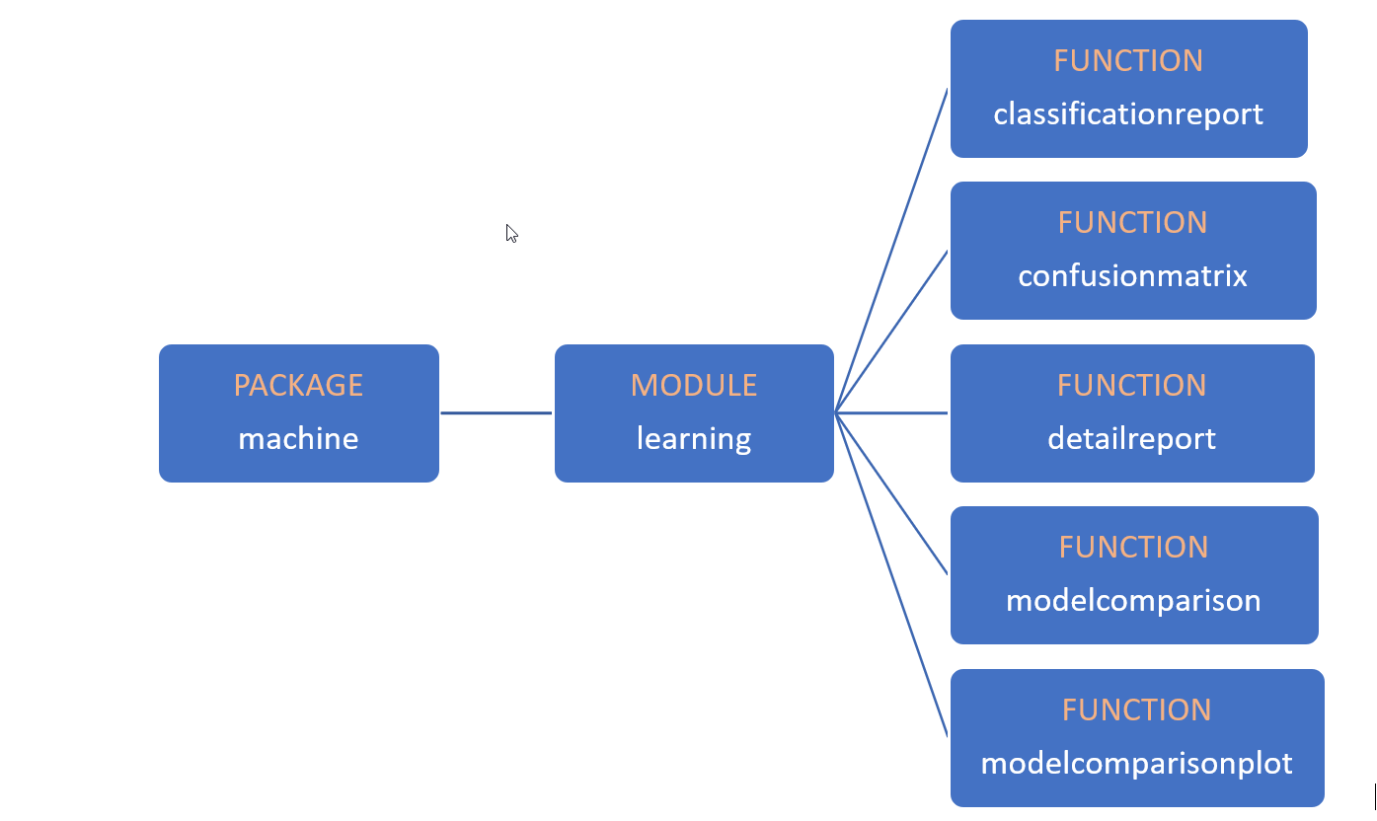
Developing the Package for Machine Learning Models
Structure of the package and module

Slide 31
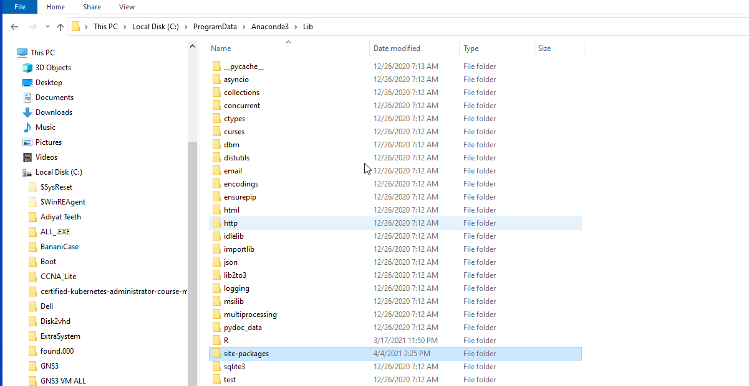
Developing the Package for Machine Learning Models
Package is put in default location
Default Package Location:
We can import from anywhere without referencing path

Slide 32
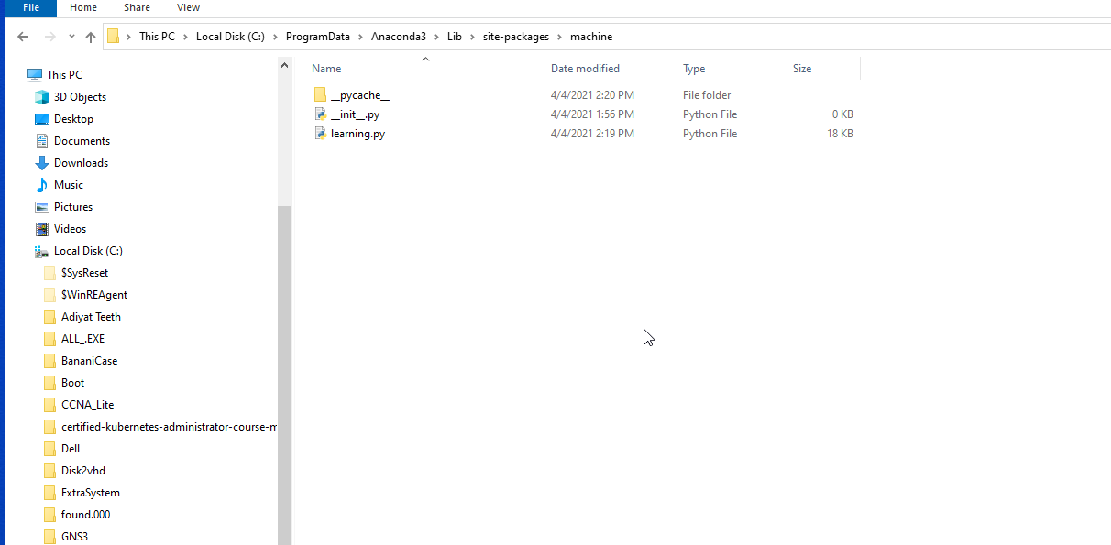
Developing the Package for Machine Learning Models
Package is put in default location
Package:
sklearn
Test-Train split
Libraries/modules
Models
Code Tables
Code Visualization

Slide 33
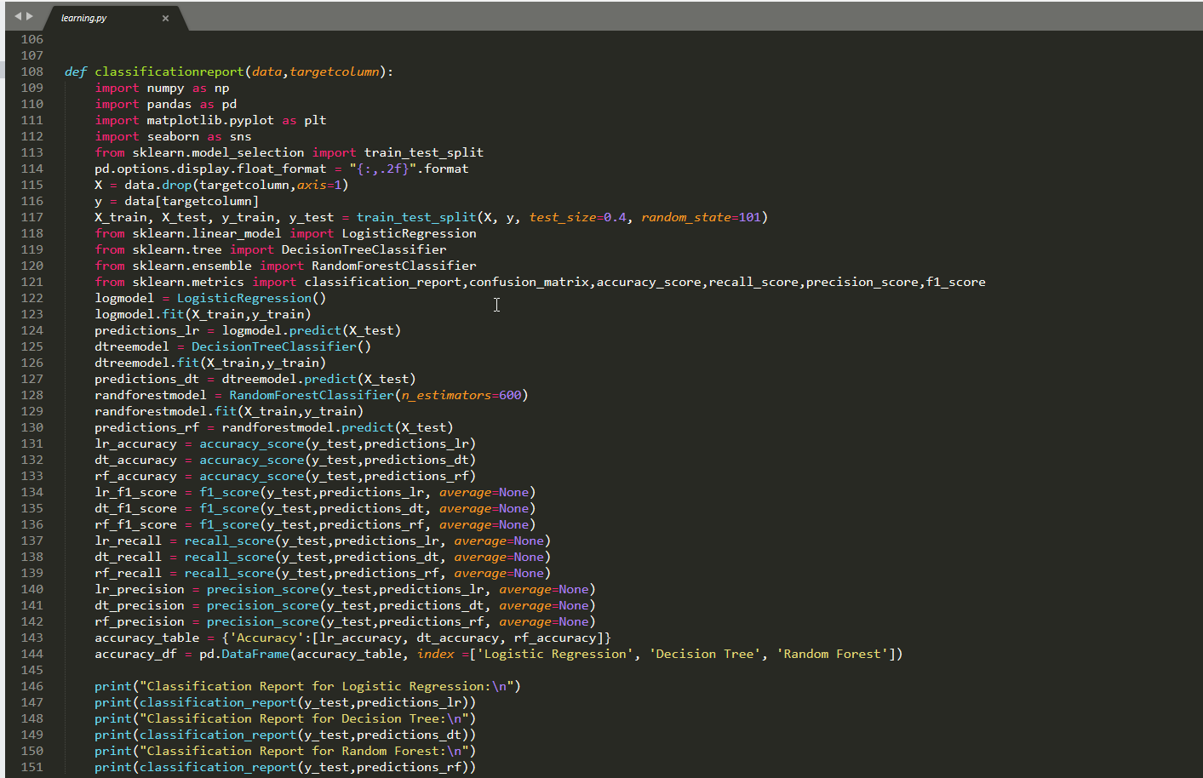
Developing the Package for Machine Learning Models
Code for one function in the module

Slide 34
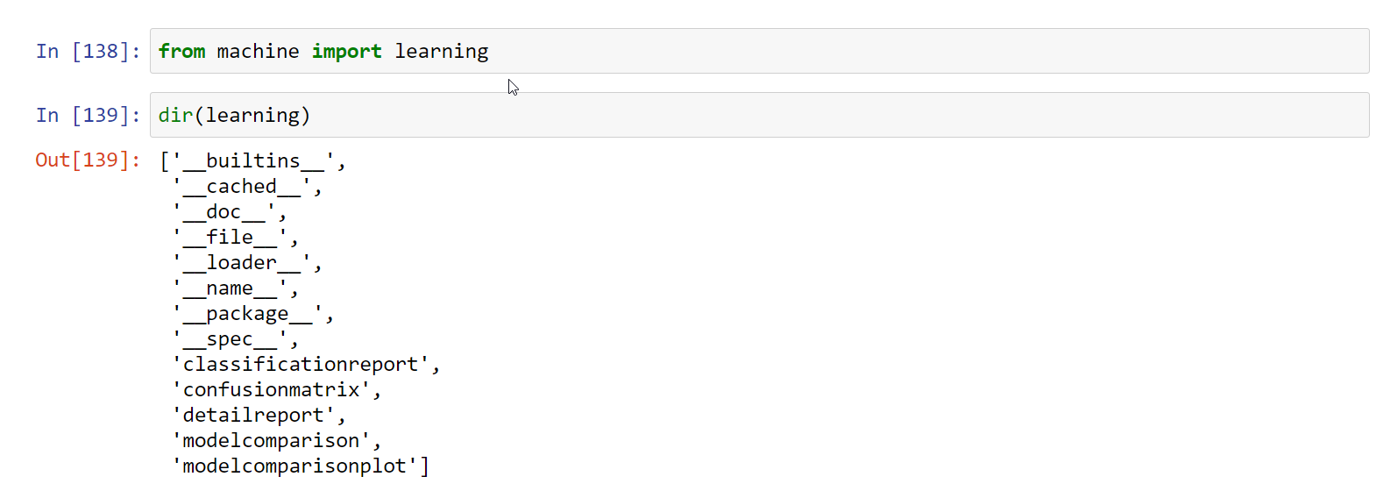
Developing the Package for Machine Learning Models
Details of the module

Slide 35
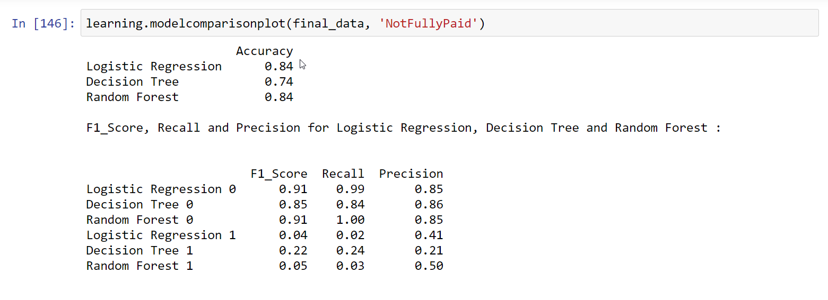
Developing the Package for Machine Learning Models
Output of one function is shown
We need to put dataset and target column as arguments

Slide 36
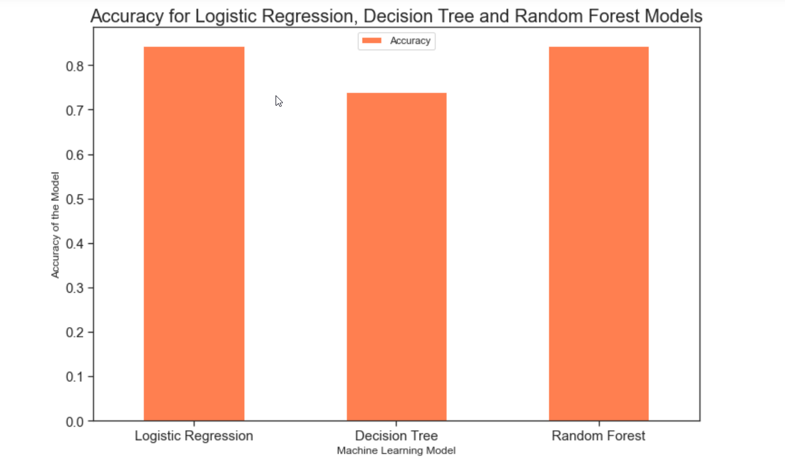
Developing the Package for Machine Learning Models
Output of one function is shown
Barplot

Slide 37
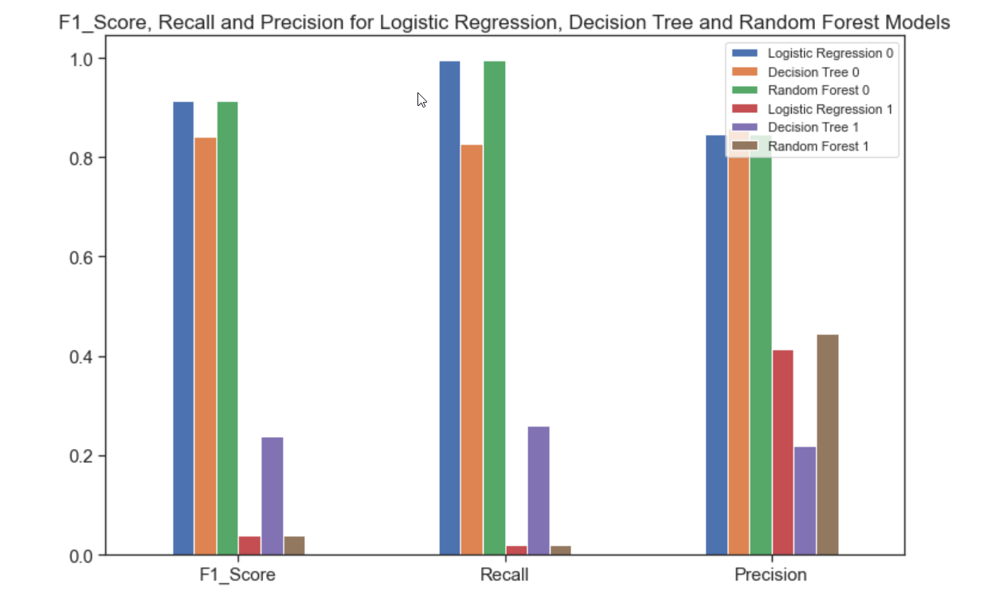
Developing the Package for Machine Learning Models
Output of one function is shown
Grouped
Barplot

Slide 38
Conclusion
Performed EDA
Tried to visualize to get clarity and insight
Attempted to build a package for machine learning models
Models are Logistic regression, Decision Tree and Random Forest
In depth knowledge required to comprehend the outcomes
Wanted to have an end to end completion fulfilling feeling

Slide 39
Thanks
Questions ?

