Slide 1


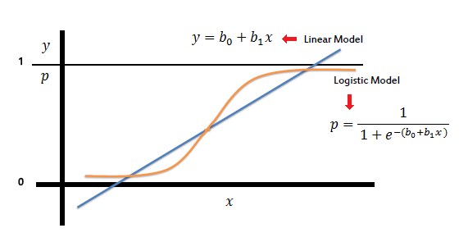
Exploratory Data Analysis And Logistic Regression

Slide 2
Submitted by
Report
Mohammad Monjur-E-Elahi
Course: R for Data Analytics [DSA06]
Program: Data Science and Application - Advanced Diploma [6060]
Metro College of Technology
Date: 5 March, 2021

Slide 3
The Project
Report
Clean the dataset
Perform required feature engineering
Conduct Univariate Analysis
Perform statistical significant association analysis
Visualize different aspects of the dataset
Develop the Logistic Regression Model
Target is any person belongs to <50K or =>50K income group
Evaluate the model performance

Slide 4
The Dataset
Report
UCI/Kaggle adult_sal.csv dataset
Got modified version with null and outliers included
Not from a particular industry
Relevant for any industry for dichotomous(binary) target predictions
Had 32584 observations and 16 variables to start with
Reshaped finally with 30139 observations and 15 columns
9 categorical and 6 numerical variables
Income was our target column

Slide 5
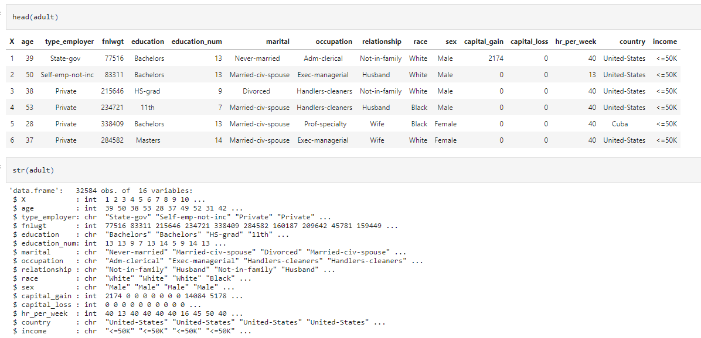
At the beginning
Report

Slide 6
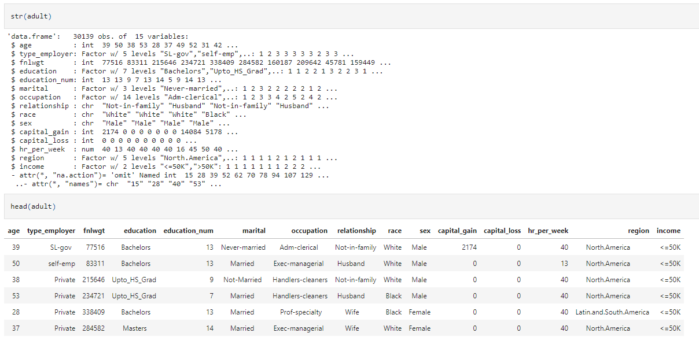
Ready for the model
Report

Slide 7
Steps taken/Question Answered
Report
Had to answer about 40 questions in this journey
Would like to mention only one from similar ones

Slide 8
Contents Answering Questions
Report
Q1Removing the additional index
Q2Dealing with null values, “?” values and duplicate rows
Q3Removing rows with missing values
Q4Performed feature engineering using function
Q5Dealt with outliers of numeric column hr_per_week
Q6Analyzed distribution of all the columns
Q7Statistically significant Association between target and other columns
Building and evaluating Logistic Regression Model
Conclusion

Slide 9
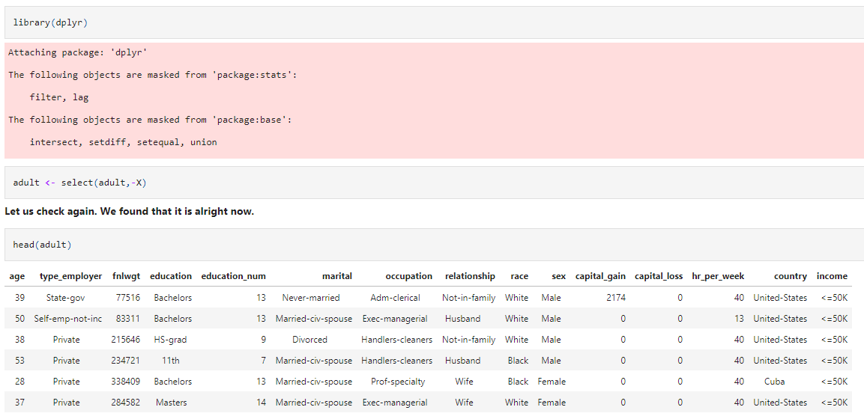
Used select command from dplyr library
Report
Contents

Slide 10
Null, “?”, duplicate rows and row with only NA
Report
Converts null to NA
adult[adult == ''] <- NA
r1 <- which(duplicated(adult))
adult <- adult[-r1,]
r2 <- which(!complete.cases(adult))
adult[r2,]
adult <- adult[-r2,]
adult[adult == '?'] <- NA
Removes duplicated rows
Finds rows with all column values NA
Removes rows with all column values NA
Converts ‘?’ to NA
Contents

Slide 11
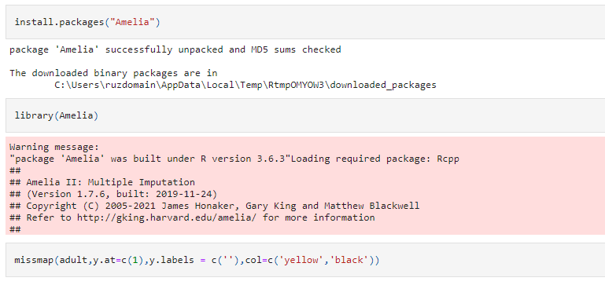
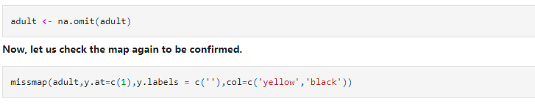
Used Amelia library to visualize and remove
Report

Slide 12
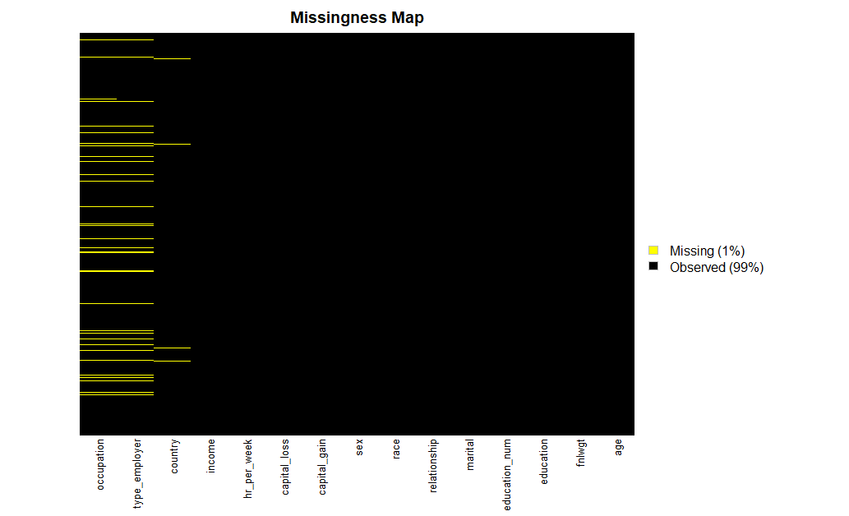
Before removing
Report

Slide 13
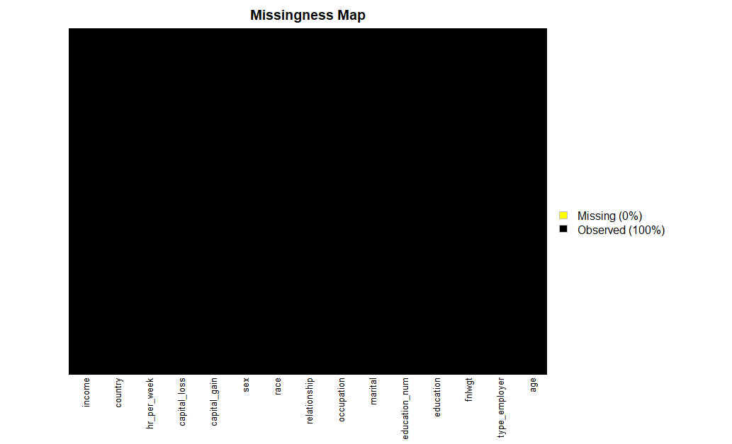
After removing
Report
Contents

Slide 14
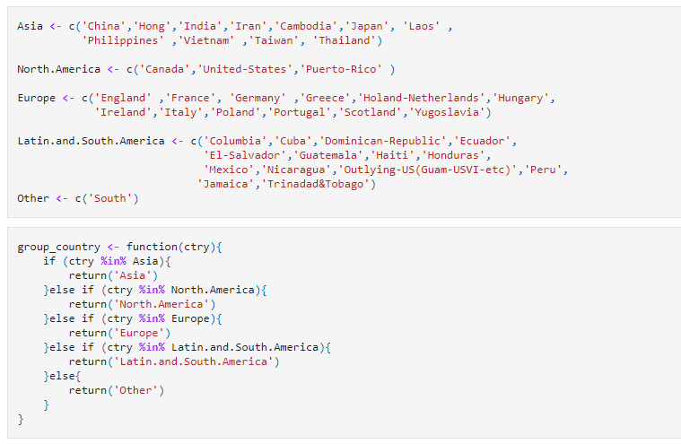
Engineered Features categories in type_employer, education, marital and country
Report
Grouped the countries as per region
Applied this function to engineer the categories

Slide 15
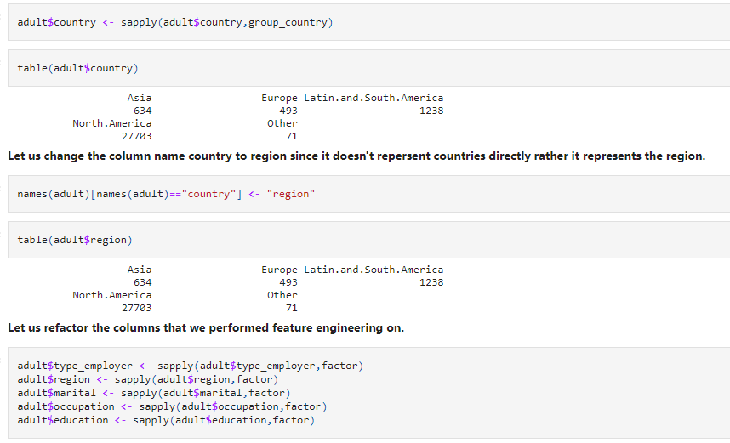
We show the country column Changed the column name to region and refactored
Report
Applied the UDF to regroup the countries
Modified the column name from country to region
Contents

Slide 16
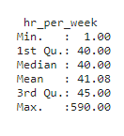
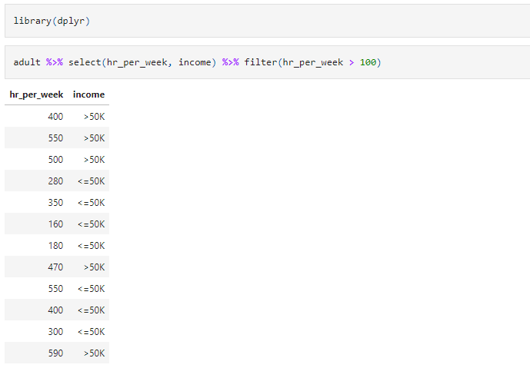
Outliers Handling Found a pattern of mistake in hr_per_week and adjusted
Report
Seem completely impossible and look like mistakenly got an additional zero

Slide 17
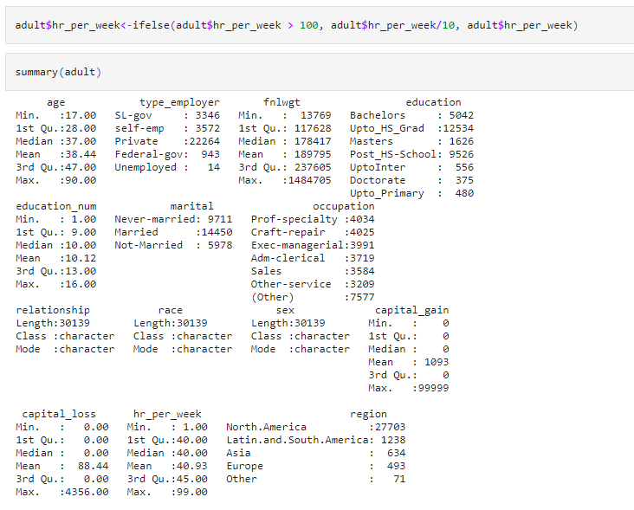
The outliers are now adjusted
Report
Outliers have been adjusted
Contents

Slide 18
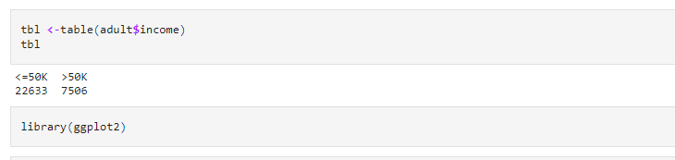
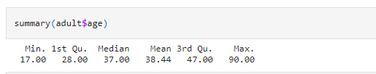
Categorical variable income and numerical variable age is depicted here
Report
For categorical variable tabular form is used
For numerical variable summary is used

Slide 19
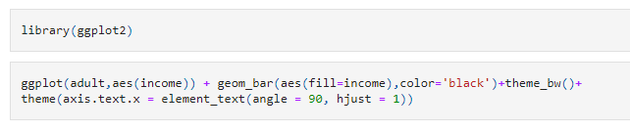
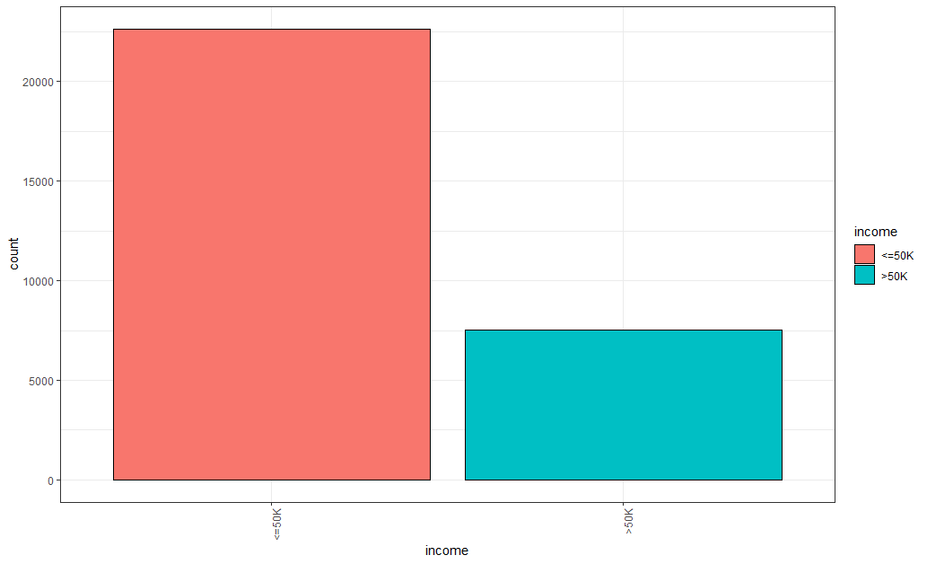
We show one categorical and one numerical Column: income, the target column
Report
We are dealing with unbalanced data

Slide 20
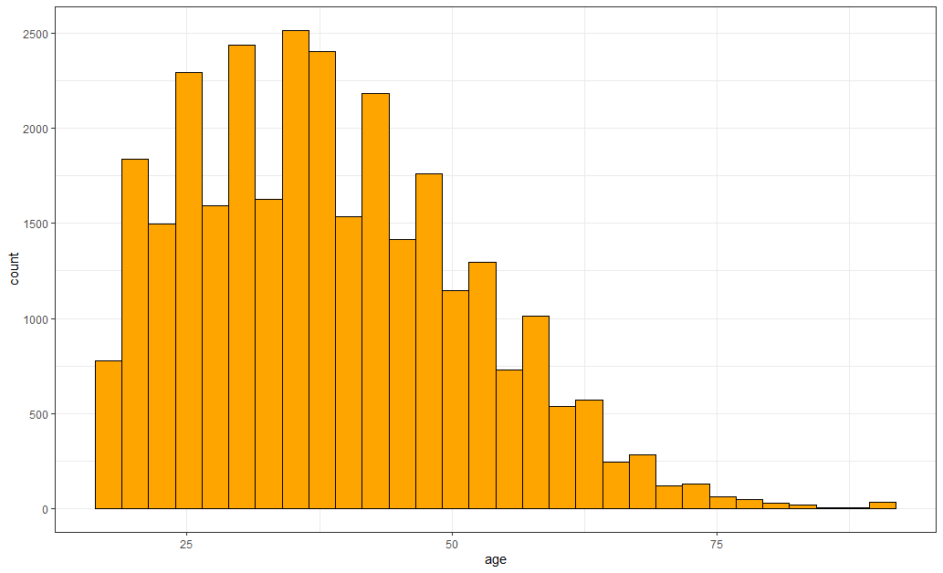
Column: age, a numerical column
Report
Contents

Slide 21
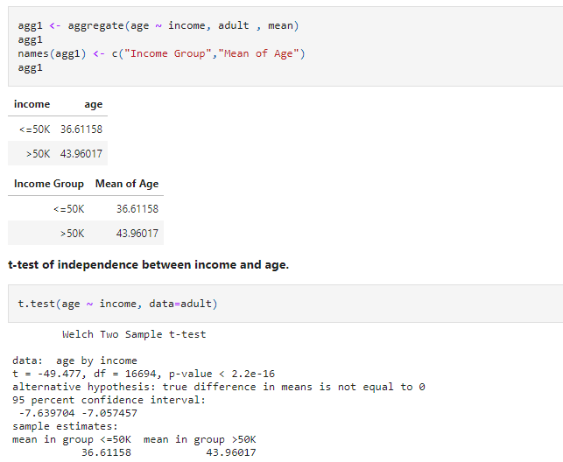
Bivariate Analysis Between numerical age and target income
Report
For numerical versus categorical we used t-test
Indicates statistically significant associations

Slide 22
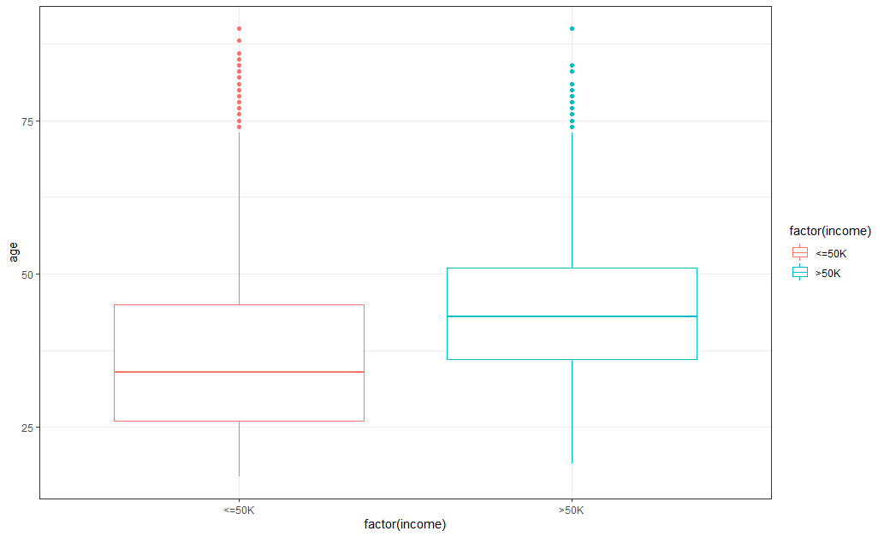
Grouped box plot
Report
Mean age of people earning more than 50k is higher than the same of people earning less than 50k

Slide 23
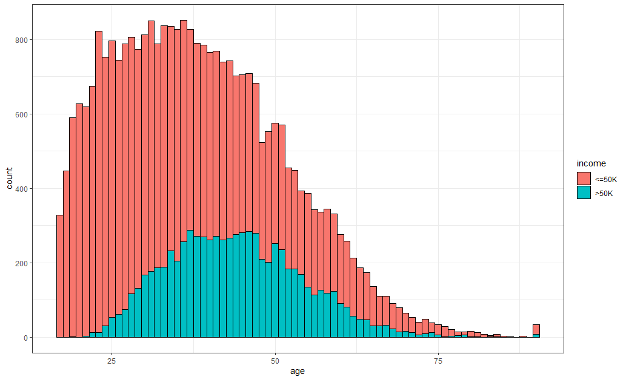
Histogram
Report

Slide 24
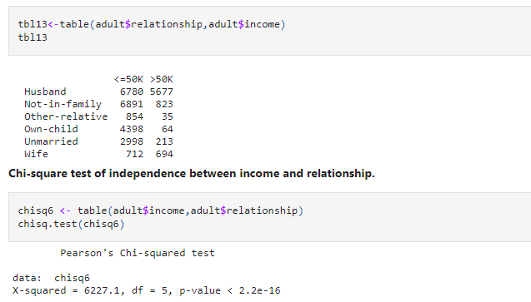
Bivariate Analysis Between categorical region and target income
Report
Chi-square test for categorical versus categorical
This p-value suggests statistical significant association

Slide 25

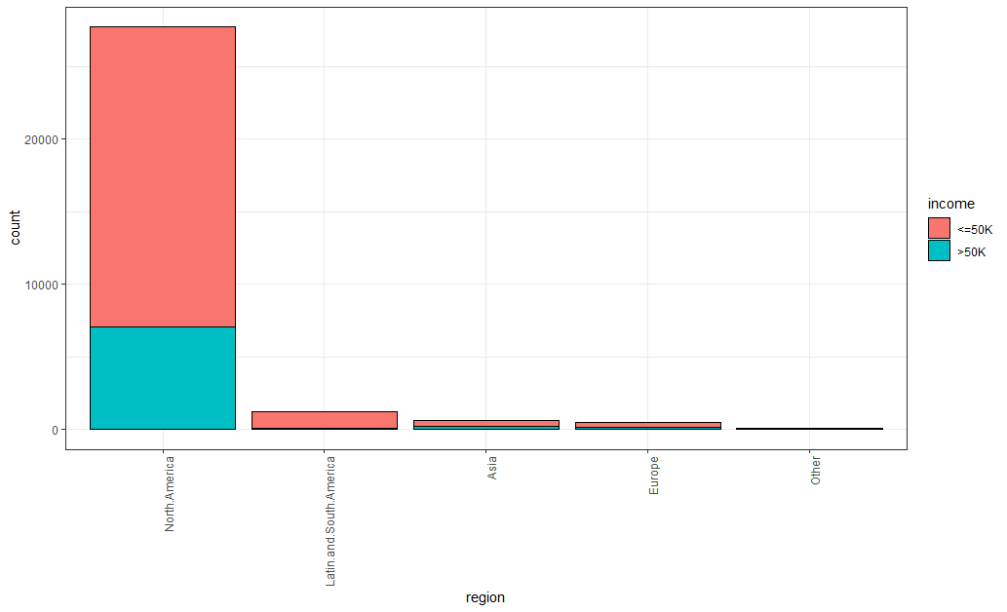
Bar plot
Report
North America has the highest ratio of income greater than 50k
Contents

Slide 26
Logistic Regression
Report
A type of classification model
Attempts to predict the outcome of categorical dependent variables
Uses one or more independent variables
The independent variables can be either categorical or numerical
Based on the logistic function, which always takes values between 0 and 1

Slide 27




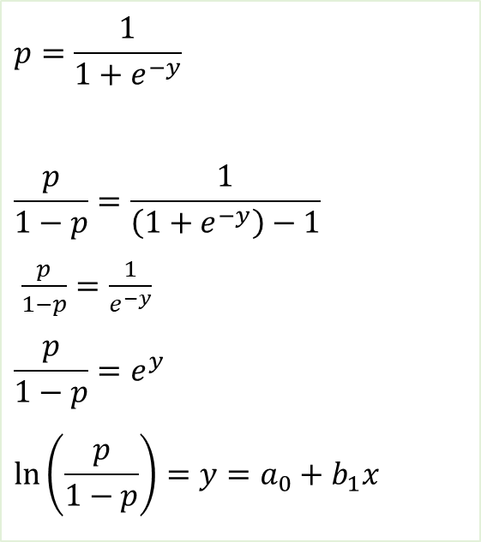
Logistic Regression Function
Report
$$p=\frac{1}{1+e^{−y}}$$
$$\frac{p}{1−p}=\frac{1}{\left(1+e^{−y}\right)−1}$$
$\frac{p}{1−p}=\frac{1}{e^{−y}}$
$$\frac{p}{1−p}=e^{y}$$
$$\ln\left(\frac{p}{1−p}\right)=y=a_{0}+b_{1}x$$
$$⇒$$
$$⇒$$
$$⇒$$
$$⇒$$

Slide 28
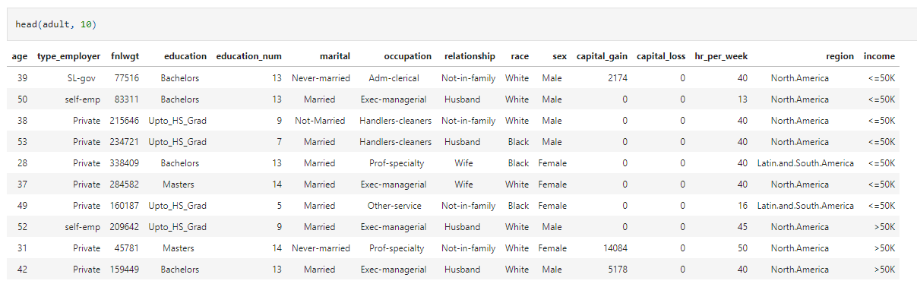
Check the head
Report

Slide 29
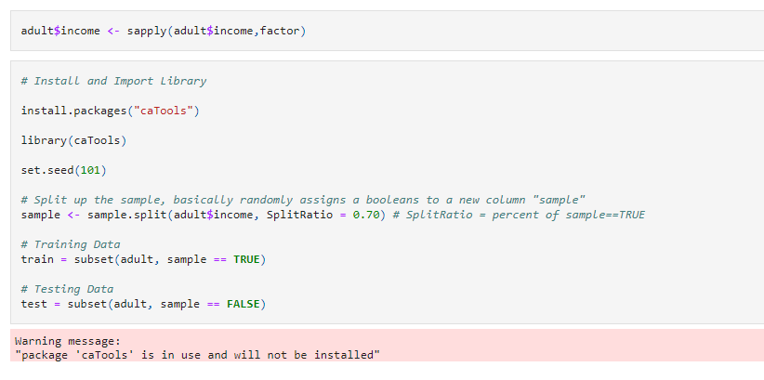
Train Test Split Used CaTools library
Report
caTools is required for Logistic Regression Modeling

Slide 30
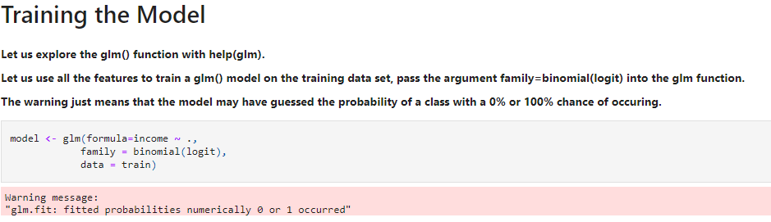
Training the model
Report
We built model with all the independent variables

Slide 31
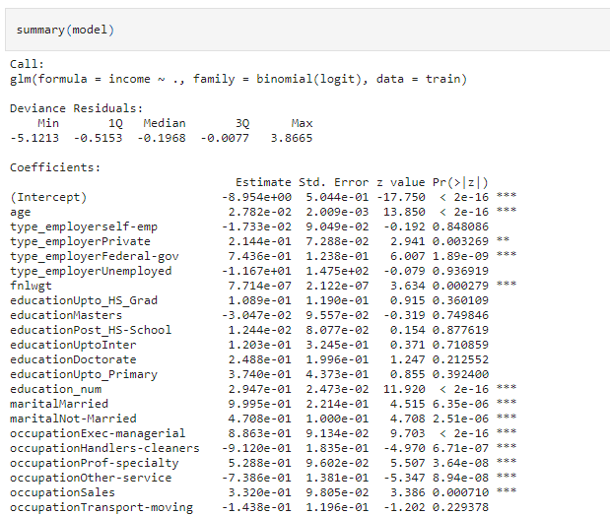
Summary of model
Report
Categories/features with 3 stars are most significant

Slide 32
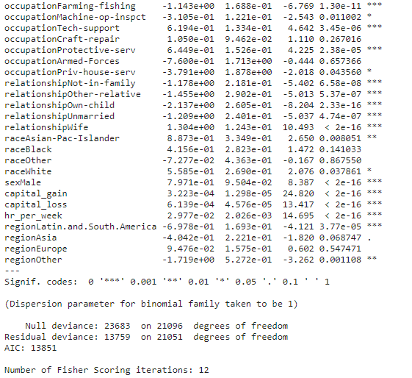
Summary of model…
Report
Categories/features with 3 stars are most significant

Slide 33
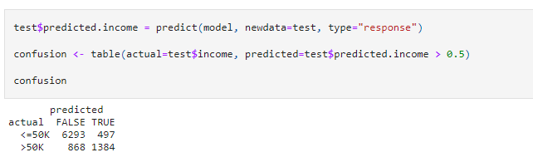
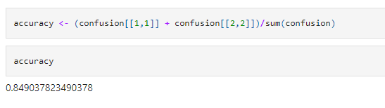
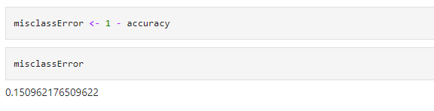
Evaluate the model
Report
Total correct predictions by total predictions
Total incorrect predictions by total predictions
Contents

Slide 34
Conclusion
Report
Performed EDA
Tried to visualize to get clarity
Attempted to build a Logistic Regression Model
Realized that in depth knowledge required
Lots of scopes to fine tune the model
The model seems to be a good one based on accuracy
Contents

Slide 35
Report
Thanks
Questions ?

