Slide 1


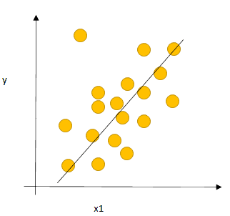

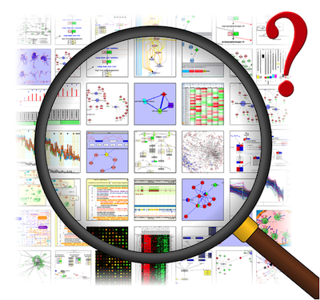
Retail Sales Analysis For Revenue Enhancement
Mohammad Monjur-E-Elahi
Course: Data Science Project Using SAS [DSA14]
Program: Data Science and Application - Advanced Diploma [6060]
Metro College of Technology
Date: 28 July, 2021

Slide 2
Outline
Retail Transaction Dataset for two years provided
Additional Dataset Relating to Geographical Location
We are tasked with recommendations to increase sales

Slide 3
Executive Summary
Transaction Dataset | Location Dataset | Independent Variables | Dependent Variable
Customer ID | Order Number | Source | Sales
Item Code | Customer Number | Category
Source | City | Order Date
Order Date | Prov | Prov
Item Description | Postal Code | Quantity
Category | Order First Time | Price
Price | Source
Quantity | Sales Amount
We Calculated: Sales = Quantity*Price | Item Num
 | Item Description
 | Category Code
 | Quantity
Transaction had 34,288 rows
Location had 1,284 rows
Joined dataset 29,298 observations

Slide 4
Business Questions
Find the Province to focus to increase sales
Find the best selling Category to increase sales
Find the Source of order with potential to increase sales
Find the Top Customers for promotion for sales volumes
Find the Day of Week to focus to increase sales

Slide 5
Objectives
Perform Univariate Analysis and Bivariate Analysis
Perform Predictive Modeling
Recommend measures to increase sales based on Analysis

Slide 6
Methodology
Collection of Data
Secondary. Provided by Metro College of Technology
Definition of Data
29298 Observations, 7 columns
Exclusions
Kept Location from EC90 and Description, removed Price from transaction dataset
Inclusions
Location information from ec90, Sales included by calculation
Software Used
SAS 9.4
Statistical Techniques
Univariate, Bivariate, ANOVA

Slide 7
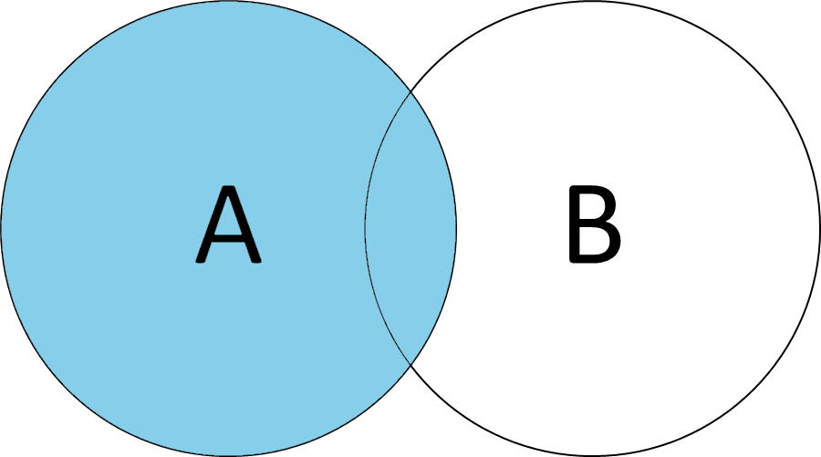
Conceptual Framework
Independent
Variables
Source
Category
Dependent
Variable
Prov
Sales
Transaction
Location
Order Date
Quantity
Price

Slide 8
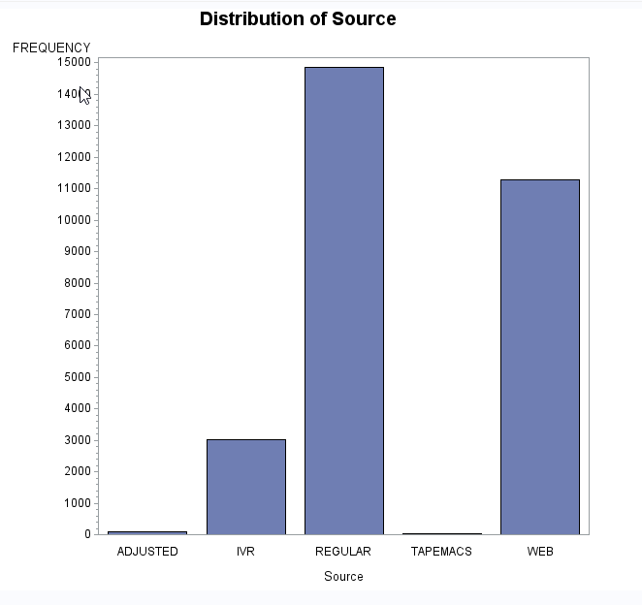
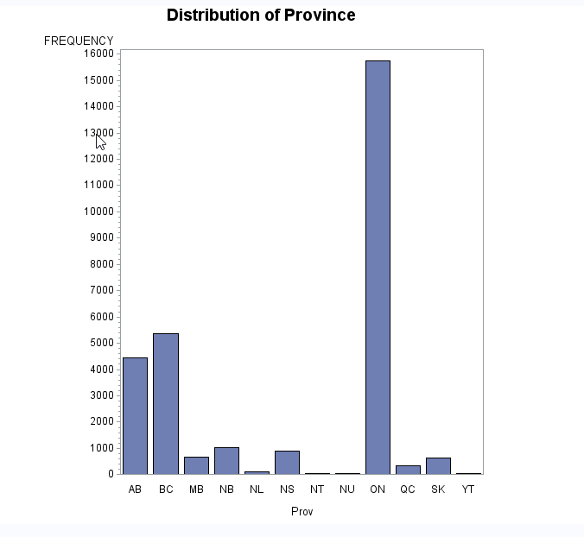
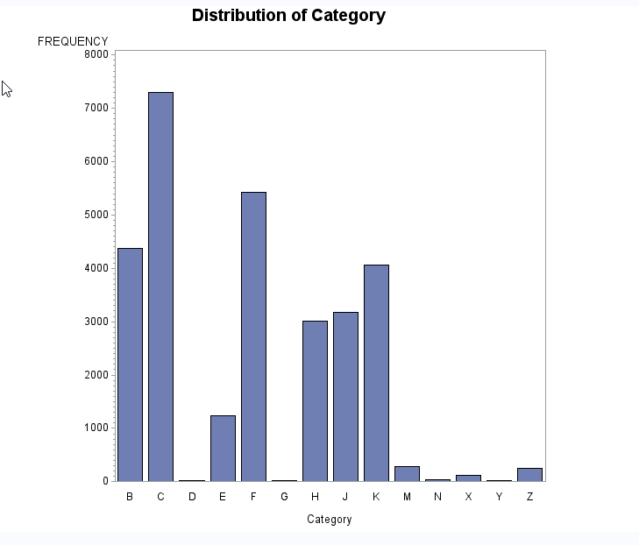
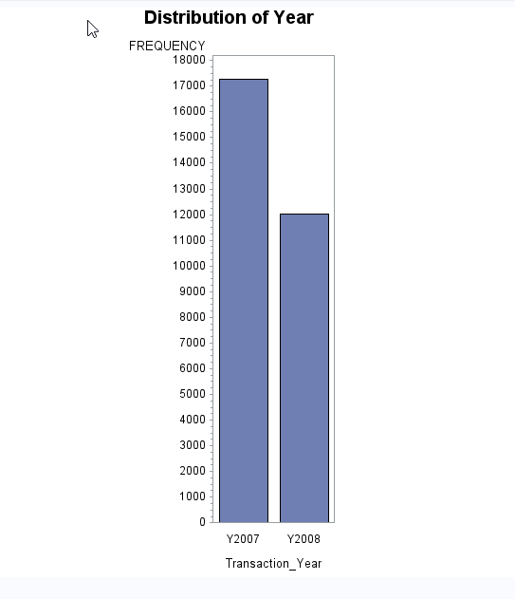
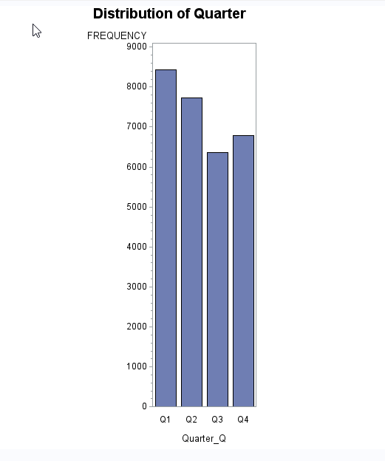
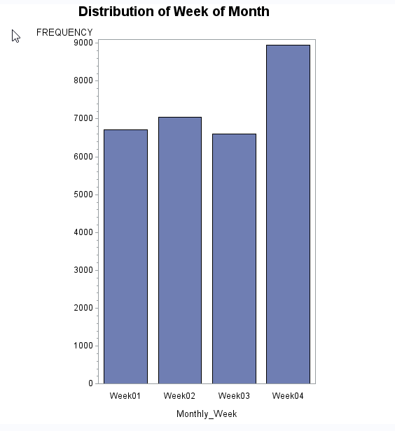
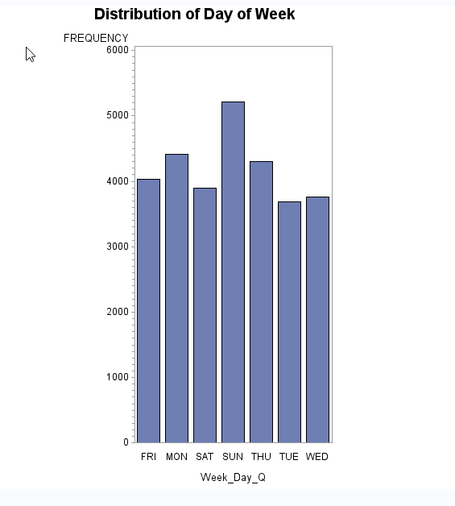
Descriptive Analysis Univariate
Regular and Web are the dominant sources
Ontario is far ahead
C, F, B are top in Category
Data for year is imbalance
Q1, Q2 high transaction is due to incomplete data for 2008
Distribution of Week of months and Days of week are also depicted

Slide 9
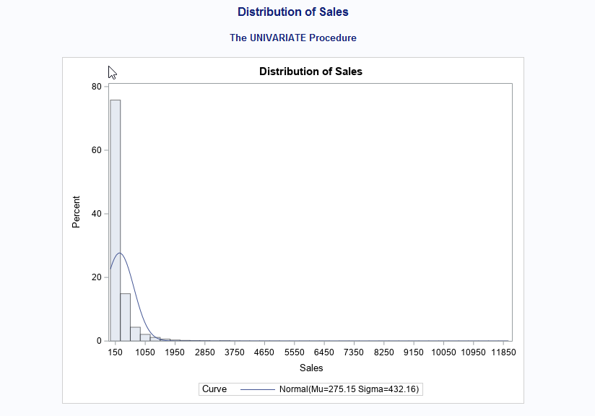
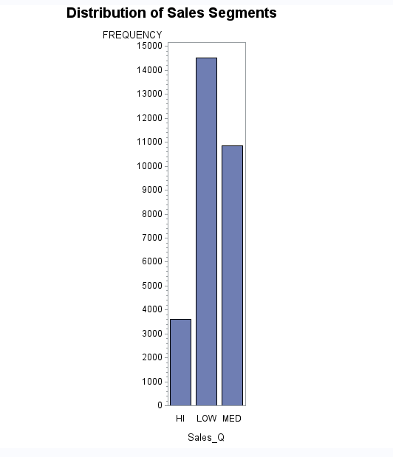
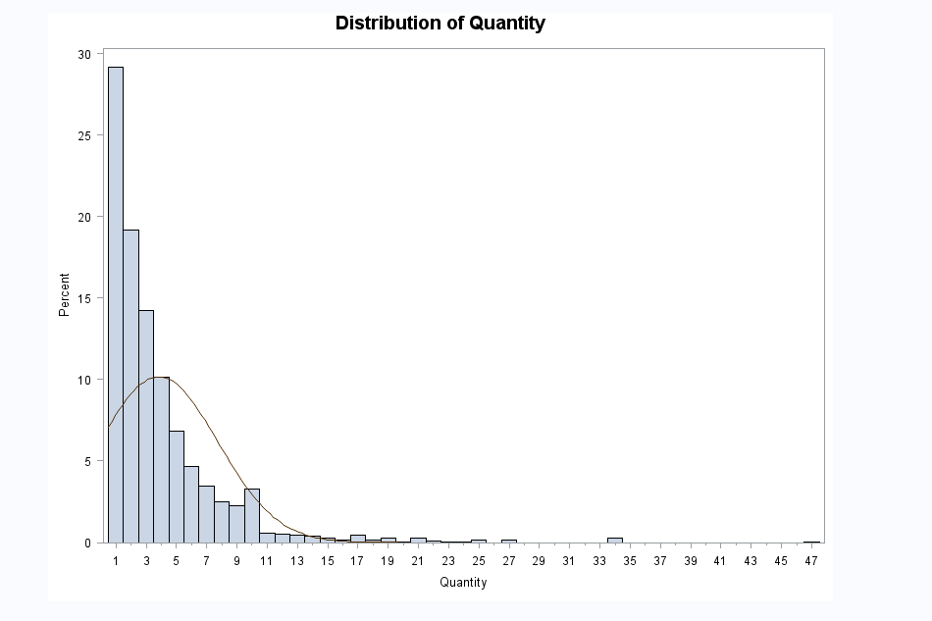
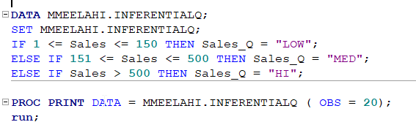
Descriptive Analysis Univariate
Distribution of Sales and Quantity are not normal
Segmented Sales to Low, Medium and High

Slide 10
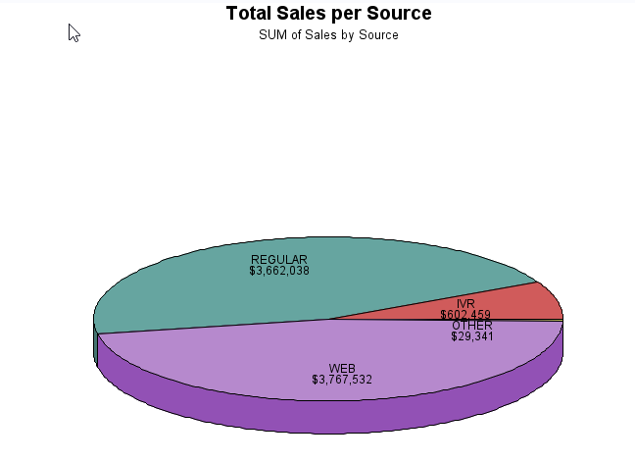
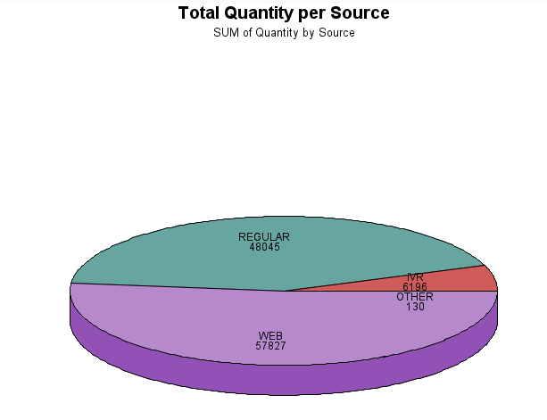
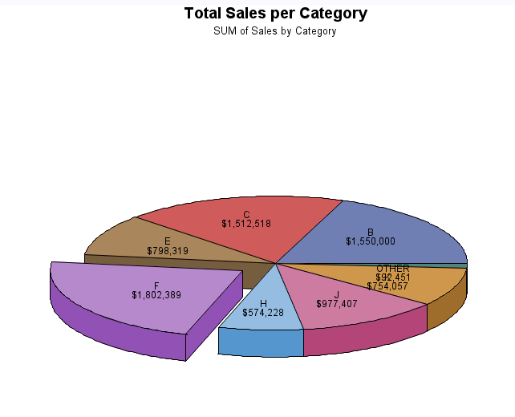
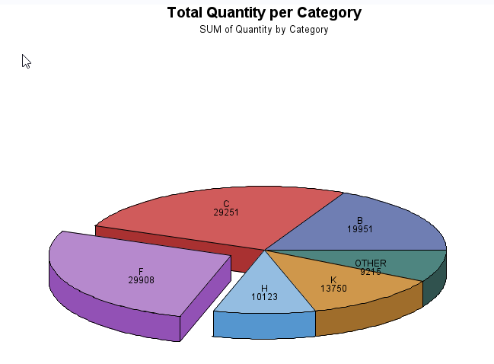
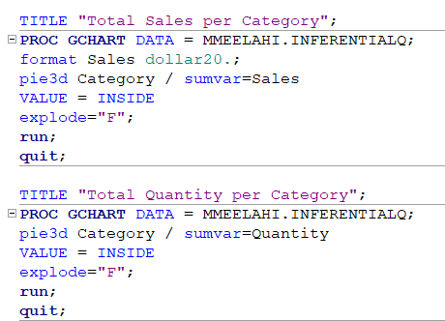
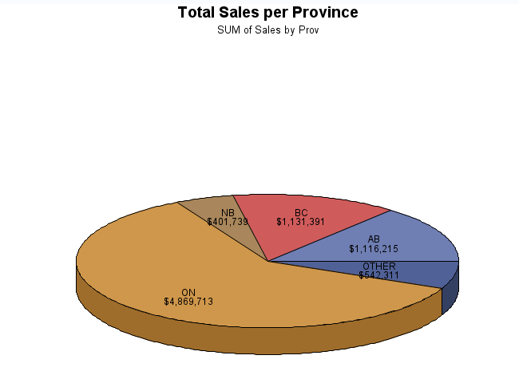
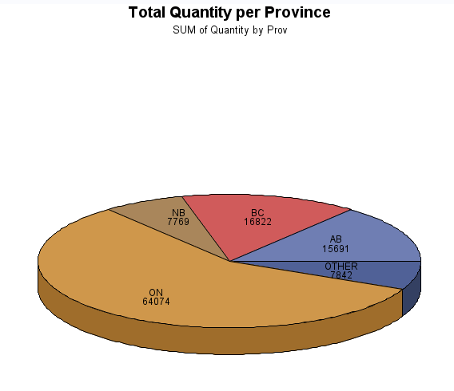
Descriptive Analysis Bivariate
Sales & Quantity Per Category
C, F, B are Top Three
Sales & Quantity Per Source
Web and Regular are Top Two
Sales & Quantity Per Province
Ontario is far ahead

Slide 11
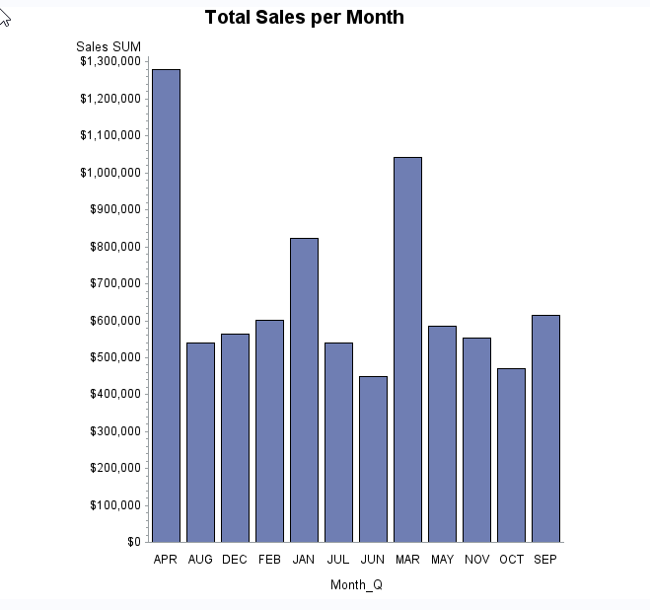
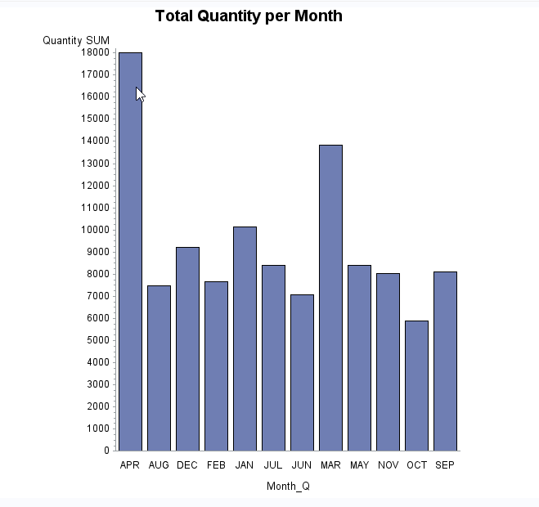
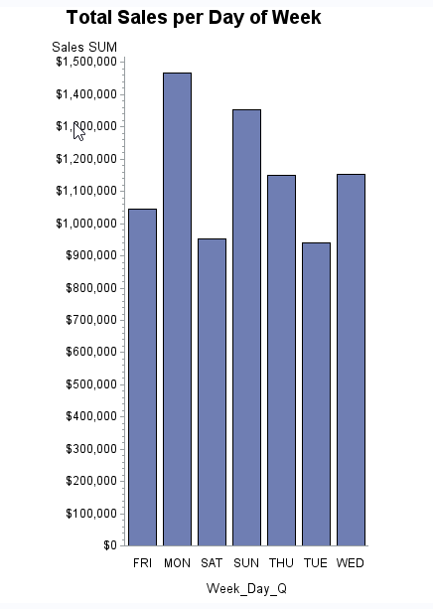
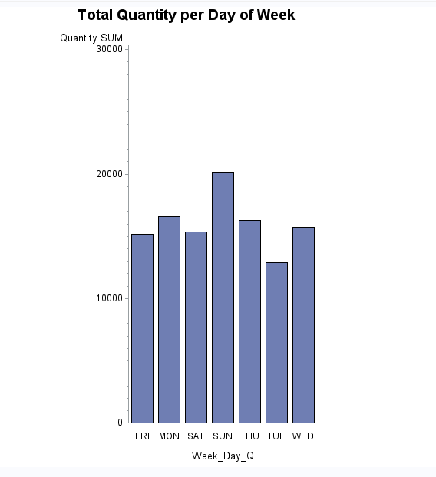
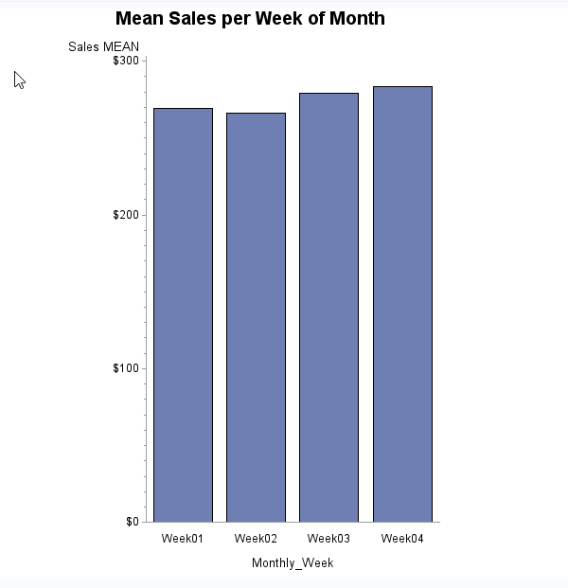
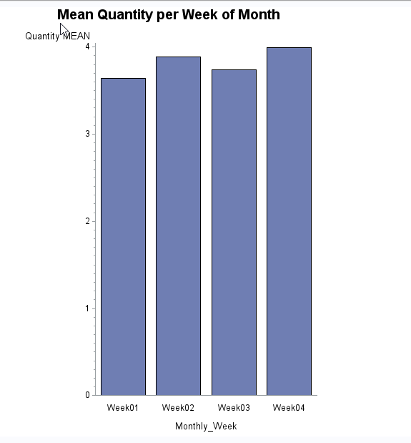
Descriptive Analysis Bivariate
April & March the Months of large Sales
Could well be due to data imbalance
Bigger Sales Happen on Mondays & Sundays
Mean Sale is slightly higher at the end of the month

Slide 12
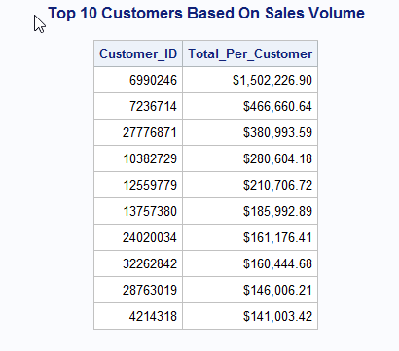
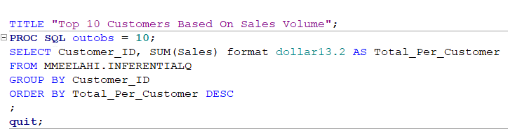
Descriptive Analysis Bivariate
We calculated the Total Sales for two years

Slide 13
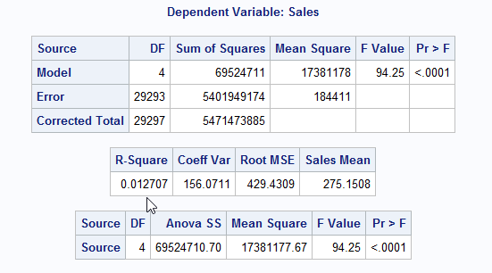
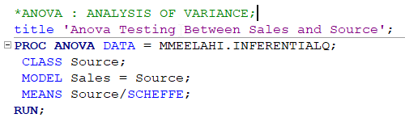
Hypothesis Testing
Target (Numeric) | Feature(Categorical) | P-Value | Statistical Significance
Sales | Category | <.0001 | Significant
Sales | Prov | <.0001 | Significant
Sales | Source | <.0001 | Significant
Sales | Quarter | <.0001 | Significant
Sales | Month | <.0001 | Significant
Sales | Day Of Week | <.0001 | Significant
Sales | Week of Month | 0.0422 | Significant

Slide 14
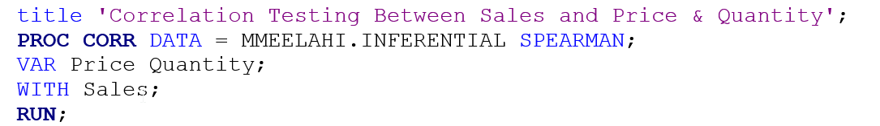
Hypothesis Testing
Target (Numeric) | Feature (Numeric) | P-Value | Statistical Significance
Sales | Quantity | <.0001 | Significant
Sales | Price | <.0001 | Significant

Slide 15
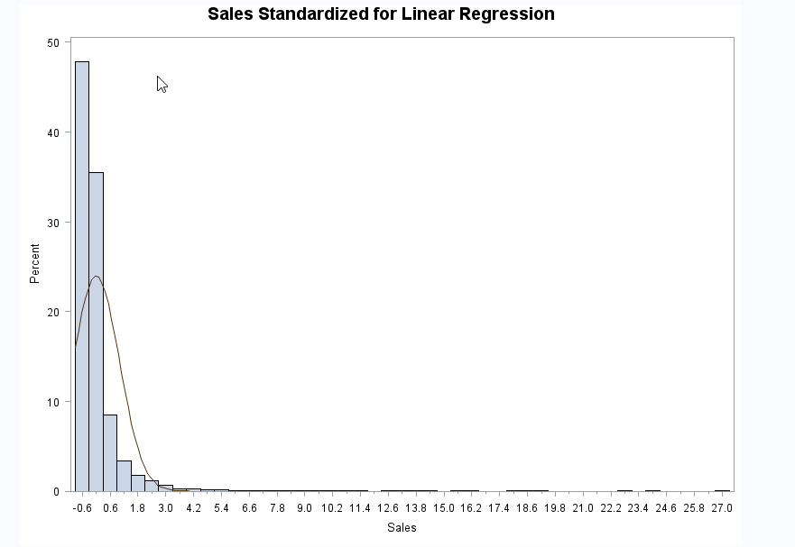
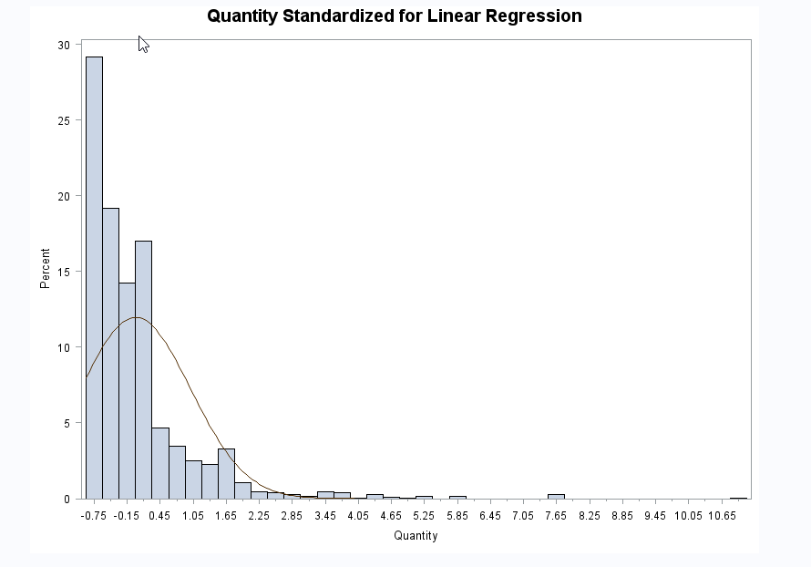
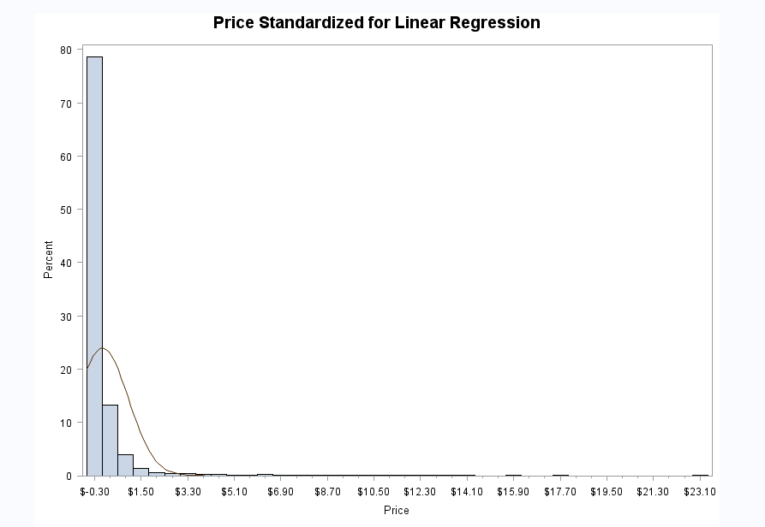
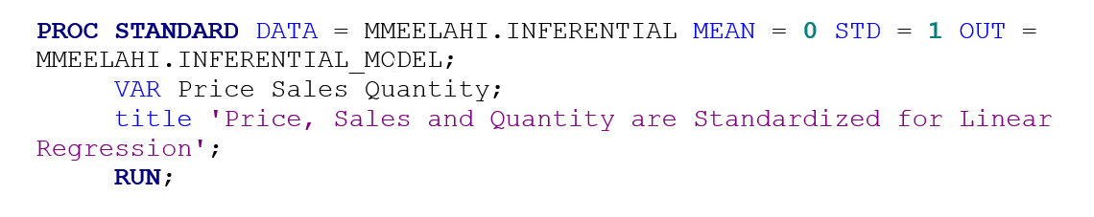
Predictive Analysis
Standardized the Numeric Sales, Quantity and Price

Slide 16
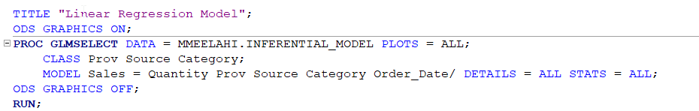
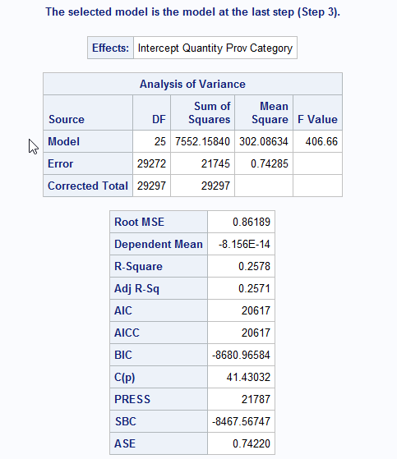
Predictive Analysis
The Model Turns out to be a very weak one
Need to work to sort issues out
May be inclusion of Category from EC90 might improve
We changed the model by including Price and excluding Order_date and this gave much better result as shown on the next slide

Slide 17
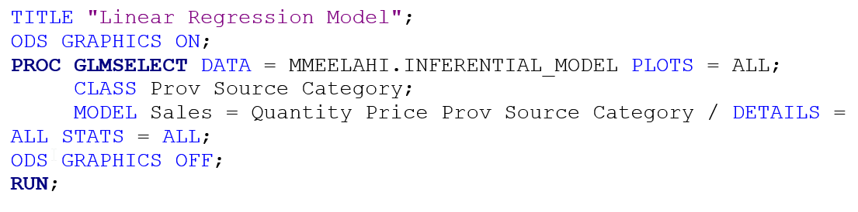
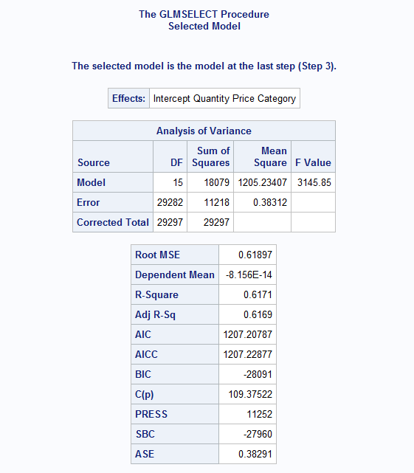
Predictive Analysis
Now the model is much better when we compare the R2 Score.

Slide 18
Conclusion
Product of Category F, B and C are most sold
Web is the largest Source for the Sales
Ontario is by far the best revenue earning
Mondays and Sundays feature bigger Sales
Top 10 Customers have been identified

Slide 19
Recommendations
Strengthen our promotion and other Sales and marketing strategies on the below aspects to increase revenue
Province: Ontario
Category: F, B & C
Source: Web
Days of Week: Mondays & Sundays
Customers: As Listed in Top 10

Slide 20
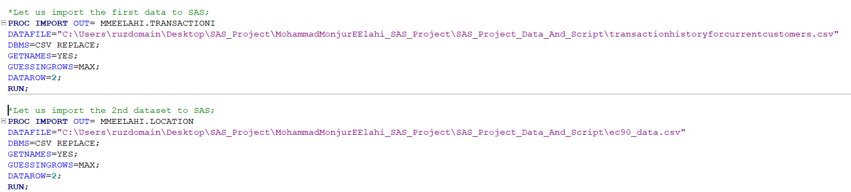
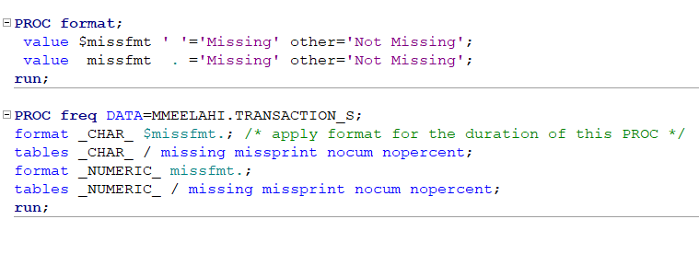
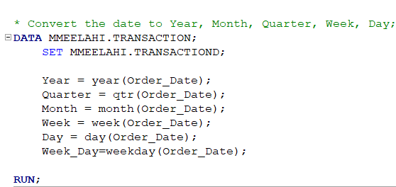
Appendix

Slide 21
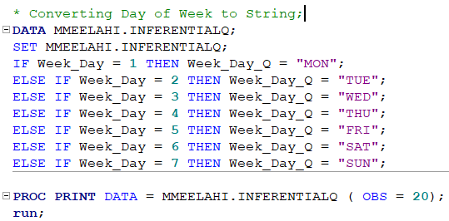
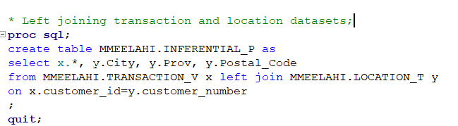

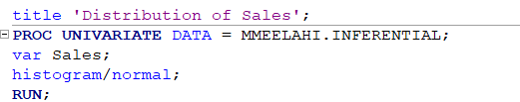
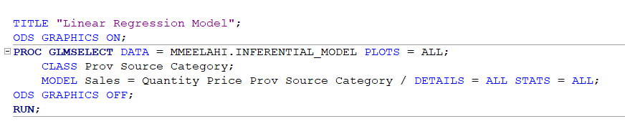
Appendix

Slide 22
Thanks
Questions ?

