Slide 1



Exploratory Data Analysis On Customer Churn

Slide 2
Submitted by
Mohammad Monjur-E-Elahi
Course: Advance SAS Programming[DSA05]
Program: Data Science and Application - Advanced Diploma [6060]
Metro College of Technology
Date: 24 April, 2021

Slide 3
The Project
Explore the dataset
Perform required feature engineering to have column for churn
Conduct Segmentation, Univariate, Bivariate Analysis
Visualize different aspects of the dataset
Perform statistical significant association analysis

Slide 4
The Dataset
New_Wireless_Fixed.txt dataset
From Telecommunication Industry
Customer Churn was the focus
Had 102255 observations and 10 variables to start with
4 categorical and 6 numerical variables

Slide 5
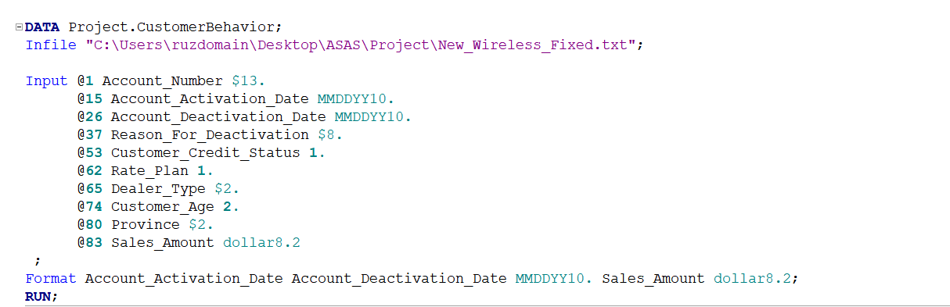
The Dataset
Importing the Data to SAS

Slide 6
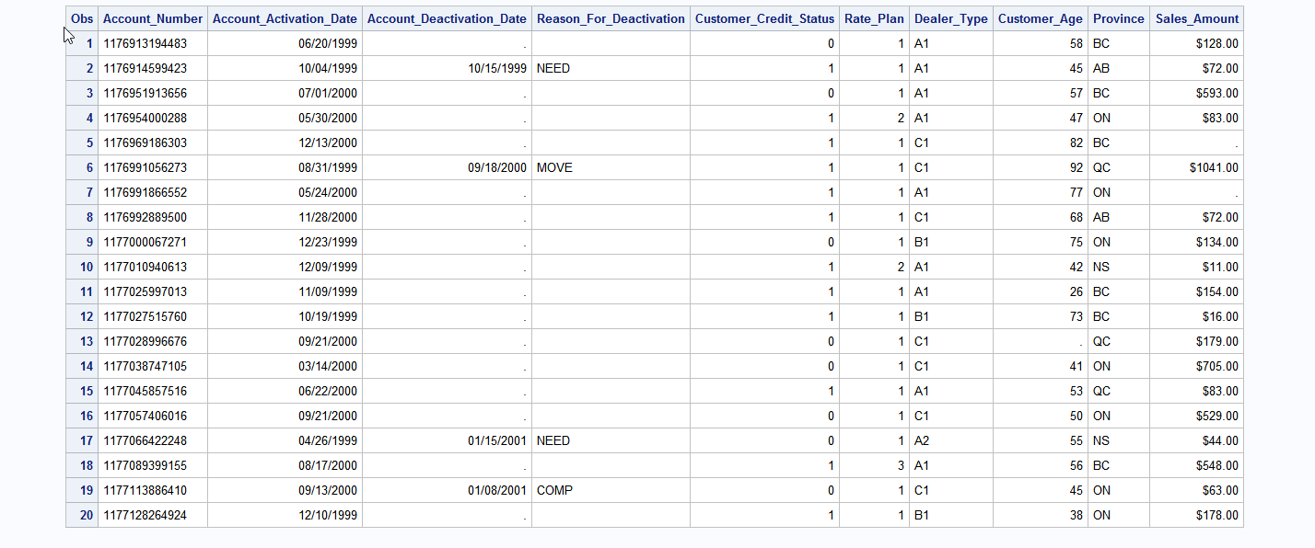
The Dataset
Top 20 rows of the dataset

Slide 7
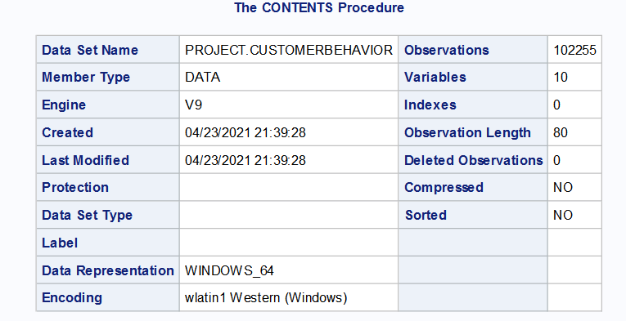
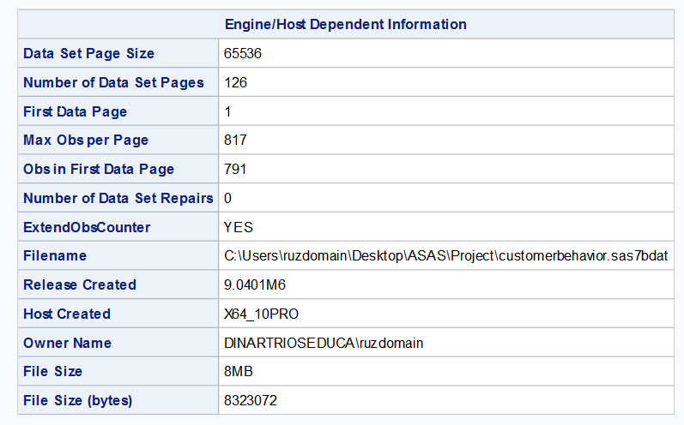
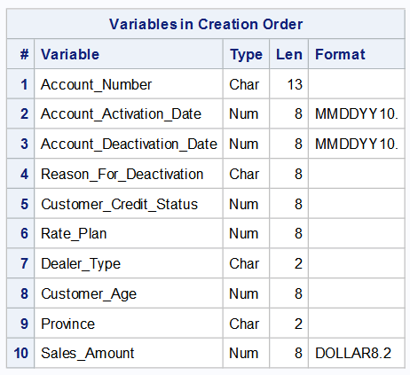
The Dataset
Contents of the dataset

Slide 8
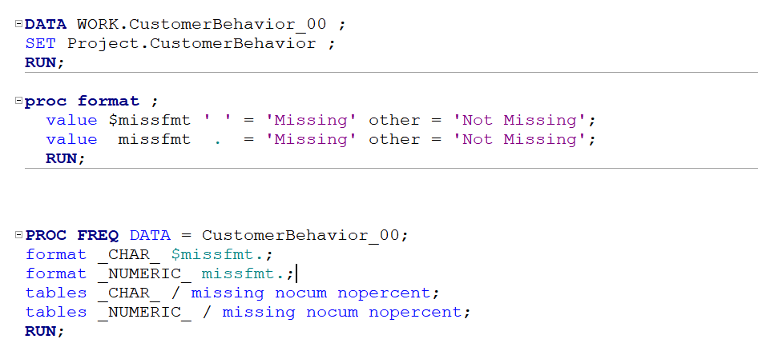
The Dataset
Missing value analysis

Slide 9
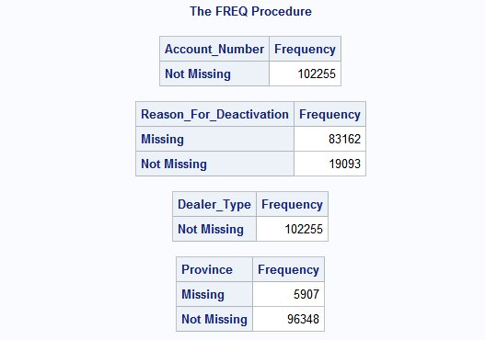
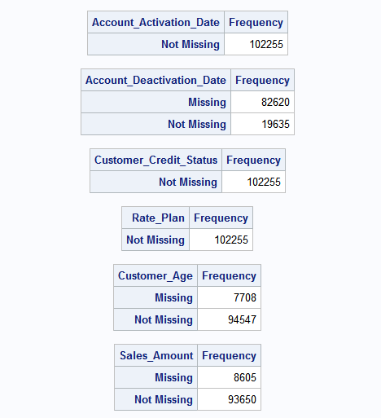
The Dataset
Missing value analysis

Slide 10



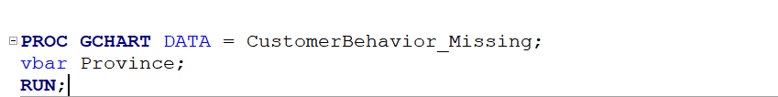

The Dataset
Missing value analysis

Slide 11
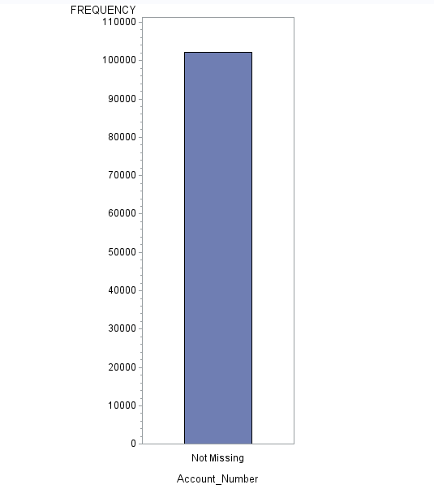
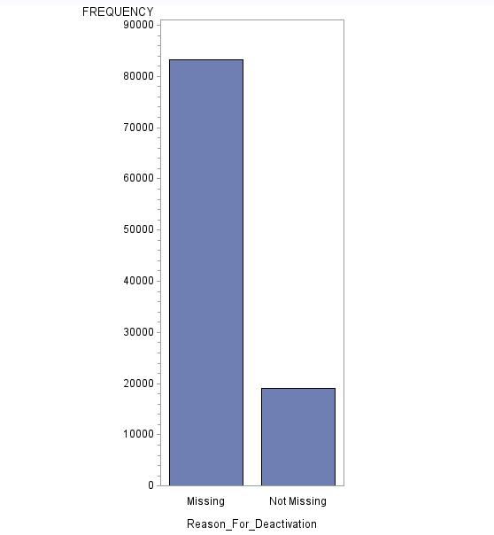
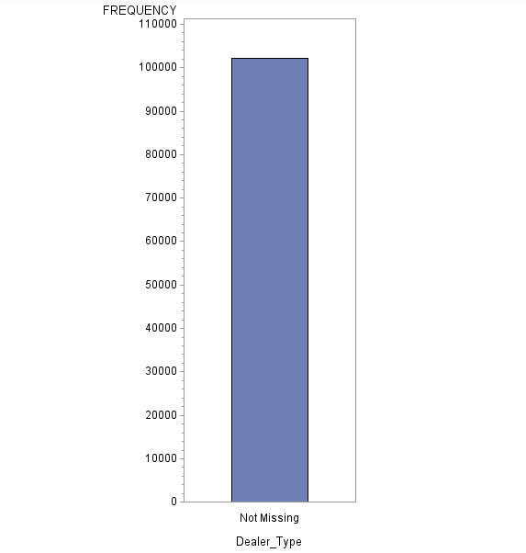
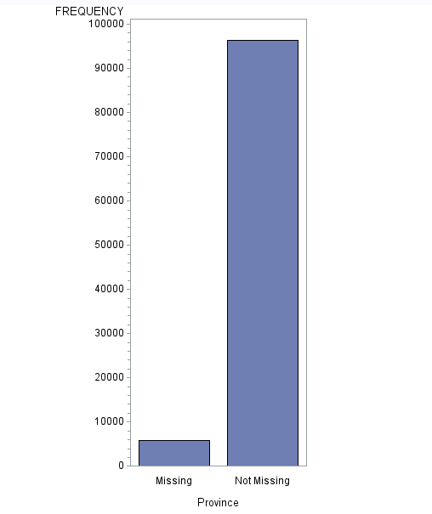
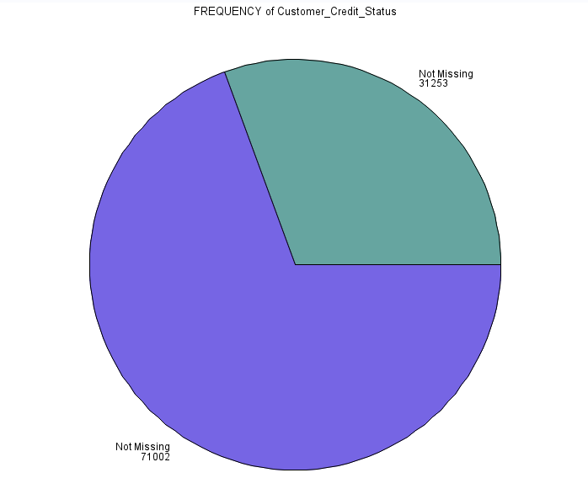
The Dataset
Missing value analysis

Slide 12
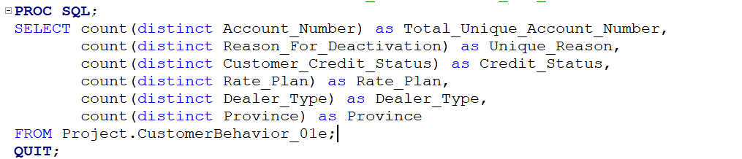

The Dataset
Finding Unique Values(Account Number is found Unique)

Slide 13
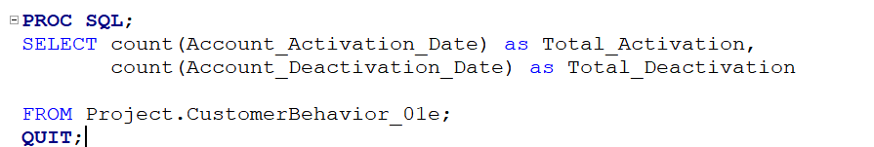
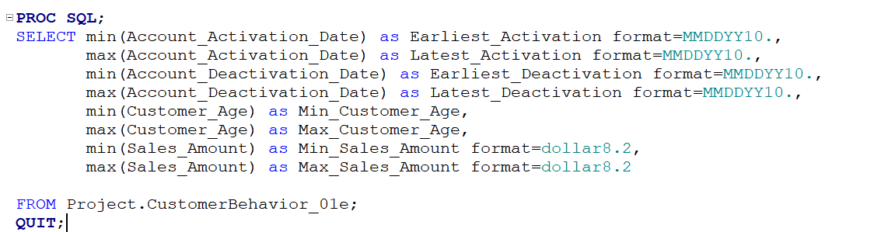

The Dataset
Earliest/Latest Activation & Deactivation

Slide 14

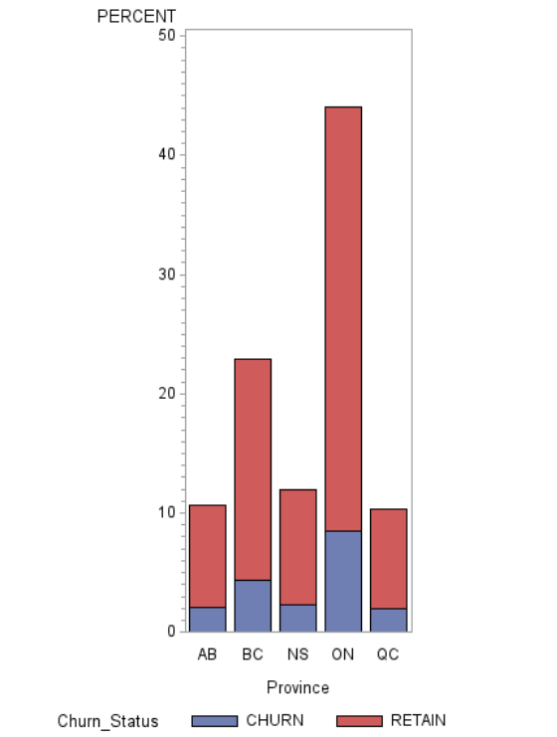

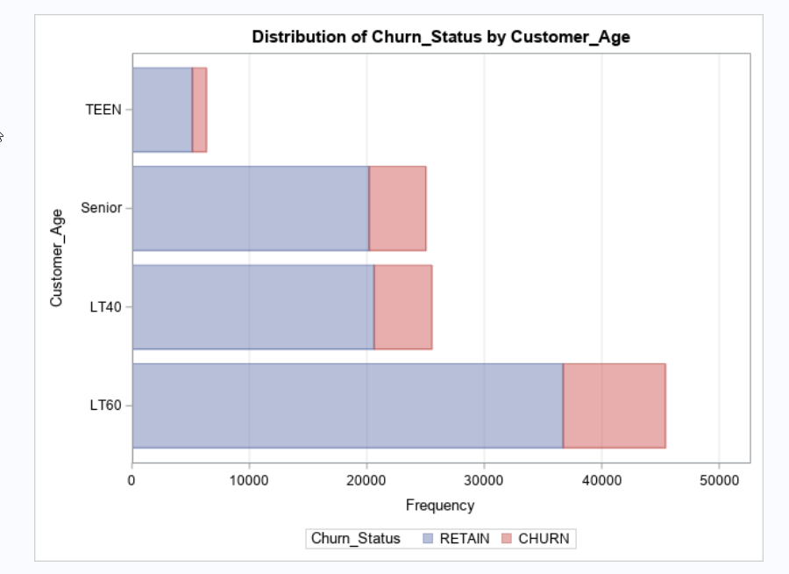
The Dataset
Age and province distributions of active and deactivated customers

Slide 15
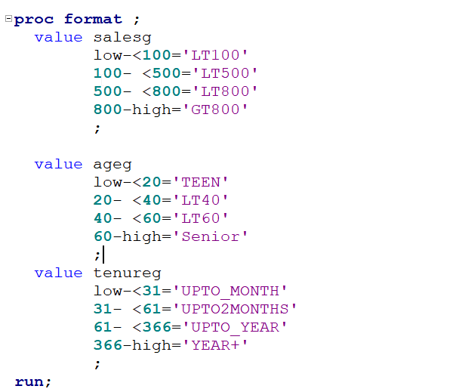
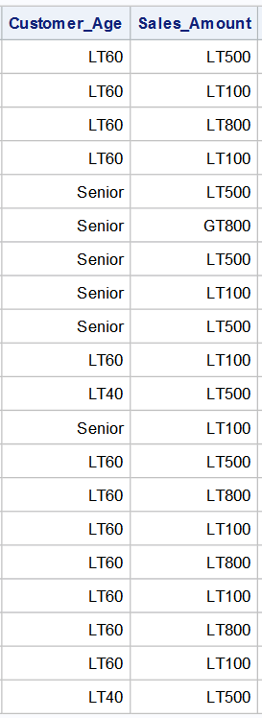
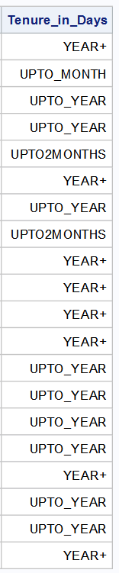
Segmentation

Slide 16
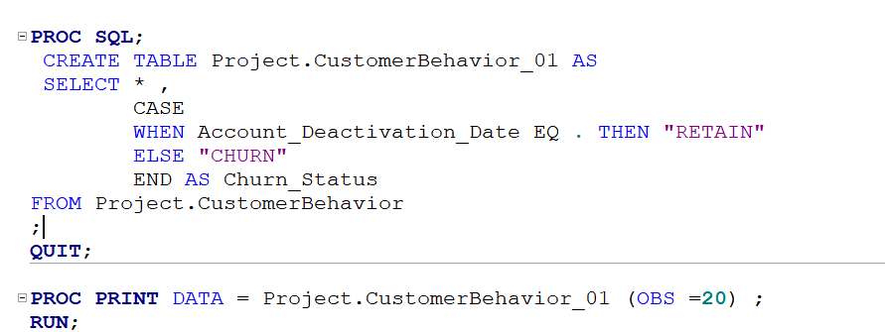
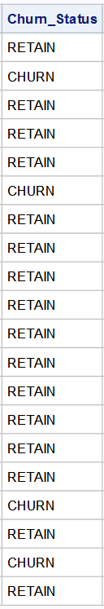
Churn Column Incorporation

Slide 17
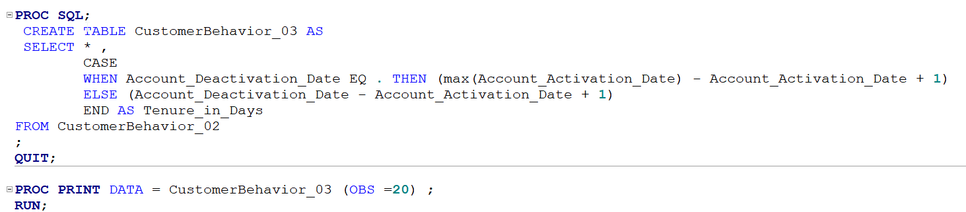
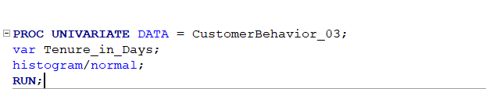
Calculating Tenure in Days

Slide 18
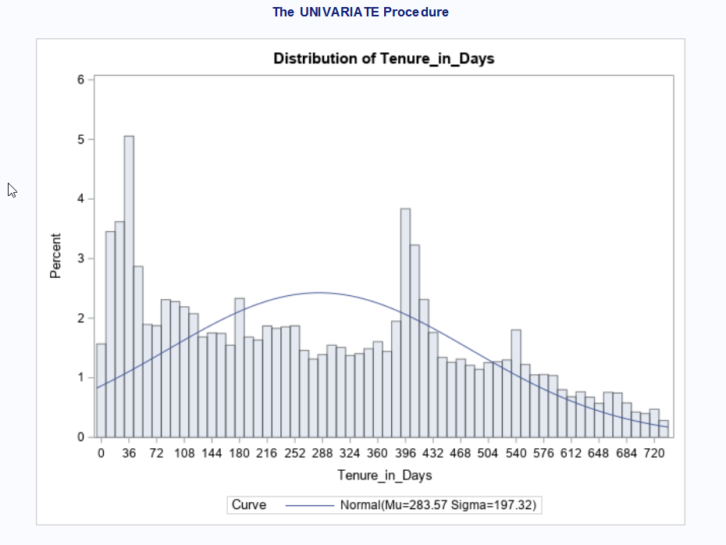
Calculating Tenure in Days
Simple Statistics of Tenure

Slide 19
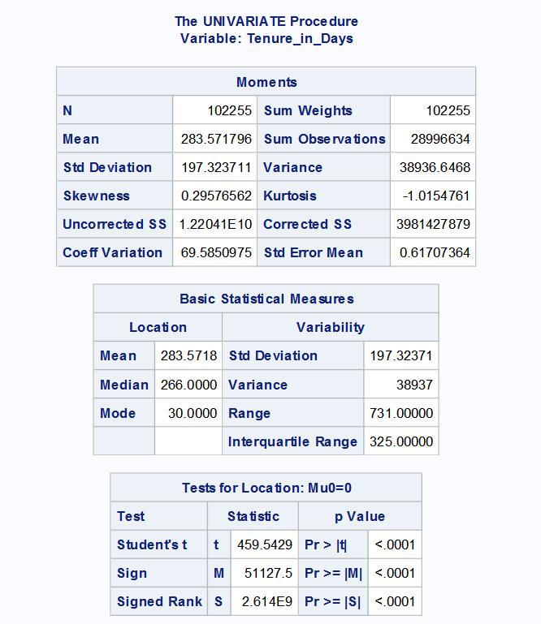
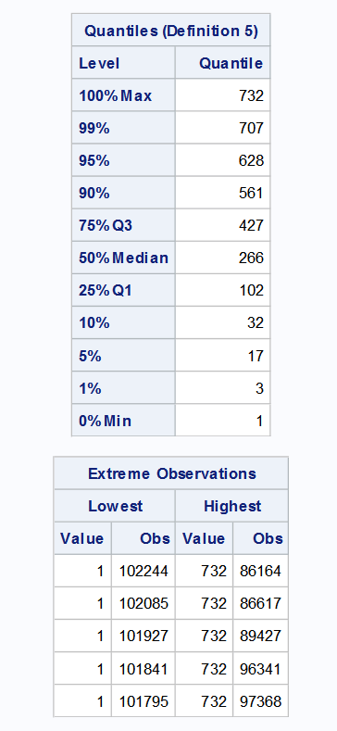
Calculating Tenure in Days
Simple Statistics of Tenure

Slide 20
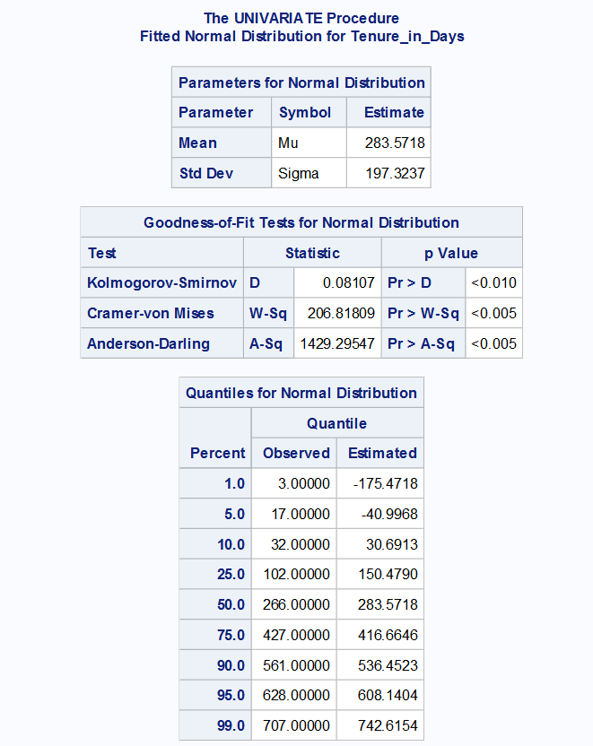
Calculating Tenure in Days
Simple Statistics of Tenure

Slide 21
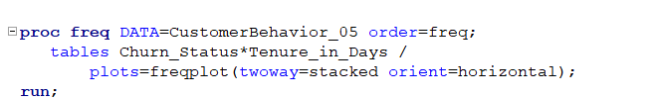
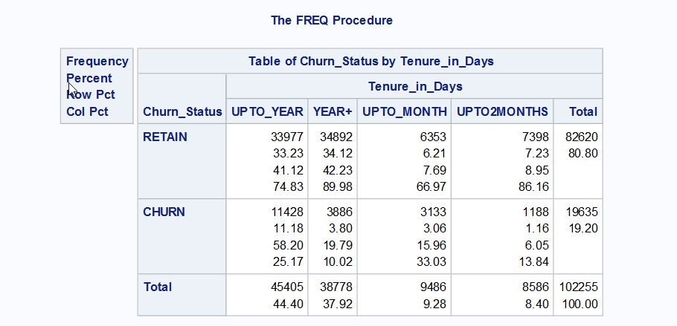
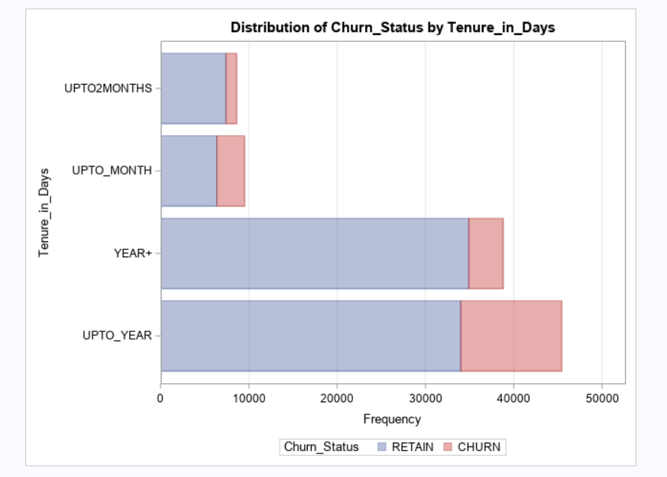
Account Status Vs Segmented Tenure

Slide 22
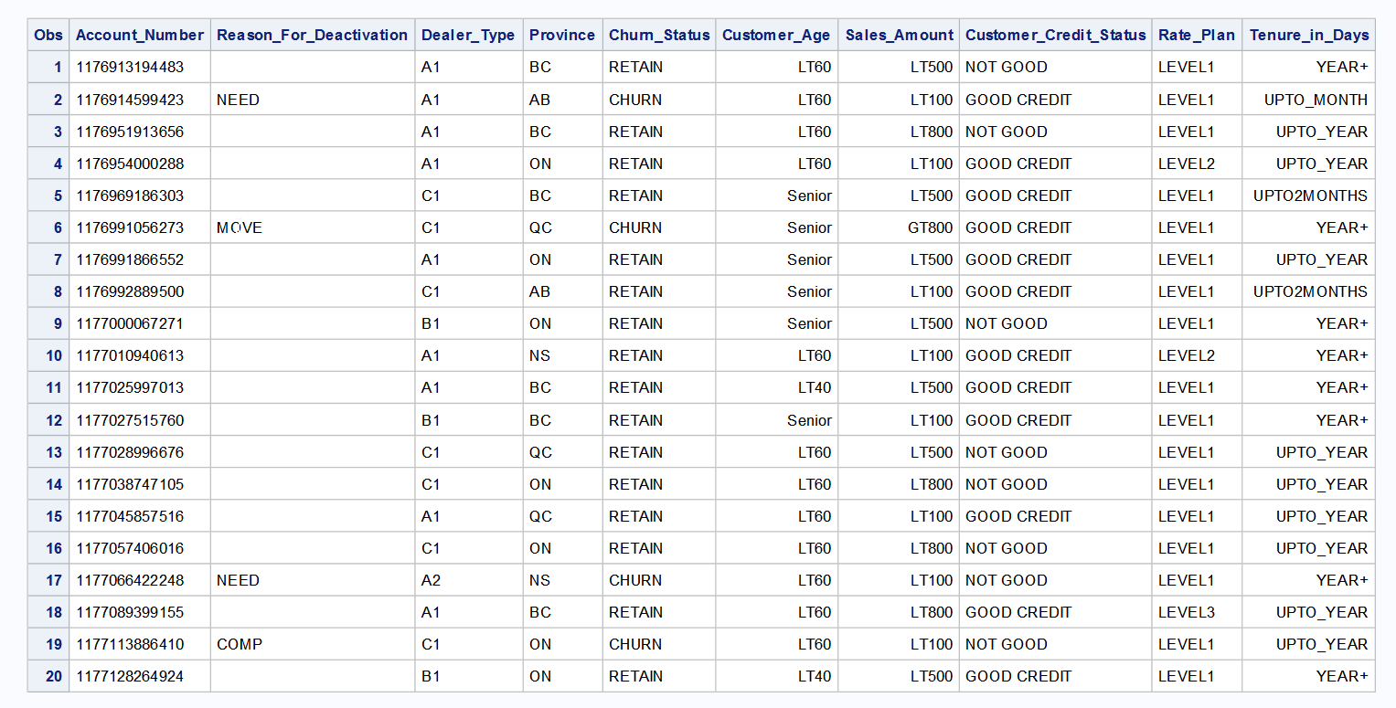
Statistical Significance
Dataset After Segmentation and transformation of dates to Churn_Status

Slide 23
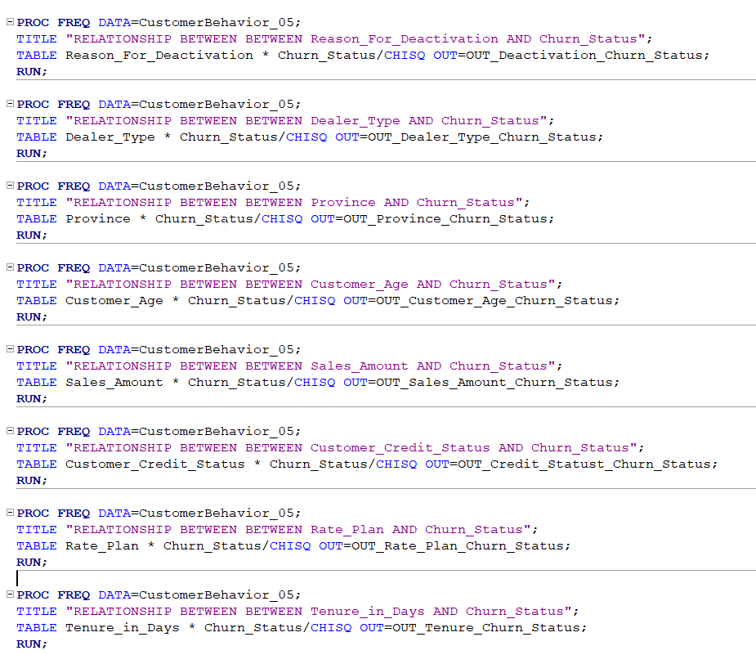
Statistical Significance
Chi-Squire Test between Target Churn Column and other columns

Slide 24
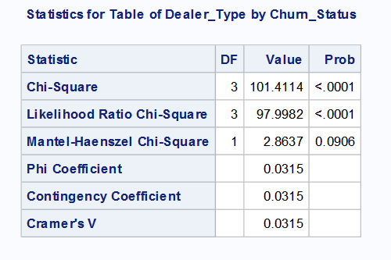
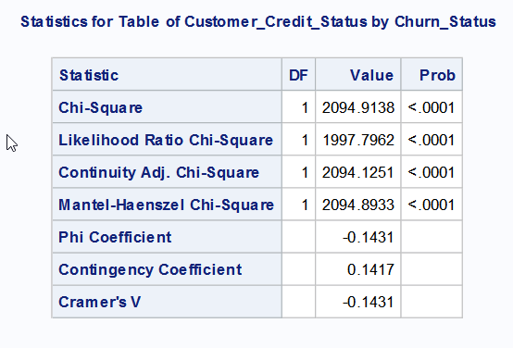
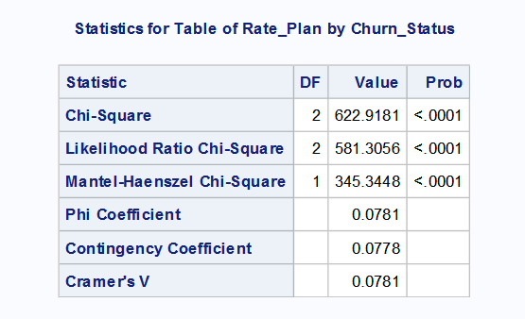
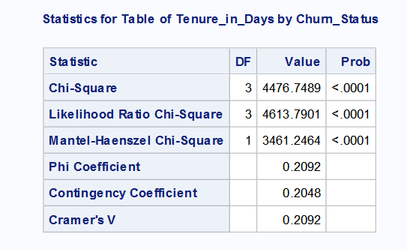
Statistical Significance
The below columns showed statistical significant associations

Slide 25
Conclusion
Performed EDA
Tried to visualize to get clarity
Performed statistical significant association with Customer Churn
Four of the independent variables showed statistical significance
Classification model should be used after further analysis

Slide 26
Thanks
Questions ?

