Slide 1
Python Programming Project
Solution of Quadratic Equation
Desktop GUI APP
&
Web APP
ax² + bx + c = 0

Slide 2

Desktop GUI APP
User Defined Function for Quadratic Equation
Tkinter Library used for GUI
.EXE for running the app without Python installed
Code uploaded to GitHub repository
GitHub repository:
https://github.com/mohammadmonjureelahi/pythonprojects.git
ax² + bx + c = 0
$$x=\frac{−b±\sqrt{b^{2}−4ac}}{2a}$$

Slide 3
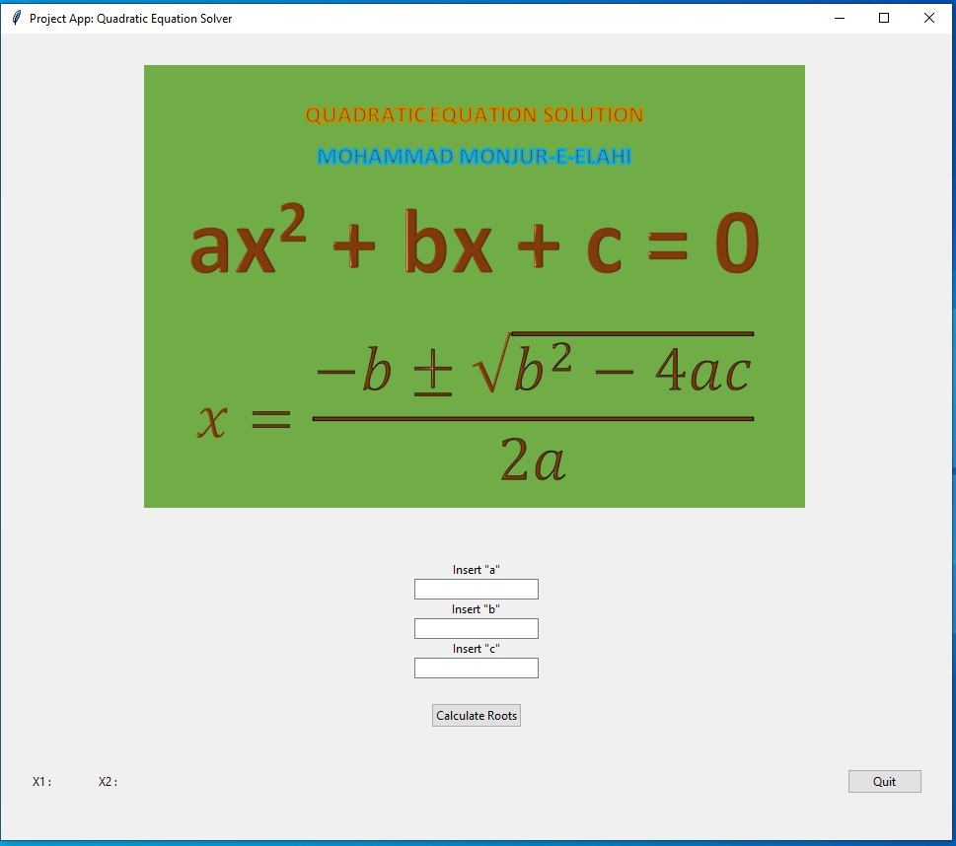
Ran the Program from Spyder, cmd or .EXE
ax² + bx + c = 0
$$x=\frac{−b±\sqrt{b^{2}−4ac}}{2a}$$
Codes

Slide 4
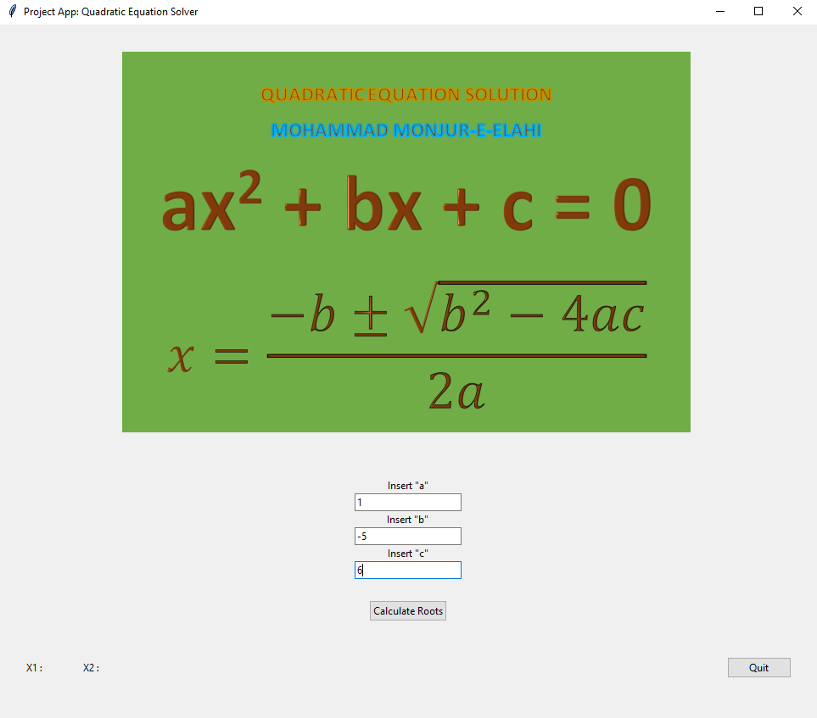
Inserted values for a, b, c
ax² + bx + c = 0
$$x=\frac{−b±\sqrt{b^{2}−4ac}}{2a}$$
Codes

Slide 5
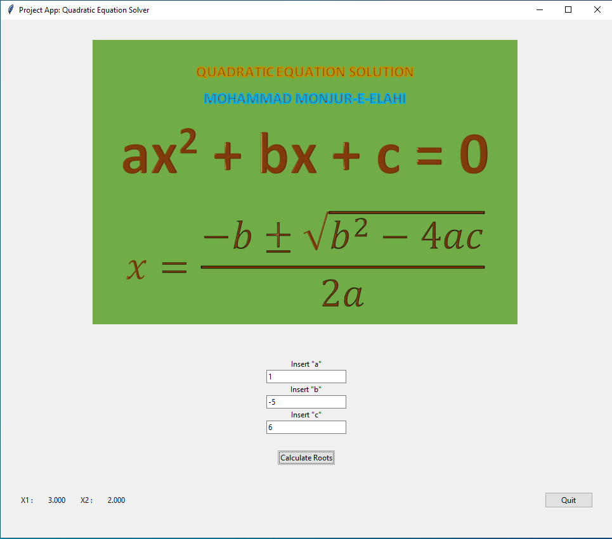
Provides output as x1 and x2
ax² + bx + c = 0
$$x=\frac{−b±\sqrt{b^{2}−4ac}}{2a}$$
Codes

Slide 6
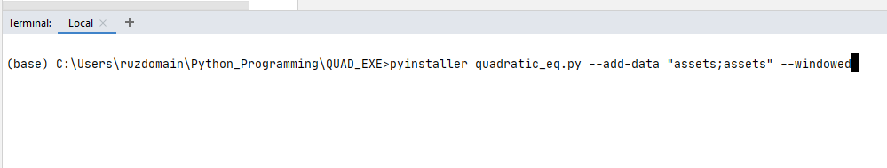
Creating the Executable Folder
I used PyCharm for creating the executable Python App for Microsoft Windows Operating System. The steps are as mentioned below:
Install pyinstaller
Run the pyinstaller command below to create a folder with all necessary files and assets folder so that when we run the .exe file the app is running:
pyinstaller quadratic_eq.py --add-data "assets;assets" --windowed
ax² + bx + c = 0
$$x=\frac{−b±\sqrt{b^{2}−4ac}}{2a}$$
Codes

Slide 7
Web APP
User Defined Function for Quadratic Equation
Module with Quadratic Equation Function
HTML templates with Python Program and Module with Function
CSS used for styling and look of the web page
Uploaded to GitHub repository
GitHub repository:
https://github.com/mohammadmonjureelahi/pythonprojects.git
ax² + bx + c = 0
$$x=\frac{−b±\sqrt{b^{2}−4ac}}{2a}$$

Slide 8
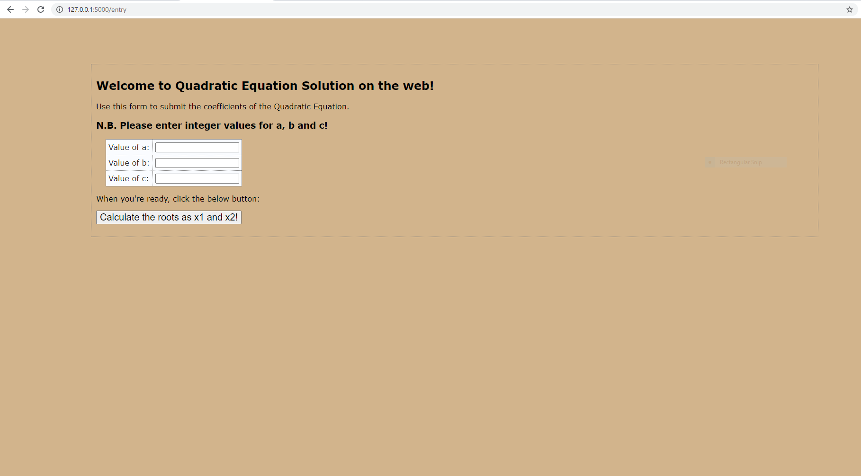
Ran the Program from cmd or clicking .py file
ax² + bx + c = 0
$$x=\frac{−b±\sqrt{b^{2}−4ac}}{2a}$$
Codes

Slide 9
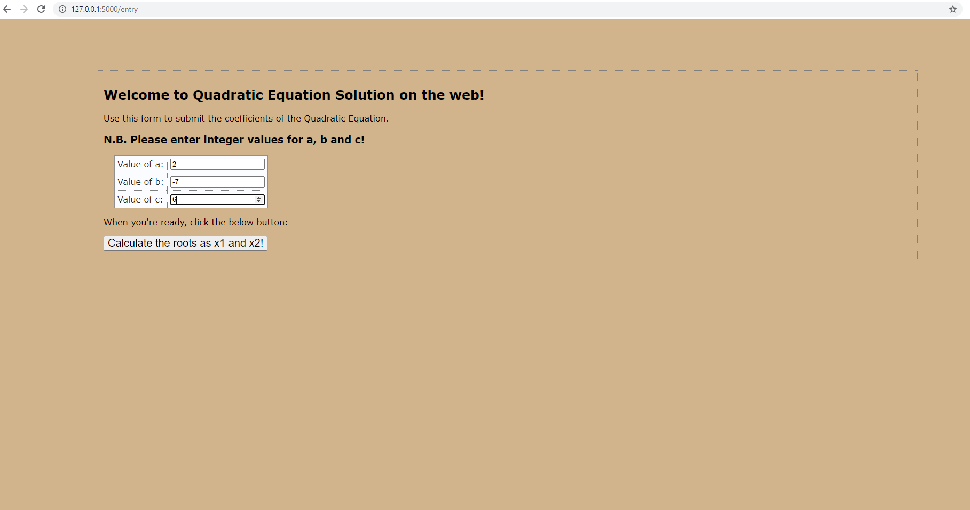
Inserted values for a, b, c
ax² + bx + c = 0
$$x=\frac{−b±\sqrt{b^{2}−4ac}}{2a}$$
Codes

Slide 10
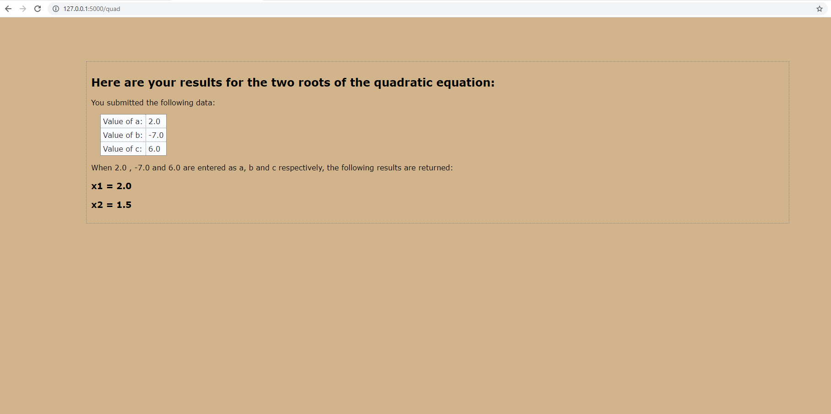
Provides output as x1 and x2
ax² + bx + c = 0
$$x=\frac{−b±\sqrt{b^{2}−4ac}}{2a}$$
Codes

Slide 11
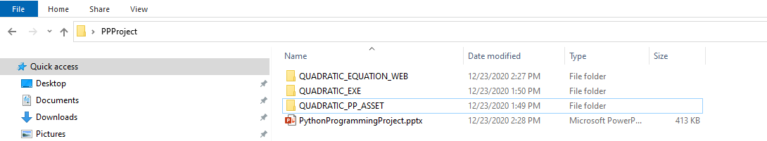
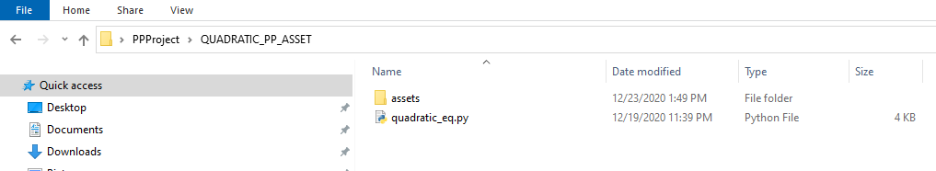
Contents for GUI APP Codes
Main directory QUADRATIC_PP_ASSET
Inside QUADRATIC_PP_ASSET we have the python file and asset
quadratic_eq.py is the main program and asset folder contains a .png picture
ax² + bx + c = 0
$$x=\frac{−b±\sqrt{b^{2}−4ac}}{2a}$$

Slide 12
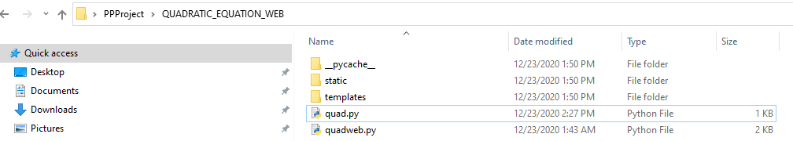
Contents for Web APP Codes
Main directory QUADRATIC_EQUATION_WEB
Inside QUADRATIC_EQUATION_WEB we have the python file, module for UDF, and folders for templates and .css file
quadweb.py is the main program, quad.py is the module, templates folder contains the .html files and static contains the .css file.
ax² + bx + c = 0
$$x=\frac{−b±\sqrt{b^{2}−4ac}}{2a}$$

Slide 13
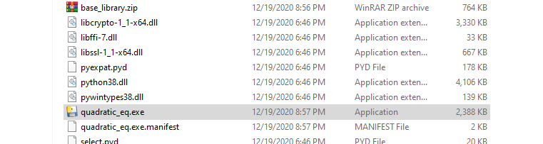
.EXE for GUI APP Go to .exe
Main directory QUADRATIC_EXE
Inside QUADRATIC_EXE we have the .exe file named quadratic_eq.exe.
ax² + bx + c = 0
$$x=\frac{−b±\sqrt{b^{2}−4ac}}{2a}$$

Slide 14
Thank you
ax² + bx + c = 0
$$x=\frac{−b±\sqrt{b^{2}−4ac}}{2a}$$

