Slide 1
The Discrete Fourier Transform
主講人：虞台文

Slide 2
Content
Introduction
Representation of Periodic Sequences
  DFS (Discrete Fourier Series)
Properties of DFS
The Fourier Transform of Periodic Signals
Sampling of Fourier Transform
Representation of Finite-Duration Sequences
  DFT (Discrete Fourier Transform)
Properties of the DFT
Linear Convolution Using the DFT

Slide 3
The Discrete Fourier Transform
Introduction

Slide 4
Signal Processing Methods
Periodicity
Periodic
Aperiodic
Fourier Series
Continuous-Time
Fourier Transform
Continuous
Time
DFS
Discrete-Time
Fourier Transform
and z-Transform
Discrete
Finite
Infinite
Duration

Slide 5
Frequency-Domain Properties
Periodicity
Periodic
Aperiodic
Fourier Series
Continuous-Time
Fourier Transform
Discrete
&
Aperiodic
Continuous
&
Aperiodic
Continuous
Time
DFS
Discrete-Time
Fourier Transform
and z-Transform
?
Continuous
&
Periodic (2π)
Discrete
Finite
Infinite
Duration

Slide 6
Frequency-Domain Properties
Periodicity
Periodic
Aperiodic
Fourier Series
Continuous-Time
Fourier Transform
Discrete
&
Aperiodic
Continuous
&
Aperiodic
Continuous
Relation?
Time
Relation?
Relation?
DFT
Discrete-Time
Fourier Transform
and z-Transform
?
Continuous
&
Periodic (2π)
Relation?
Discrete
Finite
Infinite
Duration

Slide 7
Frequency-Domain Properties
Periodicity
Periodic
Aperiodic
Fourier Series
Continuous-Time
Fourier Transform
Discrete
&
Aperiodic
Continuous
&
Aperiodic
Continuous
Time
DFT
Discrete-Time
Fourier Transform
and z-Transform
Discrete
&
Periodic
Continuous
&
Periodic (2π)
Discrete
Finite
Infinite
Duration

Slide 8
The Discrete Fourier Transform
Representation of Periodic Sequences --- DFS

Slide 9
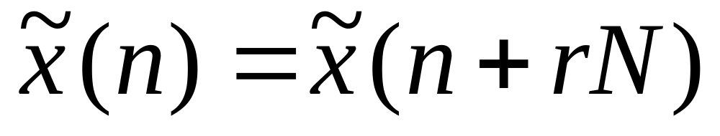
Periodic Sequences
Notation: a sequence with period N
where r is any integer.

Slide 10
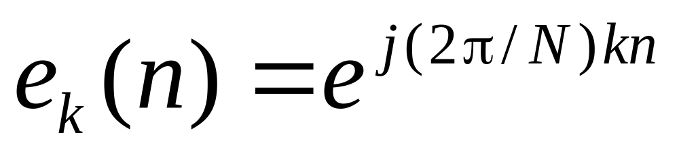
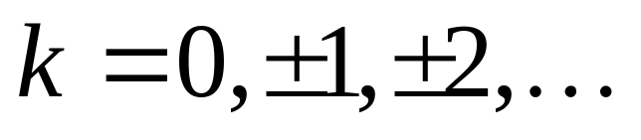
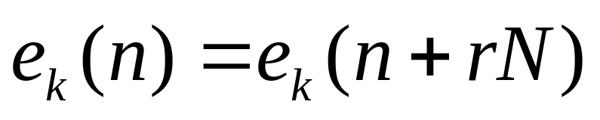
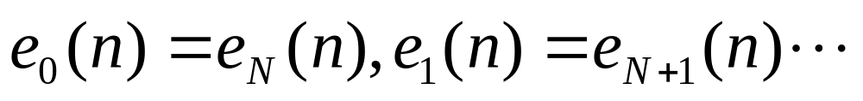
Harmonics
Facts:
Each has Periodic N.
N distinct harmonics e₀(n), e₁(n),…, e_{N−1}(n).

Slide 11
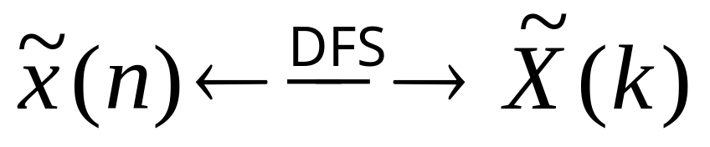
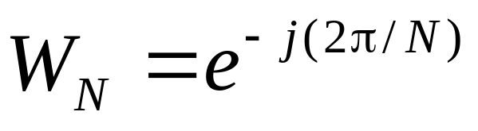
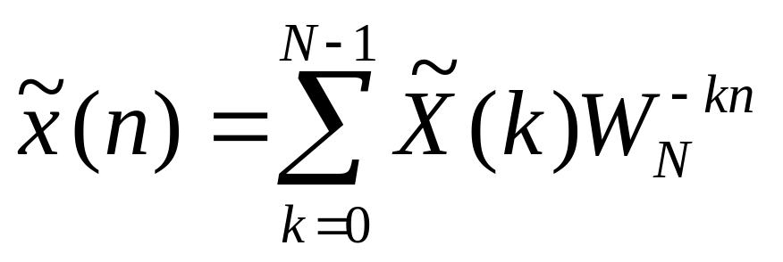
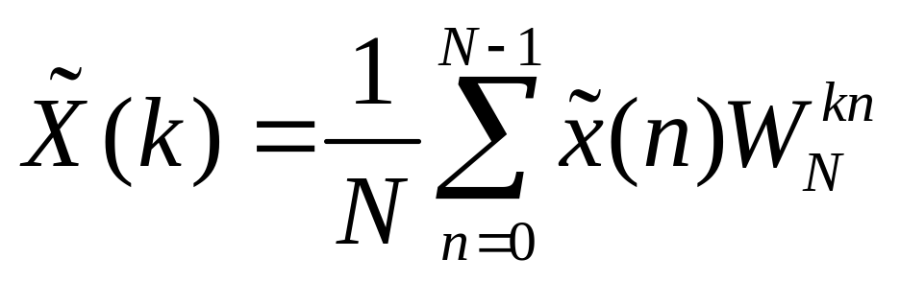
Synthesis and Analysis
Notation
Both have
Period N
Synthesis
Analysis

Slide 12
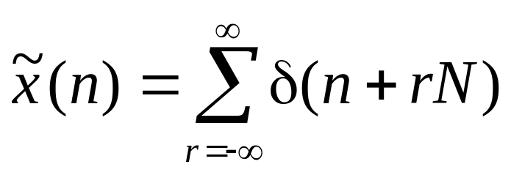
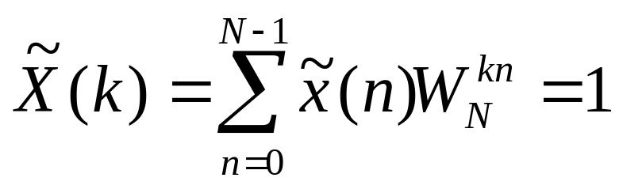
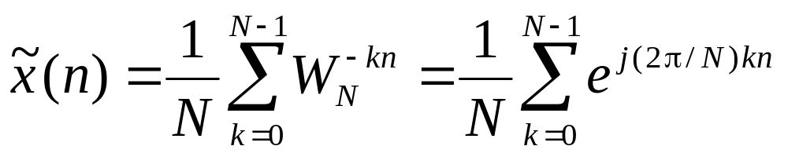
Example
A periodic impulse train with period N.

Slide 13
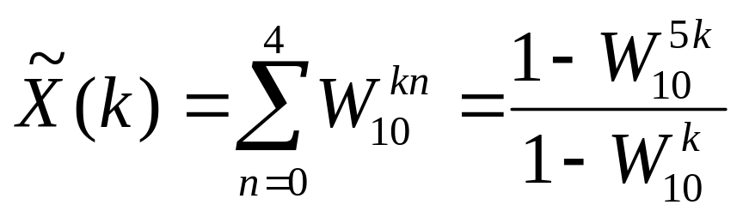
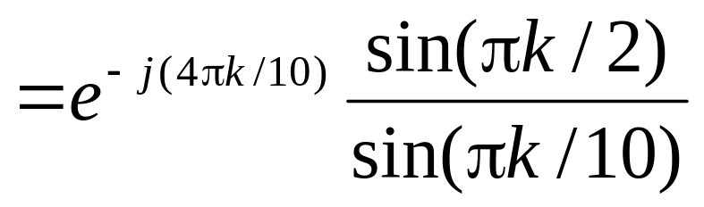
Example
0
1
2
3
4
5
6
7
8
9
n

Slide 14
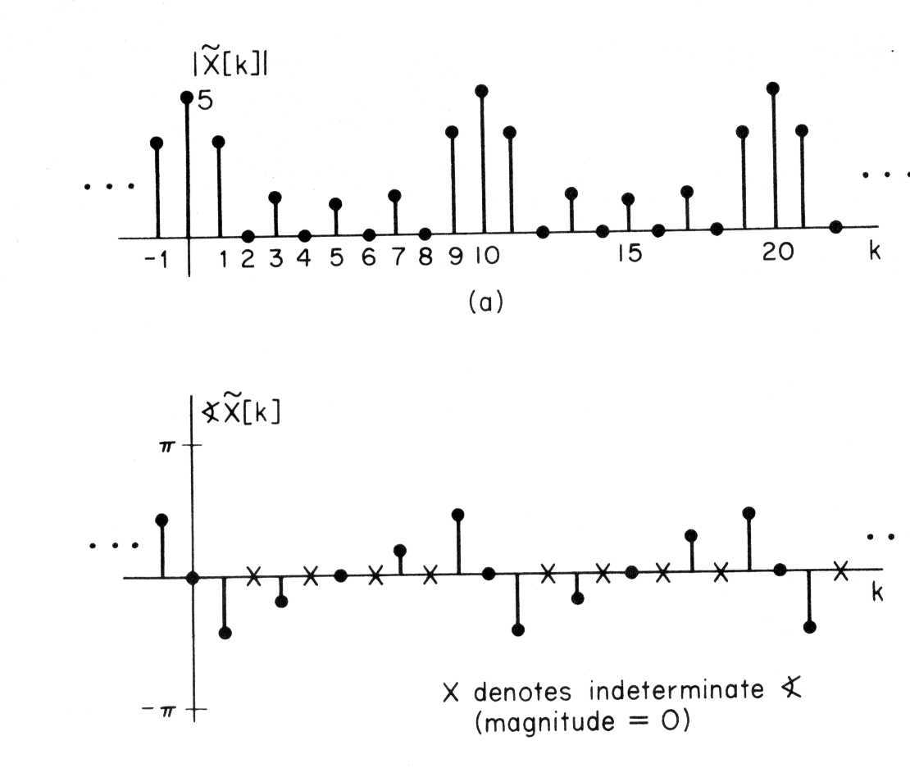
Example
0
1
2
3
4
5
6
7
8
9
n

Slide 15
Example
0
1
2
3
4
5
6
7
8
9
n

Slide 16
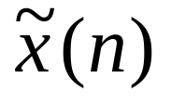
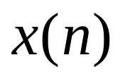
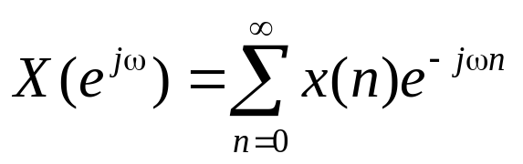
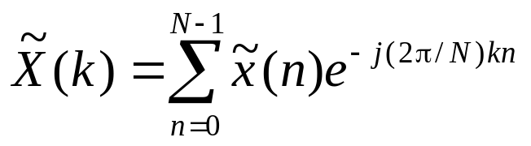
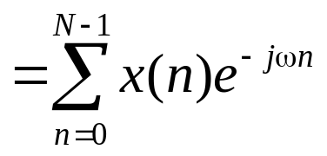
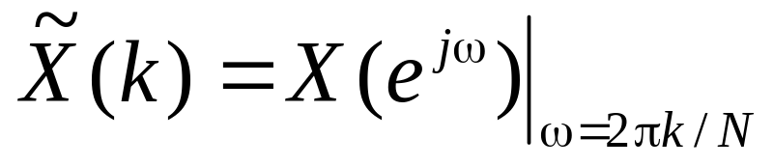
DFS vs. FT
−N
0
N
n
0
n

Slide 17
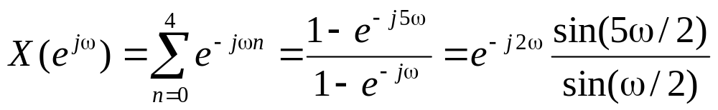
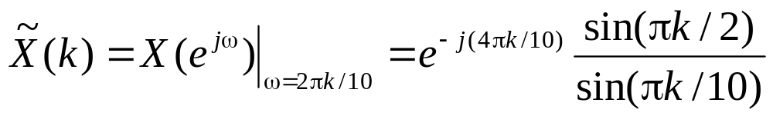
Example
0
1
2
3
4
5
6
7
8
9
n
0
1
2
3
4
5
6
7
8
9
n

Slide 18
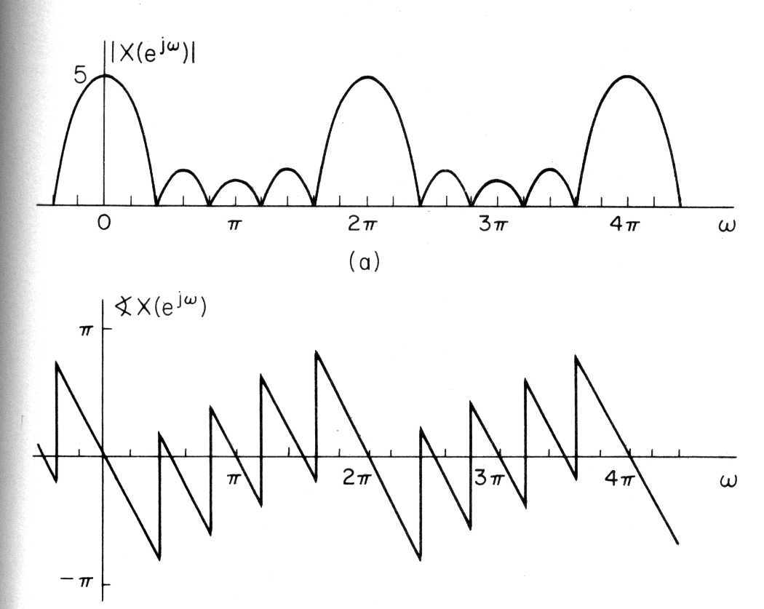
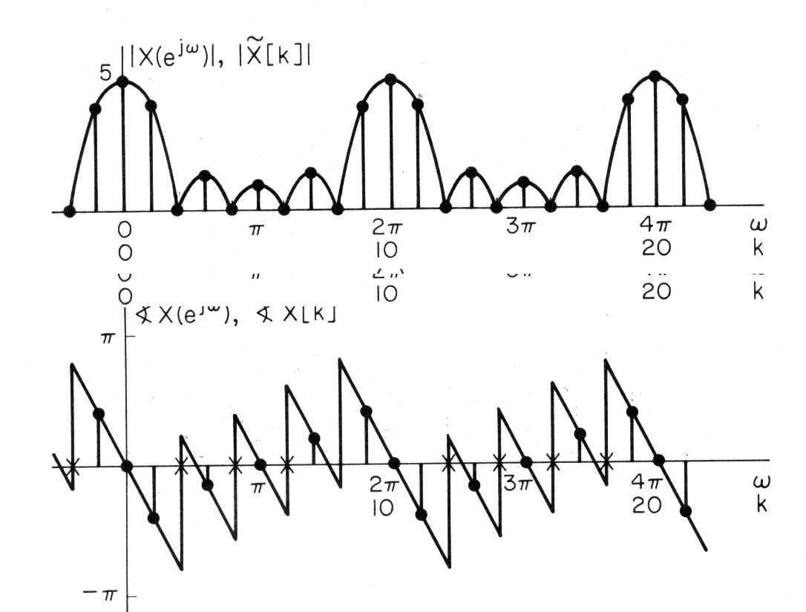
Example
0
1
2
3
4
5
6
7
8
9
n
0
1
2
3
4
5
6
7
8
9
n

Slide 19
Example
0
1
2
3
4
5
6
7
8
9
n
0
1
2
3
4
5
6
7
8
9
n

Slide 20
The Discrete Fourier Transform
Properties of DFS

Slide 21
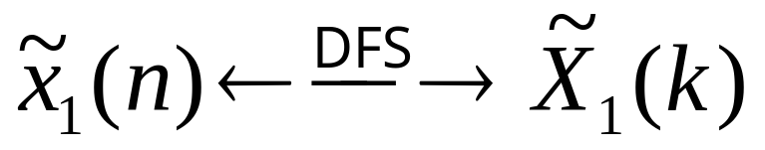
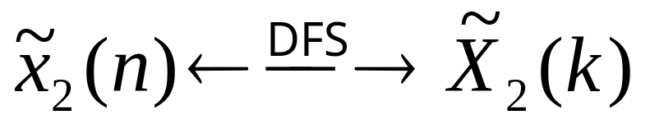
Linearity

Slide 22
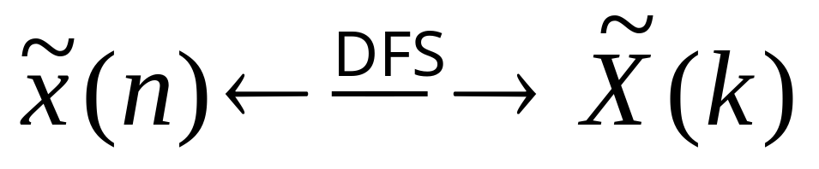
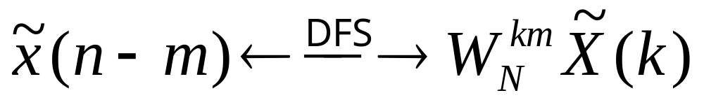
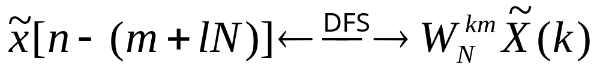
Shift of A Sequence
Change Phase (delay)

Slide 23
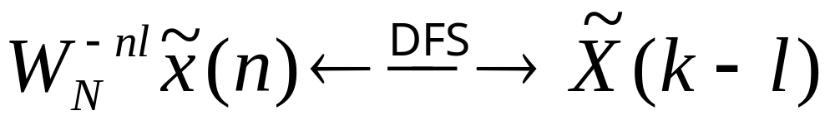
Shift of Fourier Coefficient
Modulation

Slide 24
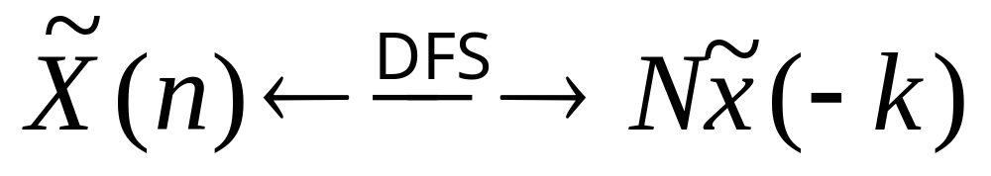
Duality

Slide 25


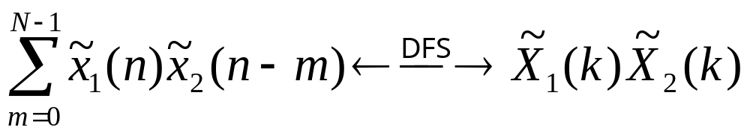
Periodic Convolution
Both have
Period N

Slide 26
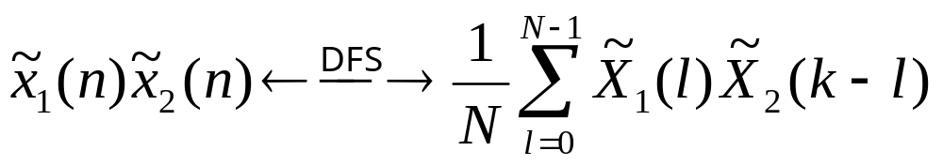
Periodic Convolution
Both have
Period N

Slide 27
The Discrete Fourier Transform
The Fourier Transform of Periodic Signals

Slide 28
Fourier Transforms of Periodic Signals
Periodicity
Periodic
Aperiodic
Fourier Series
Continuous-Time
Fourier Transform
Discrete
&
Aperiodic
Sampling
Continuous
&
Aperiodic
Continuous
Time
DFT
Discrete-Time
Fourier Transform
and z-Transform
DFS
Sampling
Continuous
&
Periodic (2π)
Discrete
Finite
Infinite
Duration

Slide 29

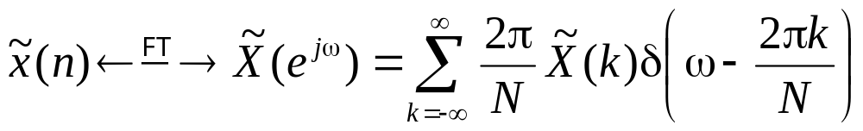
Fourier Transforms of Periodic Signals
−N
0
N
n
0
n

Slide 30
The Discrete Fourier Transform
Sampling of
Fourier Transform

Slide 31
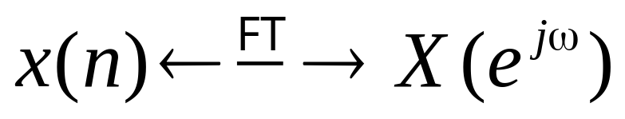
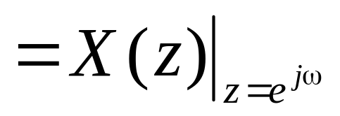
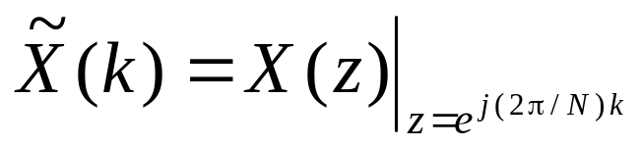
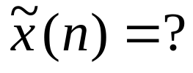
Equal Space Sampling of Fourier Transform
0
N’−1
n
z-plane
z-plane
N
>
=
<
N’

Slide 32
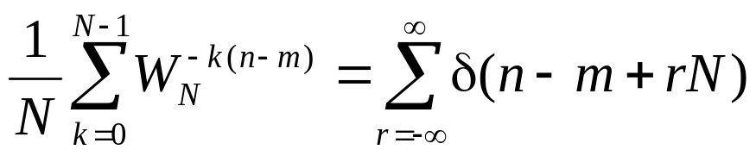
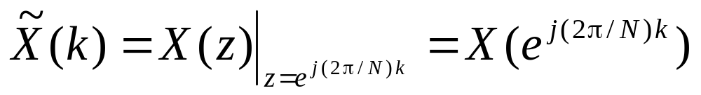
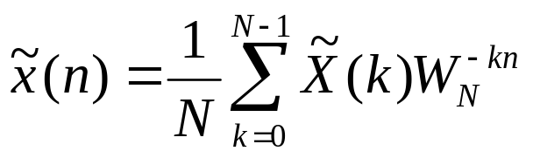
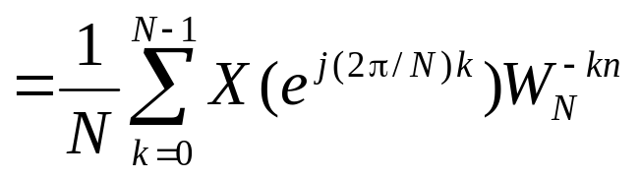
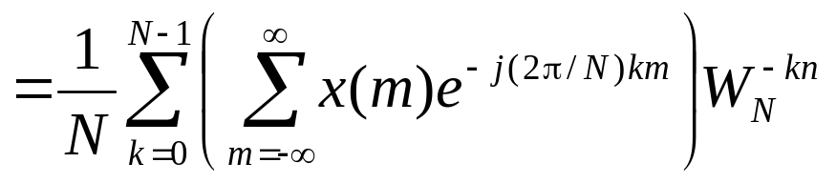
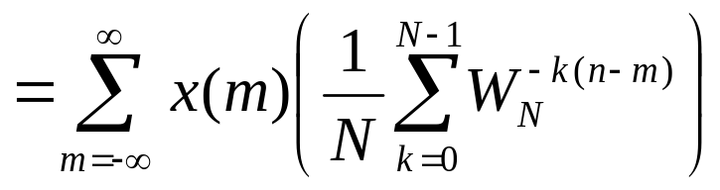
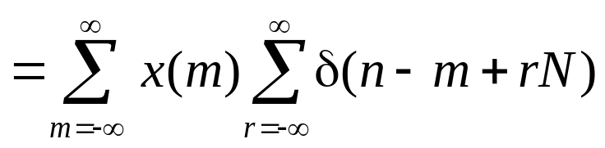
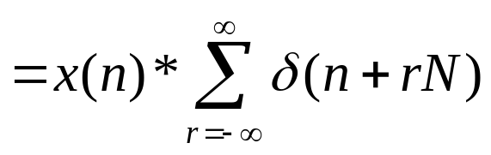
Equal Space Sampling of Fourier Transform

Slide 33

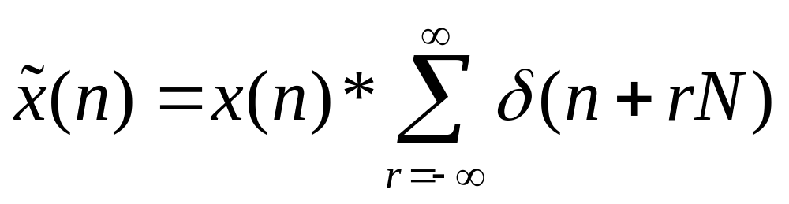
Equal Space Sampling of Fourier Transform
z-plane

Slide 34
Example
N’=9
n
0
8
N=12
n
0
8
12
N=7
n
0
8
12

Slide 35
Example
N’=9
n
0
8
N=12
Time-Domain Aliasing
n
0
8
12
N=7
n
0
8
12

Slide 36
Time-Domain Aliasing vs. Frequency-Domain Aliasing
To avoid frequency-domain aliasing
  Signal is bandlimited
  Sampling rate in time-domain is high enough
To avoid time-domain aliasing
  Sequence is finite
  Sampling interval (2π/N) in frequency-domain is small enough

Slide 37
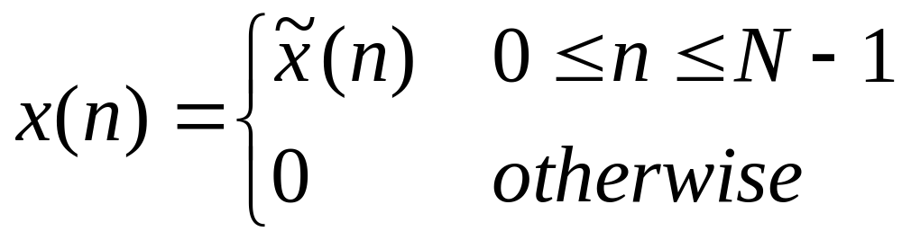
DFT vs. DFS
Use DFS to represent a finite-length sequence is call the DFT (Discrete Fourier Transform).
So, we represent the finite-duration sequence by a periodic sequence. One period of which is the finite-duration sequence that we wish to represent.

Slide 38
The Discrete Fourier Transform
Representation of
Finite-Duration Sequences --- DFT

Slide 39
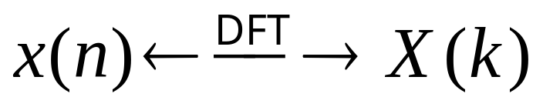



Definition of DFT
Synthesis
Analysis

Slide 40








Example

Slide 41







Example

Slide 42
The Discrete Fourier Transform
Properties of the DFT

Slide 43





Linearity
Duration N₁
n
0
N₁−1
Duration N₂
n
0
N₂−1

Slide 44




Circular Shift of a Sequence
n
0
N
n
0
N
n
0
N

Slide 45

Circular Shift of a Sequence

Slide 46
Duality

Slide 47


Example
Choose N=10
Re[x₁(n)]= Re[X(n)]
Re[X(k)]
Im[x₁(n)]= Im[X(n)]
Im[X(k)]
X₁(k) = 10x((−k))₁₀

Slide 48



Linear Convolution (Review)

Slide 49



Circular Convolution
both of length N

Slide 50




Example
n₀=2, N=5
0
n₀
N
0
N
0
0

Slide 51
Example
n₀=2, N=7
0
n₀
N
0
N
0
0

Slide 52







Example
L=N=6
0
L
0
L
N
0
L

Slide 53


Example
L=2N=12
0
L
N
0
L
N
N
0
N

Slide 54
The Discrete Fourier Transform
Linear Convolution Using the DFT

Slide 55
Why Using DFT for Linear Convolution?
FFT (Fast Fourier Transform) exists.
But., we have to ensure that circular convolving nature of DFT gives the linear convolving result.

Slide 56
The Procedure
Let x₁(n) and x₂(n) be two sequences of length L and P, respectively.
Compute N-point (N = ?) DFTs X₁(k) and X₂(k).
Let X₃(k) = X₁(k) X₂(k), 0 ≤ k ≤ N−1.
Let x₃(n) = DFT⁻¹[X₃(k)] = x₁(n) ℵ x₂(n).
x₁(n) * x₂(n) = x₁(n) ℵ x₂(n)?

Slide 57

Linear Convolution of
Two Finite-Length Sequences
x₂(m)
m
0
P
L
x₁(m)
m
0
L
x₂(−1− m)
x₃(−1) = 0
m
−P
−1
0
L
x₃(n) ≠ 0
n = 0, 1, …, L+P−2
x₂(−n− m)
m
0
n−P+1
L
n
x₂(L+P−1− m)
x₃(L+P−1) = 0
m
0
n
L
n+P−1

Slide 58
Linear Convolution of
Two Finite-Length Sequences
Length of x₃(n) = x₁(n)*x₂(n) = L+P−1
x₂(m)
m
0
P
L
x₁(m)
m
0
L
x₂(−1− m)
x₃(−1) = 0
m
−P
−1
0
L
x₃(n) ≠ 0
n = 0, 1, …, L+P−2
x₂(−n− m)
m
0
n−P+1
L
n
x₂(L+P−1− m)
x₃(L+P−1) = 0
m
0
n
L
n+P−1

Slide 59






Circular Convolution as Linear Convolution with Time Aliasing
x₁(n) −− Length L
x₂(n) −− Length P
x(n) = x₁(n)*x₂(n) −− Length L+P−1

Slide 60
Circular Convolution as Linear Convolution with Time Aliasing
x₁(n)
n
0
L
x₂(n)
n
0
P
L
x (n)
n
0
P
L
L+P−1

Slide 61


N = L+P−1
x (n)
n
0
L
L+P−1
n
0
L
L+P−1
n
0
L
L+P−1

Slide 62
For Finite Sequences
x₁(n)
Zero padding to length L+P−1
n
0
L
x₂(n)
Zero padding to length L+P−1
n
0
P
x _{p}(n) = x₁(n)*x₂(n)
= x₁(n)ℵx₂(n), 0 ≤ n ≤ L+P−2
n
0
L+P−2

Slide 63

N = L
x (n)
n
0
P−1
L
L+P−1
n
− L
0
P−1
L
L+P−1
n
0
P−1
L
L+P−1

Slide 64
N = L
x (n)
n
0
P−1
L
L+P−1
n
− L
0
P−1
L
L+P−1
Corrupted
(P−1) points
Uncorrupted
(L−P+1) points
n
0
P−1
L
L+P−1

Slide 65

FIR Filter for Indefinite-Length Signals
h (n)
x (n)
Overlap-Add Method
Overlap-Save Method
Block
Convolution

Slide 66





Overlay-Add Method
h (n)
x (n)

Slide 67


Overlay-Add Method

Slide 68

Overlay-Add Method
Set N = L+P−1
for each block convolution

Slide 69

Overlay-Save Method
Each block is of length L.
P−1 samples are overlaid btw. adjacent blocks.
Set N = L+P−1 for each block convolution.
Save the last L−P+1 values for each block convolution.

