Slide 1
QUANTATHON V3 · SRNL & CLEMSON · EARTHQUAKE-Q
An honest aftershock-risk forecast for the central & eastern US
P(≥1 M≥2.0 earthquake within 100 km in each 30-day window) for 1,551 cells × 15 windows = 23,265 calibrated probabilities, issued 2025-01-01.
+0.160
+0.146
0.0066
No lift
bits on the sealed judge window
bits on the 2021–2023 test
calibration error on judge (target < 0.02)
from quantum features (paired 95% CI)
Team Schrödinger's Cats · 27 September 2026

Slide 2
SUMMARY FOR MENTORS
Where we stand: results you can act on
Question | Answer | Evidence
Is the forecast skilful? | Yes: +0.160 bits on judge | Test +0.146; AUC 0.913 judge
Are the probabilities honest? | Yes: ECE 0.0066 | Target < 0.02; reliability curve on diagonal
Did we leak the future? | No sign of it | Judge score ≥ test score (Deck's tell-tale check)
Does it beat physics (ETAS)? | Tie | ETAS approx. 0.1453 vs 0.1458; paired CI spans 0
Does it beat location alone? | Yes: +0.010 bits (judge) | Location-only 0.150 judge, 0.141 test
Do external drivers help? | No | Geomagnetic, solar, tidal, GPS: 0 or negative
Does quantum help? | No: slightly worse | ΔIG -0.0009 bits, 95% CI [-0.0015, -0.0004]
Is it ready to submit? | Yes, corrected file | Row-alignment bug found and fixed (bad file: −0.37 bits)
Earthquake-Q · Team Schrödinger's Cats · QuantathonV3
2

Slide 3
PROBLEM
The task and how it is scored
▪ Target: probability of ≥1 M≥2.0 earthquake within 100 km of a 0.5° cell in a 30-day window.
▪ Grid: 1,551 cells over 25–50°N, 65–90°W × 15 windows from 2025-01-01 = 23,265 forecasts.
▪ Rare target: 7.5% of test cell-windows are positive, so accuracy is meaningless (always 'no' ≈ 92%).
▪ Primary score: information gain over climatology, in bits per cell-window.
▪ Honesty: calibration (ECE, Brier) and a judge score that does not collapse vs test.
▪ Stakeholders: 30-day entry decisions for rescue crews, 6-month planning for repair crews.
Scoring equations (from the challenge README)
▪ LL(q) = −mean[ y·ln q + (1−y)·ln(1−q) ]
▪ IG = [ LL(base rate) − LL(forecast) ] / ln 2 (bits)
▪ q clipped to [10⁻⁴, 1−10⁻⁴]: a forecast never claims certainty
▪ ECE = Σ_b (n_b/N)·| ȳ_b − q̄_b | over 10 probability bins
▪ Entropy ceiling at 7.5% base rate ≈ 0.38 bits: no forecaster can exceed it
Earthquake-Q · Team Schrödinger's Cats · QuantathonV3
3

Slide 4
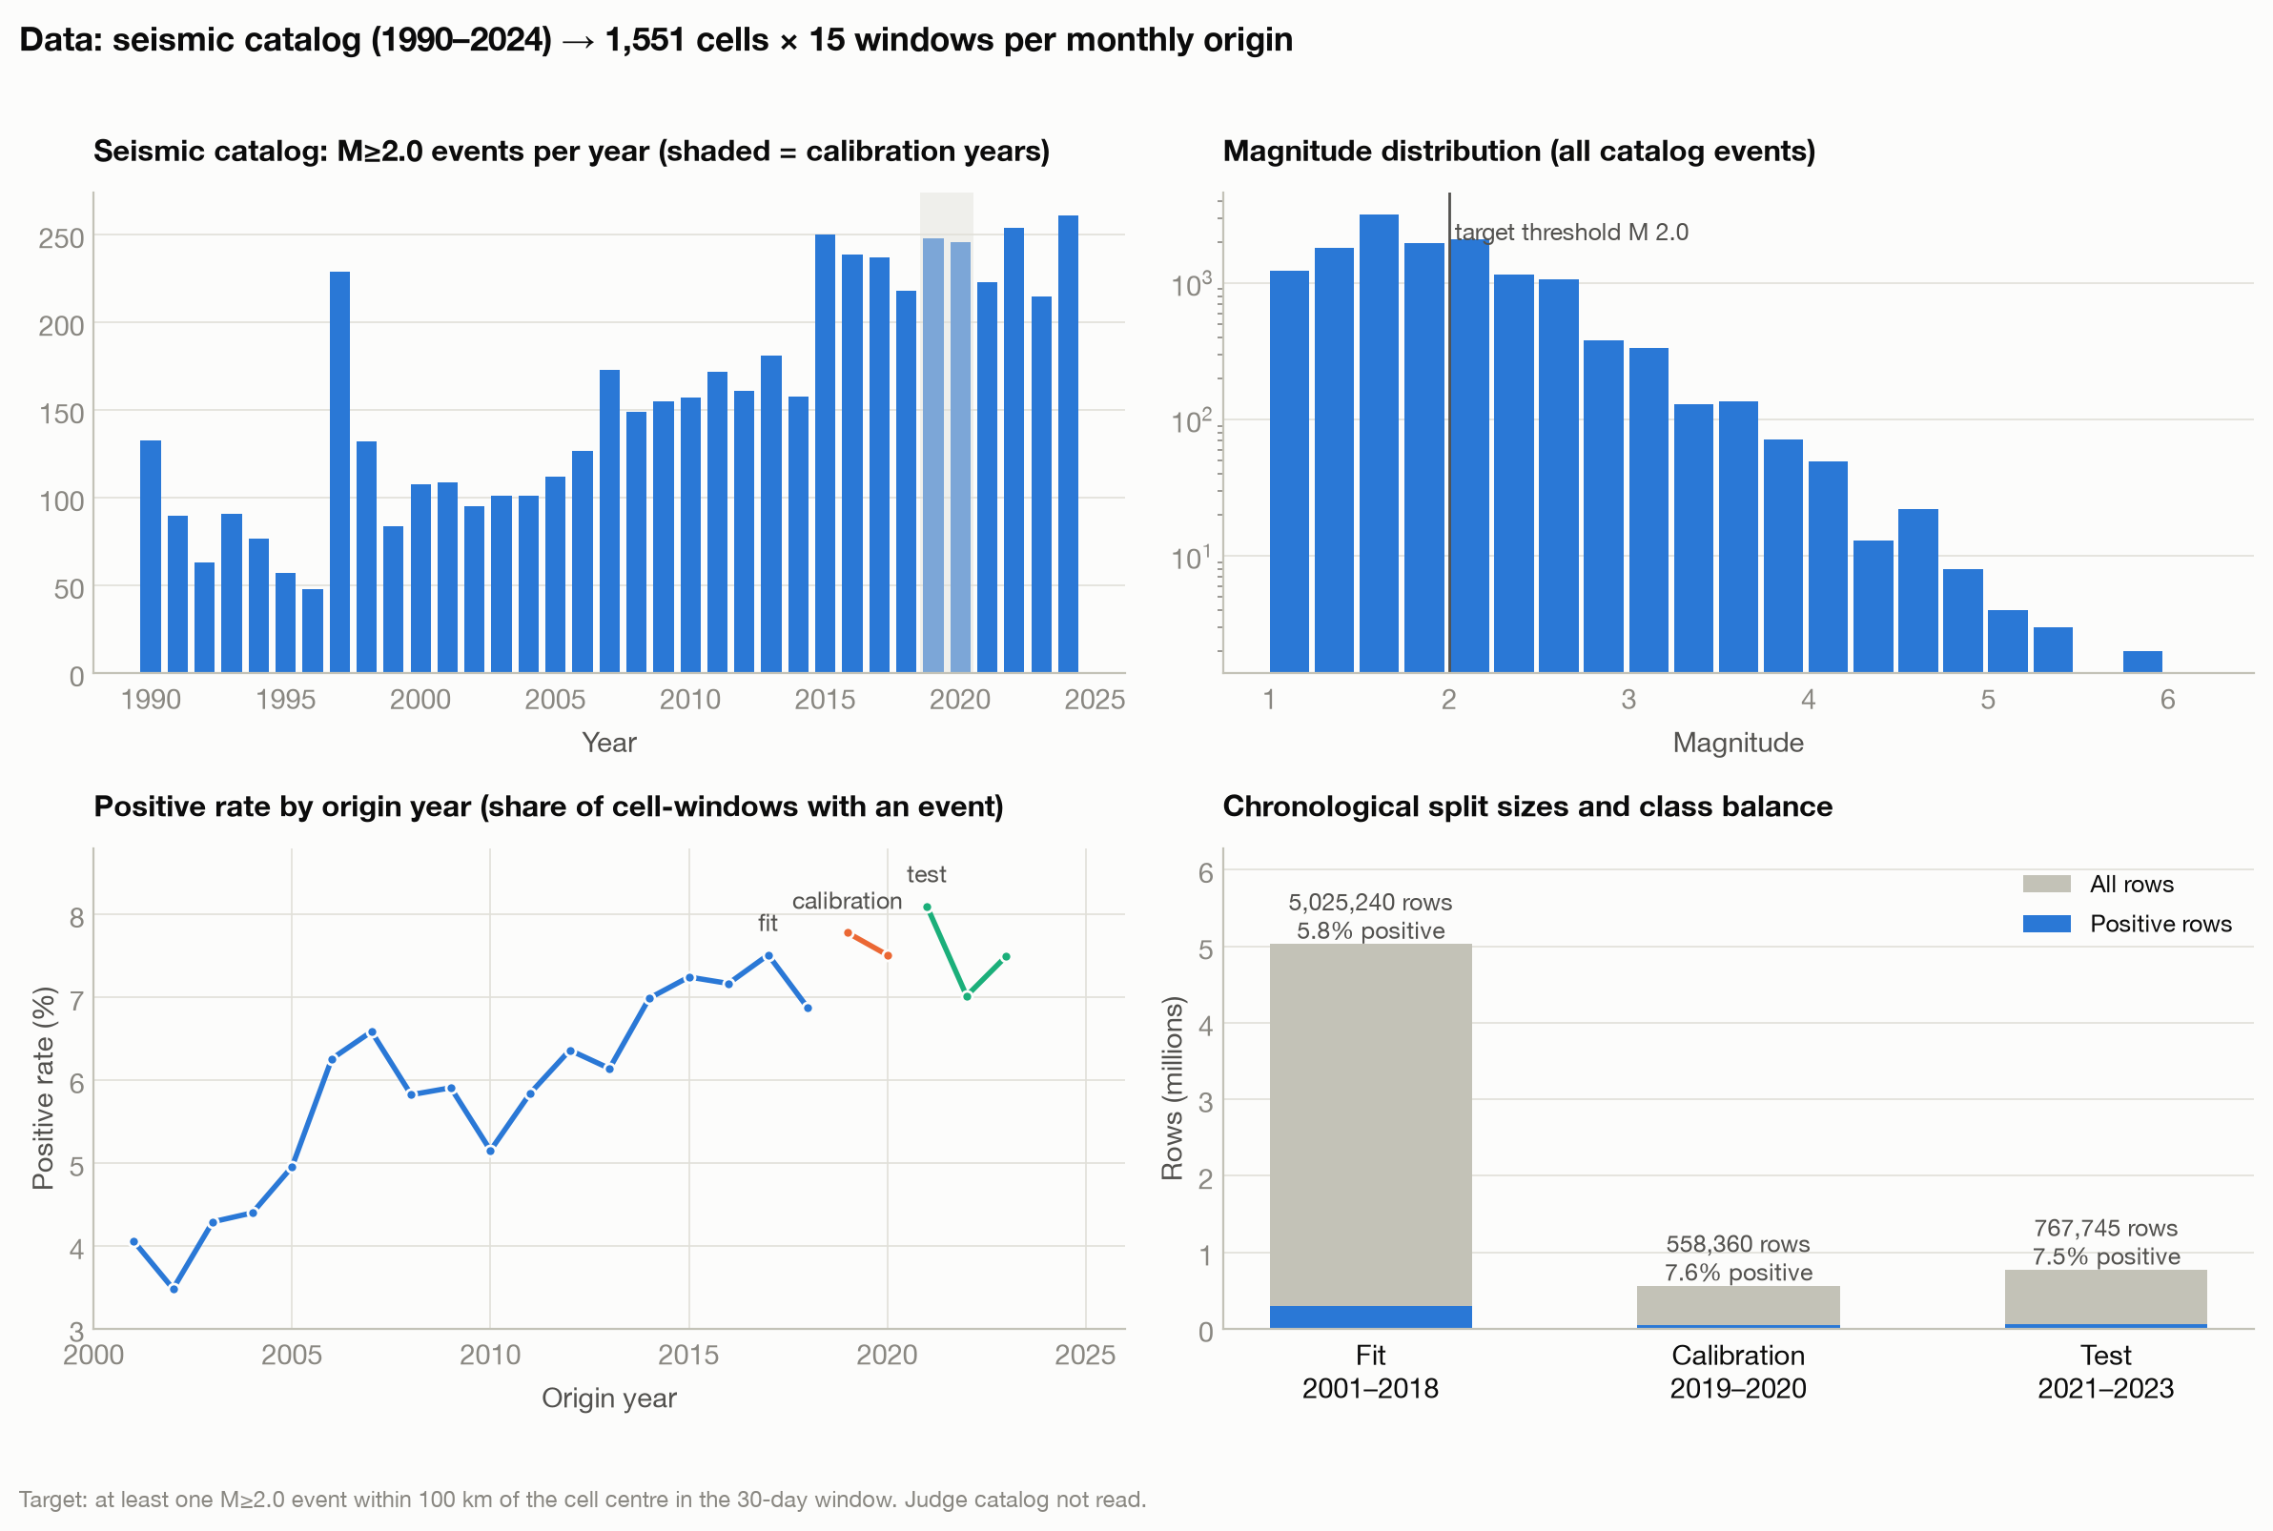
DATA
Data: five raw streams, split strictly by time
Split | Origins | Rows | Positive
Fit | 2001-01 → 2018-12 | 5,025,240 | 5.8%
Calibration | 2019-01 → 2020-12 | 558,360 | 7.6%
Test | 2021-01 → 2023-09 | 767,745 | 7.5%
Judge (once) | 2025-01 → 2026-02 | 23,265 | 7.9%
▪ Seismic catalog: 13,624 USGS events (train+test files); magnitude of completeness Mc = 1.75.
▪ Each example = cell × monthly issue date × 15 lead windows (train the way you are scored).
▪ Features use only events strictly before the issue date.
▪ Geomagnetic, solar, tidal and GPS streams were tested and excluded (slide 9).
Earthquake-Q · Team Schrödinger's Cats · QuantathonV3
4

Slide 5
METHOD
Model architecture: gradient-boosted trees + per-horizon calibration
Raw catalog
10 features
Pooled GBDT
Isotonic ×15
Clip + output
USGS events
M ≥ 1.75, before
issue date
counts 7/30/90/365 d
within 100 km, recency,
acceleration, lat/lon,
horizon h/14
HistGradientBoosting
120 trees × 31 leaves
one model, 15 horizons
one calibrator per
horizon, fit on
2019–2020 only
[10⁻⁴, 1−10⁻⁴]
23,265 probabilities
cell × window
▪ Why trees: strongest learner for tabular data in the Deck and in benchmarks (Grinsztajn 2022); our MLP scored lower.
▪ Why pooled: one model sees all 15 horizons (5.0 M rows) instead of 15 small models; +0.0022 bits vs per-horizon models.
▪ Why isotonic per horizon: monotone re-mapping to true frequencies, fit on later held-out dates only.
Gradient boosting in one line
▪ F_m(x) = F_{m−1}(x) + η · f_m(x), η = 0.06
▪ f_m = regression tree fit to the gradient of log loss
▪ Histogram splits over 255 bins; L2 penalty λ = 1.0
▪ Learned: 120 trees, 3,720 leaves, ≈10,920 values
Earthquake-Q · Team Schrödinger's Cats · QuantathonV3
5

Slide 6
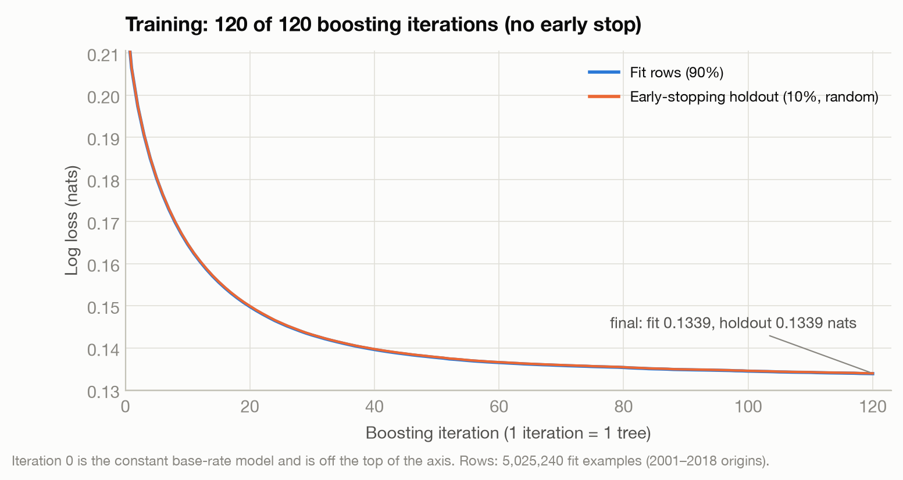
METHOD
Experimental parameters
Parameter | Value
Algorithm | scikit-learn HistGradientBoostingClassifier (log loss)
Boosting iterations (≈ epochs) | 120 of 120; early stopping armed, not triggered
Batch size | Not applicable: each iteration fits one tree on the full fit set
Learning rate η | 0.06
Max leaves / min rows per leaf | 31 / 20
Max depth | unlimited (deepest tree: 15)
L2 regularization / bins | 1.0 / 255
Early-stopping holdout | random 10% of fit rows, patience 10
Calibration | 15 isotonic regressions, 2019–2020 origins, clip [1e-4, 1−1e-4]
Seed / software | 42 · Python 3.12.14, scikit-learn 1.9.1
Comparison models on the same rows
▪ Climatology, location-only prior, ETAS approximation
▪ 15 per-horizon GBDTs; MLP (32,16), Adam lr 1e-3, batch 256, 58–69 epochs
▪ External-driver ablations; 4-qubit quantum features
Earthquake-Q · Team Schrödinger's Cats · QuantathonV3
6

Slide 7
METHOD
Methods and the literature behind them
Method | Equation / idea | Reference
Gutenberg–Richter law | log₁₀ N(≥M) = a − b·M | Gutenberg & Richter (1944)
b-value (max. likelihood) | b = log₁₀e / (M̄ − Mc) | Aki (1965)
Completeness Mc | MAXC + 0.2 → Mc = 1.75 | Wiemer & Wyss (2000); Mignan & Woessner (2012)
ETAS triggering | λ(t) = μ + Σ K·e^{α(mᵢ−Mc)}·(t−tᵢ+c)^{−p} | Ogata (1988); Utsu (1961)
Declustering | space–time windows by magnitude | Gardner & Knopoff (1974)
Gradient boosting | F_m = F_{m−1} + η·f_m | Friedman (2001); Ke et al. (2017)
Isotonic calibration | monotone map score → frequency | Zadrozny & Elkan (2002)
Proper scoring / IG | log score; IG in bits | Gneiting & Raftery (2007)
Calibration error | ECE over probability bins | Guo et al. (2017)
Block bootstrap | resample contiguous time blocks | Künsch (1989)
Permutation importance | loss increase when a feature is shuffled | Breiman (2001)
Quantum feature maps | angle encoding + Pauli read-out | Havlíček et al. (2019); Schuld & Killoran (2019)
Earthquake-Q · Team Schrödinger's Cats · QuantathonV3
7

Slide 8
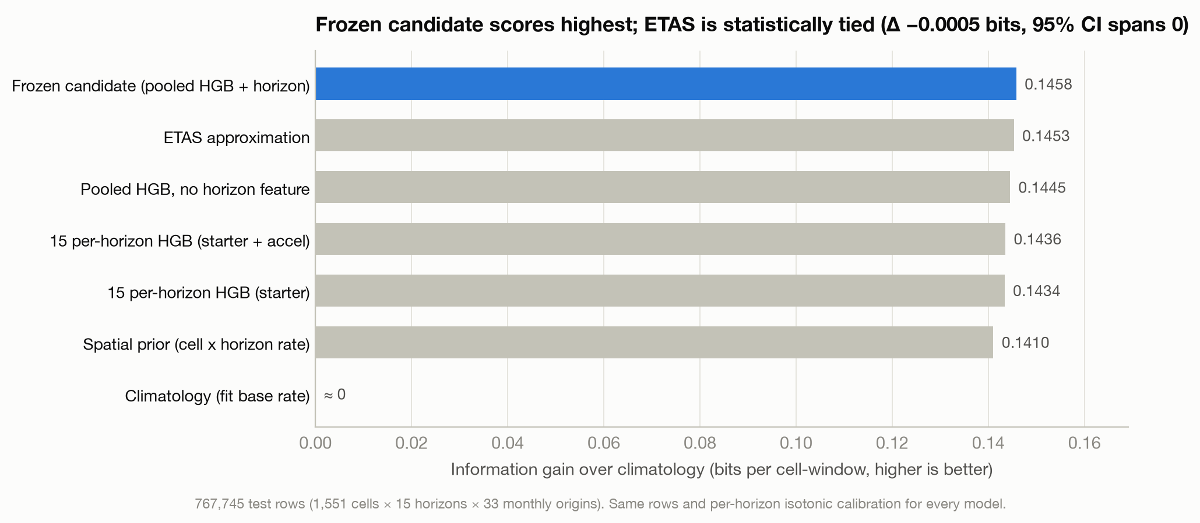
RESULTS
Results: skilful, calibrated, tied with physics
+0.1458
bits on test (2021–2023), 767,745 cell-windows
0.906
ROC AUC (Deck: ~0.85 comes from location alone)
0.0071
calibration error (Deck target < 0.02)
▪ Matches the Deck's finding of parity with physics: ETAS approximation 0.1453 bits, Δ −0.0005, paired 95% CI [−0.0016, +0.0006].
▪ Location alone gets 0.141 bits (97% of ours; the Deck reports ~93%). Feature engineering adds the rest.
Earthquake-Q · Team Schrödinger's Cats · QuantathonV3
8

Slide 9
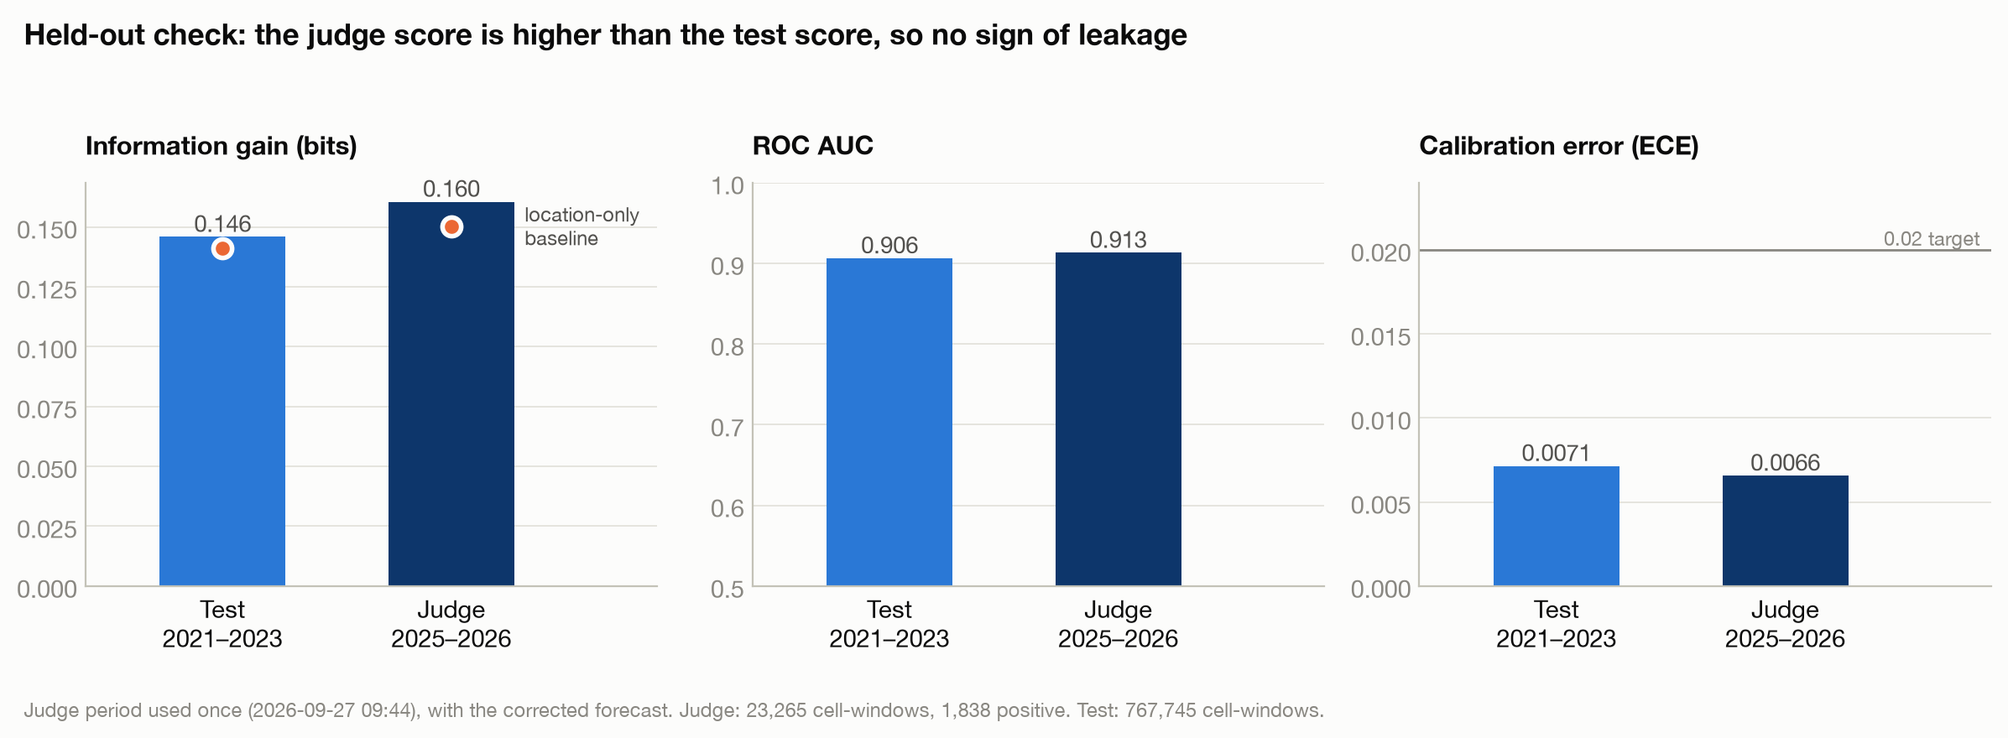
RESULTS
Held-out check on the sealed judge window: no leakage
Forecast on judge (used once) | IG (bits) | AUC | ECE
Frozen model (corrected file) | +0.1605 | 0.913 | 0.0066
Location-only baseline | +0.1503 | 0.907 | 0.0166
Original file (row bug) | -0.3700 | 0.514 | 0.0879
Why this matters
The Deck's tell-tale for leakage is a judge score far below test. Ours went up (+0.146 → +0.161), like the reference (+0.110 → +0.134).
Earthquake-Q · Team Schrödinger's Cats · QuantathonV3
9

Slide 10
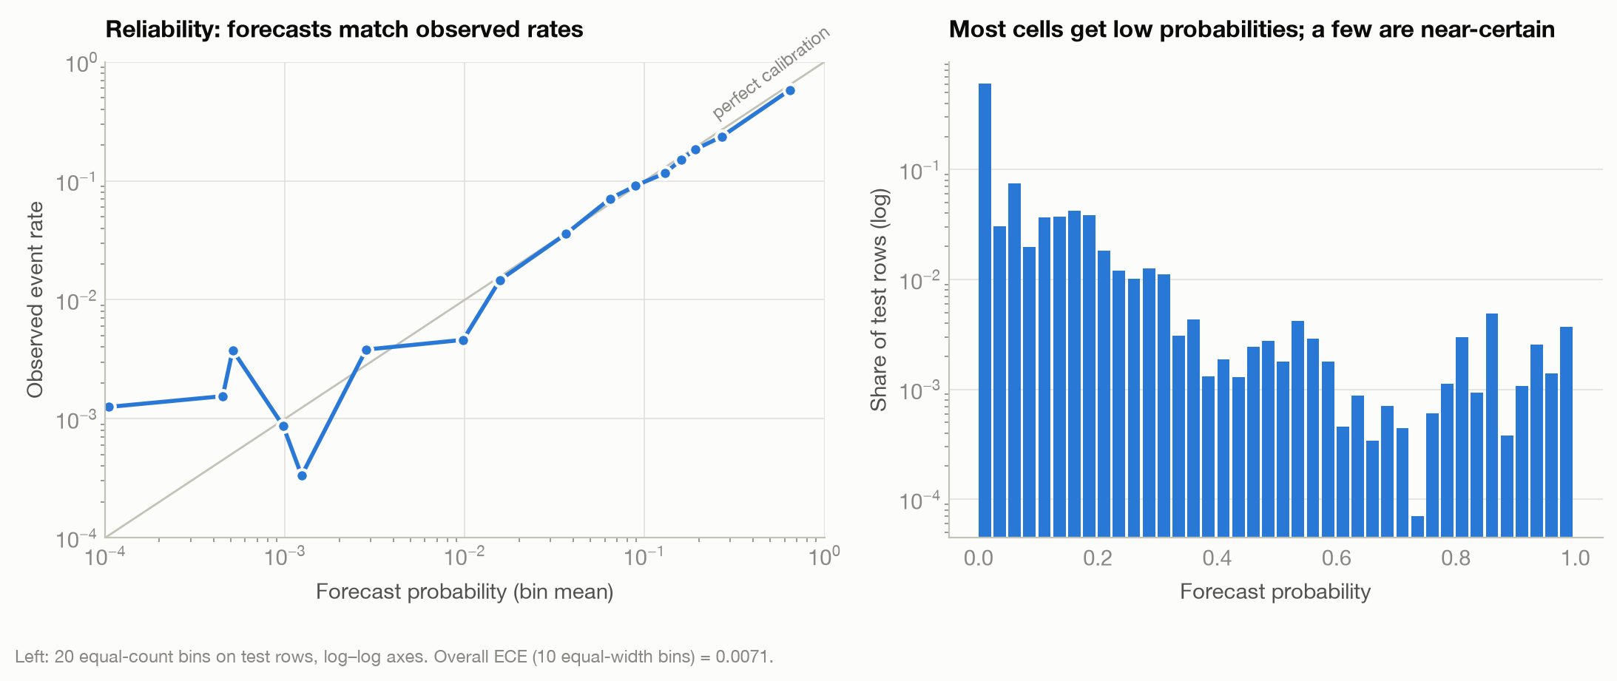
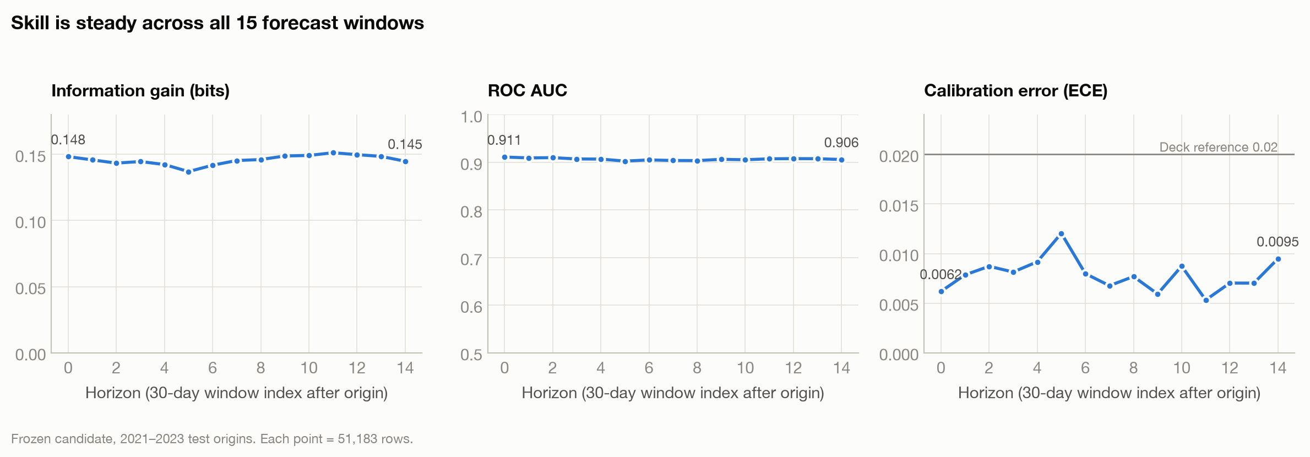
RESULTS
Honest probabilities at every lead time
▪ When we say 12%, events followed 11.6% of the time on test (Elevated band); 29% → 26% (High band).
▪ Skill holds for all 15 windows: test IG 0.137–0.151 bits; judge 0.104–0.245 bits per window.
▪ Every per-horizon calibration error is below 0.02 on test (overall 0.0071).
▪ Calibrators are fit on 2019–2020 only, never on training scores (Deck Module 5).
▪ Caveat: a few labels near split boundaries overlap; removing them gives 0.1417 bits (-0.0041), so treat sub-0.004 gaps as ties.
Earthquake-Q · Team Schrödinger's Cats · QuantathonV3
10

Slide 11
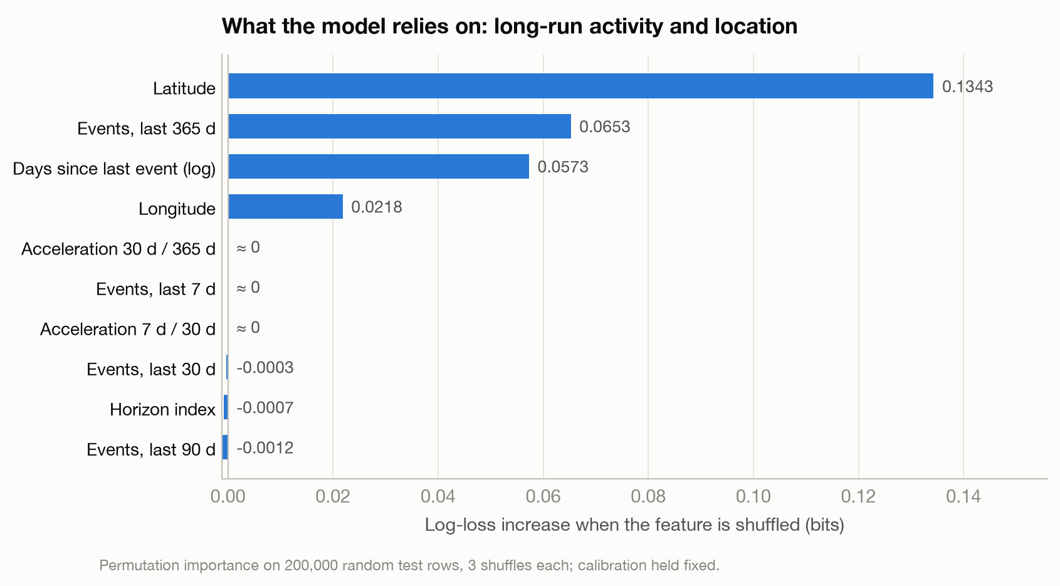
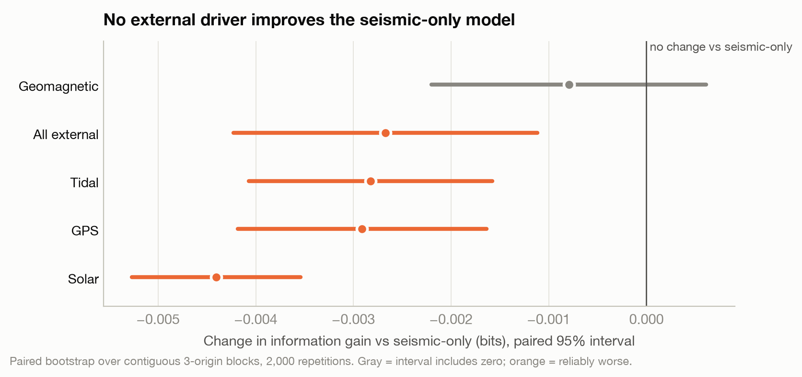
RESULTS
What carries the signal: location and the last year of activity
▪ Permutation importance on held-out test rows (not tree gain, which rewards static location fingerprints — Deck Module 4).
▪ Geomagnetic, solar, tidal and GPS features never help: four of five make the forecast reliably worse (paired 3-origin block bootstrap).
▪ Short-window counts and acceleration ratios add little on their own: they overlap with the 365-day count.
Earthquake-Q · Team Schrödinger's Cats · QuantathonV3
11

Slide 12
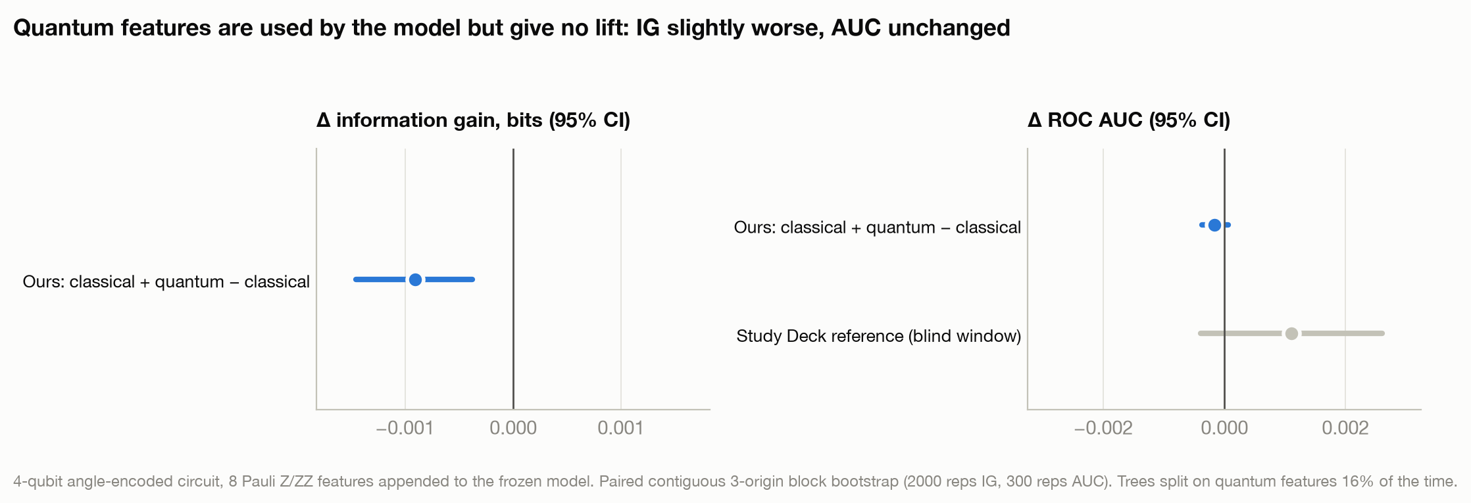
QUANTUM
Quantum: did it help? Measured with a paired test
Why we tried it
▪ The Deck's Approach 1: quantum feature maps as extra inputs to a classical model.
▪ Entangled read-outs (ZZ) can express feature interactions a single feature cannot.
▪ Testable: classical vs classical + quantum on identical rows.
 | IG (bits) | AUC
Classical (frozen) | 0.1458 | 0.9061
Classical + quantum | 0.1449 | 0.9060
Difference (95% CI) | -0.0009 [-0.0015, -0.0004] | -0.0002 [-0.0004, +0.0001]
How we built it
▪ 4 qubits, angle encoding RY(π·xᵢ) of dynamic features only (365-d count, recency, 2 acceleration ratios)
▪ CNOT ring, re-upload, CNOT ring; read ⟨Zᵢ⟩ and ⟨ZᵢZᵢ₊₁⟩ → 8 features
▪ Exact statevector simulation, checked against Qiskit on 6 rows
Verdict: the model uses the quantum features (trees split on them 16% of the time), but information gain gets slightly worse (CI entirely below 0) and AUC does not change (CI spans 0). No quantum lift. This matches the Deck's reference (ΔAUC +0.0011, CI [−0.0004, +0.0026]). Kernels and VQCs were not run at this scale: fidelity kernels concentrate and VQCs hit barren plateaus (McClean 2018; Thanasilp 2024).
Earthquake-Q · Team Schrödinger's Cats · QuantathonV3
12

Slide 13
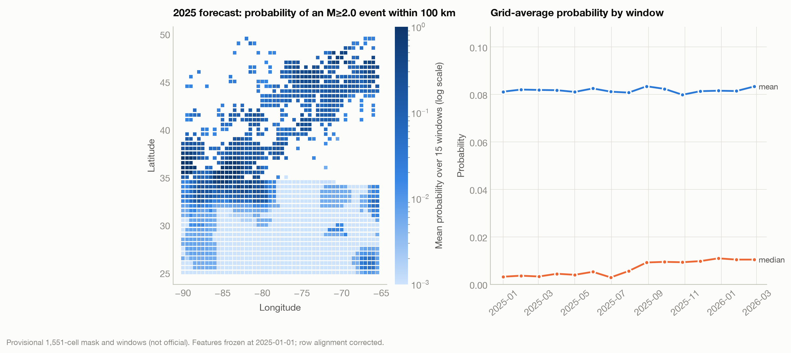
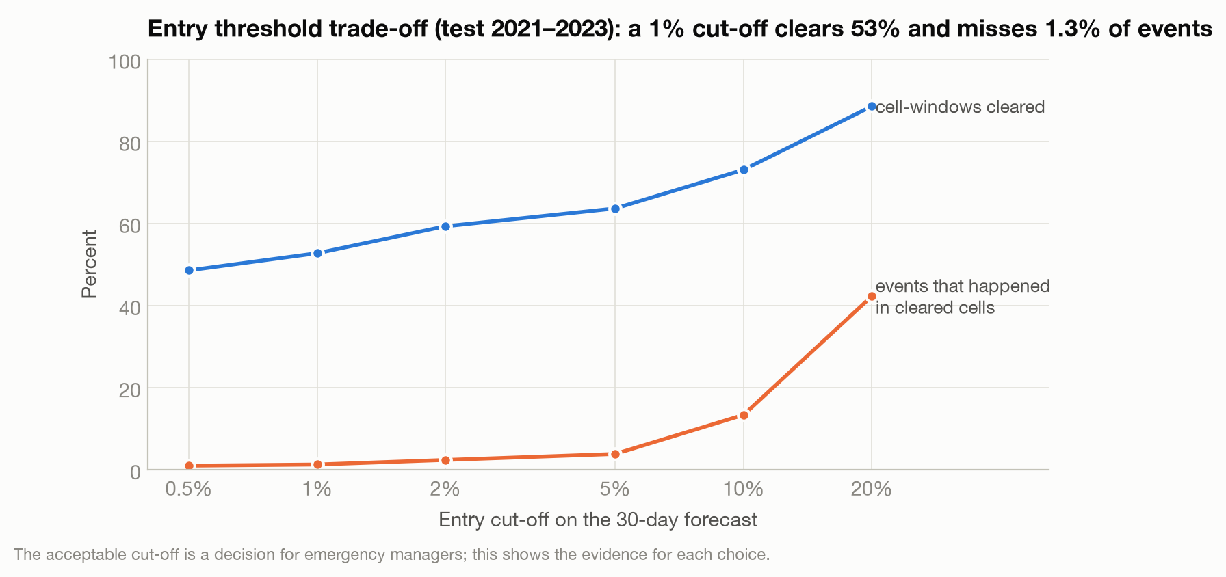
STAKEHOLDERS
For decision-makers: a map, a 6-month view, and entry thresholds
▪ Clickable map: click an epicenter → 30-day and 6-month risk for the nearest cell, with what that band meant on test data.
▪ 6-month (repair crews): 1 − Π(1 − pₕ) over windows 1–6. Test: 24.5% forecast vs 22.4% observed, +0.379 bits; judge +0.302 bits. Errs cautious where quakes cluster.
▪ Entry threshold (rescue crews): a 1% cut-off cleared 53% of cell-windows and missed 1.3% of events; 5% cleared 64% and missed 3.9%.
▪ Who decides: the acceptable risk is for emergency managers; we supply calibrated numbers and their track record.
▪ Hot spot: New Madrid seismic zone (36°N, 89–90°W) is near-certain every month.
Earthquake-Q · Team Schrödinger's Cats · QuantathonV3
13

Slide 14
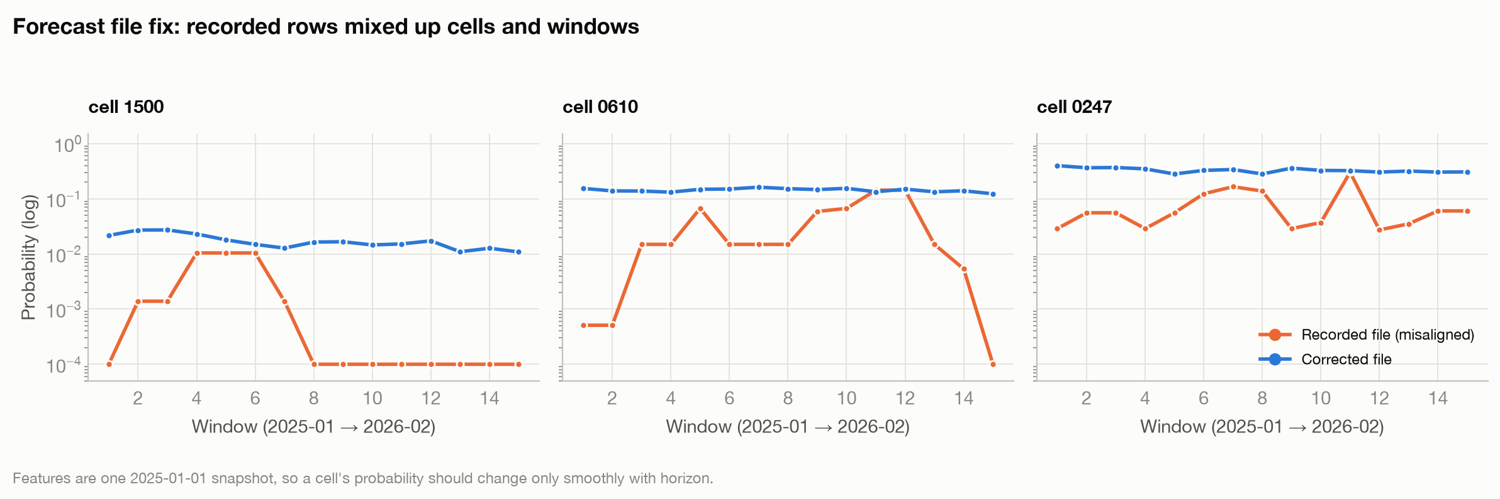
REPRODUCIBILITY
Quality control: what we checked, and the bug we caught
Check | Result
Training data regenerates identically | Pass
Headline metrics reproduce | Pass
ECE < 0.02 (all groups) | Pass
No external driver helps | Pass
Headline scripts never read judge | Pass
Forecast order and values | Pass (fixed)
Judge ≥ test (no leakage) | Pass
Verification suite | 18/19 (1 = old file)
▪ Full rerun from raw catalogs: training data bit-identical; every recorded metric reproduced exactly.
▪ Our first forecast file paired window-ordered probabilities with cell-ordered rows: 22,163 of 23,265 wrong.
▪ On judge that file would score -0.37 bits; the corrected file scores +0.160.
▪ 200 random rows recomputed with independent code: exact match.
Earthquake-Q · Team Schrödinger's Cats · QuantathonV3
14

Slide 15
HONESTY
Limitations we want you to know
▪ Model selection used the test period. The judge score is the only untouched number; we used it once.
▪ ETAS is an approximation. Our fitted triggering strength K collapsed to ~0, so it behaves like a background-rate model; a proper declustered ETAS refit is the top next step.
▪ Label windows cross split boundaries. Removing those rows costs 0.0041 bits on test, larger than our gap to ETAS.
▪ The 1,551-cell mask and window dates are our construction from the Deck's specification (judge data ends March 2026).
▪ 6-month risk assumes independent windows. Conservative at moderate/high risk; slightly low below 1% (0.06% vs 0.45%).
▪ Quantum test uses simulated 4-qubit circuits. A null result for this encoding, not a verdict on all quantum methods.
▪ A probability map is not a safety guarantee. Entry thresholds need agreement with emergency managers.
Earthquake-Q · Team Schrödinger's Cats · QuantathonV3
15

Slide 16
NEXT STEPS
Decisions we would like from mentors
Decision | Our recommendation | Why
Submit the frozen model? | Yes, corrected file | +0.160 judge bits, ECE 0.0066, no leakage sign
Add quantum features? | No | ΔIG -0.0009 bits, CI below 0; ΔAUC CI spans 0
Add external drivers? | No | 0 or negative in paired tests
Invest next in… | Declustered ETAS refit, ETAS as model input | Deck's highest-value task; physics as starting point
Entry threshold for rescue crews? | Managers choose; 1–5% range | 1% clears 53%, misses 1.3%; 5% clears 64%, misses 3.9%
Publish the map? | Yes, with caveats | Calibrated, shows its own track record
Earthquake-Q · Team Schrödinger's Cats · QuantathonV3
16

Slide 17
LITERATURE
References
Aki, K. (1965). Maximum likelihood estimate of b in the formula log N = a − bM. Bull. Earthq. Res. Inst. 43, 237–239.
Breiman, L. (2001). Random forests. Machine Learning 45, 5–32.
Friedman, J. H. (2001). Greedy function approximation: a gradient boosting machine. Ann. Statist. 29, 1189–1232.
Gardner, J. K. & Knopoff, L. (1974). Is the sequence of earthquakes in Southern California, with aftershocks removed, Poissonian? BSSA 64, 1363–1367.
Gneiting, T. & Raftery, A. E. (2007). Strictly proper scoring rules, prediction, and estimation. JASA 102, 359–378.
Grinsztajn, L., Oyallon, E. & Varoquaux, G. (2022). Why do tree-based models still outperform deep learning on tabular data? NeurIPS.
Guo, C., Pleiss, G., Sun, Y. & Weinberger, K. Q. (2017). On calibration of modern neural networks. ICML.
Gutenberg, B. & Richter, C. F. (1944). Frequency of earthquakes in California. BSSA 34, 185–188.
Havlíček, V. et al. (2019). Supervised learning with quantum-enhanced feature spaces. Nature 567, 209–212.
Ke, G. et al. (2017). LightGBM: a highly efficient gradient boosting decision tree. NeurIPS.
Künsch, H. R. (1989). The jackknife and the bootstrap for general stationary observations. Ann. Statist. 17, 1217–1241.
McClean, J. R. et al. (2018). Barren plateaus in quantum neural network training landscapes. Nat. Commun. 9, 4812.
Mignan, A. & Woessner, J. (2012). Estimating the magnitude of completeness for earthquake catalogs. CORSSA.
Ogata, Y. (1988). Statistical models for earthquake occurrences and residual analysis for point processes. JASA 83, 9–27.
Schuld, M. & Killoran, N. (2019). Quantum machine learning in feature Hilbert spaces. Phys. Rev. Lett. 122, 040504.
Thanasilp, S., Wang, S., Cerezo, M. & Holmes, Z. (2024). Exponential concentration in quantum kernel methods. Nat. Commun. 15, 5200.
Utsu, T. (1961). A statistical study on the occurrence of aftershocks. Geophys. Mag. 30, 521–605.
Wiemer, S. & Wyss, M. (2000). Minimum magnitude of completeness in earthquake catalogs. BSSA 90, 859–869.
Zadrozny, B. & Elkan, C. (2002). Transforming classifier scores into accurate multiclass probability estimates. KDD.
Challenge materials: Earthquake-Q Intro Briefing, Study Deck (100 slides), Classical Starter notebook, README (QuantathonV3, SRNL & Clemson, 2026).
Earthquake-Q · Team Schrödinger's Cats · QuantathonV3
17

