Slide 1
Assessment of available amber forcefields to model DNA-Ligand interactions
Paper: Misra, Manas, and Anil Kumar Yadav. "Assessment of available AMBER force fields to model DNA-ligand interactions." Biointerface Res. Appl. Chem 13 (2022): 156.
Presented by: Hannah Gates, Vaishnavey Srinivasan, Mohammad Reza Zargar, Sophie Krivograd, and Sristi Dey

Slide 2
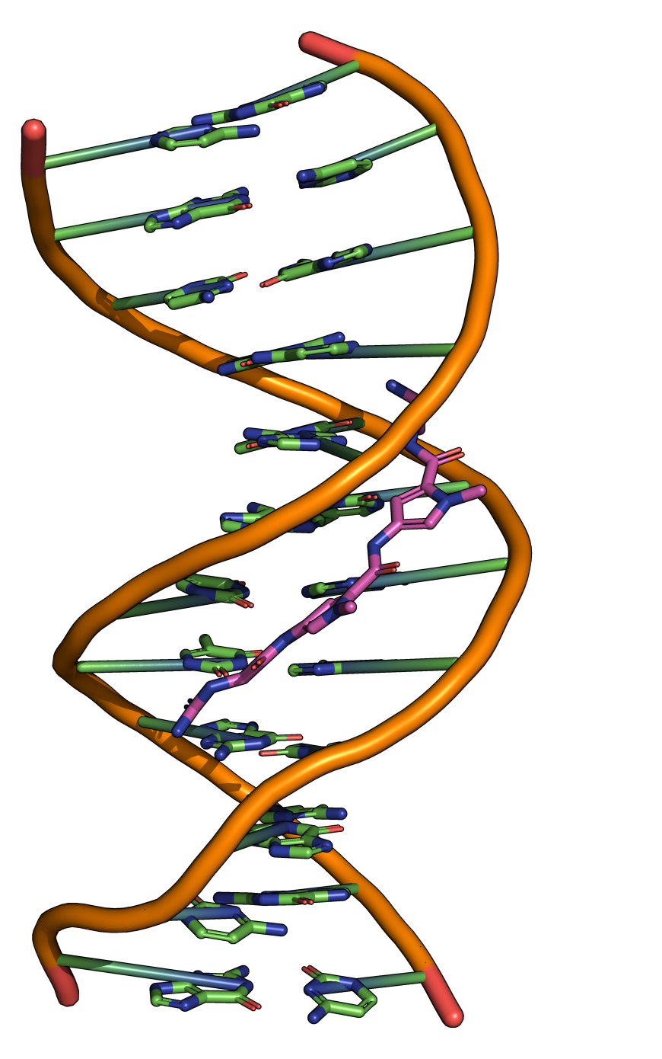
Literature Summary: Introduction
DNA-Drug Interaction & Molecular Docking: DNA is a common target for anticancer drugs and molecular docking is used to predict the most favorable binding pose of a ligand with DNA based on binding affinity.
Molecular Dynamics (MD) Simulation: After docking, MD simulations are employed to evaluate the stability and time evolution of the ligand-DNA complex using force fields to model atomic interactions.
Force Field Fundamentals: Force fields calculate bonded (stretching, bending, dihedral) and non-bonded (Coulombic, Lennard-Jones) interactions and their parameters influence simulation accuracy.
Simulation Setup with GROMACS: Various versions of the AMBER force field embedded in GROMACS will be tested to determine the most effective one for simulating ligand-DNA interactions
PDB ID: 195D

Slide 3

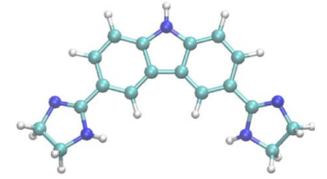
Literature Summary: Methods
System Selection and Preparation: A known DNA groove-binding ligand (3,6-bis(4,5-dihydro-1H-imidazol-2-yl)-9H-carbazole) was selected from literature, and the target B-DNA dodecamer (PDB ID: 195D) structure was cleaned by removing water molecules using UCSF Chimera.
Molecular Geometry Optimization: The ligand was optimized using Density Functional Theory (DFT) with the B3LYP functional and 6-31G basis set in Gaussian 09 to ensure minimum potential energy and accurate geometry.
Molecular Docking: AutoDock4 with the Lamarckian Genetic Algorithm was used for docking; the pose with the lowest binding affinity was selected for further simulation.
Molecular Dynamics Simulation Setup: GROMACS 5.1.1 was used to simulate the DNA-ligand complex for 100 ns using seven AMBER force fields. Ligand and DNA topologies were generated using ANTECHAMBER and GROMACS, respectively.
Simulation Environment and Execution: The complex was solvated with TIP3P water and neutralized with sodium ions,. Then, the system was equilibrated using NVT and NPT ensembles, PME handled long-range interactions, and the LINCS algorithm constrained hydrogen bonds.

Slide 4

Vague Methodology in the paper
System Selection and Preparation: Did not state where or how they obtained their ligand for the study.
Molecular Geometry Optimization: Literature states that DFT was performed on the ligand and although they do provide the functional and basis set used, they do not provide whether the calculations were performed in vacuum or not.
Molecular Docking: They performed docking studies utilizing AutoDock4, but they do not state what the dimensions for docking boundary box were used to implement docking.
Molecular Dynamics Simulation Setup: They stated that they made topology for the ligand using ANTECHAMBER but do not provide the code or the output files produced for this specific ligand.
Simulation Environment and Execution: There were some time inconsistencies where they stated that NVT equilibration step was ran for 50 seconds but the NPT equilibration step was run for 25,000 steps.

Slide 5
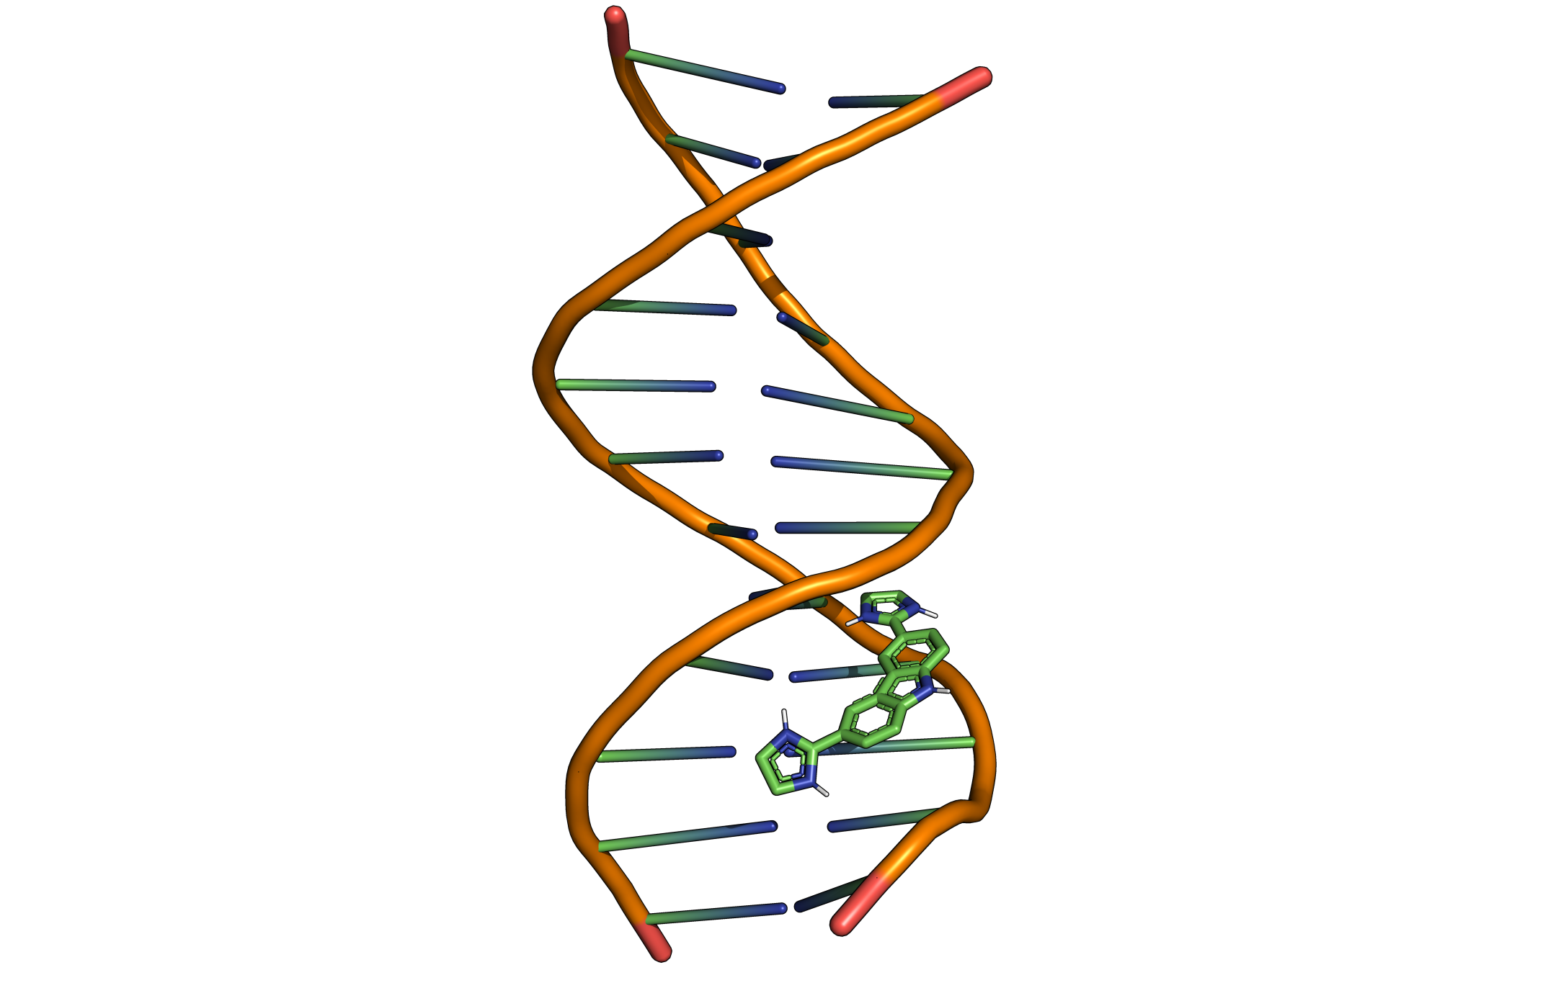
Our Proposed Modified Methodology
System Selection and Preparation:
3,6-bis(4,5-dihydro-1H-imidazol-2-yl)-9H-carbazole was loaded into WebMO and exported as a pdb.
Open Babel was utilized to convert the ligand PDB to a readable input file for Gaussian16.
The DNA crystal structure (PDB ID: 195D) was obtained from the Protein Data Bank and cleaned using PyMOL where water molecules and the original ligand are removed to achieve a DNA only pdb file.
Molecular Geometry Optimization:
Optimization was performed in an implicit water environment using the Self Consistent Reaction Field (SCRF) and the Polarizable Continuum Model (PCM) with the B3LYP functional and 6-31G Basis set.
Molecular Docking:
Using the geometry optimized ligand structure, the ligand was docked to the DNA using AutoDock4 MGLTools version1.5.6 & Vina 1.1.2
Box dimensions: [40 40 40]

Slide 6


Our Proposed Modified Methodology
Molecular Dynamics Simulation Setup
We provide a batch script that parametrizes the ligand using ANTECHAMBER, parmchk2, and the Amber Tools embedded code acpype.py
GROMACS 2024 was utilized to parameterize the DNA, generating the GROMACS files based on its respective forcefield
Forcefields used: Amber03, Amber94, Amber96, Amber99, Amber99sb, Amber99sb-IDLN, and Ambergs
The newly parameterized DNA and ligand coordinates were then combined to produce a fully bound complex with the correct coordinates, which was used as an input file for MD simulations
Simulation Environment and Execution
Energy Minimization was carried out for 50,000 steps
Constant number, volume, and temperature (NVT) equilibration was performed for 100 ps at 300K
Constant number, pressure, and temperature (NPT) equilibration was performed for 100 ps at 1 bar and 300K
Production run for the MD simulation was executed for 100 ns
A batch script for analysis was made utilizing GROMACS commands and python

Slide 7
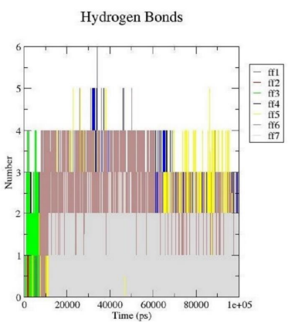
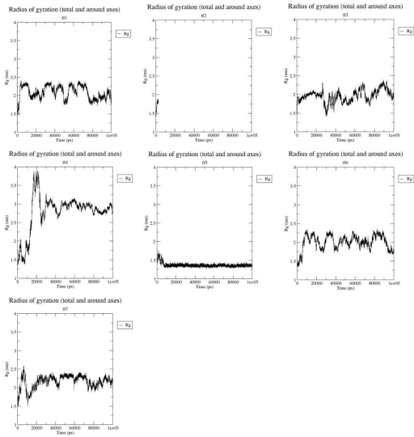
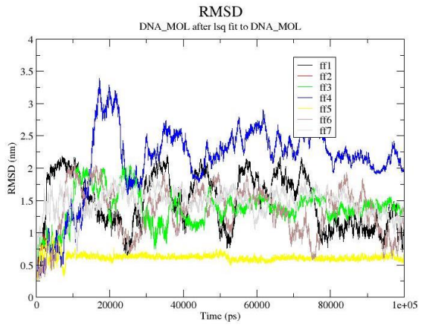
Results: Literature Graphs
Radius of Gyration
Root Mean Squared Deviation (RMSD)
Hydrogen Bonds

Slide 8
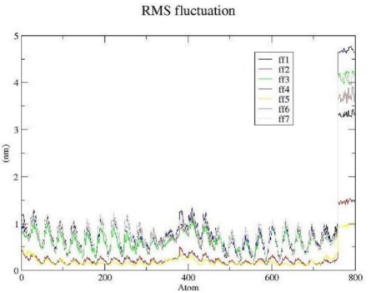
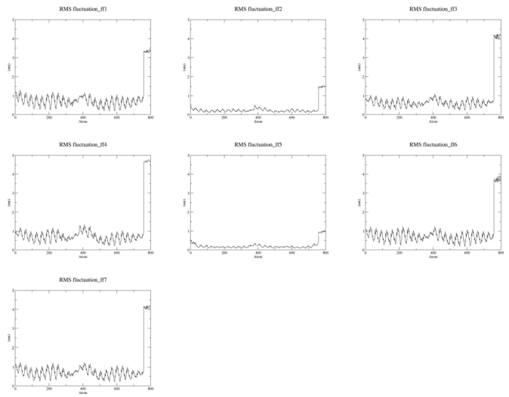
Results: Literature Graphs
Root Mean Squared Fluctuation (RMSF)

Slide 9
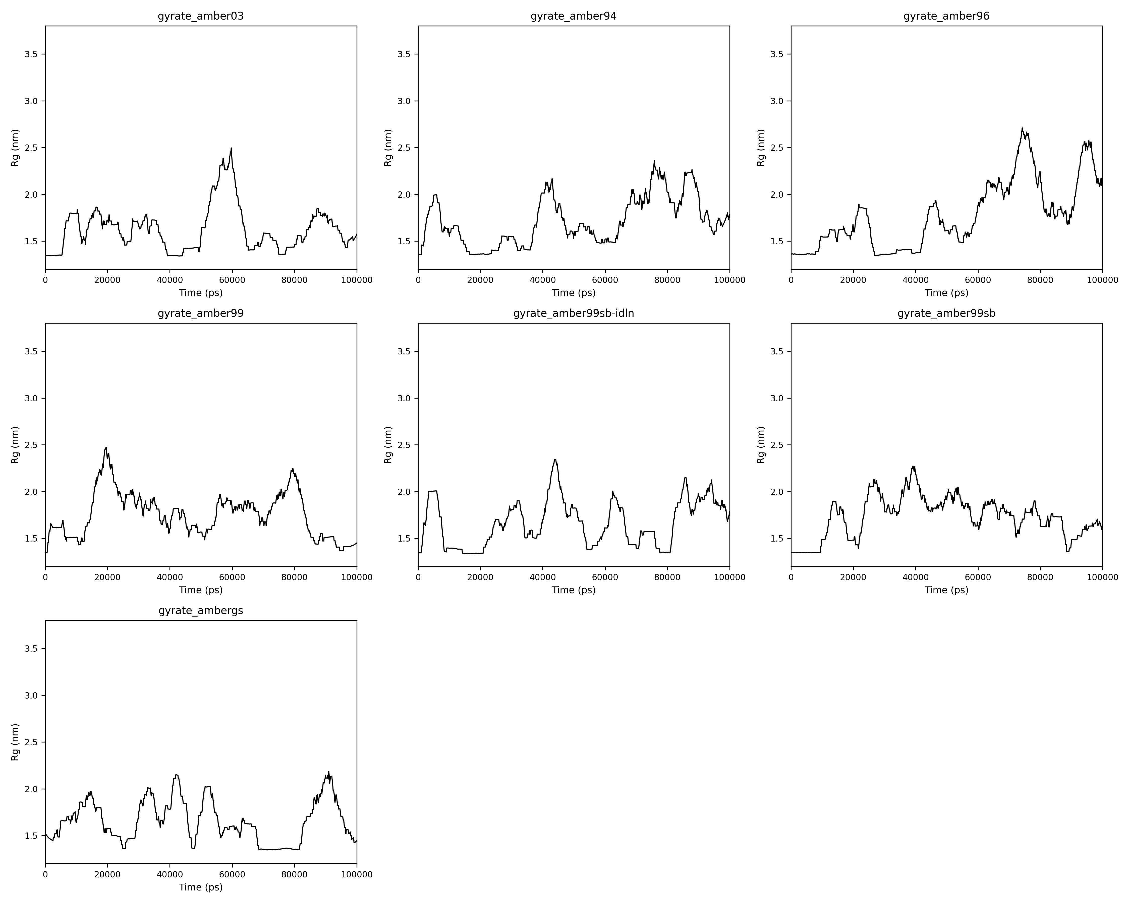
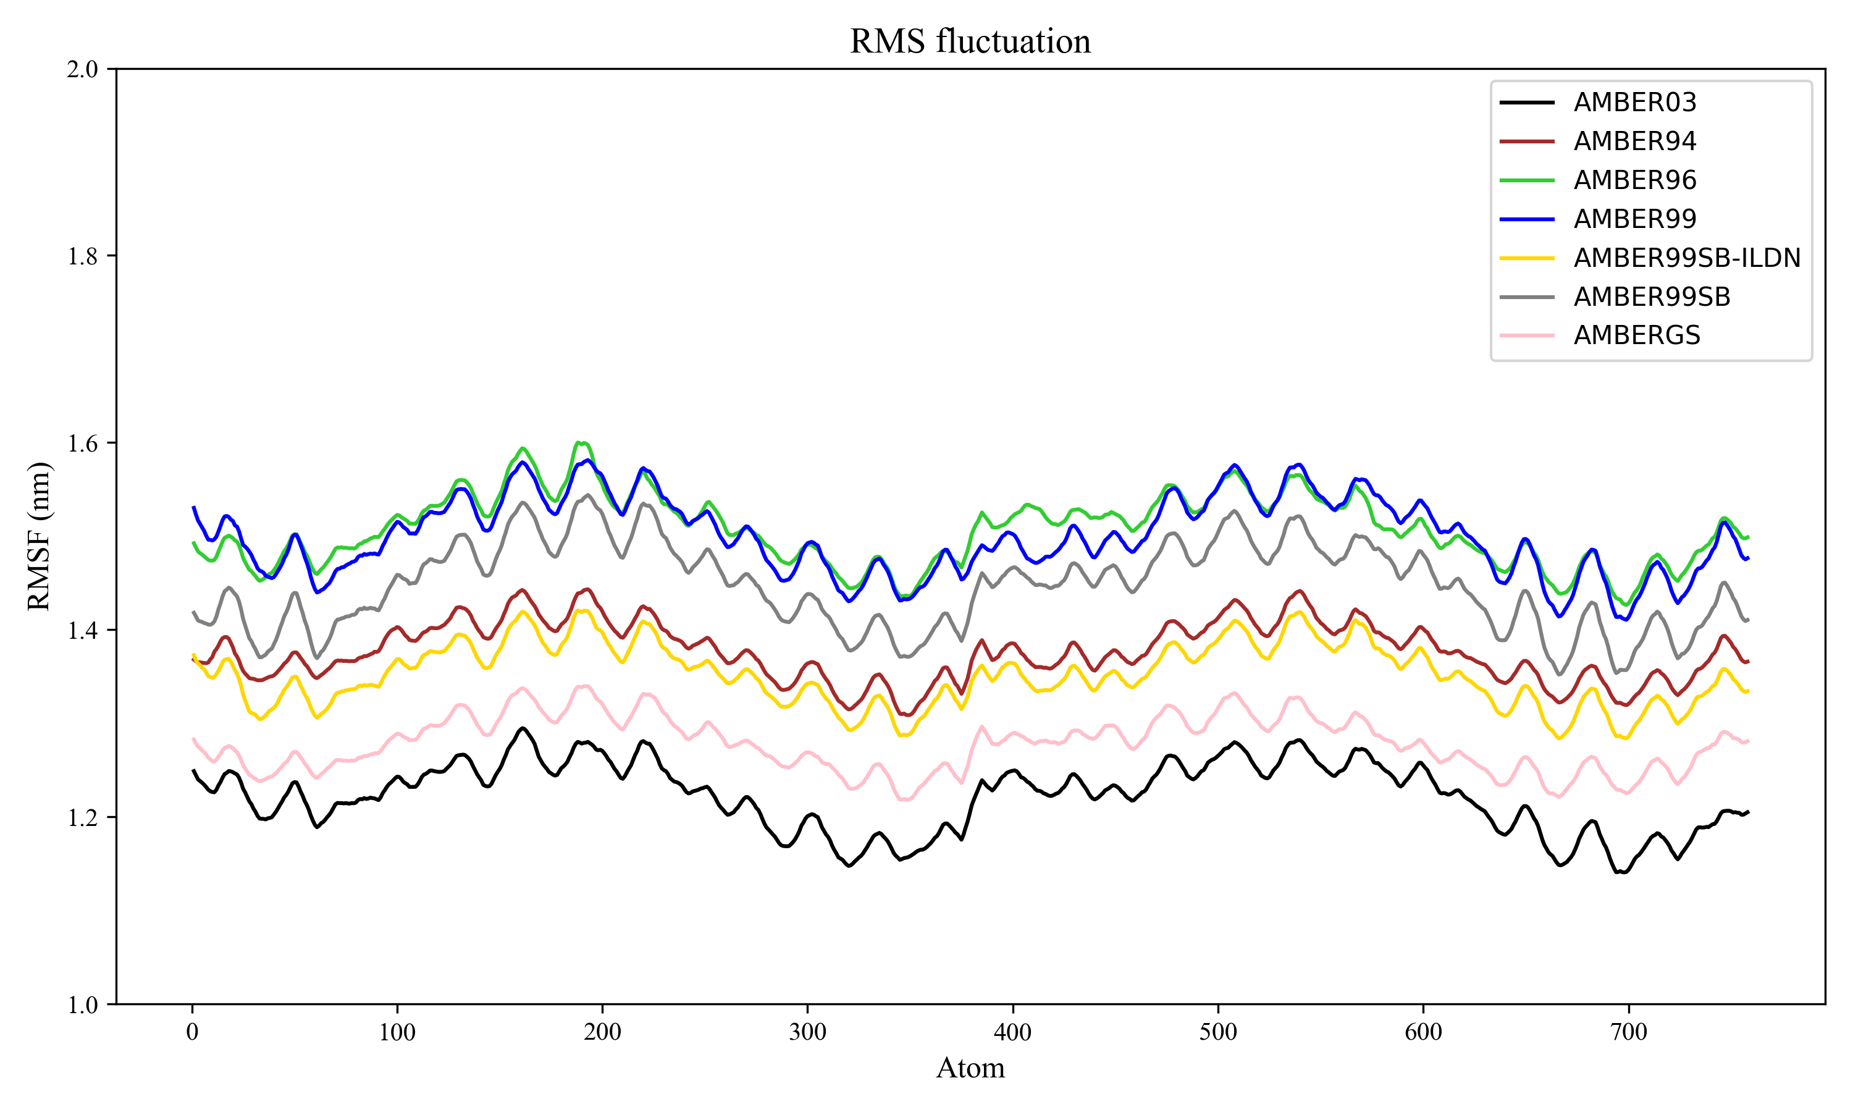
Results: Our Graphs
Radius of Gyration
Root Mean Squared Fluctuation (RMSF)

Slide 10
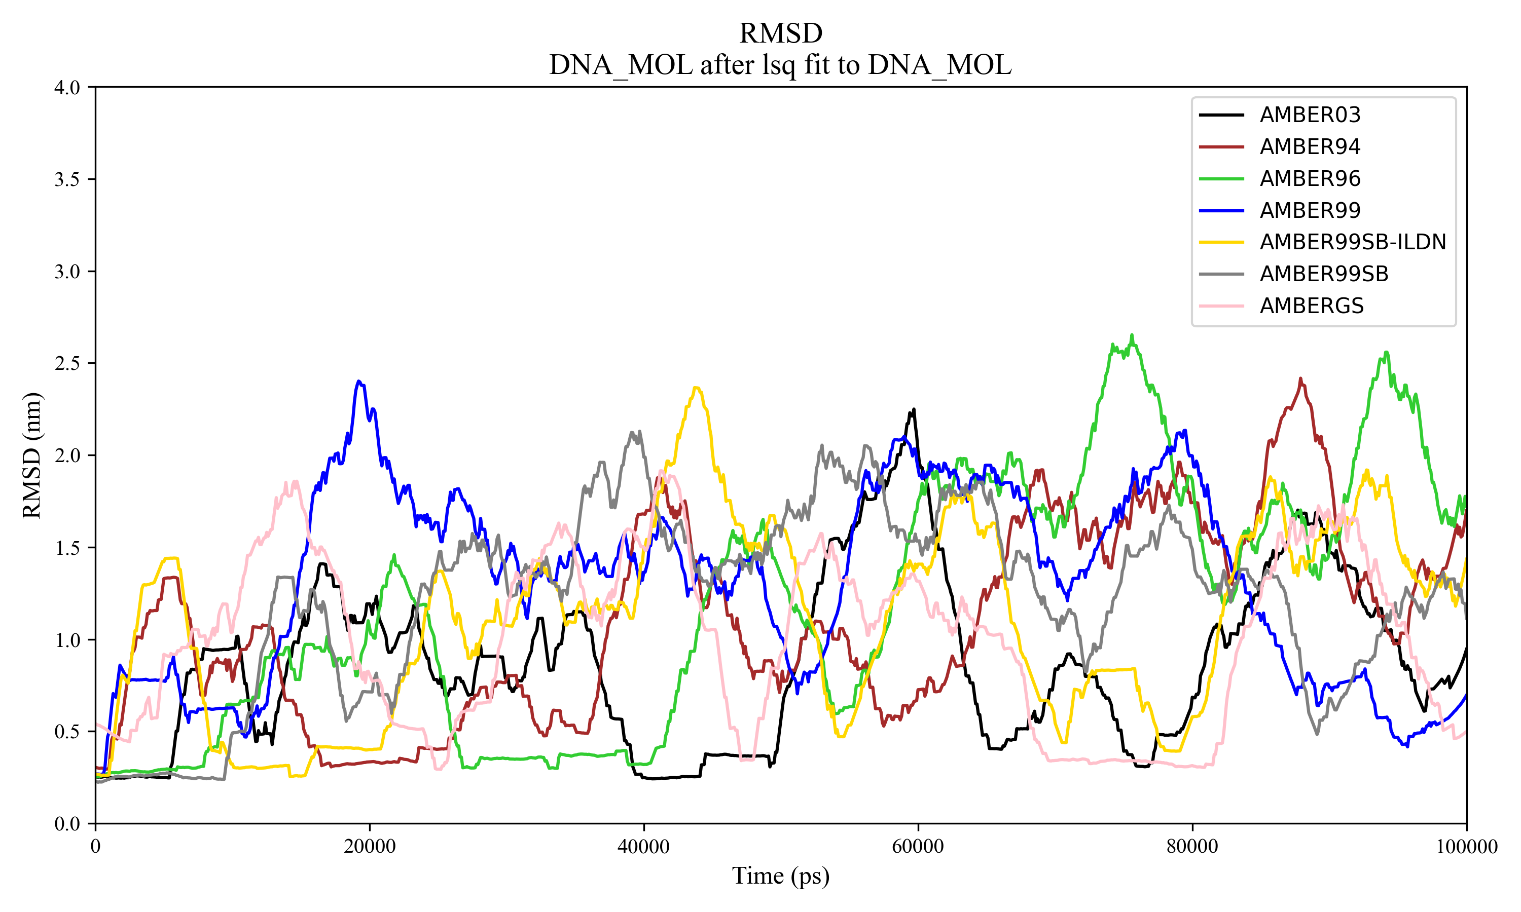
Results: Our Graphs
Root Mean Squared Deviation (RMSD)

Slide 11
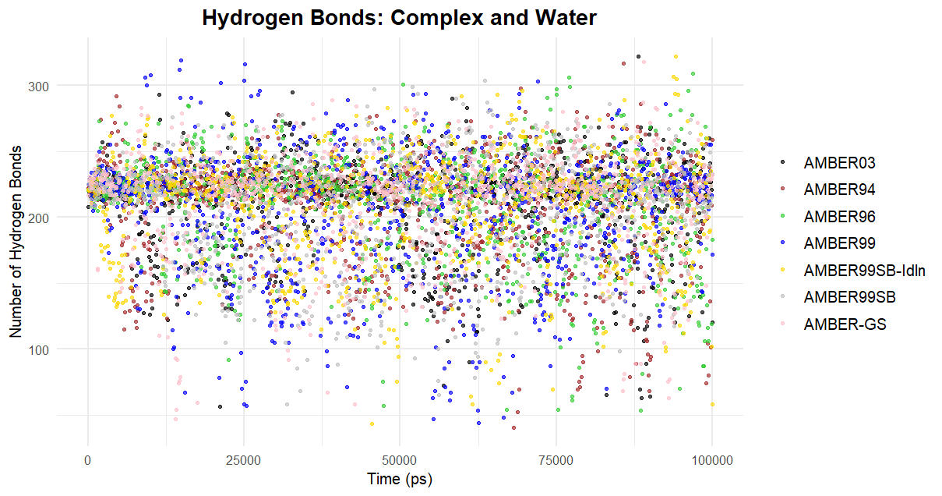
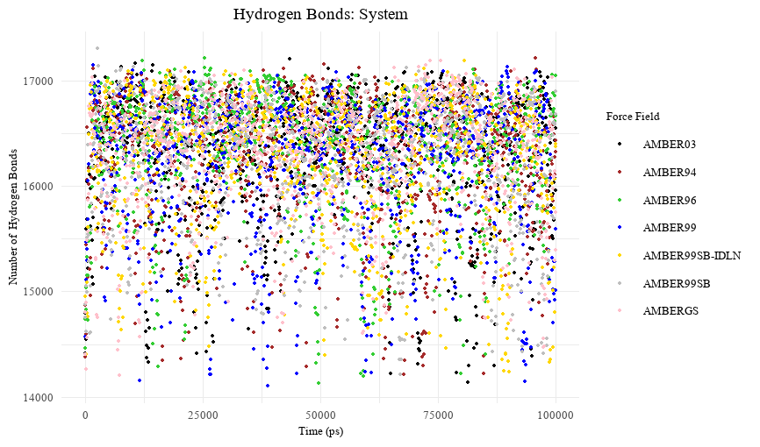
Results: Our Graphs
Hydrogen Bonds: Complex and Water
Hydrogen Bonds: System

Slide 12

Results: Our Graphs- Library used for plotting in python
os for file and directory management
glob for efficient file pattern matching
pandas for data manipulation and analysis
matplotlib.pyplot for comprehensive data visualization and plotting.

Slide 13
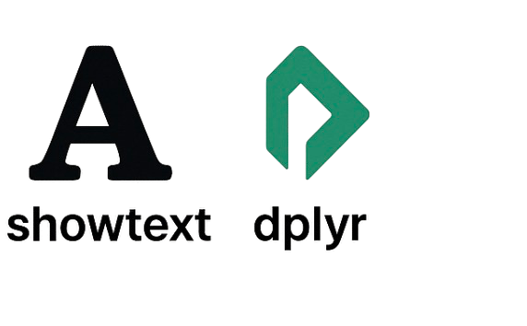
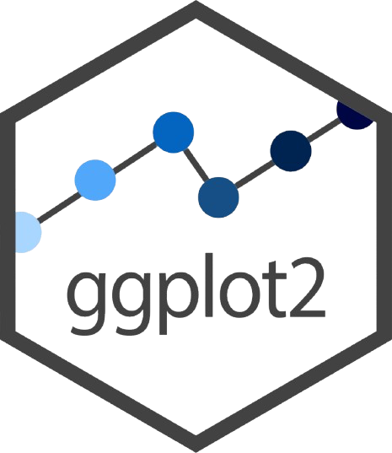
Results: Our Graphs- Library used for plotting in R
ggplot for creating high-quality, customizable plots
dplyr for data manipulation and transformation
showtext for enhance the appearance of text in plots by allowing the use of custom fonts

Slide 14
Questions?

