Slide 1


Decentralized Voting System on Ethereum Blockchain
Supervisor: Dr. Ramzi Saifan
Authors:
Mohammad Sohail Saleem Saleem 0193391
Omar Hussam Aldeen abdallah AlSheikhDurrah 0202652
The University of Jordan
School of Engineering – Department of Computer Engineering Date: June 3, 2025
Notes:
"Good morning/afternoon everyone. I'm Mohammad Sohail, and alongside my colleague Omar, we’ve developed a Decentralized Voting System built on the Ethereum blockchain, supervised by Dr. Ramzi Saifan. Let’s walk you through how blockchain can make voting secure and trustworthy."

Slide 2
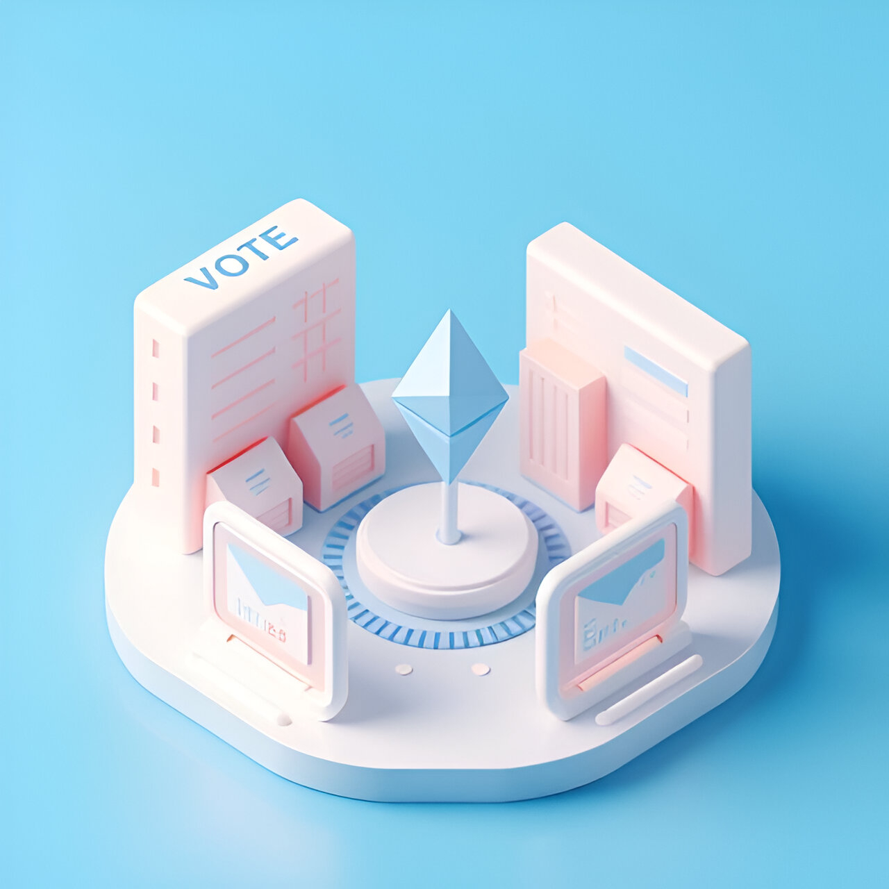
Executive Summary
Our project introduces a secure and transparent voting platform using Ethereum blockchain.
Traditional systems are vulnerable to fraud, manipulation, and lack of trust.
We address this with immutable smart contracts and role-based access control.
Voters log in securely, cast anonymous votes using hashed data, and see live results.
Admins manage blocs, while all votes are permanently stored on-chain — ensuring full integrity and transparency.
Notes:
“Let me start with a summary of what we built. This project introduces a secure and transparent blockchain voting system using Ethereum. Unlike traditional platforms — which are often centralized and easy to manipulate — we store every vote on-chain, meaning it can’t be changed or deleted later.
We use MetaMask for login and wallet connection. Once users log in, they vote anonymously using hashed data. The system instantly displays real-time results after voting, and because the data is public on the blockchain, it’s completely verifiable.
Admins can add or manage blocs, but they can’t touch the vote data itself — that’s protected by smart contract logic. So, voters control the process, not the system owners.”

Slide 3
Motivation & Problem Statement
Current electronic voting systems are often centralized, lacking transparency and prone to manipulation.
Public trust is undermined by the possibility of vote tampering and unverifiable results.
Traditional voting methods are also inefficient, slow to process, and not easily auditable.
Our project addresses these issues through a blockchain-based architecture that ensures security, integrity, and verifiability.
Notes:
Traditional voting systems are usually centralized, which means one organization controls everything. That makes the system vulnerable to fraud or manipulation — especially if no one’s watching.
This lack of transparency often leads to loss of trust. Voters can’t verify what really happened after they submit a vote. On top of that, traditional systems are slow, hard to audit, and can’t scale easily.
We wanted to solve all of that by using blockchain. It offers transparency, integrity, and security by design — and with smart contracts, the rules are enforced automatically, not by people.”

Slide 4
Blockchain Basics
Blockchain: A decentralized, immutable ledger
Ethereum: Allows for programmable contracts (smart contracts)
MetaMask: Browser extension that enables blockchain wallet interactions
Ethers.js: JavaScript library to interact with Ethereum in our frontend
Notes:
“To build our system, we relied on four key blockchain tools.
First, Blockchain itself. It’s a digital ledger — like a public notebook — where everyone can see the entries, and no one can change them once written.
Then we used Ethereum, which supports smart contracts. These are self-executing rules that handle all the voting logic automatically.
We integrated MetaMask, which is a browser extension that acts as a secure wallet. It lets users log in and sign transactions — without needing a traditional account.
And finally, we used Ethers.js, a JavaScript library that allows our frontend to talk directly to the Ethereum blockchain.”

Slide 5
Advantages of blockchain
Decentralization – Eliminates single points of failure and centralized control.
Transparency – All participants can view transactions, promoting openness and verifiability.
Immutability – Once data is written, it cannot be changed, ensuring vote integrity.
Security – Utilizes advanced cryptography to secure transactions.
Auditability – Transactions are recorded with timestamps, enabling traceable audits.
Notes:
“So why is blockchain the right fit for voting?
First, decentralization — it removes the need for a central authority. No single group can control the data.
Second, transparency — all transactions are visible on the public ledger. Anyone can verify the results at any time.
Third, immutability — once a vote is recorded, it can’t be changed or deleted. This protects against tampering.
Then there’s security — all data is protected with cryptography, making it nearly impossible to hack.
And finally, auditability — since every transaction is timestamped, the entire process can be reviewed step by step. Together, these features make blockchain a perfect match for fair and trustworthy elections.”

Slide 6
design

Slide 7
system interaction diagram
Data Base
Send query (for voting and login)
Receive response
Backend
Send Request
Frontend
Communication Just For Login Process
Blockchain
(Ganache)
Connect to blockchain for saving votes purpose
MetaMask Wallet
Connect to MetaMask to connect to blockchain
Figure 1: System Interaction Diagram
Notes:
“This diagram gives a high-level view of how the system components interact.
It starts with the frontend, where the user logs in or votes. The login process sends a request to the backend, which communicates with the database to check user credentials.
Once logged in, the user connects to the MetaMask wallet — this is key because all voting interactions are done directly between the frontend and the blockchain.
The backend is involved only in login and admin features — it never touches the votes.
The blockchain — in this case, Ganache — is where votes are written via smart contracts. So even if the backend is compromised, the votes remain safe and untampered.
This separation ensures maximum security and decentralization.”

Slide 8
System Architecture
Frontend: HTML, CSS, JavaScript, Chart.js
Backend: Node.js with Express.js
Database: MySQL
Blockchain: Ethereum smart contract, Ganache for local testing
Wallet: MetaMask integration
Notes:
“Now let’s look at the system’s main building blocks.
On the left, we have the frontend — this is the user interface. It’s responsible for login, displaying candidates, submitting votes, and rendering real-time results.
Next, the MetaMask wallet is integrated into the frontend. It allows users to sign transactions and send them securely to the blockchain.
In the middle, we have the backend. It handles login using JWT tokens and provides admin functionality like adding or editing blocs. But again, it does not touch the vote data.
Then we have the MySQL database, which stores user info, bloc details, and admin data — but not votes.
Finally, the Ethereum blockchain is where voting happens. The smart contract stores hashed votes permanently and ensures one vote per user.”

Slide 9
System Architecture
No
Start
Admin or user?
If User
Login successful?
Yes
User selects
Primary college
Sub college
User visit the website
Display the login page
If Admin
Add new college
Change the name of the college
You can view the chart
MetaMask && Enough gas
First time ?
You can view the chart
You voted successfully
Yes
Yes
No
No
You must install MetaMask Or check the gas
You have already voted
Figure 2: Login and Voting Flow for Users and Admins in the Blockchain Voting System
Notes:
“This chart walks through the full process from both the user and admin perspectives.
On the left, the user starts by visiting the website and logging in using their email and password.
Once logged in, the system checks: is it the first time this user is logging in? If yes, they’re asked to install MetaMask and make sure they have gas.
After successful wallet connection, the user selects a university bloc and a college bloc, then submits their vote. These votes are hashed and sent directly to the smart contract.
The user then sees live results rendered from the blockchain — no backend involvement.
On the admin side, the flow is slightly different. The admin logs in and gets access to additional options like adding, editing, or deleting blocs.
They can also monitor charts and results, which are updated in real time from the blockchain and displayed through Chart.js.
This flow ensures a clear separation of roles, and it maintains decentralization and data integrity throughout.”

Slide 10
Implementation

Slide 11
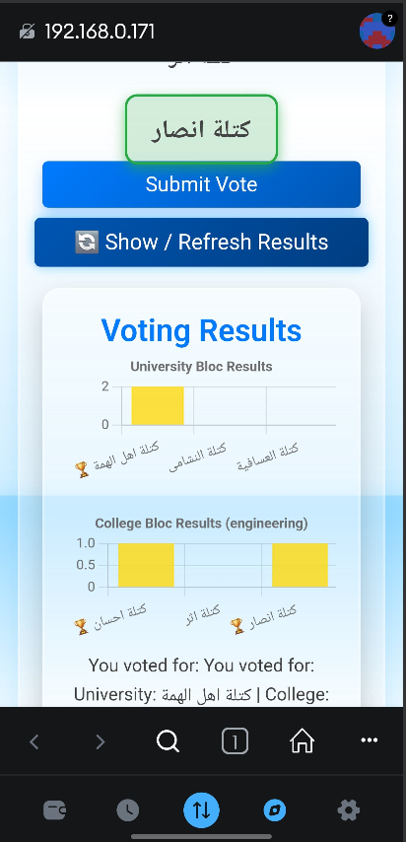
User Interface (Frontend)
Clean and responsive UI designed with accessibility and minimalism in mind.
Login screen integrates with MetaMask for secure identity verification and Ethereum account binding.
The interface is designed to be fully compatible across various devices, including laptops, tablets, and smartphones.
The system provides immediate visual confirmation after successful vote submission, enhancing user trust and improving the overall voting experience.
Figure 3: Mobile User Interface Displaying Voting Results
Notes:
“This is the main voting interface users interact with. We designed it to be clean and responsive, so it works well on both desktop and mobile. When users log in, they’re asked to connect their MetaMask wallet — which ties their Ethereum address to their session.
The voting page includes options to select both university and college blocs. After casting their votes, users get visual confirmation and instantly see updated vote results from the blockchain. Everything is handled on the frontend, and the experience is smooth and interactive.”

Slide 12

Backend API Functionality
Handles user login,
Utilizes JWT (JSON Web Token) for secure, token-based authentication.
Does not handle voting — votes are sent directly from frontend to blockchain
Provides admin-only routes for managing university and college blocs (add, edit).
Notes:
“The backend is focused on login and admin features. It handles user authentication using JWT — JSON Web Tokens — to secure session data.
However, the voting process is not handled by the backend. Votes go directly from the frontend to the blockchain using Ethers.js.
The backend is only used to manage university and college blocs, and only admins can access those routes. This separation adds security and keeps vote handling truly decentralized.”

Slide 13
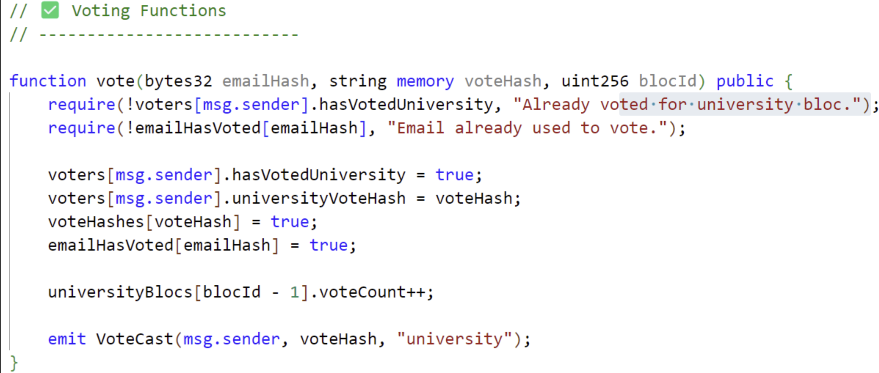
Smart Contract Design
Developed in Solidity, deployed on Ethereum-compatible network.
Implements two main functions:
vote() for university bloc voting
voteCollegeBloc() for college-specific bloc voting
Preventing the same student to vote from different wallet by passing the EmailHash as a parameter
Figure 4: Voting code using solidity
Notes:
“Our smart contract was written in Solidity and deployed on an Ethereum-compatible test network. It includes two voting functions: vote() for university blocs and voteCollegeBloc() for college blocs.
To prevent someone from voting more than once — even using different wallets — we hash the user’s email. This emailHash is sent to the contract and stored after voting. If a duplicate is detected, the contract blocks it.
This ensures one person can only vote once, and the contract logic makes it impossible to bypass.”

Slide 14
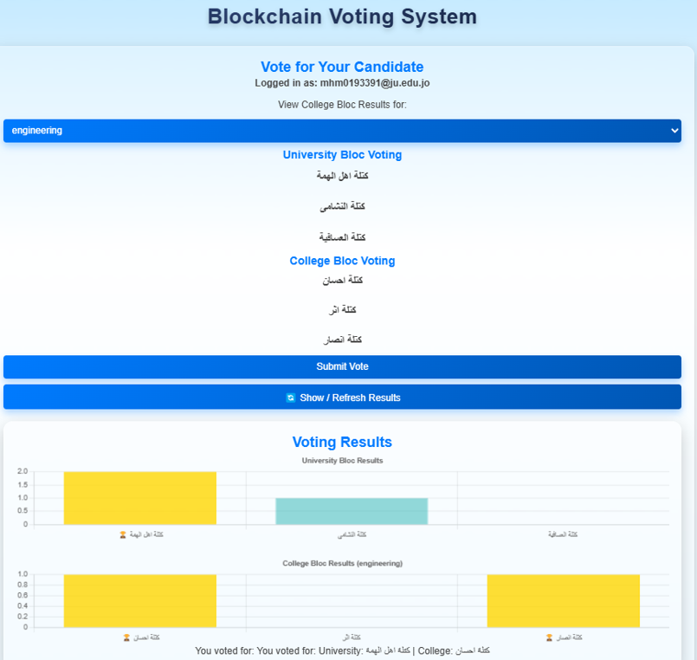
Voting Result Charts (User View)
Displays real-time voting results for university and college blocs.
Users can view updated vote counts immediately after submission.
Charts are generated using Chart.js with smooth transitions and winner highlighting.
The interface allows toggling between different college blocs via dropdown.
Figure 5: User Voting Interface
Notes:
“Once a vote is cast, users immediately see the updated vote results on the same screen.
We use Chart.js to display real-time results for both university and college blocs.
The charts are clean, animated, and highlight the current winner. There’s also a dropdown to switch between colleges so users can view results specific to their faculty.
Since results are pulled from the blockchain, they reflect the true state of votes — nothing is faked or cached.”

Slide 15
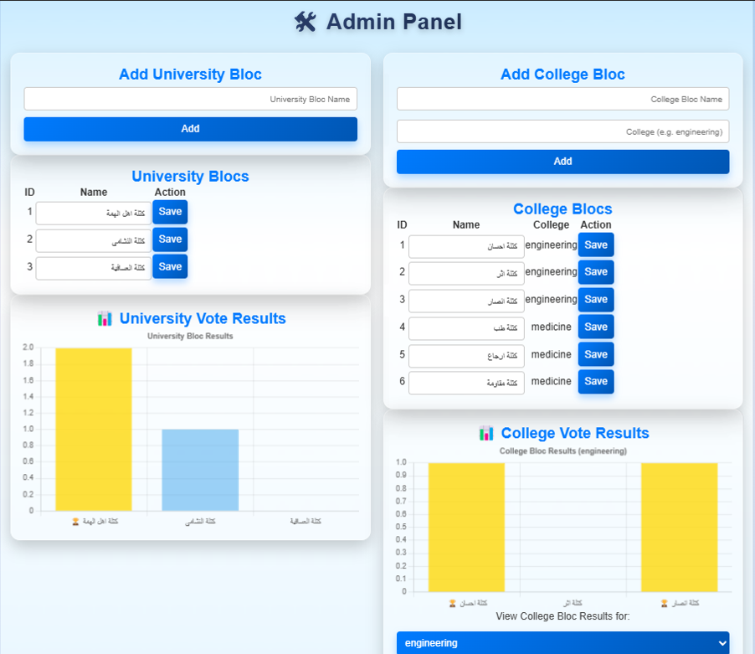
Admin Panel Features
Enables admins to add and edit university and college blocs.
Supports college-based filtering to view bloc-specific vote results.
Displays responsive charts that update automatically after voting events.
Ensures real-time syncing between the database and blockchain smart contract.
Role-based access control restricts visibility of this panel to admin users only.
Figure 6: Admin Result Dashboard
Notes:
“The admin panel is separate from the user interface. Admins can add, edit, or delete blocs using simple forms.
There’s also a dropdown to filter college-specific results and a real-time chart area that updates after each voting event.
The system keeps the database and smart contract in sync, and only admins have access through role-based login.
This gives admins the ability to manage the system but not alter votes — preserving transparency.”

Slide 16
Impressive features
Fully responsive interface optimized for desktop and mobile platforms
Toggleable dark/light themes with smooth CSS transitions
Glass morphism-inspired UI providing modern, visually appealing aesthetics
Interactive elements, including animated buttons and floating cards for enhanced user experience
Notes:
“We also added features to make the interface more modern and engaging.
The UI is fully responsive, so it adapts to any screen size.
Users can switch between dark and light themes with a single button.
We applied glassmorphism styling to enhance the visuals — and added interactive elements like floating cards and button animations.
These enhancements improve usability and create a better user experience.”

Slide 17

Security & Integrity
Users passwords are stored as a hash in the database
Voter emails are hashed before interacting with the blockchain to ensure privacy.
Votes are hashed before submission to enhance data protection.
Smart contract logic enforces one-vote-per-user by tracking voting status.
Notes:
“Security was a major focus in our system.
User passwords are hashed in the database.
Voter emails are hashed before being sent to the blockchain.
The votes themselves are salted and hashed, so they’re unreadable even if intercepted.
Finally, our smart contract logic ensures one vote per person, with all voting activity stored permanently on-chain.
This combination makes the system secure, private, and tamper-proof.”

Slide 18
Live demonstration

Slide 19
Live Demonstration
Step 1: Log in using MetaMask and registered email address
Step 2: Cast votes for both university and college blocs
Step 3: View real-time vote distribution via dynamic Chart.js graphs
Step 4: Log in as admin to manage blocs and analyze election results
Notes:
“Now I’ll demonstrate how our system works, step by step.”
🔹 Step 1: Log in using MetaMask and registered email
“First, the user enters their email and password on the login page. Once authenticated, the system asks them to connect to MetaMask. This links their Ethereum wallet for secure voting.”
🔹 Step 2: Cast votes for university and college blocs
“After logging in, the user sees the list of available university blocs and college blocs. They choose one of each, then hit submit. Behind the scenes, the vote is hashed and sent directly to the blockchain.”
🔹 Step 3: View real-time vote results
“After voting, the user sees updated Chart.js graphs showing the live vote counts. The winner is highlighted, and results are refreshed instantly from the blockchain — not the backend.”
🔹 Step 4: Log in as admin to manage blocs and view results
“Now we’ll switch to the admin panel. Here, the admin can add or edit blocs and view charts filtered by college. Only admins can see this panel, and all interactions are reflected live on the blockchain and frontend charts.”

Slide 20

Challenges Faced
Requires a Web3 wallet (e.g., MetaMask), unlike traditional systems
MetaMask transaction delays and user rejections during signing or gas confirmation
Scalability: At present, the system operates in a local environment, which limits its ability to handle large-scale or distributed deployments.
Notes:
“Like any project, we encountered some challenges.
First, the system requires a Web3 wallet like MetaMask, which is unfamiliar to some users and adds a bit of learning curve.
We also faced transaction delays and user rejections in MetaMask, especially when users weren’t familiar with signing or confirming gas fees.
Lastly, the system currently runs in a local environment, which means it’s not yet ready to scale to national-level elections. However, it’s built in a way that makes scaling and public deployment possible later.”

Slide 21
Future Enhancements
Generalize the system to be useable for other organizations
Introduce email-based verification codes to prevent fraudulent participation
Upgrade deployment to a public Ethereum or Polygon network for scalability and decentralization
Notes:
“Looking ahead, we have several enhancements in mind.
We plan to deploy the system on a public Ethereum or Polygon network — this will allow full decentralization and real-world usage.
We also want to integrate zero-knowledge proofs (zk-SNARKs) to protect user privacy while still proving the vote happened.
Another improvement is email-based verification codes to prevent fake logins or double accounts.
Finally, we want to generalize this system so it can be used by universities, companies, or even government agencies.”

Slide 22
Conclusions & Q/A
Blockchain can solve key issues in traditional voting systems — such as fraud, lack of transparency, and trust.
Our system uses smart contract logic to ensure one vote per person, with immutable storage.
The interface is user-friendly, supports real-time vote tracking, and works across all devices.
We’ve created a scalable, tamper-proof voting platform ready for use in educational and organizational settings.
Notes:
“To wrap up, here are the main conclusions from our project:
Blockchain helps solve some of the biggest problems in voting — like tampering and lack of trust.
Our smart contract ensures only one vote per person, and that vote can’t be changed.
The interface is simple, responsive, and gives live results to increase transparency.
Overall, we’ve developed a secure, tamper-proof voting system that can be applied in schools, universities, or organizations.

Slide 23

Thank You for Your Attention
We appreciate your time and interest in our project. Questions and feedback are welcome.
Notes:
“Thank you for your attention. We really appreciate the opportunity to present this project. Your feedback is welcome!”

