Slide 1
Coding for DNA storage
Shubham Chandak, Kedar Tatwawadi
EE 388 course project

Slide 2
Outline
DNA storage model
Capacity computation
Two coding strategies
Experimental results
Conclusion and future work

Slide 3
DNA storage
DNA as a storage medium
High density: 215 petabytes/gram¹
High durability²
Synthesis (writing) and sequencing (reading) error-prone and expensive
Error correction needed for reliable data recovery

Slide 4
Storage model I
P
P
Binary data
Encoding
Reading
Decode
Binary data
Pool of distinct
short DNA sequences
(~150 nucleotides)
“Reads”
sampled with
replacement
+
substitution errors
Notes:
Rough sizes of data 1 GB, short – 100s
Define reads

Slide 5
Storage model II
For this talk:
Ignore DNA symbols and constraints – work with binary sequences
Assume that the index of each sequence is transmitted without error
Notes:
Figure to represent model. Color/number to represent index in sampling process.
Index in reads.
Define c = coverage
Reading/writing tradeoff – define alpha

Slide 6


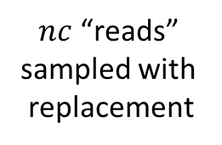
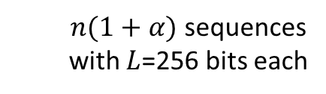
Storage model II
P
P
P
1
4
4
2
2
2
$nL$ information bits
3
7
7
Encoding
.
.
.
.
.
.
BSC($ε$)
.
.
.
2
2
$n(1+α)$ sequences
with $L$=256 bits each
$nc$ “reads”
sampled with
replacement
Noisy
reads
Notes:
Figure to represent model. Color/number to represent index in sampling process.
Index in reads.
Define c = coverage
Reading/writing tradeoff – define alpha

Slide 7
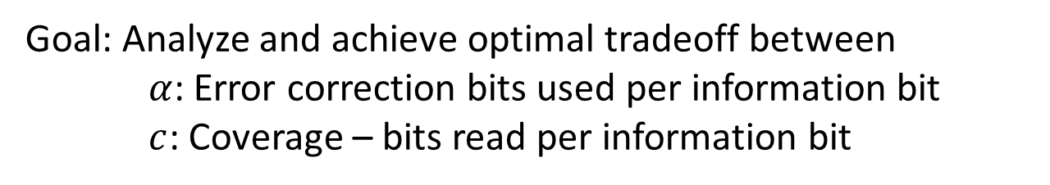
Storage model II
P
P
P
1
4
4
2
2
2
$nL$ information bits
3
7
7
Encoding
.
.
.
.
.
.
BSC($ε$)
.
.
.
2
2
$n(1+α)$ sequences
with $L$=256 bits each
$nc$ “reads”
sampled with
replacement
Noisy
reads
Goal: Analyze and achieve optimal tradeoff between
$α$: Error correction bits used per information bit
$c$: Coverage – bits read per information bit
Notes:
Figure to represent model. Color/number to represent index in sampling process.
Index in reads.
Define c = coverage
Reading/writing tradeoff – define alpha

Slide 8

Capacity: error free reads
Let $λ=c/(1+α)$
Poisson model: Erasure channel over $L$ bit strings with erasure probability $e^{−λ}$
Notes:
Missing reads because of sampling reads

Slide 9

Capacity: error free reads
Let $λ=c/(1+α)$
Poisson model: Erasure channel over $L$ bit strings with erasure probability $e^{−λ}$
Rate = $\frac{1}{1+α}≤1−e^{−λ}$
$c≥\left(1+α\right)\log_{e}{\frac{1+α}{α}}$
Notes:
Missing reads because of sampling reads

Slide 10
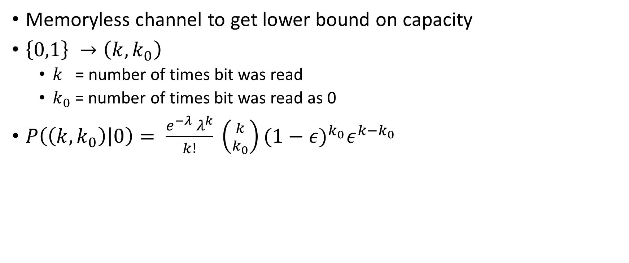

Capacity: BSC($ε$)
Memoryless channel to get lower bound on capacity
$\left\{0,1\right\} →\left(k,k_{0}\right)$
$k$ = number of times bit was read
$k_{0}$ = number of times bit was read as 0
$P\left(\left(k,k_{0}\right) | 0\right)= \frac{e^{−λ }λ^{k}}{k!} \left({k \atop k_{0}}\right){(1−ε)}^{k_{0}}ε^{k−k_{0}}$

Slide 11
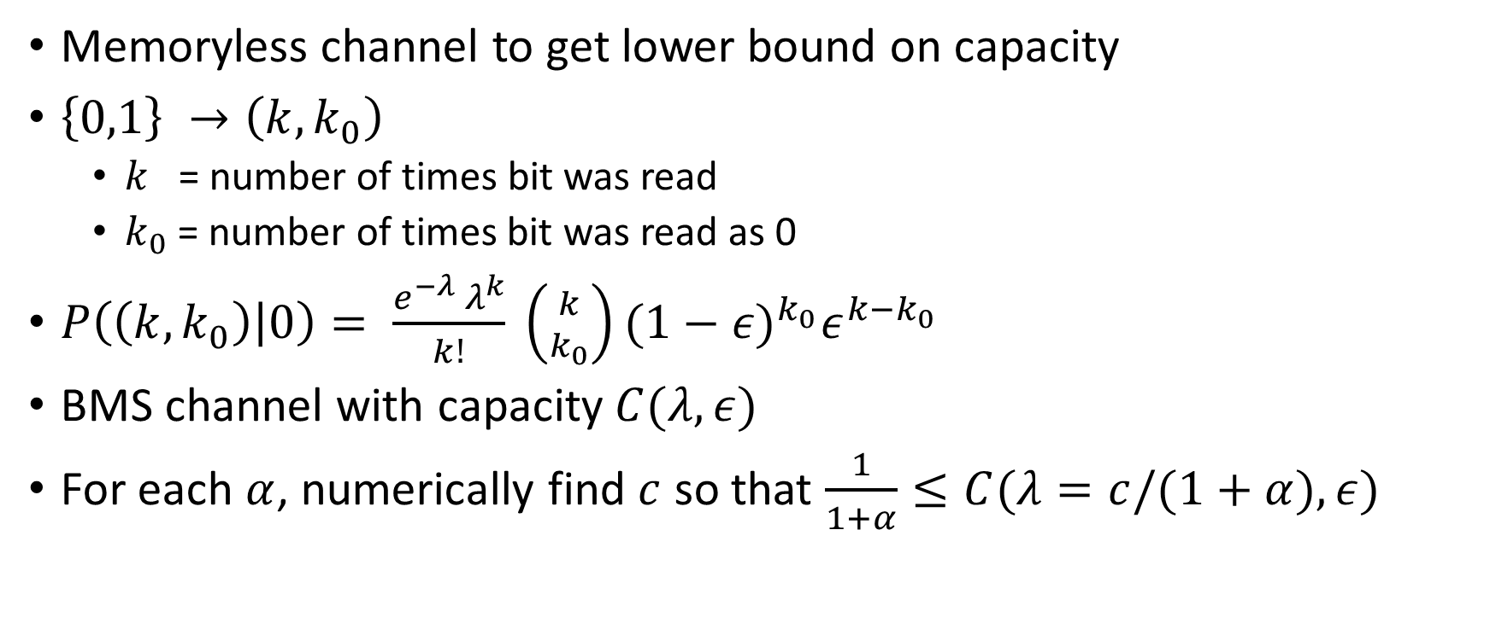
Capacity: BSC($ε$)
Memoryless channel to get lower bound on capacity
$\left\{0,1\right\} →\left(k,k_{0}\right)$
$k$ = number of times bit was read
$k_{0}$ = number of times bit was read as 0
$P\left(\left(k,k_{0}\right) | 0\right)= \frac{e^{−λ }λ^{k}}{k!} \left({k \atop k_{0}}\right){(1−ε)}^{k_{0}}ε^{k−k_{0}}$
BMS channel with capacity $C(λ,ε)$
For each $α$, numerically find $c$ so that $\frac{1}{1+α}≤C(λ=c/(1+α),ε)$

Slide 12
Capacity plot

Slide 13
Coding strategy I: RaptorQ + BCH
RaptorQ¹
Rateless erasure code
For K source packets: 99.9999% probability of recovery given K+2 packets
BCH²: Good minimum distance properties
Encoding
Decoding: Consensus -> BCH decoding -> Raptor decoding
Segment
RaptorQ
BCH
nL bits

Slide 14
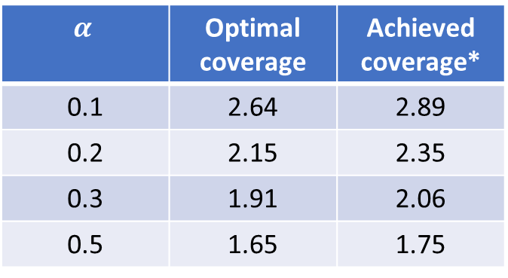

Coding strategy I: results
$$n=1000, ε=0\%$$
$$α$$ | Optimal coverage | Achieved coverage*
0.1 | 2.64 | 2.89
0.2 | 2.15 | 2.35
0.3 | 1.91 | 2.06
0.5 | 1.65 | 1.75

Slide 15

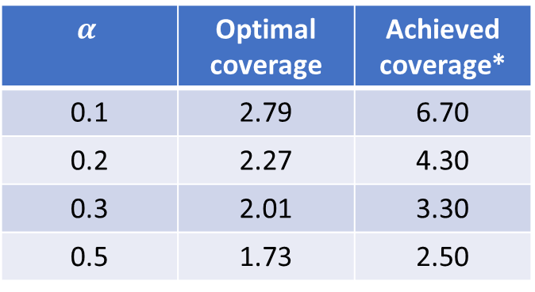
Coding strategy I: results
$$n=1000, ε=0\%$$
$$n=1000, ε=0.5\%$$
$$α$$ | Optimal coverage | Achieved coverage*
0.1 | 2.64 | 2.89
0.2 | 2.15 | 2.35
0.3 | 1.91 | 2.06
0.5 | 1.65 | 1.75
$$α$$ | Optimal coverage | Achieved coverage*
0.1 | 2.79 | 6.70
0.2 | 2.27 | 4.30
0.3 | 2.01 | 3.30
0.5 | 1.73 | 2.50

Slide 16
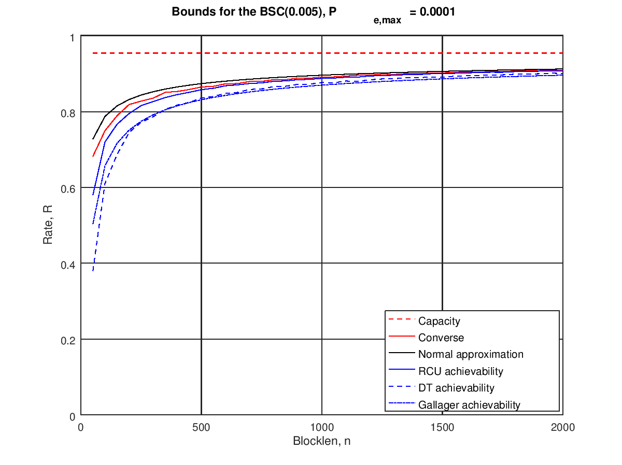
Limitations of small block length codes

Slide 17


Coding strategy II: LDPC
LLR = $\left(2k_{0}−k\right)\log_{e}{\frac{1−ε}{ε}}$
$k$ = number of times bit was read
$k_{0}$ = number of times bit was read as 0
Regular LDPC
LDPC
Segment
nL bits
n($1+α$)L bits

Slide 18

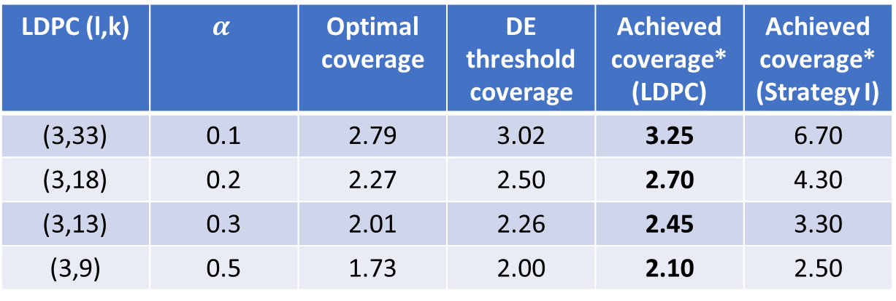
Coding strategy II: results I
$$n=1000, ε=0.5\%$$
LDPC (l,k) | $$α$$ | Optimal coverage | DE threshold coverage | Achieved coverage* (LDPC) | Achieved coverage* (Strategy I)
(3,33) | 0.1 | 2.79 | 3.02 | 3.25 | 6.70
(3,18) | 0.2 | 2.27 | 2.50 | 2.70 | 4.30
(3,13) | 0.3 | 2.01 | 2.26 | 2.45 | 3.30
(3,9) | 0.5 | 1.73 | 2.00 | 2.10 | 2.50

Slide 19
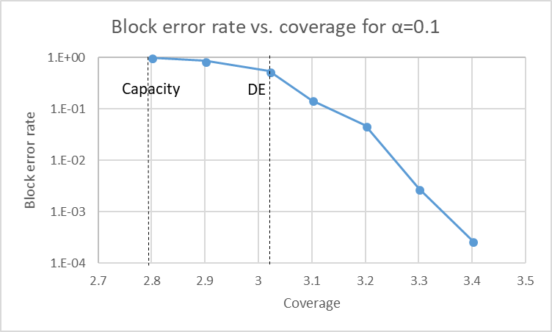
Coding strategy II: results II

Slide 20
Conclusion and future work
Analyzed DNA storage problem for simplified model
Implemented schemes to achieve close-to-optimum performance

Slide 21
Conclusion and future work
Analyzed DNA storage problem for simplified model
Implemented schemes to achieve close-to-optimum performance
Adding index to segments
Protect index with BCH code
Converting binary data to DNA symbols {A, C, G, T}
Constraint: Runs of 3 or more not allowed, e.g., AAA
Interaction between error correction and constraint coding
Exploiting non-IID noise in reads

Slide 22
Thank You!

