Slide 1



Tutorial: Incorporating CVA5, a Highly Configurable RISC-V Soft Processor, into Your FPGA Designs
Reconfigurable Computing Lab
Friday, March 14, 2025
Author:Mohammad Asadi; Presenter: Lesley Shannon
msa417@sfu.ca

Slide 2
FPGAs and Soft Processors
FPGAs commonly have soft processors provided by the vendors, but they are not open source
The ability to port and adapt a processor’s architecture is valuable for industry, research and education
RISCV is an open source ISA with significant a significant open source ecosystem
However, most RISCV processors target ASICs

Slide 3
Our Goal
FPGAs provide an excellent platform for heterogeneous computing systems research, including architectural integration and system software.
Our goal: To provide a vendor independent framework for heterogeneous system design and research on FPGAs.
Our Solution: CVA5 (aka Taiga)

Slide 4
Intro to CVA5
CVA5: A 32-bit RISC-V soft processor designed and optimized for FPGAs.
TRL-4 - goal TRL5
Resource Efficient
High Performance: Achieves up to 250 MHz on UltraScale+ FPGAs (single-core).
Highly Configurable: Can be tailored to different use cases.

Slide 5
Goal and Use Cases
Use Cases:
Research & Education – A flexible platform for academic studies and teaching.
Supports OS Development – Enables experimentation and innovation in operating systems
Accelerator Integration – Supports both tightly and loosely coupled accelerators on FPGAs.
Goal:
Enable efficient heterogeneous SoC designs on FPGAs

Slide 6
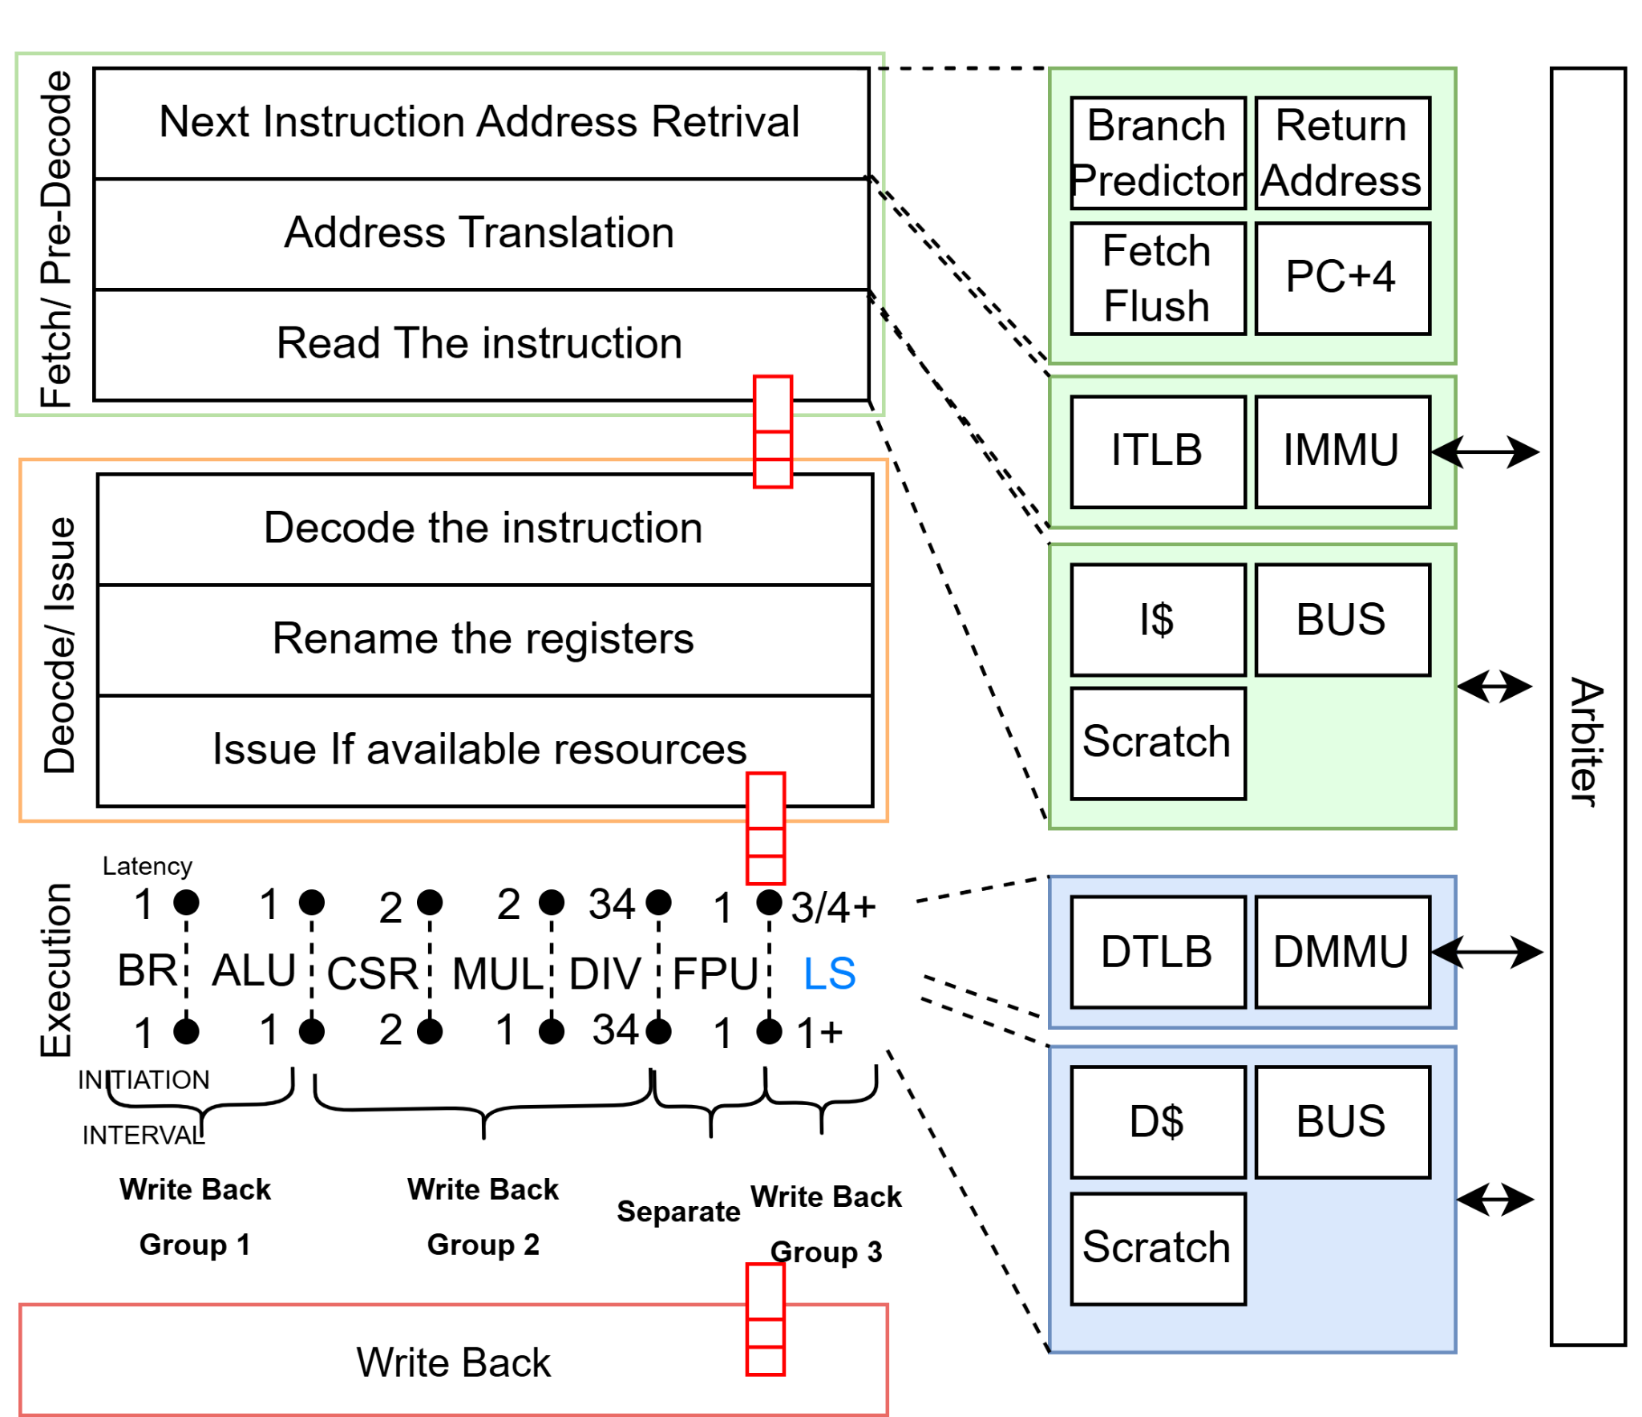
High Level View
Fetch
Decode
Memory Access
Execute
Write Back

Slide 7
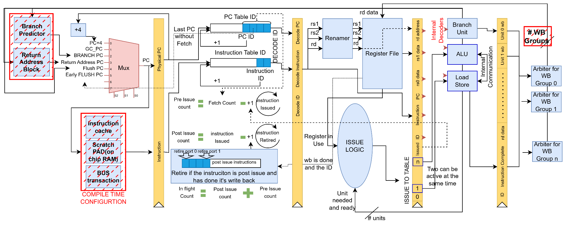
RISC-V I
Fetch
ID Assignment
Decode/Issue
Execute
Write back

Slide 8
Minimum Configuration
The minimum configuration supports only the 'I' extension of RISC-V (integer instructions).
Inclusion of the branch predictor and return address stack is configurable.
Memory access options are user-configurable: choose between cache, direct bus connection, or scratchpad (on-chip memory).

Slide 9
Changing the CPU Configuration
Changing CPU Configuration

Slide 10
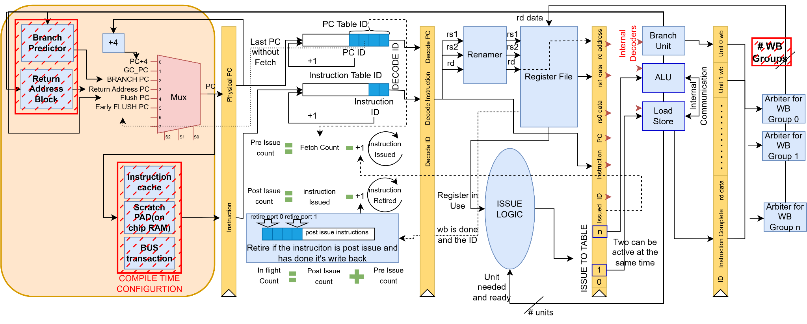
Fetch
Fetch
ID Assignment
Decode/Issue
Execute
Write back

Slide 11
Fetch PC
In these cases we use the PC+4
No Branch Prediction
No Interrupt
No Flush
PC+4
MUX
Register
PC

Slide 12
Fetch PC
Branch Predictor predict a return instruction.
The PC get updated from the return address block
PC+4
Return Address PC
Predicted
Return
MUX
Register
PC

Slide 13
Return Address Block
Return Address Stack
Branch Predictor predicts a call instruction.
PUSH
Current PC+4
0x0fdc
0x0fdc
0x00c8
0x00c8
0x0004
0x0004

Slide 14
Return Address Block
Return Address Stack
Branch Predictor predicts a return instruction.
POP
Use this for the next instruction to jump to
Current PC+4
0x0fdc
0x0fdc
0x00c8
0x00c8
0x0004
0x0004

Slide 15
Fetch PC
Branch prediction does not take effect on the first iteration.
Branch Block sends data to the Branch Predictor.
Branch Predictor stores the Program Counter (PC).
On the next call, if the address exists as a branch or call in the Branch Predictor, the saved data is used.
PC+4
Return Address PC
Branch Predictor PC
Predicted
Return
MUX
Register
PC

Slide 16
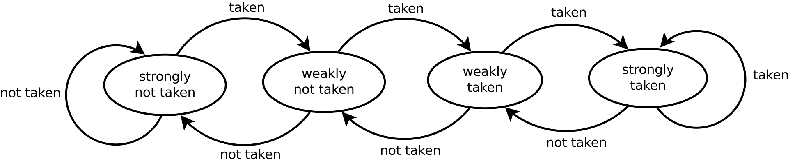
Branch Predictor
Tag bank to see if to accept the branch or not
Hashed PC
Next PC
ways
Address
Address
Tag
Valid
Is Return
Is Call
Is Branch
metadata
Branch Unit
Fetch
Data
Tag bank
Data
Accept the branch IF:
Tag matches
Valid is high
One level branch predictor

Slide 17
Effect of Branch Predictor
Branch Predictor

Slide 18
Branch Predictor
Where To jump to?
Hashed PC
ways
Address
Address
Brand Unit Next address
Data
Data bank
Data
Jump PC
Enable
If state Changed from taken to not taken in the last branch instruction

Slide 19
Fetch PC
Early Branch Flush
Occurs when the Branch Predictor predicts a branch, but the instruction is not actually a branch.
Happens when the same PC maps to multiple instructions
PC+4
Return Address PC
Branch Predictor PC
Predicted
Return
MUX
Register
PC
Early Flush PC

Slide 20
Fetch PC
Examples:
Virtual Addressing – Different mappings can lead to mispredictions.
Dynamic Instruction Modification – Changing instructions at runtime can cause incorrect
PC+4
Return Address PC
Branch Predictor PC
Predicted
Return
MUX
Register
PC
Early Flush PC

Slide 21
Fetch PC
When a taken branch is incorrect, we revert to the branch instruction and take the correct path.
Since the branch unit takes 1 cycle and instructions are issued in order, the mispredicted branch is the last incorrectly executed instruction.
This allows us to flush all incorrect instructions efficiently.
PC+4
Return Address PC
Branch Predictor PC
Predicted
Return
MUX
Register
PC
Early Flush PC
Branch Flush PC

Slide 22
Fetch PC
PC+4
Interrupt: Execution is redirected to the interrupt handler.
Exception: The pipeline is flushed, and control jumps to the exception handler.
Return Address PC
Branch Predictor PC
Predicted
Return
MUX
Register
PC
Early Flush PC
Branch Flush PC
Global Control PC

Slide 23
Setting Global Control PC to Enable Interrupts
_start:
j crt_init
nop
nop
nop
nop
nop
nop
nop
crt_init:
la sp, _fstack
la a0, trap_entry
csrw mtvec, a0
sw x0, smp_lottery_lock, a1

Slide 24
Trap Function
.global trap_entry
trap_entry:
sw x1, - 1*4(sp)
sw x5, - 2*4(sp)
sw x6, - 3*4(sp)
sw x7, - 4*4(sp)
sw x10, - 5*4(sp)
sw x11, - 6*4(sp)
sw x12, - 7*4(sp)
sw x13, - 8*4(sp)
sw x14, - 9*4(sp)
sw x15, -10*4(sp)
sw x16, -11*4(sp)
sw x17, -12*4(sp)
sw x28, -13*4(sp)
sw x29, -14*4(sp)
sw x30, -15*4(sp)
sw x31, -16*4(sp)
addi sp,sp,-16*4
call isr
lw x1 , 15*4(sp)
lw x5, 14*4(sp)
lw x6, 13*4(sp)
lw x7, 12*4(sp)
lw x10, 11*4(sp)
lw x11, 10*4(sp)
lw x12, 9*4(sp)
lw x13, 8*4(sp)
lw x14, 7*4(sp)
lw x15, 6*4(sp)
lw x16, 5*4(sp)
lw x17, 4*4(sp)
lw x28, 3*4(sp)
lw x29, 2*4(sp)
lw x30, 1*4(sp)
lw x31, 0*4(sp)
addi sp,sp,16*4
mret
.text

Slide 25
Fetch PC
Lowest Priority
PC+4
Return Address PC
Branch Predictor PC
Predicted
Return
MUX
Register
PC
Early Flush PC
Branch Flush PC
Global Control PC
Highest Priority

Slide 26
Branch Predictor Call and Return Example
# Main function
Main:
jal func1 # Jump to func (stores return in ra)
jal func1 # Jump to func (stores return in ra)
nop # Any other instructions
ecall # Exit program
func1:
jal func2 # Jump to func (stores return in ra)
nop # Any other instructions
nop # Any other instructions
jr ra # Jump back to return address
func2:
# PC = 0x1020 (Example Address)
jr ra # Jump back to return address
nop # Any other instructions
nop # Any other instructions
Fetch
jal(1)
Decode
Execute
Writeback

Slide 27
Branch Predictor Call and Return Example
# Main function
Main:
jal func1 # Jump to func (stores return in ra)
jal func1 # Jump to func (stores return in ra)
nop # Any other instructions
ecall # Exit program
func1:
jal func2 # Jump to func (stores return in ra)
nop # Any other instructions
nop # Any other instructions
jr ra # Jump back to return address
func2:
# PC = 0x1020 (Example Address)
jr ra # Jump back to return address
nop # Any other instructions
nop # Any other instructions
Fetch
jal(2)
Decode
jal(1)
Execute
Writeback

Slide 28
Branch Predictor Call and Return Example
# Main function
Main:
jal func1 # Jump to func (stores return in ra)
jal func1 # Jump to func (stores return in ra)
nop # Any other instructions
ecall # Exit program
func1:
jal func2 # Jump to func (stores return in ra)
nop # Any other instructions
nop # Any other instructions
jr ra # Jump back to return address
func2:
# PC = 0x1020 (Example Address)
jr ra # Jump back to return address
nop # Any other instructions
nop # Any other instructions
Fetch
nop
Decode
jal(2)
Execute
jal(1)
Writeback
First instruction is a call instruction save its address

Slide 29
Branch Predictor Call and Return Example
# Main function
Main:
jal func1 # Jump to func (stores return in ra)
jal func1 # Jump to func (stores return in ra)
nop # Any other instructions
ecall # Exit program
func1:
jal func2 # Jump to func (stores return in ra)
nop # Any other instructions
nop # Any other instructions
jr ra # Jump back to return address
func2:
# PC = 0x1020 (Example Address)
jr ra # Jump back to return address
nop # Any other instructions
nop # Any other instructions
Fetch
Jal func2
Decode
Execute
Writeback
jal(1)
Branch Flush

Slide 30
Branch Predictor Call and Return Example
# Main function
Main:
jal func1 # Jump to func (stores return in ra)
jal func1 # Jump to func (stores return in ra)
nop # Any other instructions
ecall # Exit program
func1:
jal func2 # Jump to func (stores return in ra)
nop # Any other instructions
nop # Any other instructions
jr ra # Jump back to return address
func2:
# PC = 0x1020 (Example Address)
jr ra # Jump back to return address
nop # Any other instructions
nop # Any other instructions
Fetch
nop
Decode
Jal func2
Execute
Writeback
First instruction in func1 is a call instruction save its address

Slide 31
Branch Predictor Call and Return Example
# Main function
Main:
jal func1 # Jump to func (stores return in ra)
jal func1 # Jump to func (stores return in ra)
nop # Any other instructions
ecall # Exit program
func1:
jal func2 # Jump to func (stores return in ra)
nop # Any other instructions
nop # Any other instructions
jr ra # Jump back to return address
func2:
# PC = 0x1020 (Example Address)
jr ra # Jump back to return address
nop # Any other instructions
nop # Any other instructions
nop
Fetch
Decode
nop
Execute
Jal func2
Writeback
Branch Flush

Slide 32
Branch Predictor Call and Return Example
# Main function
Main:
jal func1 # Jump to func (stores return in ra)
jal func1 # Jump to func (stores return in ra)
nop # Any other instructions
ecall # Exit program
func1:
jal func2 # Jump to func (stores return in ra)
nop # Any other instructions
nop # Any other instructions
jr ra # Jump back to return address
func2:
# PC = 0x1020 (Example Address)
jr ra # Jump back to return address
nop # Any other instructions
nop # Any other instructions
Jr ra
Fetch
Decode
Execute
Writeback
Jal func2

Slide 33
Branch Predictor Call and Return Example
# Main function
Main:
jal func1 # Jump to func (stores return in ra)
jal func1 # Jump to func (stores return in ra)
nop # Any other instructions
ecall # Exit program
func1:
jal func2 # Jump to func (stores return in ra)
nop # Any other instructions
nop # Any other instructions
jr ra # Jump back to return address
func2:
# PC = 0x1020 (Example Address)
jr ra # Jump back to return address
nop # Any other instructions
nop # Any other instructions
Fetch
nop
Decode
nop
Jr ra
Execute
Writeback
Jal func2
The instruction is return and the address is written in RAS block

Slide 34
Branch Predictor Call and Return Example
# Main function
Main:
jal func1 # Jump to func (stores return in ra)
jal func1 # Jump to func (stores return in ra)
nop # Any other instructions
ecall # Exit program
func1:
jal func2 # Jump to func (stores return in ra)
nop # Any other instructions
nop # Any other instructions
jr ra # Jump back to return address
func2:
# PC = 0x1020 (Example Address)
jr ra # Jump back to return address
nop # Any other instructions
nop # Any other instructions
Fetch
Jal func1
Decode
Execute
Writeback

Slide 35
Branch Predictor Call and Return Example
# Main function
Main:
jal func1 # Jump to func (stores return in ra)
jal func1 # Jump to func (stores return in ra)
nop # Any other instructions
ecall # Exit program
func1:
jal func2 # Jump to func (stores return in ra)
nop # Any other instructions
nop # Any other instructions
jr ra # Jump back to return address
func2:
# PC = 0x1020 (Example Address)
jr ra # Jump back to return address
nop # Any other instructions
nop # Any other instructions
nop
Fetch
Decode
Jal func1
Execute
Writeback
Because we save the pc in branch predictor it is not going to use its data for jump to func1

Slide 36
Branch Predictor Call and Return Example
# Main function
Main:
jal func1 # Jump to func (stores return in ra)
jal func1 # Jump to func (stores return in ra)
nop # Any other instructions
ecall # Exit program
func1:
jal func2 # Jump to func (stores return in ra)
nop # Any other instructions
nop # Any other instructions
jr ra # Jump back to return address
func2:
# PC = 0x1020 (Example Address)
jr ra # Jump back to return address
nop # Any other instructions
nop # Any other instructions
Fetch
Jal func2
Decode
Execute
Writeback
A push of the return address happens in the RAS because this PC is detect as call function

Slide 37
Branch Predictor Call and Return Example
# Main function
Main:
jal func1 # Jump to func (stores return in ra)
jal func1 # Jump to func (stores return in ra)
nop # Any other instructions
ecall # Exit program
func1:
jal func2 # Jump to func (stores return in ra)
nop # Any other instructions
nop # Any other instructions
jr ra # Jump back to return address
func2:
# PC = 0x1020 (Example Address)
jr ra # Jump back to return address
nop # Any other instructions
nop # Any other instructions
Fetch
Jr ra
Decode
Jal func2
Execute
Writeback
This happens because of the branch predictor prediction

Slide 38
Branch Predictor Call and Return Example
# Main function
Main:
jal func1 # Jump to func (stores return in ra)
jal func1 # Jump to func (stores return in ra)
nop # Any other instructions
ecall # Exit program
func1:
jal func2 # Jump to func (stores return in ra)
nop # Any other instructions
nop # Any other instructions
jr ra # Jump back to return address
func2:
# PC = 0x1020 (Example Address)
jr ra # Jump back to return address
nop # Any other instructions
nop # Any other instructions
Fetch
nop
Decode
Jr ra
Execute
Jal func2
Writeback
A pop happens in the RAS and the PC is detect as return PC in branch predcitor

Slide 39
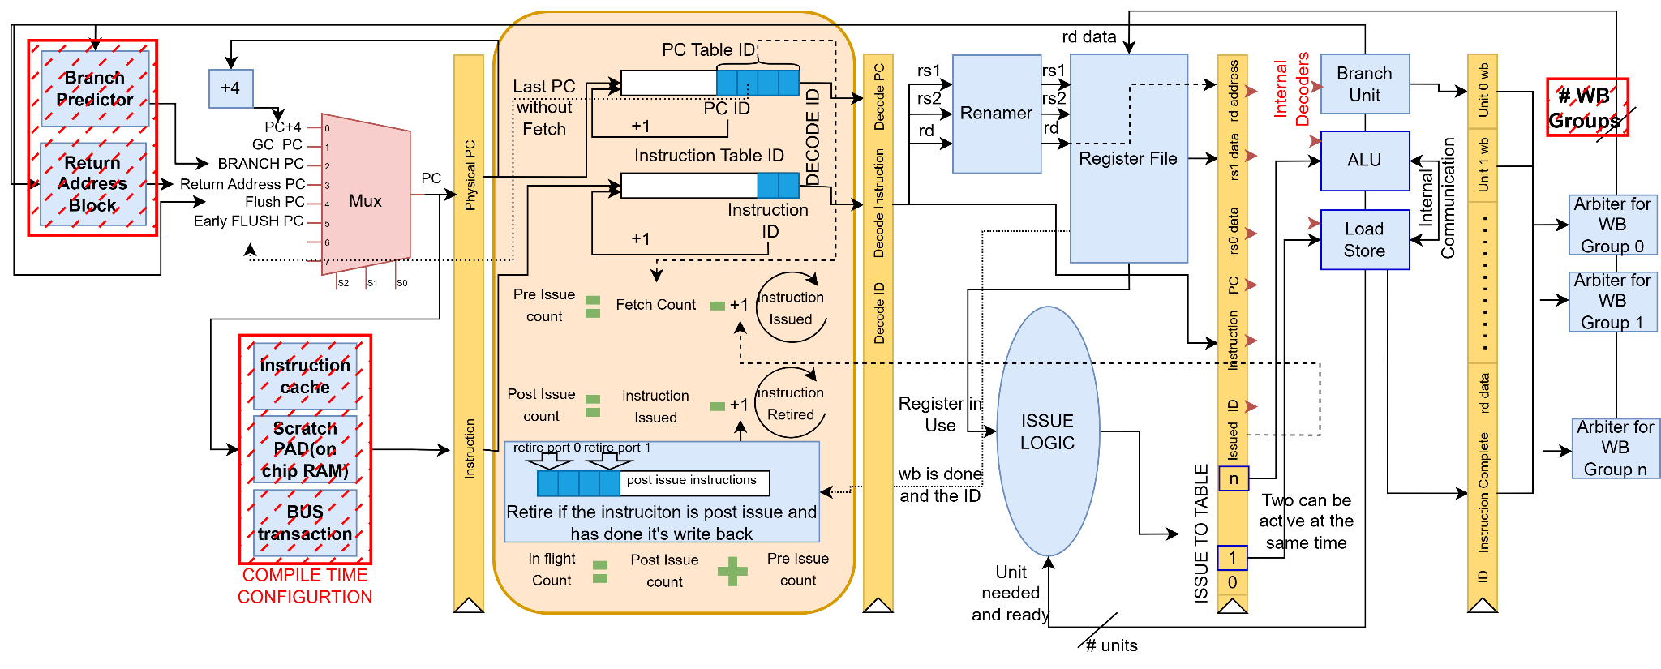
ID Assignment
Fetch
ID Assignment
Decode/Issue
Execute
Write back

Slide 40
ID Assignment(Tables)
Fetched PCs
PC6
PC5
PC4
PC3
PC2
Fetched instructions
IN4
IN3
IN2
Issued waiting for retire
PC1
PC0

Slide 41
ID Assignment(New PC)
Fetched PCs
PC7
PC6
PC5
PC4
PC3
PC2
Fetched instructions
IN4
IN3
IN2
Issued waiting for retire
PC1
PC0

Slide 42
ID Assignment(New Instruction)
Fetched PCs
PC7
PC6
PC5
PC4
PC3
PC2
Fetched instructions
IN5
IN4
IN3
IN2
Issued waiting for retire
PC1
PC0

Slide 43
ID Assignment(Instruction Issued)
Fetched PCs
PC7
PC6
PC5
PC4
PC3
Fetched instructions
IN5
IN4
IN3
Issued waiting for retire
PC2
PC1
PC0

Slide 44
ID Assignment(Instruction Retires)
Fetched PCs
PC7
PC6
PC5
PC4
PC3
Fetched instructions
IN5
IN4
IN3
Waiting for write back
Issued waiting for retire
PC2
PC1
PC0
Write back done

Slide 45
ID Assignment(Instruction Retires)
Fetched PCs
PC7
PC6
PC5
PC4
PC3
Fetched instructions
IN5
IN4
IN3
Waiting for write back
Issued waiting for retire
PC2
PC0
Write back done

Slide 46
ID Assignment(retiring a new instruction)
If the instruction is post-issue and has already written back to the register file, it can be retired.
Some instructions take more than 1 cycle to execute, and multiple instructions can be in the execution stage.
Should we wait for the last instruction in the FIFO?
But there can be another complete instruction after this one
Solution: We use two retiring ports:
If one port is waiting for a write-back, the other port can retire another instruction.

Slide 47
ID Assignment(why ID block?)
Uses 4-bit ID instead of a 32-bit PC.
Simplifies and enhances efficiency in tracking instructions.

Slide 48
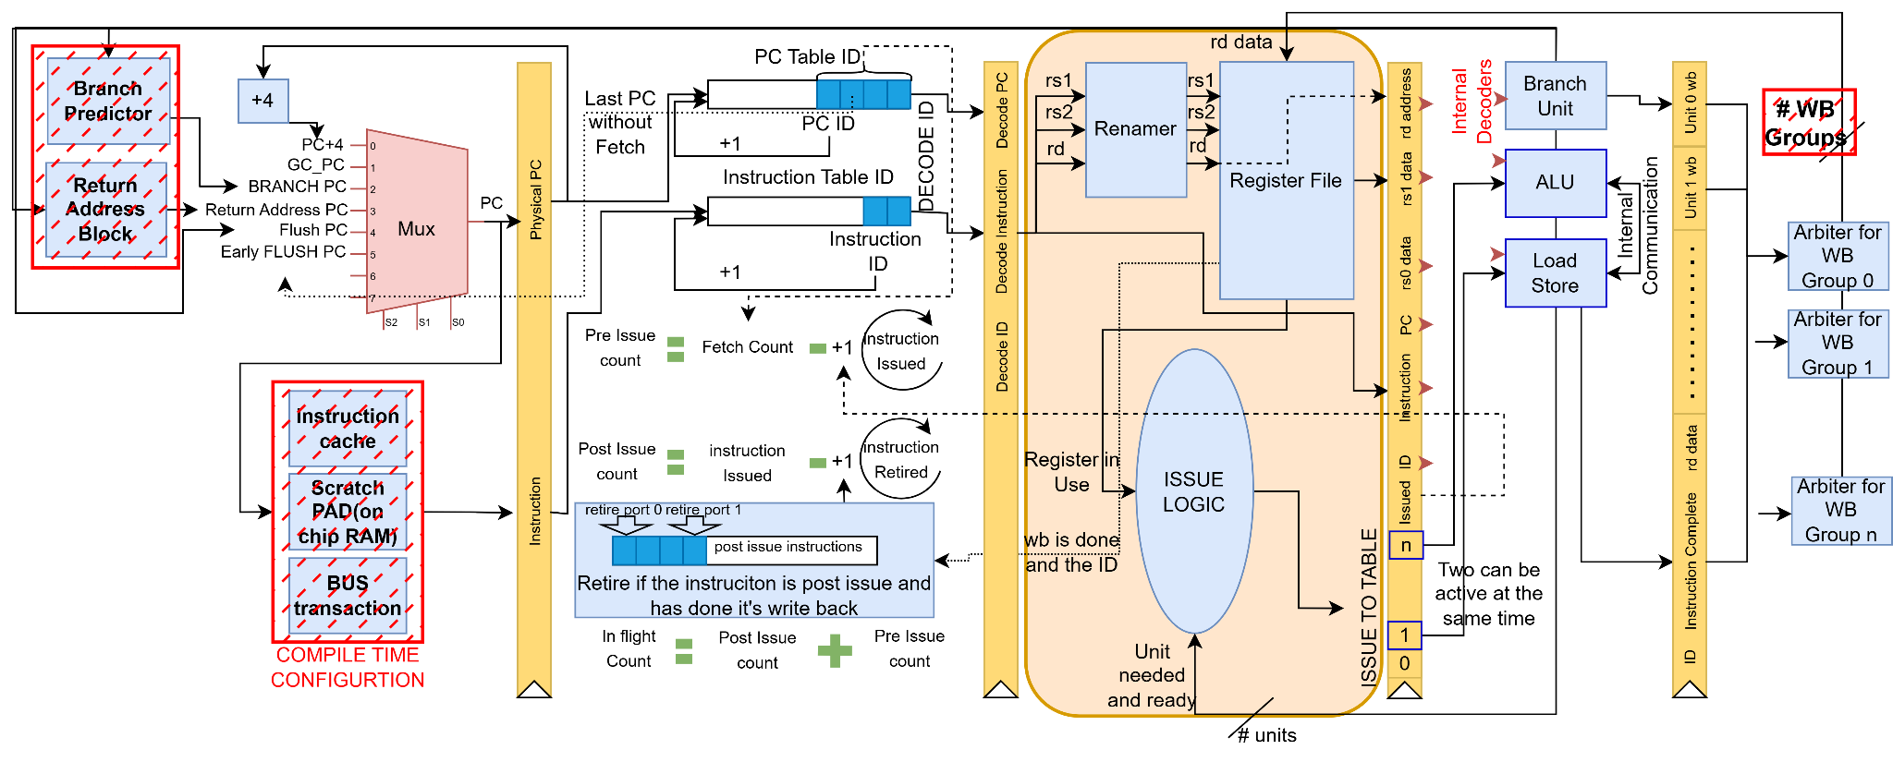
Decode/Issue
Fetch
ID Assignment
Decode/Issue
Execute
Write back

Slide 49
Decode(happens in the execution units)
Instructions
This unit is needed for the instruction
This unit is ready
Internal Decoder
Any Execution Unit
This unit uses rs0 register
This unit uses rs1 register

Slide 50
Issue Logic
1- Issue sends the instruction to all the execution blocks
Execution Unit 1
Execution Unit 2
Issue Block
instruction
Execution Unit n

Slide 51
Issue Logic
2- Look for the execution units which claim the instruction
Execution Unit 1
Execution Unit 2
Issue Block
Unit is needed for the instruction
Execution Unit n

Slide 52
Issue Logic
3- Waits until those units are ready to accept the instruction
Execution Unit 1
Execution Unit 2
Issue Block
Unit is ready for a new instruction
Execution Unit n

Slide 53
Issue Logic
4- Waits until rs0 and rs1 get their previous writebacks
Register File
Wait for the registers
Issue Block

Slide 54
Issue Logic
5- Issue the instruction to the corresponding execution units
Execution Unit 1
Execution Unit 2
Issue Block
Issue signal
Execution Unit n

Slide 55
Renamer
If the instruction writes to a register (rd), a new empty entry is assigned in the renamed list.
The entry becomes empty again after a write-back to the same register.
Decode/Issue
Rs0 physical address
Rs1 physical address
Rd physical address
Rd Renamed Address
Rs1 Renamed Address
Rs0 Renamed Address
Renamer

Slide 56
Register File and Renamer
64 registers are available in the register file.
1 clock cycle to get the renamed register for rs0, rs1, and rd.
1 clock cycle to check if the register is in use (between decode and issue stages).
1 clock cycle to read the content of the register.
1 clock cycle for write-back to the register.
Supports multiple out-of-order writebacks based on the writeback group (enabled by the renamer).

Slide 57
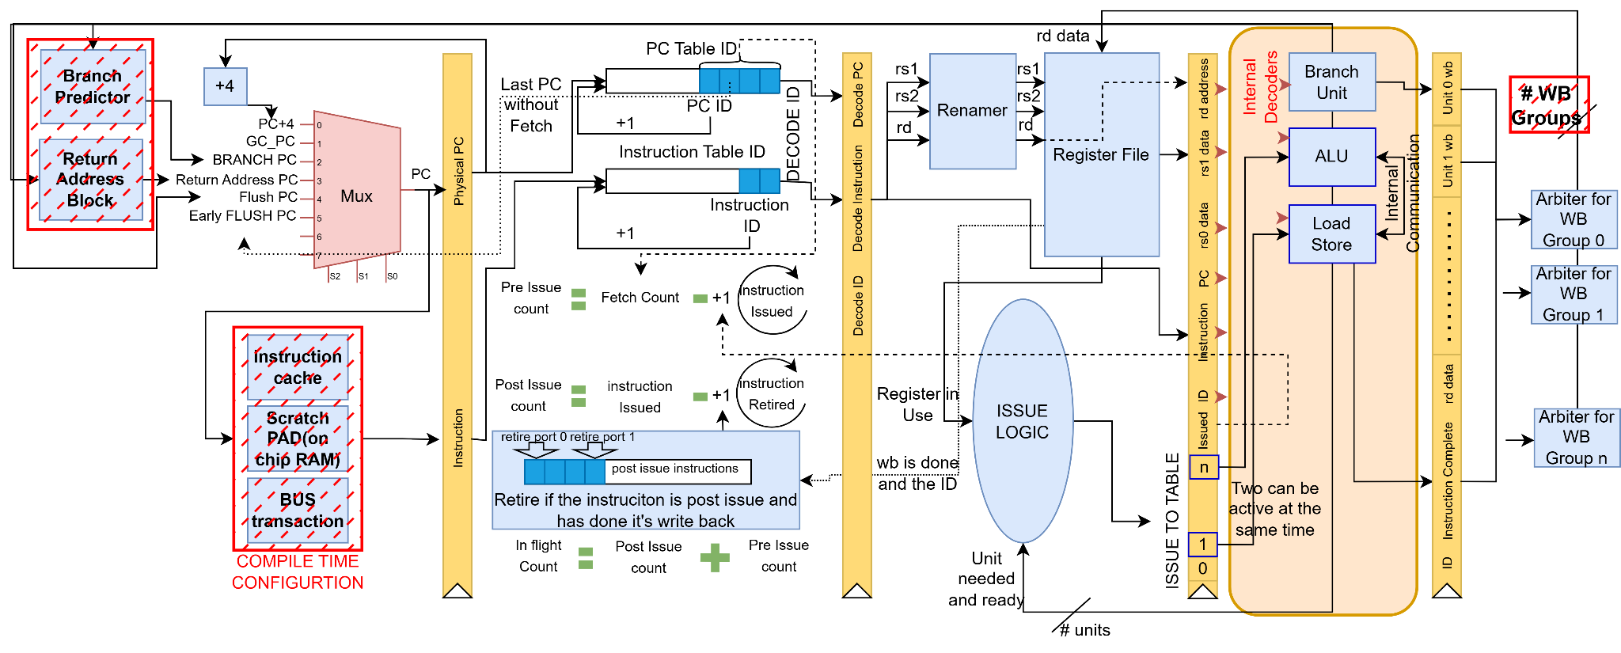
Execution Unit
Fetch
ID Assignment
Decode/Issue
Execute
Write back

Slide 58
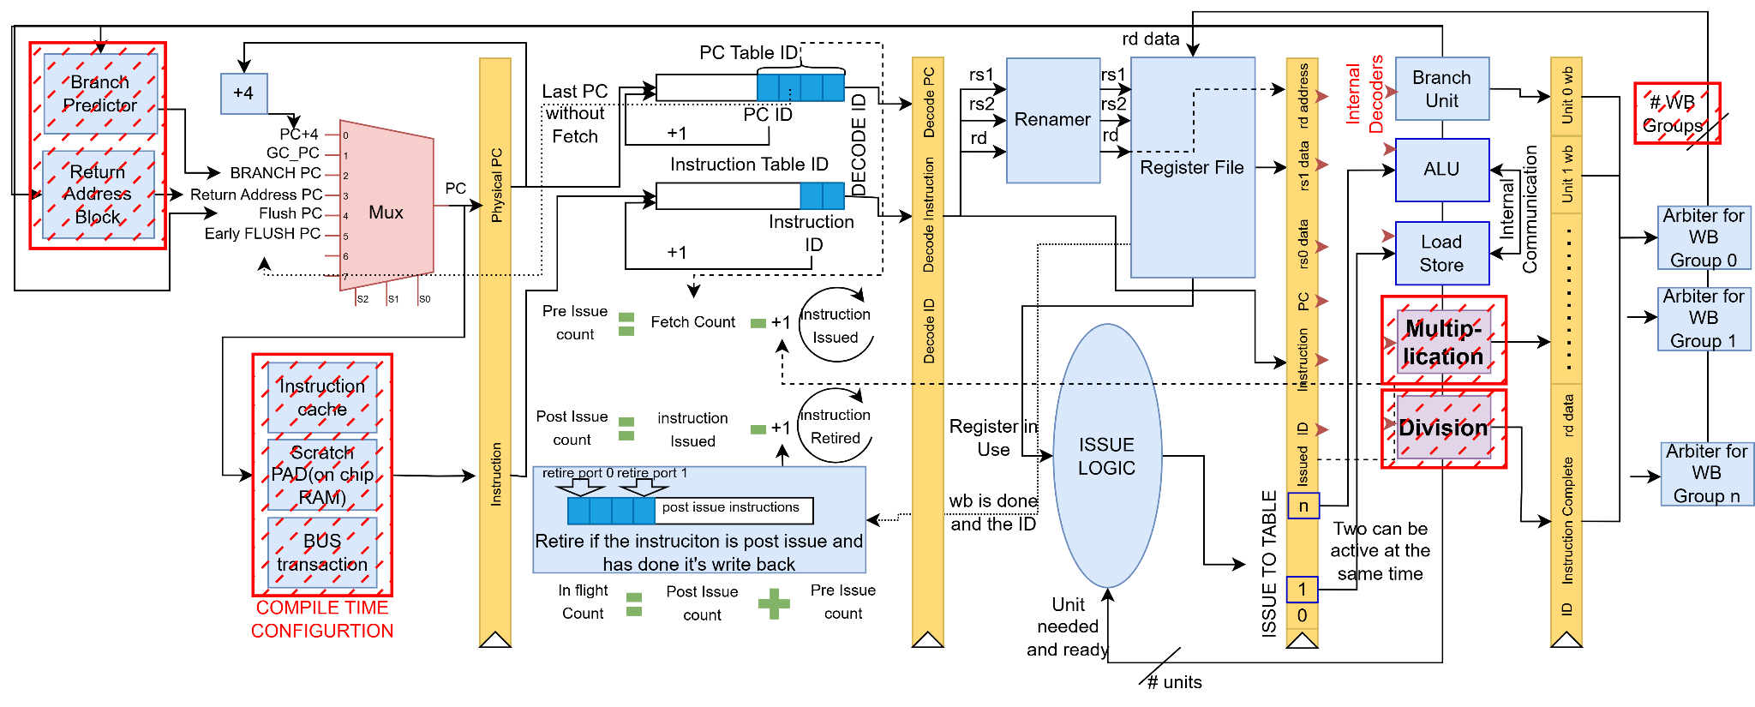
RISC-V IM
Fetch
ID Assignment
Decode/Issue
Execute
Write back

Slide 59
M Configuration
Adding the 'M' configuration enables the CPU to handle division and multiplication operations much faster.
The 'M' configuration increases resource usage by 847 LUTs, 360 flip-flops, and 4 DSP slices.
The multiplication and division units are independent, allowing configurations that include only division or only multiplication as needed.

Slide 60
Advantage of M Instruction on the Overall Performance
M Instruction Video

Slide 61
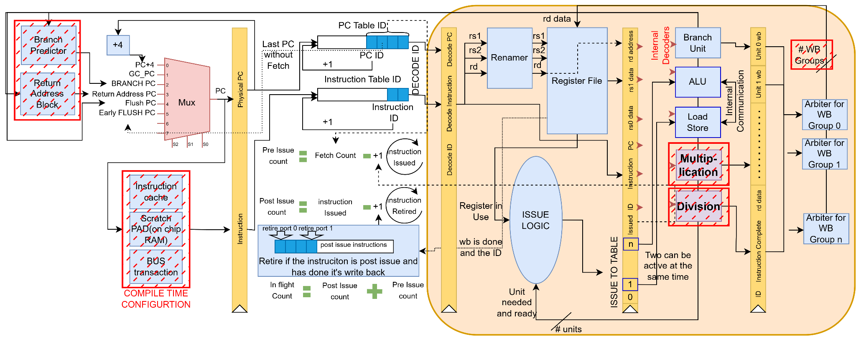
RISC-V IMFD connection
Fetch
ID Assignment
Decode/Issue
Execute
Write back

Slide 62
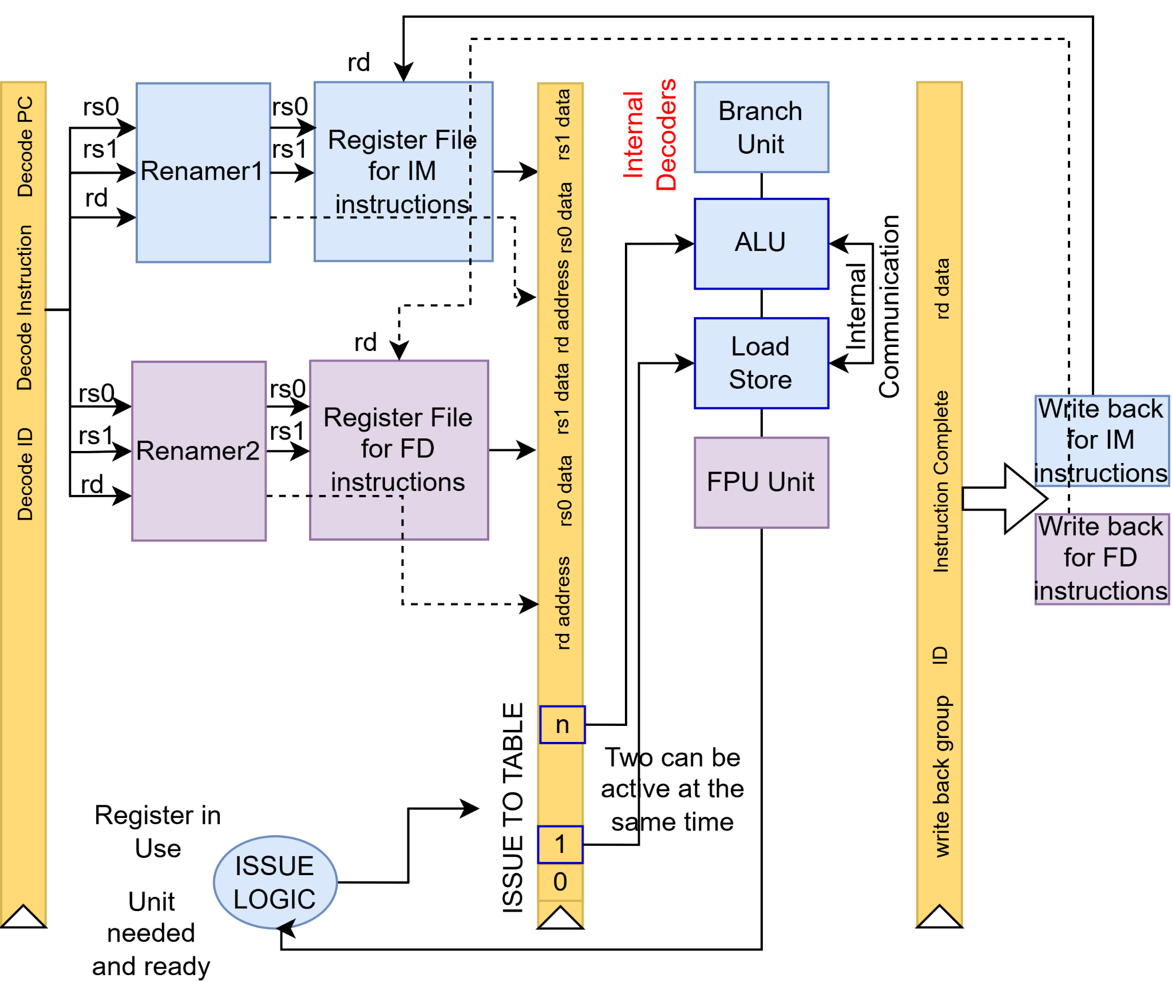
RISC-V FD

Slide 63
RISC-V FD
Designed for FPGA RISC-V soft processors; fully IEEE-compliant.
Supports configurable floating-point precision levels.
Optimized for runtime performance:
25% lower latency on common instructions vs. previous designs.
Efficient resource usage with minimal performance trade-offs.

Slide 64
RISC-V FD
Allows dynamic exploration of mantissa widths without code changes.
Demonstrated results:
1.35× speedup on apps like DCT & Black-Scholes model.
43% LUT & 35% flip-flop reduction (with 16-bit mantissa).
Less than 0.025% average loss in numerical accuracy.

Slide 65
RISC-V FD - Default Configuration
Double-Precision Settings
Exponent width: 11 (IEEE-754 compliant)
Fraction width: 52 (IEEE-754 compliant)
Single-Precision Settings
Exponent width: 8 (IEEE-754 compliant)
Fraction width: 23 (IEEE-754 compliant)

Slide 66
Mantissa configuration
Floating Point Unit Example

Slide 67
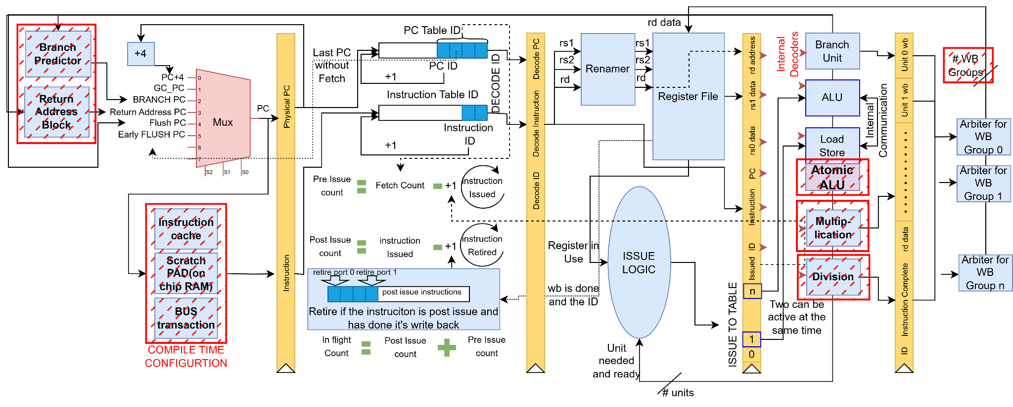
RISC-V IMA
Can be configured to include atomic or not(effect on the size of load and store unit)

Slide 68
A Configuration
Atomic operations are supported by adding an ALU to the load/store unit and modifying the data cache to handle them.
The 'A' configuration is highly efficient, adding only 6 LUTs and 28 flip-flops.

Slide 69
Closer Look at Execution Unit
ALU Delay 1 clock cycle
Branch Delay 1 clock cycle
CSR Delay 1-2 clock cycle
Multiply Delay 2 clock cycle
FPU Delay 2 clock cycle
Divide Delay 34 clock cycle
Custom Delay (?) clock cycle(s)
Load and Store Delay 3-4+ clock cycle

Slide 70
Adding Custom Instructions
Custom Instruction Video

Slide 71
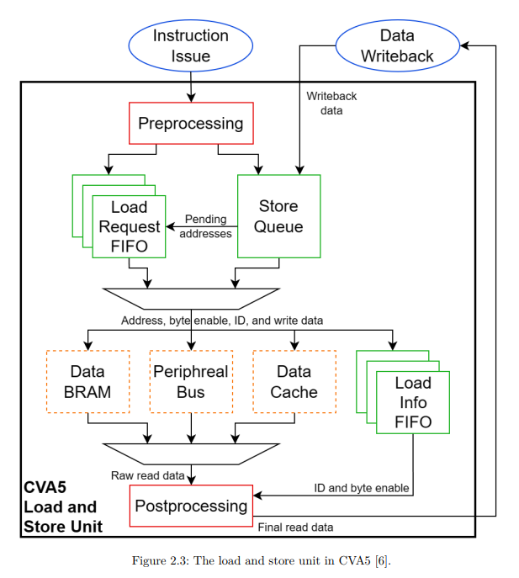
Load and Store Unit
There are two queues: one for load and one for store instructions.
Store instructions can be issued without waiting for the rs2 register, using forwarding.
The load queue has priority over the store queue.

Slide 72
Load and Store Unit
For data reading, there are 3 options:
Data Cache
Scratchpad (BRAM)
Peripheral Bus

Slide 73
I$
Cycle 1: The tag and data banks are accessed for the request.
Cycle 2: Hit/miss determination is performed.
Cycle 3 (on a miss): A memory request is initiated to fetch the data.
Tag Bank
Tag
If tag matched output the instruction else send a mem request
Fetch
Physical Address
Hashed Address
FIFO
Data Bank
Instruction
Fifo is for a continues address retrieval while the I$ is busy. When the FIFO is full the fetch stops the address retrieval process.
1 cycle
1 cycle

Slide 74
I$
FIFO (First-In-First-Out): Acts as a buffer for continuous address retrieval while the Instruction Cache (I$) is busy, ensuring uninterrupted instruction flow.
Fetch Stalling: When the FIFO becomes full, the instruction fetch process halts to prevent overflow, pausing address retrieval until space becomes available.
Tag Bank
Tag
If tag matched output the instruction else send a mem request
Fetch
Physical Address
Hashed Address
FIFO
Data Bank
Instruction
1 cycle
1 cycle

Slide 75
I$ and D$ Configurations
Replacement policy: Random replacement policy(Cycler).
Configuration: Configurable line size, line width and number of ways.
Linux configuration: 512 lines, line width and a 2 way cache.
Can make a section uncachable.

Slide 76
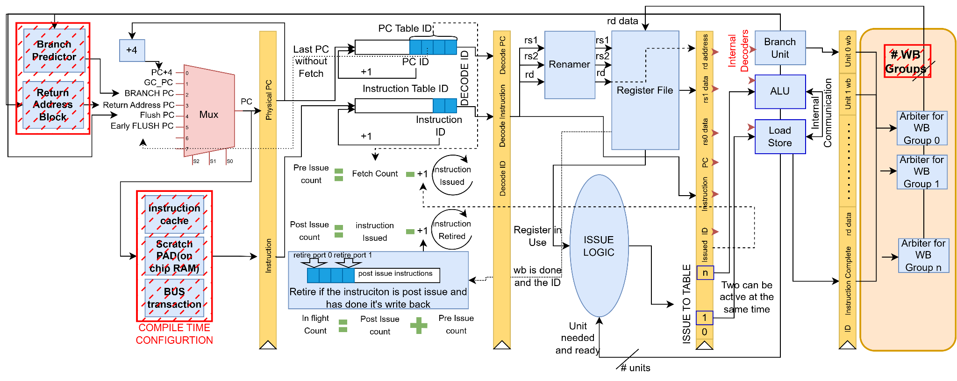
Write Back
Fetch
ID Assignment
Decode/Issue
Execute
Write back

Slide 77
Write Back to Register File
Write back packets
Execution unit 0
Arbiter
Execution unit 1
Write back packet
Register File
Execution unit 2
Execution unit N

Slide 78
Write Back(Problem)
If all execution units were single-cycle, there would be no write-back conflicts, since only one unit writes back at a time.
However, the Load/Store unit has variable latency and often takes more than one cycle.
This can lead to write-back conflicts when a load/store overlaps with another instruction.

Slide 79
Write Back(Solution)
Add a dedicated arbiter for the Load/Store unit.
Modify the register file to support dual write-back ports (i.e., commit two registers simultaneously).
For other multi-cycle instructions, apply the same strategy.

Slide 80
Closer Look at Execution Unit in Writeback
ALU Writeback Group 1
Branch Writeback Group 1
CSR Writeback Group 2
Multiply Writeback Group 2
FPU Writeback Group 2
Divide Writeback Group 2
Custom Writeback Group 2
Load and Store Writeback Group 3

Slide 81
Following the Instructions on the DATA-PATH
Put link here

Slide 82
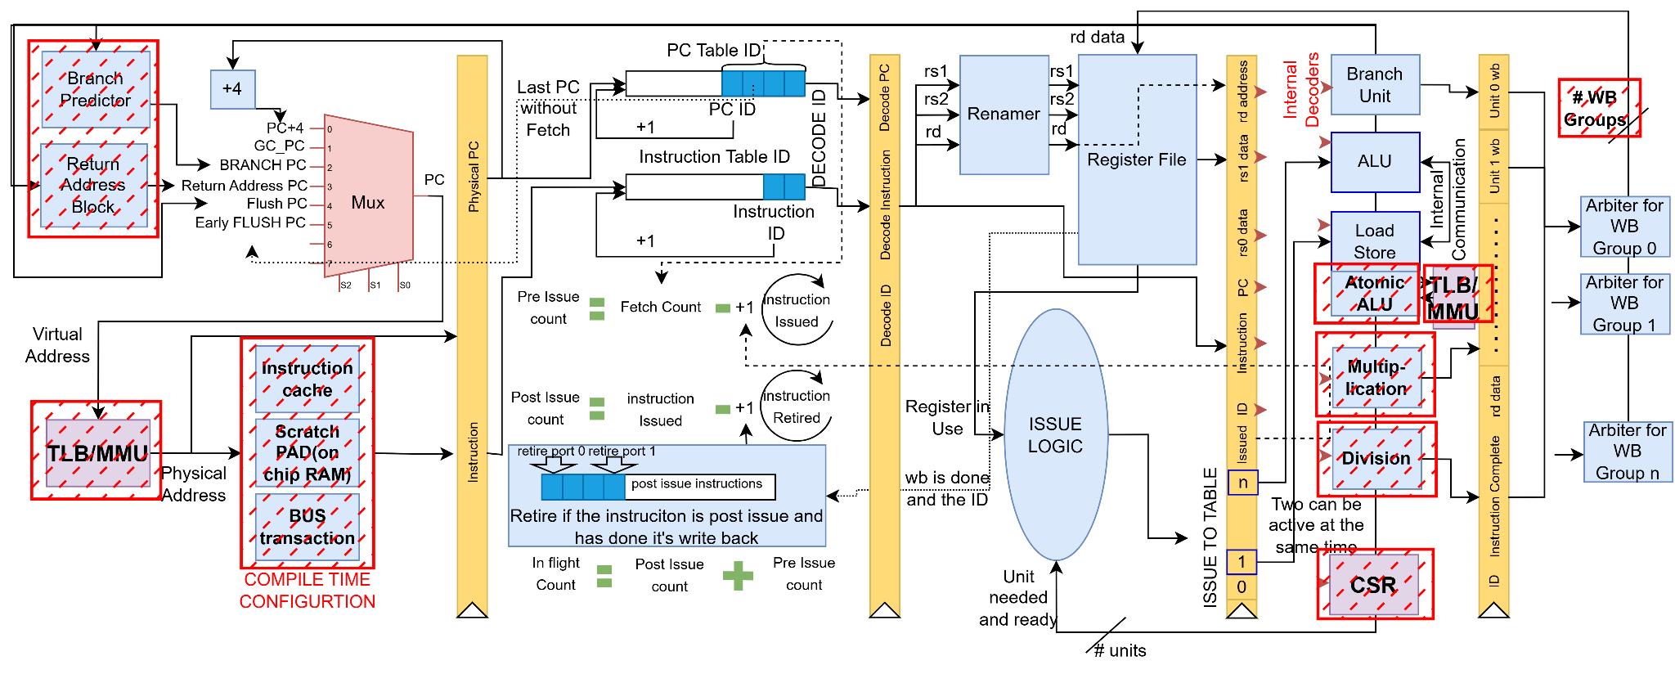
RISC-V LINUX(IMA+virtual memory+Zicsr+Zifence)
Fetch
ID Assignment
Decode/Issue
Execute
Write back

Slide 83
Converting Virtual PC to Physical PC - Connected to Original Fetch Logic
PC+4
Return Address PC
Branch Predictor PC
Predicted
Return
TLB
MMU
MUX
Register
Virtual PC
Mem Request
Early Flush PC
Branch Flush PC
0-1+
Global Control PC
Physical PC

Slide 84
TLB
When translation is off, address resolution happens instantly.
Latency: 0 cycles – No translation overhead.
Virtual
Address
MUX
Physical Address

Slide 85
TLB
TLB Hit: Takes 1 cycle if the data is in the Translation Lookaside Buffer (TLB).
TLB Miss: The MMU requests memory to retrieve the page information, adding latency.
Virtual Address
{ppn1,ppn0,virtual_address[11:0]}
MUX
Physical Address
ways
MMU
Address
Address
Virtual Address bit 12 to depth
Mem Request
Memory
Data
Data
Page Information
If doesn’t exist

Slide 86
TLB(Super Pages)
Handled the same way as ordinary pages, with the primary difference being size.
Larger page size than ordinary pages.
Only PPN1 is used for the conversion.
Virtual Address
{ppn1,ppn0,virtual_address[11:0]}
MUX
Physical Address
{ppn1,virtual_address[21:0]}

Slide 87
MMU
The MMU sends a request to memory to retrieve the Page Table Entry (PTE) for the virtual address.
If the PTE is valid and has the necessary permissions, it is sent to the TLB.
If the PTE is invalid, a page fault is triggered and sent to the CPU.

Slide 88
Fetch Instruction with Virtual Memory
Estimated Duration for Virtual-to-Physical (V2P) Conversion: The entire process is expected to take approximately 0 to 1+ cycles.
PC+4
Return Address PC
Branch Predictor PC
Predicted
Return
TLB
MMU
Register
Virtual PC
Mem Request
Early Flush PC
MUX
Branch Flush PC
0-1+
Global Control PC
Physical PC

Slide 89
Fetch Instruction with Virtual Memory
Read from BUS: Data is fetched from the system bus.
PC+4
Return Address PC
Branch Predictor PC
Predicted
Return
TLB
MMU
Register
Virtual PC
Mem Request
Early Flush PC
MUX
Branch Flush PC
0-1+
Bus
Global Control PC
Physical PC

Slide 90
Fetch Instruction with Virtual Memory
Read from L1$: Data is fetched from the Level 1 Cache (L1).
PC+4
Return Address PC
Branch Predictor PC
Predicted
Return
TLB
MMU
Register
Virtual PC
Mem Request
Early Flush PC
MUX
Branch Flush PC
0-1+
Bus
Global Control PC
Physical PC
2+
L1$

Slide 91
Fetch Instruction with Virtual Memory
Read from Scratchpad (On-chip RAM): Data is retrieved from the scratchpad memory, a small but fast on-chip RAM.
PC+4
Return Address PC
Branch Predictor PC
Predicted
Return
TLB
MMU
Register
Virtual PC
Mem Request
Early Flush PC
MUX
Branch Flush PC
0-1+
Bus
Global Control PC
Physical PC
2+
L1$
RAM

Slide 92
Different Configuration Results on the Zedboard(XC7Z020)
Name | Slice LUTs | Slice Registers | Slice | Block RAM Tile | DSPs | Frequency(MHZ)
RV32I (Base Integer ISA) | 2134 | 1241 | 716 | 18.5 | 0 | 100
RV32I + Branch Predictor | 2292 | 1299 | 744 | 20.5 | 0 | 100
RV32IM + Branch Predictor | 2843 | 1659 | 895 | 20.5 | 4 | 95
RV32IMA + Branch Predictor | 3014 | 1705 | 985 | 20.5 | 4 | 95
RV32IMAFD + Branch Predictor | 9747 | 5045 | 3003 | 20.5 | 13 | 92
Linux-Compatible (RV32IMA + Branch Predictor, no FD) | 4614 | 2879 | 1538 | 20.5 | 4 | 85

Slide 93
Different Configuration Results on the VCU118
Name | Total LUTs | FFs | RAMB36 | RAMB18 | DSPs
RV32I (Base Integer ISA) | 1824 | 993 | 18 | 1 | 0
RV32I + Branch Predictor | 1969 | 1051 | 18 | 5 | 0
RV32IM + Branch Predictor | 2543 | 1411 | 18 | 5 | 4
Linux-Compatible (RV32IMA + Branch Predictor, no FD) | 4165 | 3383 | 18 | 5 | 4
RV32IMFD + Branch Predictor | 8996 | 4762 | 18 | 5 | 13

Slide 94
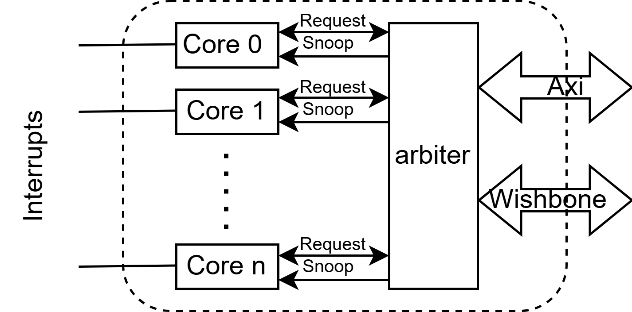
Multi-Core Handling on the First Level Cache
Snooping is used to maintain data cache coherency.
Since the data cache is a write-through cache, every time a write request is made to an address, the same cache line is invalidated in other caches.

Slide 95
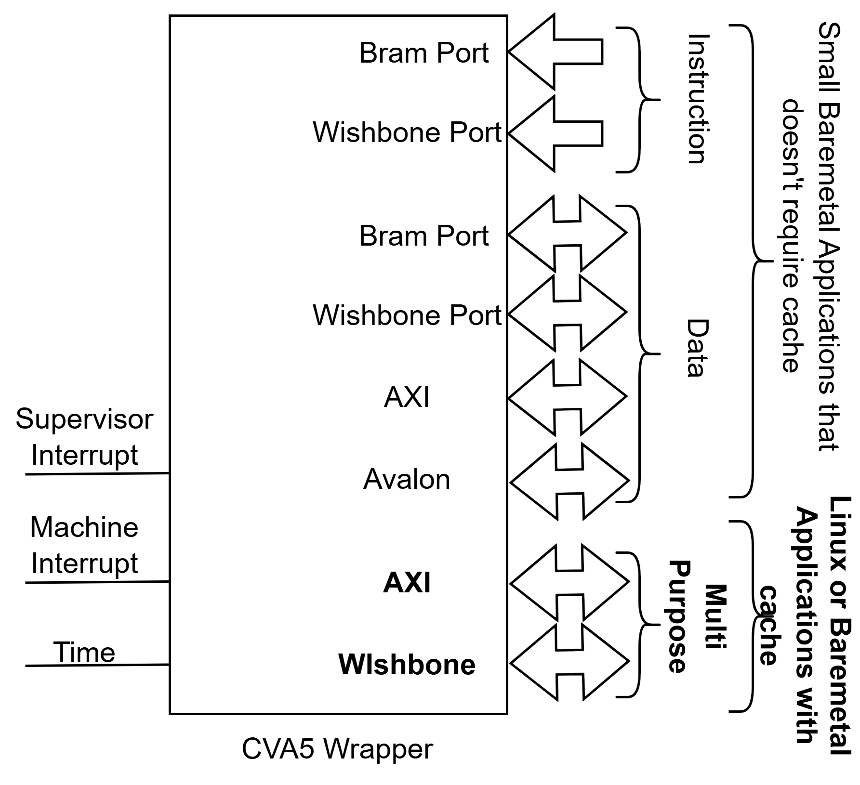
Communication With The Outside
The CPU can have multi-purpose ports that handle both data and instructions.

Slide 96
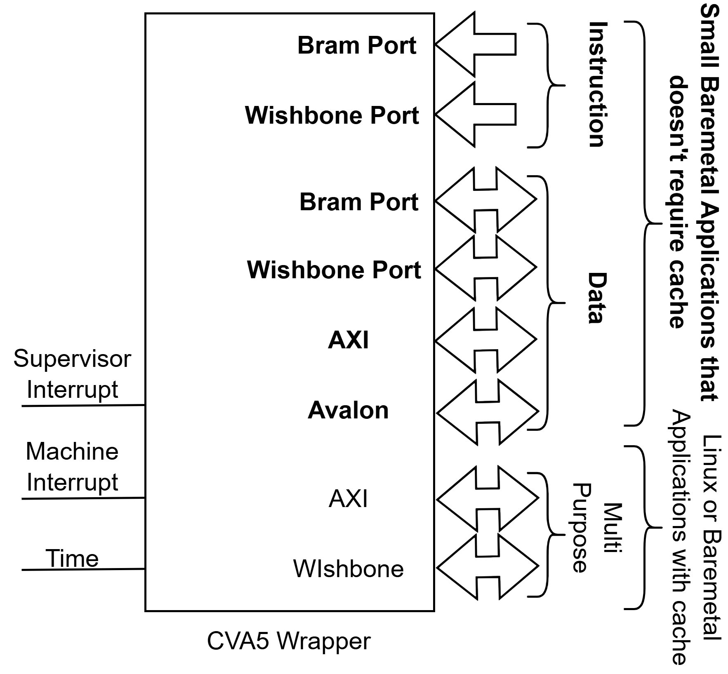
Communication With The Outside
or separate connections for different tasks.

Slide 97
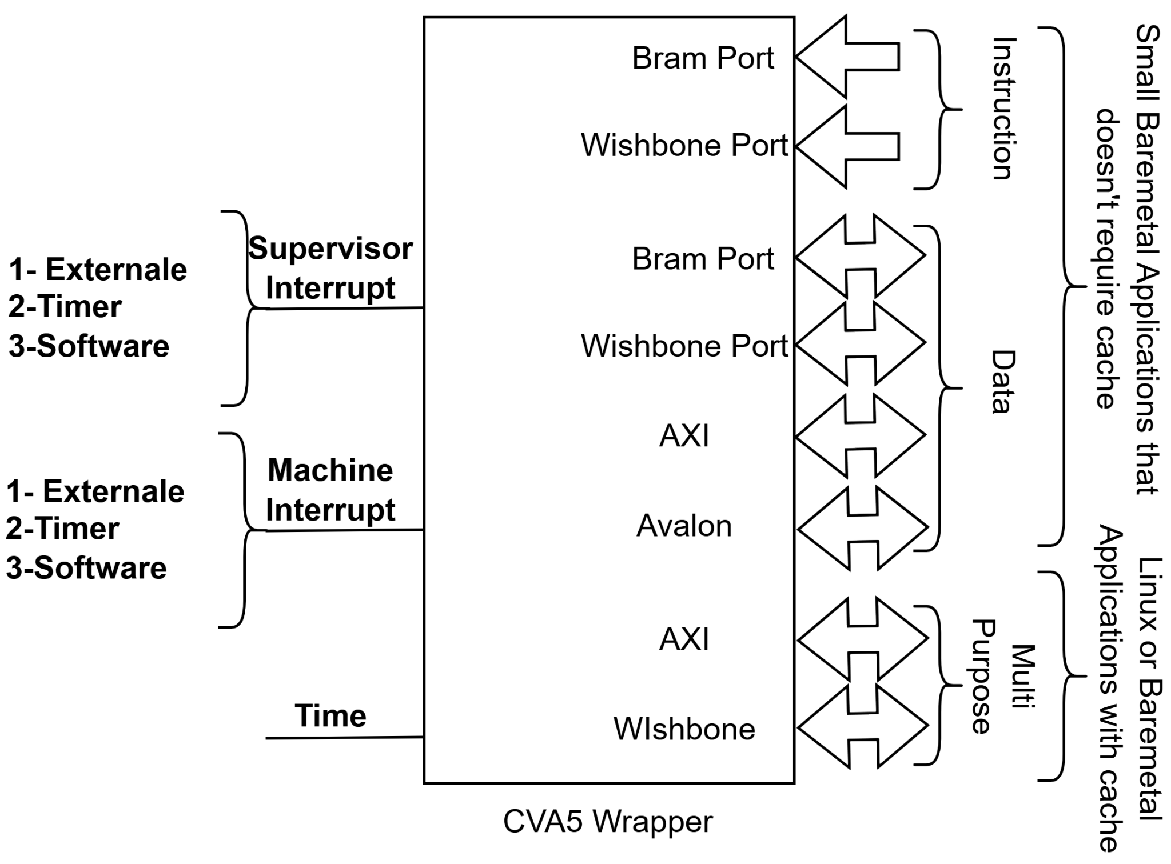
Communication With The Outside
The CPU also handles machine interrupts and supervisor interrupts, which include:
External Interrupt
Timer Interrupt
Software Interrupt

Slide 98
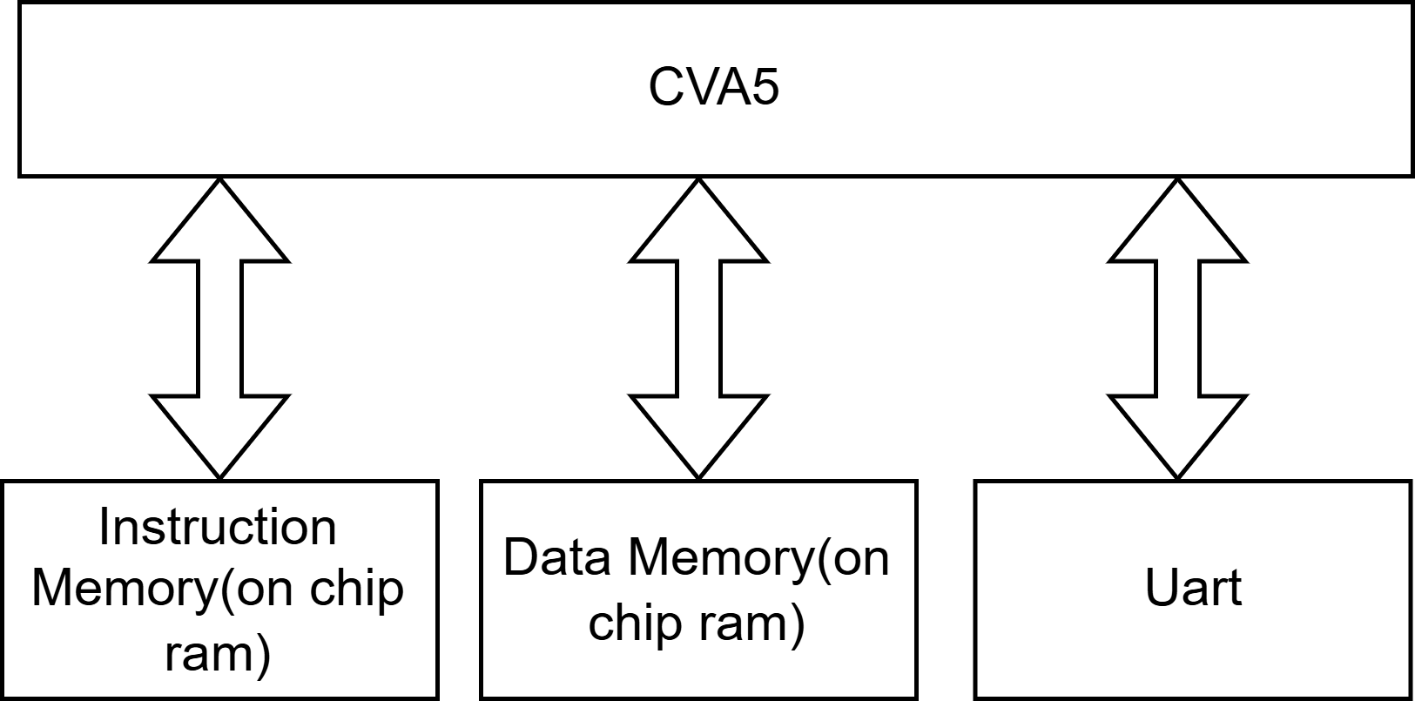
Bare-Minimum SOC
The only important connections are the instruction and data, which can be in local memories or a scratchpad..
Since there are no common connections like Wishbone or AXI, the CPU can have its own separate UART connection.

Slide 99
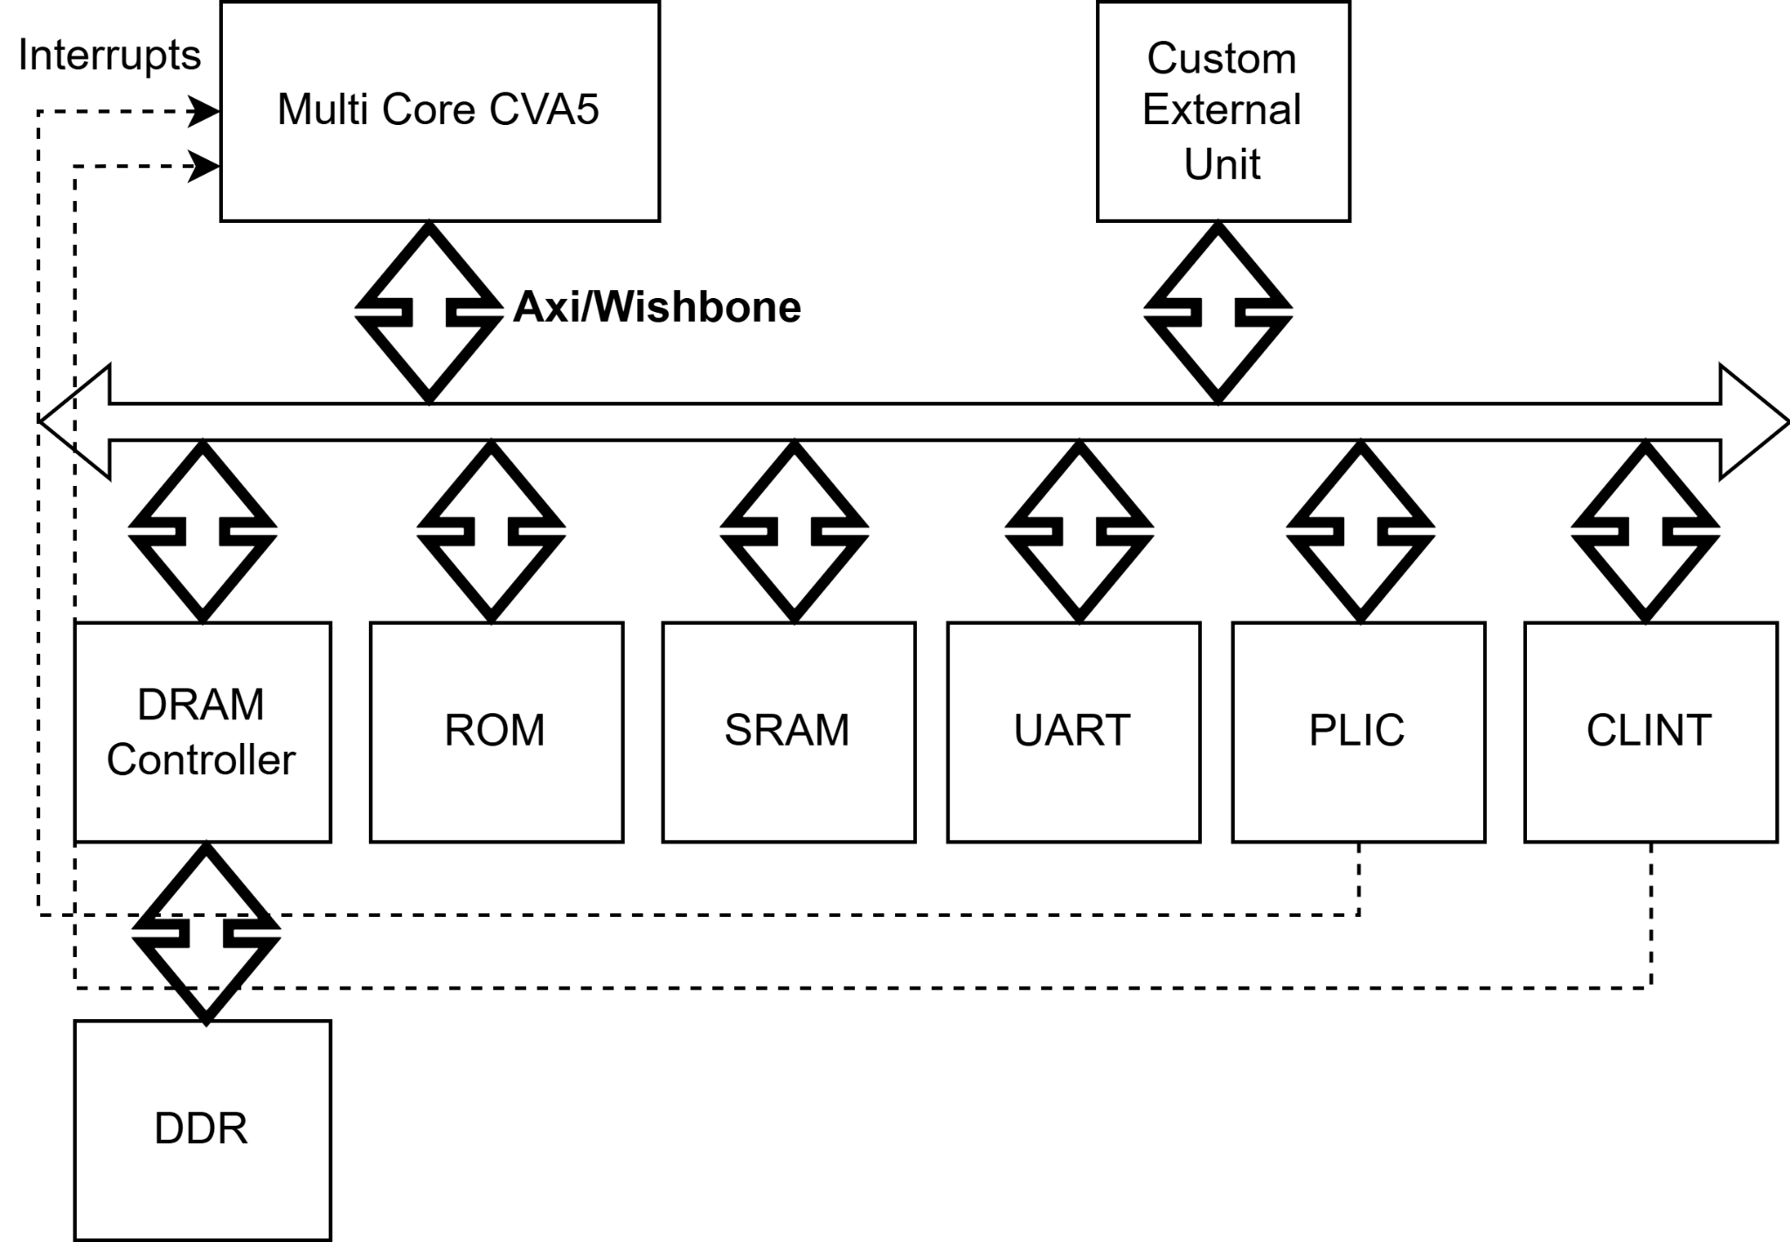
Linux Block Design
Connections can be established using either AXI or Wishbone protocols.

Slide 100
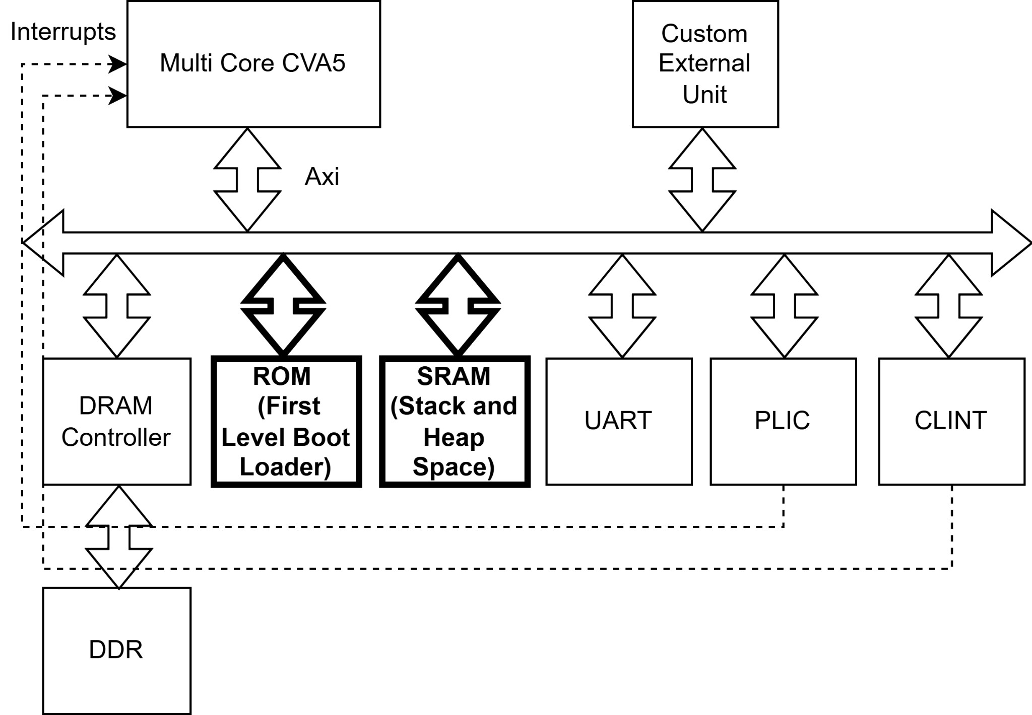
Linux Block Design
The first-level bootloader is stored in ROM, while SRAM serves as the stack and heap space for the bootloader.

Slide 101
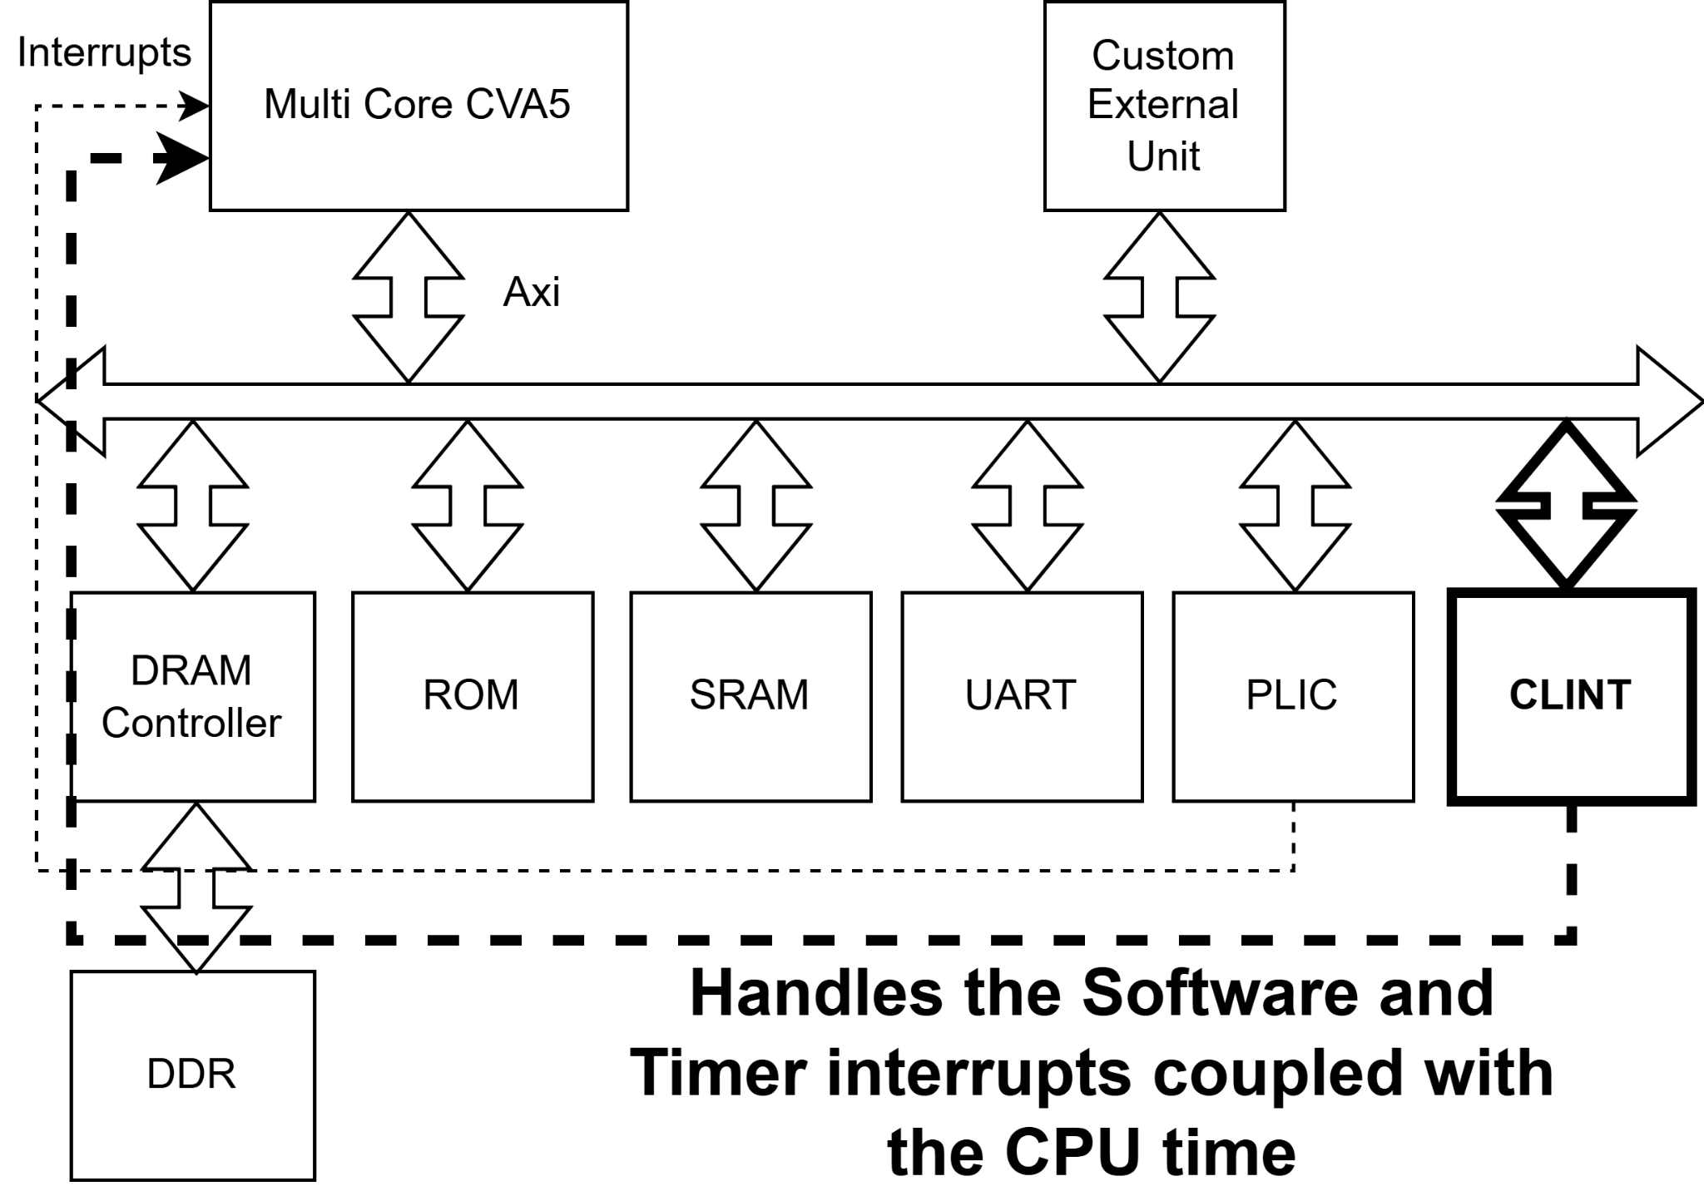
Linux Block Design
The CLINT handles inter-processor and timer interrupts, forwarding relevant interrupt values.

Slide 102
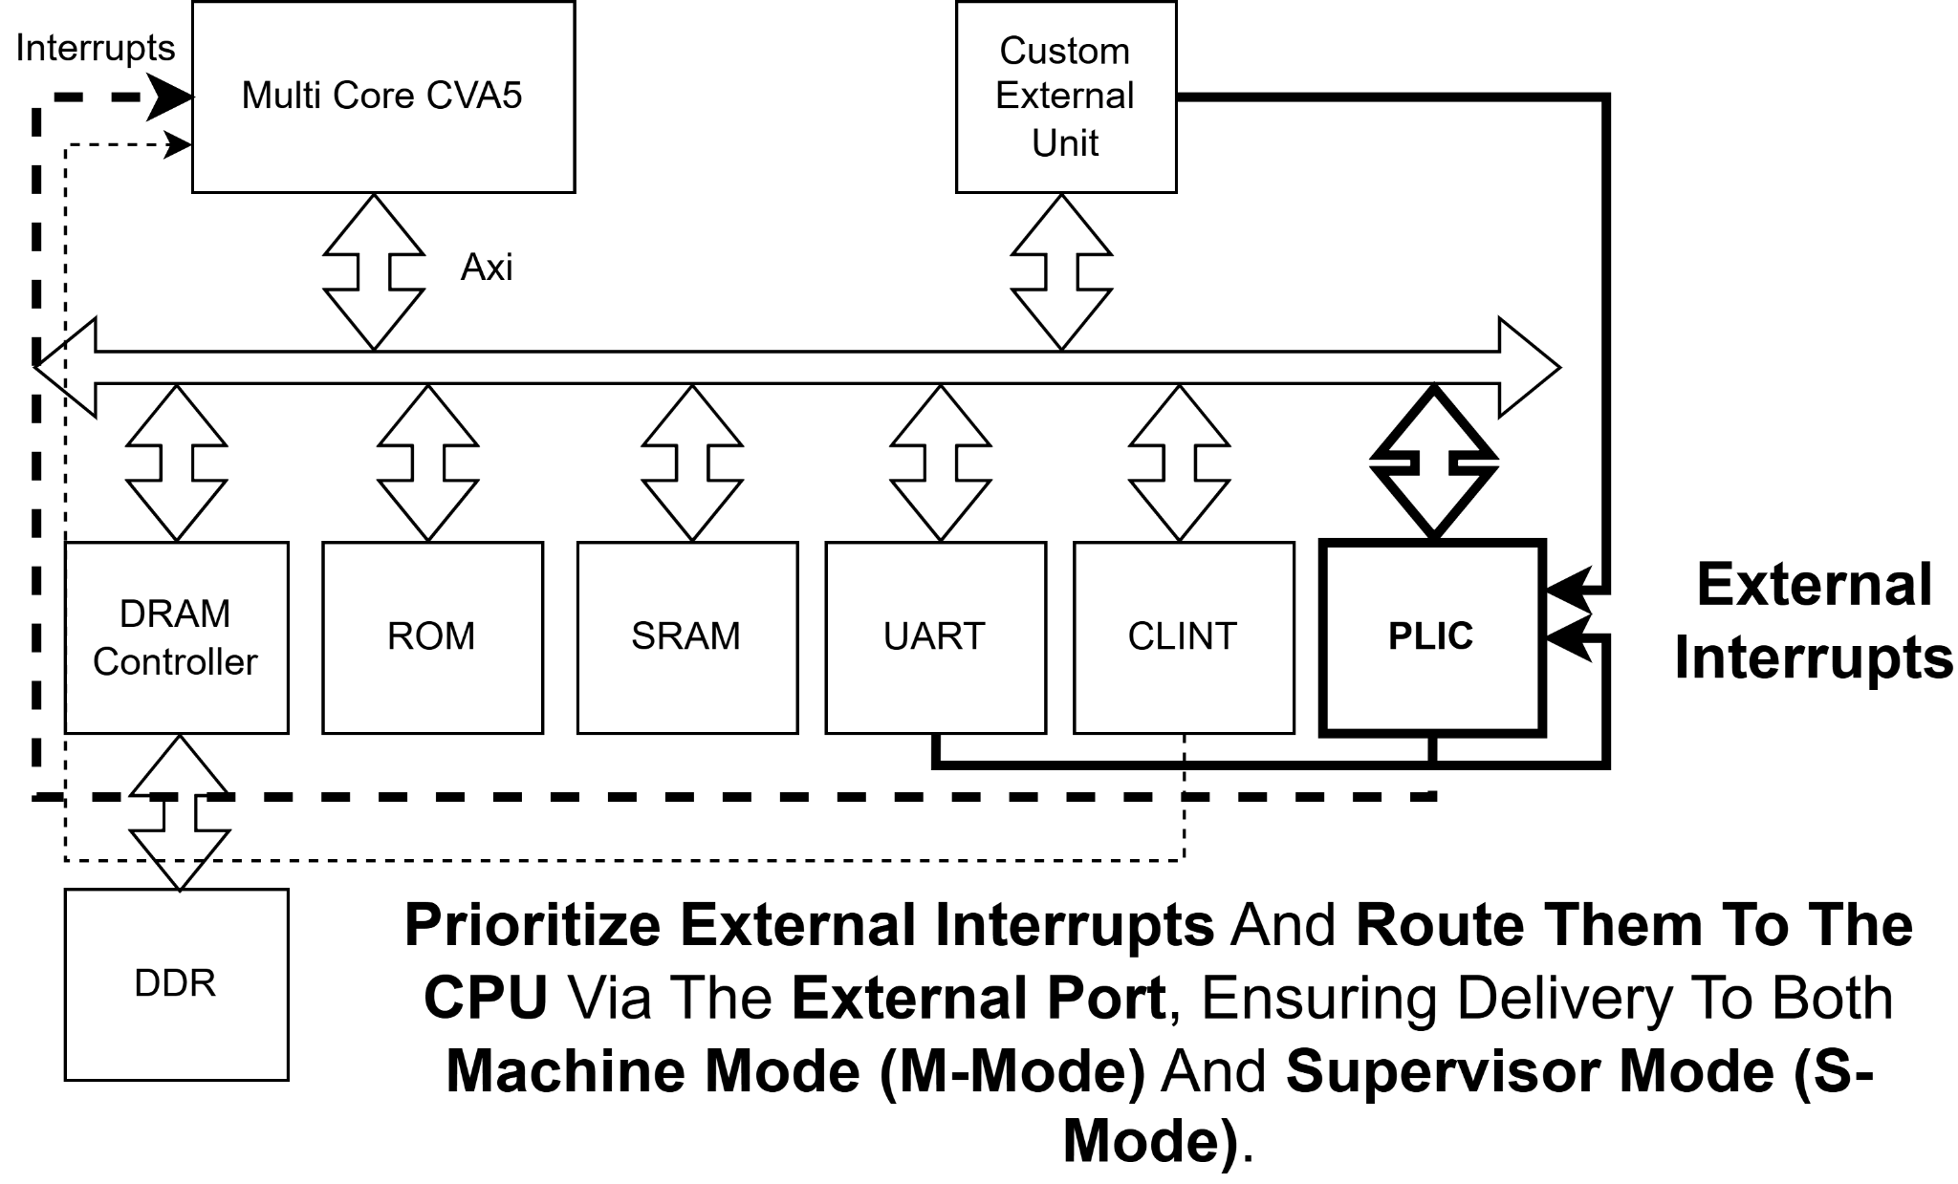
Linux Block Design
The PLIC manages external interrupts, sorting or discarding them based on CPU needs before passing them to the CPU.

Slide 103
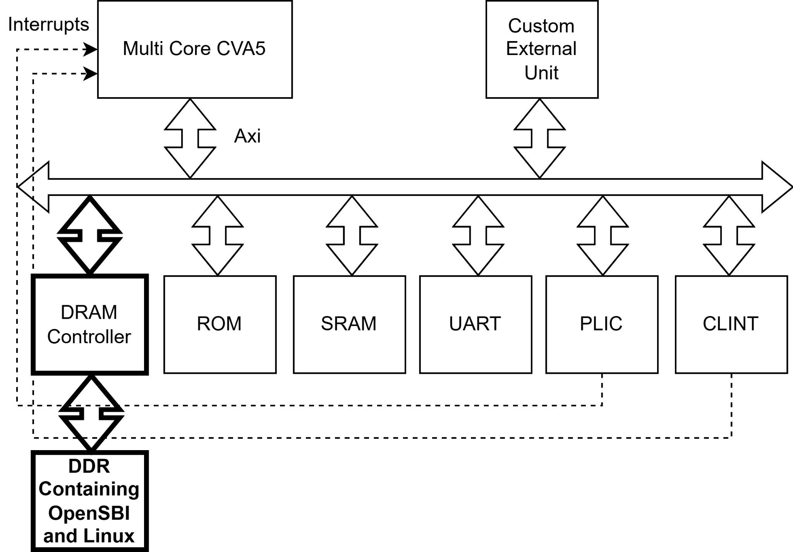
Linux Block Design
Both the Linux image and OpenSBI are stored in DDR.

Slide 104

Linux Block Design
External blocks can also be integrated into the system as needed.(Optional)

Slide 105
Adding External Accelerator to Litex
External Accelerator

Slide 106
Region List
MEMORY {
plic : ORIGIN = 0xf8000000, LENGTH = 0x00400000
clint : ORIGIN = 0xf0010000, LENGTH = 0x00010000
rom : ORIGIN = 0x00000000, LENGTH = 0x00020000
sram : ORIGIN = 0x01000000, LENGTH = 0x00002000
main_ram : ORIGIN = 0x40000000, LENGTH = 0x04000000
csr : ORIGIN = 0xf0000000, LENGTH = 0x00010000
}

Slide 107
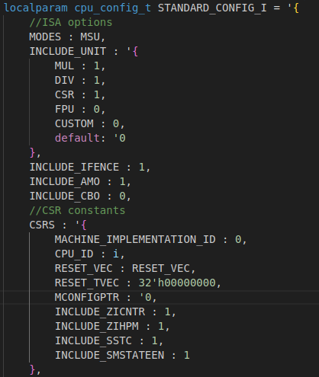
CPU Configuration(Execution Units)
To change the configuration, you only need to modify the wrapper (litex_wrapper.sv).
You can choose to add or remove extra units, including the multiplication unit, division unit, Control Status Register unit, floating point unit, and custom unit.
You can also include or exclude the IFENCE, AMO, and CBO instructions.
Finally, there is a level of customization available in the CSR unit.

Slide 108
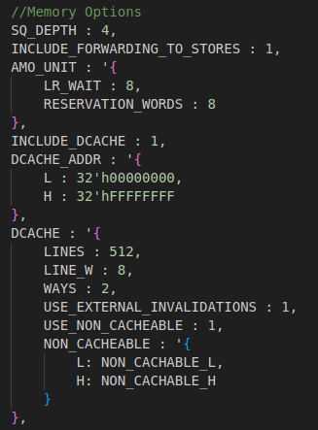
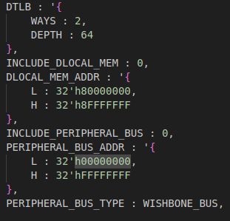
CPU Configuration(Load and Store Unit)
SQ DEPTH refers to the load and store queue depth.
Forwarding is used so the store queue does not wait for the results of its RS registers.
You can select whether you have a cache or not and define the address range.
Finally, you can easily adjust the cache parameters and exclude certain sections from it.
The size of the Data TLB can also be modified, or you can use a scratchpad or simply a bus connection for data read.

Slide 109
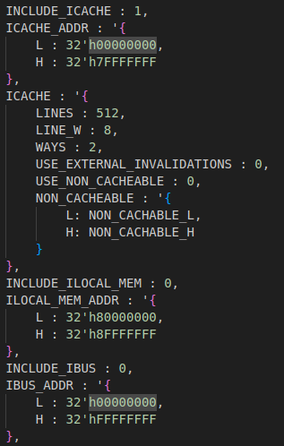
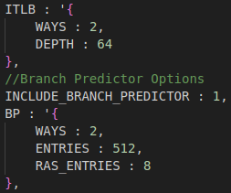
CPU Configuration(Fetch Unit)
You can select between having a cache, a scratchpad, or a simple bus connection with no additional components.
You have the flexibility to experiment and find the best cache configuration for your needs.
You can also adjust the TLB size to fit your requirements.
Finally, you can include, exclude, and modify the size of the branch predictor.

Slide 110
How to Install and work with Litex
https://github.com/enjoy-digital/litex/pull/2211
https://github.com/litex-hub/pythondata-cpu-cva5/pull/1
Installation:
$ wget https://raw.githubusercontent.com/enjoy-digital/litex/master/litex_setup.py
$ chmod +x litex_setup.py
$ ./litex_setup.py --init --install --user (--user to install to user directory) --config=(minimal, standard, full)
$ pip3 install meson ninja
$ ./litex_setup.py --gcc=riscv
Install Vivado

Slide 111
How to Run and Work With Litex
Run on Simulation:
litex_sim --cpu-type cva5 --with-sdram --sdram-init (binary file or a group of binaries) --cpu-count 1 --variant (Linux, non) --bust-type (wishbone or axi)
Run on Hardware:
python3 -m litex_boards.targets.xilinx_vcu118 --build --cpu-type cva5 --cpu-count 1 --variant (Linux, non) --bust-type (wishbone or axi)
cpu-variant(different compilers for the bare metal)
CPU_VARIANTS = ["minimal", "standard","standard+atomic","standard+atomic+float+double"]
GCC_FLAGS = {
"minimal" : "-march=rv32i2p0 -mabi=ilp32 ",
"standard" : "-march=rv32i2p0_m -mabi=ilp32 ",
"standard+atomic" : "-march=rv32i2p0_ma -mabi=ilp32 ",
"standard+atomic+float+double" : "-march=rv32i2p0_mafd -mabi=ilp32 ",
}

Slide 112
Adding an external Accelerator
The first step to add a new module is to add the sources in the cva5 core.py using the command: platform.add_source(os.path.join(cva5_path, "examples/litex/litex_wrapper.sv"))
The second step is to connect the module to the SoC.
self.clintbus = clintbus = axi.AXIInterface(data_width=32, address_width=32, id_width=4)
self.specials += Instance("clint_wrapper",
p_NUM_CORES = int(self.cpu_params["p_NUM_CORES"]),
p_AXI = 1,
i_clk = ClockSignal("sys"),
i_rst = ResetSignal("sys"),
o_mtip = mtip,
o_msip = msip,
o_mtime = mtime,
i_s_axi_awvalid = clintbus.aw.valid,
i_s_axi_awaddr = clintbus.aw.addr,
i_s_axi_wvalid = clintbus.w.valid,
i_s_axi_wdata = clintbus.w.data,
i_s_axi_bready = clintbus.b.ready,
i_s_axi_arvalid = clintbus.ar.valid,
i_s_axi_araddr = clintbus.ar.addr,
i_s_axi_rready = clintbus.r.ready,
o_s_axi_awready = clintbus.aw.ready,
o_s_axi_wready = clintbus.w.ready,
o_s_axi_bvalid = clintbus.b.valid,
o_s_axi_arready = clintbus.ar.ready,
o_s_axi_rvalid = clintbus.r.valid,
o_s_axi_rdata = clintbus.r.data
)

Slide 113
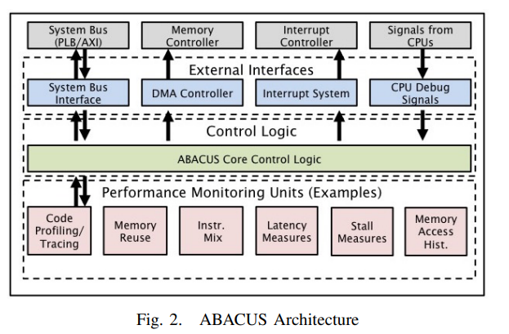
Example of External module(ABACUS)
Abacus is a profiler unit written by Professor Shannon, which was replicated in the fall term by intern Rojnesh Joshi.
It provides details on the number of different instructions executed so far.
It also gives information about cache and branch mispredictions, including the number of hits and misses, and other related metrics.
You can access it from this GitHub repository: ABACUS-CPU-Profiler.

Slide 114
Adding internal accelerator(Custom instruction unit)
Set the custom option to 1 in the config.
Modify the core/execution_units/custom_unit.sv file to implement your custom instruction.
Add the riscv.h file (cva5-linux/DEMO/CUSTOM/riscv.h) to your C code.
The current opcode for the custom unit is 0b1111011.
To run your instruction, use the following syntax: opcode_R(opcode, func3, func7, rs1, rs2) Example: uint32_t y = opcode_R(0b1111011, 0, 0, x1, x2);

Slide 115
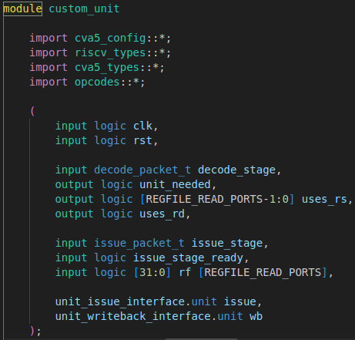
Modify the custom instruction unit (input and outputs)
unit_needed is a signal connected to both the decode and issue stages, indicating whether this unit should handle the instruction. assign unit_needed = decode_stage.instruction inside {CUSTOM};
uses_rs and uses_rd are output signals that indicate whether the instruction uses rd and rs registers for its operation. These signals help the decode and issue stages ensure the registers are ready before issuing the instruction.
Rf provides the value of the registers.
Wb is the value that will be written back to the register file.
Issue_stage contains information about the issued instruction, such as its ID, PC, the instruction or renamed register addresses, and other relevant data.
Decode_stage is similar to the issue stage but occurs before it.
Issue is a set of handshake signals between the decode, issue, and the custom instruction.

Slide 116
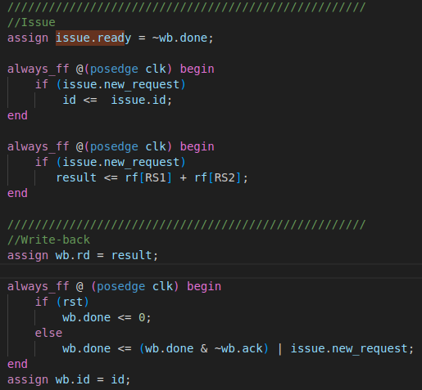
Main computation and handshakes
Issue.ready is a signal that indicates whether the custom instruction unit, or any other unit, is ready to accept a new instruction. Common reasons for setting it to 0 include:
A full FIFO.
The custom unit is not pipelined and must respond to each instruction individually.
Issue.new_request is a signal coming from both the decode and issue stages, indicating whether everything (like registers) is ready for this unit to begin its process.
wb.rd represents the result we want to write back to the register file.
wb.id is the ID of the instruction that we want to write back.
wb.done is a signal indicating whether the rd is valid in the next cycle.
wb.ack shows whether the write back has been accepted by the register file.

Slide 117
Performance Measurement(ALU operation)
Code:
void test_alu(){
uint64_t start = read_mcycle64();
for(int i=0;i<10000;i++){ asm volatile ("addi x31, x31, 1" ::: "x31"); }
uint64_t end = read_mcycle64(); // x = x+1;
printf("start is %lld and end is %lld, while the time is = %lld",start,end,end-start); }
Clock cycles = 30058

Slide 118
Performance Measurement(Division Operation)
Code:
for(int i = 1; i < 10000; i++){
asm volatile ("nop");
x /= i;
}
Running it Without the division module :
litex_sim --cpu-type cva5 --with-sdram --cpu-count 1 --cpu-variant minimal --no-compile-gateware
make
litex_sim --cpu-type cva5 --with-sdram --sdram-init demo.bin --cpu-count 1 --cpu-variant minimal
Clock cycles = 392191
Running it with the division module :
litex_sim --cpu-type cva5 --with-sdram --cpu-count 1 --cpu-variant standard --no-compile-gateware
litex_sim --cpu-type cva5 --with-sdram --sdram-init demo.bin --cpu-count 1 --cpu-variant standard
Clock cycles = 40135

Slide 119
Performance Measurement(Multiplication Operation)
Code
for(int i = 1; i < 10000; i++){
asm volatile ("nop");
x *= i;
}
Running it Without the multiplication module :
litex_sim --cpu-type cva5 --with-sdram --sdram-init demo.bin --cpu-count 1 --cpu-variant minimal
Clock cycles = 116249
Running it with the multiplication module :
litex_sim --cpu-type cva5 --with-sdram --sdram-init demo.bin --cpu-count 1 --cpu-variant standard
Clock cycles = 40111

Slide 120
Performance Measurement(Branch Predictor Effect)
A simple if statement that only the else get executed every time for a 1000 cycles
With branch predictor: time is = 40181
Without branch predictor: time is = 120165

Slide 121
Run OS (preparing the binaries)
Getting the DTS.
Git clone https://gitlab.com/sfu-rcl/cva5-linux.git
Git checkout block_design
Cd DTS
Run the Gen_DTS.py script to produce the dts file.
Getting the openSBI binary file:
Git clone https://gitlab.com/sfu-rcl/cva5-linux.git
Git checkout block_design
Cd OPENSBI
Run the ./opensbi_maker.sh(it will automatically clone and replace the files for the cva5 and give you the binary file)
Getting the Linux Image:
Git clone https://gitlab.com/sfu-rcl/cva5-linux.git
Git checkout block_design
Cd LINUX_IMAGE
Run the ./build_root.sh(this script will automatically clone and replace the field for the cva5 in the build root directory)
Make a boot.json file containing all the binaries and their address in memory
{"Image":"0x40000000","rv32.dtb":"0x40ef0000","rootfs.cpio":"0x41000000","fw_jump.bin":"0x40f00000"}
If you don’t want to build the Images, the prebuild version is already there for use under the Image folder.

Slide 122
Making the hardware
On Litex:
Pick your hardware name and then build it
Example vcu118: python3 -m litex_boards.targets.xilinx_vcu118 --build --cpu-type cva5 --cpu-count 1 --variant (Linux, non) --bust-type (wishbone or axi)
litex_term /dev/ttyUSB1 --images=boot.json(for the uart communication)
On Vivado
Clone the https://gitlab.com/sfu-rcl/cva5-linux.git
Build the IPs
To build the CVA5 IP cd into the IP directory and cva5 subdirectory and run the script(this script will automatically build the latest version of cva5, plic and clint IPs for your boards)
To build the uart_timer IP cd into the IP directory and Litex_Timer_Uart sub directory, then run the script.
Go back into the main directory and run the vivado -mode gui -source linux_wrapper.tcl (This script will automatically build the block design for you)
Then you can modify the block design and generate the bitstream.
Program the board
litex_term /dev/ttyUSB1 --images=boot.json(for the uart communication)

Slide 123
Comparison to Vexriscv-SMP(Linux Configuration Without FPU)
Name | Total LUTs | Logic LUTs | LUTRAMs | SRLs | FFs | RAMB36 | RAMB18 | URAM | DSP Blocks | Frequency single core
xilinx_vcu118 (vex) SOC | 13494 | 10968 | 2504 | 22 | 9810 | 20 | 0 | 0 | 4 | 250
xilinx_vcu118 (cva5) SOC | 11795 | 9487 | 2306 | 2 | 8239 | 36 | 5 | 0 | 4 | 250

Slide 124
Linux Boot time
Configuration | Boot Time (seconds)
SMP 4-core | 3.291165
SMP 2-core | 2.879889
SMP 1-core | 3.039408
CVA5 4-core | 8.110051
CVA5 2-core | 2.874899
CVA5 1-core | 2.573273

Slide 125
Detailed Usage(Litex SOC)
Instance | Total LUTs | Logic LUTs | LUTRAMs | SRLs | FFs | RAMB36 | RAMB18 | URAM | DSP Blocks
Final Litex SOC | 11795 | 9487 | 2306 | 2 | 8239 | 36 | 5 | 0 | 4
CPU Wrapper SOC(contains the arbiter and the CPU cores) | 6267 | 4785 | 1480 | 2 | 5406 | 18 | 0 | 0 | 0
plic_wrapper | 32 | 32 | 0 | 0 | 39 | 0 | 0 | 0 | 0
clint_wrapper | 38 | 38 | 0 | 0 | 130 | 0 | 0 | 0 | 0

Slide 126
Detailed Usage(Wrapper SOC)
Instance | Total LUTs | Logic LUTs | LUTRAMs | SRLs | FFs | RAMB36 | RAMB18 | URAM | DSP Blocks
Inner SOC (CPU+Arbiter) | 5458 | 4632 | 826 | 0 | 2664 | 18 | 5 | 0 | 4
CPU | 4165 | 3383 | 782 | 0 | 2614 | 18 | 5 | 0 | 4
Arbiter | 1293 | 1249 | 44 | 0 | 50 | 0 | 0 | 0 | 0

Slide 127
Detailed Usage(CPU Part 1)
Instance | Total LUTs | Logic LUTs | LUTRAMs | SRLs | FFs | RAMB36 | RAMB18 | URAM | DSP Blocks
gen_cores[0].cpu | 4165 | 3383 | 782 | 0 | 2614 | 18 | 5 | 0 | 4
branch_unit_block | 54 | 54 | 0 | 0 | 61 | 0 | 0 | 0 | 0
d_tlb | 158 | 70 | 88 | 0 | 93 | 0 | 0 | 0 | 0
decode_and_issue_block | 124 | 124 | 0 | 0 | 222 | 0 | 0 | 0 | 0
fetch_block | 201 | 201 | 0 | 0 | 220 | 8 | 1 | 0 | 0

Slide 128
Detailed Usage(CPU Part 2)
Instance | Total LUTs | Logic LUTs | LUTRAMs | SRLs | FFs | RAMB36 | RAMB18 | URAM | DSP Blocks
gc_unit_block | 175 | 175 | 0 | 0 | 95 | 0 | 0 | 0 | 0
gen_core_arb.arb | 1 | 1 | 0 | 0 | 2 | 0 | 0 | 0 | 0
gen_csrs.csr_unit_block | 875 | 875 | 0 | 0 | 716 | 0 | 0 | 0 | 0
gen_div.div_unit_block | 228 | 228 | 0 | 0 | 202 | 0 | 0 | 0 | 0
gen_dmmu.d_mmu | 14 | 14 | 0 | 0 | 64 | 0 | 0 | 0 | 0

Slide 129
Detailed Usage(CPU Part 3)
Instance | Total LUTs | Logic LUTs | LUTRAMs | SRLs | FFs | RAMB36 | RAMB18 | URAM | DSP Blocks
gen_mul.mul_unit_block | 50 | 50 | 0 | 0 | 49 | 0 | 0 | 0 | 4
gen_wb[2].writeback_block | 68 | 68 | 0 | 0 | 0 | 0 | 0 | 0 | 0
i_tlb | 96 | 28 | 68 | 0 | 5 | 0 | 0 | 0 | 0
id_block | 335 | 243 | 92 | 0 | 70 | 0 | 0 | 0 | 0

Slide 130
Detailed Usage(CPU Part 4)
Instance | Total LUTs | Logic LUTs | LUTRAMs | SRLs | FFs | RAMB36 | RAMB18 | URAM | DSP Blocks
load_store_unit_block | 803 | 625 | 178 | 0 | 413 | 10 | 0 | 0 | 0
ras_block | 35 | 11 | 24 | 0 | 16 | 0 | 0 | 0 | 0
register_file_block | 643 | 363 | 280 | 0 | 290 | 0 | 0 | 0 | 0
renamer_block | 137 | 89 | 48 | 0 | 24 | 0 | 0 | 0 | 0

Slide 131
Linux Build on Litex Tutorial
Tutorial Video

Slide 132
Linux Build on Vivado Tutorial
Tutorial Video

Slide 133
Upcoming opportunities and initiatives with CVA5
We are satisfied with the stability of CVA5 for both teaching and research
We evaluate it as TRL-4/TRL-5
We are working with both AMD and Altera to determine if we can use it in some teaching materials <stay tuned>
We are also hoping to promote CVA5 for teaching as we develop new materials independently
We will be continuing to develop this research framework for portable and composable heterogeneous research

Slide 134
Future Work
We will continue to use CVA5 in active research at SFU
One project will have us look at supporting a hardware based scheduler for heterogeneous systems
A second project will use formal specification and verification to verify the core and confirm it at TRL-5.

Slide 135
Any Questions?
Thank you for listening

