Slide 1
Data Analysis: Covid Vs Monkeypox
Group 20:
Mohammad Shaik
Rajesh Tummala
Kranthi Mangalagiri
Niharika Thakur
Principles Of Big data Management

Slide 2
Agenda
A Comparative Analysis of Global pandemic COVID 19 and Monkeypox and its Initiatives and the Evolution of Global Transmission examining data to discover the association.
Monkeypox and Corona have a significant impact on global population. In this project, We are going to work with the COVID19 & Monkeypox dataset, published by kaggle, which consists of the data related to the cumulative number of confirmed & death cases, per day, in each Country. By using Big Data tools, we are going perform Ingestion, Processing, Analyzing and Visualizing the reports.

Slide 3
Goals
Learning Insights from reading COVID19 & Monkeypox data
Pivoting the data.
Preparing it for the analysis by dropping columns and aggregating rows.
Plotting correlation between attributes.
Deciding on and calculating a good measure for our analysis.
Merging two datasets for Visualizing our analysis results.
Design and creating ETL Pipeline.
Integrating Databricks notebook to ETL Pipeline to automate the Data Preprocessing.

Slide 4
Technology Stack
Python (PySpark Framework)
Data Wrangling
Data Cleaning & Preprocessing (Numpy, pandas)
Data Visualization in EDA (seaborn, matplotlib, plotly)
Notebook Creation (Databricks).
ETL Pipeline (Azure Data Factory).

Slide 5
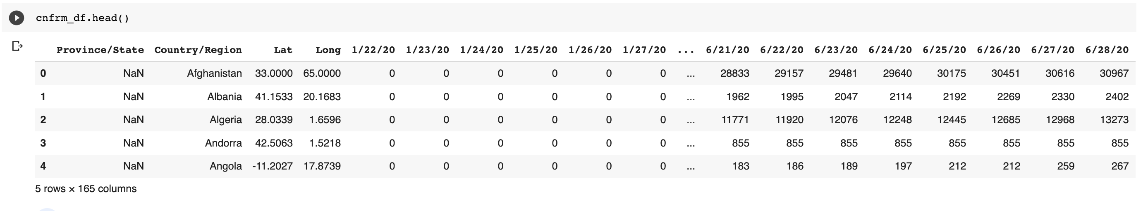
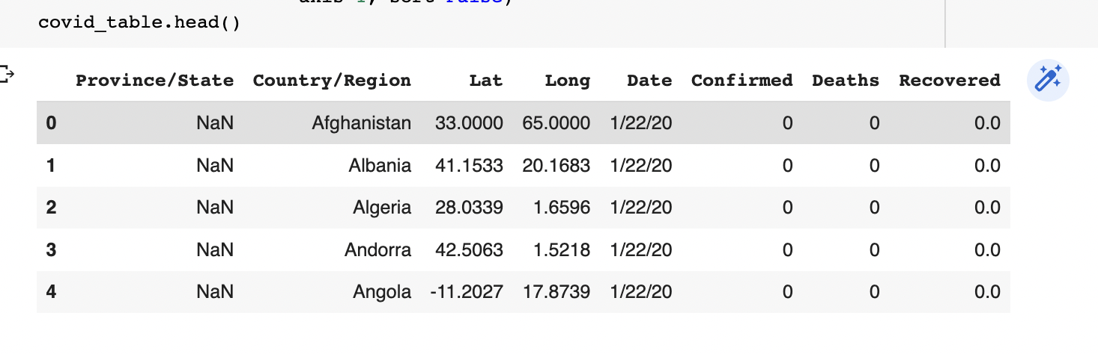
COVID-19 Outbreak Analysis
Data Ingestion of world-wide Confirmed, Death & Recovered cases datasets.
Data Wrangling had been done on the Confirmed cases dataset.

Slide 6
COVID-19 Outbreak Analysis
Data Cleaning and Preprocessing
Renaming column names.
Check null values in the dataset and fill those null or missing values as per analysis.
Modifying the datatypes of a dataset.
Removing Uncertainity or Inconsistance in data

Slide 7
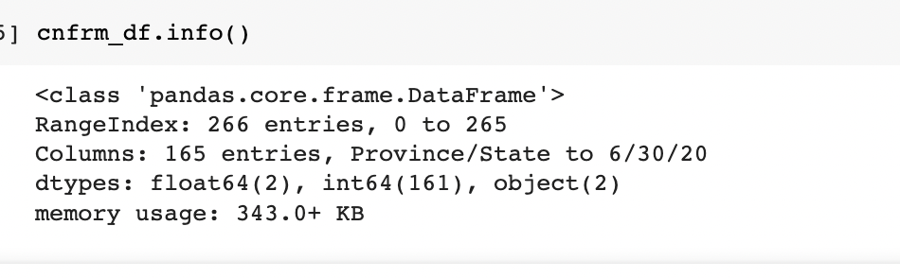
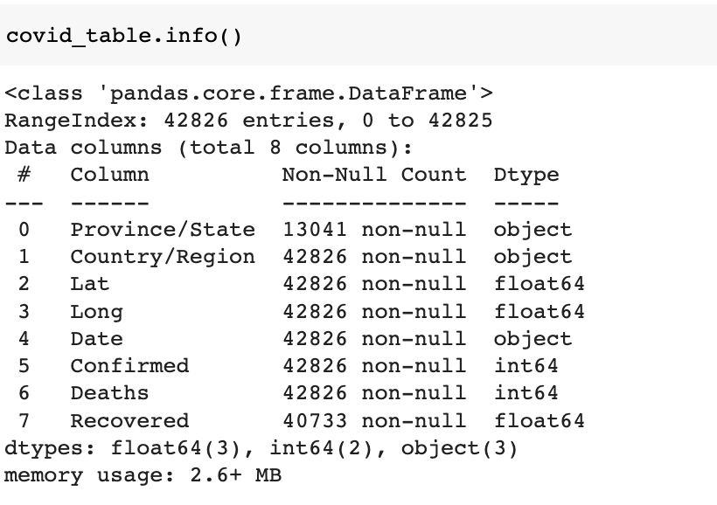
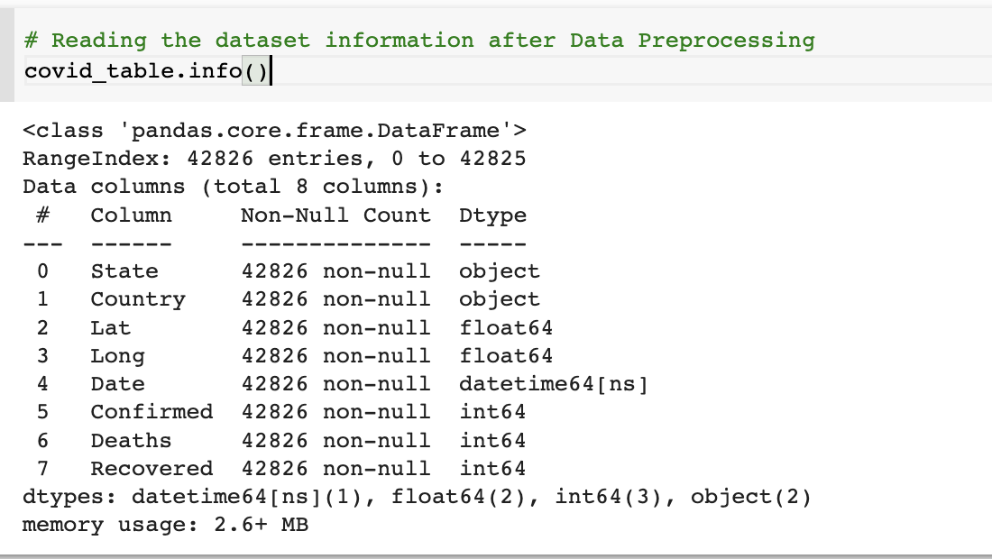
COVID-19 Outbreak Analysis
Dataset Information before and after Data Wrangling, Cleaning and Preprocessing

Slide 8
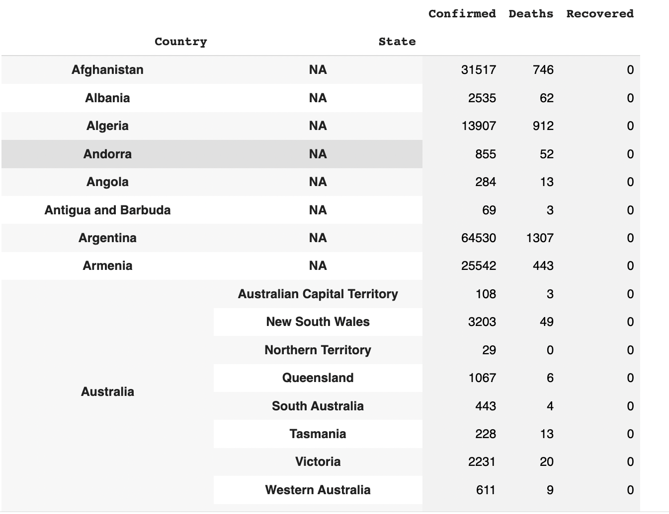
COVID-19 Outbreak Analysis
Exploratory Data Analysis
Merged the datasets of confirmed, Deaths & Recovered into one final dataframe as below which shows the cases for each country w.r.t state.

Slide 9
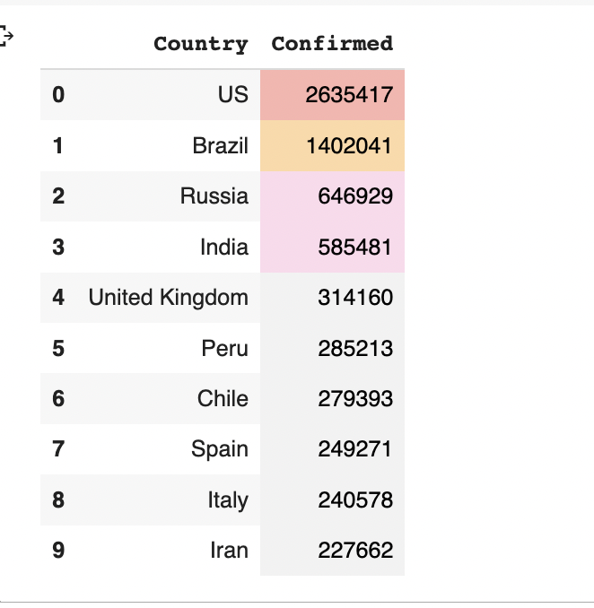
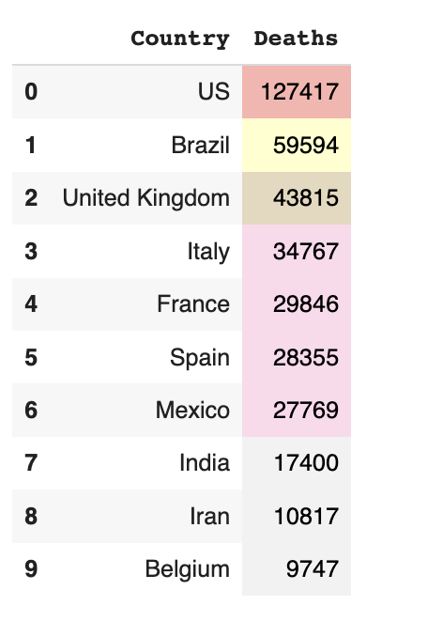
COVID-19 Outbreak Analysis
Exploratory Data Analysis
Top 10 Countries with most no. of Confirmed cases and Death cases.

Slide 10
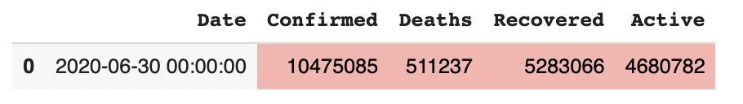
COVID-19 Outbreak Analysis
Exploratory Data Analysis
Similarly, Data Ingestion, Data Cleaning & Preprocessing, EDA for covid_19_clean_complete has been done.
Analysis showing that total number of Confirmed, Deaths & Recovered Cases s per the latest date.

Slide 11
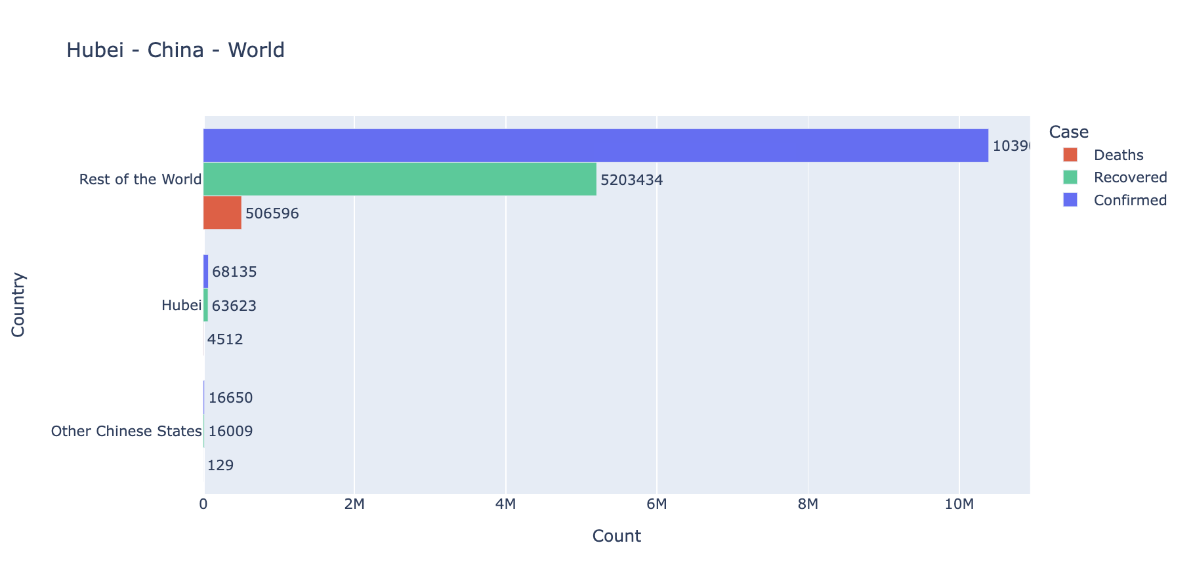
COVID-19 Outbreak Analysis
Data Visualization
As the first case was found in Hubei, Wuhan. Here we were comparing the cases w.r.t Wuhan state, other chinese states as well as rest of the world for the latest date.

Slide 12
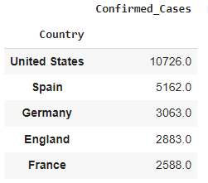
MonkeyPox Outbreak Analysis
Data Ingestion of world-wide Confirmed, daily cases & case detection datasets.​
Data Cleaning & Preprocessing has been done on case detection dataset
Insights from Datasets loaded and Initial Data Analysis on daily cases dataset.

Slide 13
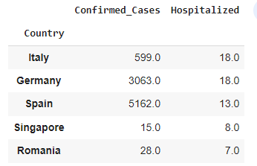
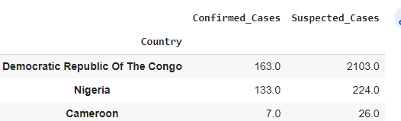
MonkeyPox Outbreak Analysis
Insights from Datasets loaded and Initial Data Analysis on daily cases dataset.​

Slide 14
MonkeyPox Outbreak Analysis
When was the first case in United States was Identified?
When was the first case Identified?

Slide 15
Structural Outline
ETL PipeLine
Data Bricks
Source
Ingestion
Data Wrangling
EDA
Data Cleaning & Preprocessing

Slide 16
Datasets
https://www.kaggle.com/datasets/imdevskp/corona-virus-report
https://www.kaggle.com/datasets/sudalairajkumar/novel-corona-virus-2019-dataset
https://www.kaggle.com/datasets/deepcontractor/monkeypox-dataset-daily-updated?select=Daily_Country_Wise_Confirmed_Cases.csv
https://www.kaggle.com/code/andrewmvd/monkeypox-cases-analysis/data

Slide 17

Thank You!

