Slide 1
Kinematics of Rigid Bodies
Engineering Mechanics

Slide 2
Introduction to Rigid Body Kinematics
Definition of a Rigid Body:
A system of particles where distance between any two particles remains constant
Types of Motion:
• Translation: All points move along parallel paths
• Rotation: All points move in circular paths around a fixed axis
• General Plane Motion: Combination of translation and rotation
• Spatial Motion: Most general 3D motion

Slide 3
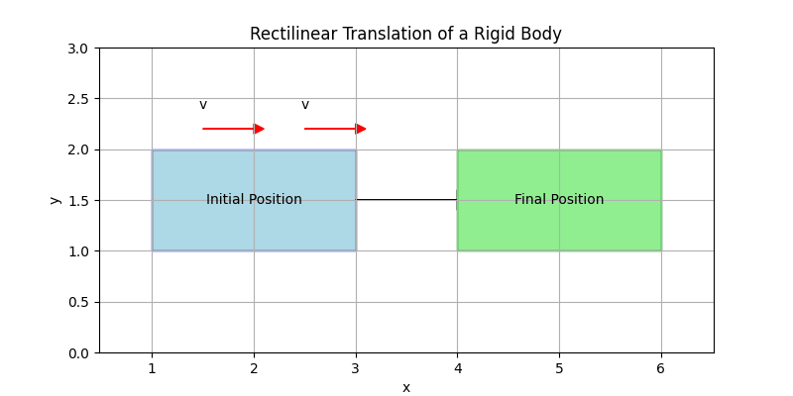
Translation
Key Characteristics:
• All points have identical velocities
• All points have identical accelerations
Key Equations:
Position: ri = ro + rio (constant)
Velocity: vi = vo
Acceleration: ai = ao

Slide 4
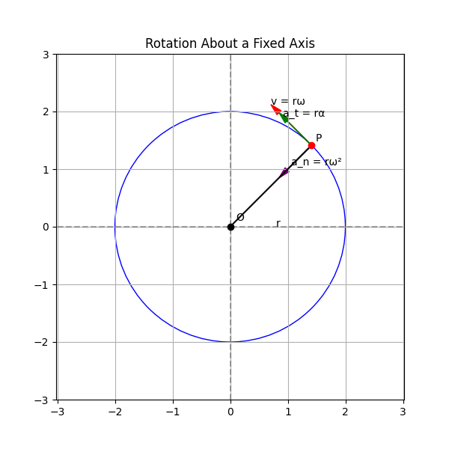
Rotation About a Fixed Axis
Key Parameters:
• Angular position (θ)
• Angular velocity (ω = dθ/dt)
• Angular acceleration (α = dω/dt)
For a point at distance r from axis:
• Linear velocity: v = rω
• Tangential acceleration: at = rα
• Normal acceleration: an = rω²

Slide 5
General Plane Motion
Combination of translation and rotation
Velocity Analysis:
vB = vA + ω × rBA
Acceleration Analysis:
aB = aA + α × rBA + ω × (ω × rBA)

Slide 6
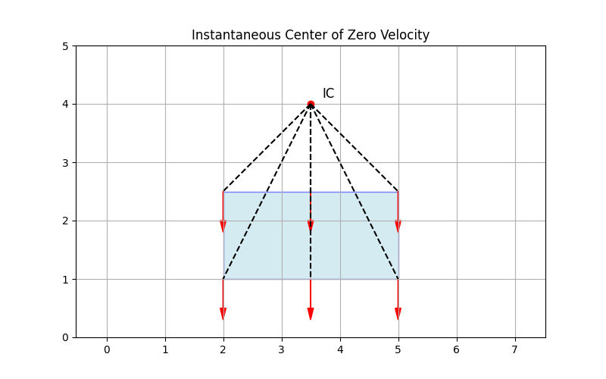
Instantaneous Center of Zero Velocity
Definition:
A point in a rigid body (or its extension) that has zero velocity at a given instant
Properties:
• Every point rotates about the IC at that instant
• Velocity vectors are perpendicular to lines drawn from IC
• Velocity magnitude: v = ω × d (distance from IC)

Slide 7
Relative Motion Analysis
Relative Velocity:
vB/A = vB - vA = ω × rB/A
Relative Acceleration:
aB/A = aB - aA = α × rB/A + ω × (ω × rB/A)
Applications:
• Analysis of connected rigid bodies
• Mechanical linkages
• Slider-crank mechanisms

Slide 8
Example Problem: Rotating Wheel
Problem:
A wheel rotates according to the relation θ = 2t³ - 3t² + t
(θ in radians, t in seconds)
Find the angular velocity and angular acceleration at t = 2 seconds
Solution:
ω = dθ/dt = 6t² - 6t + 1
α = dω/dt = 12t - 6
At t = 2 seconds:
ω = 6(2)² - 6(2) + 1 = 24 - 12 + 1 = 13 rad/s
α = 12(2) - 6 = 24 - 6 = 18 rad/s²

Slide 9
Summary
Key Topics Covered:
• Types of rigid body motion (translation, rotation, general plane motion)
• Kinematic equations for different motion types
• Instantaneous center of zero velocity
• Relative motion analysis
Next Topics:
• Kinetics of rigid bodies
• Work-energy principles for rigid bodies
• Impulse-momentum principles for rigid bodies

