Slide 1


How do I become a …
Presented to you by:
Btara Truhandarien | Bhuvan Chopra
Grace Kingsly | Mohammad Ullah

Slide 2
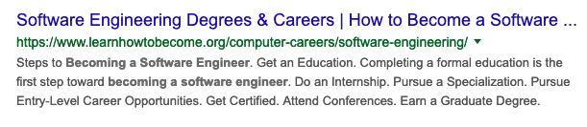
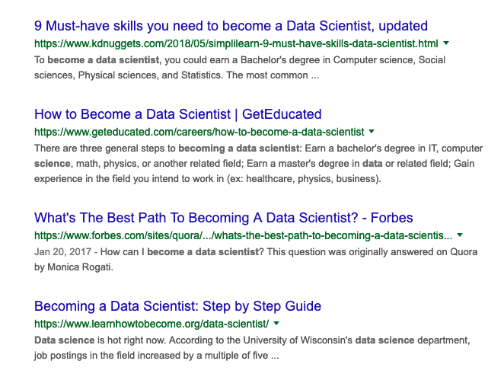
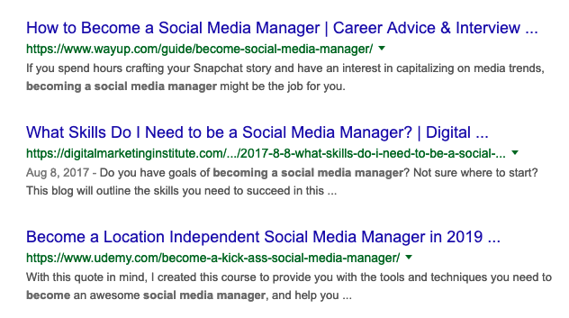
Don’t you want to know?

Slide 3

“For companies and their employees to succeed, they need to focus on building skills for the future”
David Blake, Degreed Cofounder
Kelly Palmer, Degreed CLO
Notes:
In order to reach your desired professional goal/career, obtaining the right skills (and knowledge) will be a crucial part of the step

Slide 4
Not just us
Company HR
University
EdTech companies
LinkedIn etc.
All has a reason to know
Notes:
The benefits of knowing relevant skills is not just for us but also various organizational-level parties:
Company HR can hope to design better and more relevant training programs
University in order to provide relevant materials
EdTech companies in a similar position to universities (and perhaps even more so)
Companies like LinkedIn can bring forward a new user-tailored product line based on skills sought by its users

Slide 5

Our approach
Clean and integrate
Scrape
Analyze
Notes:
We’re scraping resumes from Indeed in order to collect skills data points.
Why resumes? ->
- We want to understand real people, not idealized candidates for that main reason we have opted out to use job descriptions
- We also believe that people are incentivized to flesh out their skills for attracting employees
Why Indeed? ->
Actually scrapable
A good and diverse resume repository
Resumes posted have clear structure and eases scraping
Restricted to Canada (at most US)

Slide 6
Our approach (cont.)
Preliminary search on various job titles (titles from O*NET Database)
Over various industries (NAICS classification)
Attempt to diversify collected job title
Choose 10 - 20 job titles that yields highest # of resumes in preliminary search
Some examples: Software Engineer, Cook, Financial Manager, Host, Hair Stylist
Focusing on Canada, considering US
Notes:
Progress wise a bit lagging behind (we should already be starting to clean)
O*NET Database:
- US occupational information
NAICS:
North American Industry Classification System

Slide 7
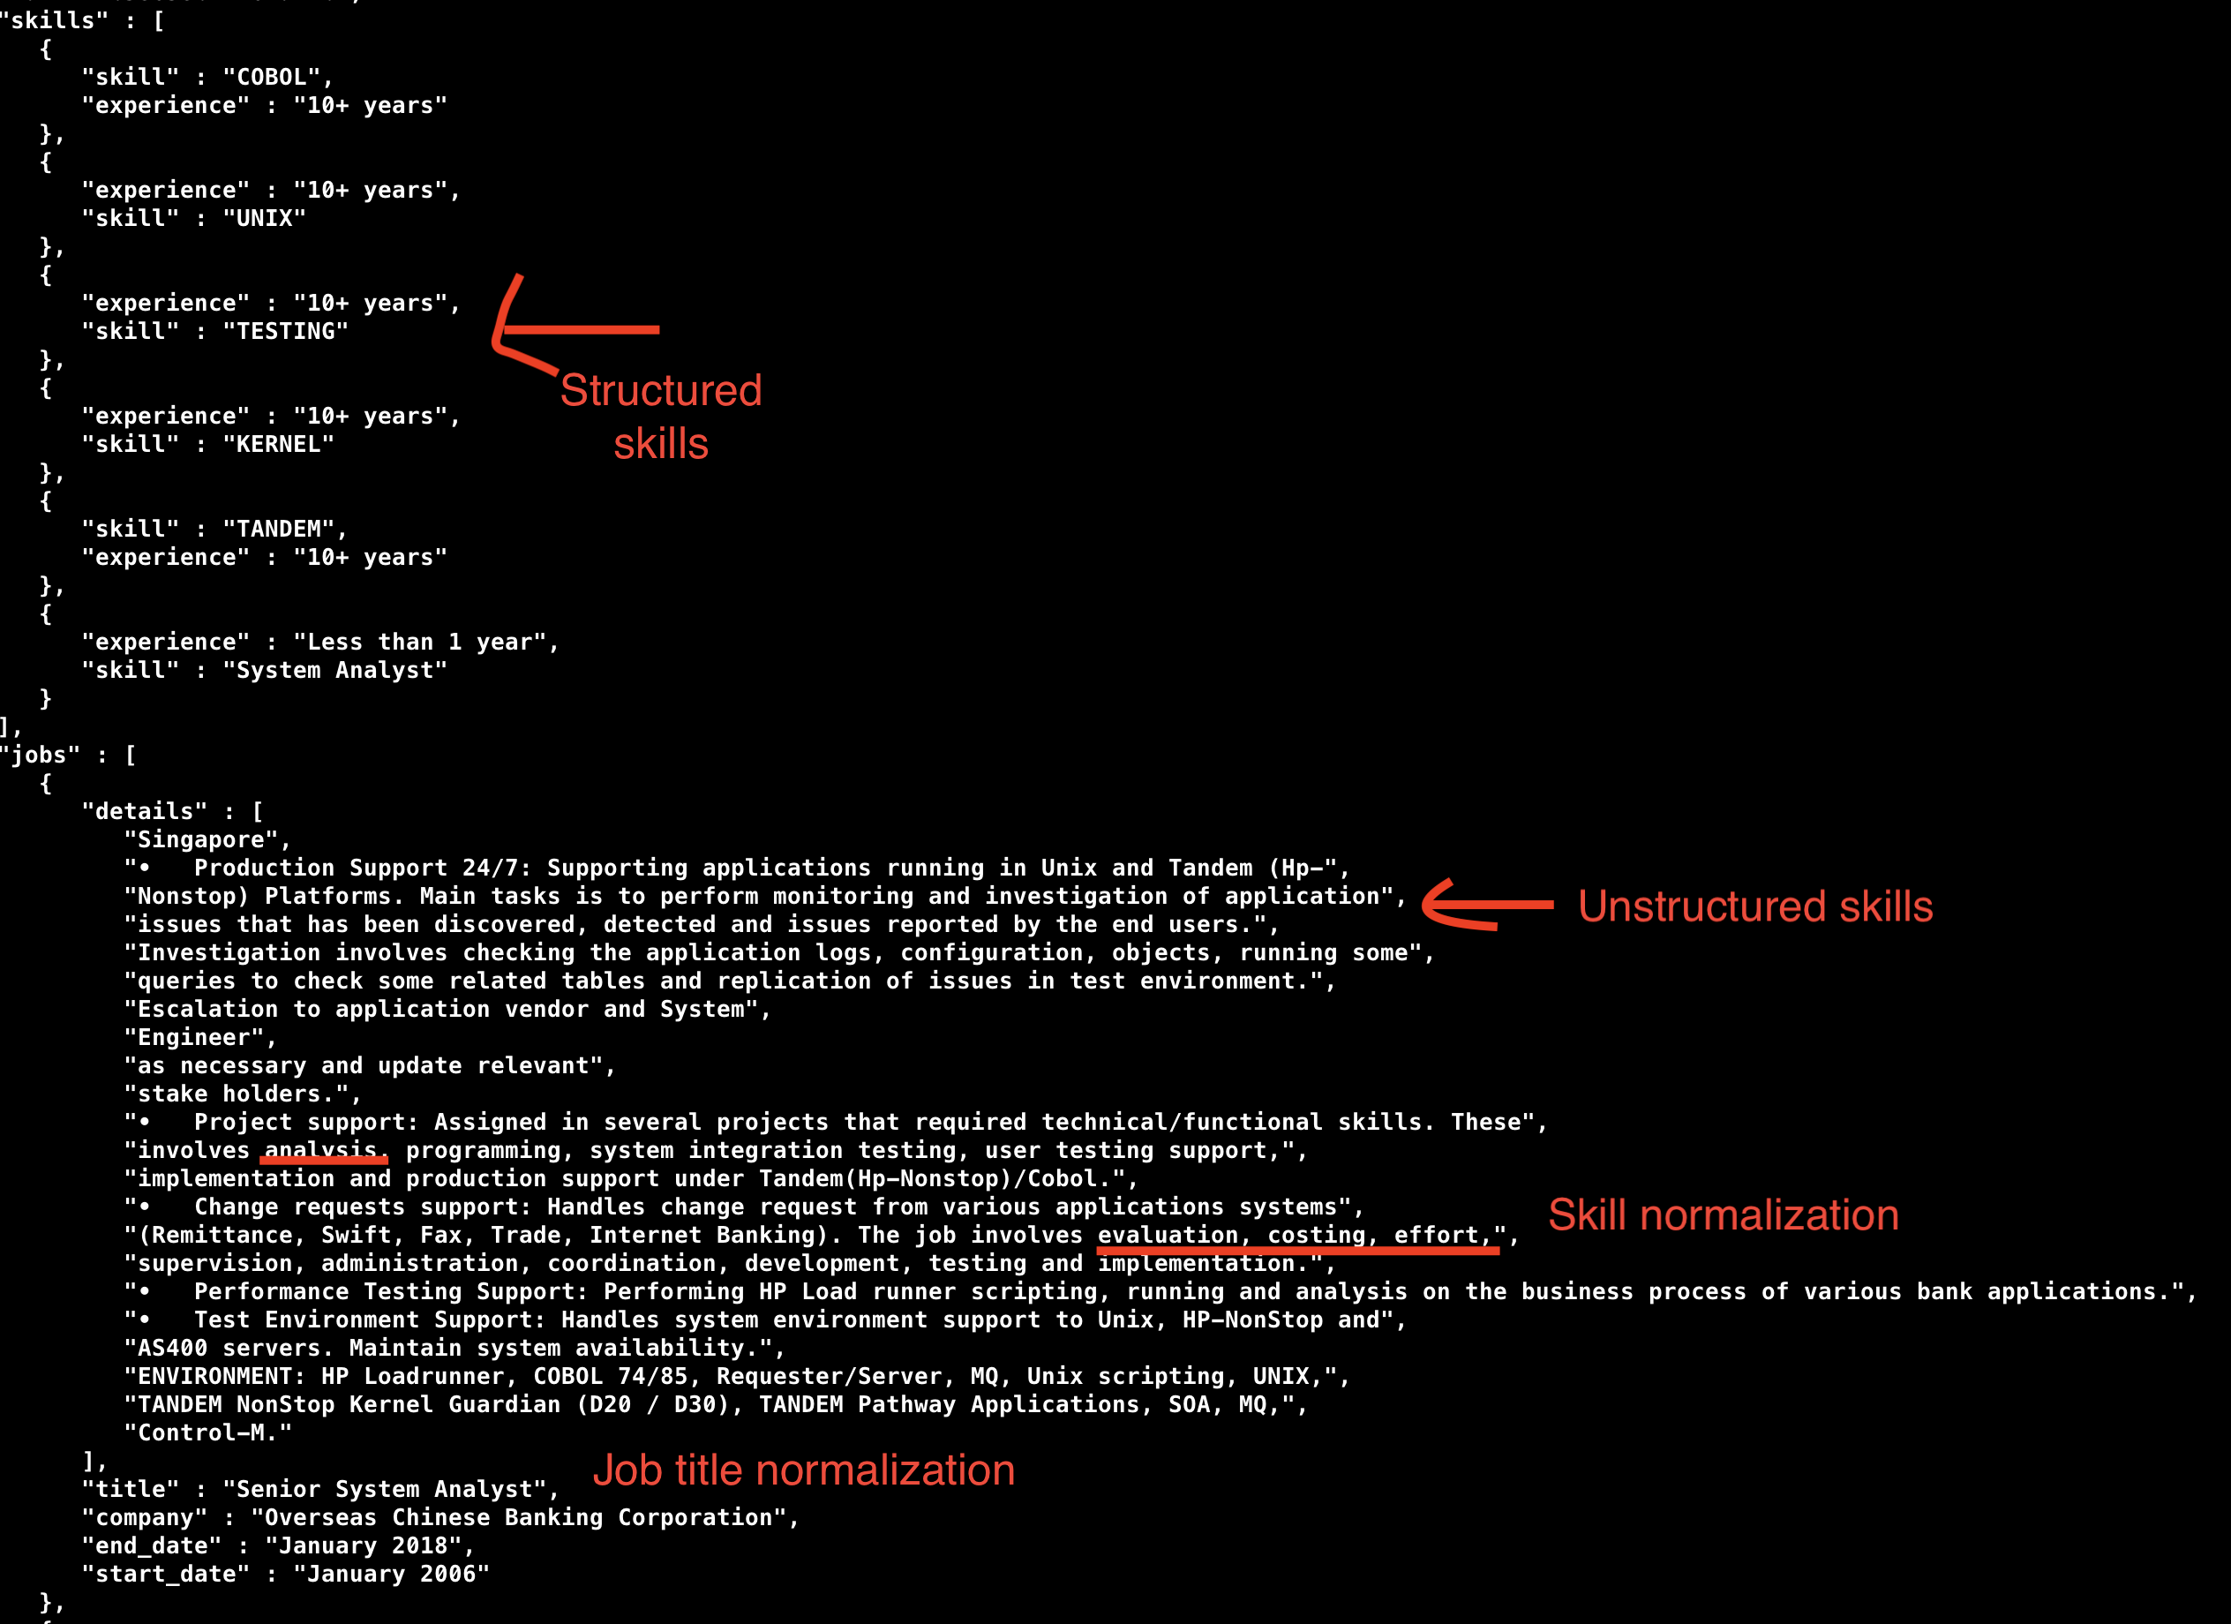
Current challenge
Currently looking into:
Named Entity Recognition
Named Entity Normalization
Heuristics
Skills ML and Open Skills API(http://dataatwork.org/)
Notes:
Unstructured text makes it hard to extract relevant information. Relying on heuristics, data mining and NLP just to get data points
Named Entity Recognition: Extracting desired textual entities (skills in our case) from unstructured text
Named Entity Normalization: task of defining an unambiguous reference for multiple synonyms from unstructured text
Heuristics: Strategies that may or may not work e.g getting bi-grams or sequence of two words that end with skill/skills

Slide 8
Future task
Skills and job normalization
Answer questions like:
What are common/uncommon skills for a job
What are the most relevant skills for a job (e.g most present, Pearson’s correlation matrix, distribution)
Commonly shared skills among jobs
Skills-job advisor model

Slide 9
Skills-job Advisor Model
Premise: There are times where the required skills are unclear/unknown to a person. Often enough that economies of scale is a factor along with soundness.
Idea:
User’s set of skills and desired job
Skills-job advisor model
Advice on what skills to cultivate

Slide 10
Considered Models
Unsupervised
Supervised DL
Cluster similar sets of skills
Assign clusters to some job title (through inspection)
Take representative of cluster, Y, and given skill set X and take the skill gap difference between Y and X as advice
Use a GAN to change given skills X to a set of skills Y appropriate for target job T
Take the skill gap difference between Y and X as advice
Reference Idea: https://arxiv.org/pdf/1712.02328.pdf
Notes:
GAN: Generative Adversarial Network

Slide 11
Modeling Challenges
Feature engineering
High dimensionality and meaning of features
What is a good advice for skills and jobs? Is there an appropriate ‘advice measurement’?
Finding comparable work
DL research and references focuses on images and videos, transfer application problem
Notes:
Feature engineering:
- Some or all skills to take into account as features
High dimensionality and meaning of features:
Will either of the models work with high dimensions
We don’t want to do PCA or similar process probably since we want to keep the meaning of the features
Computational cost
Good advice:
- It is hard to find pointers and work to reference (idea/code)
DL Research:
- Most DL research is in the are of images and videos (especially for GANs), transferring the application to this scenario may run into problems
Good advice:
Particularly with GANs, goodness of result often depends on human observation

Slide 12
Long road
“HARD IS TRYING TO REBUILD YOURSELF, PIECE BY PIECE, WITH NO INSTRUCTION BOOK, AND NO CLUE AS TO WHERE ALL THE IMPORTANT BITS ARE SUPPOSED TO GO”
There is much to be done and we have only touched the surface but we are excited
Nick Hornby, Writer

