Slide 1
CSE 477: Introduction to Computer Security
Lecture – 10
Course Teacher: Dr. Md Sadek Ferdous
Assistant Professor, CSE, SUST
E-mail: ripul.bd@gmail.com

Slide 2
Outline
Cryptographic protocols
These lectures have been created from several other lectures whose references are given below:
  Foundations of Computer Security by Dr. Bill Young, University of Texas at Austin. The lecture series can be found at
    https://www.cs.utexas.edu/~byoung/cs361/lecture1.pdf
  Cryptographic protocol lecture by Prof. Dr.-Ing. Georg Carle, University of University of Tübingen, Germany
    http://www.ccs-labs.org/~dressler/teaching/netzsicherheit-ws0304/07_CryptoProtocols_2on1.pdf

Slide 3
Thought experiment
Consider the following scenario
  Your friend Ivan lives in a repressive country where the police spy on everything and open all the mails
  You need to send a valuable object to Ivan
  How can you get the item to Ivan securely?
How do you think you can do it physically?

Slide 4
Thought Experiment
You will need a box with a hasp big enough for several locks
Put the item into the box, attach your lock to the hasp, and mail the box to Ivan
Ivan adds his own lock and mails the box back to you
You remove your lock and mail the box back to him
He now removes his lock and opens the box
https://www.homedepot.com/p/Master-Lock-Steel-Lockout-Hasp-MLK420/206322471
http://www.ifam.es/wp-content/uploads/2015/06/portacandado-pmi-ifam.jpg

Slide 5
Protocol
The procedure just described could be regarded as a protocol
A protocol is a structured dialog intended to accomplish some communication-related goal

Slide 6
Security protocol goal
To send some content confidentially
  in the context of a hostile or untrustworthy environment
  when the two parties don’t already share a secret/key
You could implement the “same” protocol to send a message confidentially across the Internet
Here:
  the valuable thing is the contents of a secret message
  the locks are applications of some cryptographic algorithms with appropriate cryptographic keys

Slide 7
Protocol goal
But for this to work in the computing world there’s a particular feature that the ciphers have to satisfy
Can you see what it is?

Slide 8
Protocol goal
But for this to work in the computing world there’s a particular feature that the ciphers have to satisfy
Can you see what it is?
Imagine that instead of putting another lock on the hasp, Ivan puts your lockbox inside another locked box
The protocol no longer works
  you can’t reach inside his box to take off your lock

Slide 9
Cryptographic protocols
Almost everything that occurs on the Internet occurs via a protocol
An Internet protocol is a structured dialogue among two or more parties using the Internet
  controlling the syntax, semantics, and synchronization of communication, and
  designed to accomplish a communication-related function
A cryptographic protocol is a protocol using cryptographic mechanisms to accomplish some security-related function

Slide 10
Cryptographic protocols
All cryptographic protocols share the following characteristics
  several principals are exchanging messages
  they are attempting to accomplish some security-related function
  they are operating in a hostile and insecure environment
The protocol must be robust and reliable in the face of a determined attacker

Slide 11
Goals
Among the goals of cryptographic protocols are the following
Unicity: secret shared by exactly two parties
Integrity: message arrived unmodified
Authenticity: message claim of origin is true
Confidentiality: message contents are inaccessible to an eavesdropper
Non-repudiation of origin: sender can’t deny sending
Non-repudiation of receipt: receiver can’t deny receiving

Slide 12
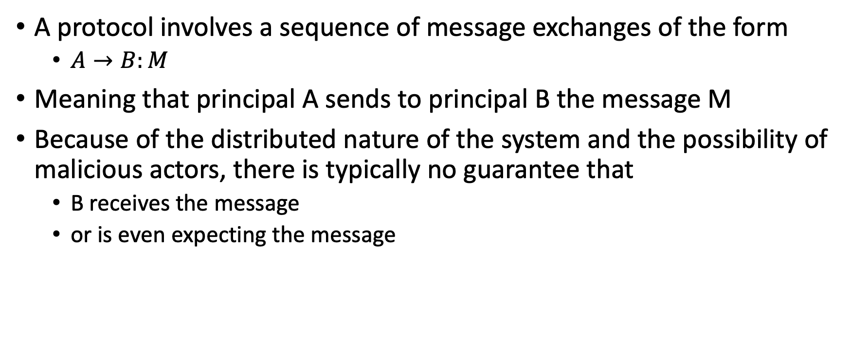
Cryptographic protocols
A protocol involves a sequence of message exchanges of the form
  $A→B:M$
Meaning that principal A sends to principal B the message M
Because of the distributed nature of the system and the possibility of malicious actors, there is typically no guarantee that
  B receives the message
  or is even expecting the message

Slide 13
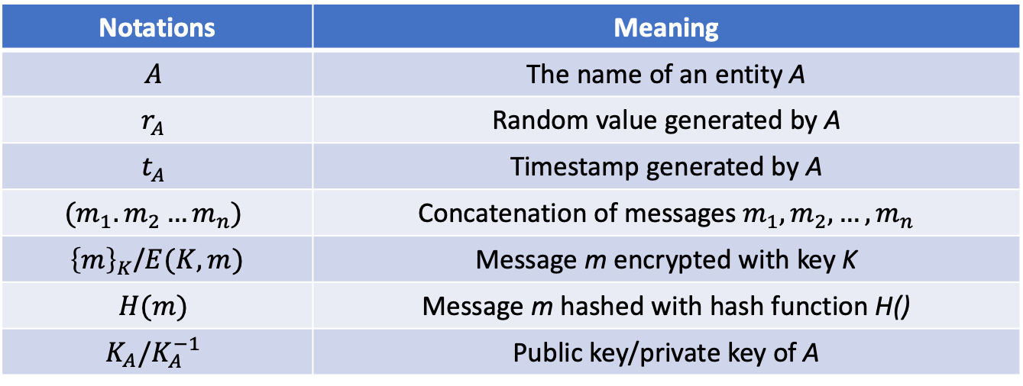
Other notations
Notations | Meaning
$$A$$ | The name of an entity A
$$r_{A}$$ | Random value generated by A
$$t_{A}$$ | Timestamp generated by A
$$(m_{1}.m_{2}…m_{n})$$ | Concatenation of messages $m_{1},m_{2},…, m_{n}$
${\left\{m\right\}}_{K}$/$E(K,m)$ | Message m encrypted with key K
$$H(m)$$ | Message m hashed with hash function H()
$$K_{A}/K_{A}^{−1}$$ | Public key/private key of A

Slide 14
Thought Experiment protocol
You and Ivan are trying to share a valuable item so that it will not be revealed to another party
We would like to simulate this using a cryptographic protocol
  The valuable item is a secret message
One way to achieve this:
  You encrypt the message and send it to Ivan (identical to adding the first lock)
  Ivan encrypts the message and sends it back to you (adding the second lock)
  You need to decrypt the inner message??? (Unlocking your lock)

Slide 15
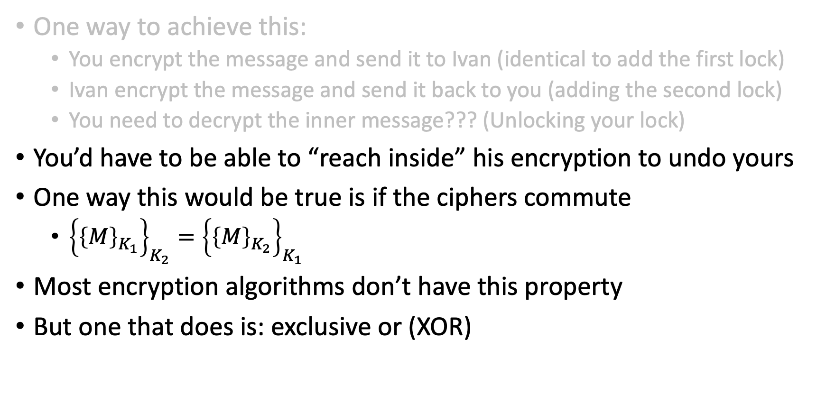
Thought Experiment protocol
One way to achieve this:
  You encrypt the message and send it to Ivan (identical to add the first lock)
  Ivan encrypt the message and send it back to you (adding the second lock)
  You need to decrypt the inner message??? (Unlocking your lock)
You’d have to be able to “reach inside” his encryption to undo yours
One way this would be true is if the ciphers commute
  ${\left\{{\left\{M\right\}}_{K_{1}}\right\}}_{K_{2}}={\left\{{\left\{M\right\}}_{K_{2}}\right\}}_{K_{1}}$
Most encryption algorithms don’t have this property
But one that does is: exclusive or (XOR)

Slide 16
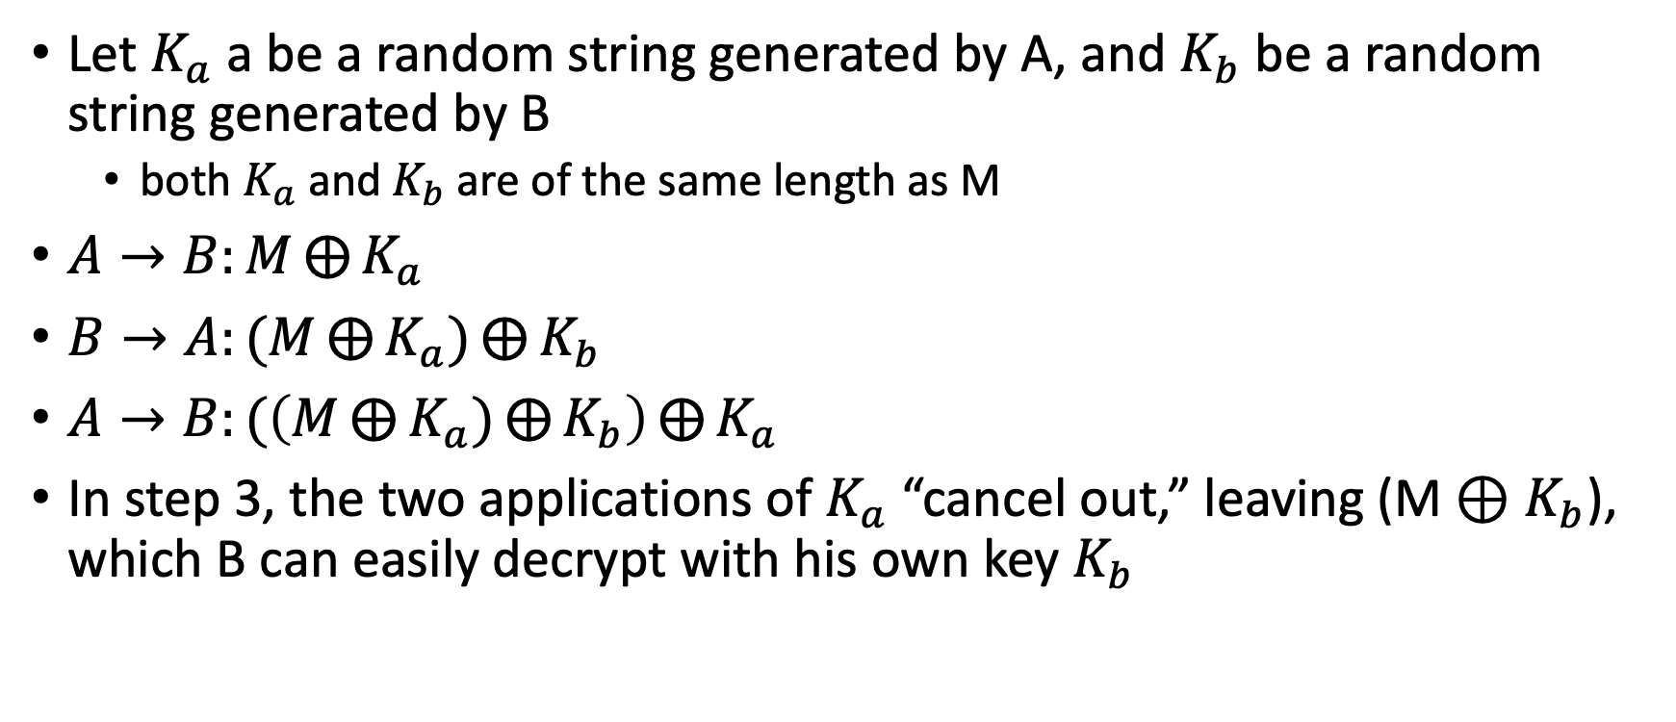
Thought Experiment protocol
Let $K_{a}$ a be a random string generated by A, and $K_{b}$ be a random string generated by B
  both $K_{a}$ and $K_{b}$are of the same length as M
$A→B:M⨁{K_{a}}$
$B→A:(M⨁{K_{a})}⨁{K_{b}}$
$A→B:(\left(M⨁{K_{a})}⨁{K_{b}}\right)⨁{K_{a}}$
In step 3, the two applications of $K_{a}$ “cancel out,” leaving (M ⊕ $K_{b}$), which B can easily decrypt with his own key $K_{b}$

Slide 17
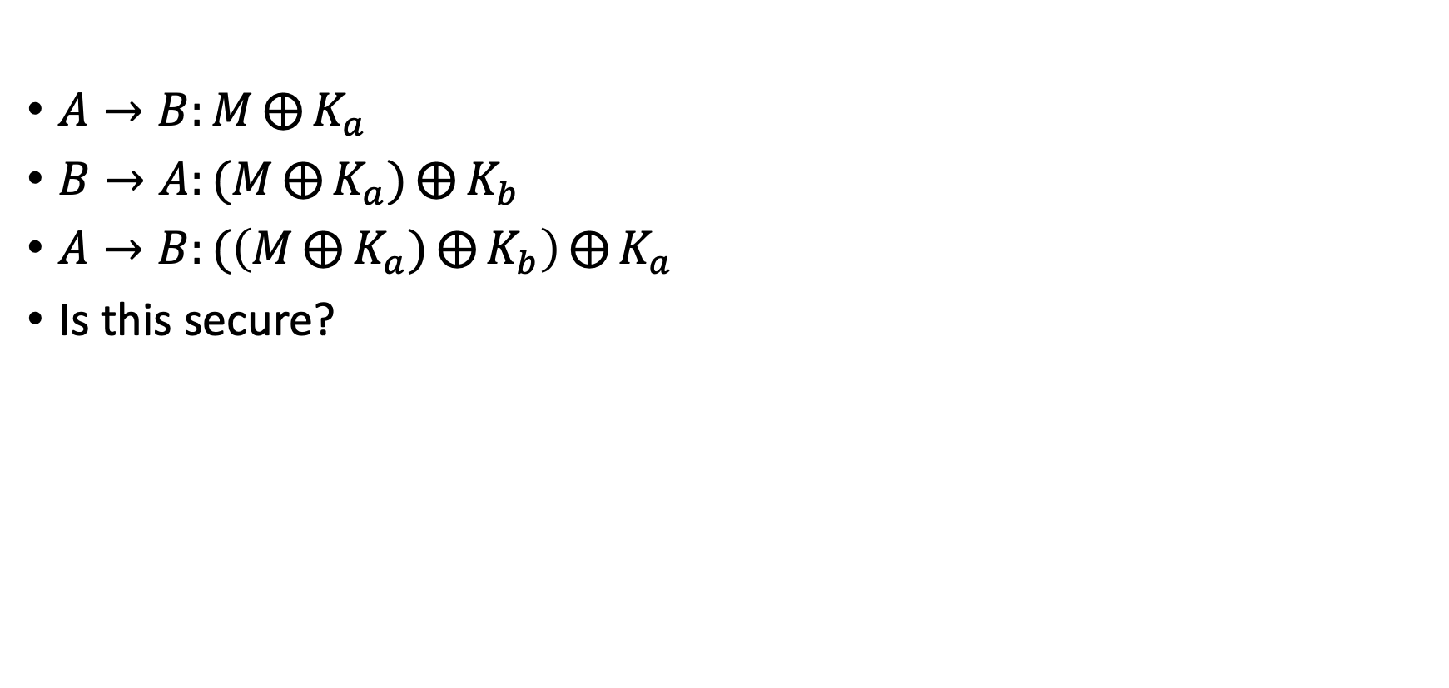
Thought Experiment protocol
$A→B:M⨁{K_{a}}$
$B→A:(M⨁{K_{a})}⨁{K_{b}}$
$A→B:(\left(M⨁{K_{a})}⨁{K_{b}}\right)⨁{K_{a}}$
Is this secure?

Slide 18
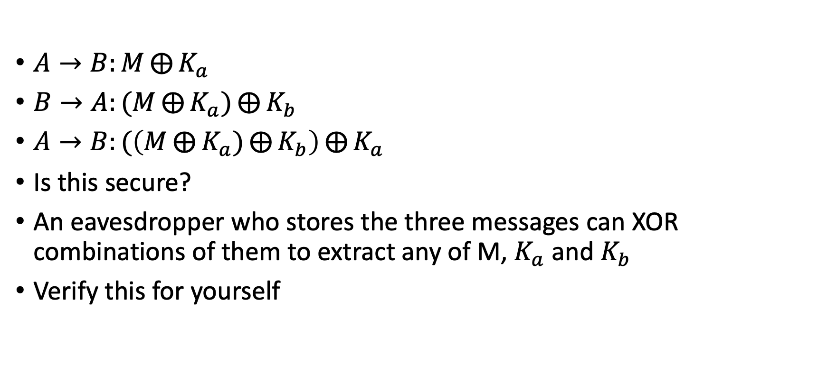
Thought Experiment protocol
$A→B:M⨁{K_{a}}$
$B→A:(M⨁{K_{a})}⨁{K_{b}}$
$A→B:(\left(M⨁{K_{a})}⨁{K_{b}}\right)⨁{K_{a}}$
Is this secure?
An eavesdropper who stores the three messages can XOR combinations of them to extract any of M, $K_{a}$ and $K_{b}$
Verify this for yourself

Slide 19
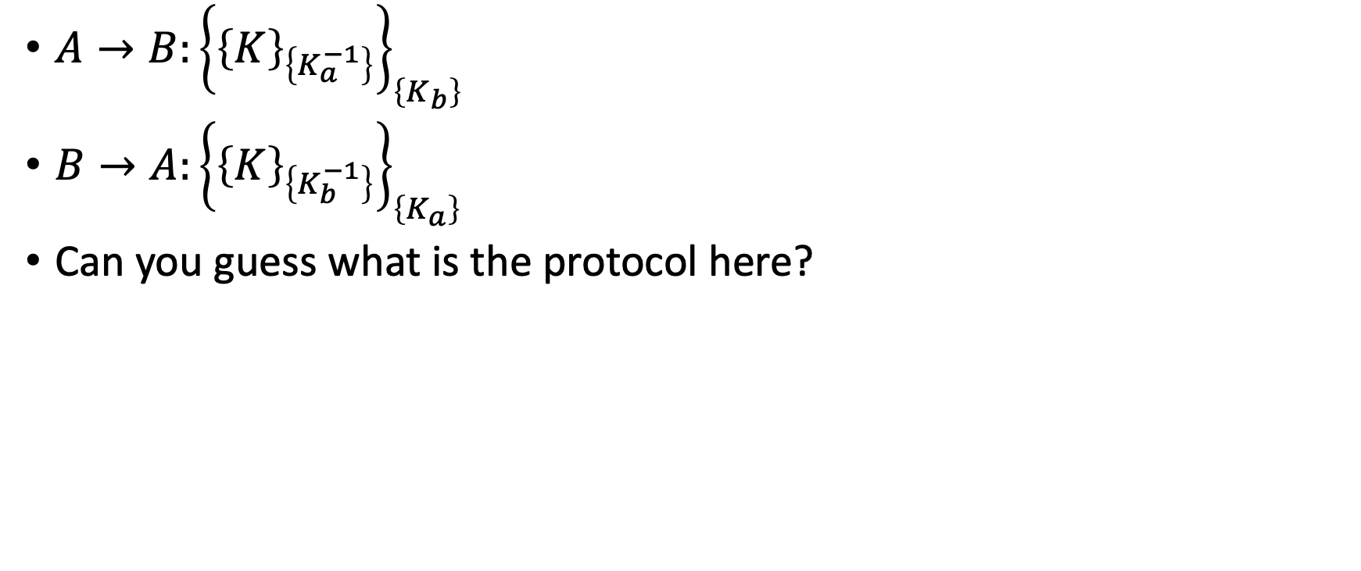
Cryptographic protocols: an example
$A→B:{\left\{{\left\{K\right\}}_{\left\{K_{a}^{−1}\right\}}\right\}}_{\left\{K_{b}\right\}}$
$B→A:{\left\{{\left\{K\right\}}_{\left\{K_{b}^{−1}\right\}}\right\}}_{\left\{K_{a}\right\}}$
Can you guess what is the protocol here?

Slide 20
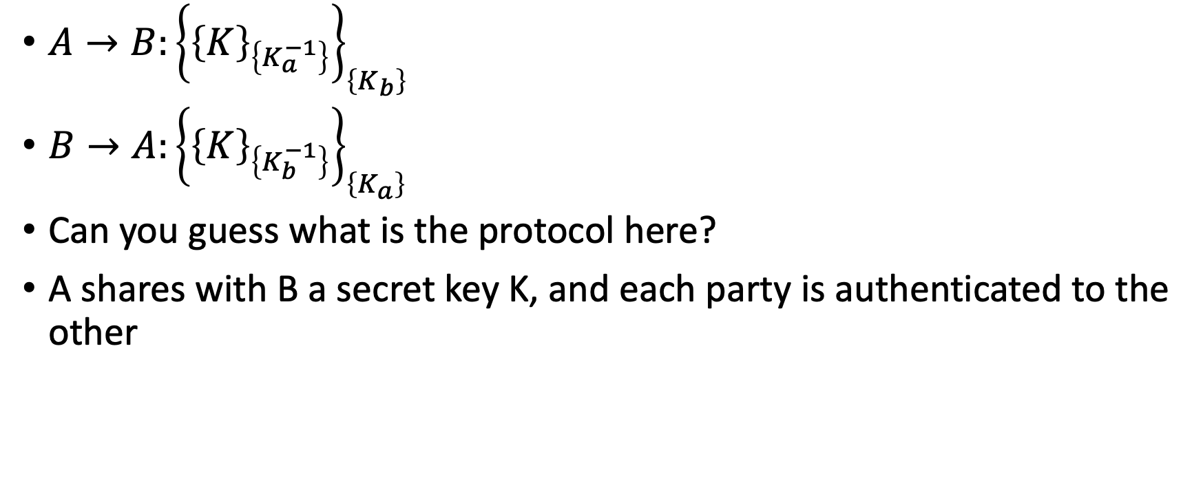
Cryptographic protocols: an example
$A→B:{\left\{{\left\{K\right\}}_{\left\{K_{a}^{−1}\right\}}\right\}}_{\left\{K_{b}\right\}}$
$B→A:{\left\{{\left\{K\right\}}_{\left\{K_{b}^{−1}\right\}}\right\}}_{\left\{K_{a}\right\}}$
Can you guess what is the protocol here?
A shares with B a secret key K, and each party is authenticated to the other

Slide 21
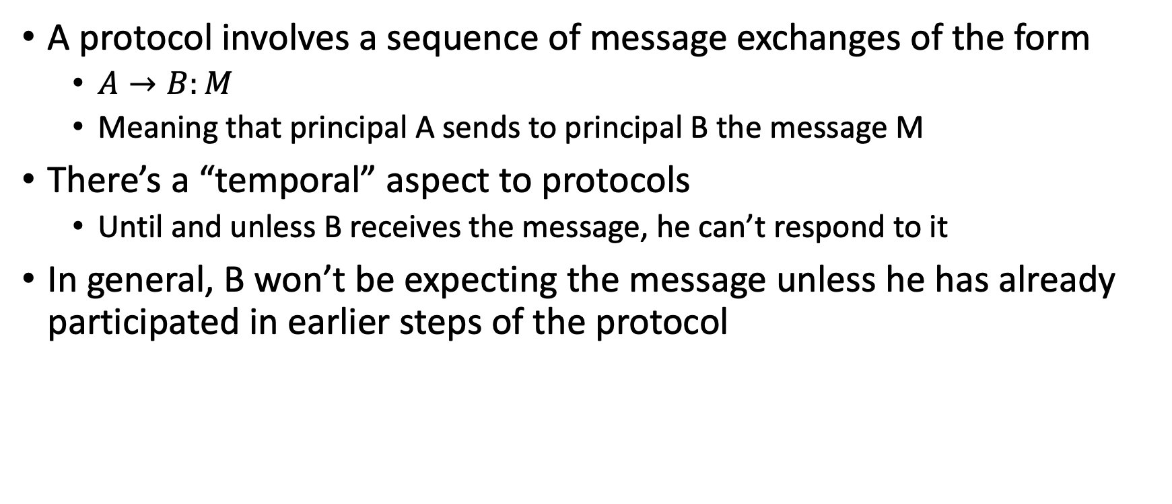
Cryptographic protocols
A protocol involves a sequence of message exchanges of the form
  $A→B:M$
  Meaning that principal A sends to principal B the message M
There’s a “temporal” aspect to protocols
  Until and unless B receives the message, he can’t respond to it
In general, B won’t be expecting the message unless he has already participated in earlier steps of the protocol

Slide 22
Cryptographic protocols: abstract view
There is a lot involved in making a protocol work, particularly at the implementation level at this point
We’ll ignore issues like
  What are the mechanisms of message transmission?
  How does a principal know when decryption has succeeded?
  How can you reliably parse a message of multiple components?
  If a message contains the name of a principal, what is the form of that name?
  How are public keys maintained and distributed?
Those are all important issues, but we want to look at protocols abstractly

Slide 23
Cryptographic protocols: abstract view
An analysis of any protocol attempts to answer the following types of questions
  What are the goals of the protocol?
  What does the protocol actually achieve?
  Does it achieve its stated objective?
  Does it include unnecessary steps or messages?
  What assumptions are made?
  Does it encrypt items that could be sent in the clear?
  Is it susceptible to attack?
  What would an attack look like?

Slide 24
Cryptographic protocols: attacks
A difficult aspect of analysing cryptographic protocols is answering these questions
  What constitutes an attack?
  Are both authentication and secrecy (confidentiality) assured?
  Is it possible to impersonate one or more of the parties?
  Is it possible to interject messages from an earlier exchange (replay attack)?
  What tools can an attacker deploy?
  If any key is compromised, what are the consequences?

Slide 25
Cryptographic protocols: attacks
This is a partial list of attacks on protocols:
Known-key attack: attacker gains some keys used previously and uses this info in some malicious fashion
Replay: attacker records messages and replays them at a later time
Impersonation: attacker assumes the identity of one of the legitimate parties in a network
Man-in-the-Middle: attacker interposes himself between two parties and pretends to each to be the other
Interleaving attack: attacker injects spurious messages into a protocol run to disrupt or subvert it

Slide 26
Cryptographic protocols: attackers
The designer of a protocol should assume that an attacker can access all of the traffic and interject his own messages into the flow
The protocol should be robust in the face of such a determined and resourceful attacker

Slide 27
Cryptographic protocols: key points
Due to the distributed nature of the system, protocols are highly asynchronous
A party to a protocol won’t know anything about the current run of the protocol except the messages it has received and sent
Except for the initiator, other parties will not even know that they are participating until they receive their first message
Each message sent must be of a form the recipient can identify and respond to
Each protocol must satisfy some cryptographic goals and accomplish some security function

Slide 28

The lecture slides can be found in the following location!

